Slide 1
A Course on
“ Hydropower Engineering (SEE 7092)”
By: Dr. Tilahun Nigussie
Assistant Professor in Thermal and Energy Systems Engineering:
Addis Ababa Institute of Technology, Addis Ababa University
Course Break down

Slide 2
Hydropower Engineering (SEE-7069)
Chapter one
Introduction to Hydropower

Slide 3
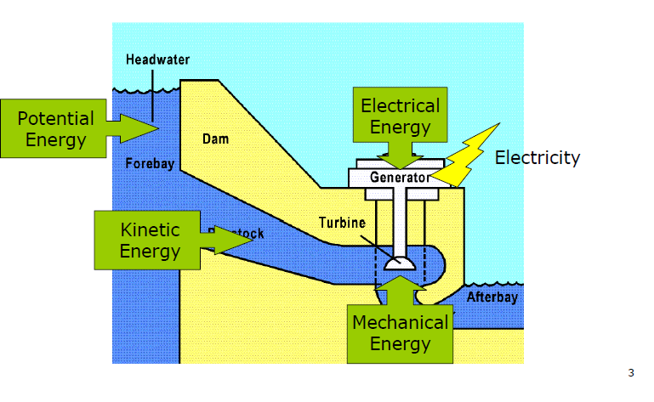
Introduction
Hydropower Engineering refers to the technology involved in converting the pressure energy and kinetic energy of water into more easily used electrical energy.

Slide 4
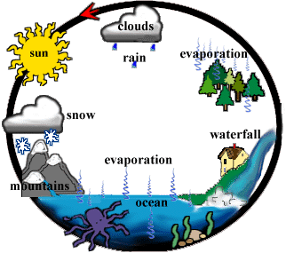
Because the hydrologic cycle is a never ending system, hydropower is considered a renewable energy. Indeed, it is the largest renewable resource used for electricity generation
Fig1.1 Hydrologic Cycle
Water Evaporates from Lakes and Oceans, forms clouds, precipitates as rain or snow, then flows back to the ocean

Slide 5
The amount of water power developed from any stream, river or lake is a function of mainly:
        The flow rate of water
        The head that is available
Hydroelectric power and energy that can be generated in a hydropower plant is determined from:
        P = γQH_{n}η
        E = γQH_{n}ηΔt
        Where P is the power in kW, γ is the specific weight of water in kN/m³, Q is the discharge in m³/s, H_{n} is the net head (gross head minus hydraulic losses) in meters, η is the overall efficiency (%), E is the hydroelectric energy in kWh and Δt is the time interval for power generation in hours.

Slide 6
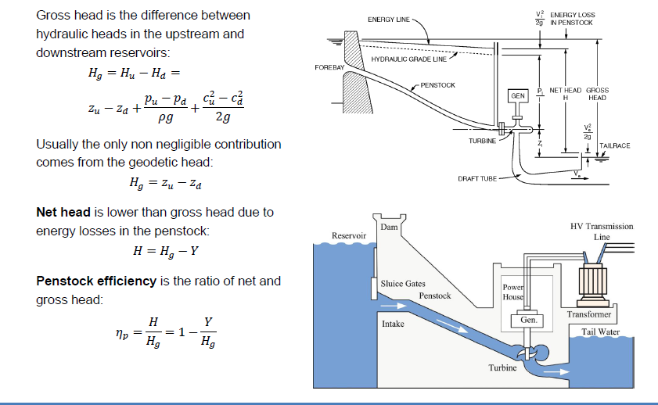

Slide 7
History of Hydropower
Earlier in the history of energy development and use, water wheels provided power by direct connection or with pulley and gear systems to drive various machines, such as grist mills and textile mills.
Since ancient times, water wheels have been used for lifting water from a lower to a higher elevation in irrigation systems.
The ancient Greeks invented the water wheel and were, along with the Romans, the first to use it in nearly all of the forms and functions.
The modern turbine has been developed as a result of the improvements of the waterwheel. Most of the developments were achieved by French engineers.

Slide 8
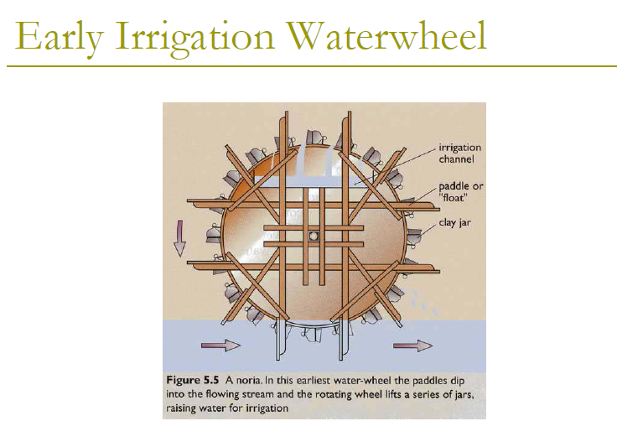

Slide 9
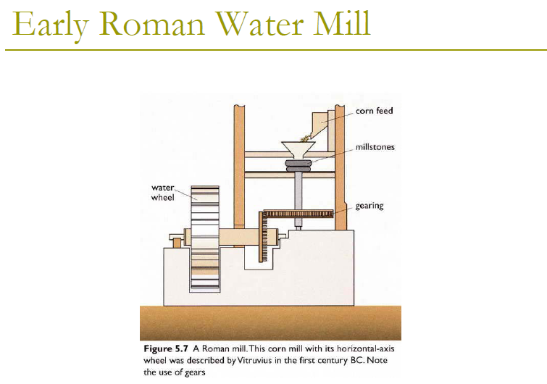

Slide 10
Water Wheels
Types of water wheels are based upon where the water strikes it
  Pitchback – water drops from top and is deflected backwards to fall back towards the dam/river
  Overshot – shoots over the top onto the wheel; the usual kind
  Breastshot – strikes about 50% to 80% of height of the near side of the wheel
  Undershot – pushes underneath and need not be more than immersed in a stream
Waterwheels turn slowly compared with turbines
  one to fifty rpm

Slide 11
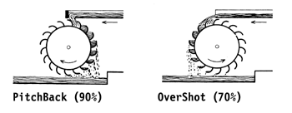
Pitchback
Note the difference in direction of the water flow
A containing surround structure could force the water against the wheel as it falls and increase the weight of the water in the wheel

Slide 12
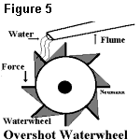
Overshot
The water flows across the top of the wheel, pushing it forward, but also partially filling the buckets so that the weight pushes downward to turn the wheel
The inertia of the water helps turn the wheel only slightly since it doesn’t flow very fast
  A very fast flow would be needed to get kinetic energy

Slide 13
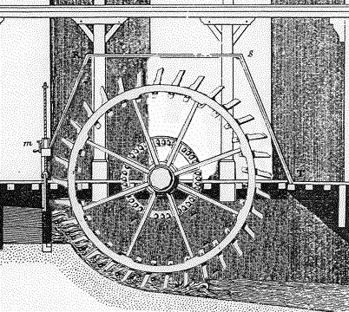
Breastshot
Note the contoured channel or surround at the bottom of the wheel that holds the water into the wheel
Water Flow
The water strikes the wheel about mid-way up so the inertia and the weight of the water push the wheel around

Slide 14
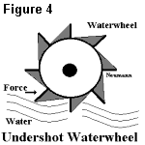
Undershot
The undershot wheel is simply placed in a stream with the bottom of the wheel pushed by the current
Works well where there is little depth and no head
Inefficient, but works where others won’t
Can be on a small boat anchored in a stream

Slide 15
In 1849, the Francis turbine was invented and later used in world’s first hydroelectric power plant.
Alternating current is used today. That breakthrough came when the electric generator was coupled to the turbine, which resulted in the worlds, and the United States', first hydroelectric plant located in Appleton, Wisconsin, in 1882.
Present-day hydroelectric plant is the end-product of 2000 years of technological advance, from the creaking wooden wheel, converting a few percent of water power into useful mechanical output, to the modern turbo-generator spinning at 1500 revolutions per minute and producing electric power at efficiencies which can reach 90 % .

Slide 16
The existing development of hydropower has resulted from a fairly uniform rate of increase in competition with other modes of electrical energy production.
Until the mid-1970s, the pattern of hydro development was to develop bigger and bigger units because smaller hydro plants were not competitive with fossil fuel power plants.
During the period from 1940 to 1970, small units were actually forced out of production because of the high cost of operation and the ready availability of electrical energy from large steam power plants and large high-capacity hydro plants.
Recently, with rising costs of fossil fuels, the economic feasibility of small-scale hydro has changed making it an attractive energy production alternative.

Slide 17
Terminology and Turbine Types
Terminology
Power capacity is often used in referring to the rated capability of the hydro plant to produce energy. Manufacturers of hydraulic turbines are usually required to specify what the rated capacity of their units is in either horsepower or kilowatts.
Demand and Load
Demand refers' to the amount of power needed or desired;
load refers to the rate at which electrical energy is actually delivered to or by a system. In this context, load can include the output from several hydropower plants.

Slide 18
Full gate Discharge : is the flow condition which prevails when turbine gates or valves are fully open. At maximum rated head and full gate, the maximum discharge will flow through the turbine.
Rated discharge refers to a gate opening or plant discharge which at rated head produces the rated power output of the turbine.
Hydraulic head is the elevation difference the water falls in passing through the plant.
Gross head of a hydropower facility is the difference between head water elevation and tail water elevation. (Headwater is the water in the forebay or impoundment supplying the turbine; tail water is the water issuing from the draft tube exit.)

Slide 19
Net head is the effective head on the turbine and is equal to the gross head minus the hydraulic losses before entrance to the turbine and outlet losses.
Design head is the effective head for which the turbine is designed for best speed and efficiency.
Rated head is the lowest head at which the full-gate discharge of the turbine will produce the rated capacity of the generator. The term is sometimes used interchangeably with the term effective head.
Critical head is the net head or effective head at which full-gate output of the turbine produces the permissible overload on the generator at unit power factor. "Critical head" is used in studies of cavitation and turbine setting.

Slide 20
Types of turbines
Hydraulic turbines are machines that develop torque from the dynamic and pressure action of water.
The turbine has vanes, blades, or buckets that rotate about an axis by the action of the water. The rotating part of the turbine or water wheel is often referred to as the runner.
Rotary action of the turbine in turn drives an electrical generator that produces electrical energy or could drive other rotating machinery.
there are two different categories of turbines,
        Impulse turbines and
        Reaction turbines

Slide 21
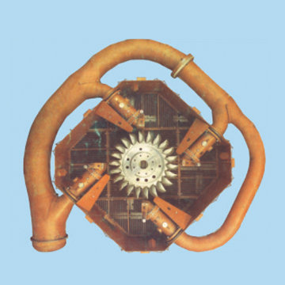
Impulse turbines
The potential energy of water flowing from a forebay through a penstock is transformed in to kinetic energy in a jet or jets of water striking the single or double bowl-shaped buckets of the impulse runner.
The runner of the impulse turbine is only partly filled with water, and the runner operates in nearly atmospheric pressure.
Fig1.2 Four-jet Pelton Turbine

Slide 22
Reaction Turbines
develops power from the combined action of pressure energy and kinetic energy of the water.
the impulse action caused by the change of velocity direction from the runner inlet to the outlet, and the reaction contribution caused by the pressure drop through the runner.
Reaction turbines can be further divided into several types, of which the principal two are the Francis and the propeIler (Kaplan) turbines.

Slide 23
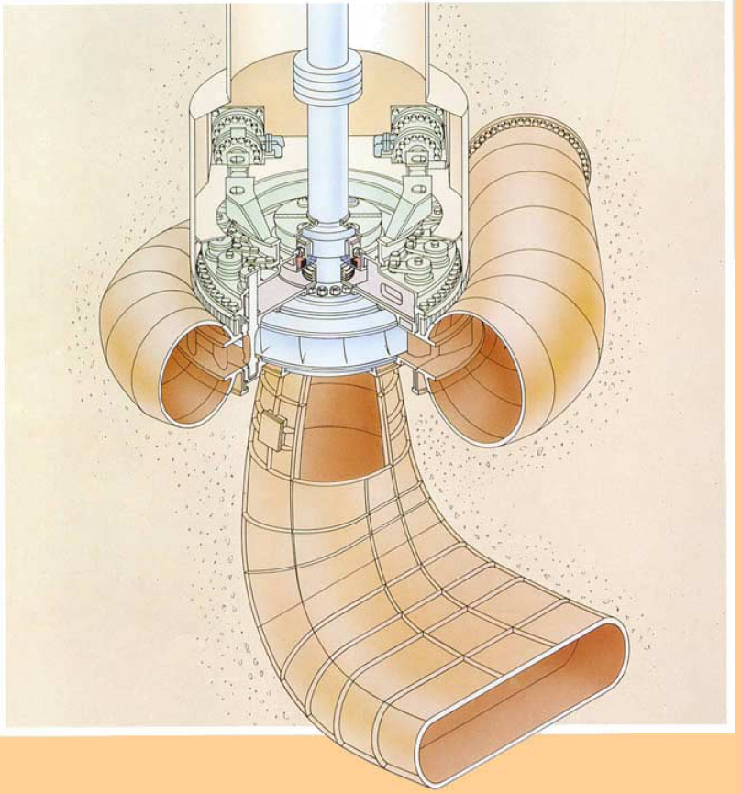
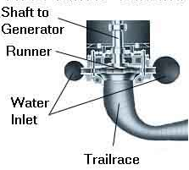

Slide 24
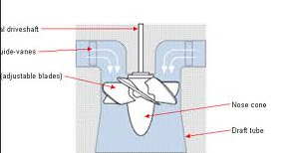
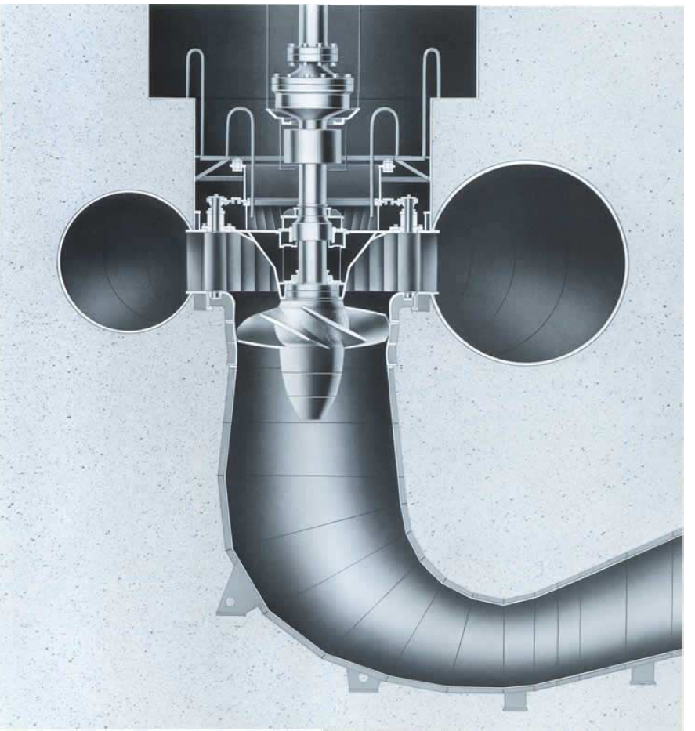


Slide 25
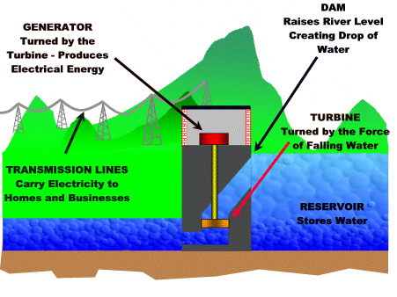
Components of Hydropower Plants
Most conventional hydroelectric plants include four major components
      Dam
      Turbine
      Generator
      Transmission lines
Fig 1.2 Major Components of a Conventional type of Hydropower Plant

Slide 26
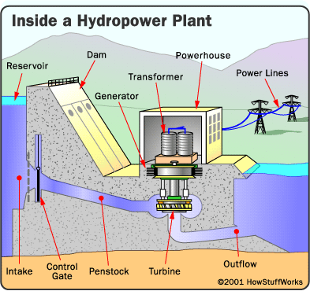
Dam - Most hydropower plants rely on a dam that holds back water, creating a large reservoir. Often, this reservoir is used as a recreational Lake.
Fig. 1.3 Basic components of a conventional hydropower plant

Slide 27
Intake - Gates on the dam open and gravity pulls the water through the penstock, a pipeline that leads to the turbine. Water builds up pressure as it flows through this pipe.
Turbine - The water strikes and turns the large blades of a turbine, which is attached to a generator above it by way of a shaft.
Generators - As the turbine blades turn, so do a series of magnets inside the generator. Giant magnets rotate past copper coils, producing alternating current (AC) by moving electrons.
Transformer - The transformer inside the powerhouse takes the AC and converts it to a higher- voltage current.
Power lines - Out of every power plant come four wires: the three phases of power being produced simultaneously plus a neutral or ground common to all three.

Slide 28
Outflow - Used water is carried through pipelines, called tailraces, and re-enters the river downstream.
Penstock pipe- The penstock pipe transports water under pressure from the forebay tank to the turbine, where the potential energy of the water is converted into kinetic energy in order to rotate the turbine.
The hydropower plant components area is categorized as:
Civil works: Includes dam, powerhouse and spillway(structures used to provide for the controlled release of flows from a dam into a downstream area, typically being the river that was dammed)
Mechanical work: includes turbine, penstock, valves and gates
Electrical and other Equipments: includes transformer, generators and auxiliary equipments

Slide 29
Potential and Developed Hydropower Resources
Hydropower potential is generally evaluated in three categories, namely theoretical, technical and economical potential.
Theoretical potential is defined as the sum of the annual energy potentially available from all natural flows from the largest rivers to the smallest creek, regardless of the losses.
Technical potential is the part of theoretical potential which can be utilized with the current technology regardless of economic and other considerations. This definition of potential subtracts friction losses in water ways and efficiencies in the electromechanical equipment as well as the extreme low heads which are considered as infeasible.

Slide 30
Economic potential is the part of the technical potential which can be regarded as economic when compared to alternative sources of power like oil and coal.
It is dependent on the cost of alternative sources. Therefore, it may change with time and should be updated regularly.
Union of the Electricity Industry uses a definition called exploitable hydropower potential for the portion of the economical potential which can be harnessed considering environmental and other special restrictions.
The Estimated total technical potential for hydropower in the world is as much as 15955 TWh/year or 4.8 times greater than today's hydropower production.

Slide 31
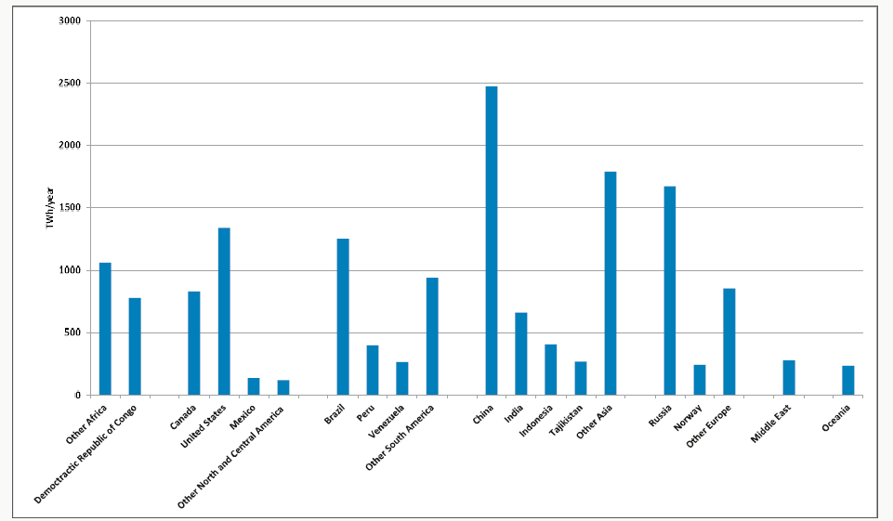
Figure 1.4 World Hydropower Technical Resource Potential

Slide 32
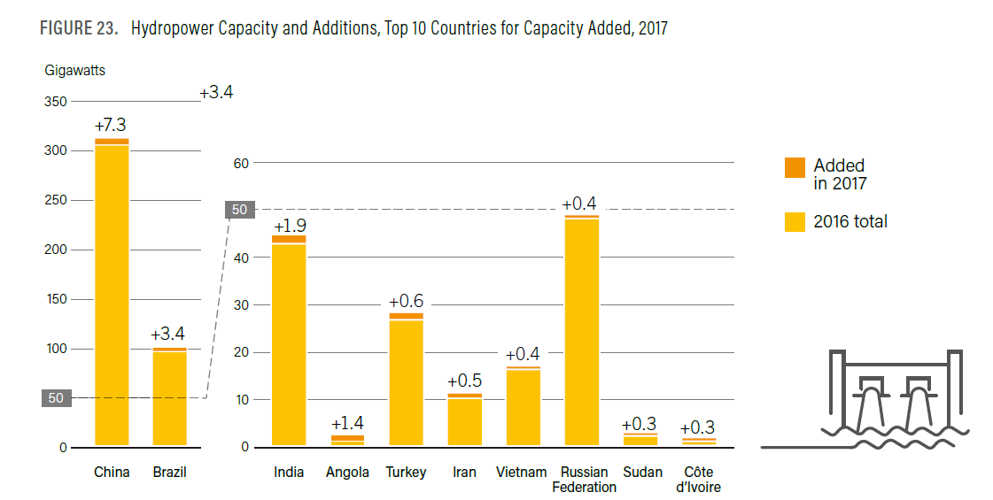

Slide 33
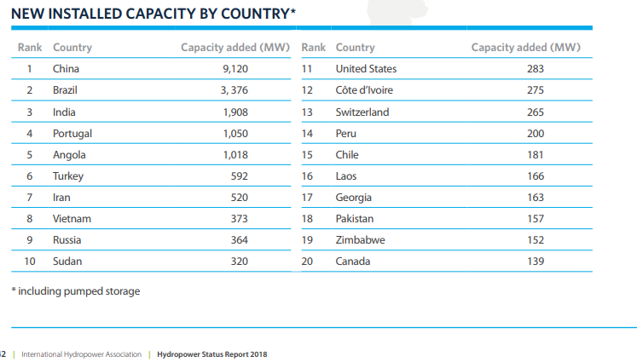

Slide 34
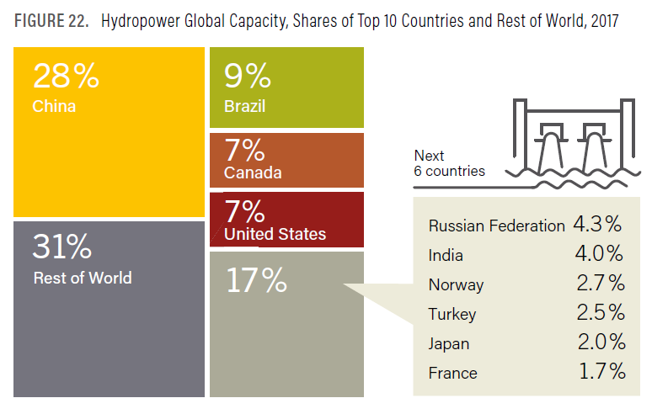

Slide 35
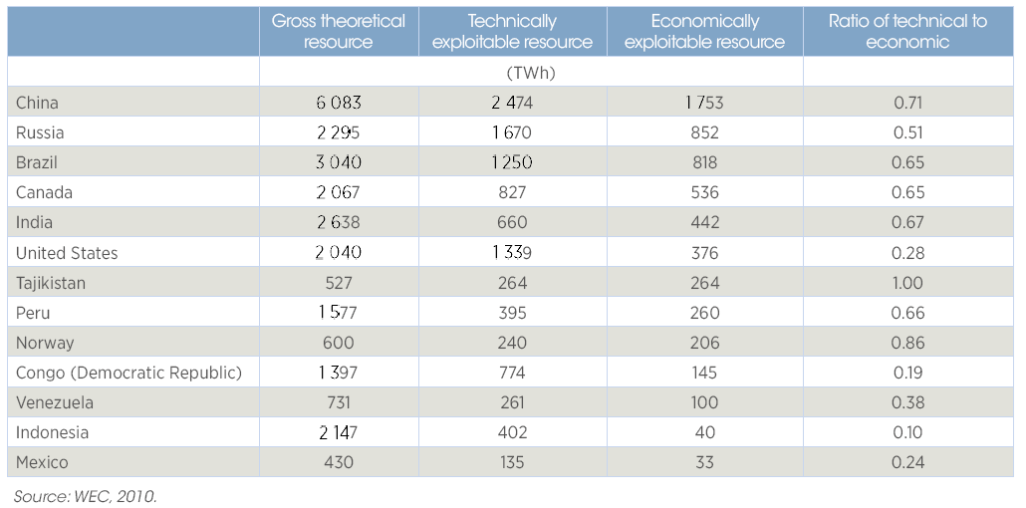
Table 1.1 Hydropower Resource potential in selected countries

Slide 36
Current Hydropower Capacity and Generation
In 2009/2010, 11 000 hydropower plants in 150 countries were generating electricity.
The total electricity generated by hydropower in 2009 reached 3329 TWh, 16.5% of global electricity production. This is around 85% of total renewable electricity generation and provided more than one billion people with power (IEA,2011).
Global installed hydropower capacity was estimated to be between 926 GW and 956 GW in 2009/2010 with a global increase of more than 5% in production in 2010.

Slide 37
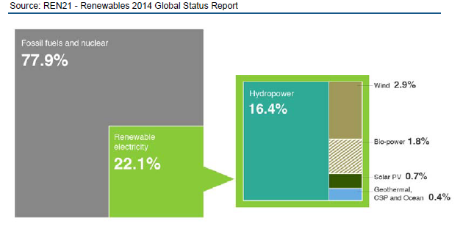
Hydropower is the leading renewable source for electricity generation globally,supplying 76% of all renewable electricity.
Reaching 1000 GW of installed capacity in 2013, it generated 16.4% of the world’s electricity from all sources.
With 40 GW of new installed capacity in 2013, the annual increase in capacity was greater than that for both wind and solar (35 and 39 GW respectively).
Figure 1.5 – Estimated renewable energy share of global electricity production,2013

Slide 38
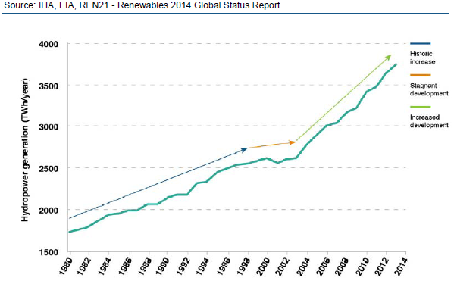
The blue arrow represents a general historic increase in hydropower following growing demand for electricity worldwide.
From 1999 through 2005 (illustrated by the orange arrow), hydropower development was largely halted worldwide, reflecting the impact of the World Commission on Dams (WCD), which was convened to review the development effectiveness of large dams and develop guidelines for the development of new dams.
From 2005 onwards (green arrow), hydropower development has seen an upswing in development, which can be partly attributed to the impact of intensive efforts by the International Hydropower Association (IHA) and hydropower companies to negotiate sustainability guidelines for the sector.
Figure 1.6 – Global total hydropower generation since 1980

Slide 39
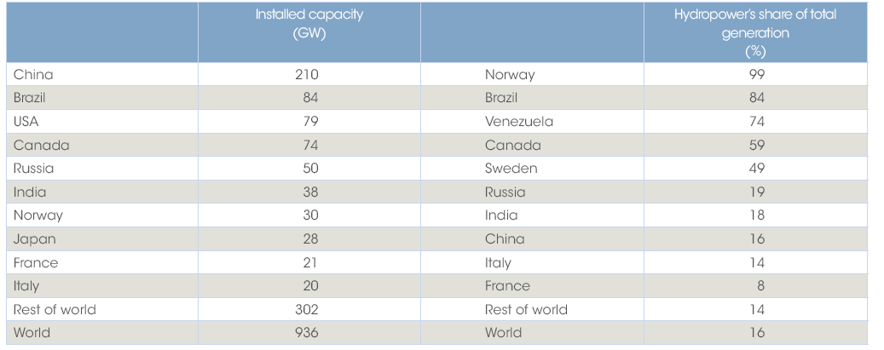
Table 1.2 Top ten countries by installed hydropower capacity and generation share,2010

Slide 40
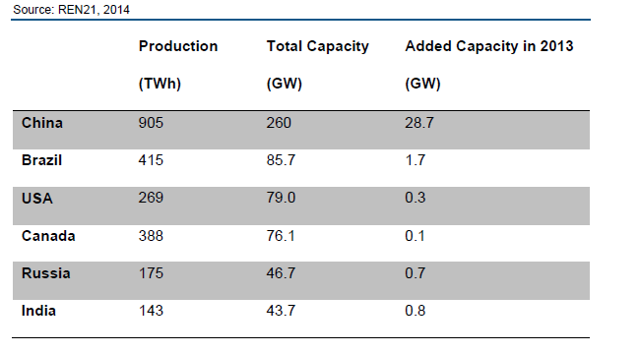
Table 1.3 – Top hydropower capacity as of 2013, by country
In recent years China has taken centre stage for hydropower capacity, accounting for
26% of global installed capacity as of 2013, far ahead of Brazil (8.6%), USA (7.8%)
and Canada (7.6%). China has strengthened its dominant position by adding 29 GW
in 2013, well over three times the new capacity of the next five countries combined.

Slide 41
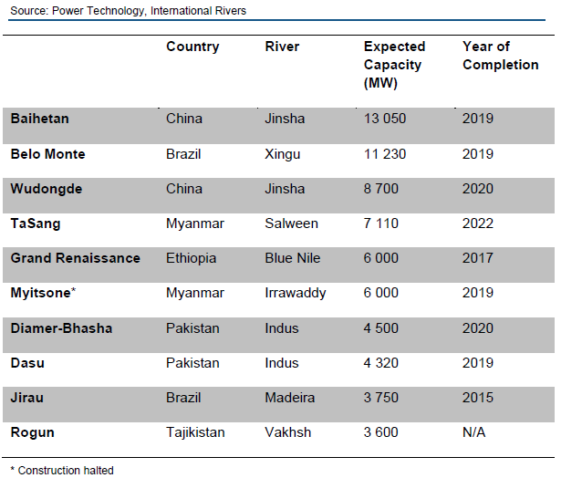
Ongoing work on faster reacting times, broader operating range, improved material resilience, and larger machines will continue to progress hydropower technology over the next several years.
Table 1.4 – Largest hydropower plants under construction, by capacity

Slide 42
Classification of Hydro-Electric Power Plants
In studying the subject of hydropower engineering, it is important to understand the different types of development. Hydroelectric power plants can be classified in different ways according to their characteristics.
Classification According to Operation Mode
Impoundment Plants
Also called ‘storage plants’ or ‘reservoir plants’ is the most common type of hydroelectric power plants . These plants are usually large hydropower schemes and use a dam to store river water in a reservoir.

Slide 43
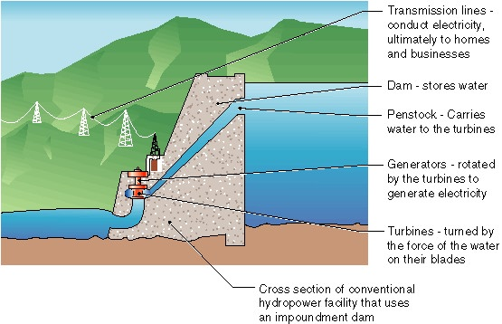
These plants store water when the flows are relatively high and this storage compensates for the low-flow seasons. Therefore, a relatively constant supply of energy is maintained throughout a year.
Fig 1.7 Major parts of storage type of Hydropower Plant

Slide 44
II. Run-of-river Plants
This type of plant generally does not have a storage. By means of a diversion weir, water is diverted from the river and given to the transmission canal or sometimes tunnel.
At the end of the transmission canal lies a head pond or forebay facilitating a gentle approach to the intake of penstock. Forebays also serve in surge reduction and sediment removal.
Since these plants do not have storage, energy generation is dependent on the flow in the river.

Slide 45
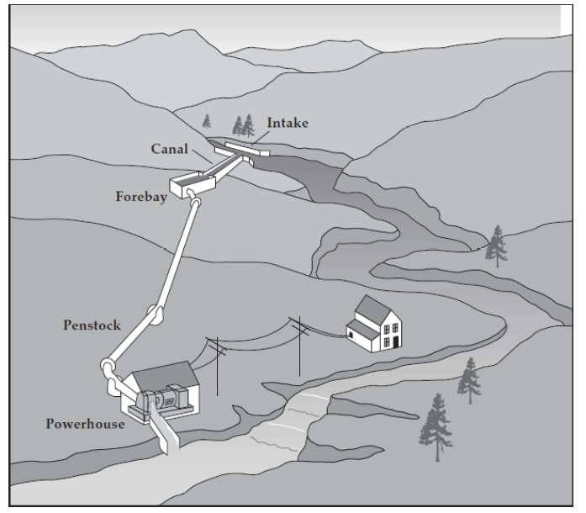

General layout of run-of-river plants is given in figure below.
Fig 1.8 General layout of run- of-river plant

Slide 46
III. Pumped-Storage Plants
In contrast to conventional hydropower plants, pumped storage plants reuse water. They store electrical energy as potential energy.
They pump water to an upper reservoir at times of surplus energy on an electrical supply grid-typically, at night. This potential energy is then released through a hydro-electrical generator at times of high demand. Therefore, pumped-storage plants function like a large battery.
The combined use of pumped storage facilities with other types of electricity generation creates large cost savings through more efficient utilization of base-load plants.

Slide 47
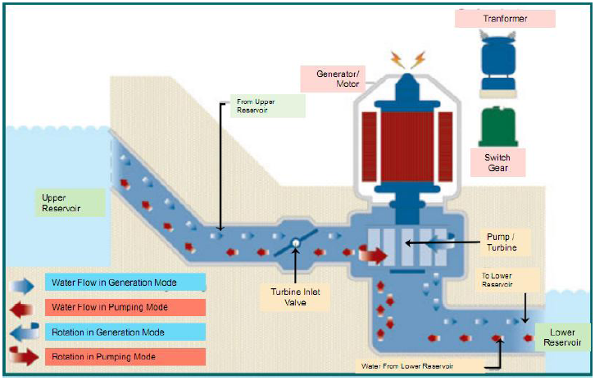
Graphical representation of a pumped-storage plant is given in figure below.
Fig 1.9 General layout of pumped storage plant

Slide 48
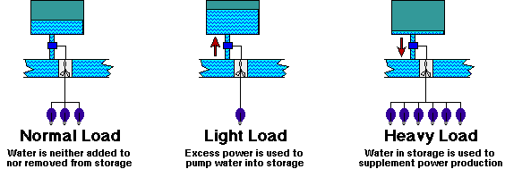
A basic function of pumped storage power stations is load leveling
Fig 1.10 Load Leveling in Pumped Storage Systems

Slide 49
Classification According to the Installed Capacity
There is no consensus in the world on the classification of hydropower plants according to installed capacity. They can be classified as large, small, mini, micro and pico hydropower plants.
Mini, micro and pico hydropower plants could be regarded as small hydro power plants; however, they have specific technical characteristics and deserve their own definition.
Different countries and organizations have different definitions. An example is the one made by Natural Resources Canada. According to this definition:

Slide 50
    Mini hydropower 100 kW to 1 MW
    Micro hydropower 10 kW to 100 kW
    Pico hydropower less than 10 kW
Ethiopia also uses a classification of hydropower systems which differs from other countries, the Ethiopian definitions are follows:
Classification According to Operating Conditions(Nature)
Base Load Plants: These plants operate continuously at a nearly constant power and provide the power demand at base of the load curve (Fig. 1.9). Storage type and run-of river plants can provide base load service.
II. Peak Load Plants: These power plants are designed primarily for the purpose of supplying the peak load of a power system (Fig. 1.9).
Terminology | Capacity limits | Unit
Large | >30 | MW
Medium | 10 - 30 | MW
Small | 1 - 10 | MW
Mini | 501 - 1,000 | kW
Micro | 11 - 500 | kW
Pico | ≤10 | kW

Slide 51
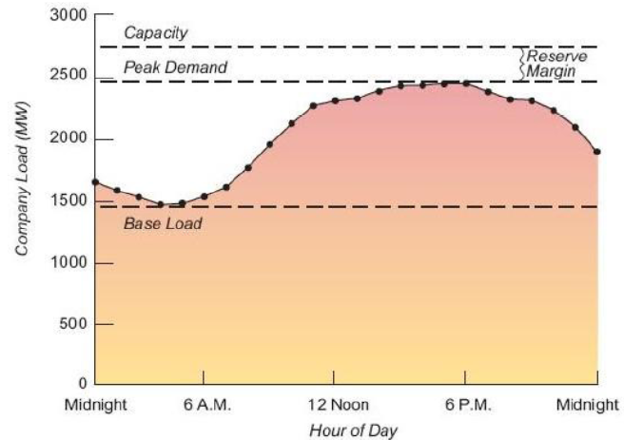
Pumped-storage plants are good examples of peak load plants. Storage type plants may also provide peak load service. Run-of-river plants can supply peak power only if they have a pond.
It is the minimum level of electricity demand required over a period of 24 hours.
Fig 1.11 Typical daily load curve

Slide 52
Classification According to Head
Power that can be generated in a hydroelectric power plant depends on the flow regime in the river and the available head.
Since head is an important parameter in describing a power plant, classifying the plants according to the available head would be meaningful.
Low head H < 10 m
Medium head 10 m < H < 50 m
High head H > 50 m

Slide 53
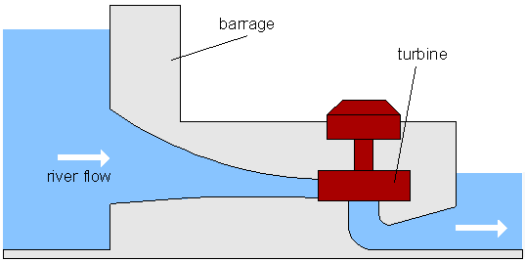
Low-head
Power plants of this type may utilize a low dam or weir to channel water, or no dam and simply use the "run of the river".
A large volume of water must pass through a low head hydro plant's turbines in order to produce a useful amount of power.
Low-head type of hydroelectric installation is shown below:
Low head H < 10 m

Slide 54
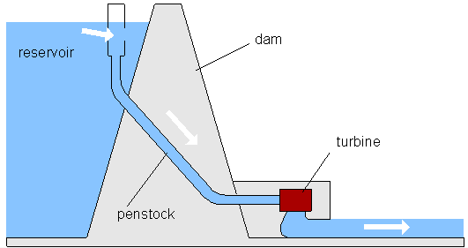
Medium-head
Medium-head (10 meters - 100 meters) hydro power plants consist of a large dam in a mountainous area which creates a huge reservoir.
Another type of medium-head facility is a pumped storage plant.

Slide 55
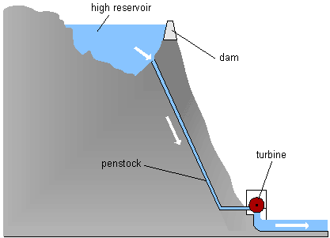
High-head
High-head hydro power plants have an elevation difference of at least 100 meters between the turbines and the water surface.
Generating stations of this type are found in the mountains areas, and high-speed turbines are used.

Slide 56
Hydropower in Ethiopia
Considering the substantial hydro­power resources, Ethiopia has one of the lowest levels of per capita electrical consumption in the world.
The gross theoretical potential (650 TWh/yr) being second only to that of Congo (Democratic Republic) in Africa.
Hydropower & Dams World Atlas 2009 shows Ethiopia‘s economically feasible potential as 162 TWh/yr, of which 10% represents the potential for small-scale hydro installations.
Currently, hydropower provides more than 95% of Ethiopia's electricity.

Slide 57
Ethiopia has enormous hydropower potential with an estimated total useable capacity of 45,000 MW (EEPCO, 2011).
However, less than 5% of this potential is utilized to date. Along with investments and geothermal potentials, the government has planned to increase the current hydropower capacity of around 2000MW to 10,000MW by 2015.
Projects now under construction include two hydropower plants with capacitates of 1870MW (Gibe III) and 6000MW (Renaissance Dam).

Slide 58
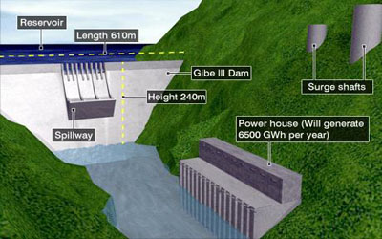
Gibe III Hydroelectric
The installed capacity of the plant is 1870 MW with an annual energy production of 6,500 GWh.

Slide 59
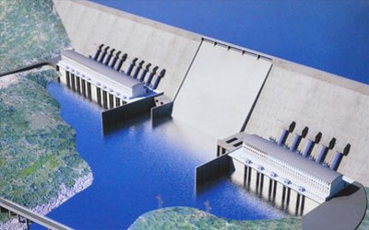
Renaissance Hydro Electric Power Project
The project has envisaged a plant with an installed capacity of 6,000 MW and 15,128 GWh annual energy generation.

Slide 60
The major components of the project include 145 m RCC Dam with 1,780 m long crest.
The Dam will create 63 M m³ reservoir with a surface area of 1,680 km² at full supply level.
Two outdoor powerhouses with 3,500 and 1,750 MW installed capacity containing 10 and 5 generating units respectively each with a capacity of 350 WM.
Two independent switchyards on the right and left bank of the dam are foreseen to transmit power from the two powerhouses to the grid.

Slide 61
  Current electricity supply structure in Ethiopia
  The Ethiopian Electric Power Corporation(EEPCO) is responsible for generating, transmitting, distributing and selling electric power.
  Currently, the Corporation has two different systems to generate electricity, i.e., Inter-Connected System (ICS), which is largely generated by hydro power plants and self-contained system (SCS), which combines both mini hydropower plants and a number of isolated diesel supplying units that are widely spread throughout the country.
  Due to the growing demand for electricity, unfavorable hydrologic conditions, and slippage of scheduled commissioning dates of new hydro generation plants, the ICS system in the past few years has frequently faced supply deficits which have led to power rationing.

Slide 62
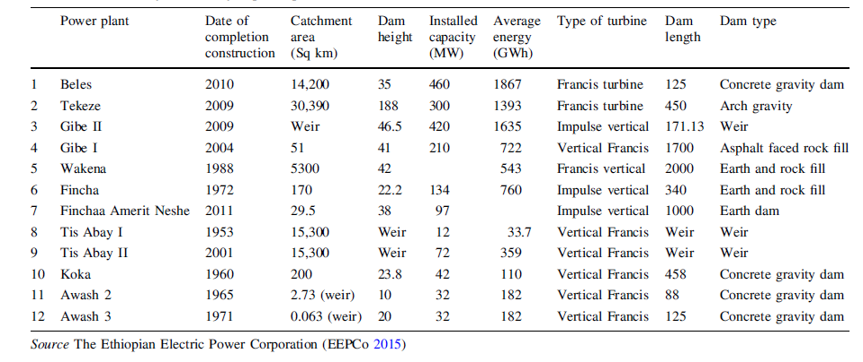
Table :The currently installed hydropower plants

Slide 63
projects included in the 25-year Master Plan of the national power utility EEPCO:
  Tekeze II 450 MW,
  Genale Dawa IV 256 MW,
  Karadobi 1600 MW; prefeasibility study by Nor consult-Lahmeyer financed by a grant from Norway is complete; the dam will be located on the Blue Nile and it expected to export power to Sudan and possibly to Egypt
  Border 800 - 1200 MW, located on the Blue Nile.
  Mandaya 2400 - 2800 MW, located on the Blue Nile.

Slide 64
Types of Hydropower Studies
Three types of studies are commonly made:
  Reconnaissance studies,
  Feasibility studies, and
  Definite plan or design studies.
Reconnaissance resource studies are made to find potential energy sources and to estimate the energy available in streams, and may not be too site specific.
This study may use contour maps to determine head available in the streams, and water flow was estimated by using parametric curves of the flow duration in the streams.

Slide 65
Feasibility studies are made to formulate a specific project or projects to assess the desirability of implementing hydropower development. These normally require duration flow data that give time variability of water discharge sufficiently accurate to make possible capacity sizing of the plants.
Definite plan or design studies are made before proceeding with implementation of final design and initiation of construction. These studies normally require daily or at least monthly flow data and usually require operational studies to determine energy output and economics over critical periods of low flow in the supplying river.

Slide 66
Site Selection for Hydropower Plants
The essential characteristics of a good site are: large catchment areas, high average rainfall and a favorable place for constructing the storage or reservoir. For this purpose, the geological, geographical and metrological conditions of a site need careful investigation.
The following factors should be given careful consideration while selecting a site for a hydro-electric power plant.

Slide 67
Available water
To know the available energy from a given stream or river, the discharge flowing and its variation with time over a number of years must be known. Preferably, the estimates of the average quantity of water available should be prepared on the basis of actual measurements of river flow.
The river flow data should be based on daily, weekly, monthly and yearly flow over a number of years.
2. Water-Storage
The output of a hydropower plant is not uniform due to wide variations of rain fall. To select the site of the dam, careful study should be made of the geology and topography of the catchment area to see if the natural foundations could be found and put to the best use.

Slide 68
3. Head of Water
The level of water in the reservoir for a proposed plant should always be within limits throughout the year.
4. Distance from Load Center
Most of the time the electric power generated in a hydro-electric power plant has to be used some considerable distance from the site of the plant. For this reason, to be economical on transmission of electric power, the routes and the distances should be carefully considered .
5. Access to Site
It is always a desirable factor to have a good access to the site of the plant. This factor is very important if the electric power generated is to be utilized at or near the plant site. The transport facilities must also be given due consideration.

Slide 69
End of Chapter

