Slide 1
Chapter 8
ARTIFICIAL INTELLIGENCE

Slide 2
Artificial Intelligence - Topics
Introduction to Machine Learning and Artificial Intelligence
Expert Systems
Biological Neural Networks (BNN)
Artificial Neural Networks (ANN) - Fundamentals
ANN Characteristics
Learning Laws in ANNs
Single Layer Perceptrons (SLP) and Multi Layer Perceptrons (MLP)
Self Organizing Maps (SOM)
Hopfield
Associative Memory
Adaptive Resonance Theory (ART)
Support Vector Machines (SVM)
Naïve Bayes Classification- Bayesian Belief Network (BNN)
Genetic Algorithm (GA) and Varieties of GA
Other Population Based Search Algorithms similar to GA
Fuzzy Logic
Simulated Annealing

Slide 3
Neural Networks

Slide 4
Content
Biological neurons
  Axon, dendrites, synaptic
Artificial Neural network
Neuron model
Network topologies
  Feed forward
  Recurrent
  Radial basis function

Slide 5
ANN
Ann is an interconnection of simple processing units which communicate by sending signals
Massively parallel
Computational models having the capacity to learn
Learning is achieved by updating the interconnection weights between processing units

Slide 6
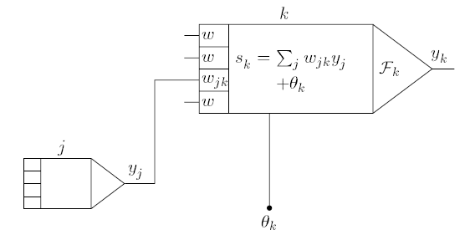

Neuron model
Receive input from neighbors and/or external sources, use it to compute output
Net input to unit k can be obtained as

Slide 7



Neuron model cont…
The output of the neuron is yk
The function F_{k} is known as activation function
The type of activation function determines the property of the network
Common activation functions

Slide 8
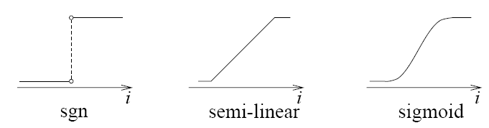
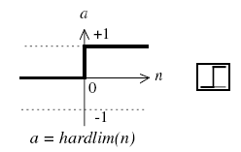
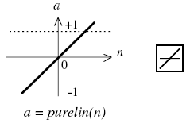
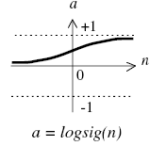
Common Activation functions
Smooth and linear functions

Slide 9
Network topologies
Neurons can be connected together to form a network
Topology is the way connection is made
In an artificial neural network
  Two or more neurons form a layer, neurons with in a layer will have same activation
  Layers will be connected to form network – different layers can have different number of neurons and different types of activation

Slide 10
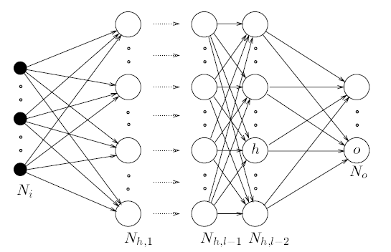
Three layer network
The network has input, hidden and output layers
Example :
  Hidden layer – tansigmod and output pure linear

Slide 11
Network topologies
Feed forward – connection extends from input to output with out any feedback.
  Static networks
  Used for mapping or function approximation
  Example: Perception
Recurrent – contain feedback
  Dynamic networks
  Example: Hopfield network
Radial basis – feed forward network with bell shaped activation function

Slide 12
Training Artificial Neural Network
In a ANN, knowledge is stored in the form connection weights
Hence learning is achieved by adjusting the weights
The process of adjusting the weights is known as training
Paradigms of learning
  Supervised learning
    Learning by example, input-output pairs or samples will be given to the network and based on the error, weights are adjusted
  Unsupervised learning
    network finds or searches clusters or patterns in the data without any external agent or teacher

Slide 13
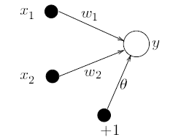


Perceptron
Network with threshold activation function
Consider a network with two inputs and one output
If the activation function is hard limiting (threshold)
Then output will be either +1 or -1

Slide 14
Example: for the inputs and weights shown determine the outputs
x1 | x2 | w1 | w2 | θ | y
0 | 0 | 0.5 | -1.5 | 1 | 1
0 | 1 | 0.5 | -1.5 | 1 | -1
1 | 0 | 0.5 | -1.5 | 1 | 1
1 | 1 | 0.5 | -1.5 | 1 | -1

Slide 15

The inverse problem- how to decide the weights values
We want to have the following mapping
How to determine the weights?
Learning rules- weights are updated as
x1 | x2 | w1 | w2 | θ | y
0 | 0 |  |  |  | -1
0 | 1 |  |  |  | -1
1 | 0 |  |  |  | -1
1 | 1 |  |  |  | 1

Slide 16
Hebbian learning rule
Start with random weights
Select an input X from samples
If y ≠ d(x), where y is the actual output of the network for input x and d(x) is the desired value, modify the connection as
Go to step 2

Slide 17
Example
A perceptron has two inputs and one output. The connection weights are -0.1 and 0.5 respectively for the two inputs. The bias is 1. Determine the weights using Hebbian learning rule so that the network implement an OR logic

Slide 18

W-H learning rule
Adjust the weights proportional to the error value
Takes less number of iteration and has better convergence

Slide 19
Multi-layer feed forward
Two layer feed forward network
Theory of universal approximation
  Hidden layer sigmoid
  Output layer linear
  Can approximate any nonlinear mapping

Slide 20
Example
Consider the following input sequence and the networks shown
For a simple feed forward network, with one neuron, linear network with delay and a recurrent network

Slide 21
Simple feed forward network
Output will be y = [0 0 1 1 1 0 0]
Linear activation
p
1
y
0

Slide 22
Linear filter, network with input delay
Output will be y=[0 0 1 2 2 1 0 0]
Linear activation
p
1
y
TD
1
0

Slide 23
Simple recurrent network
Output will be y=[0 0 1 2 3 3 3 0]
Linear activation
p
1
y
1
0
TD

Slide 24
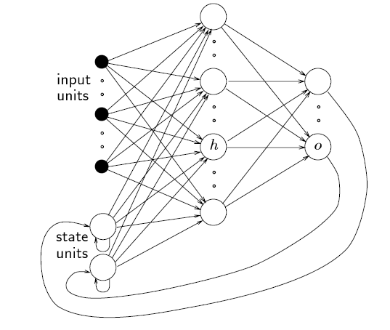
Jordan Network

Slide 25
Jordan network
It is first proposed in 1986
Its feed back comes from output to input
The input from feedback are known as states
No. states = No. of output units
Connection weight for feedback is constant which is unity
Training is simple
  Simple back propagation network is used

Slide 26
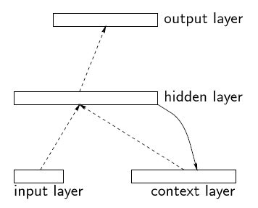
Elman network

Slide 27
Elman network
Introduced in 1990
Feedback comes from hidden units
In Jordan network, feedback units can have self connection
In Elman network, extra inputs have no self connection
Connection weight for feedback is unity

Slide 28
The Hopfield networks
The idea is first proposed by Anderson and Khonon in 1977
In 1982 Hopfield generalized it
Network contains N interconnected neurons
Connection weight is updated asynchronously and independently
All neurons are both input and output
Activation values are binary (0 and 1 or -1 and 1)

Slide 29
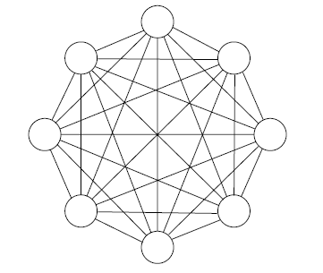
Hopfield Network
It is also known as auto associative

Slide 30


Hopfield network
If output of a neuron k at time t is Y_{k}, then the net input for neuron k is given by
Where w_{jk} is the connection weight between neuron k and j
The new activation value of the neuron becomes

Slide 31

Hopfield network
Stable neuron and stable network
  If the output of a neuron remains constant, neuron is said to be stable
  The state of the network is the vector Y=(yk) for all k
  Stable state – if all neurons are stable at that state
  Stable pattern – if network becomes stable for that input

Slide 32
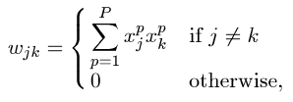
Hopfield network
Associative memory
  Input pattern and stable state are associated
  Hebb learning rule can be used
Hopfield network for optimization
  Activation is sigmoid
  Neurons are arranged in rows and columns

Slide 33
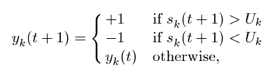

Boltzmann machines
Is extension of Hopfield networks
Works based on principle of annealing
Deterministic output
Stochastic output – probability of becoming active

Slide 34
Dynamic networks in MATLAB
Focused time delay networks –newfftd
Distributed time delay networks –newdtdnn
Layered recurrent networks –newlrn

Slide 35
Fuzzy logic and its application in Biomedical modeling

Slide 36
Contents
Fuzzy set theory
Fuzzy relations
Fuzzy logic
Fuzzy logic control

Slide 37
1 Fuzzy set
Normal set theory allows an element to be a member or not
  Universal set U={1 2 3 4 5}
  Set A={1 2}
  Draw the membership degree as a function of the elements
In fuzzy set an element can be a member to some degree
  Fuzzy set
    A- the set of all big numbers
    B- medium temperature

Slide 38
Degree of membership
In a fuzzy set, the degree of belongingness is expressed in terms of degree of membership
Membership function
  A function which maps the Universe of discourse to the numbers in [0 1]
  It assigns a number(real) for each element in U
Example
  Fuzzy set
    A= set of numbers close to 100
    1
    100

Slide 39
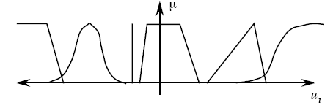
Fuzzy set cont…
For continuous case, possible shapes of mf
For discrete case
  Enumeration
  Two types of enumeration
    Fuzzy set=list in the form of degree of membership/element
    A=0.5/1+0.3/6
    Fuzzy set={(mfv,element1),(mfv,element2)…}
    A={(0.5,1),(0.3,6)}

Slide 40
2 fuzzy Logic
Some terminologies and symbols
  Linguistic variable
    Variable expressed in human language
    Linguistic description of inputs and outputs
    Example: temperature, fault
  Linguistic class(values)
    Possible divisions of the linguistic variable
    Characteristics of the linguistic variable
    Hot, cold, medium for temperature
  Universe of discourse
    The universal set or set containing the complete range of the linguistic variable
  Degree of membership – membership value μ(A)

Slide 41
Fuzzy relations cont…
Union
  Union is maximum of membership values
  For two fuzzy sets A and B,
  Set(A U B )=max(u(A),u(B))
Intersection
  Is minimum of membership values
  For two fuzzy sets A and B,
  Set(A n B )=min(u(A),u(B))
Complement
  1-membership value of the given set
  Set(A’)=1-u(A)

Slide 42
Example: Two fuzzy sets A and B are defined as follows
U={ set of positive integers below 10}
A = set of number close to 5
= {0.1/1+0.3/2+0.5/3+0.8/4+1/5+ 0.8/6+0.5/7+0.3/8+0.1/9}
B=set of small numbers
={1/1+0.9/2+0.6/3+0.4/4+0.3/5+0.1/6+0/7+ 0/8+0/9}
Find the union, intersection and complement of each set
AUB=1/1+0.9/2+0.6/3+0.8/4+1/5+0.8/6+0.5/7+
0.3/8+0.1/9
AnB=0.1/1+0.3/2+0.5/3+0.4/4+0.3/5+0.1/6
A’=0.9/1+0.7/2+0.5/3+0.2/4+0/5+0.2/6+0.5/7+…

Slide 43
Fuzzy Rules
Fuzzy rules
  Rule base or the linguistic rules define the mapping from input to output
  Condition Action
  Two types of fuzzy logic systems Type I and Type II
  Type I: If A is Big then B is small
  if part is premise , then part is consequent
  Type II: If A is Big then B=aA+b
Max number of rules
if there are n inputs, m classes for each input, single outputs,
total rules=
Rule derivation – from expert knowledge or characteristic curve

Slide 44
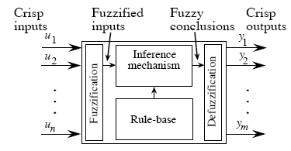
Fuzzy logic control
Parts of a fuzzy logic control

Slide 45
Fuzzification
Is converting crisp inputs to fuzzy set
Usually singleton fuzzification is used
Example: For the following fuzzy set, determine the membership value when input is 0.5
u(x)=0.5+2x/3
-0.75 0.75 x

Slide 46
Inference mechanism
Determines the consequent value based on the given fuzzy rules
Min-max inference mechanism
Two steps
  Step 1- matching – decide which rules are fired
  Step 2- use min-max to decide the consequent fuzzy set

Slide 47


Defuzzification
Determining crisp value from a fuzzy set
Various methods are there
Center of gravity, center of area, center-average, height of maxima, height of Area
COG
Center of Area

Slide 48
Applications
Dialysis hypotension control
  An automatic system for BP control by fluid removal feedback regulation
  Is implemented on dialysis machine
  Input is BP
  Output- signal that govern ultrafiltration rate(UFR)
Blood glucose regulation

Slide 49
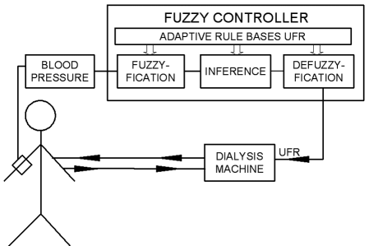
BLOCK DIAGRAM

Slide 50
Evolutionary algorithms and genetic algorithm

Slide 51
Content
Evolutionary computing and genetic algorithm
Evolutionary algorithms
Genetic algorithm
Application in medical data analysis

Slide 52
Evolutionary computing and genetic algorithm
Is inspired from natural phenomenon
Maps a physical problem into a natural phenomenon
Examples
  Particle swarm optimization
  Genetic algorithm

Slide 53
Evolutionary algorithms- Particle Swarm Optimization (PSO)
PSO is a robust stochastic optimization technique based on the movement and intelligence of swarms.
PSO applies the concept of social interaction to problem solving.
It was developed in 1995 by James Kennedy (social-psychologist) and Russell Eberhart (electrical engineer).
It uses a number of agents (particles) that constitute a swarm moving around in the search space looking for the best solution.
Each particle is treated as a point in a N-dimensional space which adjusts its “flying” according to its own flying experience as well as the flying experience of other particles.

Slide 54
Particle Swarm Optimization (PSO)
Each particle keeps track of its coordinates in the solution space which are associated with the best solution (fitness) that has achieved so far by that particle. This value is called personal best , pbest.
Another best value that is tracked by the PSO is the best value obtained so far by any particle in the neighborhood of that particle. This value is called gbest.
The basic concept of PSO lies in accelerating each particle toward its pbest and the gbest locations, with a random weighted accelaration at each time step as shown in Fig.1

Slide 55
Particle Swarm Optimization (PSO)
y
x
Fig.1 Concept of modification of a searching point by PSO
s^{k} : current searching point. s^{k+1}: modified searching point. v^{k}: current velocity. v^{k+1}: modified velocity. v_{pbest} : velocity based on pbest. v_{gbest} : velocity based on gbest

Slide 56
Particle Swarm Optimization (PSO)
Each particle tries to modify its position using the following
information:
the current positions,
the current velocities,
the distance between the current position and pbest,
the distance between the current position and the gbest.
The modification of the particle’s position can be mathematically
modeled according the following equation :
V_{i}^{k+1} = wV_{i}^{k} +c₁ rand₁(…) x (pbest_{i}-s_{i}^{k}) + c₂ rand₂(…) x (gbest-s_{i}^{k}) ….. (1)
where, v_{i}^{k} : velocity of agent i at iteration k, w: weighting function, c_{j} : weighting factor, rand : uniformly distributed random number between 0 and 1, s_{i}^{k} : current position of agent i at iteration k, pbest_{i} : pbest of agent i, gbest: gbest of the group.

Slide 57
Particle Swarm Optimization (PSO)
The following weighting function is usually utilized in (1)
w = wMax-[(wMax-wMin) x iter]/maxIter (2)
where wMax= initial weight,
wMin = final weight,
maxIter = maximum iteration number,
iter = current iteration number.
s_{i}^{k+1} = s_{i}^{k} + V_{i}^{k+1} (3)

Slide 58
Particle Swarm Optimization (PSO)
Comments on the Inertial weight factor:
A large inertia weight (w) facilitates a global search while a small inertia weight facilitates a local search.
By linearly decreasing the inertia weight from a relatively large value to a small value through the course of the PSO run gives the best PSO performance compared with fixed inertia weight settings.
Larger w ----------- greater global search ability
Smaller w ------------ greater local search ability.

Slide 59
Particle Swarm Optimization (PSO)
Flow chart depicting the General PSO Algorithm:
Start
Initialize particles with random position
and velocity vectors.
For each particle’s position (p)
evaluate fitness
Loop until all particles exhaust
If fitness(p) better than
fitness(pbest) then pbest= p
Loop until max iter
Set best of pBests as gBest
Update particles velocity (eq. 1) and
position (eq. 3)
Stop: giving gBest, optimal solution.

Slide 60
Comparison with other evolutionary computation techniques
Unlike in genetic algorithms, evolutionary programming and evolutionary strategies, in PSO, there is no selection operation.
All particles in PSO are kept as members of the population through the course of the run
PSO is the only algorithm that does not implement the survival of the fittest.
No crossover operation in PSO.
eq 1(b) resembles mutation in EP.
In EP balance between the global and local search can be adjusted through the strategy parameter while in PSO the balance is achieved through the inertial weight factor (w) of eq. 1(a)

Slide 61
Variants of PSO
Discrete PSO ……………… can handle discrete binary variables
MINLP PSO………… can handle both discrete binary and continuous variables.
Hybrid PSO…………. Utilizes basic mechanism of PSO and the natural selection mechanism, which is usually utilized by EC methods such as GAs.

Slide 62
Genetic Algorithm
Introduction to Genetic algorithm
Basic elements of GA
Operators in GA
Design of Objective function
Multi-objective GA
Application in medical data analysis

Slide 63
Introduction to Generic algorithm
Genetic algorithm is an evolutionary algorithm based on Darwin’s theory of selection of the fittest
It is a multidimensional search algorithm which solves the local minima problem of classical algorithms
Basic elements of GA algorithm
  Objective function
  Gene
  Chromosome
  Population
  Operators

Slide 64
Basic elements of GA
Objective function/ fitness function
  The objective to be fulfilled
  Constrained or unconstrained objective function
  Multiple objective functions can be combined
  It may not be differentiable
Gene – in genetics, it is the basic genetic material
  In GA based optimization, it is the basic element in a solution of the Objective function
  They can be coded as binary or real

Slide 65
Basic elements cont…
Chromosome – is a collection of genes
    It represents a candidate solution in the optimization
    Example: design the following optimization problem for GA solution
    Minimize f(x)=x(x-1.5), we need to find a single variable x
    Let us assume that we code the genes in binary (1 or 0) and let us assume also that a chromosome will have 4 genes
    Chromosome 1 = 0010
    Chromosome 2 = 0011
    Chromosome 3 = 0111

Slide 66
Basic elements cont…
Population – is a collection of chromosomes
  Genes- chromosomes- population
  Initial population – an initial set of candidate solutions, contains some number of chromosomes
An iteration of GA goes as follows
  First a candidate solution or initial population is created
  The initial population is tested to see how much the chromosomes in the population fulfill the objective function
  Select best chromosomes
  Apply operators to create new and better candidates
  Repeat the steps

Slide 67
Operators in GA
There are two major operators
  Crossover
  Mutation
Crossover
  Used to mix genetic material of two chromosomes
  Pairing is needed
  Results in 2 new off springs and 2 parents
Mutation – change in a single chromosome

Slide 68
Mutation: Local Modification
Before: (1 0 1 1 0 1 1 0)
After: (0 1 1 0 0 1 1 0)
Before: (1.38 -69.4 326.44 0.1)
After: (1.38 -67.5 326.44 0.1)
Causes movement in the search space
(local or global)
Restores lost information to the population

Slide 69
Crossover: Recombination
*
P1 (0 1 1 0 1 0 0 0) (0 1 0 0 1 0 0 0) C1
P2 (1 1 0 1 1 0 1 0) (1 1 1 1 1 0 1 0) C2
Crossover is a critical feature of genetic
algorithms:
  It greatly accelerates search early in evolution of a population
  It leads to effective combination of schemata (subsolutions on different chromosomes)

Slide 70
Cross over for real coding
Discrete
  Offspring is selected with equal probability
  Example: given parents x and y, off spring z= x or y with equal probability
Intermediate
  Single arithmetic
  Simple arithmetic
  Whole arithmetic

Slide 71
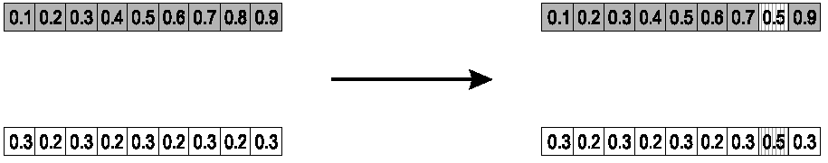
Single arithmetic crossover
Parents: ⟨x₁,…,x_{n} ⟩ and ⟨y₁,…,y_{n}⟩
Pick a single gene (k) at random,
child₁ is:
reverse for other child. e.g. with α = 0.5

Slide 72
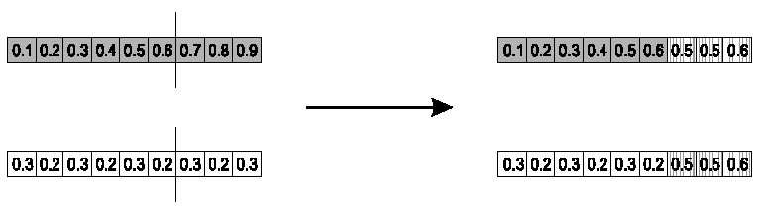
Simple arithmetic crossover
Parents: ⟨x₁,…,x_{n} ⟩ and ⟨y₁,…,y_{n}⟩
Pick random gene (k) after this point mix values
child₁ is:
reverse for other child. e.g. with α = 0.5

Slide 73
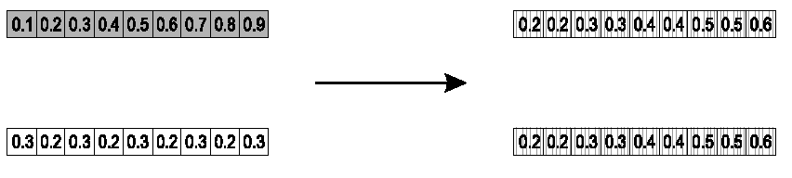
Whole arithmetic crossover
Most commonly used
Parents: ⟨x₁,…,x_{n} ⟩ and ⟨y₁,…,y_{n}⟩
child₁ is:
reverse for other child. e.g. with α = 0.5

Slide 74
Evaluation
The evaluator decodes a chromosome and assigns it a fitness measure
The evaluator is the only link between a classical GA and the problem it is solving
modified
children
evaluated
children
evaluation

Slide 75
Deletion
population
Generational GA:
entire populations replaced with each iteration
Steady-state GA:
a few members replaced each generation
discarded members
discard

Slide 76
Design of objective function
Objective function
  GA is designed to maximize a given problem and hence a fitness function has to be designed accordingly
  Is the performance index
  Determines the effectiveness of the search
  Has to be designed carefully
  Can be a differentiable or non differentiable function

Slide 77
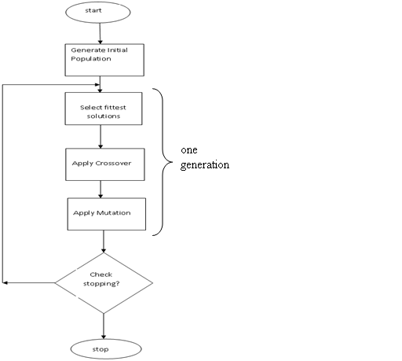

Slide 78
Simple Genetic Algorithm
{
  initialize population;
  evaluate population;
  while TerminationCriteriaNotSatisfied
  {
    select parents for reproduction;
    perform recombination and mutation;
    evaluate population;
  }
}

Slide 79
Example: find the solution of the following unconstrained optimization of three variable
Function of two variable
Binary coding - if each gene will be coded with 4 binary digits, for two genes 8 binary digits
  Possible chromosome =[01111001] x1=7 x2=9
Real coding – if solution range of x1 and x2 is assumed to be [-10 10]
  Chromosome =[57] which means x1=5 and x2=7

Slide 80
Multi objective GA
Is a GA with multiple objectives
  Minimum cost of operation and minimum loss over transmission line
Fitness function has to be designed to represent each objective
Each objective may have its own weight

