Slide 1
Chapter One
Introduction to Research and Research Methods

Slide 2
Introduction
Science can be defined as a methodological and systematic approach to the acquisition of new knowledge.
This definition of science highlights some of the key differences between how scientists and nonscientists go about acquiring new knowledge.
Specifically, rather than relying on mere casual observations and an informal approach to learn about the world, scientists attempt to gain new knowledge by making careful observations and using systematic, controlled, and methodical approaches (Shaughnessy & Zechmeister, 1997).

Slide 3
Meaning of Research
Research may be defined as
▪ The systematic investigation into and study of materials and sources in order to establish facts and reach new conclusions.
▪ Seeking through methodical processes to add to one’s own body of knowledge and to that of others, by the discovery of non-trivial facts and insights.
▪ Some people consider research as a movement, a movement from the known to the unknown
▪ It is actually a voyage of discovery.

Slide 4
research can be defined as an art of investigation
  Scientific and systematic search for relevant information on specific topic
  Process of arriving at dependable solutions to problems through systematic data collection, analysis and interpretation of data
A systematized effort to gain new knowledge; a movement from the known to unknown
  Search for new knowledge/facts through objectives, systematic and scientific method of finding solution to a problem
  Research deals with discovering, interpreting and developing of methods and systems for the advancement of human knowledge

Slide 5
Objective of research
The purpose of research is to discover answers to questions through the application of scientific procedures
The main aim of research is to find out the truth which is hidden and which has not been discovered yet
Though each research study has its own specific purpose, we may think of research objectives as falling into a number of following broad groupings
To gain familiarity with a phenomenon or to achieve new insights into it
To know accurately the characteristics of a particular problem
To determine the frequency with which something occurs
To test a hypothesis of a causal relationship between variables

Slide 6
To gain familiarity with a phenomenon or to achieve new insights into it (studies with this object in view are termed as exploratory or formative research studies);
To portray accurately the characteristics of a particular individual, situation or a group(studies with this object in view are known as descriptive research studies);
To determine the frequency with which something occurs or with which it is associated with something else (studies with this object in view are known as diagnostic research studies);
To test a hypothesis of a causal relationship between variables (such studies are known as hypothesis-testing research studies).

Slide 7
Motivation for Research
What makes people to undertake research? This is a question of fundamental importance.
The possible motives for doing research may be either one or more of the following :
Desire to get a research degree along with its consequential benefits;
Desire to face the challenge in solving the unsolved problems
Desire to get intellectual joy of doing some creative work
Desire to be of service to society
Desire to get respectability

Slide 8
Types of Research
Types of research can be classified from three different perspectives(Kumar, 2011):
Application of the findings of the research study
Objectives of the study
Mode of enquiry used in conducting the study

Slide 9
Types of research based on Application perspective
Applied research
Basic research
Evaluation research

Slide 10
Applied Research:
Research done to address a specific concern.
It is designed to offer practical solutions to a concrete problem or address the immediate and specific needs of practitioners.
It is conducted to offer solutions to a question raised by an employer, a local community, or a social cause.
Building, testing, or making connection to theory is rarely done here.
Businesses, government offices, health care facilities, social service agencies, political organizations, and educational institutions conduct applied studies and make decisions based on findings.

Slide 11
Basic Research
It is also called pure or fundamental and performed without a specific purpose in mind. Rather, it is primarily concerned with generation of new knowledge.
It is used to generate and expand theories that describe, explain or predict a phenomenon of interest to the discipline without regard to its immediate use.
Basic research is usually carried out for some of the following aims:
1. Gather and generate information.
2. Expand the body of knowledge to improve understanding about a discipline.
3. Develop or refine theories and principles

Slide 12
Evaluation research
Evaluation research is the systematic assessment of the worth or merit of time, money, effort and resources spent in order to achieve a goal
Evaluation research in which one tries to determine how well a program or policy is working or reaching its goals and objectives.
Many organizations e.g. government agencies and businesses have made evaluation research part of their ongoing operations.

Slide 13
benefits of evaluation research
Gain insights about a project or program and its operations
Evaluation Research lets you understand what works and what doesn’t, where we were, where we are and where we are headed towards.
You can find out the areas of improvement and identify strengths. So, it will help you to figure out what do you need to focus more on and if there are any threats to your business.
You can also find out if there are currently hidden sectors in the market that are yet untapped.

Slide 14
Evaluation research gives an opportunity to your employees and customers to express how they feel and if there’s anything they would like to change.
It also lets you modify or adopt a practice such that it increases the chances of success, evaluating the efforts, you can see how well you are meeting objectives and targets.
Evaluations let you measure if the intended benefits are really reaching the targeted audience and if yes, then how effectively.

Slide 15
Types of research based on Objectives
perspective
Descriptive research
Historical research
Experimental research
Quasi-experimental research

Slide 16
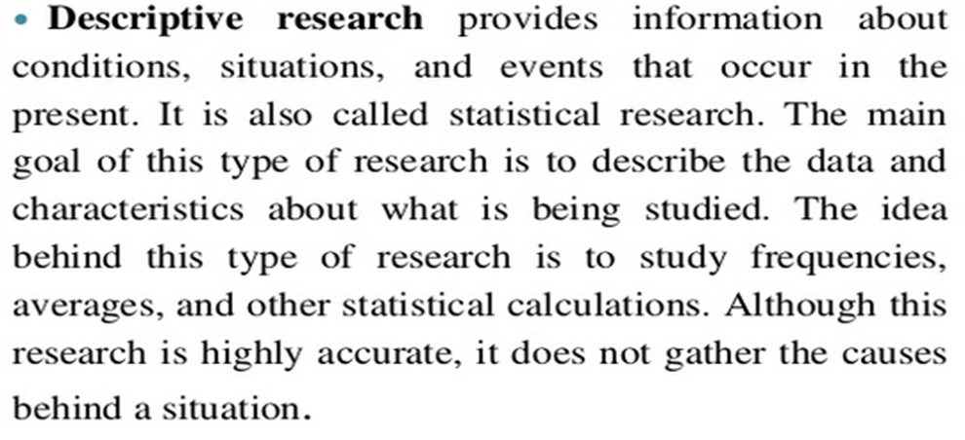

Slide 17
Descriptive research
It includes fact finding enquiries of different kind such what,why,when who and how
The main aim of this research is description of the characteristics of a phenomena at present.
This research has no control over the variable only have report what is happening or what has happened
The method used by this research involves survey method of all kind including comparative and correlation method

Slide 18
Historical Research
A systematic process of searching for information and fact to describe analyze or interpret the past
Value-can provide prospective for decision making about current problems
-issues are often better understood if we understand the historical perspective
Sources-must have good backed sources to protect from criticism
-most common sources are past records

Slide 19
Types of sources
Primary sources-original or first hand account of event or experience, persons involved, documents, records or relics
Secondary sources-an account that is at least once
removed
-persons not involved directly with an event
but has close knowledge (parents, relatives)
-newspaper

Slide 20
Experimental Research
An experiment is a research situation where at least one independent variable, called the experimental variable, is deliberately manipulated or varied by the researcher.
Independent Variable-experimental or treatment variable (it is the cause)
-what we are studying
-it is what we are manipulating in our study
Dependent Variable- what is measured to assess the effects of the independent variable
-it is thought to be dependent on the independent variable

Slide 21
Quasi-Experiments
Quasi-experiments are just like experiments except for one thing.
They violate the condition of random assignment of test subjects to treatment and control groups.
There are two main reasons why researchers fail to achieve the random assignment assumption:
  It is difficult or impossible to achieve random assignment
  There are ethical reasons for assigning some participants to the treatment group

Slide 22
Types of research based on Mode of enquiry perspective
Quantitative research (structured research)
Qualitative research (unstructured)

Slide 23
Quantitative research
Quantitative research is a more logical and data-led approach which provides a measure of what people think from a statistical and numerical point of view. For example, if you wanted to know how many of your customers support a proposed change in your products or service and how strongly (on a scale) they support it.
Quantitative research largely uses methods such as questionnaires and surveys with set questions and answers that respondents tick from a predefined selection. Answers can be measured in strengths of feeling such as ‘strongly agree’ ‘disagree’ or numbers such as scales out of 10.
Quantitative research aim to measure the quantity or amount and compares it with past records and tries to project for future period
If you want to get inside your customers’ minds you need to do qualitative research. Face-to-face interviews and focus groups can provide valuable insights into your products, your market and your customers.

Slide 24
Research approaches
Quantitative approach can be further divided into 3 groups:
Inferential approach – infer characteristics of a phenomenon through collection of data – example CO₂ emission.
Experimental approach – Researcher deliberately changes some variables to know the causal effect- example – effect of temperature rise on plant growth under open sky.
Simulation approach – Researcher artificially construct an environment and data can be generated. This permits an observation of the dynamic behavior of a system under controlled conditions.

Slide 25
Qualitative research
Unlike quantitative research which relies on numbers and data, qualitative research is more focused on how people feel, what they think and why they make certain choices.
Qualitative research is about finding out not just what people think but why they think it. It’s about getting people to talk about their opinions so you can understand their motivations and feelings.
Qualitative research can be valuable when you are developing new products and you want to test reactions and refine your approach.

Slide 26
Research processes
Research process consists of series of actions or steps necessary to effectively carry out research and the desired sequencing of these steps.
Research involves the following processes
Selecting a broad area of study
Problem definition
Developing objectives and hypothesis formulation
Literature review
Design of Research
Execution of the project : Data collection, analysis and interpretation
Reporting

Slide 27
Selecting a broad area of study: This all about Looking for a subject that interests you and will maintain your interest throughout the various stages of research that will help you to obtain the maximum self-development from the research project. /It should be related with you career. Some preliminary reading will help to determine the extent of your interest
Problem definition: The task of formulating, or defining a research problem is a step of greatest importance in the entire research process. It is important because It determines:
the data to be collected,
the characteristic of the data which are relevant,
the choice of techniques to be used
the form of the final report.
Therefore, the researcher must single out the problem s/he wants to study

Slide 28
Literature review: Purpose of the literature review is mainly to identify if the topic has been researched and to see the path of prior research and learn from others about methodological problems
Developing objectives and hypothesis formulation
– Objectives:
Statements that indicate what a researcher intends to accomplish in a more specific term;
-Hypothesis:
• An assertion about the relationship between two or more concepts.
• Important bridges between empirical inquiry and theory

Slide 29
Design of Research:
Research design refers to the arrangement of the conditions for collection and analysis of data in a manner that will satisfy or achieve the objectives of a research undertaking.
It is intended to enable the researcher to answer questions as validly, objectively, accurately and economically as possible; It provides for the collection of relevant data with minimum effort, time and money.
Reporting: Finally, the researcher has to prepare the report of what has been done by him/her. In writing the report, care has to be taken as to for whom he report is being written. The style and content varies depending on to whom the researcher is writing.

Slide 30
Significance of Research
Research has its special significance in solving various problems : Energy, Water, Technology, Food….
Research inculcates scientific and inductive thinking and it promotes the development of logical habits of thinking and organization.
Research provides the basis for nearly all government policies in our economic system.
The role of research in several fields of applied economics, whether related to business or to the economy as a whole, has greatly increased in modern times.
Research is equally important for social scientists in studying social relationships and in seeking answers to various social problems

Slide 31
In addition to what has been stated above, the significance of research can also be understood keeping in view the following points:
To those students who are to write a master’s or Ph.D. thesis, research may be a way to attain a high position in the social structure
To professionals in research methodology, research may mean a source of livelihood
To philosophers and thinkers, research may mean the outlet for new ideas and insights
To literary men and women, research may mean the development of new styles and creative work
To analysts and intellectuals, research may mean the generalizations of new theories

Slide 32
Criteria of Good Research
The objective of the research clearly defined
The research methodology used should be described in sufficient detail to permit another researcher to repeat the research for further advancement
The sampling design should be such as to yield least error
The writing should be done with complete frankness – nothing which has bearing on the result should be hidden
The validity and reliability of data as a well as calculations should be re-checked to avoid mistakes
Conclusions should be confined to those justified by data and analysis
Researcher should be a person of integrity

Slide 33
Criteria of Good Research
Clarity and relevance of the problem
Research ability of the problem
Adequacy and relevance of the literature review
Match between the purpose, design and method
Suitability of the sampling procedure and the sample
Correctness of the analytical procedure
Clarity of findings

Slide 34
Thank you !!!

