Slide 1
Project Management and Resource Allocation
Chapter - 5

Slide 2
What is a Project?
“Unique process consisting of a set of coordinated and controlled activities with start and finish dates, undertaken to achieve an objective conforming to specific requirements, including constraints of time, cost, quality and resources”
A Project is a planned set of activities
A Project has a scope
A Project has time, cost, quality and resource constraints

Slide 3
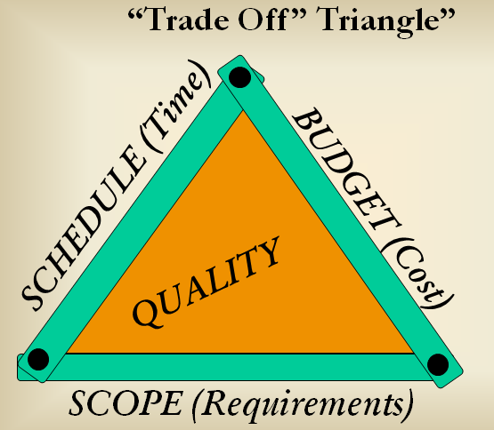
Cont…

Slide 4

What is Project Management?
The art of organising, leading, reporting and completing a project through people

Slide 5
Cont…
A project is a planned undertaking
A project manager is a person who causes things to happen
Therefore, project management is causing a planned undertaking to happen.

Slide 6
Project Manager Role
A Good Project Manager
  Takes ownership of the whole project
  Is proactive not reactive
  Adequately plans the project
  Is Authoritative (NOT Authoritarian)
  Is Decisive
  Is a Good Communicator
  Manages by data and facts not uniformed optimism
  Leads by example
  Has sound Judgement
  Is a Motivator
  Is Diplomatic
  Can Delegate

Slide 7
Stakeholder Engagement

Slide 8
Stakeholder
“A person or group of people who have a vested interest in the success of an organization and the environment in which the organization operates”

Slide 9
Key Points in Project Set-up and Definition
Create Project Management Plan (PMP)
Be clear of scope and objectives
Establish clear statement of what is to be done (WBS)
Establish Risks to be Managed
Establish Costs and Durations
Establish Resources Required

Slide 10
Project Planning

Slide 11

Cont…
Adequate planning leads to the correct completion of work

Slide 12
Cont…
Inadequate planning leads to frustration towards the end of the project & poor project performance
Project Start
Project End

Slide 13
Project scheduling
Allocation of resources like time , energy, space, equipment, human power

Slide 14
Project Monitoring and Control
Typical Monitoring Activities
  regular reviews of progress against schedule using WBS as basis (Plan against Baseline)
  regular review of actual costs (O/P from SAP) against budgeted costs and Earned Value at WBS level
  regular review of resource loading
  regular progress meetings with project team
  regular meetings with contractors
  production of periodic progress reports
  risk reviews
  inspections/ audits

Slide 15
Typical Control Activities
  assign responsibilities at Work Package level
  staged authorisation of work to be done
  staged release of budgets (staged release of WBS(e) numbers)
  ensure PM has a ‘Management Reserve’ under his control
  seek corrective action reports when WPs go ‘off track’ (overrunning or overspending)
  release Management Reserve carefully

Slide 16
Project Management and Resource Allocation
Work Break down Structure (WBS): It is a methodology for converting a large scale project into detailed schedules for its thousands of activities for planning, scheduling and control purpose.
By applying the WBS approach, the overall project planning and control can be improved.
Individual components in a WBS are referred to as WBS elements, at the lowest level of the WBS the element of work is called a work package.

Slide 17
Contd..
Each WBS component is successively broken down into smaller details at lower levels.
This process may continue until specific project activities are reached.
Basic approach for preparing a WBS is:
1) Level1: This level contains only the final project purpose. This item should be identifiable directly as an organizational budget item.
Level2: This contains the major subcomponents of the project.
This subdivision is usually identified by their contiguous location or by their related purposes.

Slide 18
Level3:
Level 3 contains definable components of the level 2 subdivisions.
Subsequent levels are constructed in more specific detail depending on the level of control desired.
If complete WBS becomes too crowded, separate WBSs may be drawn for level 2 components.
A summary for the WBS should normally be made to make the structure complete.
This should include the objectives of the work, its nature, resource requirements, and tentative schedule.
Each WBS element is assigned a code that is used for its identification throughout the project life cycle.
Alphanumeric codes may be used to indicate element level as well as component group.

Slide 19
The full scope of the work for the project is placed at the top of the diagram, and then sub-divided uniformly in to smaller elements of work at each lower level of the breakdown.
Effective use of the WBS will graphically outline the scope of the project and the responsibility for each work package.
Designing the WBS requires a delicate balance to address the different needs of various disciplines and project occasions.
Necessarily there is no right or wrong structure because what may be an excellent fit for one discipline may be an awkward burden for another.

Slide 20
Project Breakdown Structure
Level 1 Parent Project
-- -- -- -- -- -- -- -- -- --- -- --- --- --- --- ---- --- --- ---- ---- --- --- ---- ---- ----- --- --- ---- --- --- --- ---- ----- -----
Level 2 Phase1 Phase2 Phase 3
---- ------ ------ ------ ----- ------ ------ ----- ---- ------- ------ ------- ----- ------- ----- ----- ------ ------ ------- ------
Level 3 Part 1 Part 2 Part1 Part 2 Part 1 Part 1,2,….n
---- ----- ----- ----- ----- ---- ----- ------ ------ ----- ------ ----- ----- ----- ------ ----- ------ ----- ---- ---- ---- ------ ----
Level 4 Subassembly 1 Subassembly 2
--- ----- ------ ----- ----- ------ ----- ----- ----- ---- ---- --- ---- --- ---- ---- --- ---- --- ---- --- --- --- ----- ---- ---- --- ------
Level 5 Unit 1 Unit 2

Slide 21
b) Project Organization
Like any organization, projects can be managed and controlled by using different type of organization structure.
The selection of an organizational structure shows the management line and responsibilities of the project personnel.
The structure may be defined in terms of functional specializations, departmental proximity, standard management boundaries, operational relationships or product requirements.

Slide 22
Types: 1. Formal and Informal structures:
The formal organizational structure represents the officially sanctioned structure of a functional area.
The informal organizations, develop when people organize themselves in an unofficial way to accomplish an objective that is in line with the overall project goals. Here not everyone in the organization is aware of its existence.
Both these type of organizations are placed in every project environment.

Slide 23
2. Functional Organization:
This is the most common type of formal organization, whereby people are organized into groups dedicated to a particular functions.
Depending on the size and type of auxiliary activities involved in the project, several minor, but supporting, functional units can be developed for a project.
Projects that are organized along functional lines are normally resident in a specific department or area of specialization.
The project home office or headquarters is located in the specific functional department.

Slide 24
3. Product Organization:
Another approach to organize a project is to use the end product or goal of the project as the determining factor.
This is often referred to as the pure project organization or simply project organization.
The project is set up as a unique entity within the parent organization.
It has its own dedicated technical staff and administration.
It is linked to the rest of the system through process reports, organizational policies, procedures and funding.

Slide 25
This type is common in large project- oriented organizations or organizations that have multiple product lines.
Unlike the functional structure, this organization decentralizes functions.
It creates a unit consisting of specialized skills around a given project or product.
Sometimes referred to as team, task force or product group, the product organization is common in public, research and manufacturing organizations where specially organized and designed groups are assigned specific functions.

Slide 26
4. Matrix organization:
A matrix organization is a popular choice of management professionals.
This organization exists where there is multiple managerial accountability and responsibility for a job function.
It has the advantages of both the traditional and the product organization structure.
In pure product organization, technology utilization and resource sharing are limited because there is no single group responsible for overall project planning.

Slide 27
In the traditional organization, time and schedule efficiency are sacrificed.
There are usually two chains of command: Vertical and Horizontal. The vertical line deals with the project line of responsibility , horizontal line deals with the functional line responsibility.
The project manager has total responsibility and accountability for the project success.
The functional managers have the responsibility to achieve and maintain high technical performance of a project.
Project organized under a matrix structure may relate to specific problems, marketing issues, product quality improvement and so on.
Project line in matrix is usually of temporary nature while the functional line is more permanent.

Slide 28
General Manager
Director of projects Finance Manufacturing Engineering
Project A
Project B
Project C
Project D
Functional Responsibility
Project Responsibility
Matrix Organization Structure

Slide 29
Network Diagram
In network modeling of projects, the network diagram is of primary importance.
Advantages of network/arrow diagrams:
It clearly shows the inter-relationship between events.
The project is seen as integrated whole, thus making it easier for control.
It can be used even for highly complicated projects consisting of a large number of activities.
It directly indicates the time required in between two activities.

Slide 30
1) EVENT:
An event is defined to be an instant of time.
In a project, an event, may mark the initiation of an activity, the completion of an activity,
or the time after which an activity may be initiated.
Ex: Design completed, pipe line laid, electricity installed etc.
It is represented by a circle ’O’ in a network which is also known as a node or connector.
a) Merge event: When more than one activity come and join an event, such an event is known as merge event.

Slide 31
b) Burst event: When more than one activity leave an event, such an event is known as a burst event.
c) Merge and burst event: An activity may be a merge and burst event at the same time as with respect to some activities
it can be a merge event and with respect to some other activities it may be a burst event.
A
B
C

Slide 32
2) ACTIVITY:
Any individual operation, which utilizes resources and has a beginning and an end, is called an activity. A project may be divided into activities that are time consuming tasks or subprojects like: assembly of parts, mixing of concrete, preparing budget etc.
An arrow is commonly used to represent an activity with its head indicating the direction of progress in the project.
An arrow represents an activity “A” whose estimated duration is “k” unit of time.
A
k

Slide 33
Classification of Activity:
A) Predecessor activity: Activities that must be completed immediately prior to the start of another activity are called Predecessor activities.
B) Successor activity: Activities that cannot be started until one or more of other activities are completed, but immediately succeed them are called successor activities.
C) Concurrent activities: Activities that cannot be accomplished concurrently are known as concurrent activities. It may be noted that an activity can be a predecessor or successor to an event or it may be concurrent with one or more of the other activities.

Slide 34
D) Dummy activity: An activity which does not consume any kind of resource but merely depicts the technological dependence is called a dummy activity.
It may be noted that the dummy activity is inserted in the network to clarify the activity pattern in the following two ways:
1) To make the activities with common starting and finishing points distinguishable,
2) Identify and maintain the proper precedence relationship between activities that are not connected with arrows.
Ex: Consider a situation where A and B are concurrent activities, C is dependent on A, and D is dependent on A and B both.

Slide 35
Such a situation can be handled by using a dummy activity as shown in fig.(a) below.
Ex.2 Consider a case where B and C have the same job reference and they can be started independently on completion of A.
But, D could be started only after the completion of B and C. This relationship is shown by the dummy line as shown in fig. (b).
A
C
A
B
5
6
D
1
2
4
5
B
Dummy
activity
Dummy
activity
C
D
3
(a)
7
(b)

Slide 36
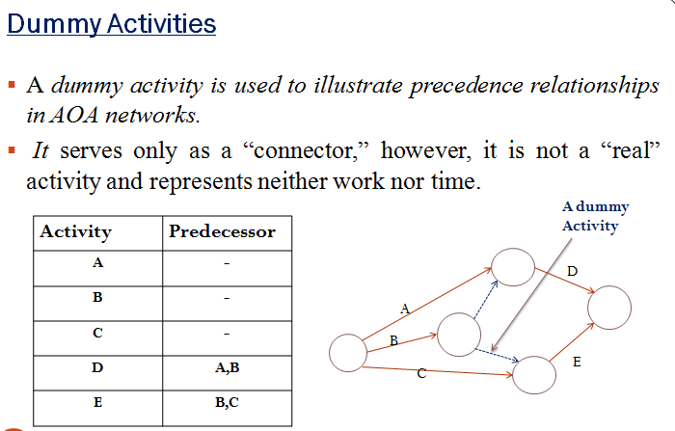

Slide 37
Rules for drawing network diagram:
1) Each activity is represented by one and only one arrow in the network:
This implies that no single activity can be represented twice in the network.
2) No two activities can be identified by the same events:
Ex: Activities a add b in fig. (a) have the same end events.
The procedure is to introduce a dummy activity either between a and one of the end events or between b and one of the events.

Slide 38
Modified representations after introducing a dummy activity d is shown in fig. (b).
As a result of using the dummy, activities a and b can now be identified by unique end events.
It must be noted that a dummy activity does not consume any time or resource.
a
2
a
a
d (Dummy)
d
b
1
3
b
b
a
a
1
3
1
3
d
b
b
d
2
2

Slide 39
3) Check the precedence relationship:
In order to ensure the correct precedence relationship in the arrow diagram, the following questions must be checked whenever any activity is added to the network.
a) What activity must be completed immediately before this activity can start?
b) What activity must follow this activity?
c) What activities must occur simultaneously with this activity?

Slide 40
Important suggestions for drawing good networks:
Try to avoid arrows which cross each other.
Use straight arrows.
Do not attempt to represent duration of activity by arrow length.
Use arrows from left to right ( or right to left). Avoid mixing two directions, vertical and standing arrows may be used if necessary.
Use dummies freely in rough draft but final network should not have any redundant dummies.
The network has only one entry point- called start event and one point of emergence- called the end event.

Slide 41
Common errors in drawing networks:
1) Dangling: To disconnect an activity before the completion of all activities in a network diagram is known as dangling. As shown in fig. below, activities (b-c) and (d-e) are not the last activities in the network. So the diagram is wrong and indicates the error of dangling.

Slide 42
1)Dangling error diagram
Fig.
Dangling
e
a
b
d
f
h
c
g

Slide 43
2) Looping or Cycling:
  Drawing an endless loop in a network is known as an error of looping as shown in the following fig.
14
13
15
22
Looping
20
Looping
23
12
21

Slide 44
3) Redundancy:
Unnecessarily inserting the dummy activity in a network diagram is known as the error of redundancy as shown in the following fig.
11
10
12
Redundancy

Slide 45
Scheduling Systems
Critical Path Method (CPM)
Program Evaluation and Review Technique (PERT)
          Gantt Chart

Slide 46
CRITICAL PATH METHOD (CPM)
    Deterministic model
    Single time estimate for each activity
    No uncertainty is considered
    No determination of success/failure probability

Slide 47
CPM is a network diagramming technique used to predict total project duration.
A critical path for a project is the series of activities that determines the earliest time by which the project can be completed.
The critical path is the longest path through the network diagram and has the least amount of slack or float.
Slack or float is the amount of time an activity can be delayed without delaying a succeeding activity or the project finish date.

Slide 48
Procedure (procedure)
Determine the activities of the project
Identify the predecessors and successor activities
Allocate resource and time for each activity
Draw the network diagram
Find the critical path
Determine the early start and finish times
Determine the latest start and finish times
Find the slack time for each non-critical activities

Slide 49
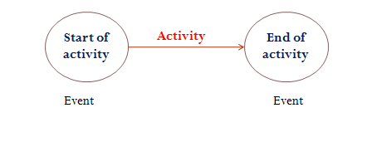
Network Representation Schemes
    AON Network [Activity-on-Node]
    AOA Network [ Activity-on- Arrow]
AOA Network [ Activity-on- Arrow]
Historically most popular
Nodes represent start and finish events for each activity
Arrows can only come from/go to single node
Only one arrow between two given nodes

Slide 50
Example [AOA Network]

Slide 51
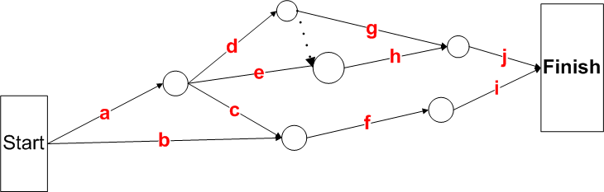
Example [Completed AOA Network]

Slide 52
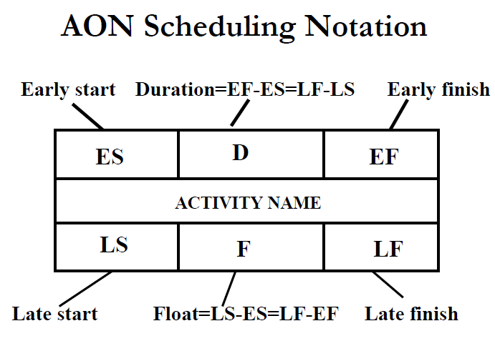
AON Network [Activity-on-Node]
The node (the block in the figure) is the activity; inside the node is information about the activity, such as its duration, start time, and finish time .
Requires no dummy nodes

Slide 53
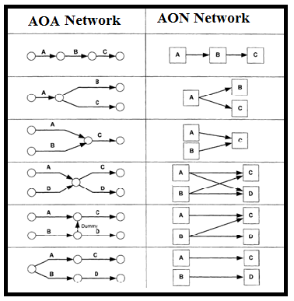
AON vs. AOA Networks

Slide 54
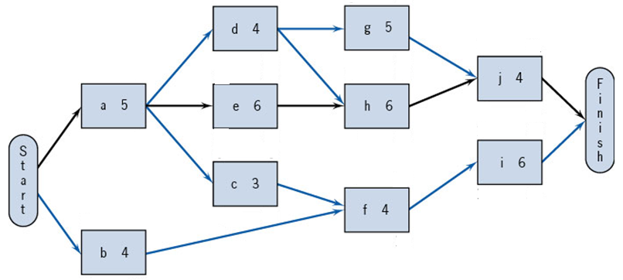
Previous Example [Completed AON Network]

Slide 55
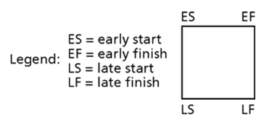
Calculation of Earliest and Latest Times
Forward pass – determines Early Start & Finish
  Early start of a given node is maximum of early finishes of preceding nodes
    Initialization : E1=0 [project start]

Slide 56
Backward pass: determines Latest Start & Finish
Late finish of a given activity is minimum of late starts of successors
  Initialization : Ln(latest occurrence of all ending nodes1)=project duration, T, as determined in forward pass

Slide 57
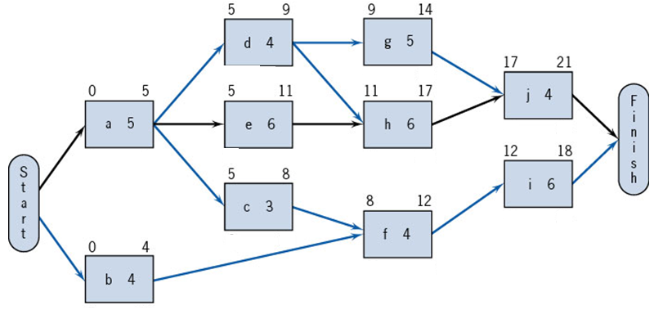
Example [ Earliest Times]
Forward Pass [ ES and EF]

Slide 58
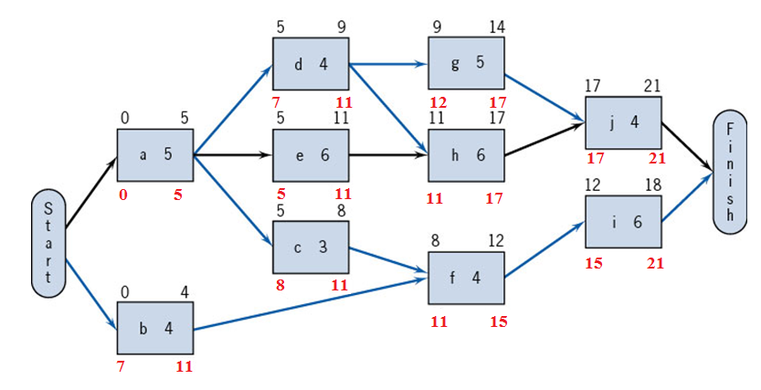
EXAMPLE [Latest Times
Backward Pass [LS and LF]

Slide 59
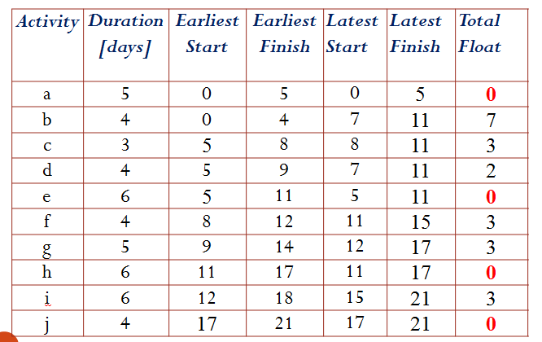
Earliest and Latest Schedule

Slide 60
Critical path, Activity Float
Float of an activity indicates the degree of freedom in timing for performing task
Activity Float=LS-ES=LF-EF
Activities of Critical path have Zero Float
[Start-a-e-h-j-Finish]

Slide 61
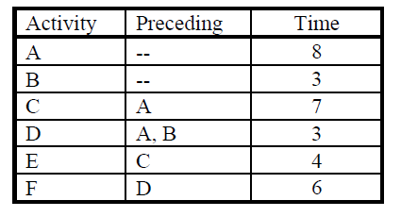
Example
A network consists of the activities in the following list. Times are given in weeks.
a. Draw the network diagram.
b. Calculate the ES, EF, LS, LF, and Slack for each activity.
c. What are critical path and project completion time?

Slide 62
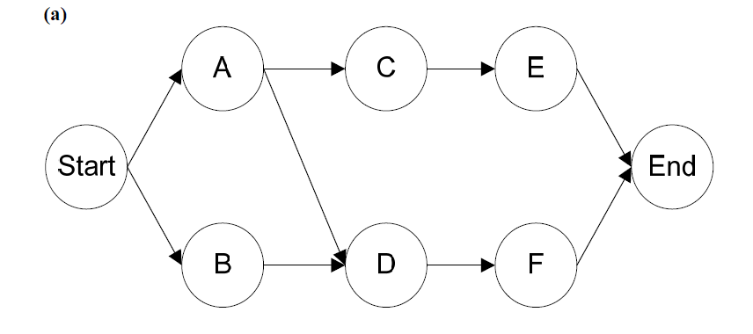
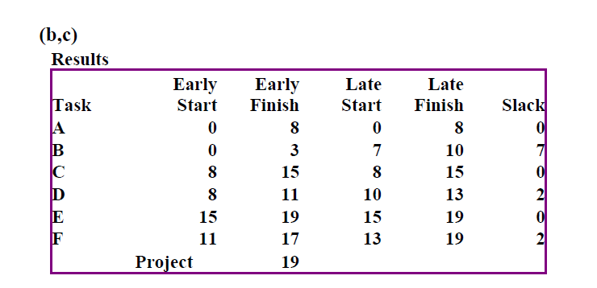

Slide 63
Project evaluation and review technique (PERT)
    Probabilistic model
    Three time estimates
    Consideration of success/failure probability

Slide 64
PERT is based on the assumption that an activity’s duration follows a probability distribution instead of being a single value
Three time estimates are required to compute the parameters of an activity’s duration distribution:
  optimistic time (a ) - the time the activity would take if things did go well
  most likely time (m ) - the consensus best estimate of the activity’s duration
  pessimistic time (b ) - the time the activity would take if things did not go well

Slide 65
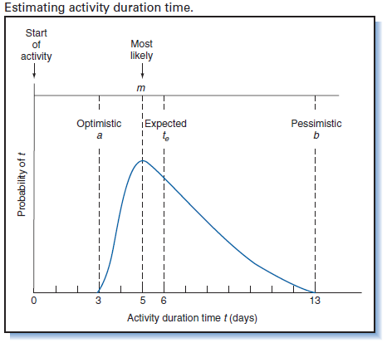

Slide 66
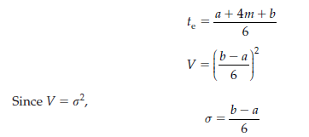
PERT Formula
Based on the distribution of the three time estimates[Beta-distribution], the mean or expected time, te, and the variance, V, of each activity are computed as:

Slide 67
Steps in PERT Analysis
Draw the network.
Find the expected time of each activity
Analyze the paths through the network and find the critical path.
The length of the critical path is the mean of the project duration probability distribution which is assumed to be normal
The standard deviation of the project duration probability distribution is computed by adding the variances of the critical activities (all of the activities that make up the critical path) and taking the square root of that sum
Probability computations can now be made using the normal distribution table.

Slide 68
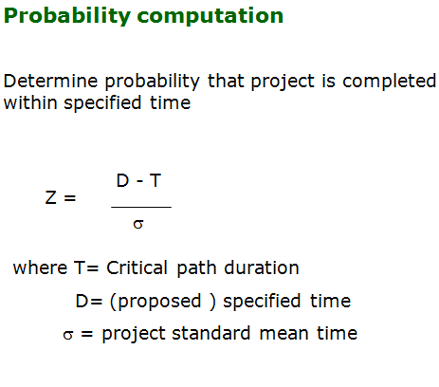

Slide 69
Project Crashing
Projects will sometimes have deadlines that are impossible to meet using normal procedures
By using exceptional methods it may be possible to finish the project in less time than normally required
However, this usually increases the cost of the project
Reducing a project’s completion time is called crashing

Slide 70
Crashing a project starts with using the normal time to create the critical path
Notations:
  NT = normal time to complete an activity
  NC = normal cost to complete an activity using normal procedures
  CT = crash time to complete an activity, the shortest possible activity time and will require additional resources
  CC=crash cost (the cost to complete the activity if it is performed in it’s shortest possible time)

Slide 71

Four Steps to Project Crashing
Find the normal critical path and identify the critical activities
Compute the crash cost per week (or other time period) for all activities in the network using the formula
Select the activity on the critical path with the smallest crash cost per period and crash this activity to the maximum extent possible or to the point at which your desired deadline has been reached
Check that the critical path you were crashing is still critical. If the critical path is still the longest path through the network, return to step 3. If not, find the new critical path and return to step 3 .

Slide 72
To shorten a project, crash only activities that are critical.
Crash from least expensive to most expensive.
Each activity can be crashed until
  it reaches it’s maximum time reduction
  it causes another path to also become critical
  it is more expensive to crash than not to crash
Continue until no more activities should be
crashed.

Slide 73
Computing crash data
Given:
  activities
  normal time
  normal cost
  crash time
  crash cost
  Compute:
  maximum time reduction
  cost to crash per period

Slide 74
Gantt Chart
A GANTT chart is a type of bar chart that illustrates a project schedule.
After the PERT/CPM analysis is completed, the following phase is to construct the GANTT chart and then to re-allocate resources and re-schedule if necessary.
GANTT charts have become a common technique for representing the phases and activities of a project work breakdown structure.
It was introduced by Henry Gantt around 1910 – 1915

Slide 75
Characteristics:
  The bar in each row identifies the corresponding task
  The horizontal position of the bar identifies start and end times of the task
  Bar length represents the duration of the task
  Good for allocating resources and re-scheduling
  Precedence relationships can be represented using arrows
  Critical activities are usually highlighted
  Slack times are represented using bars with doted lines
  The bar of each activity begins at the activity earliest start time (ES)
  The bar of each activity ends at the activity latest finish time (LF).
  A vertical cursor (such as a transparent ruler) placed at the review point
  At a review point the boxes/lines are shaded to represent the actual time spent

Slide 76
Constructing Gantt Chart
The steps to construct a GANTT chart from the information obtained by PERT/CPM are:
  Schedule the critical tasks in the correct position.
  Place the time windows in which the non-critical tasks can be scheduled.
  Schedule the non-critical tasks according to their earliest starting times.
  Indicate precedence relationships between tasks.

Slide 77
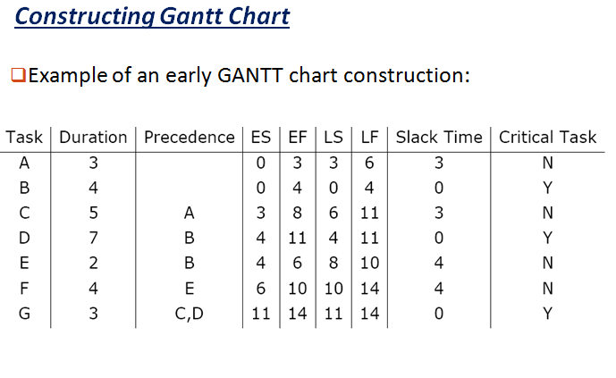

Slide 78
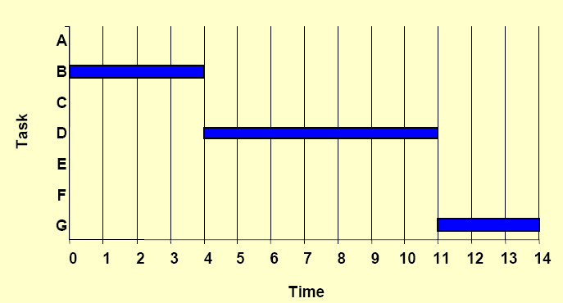
Step 1. Schedule critical tasks

Slide 79
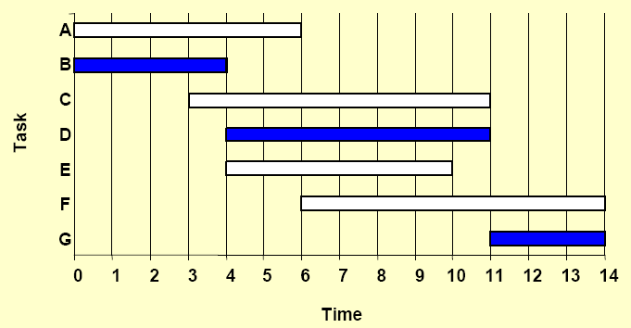
Step 2. Place time windows for non-critical tasks:

Slide 80
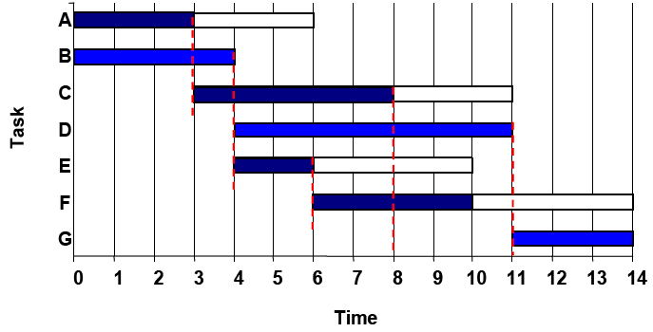
Step 3. Schedule non-critical tasks
Step 4. Indicate precedence relationships:

Slide 81
Project Risks
However small the percentage may be, there is always uncertainty in any venture.
Identification and management of risks is fundamental to any project.
Before undertaking a project, all participants want to identify the risks involved, as well as the steps that may be taken to manage them.
If the risk of the project is in line with the average risk of the company, then the expected rate of return would be the weighted average cost of capital of the firm.

Slide 82
If the risk is higher , the expected rate of return would be higher.
The expected rate of return is determined by comparing it against similar project of other companies.
Its difficult to generalize about the risk characteristics of projects, each host country and in deed each specific project has its own risk profile.
Risks are broadly divided in to two categories: 1.General ( Country ) and 2. Specific Risks.

Slide 83
1. General or Country Risks:
General risks affect the overall sectors of the country.
Factors such as country’s economic growth, its political environment, the tax code, the legal system and
the prevailing currency exchange rate are classified under this category.
General risks - divided in to three major divisions.
a) Political Risks: Related to the internal and external political situation and the stability of the host country.
These risks include: government’s attitude towards allowing private sector profits from projects,
changes in the host country’s fiscal regime, including taxation, the risk of expropriation and nationalization of the projects by the host country, cancellation of the concession and similar factors.

Slide 84
b) Country Commercial Risks:
These are related to the convertibility of revenue from the projects into foreign currencies, foreign exchange, interest fluctuation and inflation.
C) Country Legal Risks: The risks to sponsors and lenders is that legislation that is relevant to the project ( for instance, environmental legislation or property legislation) may change after a project has been implemented.

Slide 85
2. Specific Project risks:
Sponsors and lenders face specific project risks that may be generally within the control of the sponsors.
Specific project risks are divided in to 3 categories in accordance with phases of a project cycle.
a) Development risks: These are the risks associated with the bidding competition that occurs in the initial stage of the process.
The development risks also include losses caused by delays in planning and approval, which can be particularly acute in the case of transnational projects,
where project sponsors have to deal with the authorities of two or more governments.

Slide 86
b) Construction/Completion Risks:
The primary risks here are: 1. The actual cost of construction may be higher than projected (cost overruns).
Completion takes longer than projected ( completion delays).
The construction of the project may not be completed at all.

Slide 87
c). Operating Risks:
These risks result from insufficiency in performance, revenue income, material supply, etc. and from higher than- expected operating costs. These are divided in to 6 main categories.
1. Associated- infrastructure risks: These are associated with facilities outside the project, such as approach roads and transmission lines, for which construction responsibility lies with third parties rather than the project sponsors themselves.
2. Technical Risks: These include design defects in the project equipment.

Slide 88
3. Demand Risks: Most projects that rely on market-based revenues face demand risks related to volume and/or prices, thereby lowering the rate of return of the project.
4. Supply Risks: Because they are also market risks, supply risks have two components, volume and prices.
5. Management Risks: The quality of management in every project is always a critical success factor.
6. Force Major Risks: These risks denote losses from certain exceptional types of events beyond the control of the parties to the project that impeded the performance of their obligations.

Slide 89
Risk Identification Check-List:
1. General or Country Risks: a) Political Risks- Political support, Taxation, Expropriation/nationalization, Forced buy-out, cancellation of concession, Import/ Export restrictions, Failure to obtain or renew approvals risks.
b. Country Commercial Risks: Currency inconvertibility, foreign exchange, Devaluation, Inflation, Interest rate risks.
C. Country Legal risks: Changes in laws and regulations, Law enforcement risk and Delays in calculating compensation.

Slide 90
2. Specific project Risks:
a) Development Risks: Bidding, Planning delay, Approval, Transnational risks.
b) Construction/ Completion Risks: Delay, cost, re-performance, Completion, Force major, Loss or damage to work, Liability risks.
c) Operating risks: Associated infrastructure, Technical, Demand, Cost escalation, Management, Force major, Loss or damage to project facilities and Liability risks.

Slide 91
RISK MANAGEMENT:
Three considerations have to be made when designing the risk allocation and management structure.
1) It’s the cost of the project in its entirety that should decide any particular risk allocation.
A particular risk should be borne by the party most suited to deal with it, in terms of control or influence and costs.
In some cases, the party in the best position to financially bear a particular risk may prefer some method of risk allocation that, in the interest of the project, does not reduce the other party’s incentive to perform efficiently.

Slide 92
2. Since the solutions to the risk management of a project do not in principle rely on unconditional guarantees from any one party alone, the financial structure of the project must consider the following requirements : all substantial project risks have to be managed by a combination of financial resources and firm contractual commitments.
3. The risk structure has to be sufficiently sound to withstand the ups and downs of a project implementation.
How to manage some of the risks encountered in the financial aspects: By using capital market instruments like swaps, options and futures.

Slide 93
Project Crashing:
The crash time estimate is the shortest time that could be achieved if all effort were made to reduce the activity time i.e., by the use of more workers, better equipment, overtime etc., would generate higher direct cost for individual activities.
SEQUENCE OF STEPS REQUIRED TO CRASH AN ACTIVITY:
Step1. Identify the activities that need to be crashed. This can happen at any time from the initial project planning phase to project completion.

Slide 94
Step2. Identify the critical path. To crash non-critical activities is a waste of financial resource because it will simply increase the float on that activity without affecting the end date of the project.( See fig.)
Cost
Crash All
C D Crash No- critical
Cash B
Critical only Normal Time
A Normal Crash
Time
The time cost Trade-off

Slide 95
Step3: Prioritize the activities to be crashed. When there are many activities which can be crashed, it is necessary to know which activity will be crashed first?
This can be done by selecting the activity a. with the least cost per day to crash. b. that is easiest to crash. c. which can be crashed soonest to bring the project back on course.
Step4. Crash activities one day at a time, then re-analyze the network to see if any other activities have gone critical.
Note: Continue this iterative process until there are no activities with negative float.

Slide 96
Time Cost Trade- Off Theory:
Terminologies used:
Normal Time: Normal office hour. Ex. 8hrs a day, 6 days a week.
Normal Cost: The cost of activity working on normal time.
Direct Cost: Costs attributed directly to the project labor and materials. These costs usually group when the activity is crashed due to overtime, shift allowance etc.
Crash Time: The duration the activity can be reduce to, by crashing the activity.

Slide 97
Crash Cost: The new cost of activity after crashing.
Indirect Cost: This is overhead cost which cannot be directly attributed to the project, ex., office rent, management salaries. These costs are usually linear with time, therefore, if the time reduces, the indirect costs also reduces.
Discussion about the way how direct and indirect costs react when a critical activity is crashed:
1. Crashing direct cost: The duration has been reduced but the costs have increased. These additional costs are caused by overtime, shift work and a reduction in productivity. ( Below Fig.)

Slide 98
Cost
Crashing Direct costs
Crash
Normal
Time
Crash
Normal
2. Crashing Indirect Costs: the duration has been reduced but the time and the costs have also reduced. The benefit has come from reduced office rental, equipment hire, etc.

Slide 99
Unfortunately, project costs are usually split 80% direct and 20% indirect cost, so the advantage of crashing indirect costs is usually overwhelmed by the far greater direct costs. ( Below Fig.)
Cost
Crashing Indirect Costs
When the direct costs and indirect costs are combined on the same graph, an optimum position is derived. (Below fig.)
Normal
Crash
Time
Crash
Normal

Slide 100
Combined Direct and Indirect Costs
Cost
Optimum
Indirect
Direct
Time
Time cost trade-off: This fig. outline graphically four different time costs positions.
Starting at point A, that represents normal time and normal cost, consider first the effect of crashing all the non-critical activities.
The poject moves to point D with no change of the project’s duration , but the costs have increased dramatically.

Slide 101
This is not a recommended course of action as it only increases the float of non-critical activities.
Cost
The correct action would be to crash all the critical activities. The project moves to point B. Crashing the critical activities has reduced the duration of the project with a small increase in costs.
Crash All
C
Crash No- Critical
D
Crash
Critical Only
B
A
Normal Time
Normal Cost
Time
Time Cost Trade -off

Slide 102
Crashing the critical activities has reduced the duration of the project with a small increase in costs.
The fourth point on the graph, C, indicates the position when all the activities are crashed. Again this is not recommended because there has been no time improvement on point B, yet the costs have increased tremendously.
The total cost of the project can be calculated by:
C_{total} = CN_{total} + m dcp where CN_{total} = total sum of normal costs, m= Indirect cost slope, dcp= number of days in critical path.

Slide 103
Resource Allocation
Depending upon the type of constraints, the resource allocation procedure can be categorized into two main activities: resource smoothing and resource leveling.
Resource smoothing: The periods of maximun demand for resources are located and activities according to their float values are shifted for balancing the availability and requirement of resources.
So the intelligent utilization of floats can smoothen the demand of resources to the maximum possible extent.
Such type of resources allocation is called” resources Smoothing or Load smoothing”.

Slide 104
Resource Smoothing steps:
1. Determine the maximum requirement. One way is to draw the time scale version of the network and assign the resource requirements to activities.
2. Then, below the time scaled network, the cumulative resource requirements for each time unit are plotted.
3. The resource histogram is plotted on the basis of the early start times or the late start times of the activities. These resource histograms establish the frame work under which the smoothing or leveling must occur.

Slide 105
Resource Leveling:
There are various activities in a project demanding varying levels of resources.
The demand on certain specified resources should not go beyond the prescribed level.
This operation of resource allocation is called ‘Resource leveling’ or ‘ Load Leveling’.
Although the overall resources of the organization are limited, but these should not go below the amount required to perform an activity among all the activities in the process,
otherwise that particular activity cannot be computed.

