Slide 1

BONGA UNIVERSITY
COLLEGE OF NATURAL & COMPUTATIONAL SCIENCES
DEPARTEMENT OF BIOLOGY
Principles of Ecology (Biol. 2051)

Slide 2
Introduction to Ecology
Objectives
At the end of this chapter the students should be able to:
Define ecology from different perspectives
Discuss the importance of having different branches of ecology
List the branches of ecology

Slide 3
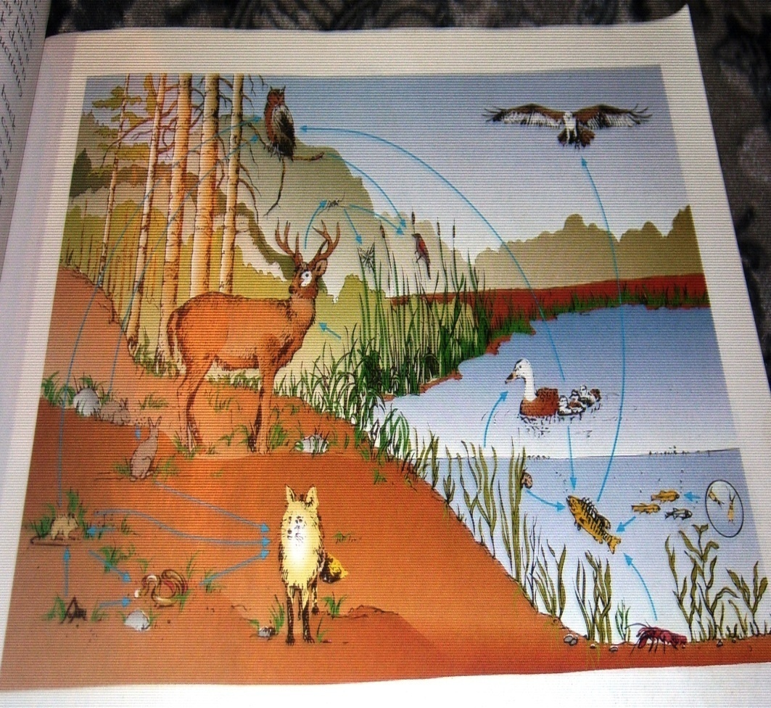
Brainstorm what does it mean by the term ECOLOGY!
.

Slide 4
Con’t….
Definition of Ecology
The word ‘ecology’ is derived from two Greek words oikos and logos.
  Oikos - means ‘house’ or ‘place to live’
  Logos - means ‘a study of’
Ecology means the study of organisms ‘at home’ (at their native environment)
The word ‘ecology’ was first coined by Ernest Haeckel in 1869
He described ecology as the scientific study of the interactions between organisms and their environment

Slide 5
Con’t….
Ecology is the study of the relationship of living organisms among themselves & with the non-living components of the environment
Ecology deals with the biology of organisms, populations, communities, ecosystems, etc. and their functional processes in their natural environment
  Different authors defined ecology in different ways
The scientific study of the interactions that determine the distribution and abundance of organisms – Krebs, 1972
The scientific study of the relationships of living organisms with each other and with their environments – Charles H. Southwick, 1976

Slide 6
Con’t….
Begon, Harper & Townsend (1986) jointly defined ecology as the description, explanation and prediction of individuals, populations, and communities in space and time
The interactions between organisms and the transformation of flux of energy and matter – Likens, 1992
As a result: Ecology deals with organisms, populations, communities, ecosystems and the biosphere

Slide 7
Cont…
Generally, Ecology is:
  the science of the habitat
  the study of organisms in their natural environment
  the study of organisms interactions with one another and with their environment
  .
Therefore, Principle of Ecology is a science that studies about rules governing interactions that exist:
  Among different organisms in the space
  Between organisms and their environment

Slide 8
Branches of Ecology
Ecology is a multidisciplinary and boundless in its concern extending across the physical, biological and social sciences
Ecological studies may be conducted at different levels of organism, habitat or ecosystem & above
In all ecosystems living things interact, share common habitat and functionally they are interdependent
Therefore, the following are some of the branches of ecology

Slide 9
division of Ecology
Ecological studies may be conducted at different levels of organism, habitat or taxonomic affinities
1. Division based on taxonomic affinities
Plant ecology
Animal ecology
2. Division based on habitat
Aquatic
Terrestrial
3. Division based on level of biological/organizational hierarchy
Autecology All branches of ecology included
Synecology either of these two branches

Slide 10
Con’t…
Autecology deals with the dynamics of species populations (individual species) and how they interact with the environment
Synecology is a sub-discipline of ecology which studies the distribution, abundance, demography, and interactions between coexisting populations (group of all species/community) in relation to their environments.
The study related to forest ecology, grassland ecology, desert ecology, marine ecology, limnology etc. are treated under Synecology
Population ecology- examines interactions that occur between a population and its environment

Slide 11
Con’t…
Palaeoecology: - deals with organisms and their habitat in the geological past
Conservation ecology: - deals with the application of ecological principles to the proper management of resources leading to sustainable yield of resources for human welfare. It also studies how to reduce the risk of species extinction
Resources ecology: - deals with renewable and non renewable resources and their management
Pollution ecology: - studies problems associated with the movement of pollutants in the environment

Slide 12
Con’t…
Chemical ecology: it is concerned with the chemical affinity or preferences shown by different organisms
Human ecology: it deals with the effects of human activities on environment and vise versa.
Applied ecology: it deals with the application of ecological concept to human needs including wild life management, biological control, forestry and conservation of natural resources.

Slide 13
Con’t…
Physiological ecology- the way that the body process of organisms is adapted to the physical environment. e.g. responses of individual organism to temperature & moisture, etc.
Genetic ecology- studies the way in which organisms ecology shape its heredity and the ways in which genes influence an ecological processes.
Ecosystem ecology- the study of most inclusive interactions, those among all the abiotic and biotic components of the system.
Evolutionary ecology: - natural selection and evolution of populations.
Behavioral ecology: - Social life of animals (instinct behavior esp. birds & fish, etc)

Slide 14
Class Work
Please form a group of three and discuss the following review questions
Define ecology from different perspectives
List and define at least ten different branches of ecology
Differentiate autecology from synecology
Suppose more than hundred Factories in Addis Ababa disposing wastes in to Akaki River, which tends to influence life in the water. Which allied field of ecology is concerned for this?
Describe and discuss sub disciplines of ecology based on levels of biological hierarchy

