Slide 1
Debre Tabor University
Faculty of Social Sciences and the Humanities
Department of Geography and Environmental Studies
Environment and Natural Resource Management Program
Course Title: Environmental Disaster Risk Management
By:
Menberu Teshome, PhD in Development Studies
Associate Professor of Environment and Development

Slide 2
Debre Tabor University
Faculty of Social Sciences and the Humanities
Department of Geography and Environmental Studies
Environment and Natural Resources Management Program
Course Title: Environmental Disaster Risk Management
Course Code: ENRM 526 Credit Hours: 3
Instructors: Menberu Teshome, PhD Academic Year: 2018/19
  Associate Professor of Environment and Development
Program: M.A. Extension Category
Overall Objectives of the Course
At the end of this course students will be able to:
Define hazard, disaster, risk, disaster risk management, and related concepts.
Identify various types of disasters, their causes, and consequences.
Analyze the distribution and rise of disasters in spatial and temporal context
Realize the global and regional disaster risk reduction initiatives
Describe theories relevant to disaster risk management/reduction
Apply methods of disaster risk identification/assessment, management, monitoring, and relevant early warning systems.
Develop community-based disaster risk reduction strategies/plans and capacity building mechanisms for disaster affected community and practitioners

Slide 3
Course Outline
1. Introduction
1.1. Basic concepts
1.2. Hazard, Risk/Disaster and Vulnerability
1.3. Hazards Classifications
  1.3.1. Speed of onset
  1.3.2. Acts of Nature or acts of Humans
2. Models of Disaster
  2.1. Conventional Views
  2.2. Pressure-Release Model
  2.3. Access Model
3. Disaster Risk Reduction Initiatives
  3.1. Global Initiatives and Disaster Reduction (2005-2015)
  3.2. African Initiatives for Disaster Risk Reduction (2006-2015)
  3.3. Ethiopia’s Initiative to Disaster Risk Management
4. Community-based Disaster risk management
  4.1. Hazard, risk, and vulnerability Assessment (Analysis)
  4.2. Capacity assessment and resource mapping
  4.3. Early Warning System
  4.4. Contingency planning

Slide 4
Course Instruction Modes
Environmental Disaster Risk Management for MA students of natural resources and environmental management is a lecture-based course.
The class period is three (3) hours. Additional sessions will be arranged when necessary. The session provides an important opportunity for students to discuss, obtain feedback, and workout assignments and future researches to apply the skills covered in the lectures.
The lecture also serves as a forum for discussion of readings; project works on climate change and adaptation issues and other related assignments.

Slide 5
Course Requirements and Responsibilities
It is the responsibility of every student to complete the required reading prior to the lecture for which it is assigned.
Assignments and exams will be based on both the lectures and the reading materials. Successful completion of this course will require regular attendance at classes, and thorough reading of all assigned materials.
There are two grade components that comprise the course requirements for ENRM 526: One project assignment, and a final exam. The assignment guidelines will be distributed and discussed in class with students. The guideline will explain in detail what is expected for the assignment and the criteria to be used in evaluation.

Slide 6
III. Method of delivery or process
Brain storming i.e. invite students to provide their own definitions, and summarize the responses.
Lecture presentation by course instructors.
Compare the definitions given by students with those of presented by the instructors.
Class exercises or questions and answers.
Conclusion on the topic.

Slide 7
1. Introduction
Through all periods of human development, the natural environment has been both an asset and a liability. Initially, the planet earth provided us with sustenance for life such as the air, food, water, warmth (heat), and materials we need to thrive. Later, with the development of agricultural practices, the environment made possible to grow crops and raise domesticated animals for consumption.
Our environment provide fundamental life support, in the form of both consumptive and public-good services. They provide ecosystem services that underpin human life. These services include:
  Provisioning services – food (wild and domestic), water and energy; wild flora and fauna form the basis for traditional medicine and a significant part of the modern pharmacological industry
  Regulating services – carbon sequestration, climatic cycles, water purification, cleansing of air, flood protection, pest control

Slide 8
1.1. Introduction --- continued
  Supporting services – nutrient cycling to in rich soils (the foundation for agriculture which in turn is the basic building block in the livelihood of all people; breeding function for protecting and improving cultivate plants and domesticated animals- pollination and seed dispersal.
  Cultural services – recreation and spiritual sites
On the bad side, the earth also generates catastrophic hazards that kill people, damage the environment, destroy property, and disrupt normal life.
These catastrophic disasters can be generated from: tsunamis, droughts, floods, landslides, volcanoes, earthquake, tornadoes, wildfires, conflicts.

Slide 9
1.1. Introduction ---- continued
More than ever what has happened in the past, today, disasters triggered by natural workings of our planet earth and human actions have been increasing with severe consequences on human life and socioeconomic environment. Disasters should not be segregated from everyday living.
There are more than 700 natural disasters every year, affecting around one person in 30.
A range of these natural hazards also threaten development.
Hazards such as floods, storms, and droughts have served as trigger events for more than 75% of the disasters that have occurred globally over the past decade.

Slide 10
1.1. Introduction ---- continued
Proportionately, these disasters affect the least developed countries most intensely, proving to be especially harmful to poverty stricken populations. In the future, a changing climate is likely to exacerbate these effects and could make development unsustainable in many places.
In addition, events such as violent conflict, illness and hunger have affected many more lives in less developed countries, whereas under different economic and political circumstances, these events have been prevented.

Slide 11
Scientists, policy-makers, and the general public aware that patterns of disasters have put people at risk.
By understanding these externalities, hazards communities, public authorities, and development organizations can minimize the risk of disasters.
Program and project planners and managers should identify types of hazards present a risk in the place where they work, understand the characteristics of hazards, location, frequency and magnitude of hazards and their potential impact on property and people.
In addition, they must assess the societal elements at risk (people, structures, services, and activities).
Planners should understand the target population’s vulnerabilities and capacities to help them effectively choose and design meaningful risk reduction measures.

Slide 12
They must understand how a society or target population perceives its risks
Yet development planners often fail to consider the threat of natural hazards sufficiently, and hazard and disaster risk management is often carried out independent of development activity.
This course starts by defining basic concepts, examination of types of disaster and their causation, reasons for peoples’ vulnerability.
There are many terms and concepts that are used again and again in risk reduction and disaster management.
The actors tend to define such concepts in ways that best fit their purposes which result in differences, some overlaps, and even confusions in the definitions.

Slide 13
1.1.Definitions of Basic Concepts in DRM
To communicate and dialogue effectively with community groups, we need to have a common language and understanding of the terms used in disaster risk reduction strategies.
Thus, in the light of this rationale and for the purpose of this course, this section deals with the key terms and concepts that are common in disaster risk management science and research
The terms hazard, risk, disaster, vulnerability, resilience, coping, and adaptation have been selected and are defined.
1.1.1. Hazard, Risk, and Disaster
Hazard: the concept of hazard is defined in various ways by different scholars. Some definitions are shown in the following ways.
Hazard: “A condition with the potential for harm to the community or environment” (Drabek, 1986).

Slide 14
    Hazard: is “the probability that in a given period in a given area, an extreme potentially damaging natural phenomenon occurs that induces air, earth or water movements, which affect a given zone” (Maskrey, 1989:1).
Hazard: “a threatening event, or the probability of occurrence of a potentially damaging phenomenon with a given time period and area” (UN Department of Humanitarian Affairs, 1992).
Hazard: “a naturally occurring or human-induced process or event with the potential to create losses, i.e. general source of danger” (Smith, 1996:5).
Hazard: “refers to an extreme natural event that poses risks to human settlements” (Deyle et al., 1998:121).

Slide 15
    Hazards: are defined “as threats to a system, comprised of perturbations and stress (and stressors), and the consequences they produce” (Tuner, et al., 2003:1)
Hazards: are defined “as a potentially damaging physical event, phenomenon or human activity that may cause the loss of life or injury, property damage, social and economic disruption or environmental degradation” (Yamin et al., 2005:4).
From the above definitions we can notice that hazard includes both natural and man-made processes or events or phenomena which may threaten human life, property, activity and the environment to the extent of causing disaster.
Hazard results from extreme natural processes, technological developments, and various forms of social exclusion. It may cause physical damage, economic losses or threaten human life and wellbeing, if it occurs in areas of human settlement, agricultural, or industrial activity.

Slide 16
Instructor’s Note
Does the mere occurrence of hazard lead to disaster risk to an area, a social system, an activity, a physical structure, etc? Let us put aside this question for a moment.
But let us make note this statement. A societal element is said to be at-risk or vulnerable when it is exposed to known hazards and is likely to be adversely affected by the impact of those hazards, if and when they occur.
The communities, structures, services or activities concerned are described as “elements at risk”. This leads to talk about risk and vulnerability. Then, what do you understand by risk? What is vulnerability?

Slide 17
2. Risk: the term risk is used in many ways to convey different meanings. The many inconsistent and ambiguous meanings attached to "risk" lead to confusion and also mean that different approaches to risk management are taken in different fields. For example:
Risk is defined as expected losses (live lost, person injured, property damaged and economic activity or livelihood disrupted) caused by a natural or man-made hazard. It can also be defined as:
  the probability of uncertain future events occurrence and the loss it would cause.
  probability of loss (likely occurrence of a hazardous event, its severity, and consequences).
  Source of danger (e.g. a particular hazard (i.e. cause), and potential threat it brings).

Slide 18
Instructors’ Note
The definition of disaster risk reflects the concept of disasters as the outcome of continuously present conditions of risk.
Disaster risk comprises different types of potential losses which are often difficult to quantify. Nevertheless, with knowledge of the prevailing hazards and the patterns of population and socioeconomic development, disaster risks can be assessed and mapped, in broad terms at least.

Slide 19
3. Disaster
Like the concept of hazard and risk, there is no universal definition of disaster as various criteria are used in defining it.
A range of meanings from various contexts& perspectives of academics, institutions, and practitioners). Definitions have been given next.
Disaster: is “a serious disruption of the functioning of society, causing widespread human, material, or environmental losses, which exceed the ability of affected society to cope using only its own resources.”
disaster is the occurrence of an extreme hazard event that impacts on vulnerable communities causing substantial damage, disruption and possible casualties, and leaving the affected communities unable to function normally without outside assistance.

Slide 20
3. Disaster …. Cont’d
Disaster: is used to describe “a catastrophic situation in which the normal patterns of life and ecosystems have been disrupted and extraordinary emergency interventions are required to save and preserve human lives and/or the environment.”
“A disaster: occurs when a significant number of vulnerable people experience a hazard and suffer severe damage and/or disruption of their livelihood system in such a way that recovery is unlikely without external aid.”
“Disasters: are events in societies or their larger subdivisions (e.g. regions, communities) that involve social disruption and physical harm. Among the key defining properties of such events are (1) length of forewarning, (2) magnitude of impact, (3) scope of impact and, (4) duration of impact.”

Slide 21
The definitions given above indicate the conceptual development and various conceptualization of disaster. Earlier works in disaster studies applied the concept of disaster to major physical disturbances (i.e. earthquake and flood) which were traditionally considered as ‘Acts of God’.
Then gradually disasters came to be viewed as physical agents and their effects as outside attacks to social systems. At that time thus disasters were blamed on processes of physical world; and ‘root causes’ to destructions were attributed to extremes of nature.
As researchers’ understanding has increased, they have seen greater complexity in natural hazards. Then they tended to seek causes in human social organizations than in nature.
As a result, disasters came to be seen as social constructs (i.e. understanding disasters in terms of social action). Although there is such shift in perspective, there is no universal definition of disaster. And yet, debates for the need of an agreed definition are going on.

Slide 22
Instructor’s Note
Disasters are often described as a result of the combination of: the exposure to a hazard; the conditions of vulnerability that are present; and insufficient capacity or measures to reduce or cope with potential negative consequences.
Disaster impacts may include loss of life, injury, disease and other negative effects on human physical, mental and social well-being, together with damage to property, destruction of assets, loss of services, social and economic disruption and environmental degradation.

Slide 23
4. Vulnerability
Various writers have defined vulnerability in many different ways by focusing on households’ or groups’ or social systems’ proneness to a certain shock or crisis.
The vulnerability concept is used in human ecology, development studies, and in research on hazard, disaster, environmental and climate changes. In these fields and other disciplines, the term is defined in different ways (i.e. in terms of physical exposure; as measure of socio-economic status (endowment and entitlement); in terms of differential ability to cope; and in terms of regions at risk. Various writers or users define it in the way that best fits to their usual practice.
Some of the definitions of vulnerability are extracted from various sources as relevant ones and given below.

Slide 24
4. Vulnerability ….. continued
Vulnerability defined as “the extent to which an individual, community, sub-group, structure, service or geographic area is likely to be damaged or disrupted by the impact of a particular disaster hazard.”
Vulnerability is defined as “the degree to which a system or part of a system may react adversely to the occurrence of a hazardous phenomenon.”.
Vulnerability is defined as “defenselessness, insecurity, and exposure to risk, shock, and stress.”
Vulnerability is defined as “the characteristics of a person or group and their situation that influence their capacity to anticipate, cope with, resist and recover from the impact of a natural hazard - an extreme natural event or process.”

Slide 25
Vulnerability is the potential to suffer harm or loss, related to the capacity to anticipate a hazard, cope with it, resist it and recover from its impact. Both vulnerability and its antithesis, resilience, are determined by physical, environmental, social, economic, political, cultural and institutional factors.
Vulnerability is a set of conditions and processes resulting from physical, social, economical and environmental factors, which increase the susceptibility of a community to the impact of hazards.
Vulnerability is a reflection of the state of the individual and collective physical, social, economic and environmental conditions at hand that are shaped continually by attitudinal, behavioral, cultural, socio-economic and political influences at the individuals, families, communities, and countries.

Slide 26
Exercise
Mr. Ahmed lives in arid zone. Last year, he borrowed 5.000.00 Birr and bought 20 goats. At the end of the year, a severe drought killed all his goats and his neighbors.
From this story identify:
    the hazard Drought
    vulnerability condition conditionondition arid zone
    the risk: 5000
    Disaster death of goats and his neighbors

Slide 27
Instructor’s Note
As it can be observed from the above definitions, the concept of vulnerability represents the divergent realities and interest in society. It provides a much needed conceptual and practical focus that could direct and improve ongoing efforts at disaster prevention, mitigation and reduction.
At conceptual level, the concept of vulnerability is seen as essential link in the nexus between the environment, society and culture, (under)development and poverty, and disaster. At practical level, the concept of vulnerability is considered as key or rich tool for interpreting and mitigating disaster.
Therefore, an emphasis is placed on the notion of vulnerability with a shift from seeing disaster as an event caused by external agent to a more sociologically as well as politically, environmentally, economically constructed process.

Slide 28
The concept of vulnerability has been an important analytical tool to understand underlying causes leading to disaster.
Thus, the first step for moving towards potential responses and durable policy has to be an analysis of vulnerability which helps trace the root causes of disasters.
The analysis of various definitions of vulnerability also indicates that most definitions share two common elements - ‘negative impact or loss’ which systems or social groups suffer, and ‘capacity’ that help recover or cope with effects.
Vulnerability is dynamic in space and time, and it involves the conjecture of physical and social processes.

Slide 29
4. Vulnerability ……. Continued
However, the affected or exposed systems or groups are not passive recipients of impacts or losses.
They have also some degree of ‘capacity’ to be mobilized in order to cope with and mitigate risk, to recover or/and adapt via learning from the experiences and past practices and living with changes and uncertainties, and using the existing opportunities created.
In other words, the other side of vulnerability is “adaptive capacity - the ability to absorb stresses and disasters and avoid unacceptable consequences.

Slide 30
Vulnerability can roughly be categorized into three groups:
A. Physical/Material Vulnerability
Hazard-prone location of community houses, farmlands, infrastructure and basic services
Design and construction materials of houses and buildings
Insecure and risky sources of livelihood
Lack of basic services: education, health, safe drinking water, shelter, sanitation, roads, electricity and communication
Exposure to violence (domestic, armed conflicts)
Age and disability
B. Social/Organizational Vulnerability
Weak family/kinship structures
Lack of leadership and initiative to solve problems or conflicts
Exclusion of certain groups from decision making about community life or unequal participation in community affairs

Slide 31
Absence or weak community organizations (in formal, governmental, indigenous)
Social status (caste, ethnicity, gender)
Neglect from government and civil institutions
C. Motivational/Attitudinal Vulnerability
Negative attitude towards change
Passivity, fatalism, hopelessness
Lack of initiative
Dependence on external support
Lack of knowledge and skills
Extremism (the holding of extreme political or religious views or the taking of extreme actions on the basis of those views).

Slide 32
5. Resilience, Coping, and Adaptation
These concepts are important in disaster research and vulnerability analysis. They are related to the concept of vulnerability and are used in different ways by different disciplines and policy communities.
The other side of vulnerability is the capacity of individuals/social groups or social systems to cope with stress or/and resilience to bounce back when a disaster unfolds.
The development of vulnerability analysis thus draws on the concepts such as entitlement, coping through diversity, and resilience. Different social systems have different level of sensitivities to shocks or stresses.
This characteristic of individuals or social groups is linked to entitlements (i.e. legal and customary rites to exercise command over food or other necessities).

Slide 33
This is evidenced that modern famines (new famines) occurred not due to insufficient food stock, but because of inability of certain groups of people to command food access through legal or customary means i.e. lack of access to bundles of entitlements.
The implication of this is that understating entitlement helps explain why certain groups are differentially at risk or vulnerable to specific disaster.
In general, the concept of entitlement enables us to understand socially differentiating causes and outcomes of vulnerability.

Slide 34
1.1.3. Resilience, Coping and Adaptation
Like terms defined above, resilience is defined in many ways focusing on the inherent ability of a systems, social group or community. The following are identified as relevant definitions resilience for the purpose at hand.
Resilience: is the measure of a system’s or parts of a system’s capacity to absorb and recover from occurrence of a hazard event.”
Resilience: is defined as the “measure of the rate of recovery from a stressful experience, reflecting the social capacity to absorb and recover from the occurrence of a hazardous event.”
Resilience: “is the capacity of a system, community or society potentially exposed to hazards to adapt, by resisting or changing in order to reach and maintain an acceptable level of functioning and structure.

Slide 35
This is determined by the degree to which the social system is capable of organizing itself to increase this capacity for learning from past disasters for better future protection and to improve risk reduction measures”
Coping: refers to the potential of a system to forestall (prevent) and reduce the impacts from stresses or perturbations (Ifejika Speranza C., 2006:26).
Coping: is the manner in which people act within the limits of existing resources and range of expectations to achieve various ends…. Coping can include defence mechanisms, active ways of solving problems and methods for handling stress (Blaikie et al., 2004:113).

Slide 36
Coping (strategies): are “the bundle of producers’ responses to declining food availability and entitlements in abnormal reasons or years” (Davies, 1996:45).
Adapting: “means a permanent change in the mix of ways in which food is acquired” (Davies, 1996:55).
Adaptation: is “the degree to which adjustments in practices, processes or structures can moderate or offset the potential for damage or take advantage of opportunities created, due to a given change in climate” (IPCC, 1997:1).
Adaptation: is “the ability to respond and adjust to actual or potential impacts of changing climate conditions in ways that moderate harm or takes advantage of any positive opportunities that climate may afford” (IISD/IUCN/SEI, 2003:5).

Slide 37
Exercises/Self-Assessment
  In order to review and to improve your understanding of terms and concepts discussed above, you need to carry out some exercises that serve as illustrative. Read the following story and try to answer the respective question
  Mr. “X” looked out at his herd of cows and felt proud. He had worked hard to build the herd up to this size and had borrowed money and animals from relatives to help expand the herd. He would have to repay the loan and pay for the animals with the first calves from his herd. He had also planted a field of maize and he knew that once the rains come he would have a good harvest. His wife looked at him in dismay. The rains aren’t going to come she said and we will all starve. We have had such a warm season and this is what happened before the last time of great hunger. The maize won’t grow and the cows will be the first to die. Luckily Mr. “X” had allowed his wife to plant some sorghum, which was known as a more drought tolerant crop. Mr “X”’s wife was urging her husband to sell some of the cows now and to buy more goats. Knowing that they were better able to with-stand the effects of drought.

Slide 38
Exercises
  On the basis of above story, attempt the following questions.
    What is the hazard
    what are the vulnerability conditions
    what is the risk
    What are the strategies used
    What is the link between vulnerability and capacity?
    Why do the husband and wife perceive the risks differently?

Slide 39
1.2. Linkages between risk, hazard, vulnerability
In contemporary academia, disasters are seen as the consequence of inappropriately managed risk. These risks are the product of a combination of both hazard/s and vulnerability. Hazards that strike in areas with low vulnerability are not considered a disaster, as is the case in uninhabited regions. Hazard does not necessarily lead to a disaster. It causes a disaster, if it is combined with a condition of vulnerability. For instance, drought is not a disaster rather it is a hazard. It causes a disaster, if it is combined with a vulnerability such as the inability to move somewhere with more water, or lack of other sources of income. In other words ‘hazard plus vulnerability equals risk or disaster”.
This can be depicted as equation: H (hazard) + (X) V (Vulnerability) = R (risk) or D (disaster)

Slide 40
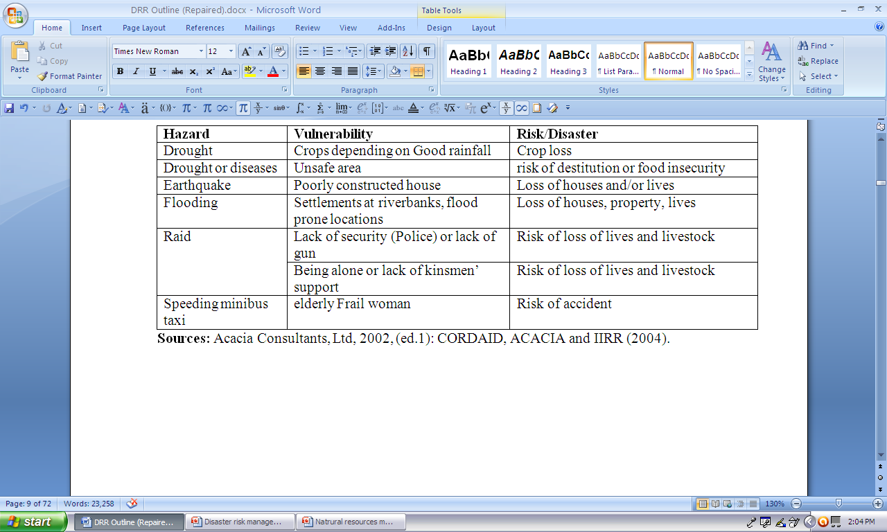
Examples are given in Table1 to illustrate the linkages of hazard, vulnerability &risk/disaster
Table1: Linkages between Hazard, Vulnerability and Risk/Disaster

Slide 41
2. Types of Hazards and Disasters
2.1. Classification based on Causes
There are many ways of classifying hazards and disasters. The most popular dichotomy has been natural versus man-made hazards and disasters.
2.1.1. Natural Hazards and Disasters
A natural hazard is a naturally occurring phenomenon that is harmful to humans and has the potential to cause damage. Natural hazards are, therefore, events such as droughts, wildfire, cyclones, typhoons, earthquakes and tsunamis. Natural hazards can not be prevented, but they can be expected.
A natural disaster occurs when a natural hazard causes a large number of deaths, displacement and damage to human being, as well as ecosystem wellbeing. Applying various measures can prevent or reduce the effects of natural hazards–i.e., the effects of natural disasters can be reduced or prevented.

Slide 42
It should be noted that natural hazards do not automatically give rise to natural disasters. Many human actions - such as bad land use system, deforestation, human development in hazardous areas - worsen the impacts of natural hazards and cause natural disasters. The impacts of natural hazards are different for different people, because some people are better able to cope with a natural hazard than others.
Let us consider types of natural hazards and ways of classifying them. They can be:
Geological/geophysical hazards (earthquakes, volcanic erruption,avalanches, and landslides).
Hydrological hazards (floods, drought, Tsunamis, etc.)
Climatic hazards (hurricanes, tropical cyclones, typhoons).
Other natural hazards (wildfires and diseases).

Slide 43
I. Geological Hazards
These hazards originate from geological processes of the earth. In order to understand some geological hazards, it is necessary to detail the theory of plate tectonic. The theory of plate tectonics provides geology with a comprehensive theory that explains "how the Earth works." The theory was formulated in the 1960s and 1970s as new information was obtained about the nature of the ocean floor, Earth's ancient magnetism, the distribution of volcanoes and earthquakes, the flow of heat from Earth's interior, and the worldwide distribution of plant and animal fossils.
The theory states that Earth's outermost layer, the lithosphere, is broken into 7 large, rigid pieces called plates: the African, North American, South American, Eurasian, Australian, Antarctic, and Pacific plates. Several minor plates also exist, including the Arabian, Nazca, and Philippines plates.

Slide 44
Earthquakes and Volcanoes: volcanoes are openings on earth’s surface through which liquid material from earth’s core (magma), gasses and other substances burst open (erupt).
Some volcanoes erupt explosively, while others erupt slowly. Some volcanoes release toxic gasses, hot rock and hot ash. Volcanoes can trigger other natural hazards such as earthquakes, landslides, tsunamis, and fire. Because volcanoes are found at the tectonic plate boundaries, earthquake prone areas and volcanic areas overlap.
Landslides: are mass movements of rock, debris and soil down a slope of land. In nature, landslides can be caused by many events. Any time tectonic plates move, the soil that covers them moves with it.
When earthquakes occur in areas with steep slopes, this soil can slip causing landslides. Volcanic eruptions, melting glaciers, excessive snow, and rainfall and erosion from rivers can also cause landslides.
The structure of soil, the amount of rain, and the water table and steepness of the slope are all factors that influence landslides.

Slide 45
II. Hydrological Hazards
Hydrological hazards originate from activities related to water. There are many types of hazards of such type, the most important of which include floods, droughts, and tsunami.
Floods: usually occur when dry areas on the banks of rivers, streams, lakes, or coastal areas become submerged with water. Floods can be set off by severe thunderstorms, tornadoes, tropical cyclones, monsoons or melting snow. In coastal areas, storm surges caused by tropical cyclones, tsunamis, or rivers swollen by extremely high tides can cause floods. Floods occur both in mountains and lowlands.
Drought: droughts are caused by the lack of water. A drought is an extended period during which there is no soil water. When a drought occurs, there is not enough water for human needs, agriculture and ecosystem.

Slide 46
Tsunami: is a series of large destructive ocean waves that is generated when a large body of water is displaced by an underwater earthquake or another movement of the earth’s surface. The most common cause of tsunami is an earthquake, followed by volcanic eruptions. When the sea floor changes as a result of an earthquake, water is displaced vertically. This water thus radiates like ripples in a pond.
Avalanche - a rapid downhill flow of a large mass of something dislodged from a mountainside or the top of a cliff, especially snow or ice.

Slide 47
III. Climatic (Meteorological) Hazards
Climatic hazards are those hazards that are associated with the climate and weather such as hurricane/typhoons/tropical cyclone and tornados. Hurricane/tropical cyclone/typhoon: The name of this natural hazard depends on where it occurs:-
Hurricane - severe tropical storm with torrential rain and strong wind. Hurricane in the Atlantic, Caribbean, Gulf of Mexico, and in the Eastern North and Central Pacific Ocean.
Typhoon - a violent tropical storm in the western Pacific and Indian oceans. It is called a typhoon in Western North Pacific and South China Sea;
Tornados - an extremely destructive funnel-shaped rotating column of air that passes in a narrow path over land. A short-lived but severe windstorm, especially one that occurs on the West African coast.

Slide 48
Tropical cyclones are huge, rotating mass of wind and thunderstorms up hundreds of kilometers across, which around areas of very slow atmosphere pressure over warm tropical waters. Winds can reach speeds of 200km per hour or more.
Tropical cyclones, therefore, can produce not only heavy, lashing rain, but also large force of winds. The combination of wind-driven waves and low-pressure of a tropical cyclone can produce a coastal storm surge (a rising of the sea level), which, when approaching the shore, can flood coastal area and wash away everything in its path.
As the cyclone moves over land, it loses energy, so coastal areas are most affected by tropical cyclones. Tropical cyclone in the Indian Ocean and South Pacific Region.

Slide 49
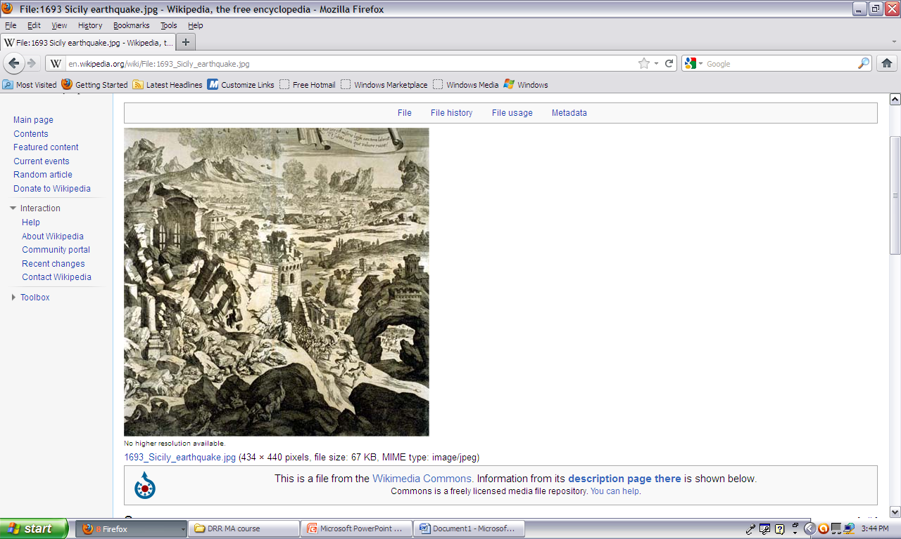
Earthquake in Sicily

Slide 50
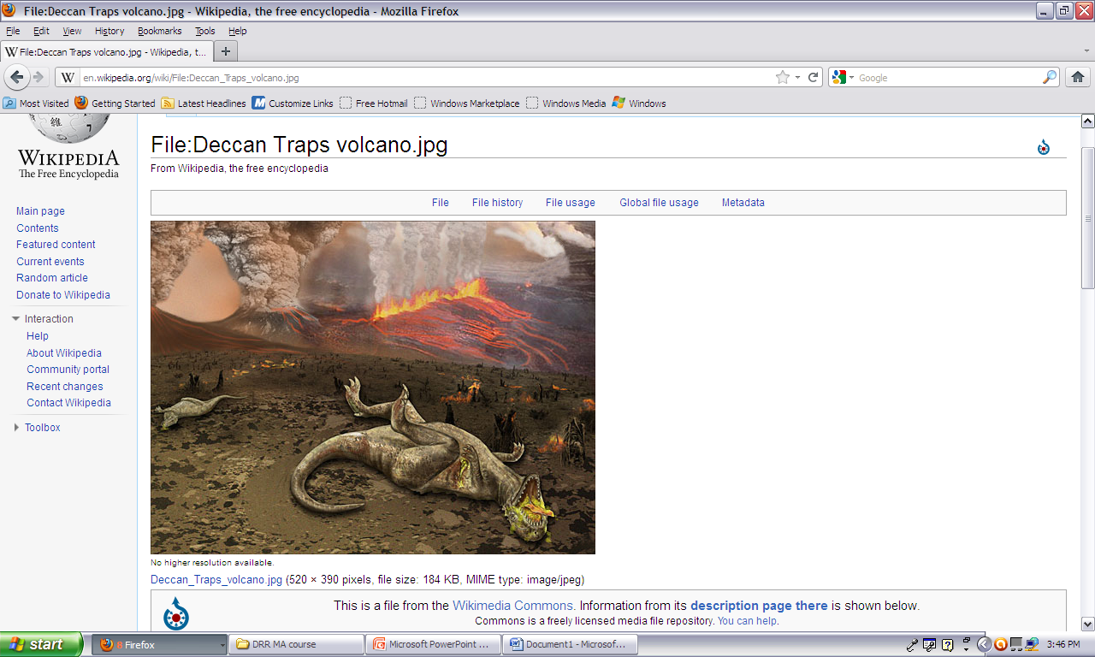
Volcanic Eruption

Slide 51
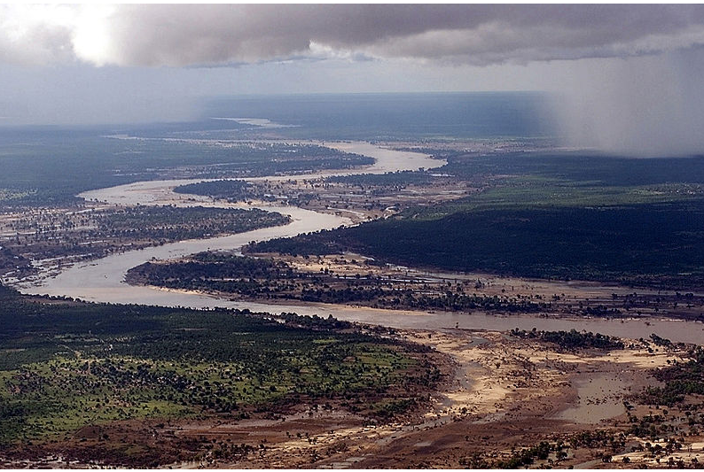
Flood in Limpopo

Slide 52
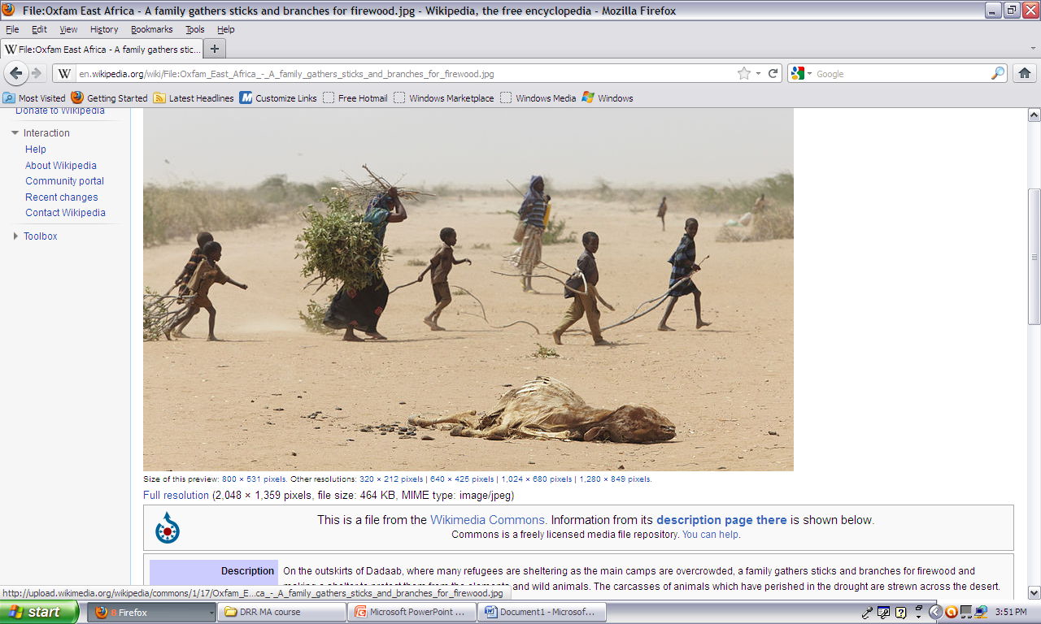
Drought in East Africa

Slide 53
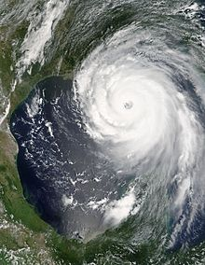
Hurricane Katrina

Slide 54
IV. Other Natural Hazards
Wildfires: Wildfires (also known as bushfires) are uncontrolled fires in forest, grasslands and scrublands. In areas where wildfires are common, the climate is moist enough to let vegetation grow effectively, but there a long, dry, hot spell during which vegetation becomes dry enough to burn. Volcanic eruptions, lightening, and changes in climatic conditions can set off wildfires. Forest fires are natural parts of the ecosystems in many forest types. For example, in coniferous forest, they are frequent and expected events affecting both flora and fauna.
Diseases: Infectious diseases that can spread rapidly through a population is also a natural hazard. A disease that spreads in particular locality is called outbreak and one that spreads through a country or a region is called an epidemic. A disease that spreads throughout the world is a pandemic. For instance, look at the following emerging and reemerging diseases that have been recorded by WHO as 1996 at different part of the world. Ebola and Crimean, Congo haemorrhagic fever, Influenza H5N1, Lassa fever, Monkey pox, Nipah Hendra, Rift valley fever, New variant Creutzfeld-Jakob disease, SARS coronavirus, Venezuelan equine, Encephalomyelitis, Yellow fever, West Nile fever, Cryptosporidiosis, Leptospirosis, Lyme borreliosis, Escherichia coli 0157, Multidrug-resistant, Salmonella, etc.

Slide 55
2.1. Classification by Causes
2.1.2. Man-made Hazards and Disasters
Anthropogenic hazards or man-made hazards can come to fruition in the form of a man-made disaster. In this case, "anthropogenic" means threats having an element of human intent, negligence, or error; or involving a failure of a man-made system. This is opposed to natural disasters resulting from natural hazards
Man made hazard and disaster refers to a disaster or emergency situation of which the principal, direct causes are identifiable human actions, deliberate or otherwise.
Apart from technological disasters, this mainly involves situations in which civilian populations suffer causalities, losses of property, basic services, and means of livelihood as a result of war, civil strife, and other conflict or policy implementation.

Slide 56
In many cases, people are forced to leave their homes, giving rise to congregations of refugees or externally or internally displaced persons.
Many modern-day disasters involve human-induced accidents aboard passenger-carrying airplanes, ships, or railroads.
Other man-made disasters can be traced to the collapse of buildings, bridges, tunnels, and mines, as well as to explosions and fires unintentionally triggered by humans.
Acts of war (internal and external) and terrorism also inflict death and destruction and therefore are considered as disasters

Slide 57
Man-made hazards/disaster can have also the following types:
I. Technological Hazards/Disasters: refers to a situation in which large numbers of people, property, infrastructure, or economic activity are directly and adversely affected by major industrial accidents, severe pollution accidents, nuclear accidents, air crashes (in populated areas), major fires, or explosions.
industrial hazards – mining accidents
Structural failure/collapse – due to engineering failures
Fire
Hazardous materials such as radiation contamination and chemical, biological, radiological, and nuclear (CBRNs)
Environmental pollution
Resource depletion
Transportation such as aviation, rail, road, space, &sea travel

Slide 58
II. Willful Hazards (sociological hazard)s: Since the events of September 11, 2001 some have suggested that another category of events be defined as intentional or willful acts - implicitly assuming that the response to such events will be different from the response to natural or technological events.
crime e.g. arson –setting fire on buildings
Sabotage
Terrorism
Civil disorder/Conflict

Slide 59
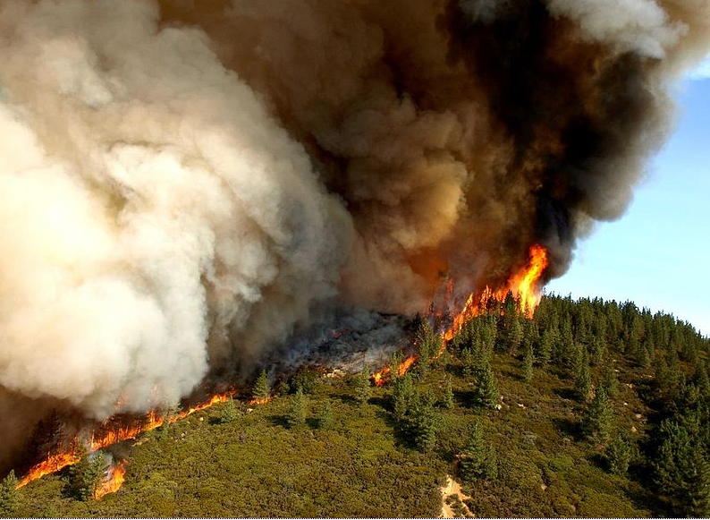

Slide 60
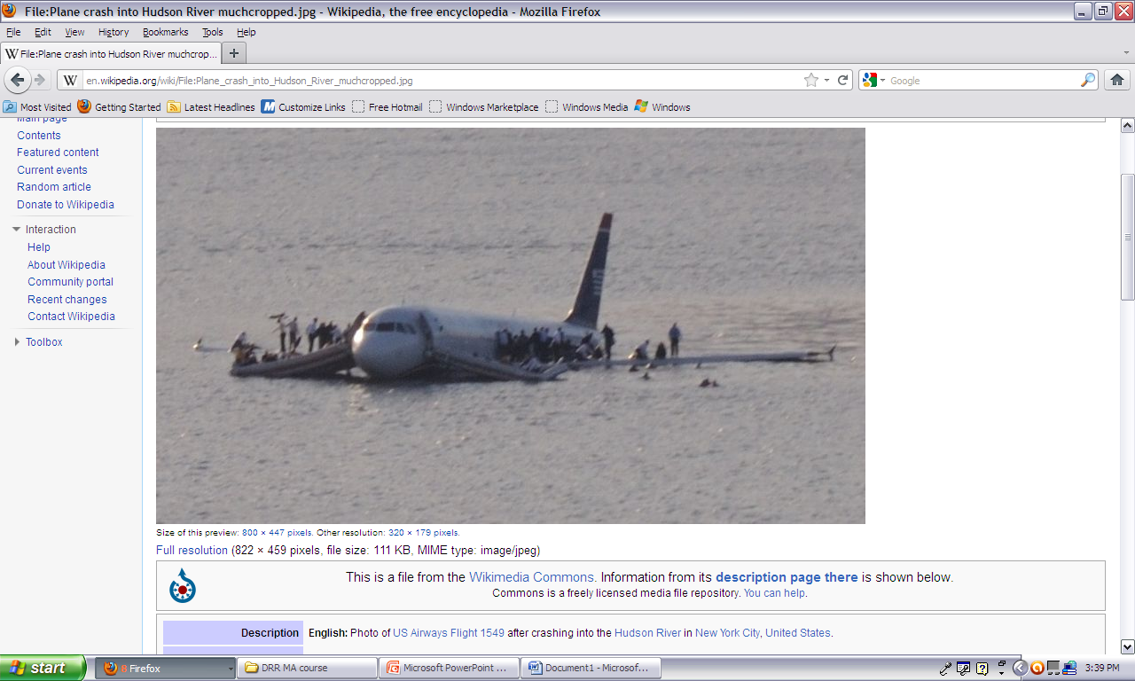
Aviation

Slide 61
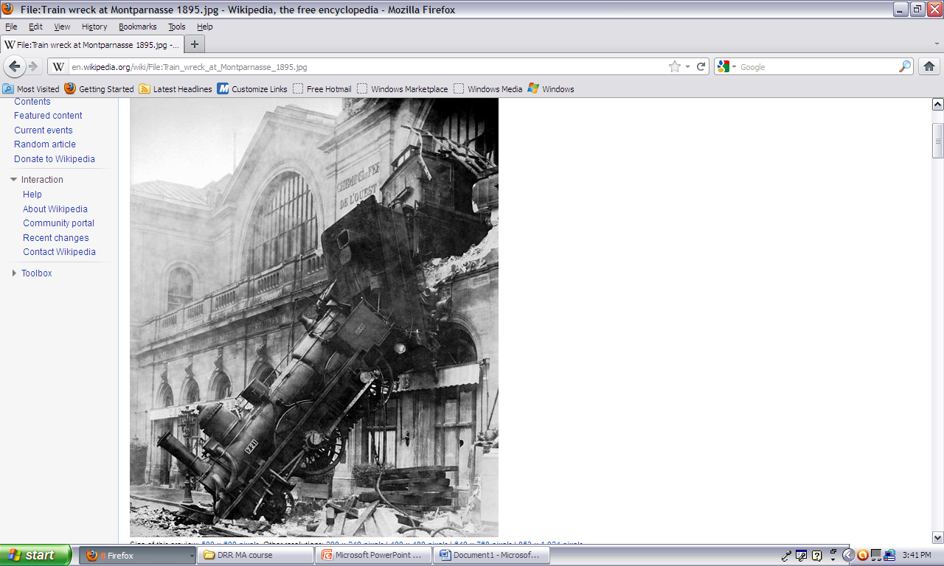
Train Accident

Slide 62
2.2. Hazards Classification
2.2.1. Speed of Onset
Slow-onset hazards
These are also called creeping disasters or slow-onset emergences. They refer to situations in which the ability of people to sustain their livelihood slowly declines to a point where survival is ultimately jeopardized.
Such situations are typically brought on or precipitated by ecological, social, economic or political conditions.
The spread of a deadly disease is also gradual. Drought and the spread of a deadly disease are examples of this type.
Sudden Onset Hazard
Disasters may be sudden calamities caused by natural phenomena and human interference. These are violent, like an earthquake or flood, tropical storms, volcanic eruptions.
They strike with little or no warning and have an immediate adverse effect on human populations, activities and economic systems.

Slide 63
Box-7: Individual Vulnerability to hazard risk and disaster
Story: Village Girls
Badda village is located ten km from a permanent stream where the village girls go to fetch water every day. The road to the stream passes through a thick forest infested with fierce lions.
Asha is a lame girl who normally accompanies other girls to the stream; Asha always lives in fear because she knows she cannot run in the event of an attack.
The lions pose serious danger to the lives of all the girls but Asha’s condition makes her an easy target. In case of attack there could be loss of life. However the community often clears the bush and ensures that armed young men escort the girls to and from the steam.

Slide 64
By referring to the above story of the village girls, answer the following questions
  Why do girls fear to go to the stream?
  Why is Asha more exposed to danger compared to other girls?
  What is the worst that can happen in case of an attack?
  What has the community done to minimize chance of an attack by lions?

Slide 65
Box- 8: Instructors Note
Lions posing danger to girls lives is a hazard
Lameness of Asha is a vulnerability condition
Serious injury or death from lion attacks is a disaster
Bush clearing and escorting the girls are preparedness measures

Slide 66
Exercise
For the last ten years, drought occurred 5 times in woreda “X”. There are two groups in the woreda. The first group is socially cohesive; people help each other. Besides, they are members of a cooperative and sell half of their goats through it. The second group, on the other hand, is totally engaged in animal rearing. This group is susceptible to animal theft and does not have any social system that promotes cooperation among community members. This group has 2000 goats. But since the people are not members of the union, they could not get any chance to sell them before drought occurred.
What is the level of risk and disaster in each group?
Which group is more vulnerable to the problem?
Identify the livelihood strategies of the groups

Slide 67
Role-play: Drought Talking
In this role-play drought is personified and depicted visiting two types of pastoralist households. The first household kept cattle only and practices controlled grazing. The household does not maintain good relationship with the neighbors. The second household keeps cattle, camels and goats and indulges in small business. It also practices controlled grazing and maintains good relationship with neighbors.
Scene 1
Drought visits the first household and the following dialogue takes place.
Drought: I am drought, I was here four years ago and I have come again. I will be around for the next one year.
First household: You always come uninvited. I know you will clear my cattle since I do not have sufficient pasture, neither I am on good terms with my neighbor. so I cannot turn to them for assistance. I regret that I have kept only cattle and that they are your easiest targets. I am afraid this time you are going to kill me.
Drought: I have come for your lot.
Scene 2
Drought visits household two.
Drought: I am drought, I was here four years ago and I have come again. I will be around for the next one year.
Second household: I knew you would come and I have made arrangements to take my cattle to my good neighbor who has enough grazing for both of us. My camels will survive your onslaught. My business will sustain my family for the period you are going to be around. Welcome.
Drought: I know you are my enemy and that you want my fame to diminish. I hope others are not going to adopt your ways

Slide 68
Exercise/Self assessment
On the basis of Role-play given in Box-8 above, reflect of the following questions.
What is the common hazard which affects the two households?
What makes the first household more vulnerable to the hazard?
What was the disaster to the first household?
What is a mitigation measure for the second household?

Slide 69
Exercise
Two years ago, a severe earthquake hit Japan very hard claiming the lives of nearly 20,000 people and devastating resources worth several billion USD. What adds fuels to the fire is radiation from nuclear plants. In fact, houses were built in a manner that they would resist the damage. Besides, a week before the occurrence of the problem, the government warned the people. Nevertheless, owing to the location of the country near the ring of fire, technological advancement and preparedness strategies could not prevent the country from the problem.
From the above statements, identify the:
Hazard: earthquake and radiation
Disaster: loss of life and resources
Vulnerable elements: the people, the country at large
Vulnerability factors: location near the ring of fire, technological advancement
Preparedness strategies: construction of wave-resistant houses and early warning
Discuss the linkages between development and disaster

Slide 70
2.3. Growth and Distribution of Disasters
2.3.1. Disaster in the world
Humankind has been exposed to disaster risk since the time of immemorial. Through centuries we have been faced with risks that parallel those we face today.
While we may not be able to prevent most natural disasters from occurring, we must urgently prevent the escalating loss of life, property and productivity.
In the past decades, the damage due to natural and human-made disasters increased worldwide in amount and magnitude. According to the Munich Re-Group, the year 2005 with overall losses exceeding US$ 210 billion set a new record and more than one hundred thousand people were killed as a result of natural catastrophes.
Developing countries suffer the greatest costs when a disaster hits – more than 95 percent of all deaths caused by disasters occur in developing countries, and losses due to natural disasters are 20 times greater (as a percentage of GDP) in developing countries than in industrialized countries
Almost on a daily basis, we are reminded of the threat posed by natural disasters. No one is impervious to the forces of nature. You may think of what has happened in Japan just a year ago, the 12 January 2010 earthquake in Haiti, and the July-August 2010 floods in Pakistan

Slide 71
Disasters can be particularly notable for the high costs associated with responding to and recovering from them.
This page lists the economic costs of relatively recent disasters.
2011 Tōhoku earthquake and tsunami, Japan: estimated more than $ 300 billion
2008 Sichuan earthquake, China, $148 billion
Deepwater Horizon oil spill, Gulf of Mexico, 2010: Between $60 and $100 billion.
Hurricane Katrina, United States, August 2005: insurances compensated $ 45 billion;
2011 Thailand floods: $45.7 billion (World Bank estimate of total economic damages and losses)
Hurricane Ike, United States, September 2008, $ 29.6 billion
1998 Yangtze River floods, China: $26 billion.
Hurricane Andrew, United States, August 1992: $ 25 billion
September 11 terrorist attacks, 2001: $20.7 billion;
Chernobyl disaster, 1986: $15 billion estimated cost of direct loss. It is estimated that the damages could accumulate to €235 billion for Ukraine and €201 billion for Belarus in the thirty years following the accident;
Armero tragedy, Colombia, 1985, $7 billion.
Exxon Valdez oil spill, 1989: The clean-up of oil spill cost an estimated $2.5 billion; recovery for settlements, $1.1 billion; and the economical loss (fisheries, tourism, etc.) suffered due to the damage to the Alaskan ecosystem was estimated at $2.8 billion;
Cedar Fire, United States, 2003, $2 billion
AZF chemical plant explosion, Toulouse, France, 2001: €1.8 billion
2011 Slave Lake wildfire, Canada, $1.8 billion.
The costs of disasters varies considerably depending on a range of factors, such as the geographical location where they occur. When a disaster occurs in a densely-populated area in a wealthy country, the financial damage might be huge, but when a comparable disaster occurs in a densely-populated area in a poorer country, the actual financial damage might relatively small, in part due to a lack of insurance. For example, the 2004 Indian Ocean earthquake and tsunami with a death toll of over 230,000 people, cost a 'mere' $15 billion, whereas the Deepwater Horizon oil spill, in which 11 people died, the damages were six-fold.

Slide 72
2.3.1. Disaster in the world … cont’d
Thereof, Hurricane Katrina including the New Orleans flood in the United States was the most expensive natural catastrophic loss in history.
Rapid population growth, global climate changes and the overexploitation of natural resources are mainly responsible for this. The images and reports of the latest natural disasters, most notably the Indian Ocean Tsunami disaster and Hurricane Katrina, are still very much remembered.
These days’ hazards are becoming eminent in every corner of the world. Every year, millions of people are affected by different kind of hazards including drought floods, conflict and others.
The impact of these hazards further aggravated by increased population densities, environmental degradation, global warming etc; in most case the magnitude that can be caused by a disaster is kwon or can be estimated and how to prevent the devastation or minimizing the impact is less known.

Slide 73
2.3.1. Disaster in the world … cont’d
Today’s fast changing global environment has led to significant consequences on society, economy, natural environment, and even politics. Global disaster statistics for 1996-2000 revealed considerable economic costs estimated at US 235 billion and 425, 000 lives lost.
Disasters caused by natural hazards alone reportedly affected an average of 211 million people per year in the past decades. The impact of disasters is more severe in the developing countries, which inevitably goes beyond their immediate devastation as the continuing toll on human lives, properties and resources exacerbates poverty and setback economic development.
In the past decades, the amount and magnitude of natural and human-made disasters is on the rise worldwide and with the increasing frequency, especially poor people in developing countries are affected by these catastrophes.
Our continent, including Ethiopia is the worst affected by hazards that has caused a greater impact on the lives and livelihoods of people.

Slide 74
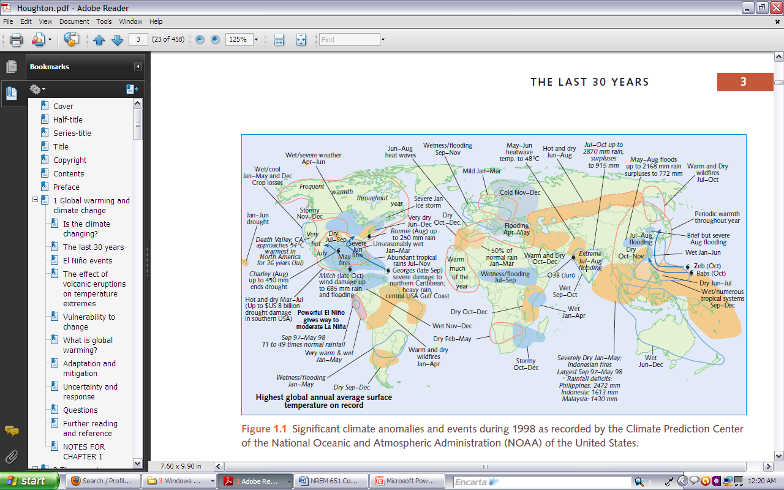

Slide 75
1.4.2. Disaster in Africa
Africa is the only continent whose share of reported disasters in the world total has increased over the past decade. More people are affected by natural hazards, and economic losses incurred are rising. Disaster impacts have become an impediment to sustainable development in Africa.
The occurrence of disasters triggered by natural hazards, the number of people affected and economic losses are rising in Africa. Hydro-meteorological hazards (drought, flood, windstorms, particularly tropical cyclones, landslides and wildfire), occur most pervasively and account for most of the people affected by disasters.
On an individual hazard basis, epidemics are the major cause of disasters. In particular, the effects of the HIV/AIDS pandemic, and the malaria and tuberculosis epidemics are impacting households and communities so severely that they place downward pressure on sustainable development, particularly in sub-Saharan Africa.
Less frequent hazards include pest infestation, earthquakes, landslides, wildfire and volcanic eruptions.

Slide 76
1.4.2. Disaster in Africa … Cont’d
In 2000-2001, about 35 million people, equivalent to 13 percent of the total population in Africa, were affected by disasters. In terms of economic losses, disasters significantly derail development in affected countries.
For example, the year 2000 flood in Mozambique lowered the country’s GDP by about 12%, and the 1992 drought reduced Zimbabwe’s and Zambia’s GDPs by about 9%.
In addition to such large, discrete and high-impact disasters, recurrent but localized hazards erode the development capacity and livelihoods of the majority of the poor and weaken their coping and survival capacities.
In the future, climate change may be a key trigger for the occurrence of disasters involving droughts, floods and other hydro-meteorological phenomena (AU/NEPAD, 2004).

Slide 77
1.4.3. Disaster in Ethiopia
Drought, famine and related disasters have been a recurring feature of Ethiopian history and indeed the history of the Horn of Africa.
The earliest reference to drought and famine in Ethiopia was in the 9th century. About 30 major drought episodes have been recorded over the last 9 centuries.
13 of these droughts covered the whole country and were reported to be severe.
The remaining droughts and famines differentially affected certain regions with Wollo and Tigray repeatedly affected of the recorded drought and famines took place in the 20th century out of which 5 occurred during 1972-1991.
Most droughts and famines lasted for one year or less except the 1066-1072, 1454-1458, 1543-1562, and 1888-1892 famine years which spread droughts and famines occurring on the average every 2-3 years as compared to every 7-10 years over the previous decades.

Slide 78
Other drought and famine years were 1972-1974, 1975-1976, 1978-1978,1983-1984, 1990-1991, 1992-1993, 1994-1995, 1997-1998, 2000-2001,2002-2003.
The climatic conditions of these drought years were characterized by either failure, late or early onset of or inadequate rainfalls during the small and/or main rainy seasons.
These drought events have shaped community risk management strategies and have influenced the nature and history of its political regimes.
These crises contributed to the end of the Imperial era, formed the justification behind the policies of the Socialist regime, and they now constrain and challenge the achievements of the current government.

Slide 79
1.4.3. Disaster in Ethiopia …. Cont’d
Causes of Drought
Climate-induced droughts could have many causes encompassing terrestrial, atmospheric, and oceanic factors.
Terrestrial factors include changes in ecological and demographic conditions resulting mainly from rapid population growth and anthropogenic activities such as extensive cultivation, deforestation, and overgrazing.
The high population growth has placed increased demands on the nature resources which have led to massive deforestation and devegetation.
As a result, vital ecological services of vegetation cover such as control of run-off and soil erosion, replenishment of ground waters and climate regulation are disrupted leading to a "drought-flood cycle" phenomenon.

Slide 80
The amount of soil lost is staggering estimated at 2 billion tons per year. The consequence is massive flooding, decreased rainfall infiltration and drying up of local streams and rivers once the rains are over.
The accelerated local and regional deforestation that has taken place during the last decades is also believed to have disrupted the hydrological cycles that control rainfall.

Slide 81
Impact of Drought
The droughts of the last two decades in Ethiopia were major social, environmental and economic disruptive forces. The primary and the most immediate shocking effects of drought related famines had been heavy loss of human and livestock population, mass starvation, death, and mass drift to relief centers and nearby towns and cities.
According to a survey made by the Ethiopian Nutrition Institute, the mortality rate for the 1974 famine in Wollo was 190 per thousand of those affected by drought. The 1984-85 droughts have claimed more than a million lives.
Drought and environmental degradation are closely inter-linked. Continued environmental degradation increases the risk of drought occurrence while repeated and prolonged drought leads to ecosystem destabilization through the process of soil erosion and desertification.
During droughts, the areas affected are denuded of vegetation leaving the soils exposed to wind erosion which in turn leads to fertility decline and forces people to cultivate lands considered marginal so as to maintain previous levels of production.
The result is shortened fallow period and expansion of degradation which ultimately may lead to desertification.

Slide 82
The total number of people affected by drought episodes for the 1990-2004 period is shown in Table 4. The corresponding food assistance requirements are shown in Table 5.

Slide 83
Table 5: Food Assistance Requirement (1990-2004)

Slide 84
Floods
There are many areas here and there that are prone to flooding of Ethiopian rivers. However, unlike drought and famine, flood and its consequences have not been properly recorded. The trend over time as a result of global climate change or due to the catchments degradation is not properly documented. However, the Disaster prevention and Preparedness Commission has identified the following area as flood prone areas for follow-up:
In Somali Administrative region on the Wabi Shebele from Imi to Mustahil.
In Gambella Administrative Region on the Baro River from the tow of Gambella to the Border town of Jikao.
In the Afar Region on the Awash River around Assaita.
In Amhara Administrative Region Immediately east of Lake Tana where River Ribb and River Gumara enter Lake Rana.
In Oromia Administrative Region around Tefki in the Teji Depression.

Slide 85
Box- 10: Facilitators Note
Floods have sometimes benefits for certain areas and community groups. For instance, in the lower arid areas where the inhabitants are nomadic pastoralists flood brings moisture to their dry season grazing land to grow enough grass that could last for most of the dry months as such it is not a threat. In some areas where farmers practice flood recede agriculture flood is considered as a beneficial positive impact. The people have developed tradition of living with it.

Slide 86
Other disasters in Ethiopia
Pankhurst states that the natural causes of famine included “drought, locusts, caterpillars and in the case of The Great Famine of 1889-1892, rinderpest.” Socio-economic factors leading to famine included “deforestation, soil erosion and exhaustion, fragmentation of land holdings, the subsistence economy with its primitive agricultural tools, civil war.
plagues and pests have been equally important in causing various catastrophes, particularly in the northern parts of the country (Tigray, Gondar, Gojam, Wollo and Shoa).
In the 17th and 18th centuries alone, locusts caused the famines of 1625-27, 1706, 1747,and 1748 and at various times during the reign of Emperor Fasilidas (1632-1667).
Epidemics such as fangle (cholera), qachne, lablab (influenza), small pox and other unspecified illness are recorded as causing the famines of 1634-5, 1683, 1685, 1693 and 1700-01.

Slide 87
In 1876, for example, 25% of the population of Tigray was killed by an outbreak of typhus.
Influenza epidemics have constantly ravaged Addis Ababa. The worst was in 1918 when one fifth of the population of Addis Ababa died of the disease.
Meningitis epidemics also have been recorded frequently specifically during and after drought periods.
The drought years 1977, 1981-1983, 1988-1989 coincided with recorded widespread meningitis outbreaks.
Similarly, malaria outbreaks and their incidence appear to coincide with the first rains after dry periods. Though there is no recorded history about malaria epidemics, malaria would appear as of 1958 to be a major public health threat in Ethiopia.
Three quarters of the country is infected by malaria.

