Slide 1
Business Research Methodology
(MBA 4101)
Chapter -TWO
DEFINING RESEARCH PROBLEM AND HYPOTHESIS FORMULATION

Slide 2
What is a Research Problem?
Problem means a question or an issue to be examined.
A research problem refers to some kind of problem which a researcher experiences or observes in the context of either a theoretical or practical situation.
A problem does not necessarily mean that something is seriously wrong with a current situation.
A problem could simply indicate an interest in an issue where finding the right answers might help to improve an existing situation.

Slide 3
Cont...d’
A problem occurs when a gap exists between the way things are now and a way that things could be better.
The gap can come about in a number of ways:
Business performance is worse than expected business performance. For instance, sales, profits, and margins could be below targets set by management.
Actual business performance is less than possible business performance.
Expected business performance is greater than possible business performance. Sometimes, management has unrealistic views of possible performance levels—either too high or too low.

Slide 4
Components of Research Problem
1. Objective or aim of the problem which is to be investigated. This answers the question “Why?” Why is there a need for investigation, inquiry or study?
2. The topic or theme which needs to be investigated. This answers the question “What?” What is to be researched or studied?”
3. The time dimension of a decision problem is always the future: The period or time of the study when the data are to be gathered. This answers the question “When?” When is the research to be performed?”
4. The area or location in which the study is to be conducted. This answers the question “Where?” Where we need to conduct the study? The space coordinates give you the geographic boundaries within which the action is to be taken.
5. Population or universe from whom the data needs to be gathered. This answers the question “Who?” or “from whom?” Who are the respondents? From who are the data to be collected?”

Slide 5
Techniques of defining a research problem
Statement of the problem in a general way:
Understanding the nature of the problem:
Surveying the available literature:
Developing the ideas through discussions:
Rephrasing the research problem:

Slide 6
Potential Sources of a Research Problem
Theory of one’s own interest
Daily problems:
Technological changes:
Unexplored areas:
Discussions with some people:

Slide 7
Criteria for Selecting Good Research Problem
Factors to be taken into account in the choice of a research problem are both external and personal.
External criteria involve such things as newness and significance for the area, availability of data and method, and administrative and institutional cooperation.
Personal criteria include such considerations as interest, training, cost, and time.

Slide 8
Criteria for the choice of research problem
Novelty / originality
Interesting
Importance
Applicable
Feasibility or Amenability

Slide 9
  Types of Variables
The dependent variable also called Criterion variable
The independent variable also called predictor variable
Moderating variable
Mediating variable

Slide 10
  Dependent variable
It is the primary interest to the researcher, to understand and describe; explain its variability or predict it
the researcher will be interested in quantifying and measuring the dependent variable as well as the other variables which influence this variable.
E.g, sales of the product, loyalty, job satisfaction of employees…
An applied researcher want to increase the productivity of firm employees. What is the dependent variable?

Slide 11
  Independent variable
It is a variable that influence the dependent variable in either positive or negative way.
When the independent variable present , the dependent variable exists.
With each unit of increase/ decrease in independent variable , there will be an increase/ decrease in the dependent variable.
In other words the variance in the dependent variable is accounted for by the independent variable.

Slide 12
  Cont’d……
To establish that a change in independent variable causes a change in the dependent variable, all of the following four conditions must met
IV & DV should covary: the change in DV should be associated with the change in IV
The IV (the presumed causal factor) should precede the DV. The cause must occur before the effect
No other factor should be possible cause the change in the DV, hence, the researcher control for the effects of the variables
A logical explanation (a Theory) is needed about WHY the IV affects the DV

Slide 13
  R/ship of IV & DV in diagram
Identify the DV & IV
A manager believes that performance of employees will in cease if the employees got good supervision and training
New product success
Stock price of the company

Slide 14
  Moderating variable
It is a variable which has a strong contingent effect on the IV and DV relationship. That is, the presence of the third variable (moderating var.) modifies the original relationship b/n the IV & DV.
For example, the availability of reference manuals that manufacturing employees have access to, and the product rejects. That is when workers follow the procedures laid down in the manual, they are able to manufacture products are flawless/faultless. This relationship will be moderated by the interest and inclination of employees to use the manual.

Slide 15
  Cont’d……
Availability of reference Manuals
(IV)
Number of Rejects
(DV)
Interest & inclination
(MV)
Workforce Diversity
(IV)
Organizational Effectiveness
(DV)
Managerial Expertise
(MV)

Slide 16
  Mediating or Intervening Variable
It is a variable that surfaces between the time the IV starts operating to influence the DV and the time their impact is felt on it.
There is thus a temporal quality/ time dimension to the mediating variable. It surfaces as a function of the IV(s) operating in any situation and helps to conceptualize and explain the influence of IV(S) on DV

Slide 17
  Cont’d….
Time: t₁ t₂ t₃
IV MV DV
Workforce
divesity
Creative
Synergy
Organizational
Effectiveness

Slide 18
  IV, MV Mod.V and DV relationship
Time: t₁ t₂ t₃
IV MV DV
Moderating Variable
Workforce
divesity
Creative
Synergy
Organizational
Effectiveness
Managerial
Expertise

Slide 19
  Cont’d….
It is now easy to see the difference between IV, MeDV and ModV.
The IV helps to explain the variance in the DV
The Mediating Variable surfaces at time t2 as a function of IV which also help us to conceptualize the relationship between the IV and DV
The moderating variable has a contingent effect on the relationship between two variable.

Slide 20
  Cont’d….
The IV explains the variance in DV, the mediating variable does not add vale to the variance already explained by the IV , where as the Moderating variable has an interaction effect with the IV in explaining the variance. Generally to make the study more scientific all variables should be carefully determined and then a theoretical frame work will be developed

Slide 21
Research question
A research question is the researcher’s translation of the business problem into a specific need for inquiry.
These research questions assume two forms: a central question and associated sub questions.
A researcher asks one or two central questions followed by no more than five sub questions.

Slide 22
Guidelines for research question
Begin the research questions with the words “what” or “how” and “Why” etc…
Focus on a single phenomenon or concept.
Use exploratory/ action verbs that convey the language of emerging design of research. These verbs tell the reader that the study will
- Discover (e.g., grounded theory)
- Find out (e.g., ethnography)
- Explore a process (e.g., case study)
- Describe the experiences (e.g., phenomenology)
- Report the stories (e.g., narrative research)

Slide 23
Examples of research question
RQ1: what attitudes do employees have toward these software packages?
RQ 2: How concerned are managers about out placement services?
RQ 3: why employees prefer out placement services?

Slide 24
  Research Hypothesis:
  Its Meaning, Types & Development
A hypothesis is a tentative, yet testable statement which predicts what you expect to find in your empirical data.
It is a logically conjectured relationship b/n two or more variables expresses in the form of testable statements.
It derived form theory
E.g. If pilots are given adequate training to handle mid-air crowded situations, air safety violations will be reduced.

Slide 25
  Formats of statements of Hypothesis
If - then statements:
To examine whether or not the assumed r/ships or d/nces exist, these hypotheses can be set as propositions or in the form of If-then statements.
Employees who are more healthy will take sick leave less frequently.
If employees are more healthy, then they will take sick leave less frequently

Slide 26
  Cont’d..
Directional and Non-directional Hypotheses:
Directional
If the r/ship b/n 2 or more variables or comparing two groups, terms such as positive, negative, more than, less than and the like are used.
these are directional hypothesis, because the direction of relationship b/n variables is indicated.

Slide 27
  Cont’d..
Examples
The greater the stress experienced in the job, the lower the job satisfaction of employees.
Women are more motivated than men.

Slide 28
  Cont’d..
Non-directional
They are statements that postulate a relationship or difference, but offer no indication of the direction of these relationships or difference.
In other words , though it may be a significant relationship b/n two variables, we may not able to say the relationship is + or –
E.g: There is a relationship b/n age and job satisfaction
There is a d/nce b/n the work ethics of American and Asian Employees

Slide 29
  Null and Alternate Hypotheses
Null hypotheses (H₀) is a hypotheses set up to be rejected in order to support the Alternate hypotheses
H₀ is expressed as NO (significant relationship or difference b/n variables)
H₀ is presumed true until statistical evidence obtained.
Alternate hypotheses (H_{a}): It is stated as opposite of the null hypotheses. It is accepted when H₀ rejected

Slide 30
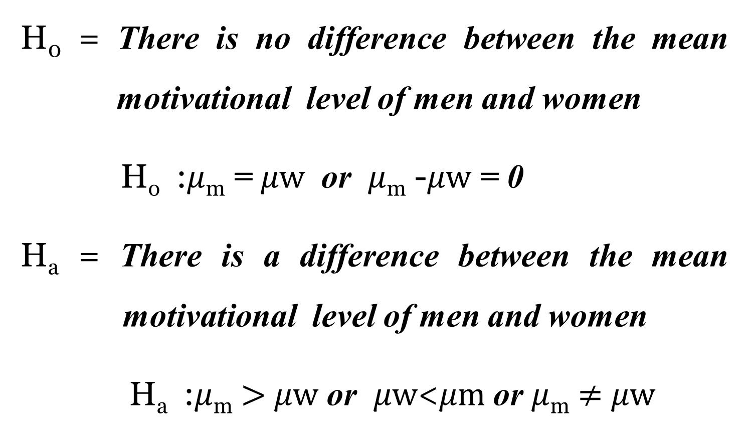
  Non-directional hypotheses
H₀ = There is no difference between the mean motivational level of men and women
H_{o} :$μ$_{m} = $μw$ or $μ$_{m} -$μw$ = 0
H_{a} = There is a difference between the mean motivational level of men and women
H_{a} :$μ$_{m} $>$ $μw$ or $μw$<$μm$ or $μ$_{m} $≠$ $μw$

Slide 31
  Cont’d..
Having formulated null and alternate hypotheses, the appropriate statistical tests (t- test, F test) can be applied to indicate whether or not alternate hypotheses is supported.

Slide 32
  Nature of Hypotheses
It can be tested – verifiable or falsifiable 
Hypotheses are not moral or ethical questions 
It is neither too specific nor to general 
It is a prediction of consequences 
It is considered valuable even if proven false

Slide 33
  Steps in testing hypotheses
1. Stating the hypothesis (Null or Alternative) 2. Setting the criteria for a decision
3. Collecting data
4. Evaluate the Null hypothesis

Slide 34
Research hypothesis vs Research questions
Hypothesis predict the nature of the answer
Hypothesis proposes a relationship between two or more variables
Questions are interrogative/?, whereas research hypotheses are declarative/. .
At times in research, particularly in exploratory research, a proposal can only offer research questions.
Research hypotheses are much more specific and therefore require considerably more theoretical support

Slide 35
Characteristics of hypothesis:
Hypothesis should be clear and precise.
Hypothesis should be capable of being tested
Hypothesis should state relationship between variables,
Hypothesis should be limited in scope and must be specific
Hypothesis should be stated as far as possible in most simple terms so that the same is easily understandable by all concerned.

Slide 36
Cont…d’
Hypothesis should be consistent with most known facts, i.e., it must be consistent with a substantial body of established facts.
Hypothesis should be amenable to testing within a reasonable time.
Hypothesis must explain the facts that gave rise to the need for explanation.

Slide 37
Errors in Hypotheses
Two types of mistakes are possible while testing the hypotheses. Type I and Type II
 |  | Your actual health
 |  | Sick | Well
The doc. Says | Sick | You are sick. Doc confirms it RIGHT | Get scared for nothing! WRONG-Type I error
 | Well | Doc missed your real illness! WRONG-Type II error. | You’re really not sick! RIGHT

Slide 38
Two Tailed. (in case of 0.05 significance level )
Acceptance region of H0
Rejection region of H0
Rejection region of H0

Slide 39
Thank You for Your Attention

