Slide 1
Leadership and Change Management
(MBA5023)
Chapter One: INTRODUCTION
BY: Yissa Hassen (Ph.D Scholar)
March, 2020
Debre Tabor, Ethiopia

Slide 2
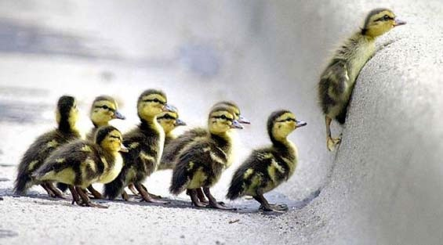
Who is a leader?
There is a leader in everybody
Leadership is not only a function of position, but it is a choice

Slide 3
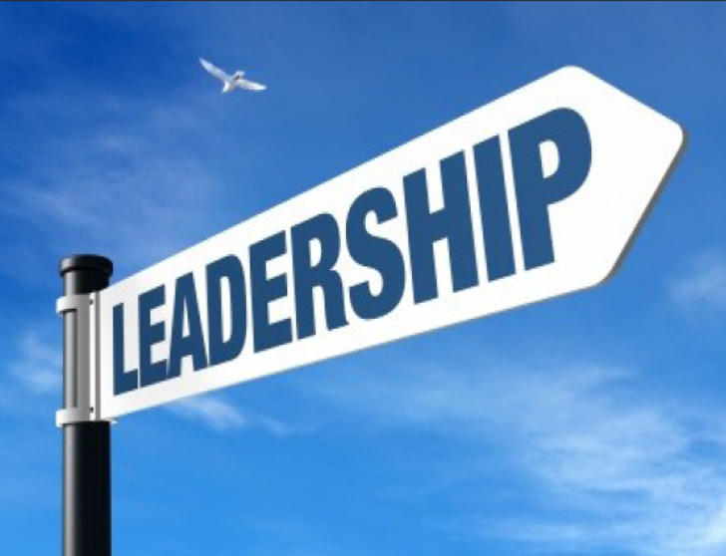
What is Leadership For You?

Slide 4

What is Leadership?
A process where by an individual influences a group of individuals to achieve a common goal

Slide 5
  1.1: Leadership Definition
The term leadership means to lead people. The behavioural approach of human behaviour about a person, group, people etc.
It is a process to influence people by the leadership quality.
Leadership behaviour is a psychological approach of human behaviour.
It influences people to give best performance in the organisation. It is the process in which follower and leaders lead.

Slide 6
Cont’d….
leadership is the “process of social influence in which one person can enlist the aid and support of others in the accomplishment of a common task”.
M Chemers.
"Leadership is ultimately about creating a way for people to contribute to making something extraordinary happen."
Alan Keith.

Slide 7
Cont’d….
Leadership is a process of giving purpose (meaningful direction) to collective effort, and causing willing effort to be expended to achieve purpose. (Jacobs & Jaques, 1990).
Leadership is the ability of an individual to influence, motivate, and enable others to contribute toward the effectiveness and success of the organization.(House et al., 1999)
Leadership is the ability of developing and communicating a vision to a group of people that will make that vision true (Kenneth Valenzuela, 2007)

Slide 8
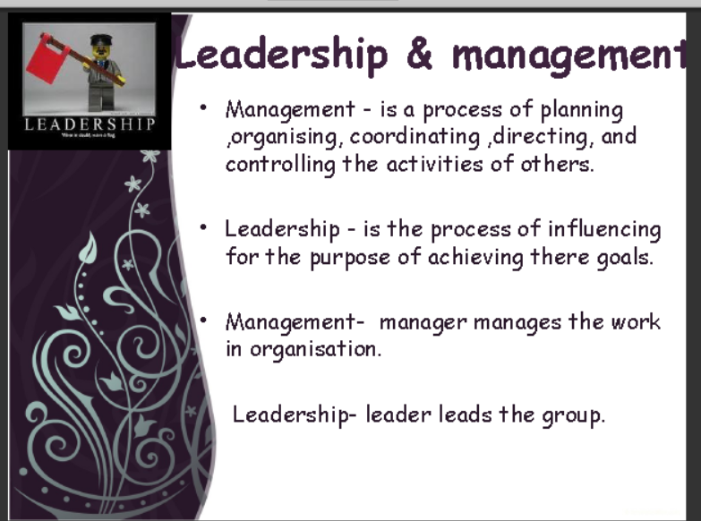

Slide 9
Leadership & Management
MANAGEMENT | LEADERSHIP
Requires five functions: planning, organizing, staffing, leading and controlling | A major part of a manager’s job
Emerge formally. Managers need formal authority to be effective. | The leader of the work group may emerge informally as the choice of the group.
Deals with both the interpersonal and administrative aspect of a manager’s job. | Deals with the interpersonal aspect of a manager’s job.
Managers deals more with carrying out the organization’s goals and maintain equilibrium | Deals with change, inspiration, motivation and influence

Slide 10
MANAGEMENT | LEADERSHIP
Managers may have to rely on formal authority to get employees to accomplish goals. | Leaders may not possess the formal power
Groups are often more loyal to a leader than a manager | Groups are often more loyal to a leader than a manager
Managers focus on system and structures | Focus on people
Managers relies on control | Leaders inspires trust
Managers imitates | Originates
Accepts the status quo | Challenges the status quo
Managers asks how and when | Leaders asks what and why

Slide 11
1.2. Manager vs Leader
MANAGERS
LEADERS
Administer
Maintain
Control
Short term view
Ask how & when
Initiate
Accept the status
Do things right.
Innovative
Develop
Inspire
Originate
Long term view
Ask what & why
Challenge the status
Do right things

Slide 12
1.3. What Makes Effective Leadership
Effective leadership is the process of achieving desired results through people’s willing participation. The heart of this definition is: desired results (goals), through people, and willing participation-people willingly follow leaders because they want them.
When leaders are effective, the influence they exert over others helps a group or organization achieve its performance goals when leaders are ineffective, their influence does not contribute to, and often detracts from, goal attainment.

Slide 13
Cont’d….
Beyond facilitating the attainment of performance goals, effective leadership increases an organization’s ability to meet all the contemporary challenges- including the need to obtain a competitive advantage, the need to foster ethical behavior, and the need to manage a diverse workforce fairly and equitably.

Slide 14
Cont’d….
Warren Bennis, who devoted decades to researching leadership issues, concludes that virtually all leaders of effective groups share four characteristics in common:
They provide direction and meaning to the people they are leading. This means they remind people what is important and why what they are doing makes important difference.
They generate trust.
They favor action and risk taking. That is, they are proactive and willing to risk failing in order to succeed.
They are surveyors of hope. In both tangible and symbolic ways they reinforce the notion that success will be attained.

Slide 15
1.3. Qualities of leadership
Intelligence
Risk taking behaviour
Positive attitude
Problem solving
Knowledgeable
Better communication
Strong determination
Wisdom

Slide 16
Cont’d…….Qualities of leadership
Kind hearted
Passion
Creativity
Vision
Confidence
Teaching ability (being model).
Readiness to accept responsibility / criticisms and to take appropriate corrective measures
Emotional stability and fairness
Planner and organizer E.t.c…

Slide 17
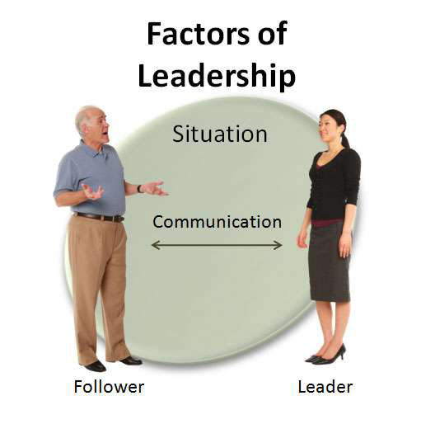
The 4 Factors of Leadership.

Slide 18
Cont’d….
Leader - You must have an honest understanding of who you are, what you know and what you can do. To be successful you have to convince your followers not your superiors, that you are worthy of being followed.
Follower -You must know your people. The fundamental starting point is having a good understanding of human nature, such as needs, emotions and motivation.

Slide 19
Cont’d….
Communication-The nonverbal communication is leading. E.g.- when you set example that communicates to your people that you would not ask them to perform anything that you would not be willing to do. Bad communication harm the relation between leader and employee.
Situation-We must use our judgment to decide the best course of action and the leadership style needed for each situation. What we do in one situation will not always work in another.

Slide 20
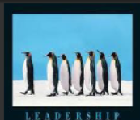
Cont’d….
It is an interpersonal influencing, exercised in situation and directed through the communication process towards the attained of a specified goal or goals.
It is process of getting other people to follow you and to do willingly the things that is you want them to do.
It is influencing people to follow you to work willing for the achievement of goal & objective.

Slide 21
Reading Assignment
Discuss the Importance of leadership for good governance and development

Slide 22


