Slide 1
Chapter-6
INTRODUCTION TO DERIVATIVE MARKET
1 Futures and Forwards,
2 Options, and
3 Swaps
Dr.Krishna Gadasandula

Slide 2
Welcome to all
2nd Year MBA. Students
Dr. Krishna Gadasandula
M.B.A., M.Com. M.Phil. and Ph.D.
With more than ten years of experience in Accounting and Finance Teaching, Research, Training & Education Management.
Mail: krishnagadasandula@gmail.com, # +91 9866349726-, 0904565415(Local Phone No.)
Hyderabad.India.

Slide 3
INTRODUCTION TO DERIVATIVES
Derivatives are the financial instruments which derive their value from the value of the underlying asset.
HISTORY:
Derivatives markets can be traced back to middle ages. They were developed to meet the needs of farmers and merchants. First future exchange was established in Japan in 16th century.
The Chicago Board of Trade was established in 1848.The international Monetary market was established in 1972 for future trading in foreign currencies

Slide 4
Players in the derivatives market?
 Hedgers
 Speculators
 Arbitrageurs

Slide 5
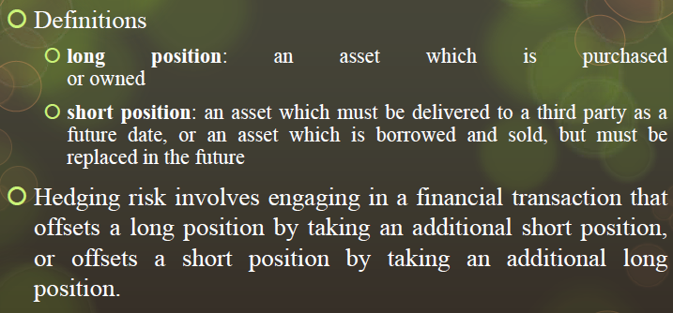
HEDGER
 A hedger is someone who faces risk associated with price movement of an asset and who uses derivatives as means of reducing risk.

Slide 6
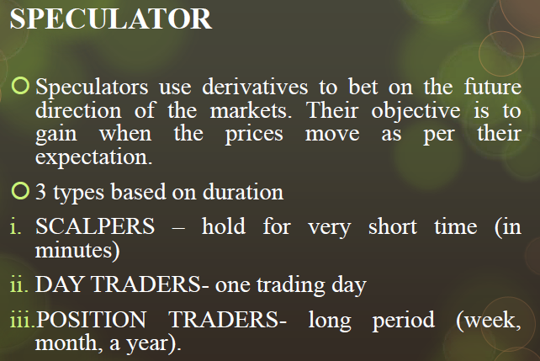

Slide 7
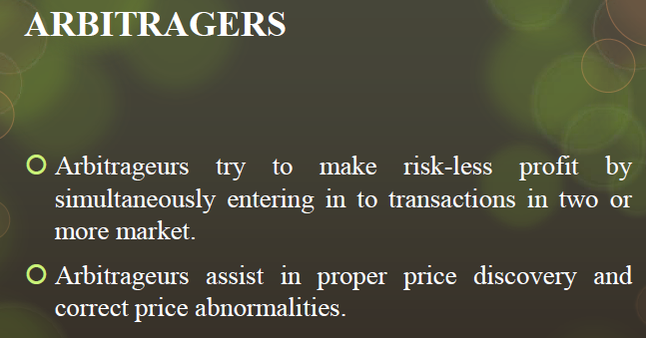

Slide 8
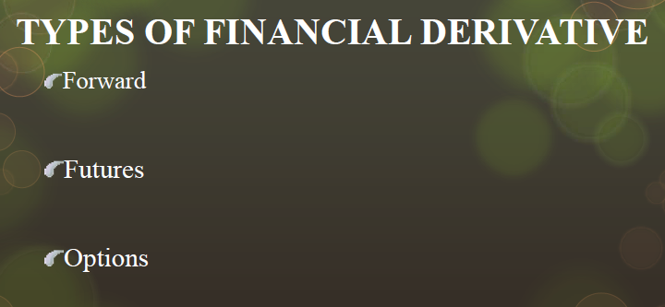
And SWAPS

Slide 9
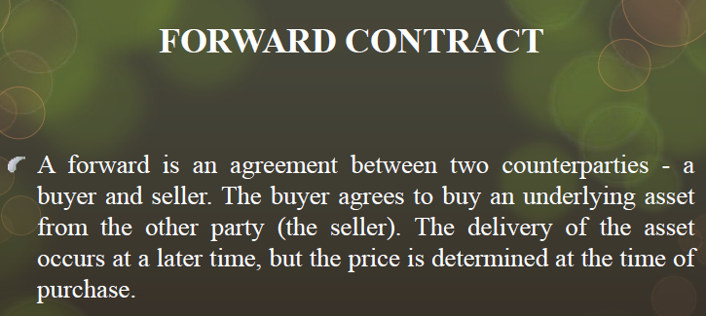
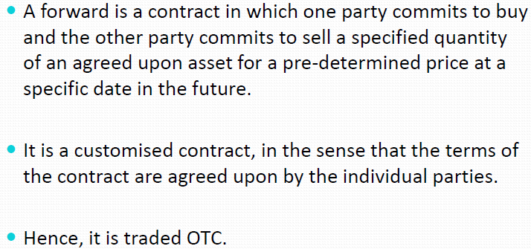

Slide 10
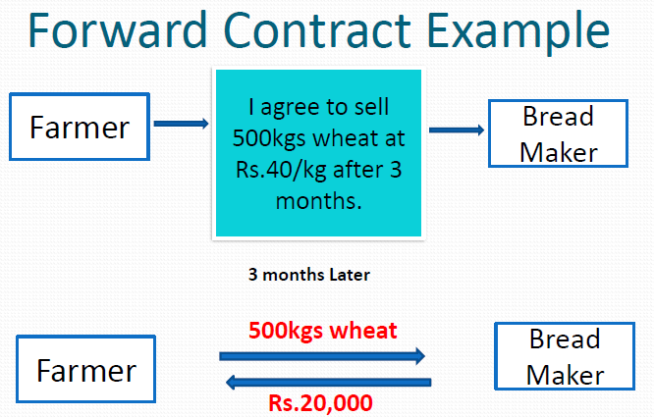

Slide 11
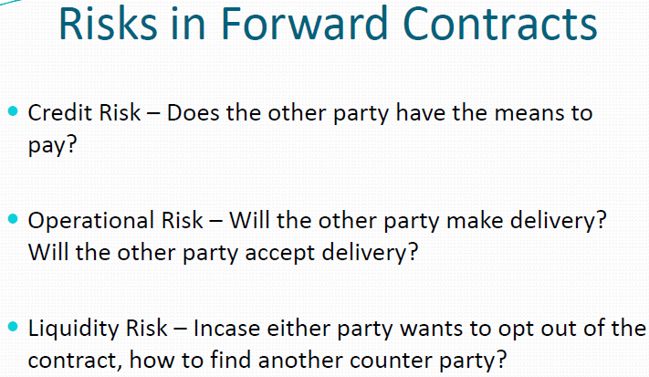
Forward contracting is valuable in hedging and speculation.

Slide 12
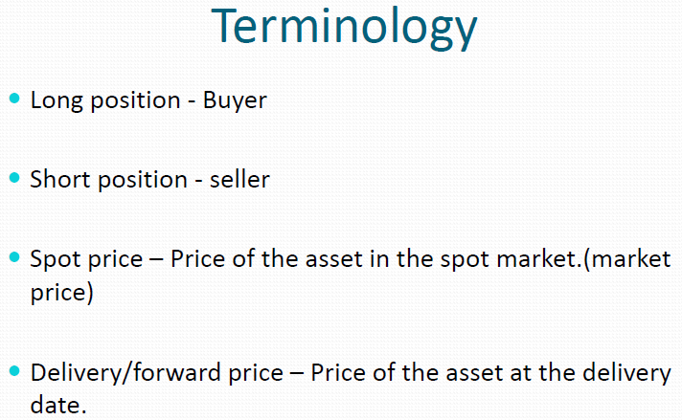

Slide 13
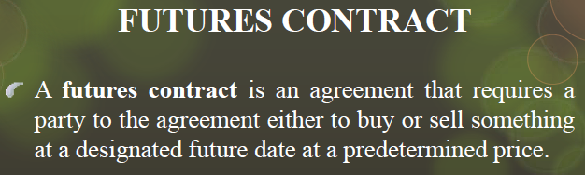
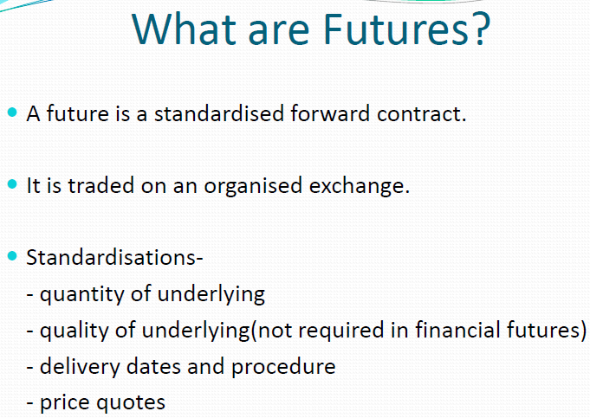

Slide 14
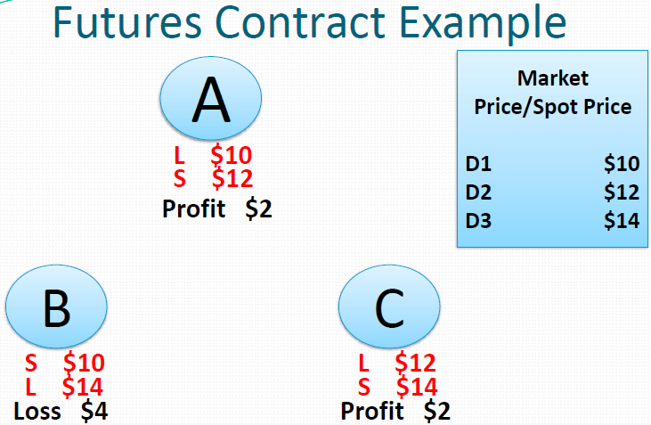

Slide 15
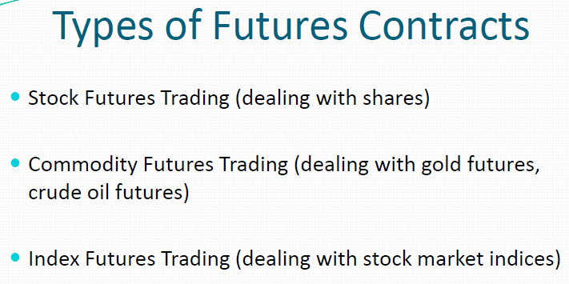

Slide 16
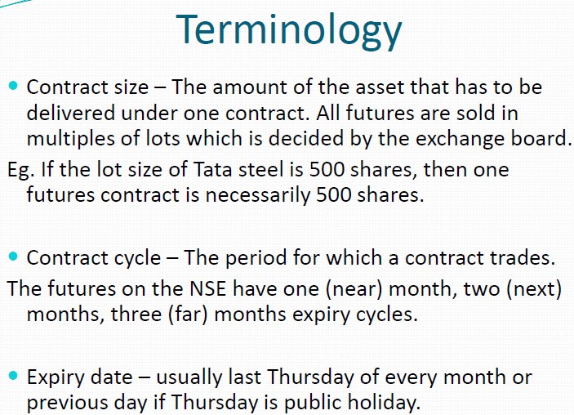
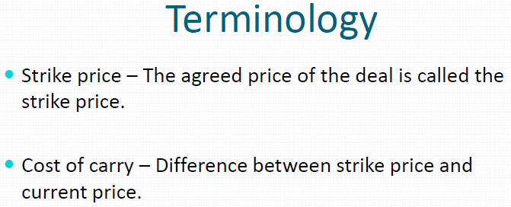

Slide 17
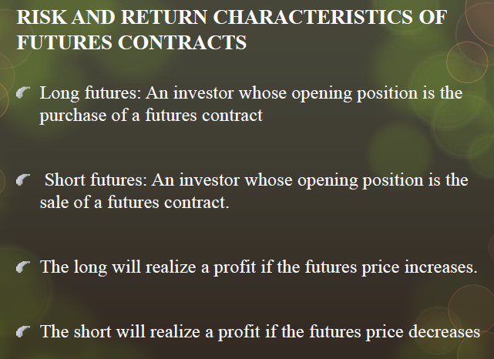

Slide 18
BASIS FOR COMPARISON | FORWARD CONTRACT | FUTURES CONTRACT
Meaning | Forward Contract is an agreement between parties to buy and sell the underlying asset at a specified date and agreed rate in future. | A contract in which the parties agree to exchange the asset for cash at a fixed price and at a future specified date, is known as future contract.
What is it? | It is a tailor made contract. | It is a standardized contract.
Traded on | Over the counter, i.e. there is no secondary market. | Organized stock exchange.
Settlement | On maturity date. | On a daily basis.
Risk | High | Low
Default | As they are private agreement, the chances of default are relatively high. | No such probability.
Size of contract | Depends on the contract terms. | Fixed
Collateral | Not required | Initial margin required.
Maturity | As per the terms of contract. | Predetermined date
Regulation | Self regulated | By stock exchange
Liquidity | Low | High

Slide 19
Options

Slide 20
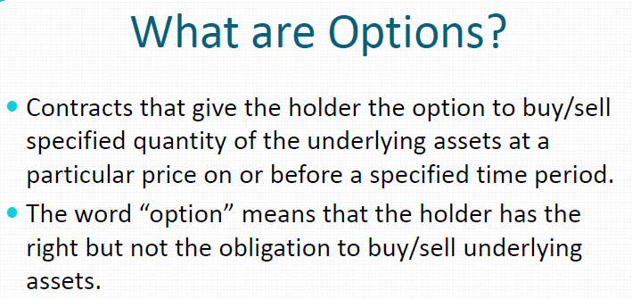

Slide 21
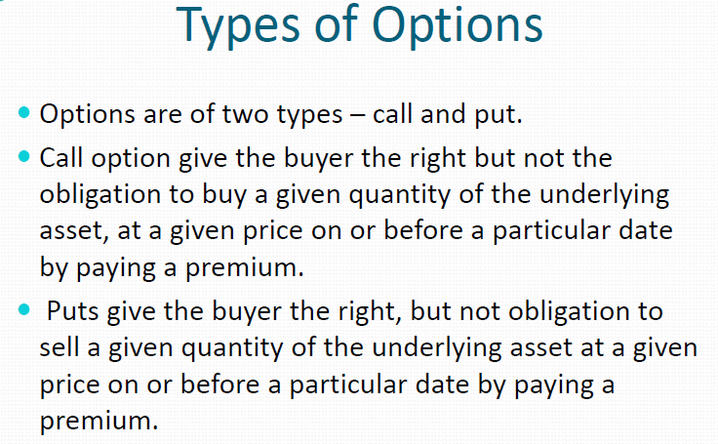

Slide 22
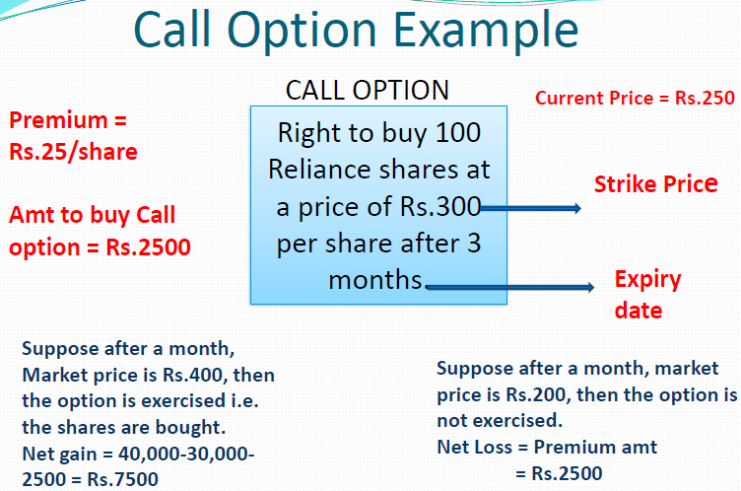

Slide 23
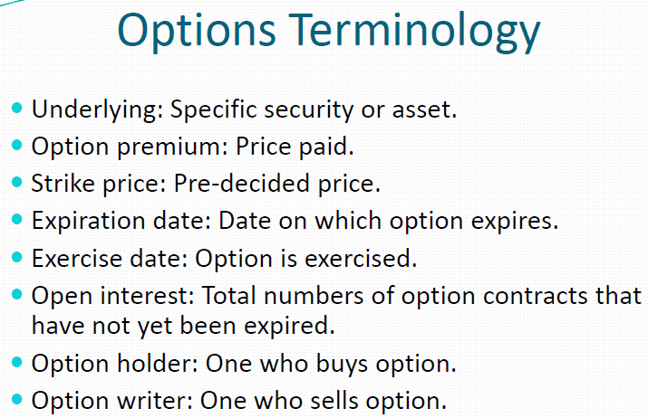

Slide 24
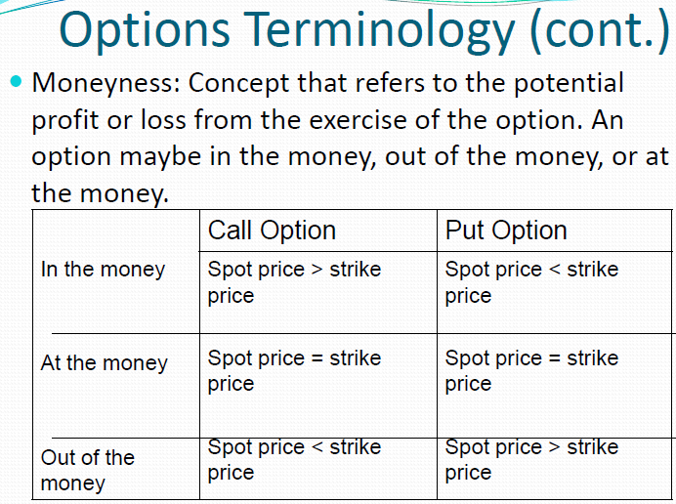

Slide 25
SWAPS

Slide 26
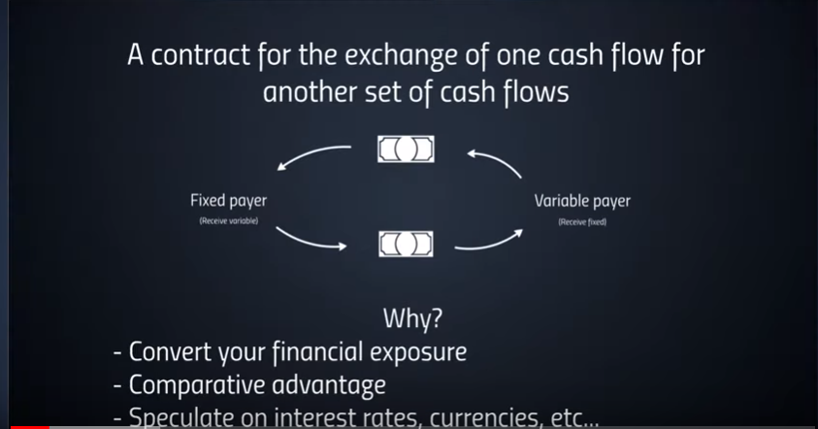
SWAPS

Slide 27
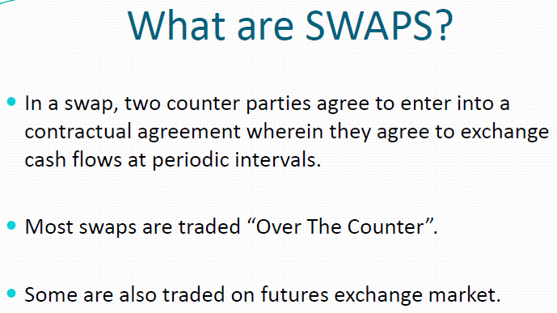

Slide 28
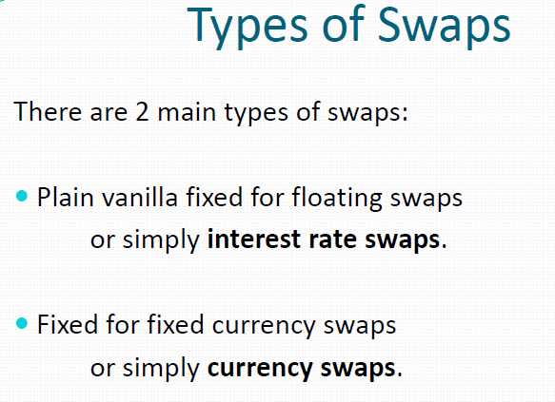

Slide 29
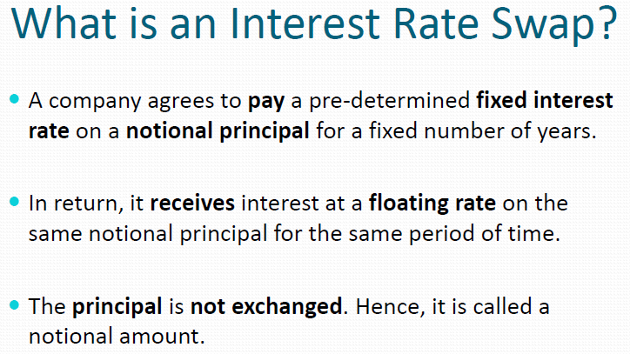

Slide 30
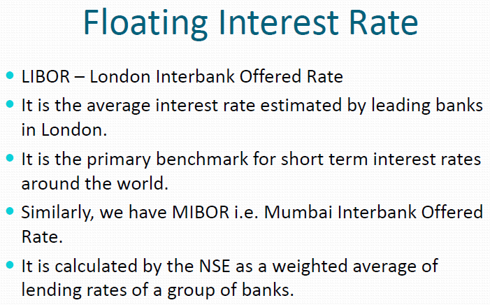

Slide 31
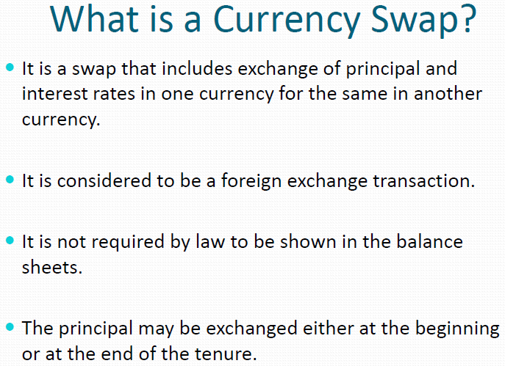

Slide 32
Thank you .

