Slide 1
Production/Operation Management
Chapter 1
Introduction to POM

Slide 2
1.1Definition of POM
It is the management of the five direct resources required for the production of goods/ services
Management: the process of planning, organizing, directing and controlling of organizational activities.
Direct resources: the 5 P’s i.e. people, plant, parts, processes, and planning and control systems.
Production/ goods and /or resources
By Yabibal A.

Slide 3
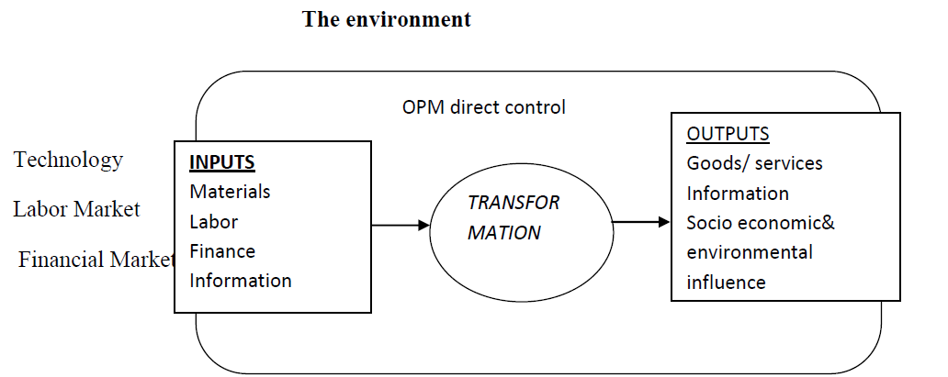
POM as a system
POM is a system in which the subsystems are to convert a set of inputs/ resources into outputs through a process called “transformation”.
By Yabibal A.

Slide 4
1.2 Manufacturing VS Service Operation
Manufacturing process
Service process
Physical output
Output can be inventoried
Low customer contact
Long response time
Capital intensive
Quality easily measured
Intangible output
Output cannot be inventoried
High customer contact
Short response time
Labor intensive
Quality not easily measured

Slide 5
Continued…
NB: Manufacturing and service operations are similar in “what is done” but different on “how it is done”.
Both involve design and operation.
We find them in an integrated way.
Example: A customer expects quality food with a quality service or a computer buyer expects a quality product with a reliable warranty and after sales service.
By Yabibal A.

Slide 6
1.3 Why OPM?
There are four major reasons to study POM.
1. It lies at the heart of business activities: It is one of the 3 most important functions
Finance – deals with getting capital and equity
OM – deals with the proper use of human and non-human resources to create products.
Marketing – selling and distributing those products
By Yabibal A.

Slide 7
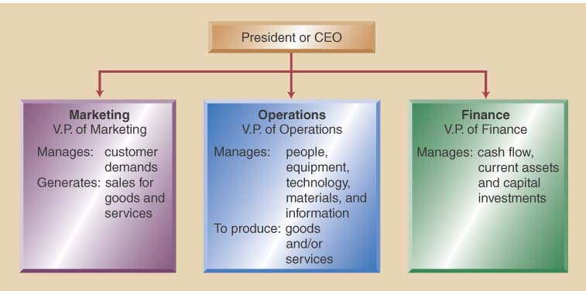
Typical organizational structure

Slide 8
Continued…
2. To know how goods and services are produced
3. Lucrative job opportunities under OM and
4. It is the most costly part of the firm.
By Yabibal A.

Slide 9
1.4 Historical evolution of POM
Division of labor/Specialization (Adam Smith, 1776): Assigning a task to an individual and this leads to greater productivity and efficiency.
Industrial revolution: James Watt invented the steam engine in 1785. The development of rail transportation facilitated the logistics of materials and people.
Standardization of parts (Eli Whitney, 1794): the era when the interchangeability of materials and parts introduced. He is a pioneer of proliferation.
By Yabibal A.

Slide 10
Continued…
Scientific study of work (F .W. Taylor, 1915): A work can be studied scientifically to improve labor efficiency through the following approaches:
Gathering data about each elements of the work and develop a standards.
Scientific selection and training of workers
Establishing good relationship between workers and the management
Separation of work and management
Human relation (Elton Mayo, 1930): Employees motivation and positive relationship between management and workers so that maximum productivity can be maintained.
By Yabibal A.

Slide 11
Continued…
Decision Model (E. W. Harris, 1930): Scientific decision making models such as EOQ formula, leaner Programming and others were introduced.
Computers (after 1950s): Computer Aided Design (CAD), Computer Aided Manufacturing (CAM), substitution of robots in complex, dangerous tasks.
By Yabibal A.

Slide 12
1.5 POM decision making areas
OM decisions can be broadly classified in to three.
1. Strategic decisions: these are long range plans and operating strategies related with the company’s product, process and facilities. Such decisions made collectively with other functional area representatives.
These include decisions related with the following
Product and service decision
Process technology decision
Long range capacity planning
Location decisions
Facility layout
By Yabibal A.

Slide 13
Continued…
2. Operating decisions: short term decisions about planning production to meet demand
These include decisions related with
Production planning systems /APP or MPS
Independent demand inventory system
Material requirement planning (MRP) and Capacity Requirement planning (CRP)
Shop-floor decisions/ short term decisions about what and when to produce at each work center
Planning and scheduling service operations
Just-in-time (JIT) manufacturing
Material management and purchasing
By Yabibal A.

Slide 14
Continued…
3. Control decisions: includes decisions about planning and controlling the day to day company’s operations.
These include decisions such as
Productivity of employees
Quality control
Planning and controlling projects
Maintenance management
By Yabibal A.

Slide 15
Steps in decision making
Step1. Defining the problem: Involves identification of variables that cause the problem (rather than symptoms of the problem).
Step2. Establishing decision criteria (Objectives): profit? Now a day’s corporate objectives are including growth and market share, employees satisfaction corporate social and environmental responsibility and others.
By Yabibal A.

Slide 16
Continued…
Step3. Formulation of decision model/s: models are abstractions of the real world.
Models can be;
Verbal models: describe the relationship between variable in words
Schematic models: pictorial (charts, graphs and diagrams) presentation of relationships among variables
Physical models: scaled down versions of the real product
Probabilistic models: relationship between variables presented with statistical probabilities (uncertainty).
Mathematical models: mathematical equations stating the relationship among variables.
By Yabibal A.

Slide 17
Continued…
Step4. Generating alternatives: by varying the parameters, the model developer can experiment the possible solutions.
Step5. Evaluation of alternatives:
Step6. Implementation and monitoring
By Yabibal A.

Slide 18


1.6 Productivity Measurement
The ratio of the products (goods and services) of an organization to the inputs consumed.
It is a measurement of how a firm effectively and efficiently converts its inputs in to outputs.
By Yabibal A.

Slide 19


Types of productivity measurements
Single factor/partial productivity: the ratio of output to a single factor
Multifactor productivity: the ratio of output to more than one input
By Yabibal A.

Slide 20

Continued…
3. Total factor productivity : the ratio of output to total input
By Yabibal A.

Slide 21
Continued…
Exercise: Bahir Dar textile factory produces fashionable garments. Employees receive a wage of $400 to produce a batch of 130 garments of which 30 were flawed. $700 and $300 are cost of raw materials and depreciation respectively. The unit price of fashionable garments is $100 and $50 for defectives.
Find the partial productivity of labor
Find the multifactor productivity of materials and depreciation
Find the total productivity
By Yabibal A.

Slide 22



Continued…
Solution:
The partial productivity of labor is;
The MFP of materials and depreciation is;
The total productivity is;
By Yabibal A.

Slide 23
Factors affecting productivity
1. Labor: the human resource which accounts 17% of productivity improvement.
Labor productivity influenced by working environment, employees’ performance and nature of the product.
2. Capital: this also accounts for 17% of productivity improvement.
Inflation and tax increases the cost of capital.
By Yabibal A.

Slide 24
Continued…
3. Management: is to make sure that labor and capital are used effectively.
It accounts for 66% of the percentage increase in productivity.
By Yabibal A.

Slide 25
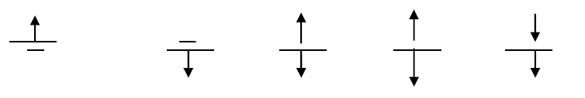
How to make productivity ratio large?
By Yabibal A.

Slide 26
Thank you!
Questions?

