Slide 1


Chapter 2
Analyzing the Marketing Environment

Slide 2
Marketing Environment
All the actors and forces influencing the company’s ability to transact business effectively with it’s target market.
Includes:
  Microenvironment - forces close to the company that affect its ability to serve its customers.
  Macro environment - larger societal forces that affect the whole microenvironment.

Slide 3
The Marketing Environment
Demographic
Company
Cultural
Economic
Company
Publics
Suppliers
Competitors
Customers
Political
Natural
Intermediaries
Technological

Slide 4
The Microenvironment
Company
Publics
Suppliers
Forces Affecting a
Company’s Ability to
Serve
Customers
Competitors
Intermediaries
Customers
Notes:
Microenvironmental Forces
Suppliers. Suppliers are the firms and persons that provide the resources
needed by the company and competitors to produce goods and services.
Company. Marketing plans must accommodate the needs of other
functional areas of the firm to coordinate product/service delivery effectively
(See following CTR and notes.
Competitors. Competitors are usually considered those companies also
serving a target market with similar products and services, although broader
definitions may apply.
Publics. Publics consist of any group that perceives itself having an interest
in the actions of the firm. Publics can have positive as well as negative
influences on the company's objectives.
Intermediaries. Intermediaries include various middlemen and distribution
firms as well as marketing service agencies and financial institutions.
Customers. Customers consist of consumer, industrial, reseller, government,
and international markets.

Slide 5
Preview
Marketing Environment
It is the actors and forces outside marketing that affect marketing management’s ability to build and maintain successful relationships with target customers.
Microenvironment
It consists of the actors close to the company that affect its ability to serve its customers, the company, suppliers, marketing intermediaries, customer markets, competitors, and publics.
Macroenvironment
The macroenvironment consists of the larger societal forces that affect the microenvironment—demographic, economic, natural, technological, political, and cultural forces.

Slide 6
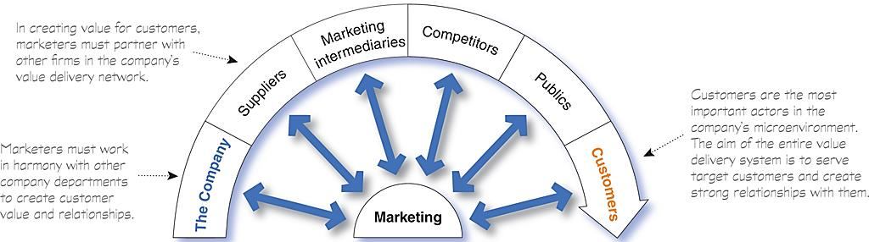
The Microenvironment
Marketing success requires building relationships with other company departments, suppliers, marketing intermediaries, competitors, various publics, and customers, which combine to make up the company’s value delivery network.

Slide 7
The Company
With marketing taking the lead, all departments—from manufacturing and finance to legal and human resources—share the responsibility for understanding customer needs and creating customer value.
Marketing management
Top management
finance
Research and development
purchasing
operations
accounting

Slide 8

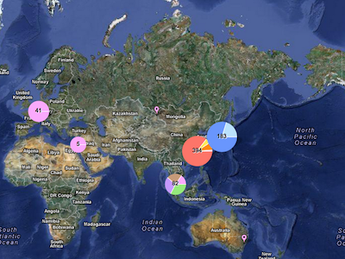
Suppliers
Suppliers provide the resources needed by the company to produce its goods and services.
Most marketers today treat their suppliers as partners in creating and delivering customer value.
Apple’s supplies in the world

Slide 9
Marketing Intermediaries
Marketing intermediaries help the company promote, sell, and distribute its products to final buyers.
Physical distribution firms help the company stock and move goods from their points of origin to their destinations.
Marketing services agencies are the marketing research firms, advertising agencies, media firms, and marketing consulting firms.
Financial intermediaries include banks, credit companies, insurance companies and other businesses that help finance transactions or insure against the risks associated with the buying and selling of goods.

Slide 10



Competitors
Marketers also must gain strategic advantage by positioning their offerings strongly against competitors’ offerings in the minds of consumers.
Each firm should consider its own size and industry position compared to those of its competitors.
V.S

Slide 11
Internal publics
This group includes workers, managers, volunteers, and the board of directors.
Local Publics
This group includes neighborhood residents and community organizations.
Large companies usually create departments and programs that deal with local community issues and provide community support.
Citizen-action publics
A company’s marketing decisions may be questioned by consumer organizations, environmental groups, minority groups, and others.
Its public relations department can help it stay in touch with consumer and citizen groups.
General public
A company needs to be concerned about the general public’s attitude toward its products and activities.
The public’s image of the company affects its buying.

Slide 12
Publics
Financial publics
Influences the company’s ability to obtain funds
Banks, investment analysts, and stockholders are the major financial publics.
A public is any group that has an actual or potential interest in or impact on an organization’s ability to achieve its objectives.
We can identify seven types of publics:
Media publics
Carries news, features, and editorial opinion.
It includes newspapers, magazines, television stations, and blogs and other Internet media.
Government Publics
Management must take government developments into account.
Marketers must often consult the company’s lawyers on issues of product safety, truth in advertising, and other matters.

Slide 13
Customers
Consist of individuals and households that buy goods and services for personal consumption.
Consist of these buyers in other countries, including customers, producers, resellers, and governments
Buy goods and services for further processing or use in their production processes
The company might target any or all five types of customer markets:
Consumer markets
Business markets
Reseller markets
Government markets
International markets
Consist of government agencies that buy goods and services to produce public services or transfer the goods and services to others who need them.
Buy goods and services to resell at a profit.

Slide 14
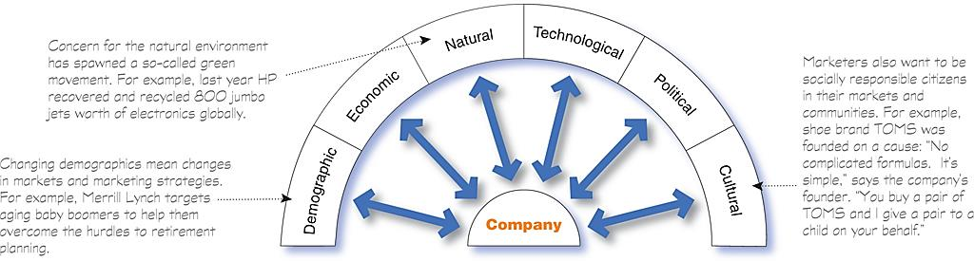
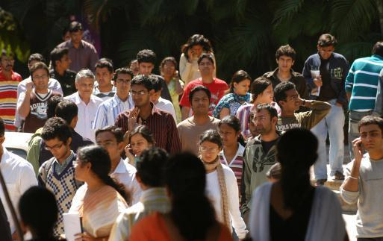
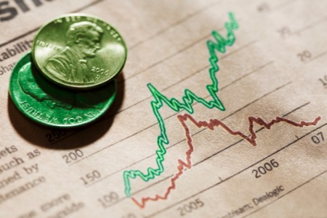
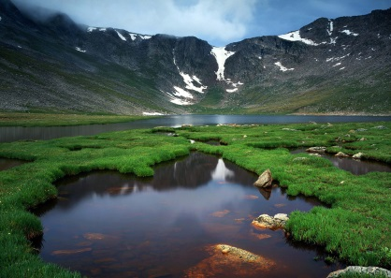


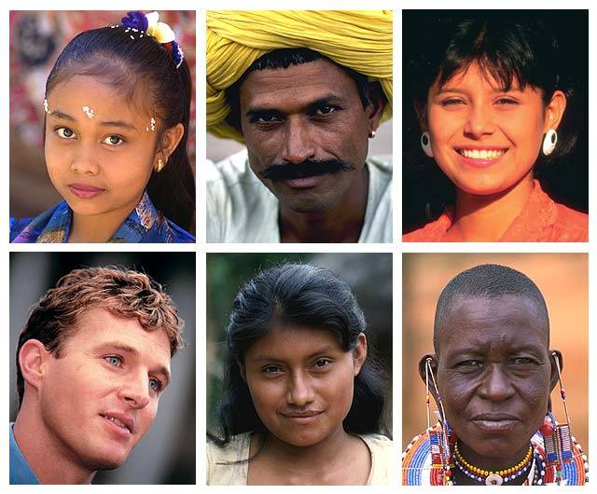
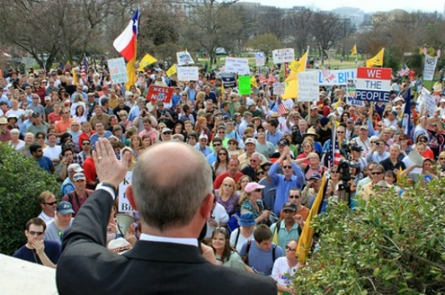
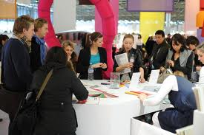

The Macroenvironment

Slide 15
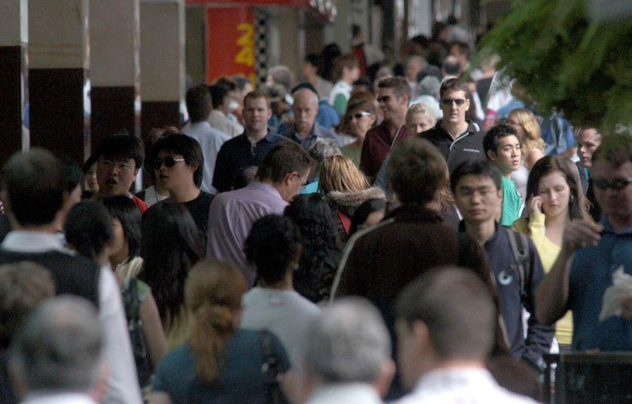
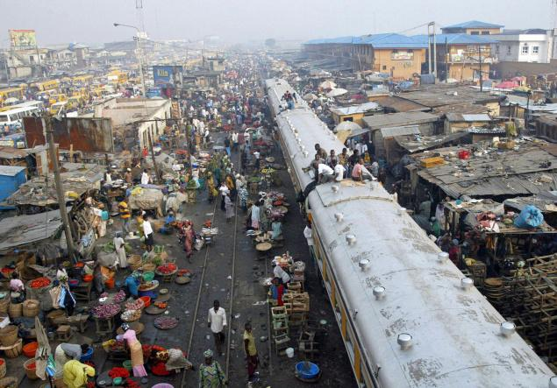
The Demographic Environment
Demography is the study of human populations in terms of size, density, location, age, gender, race, occupation, and other statistics.

Slide 16
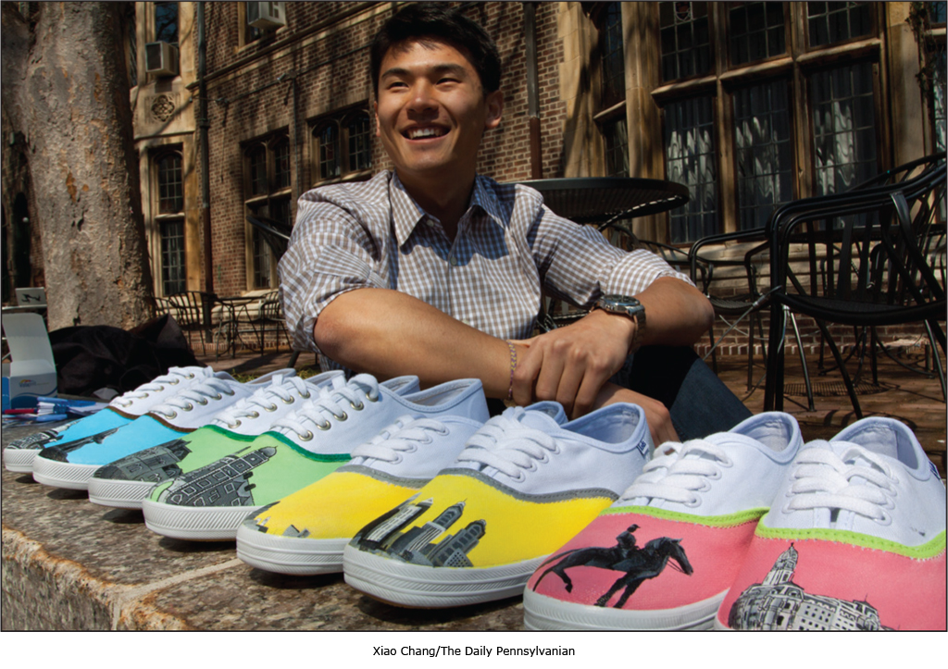

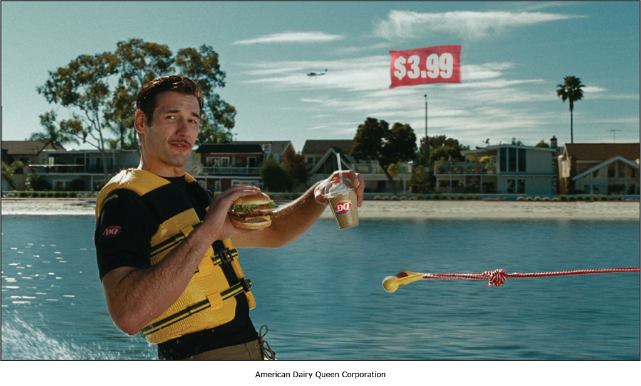
The Changing Age Structure of the Population
Generation X
The Baby Boomers
Millennials (Generation Y)
Generational Marketing
The baby boom was followed by a “birth dearth,” creating another
generation of 49 million people born between 1965 and 1976.
Author Douglas Coupland calls them Generation X because they lie
in the shadow of the boomers and lack obvious distinguishing
characteristics.
Baby boomers
Generation Y
Generation X
The post-World War II baby boom produced 78 million baby
boomers, who were born between 1946 and 1964. Over the years,
The baby boomers have been one of the most powerful forces
shaping the marketing environment.
Marketers often split the baby boomers into three smaller groups—
leading-edge boomers, core boomers, and trailing-edge boomers—
each with its own beliefs and behaviors. Similarly, they split the
Millennials into teens and young adults.
Born between 1977 and 2000, these children of the baby boomers number 83 million or more, dwarfing the Gen Xers and becoming larger even than the baby boomer segment. One thing that Millennials have in common is their utter fluency and comfort with digital technology.
From a marketing standpoint, the Gen Xers are a more skeptical
bunch. They tend to research products before they consider a
purchase, prefer quality to quantity, and tend to be less receptive
to overt marketing pitches.
The youngest boomers are now moving into their fifties; the oldest
are in their late sixties and entering retirement. The maturing
Boomers are rethinking the purpose and value of their work,
resposibilities, and relationships.
Thus, marketers need to form more precise age-specific
segments within each group. More important, defining people
by their birth date may be less effective than segmenting
them by their lifestyle, life stage, or the common values they
seek in the products they buy.
The first to grow up in the Internet era, Generation X is a highly
connected generation that embraces the benefits of new technology.
They are increasingly displacing the lifestyles, culture, and values
of the baby boomers.

Slide 17
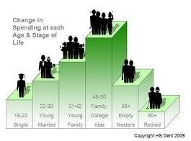


The Changing Family structure
More people are:
  Divorcing or separating
  Choosing not to marry
  Choosing to marry later
  Marrying without intending to have children
  Increasing number of working women
  Increasing number of stay-at-home dads

Slide 18


Geographic Shifts Population
The shift in where people live has also caused a shift in where they work.
For example, the migration toward micropolitan and suburban areas has resulted in a rapid increase in the number of people who “telecommute”—work at home or in a remote office and conduct their business by phone or the Internet.
This trend, in turn, has created a booming SOHO (small office/home office) market.

Slide 19



A Better-Educated, More White-Collar, More Professional Population
Changes in the Workforce
  More educated
  More white collar

Slide 20
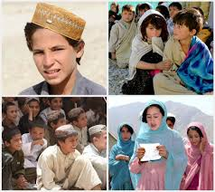
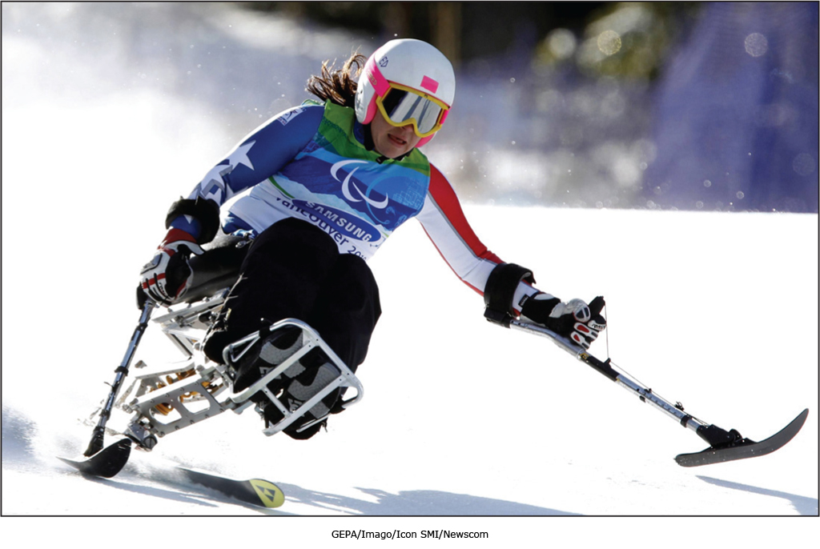

Increasing Diversity
Markets are becoming more diverse
  International
  National
Includes:
  Ethnicity
  Gay and lesbian
  Disabled

Slide 21
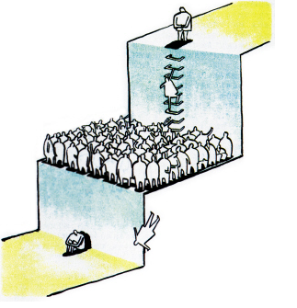
The Economic Environment
The economic environment consists of economic factors that affect consumer purchasing power and spending patterns.
Some countries have industrial economies, which constitute rich markets for many different kinds of goods.
At the other extreme are subsistence economies; they consume most of their own agricultural and industrial output and offer few market opportunities.
In between are developing economies that can offer outstanding marketing opportunities for the right kinds of products.

Slide 22
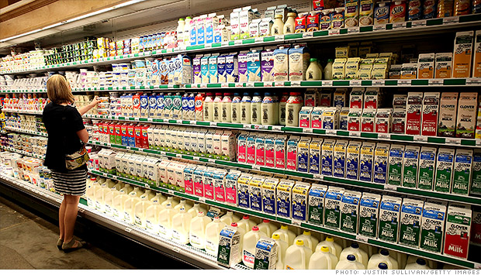
Changes in Consumer Spending
In turn, value marketing has become the watchword for many marketers.
Marketers in all industries are looking for ways to offer today’s more financially frugal buyers greater value—just the right combination of product quality and good service at a fair price.

Slide 23
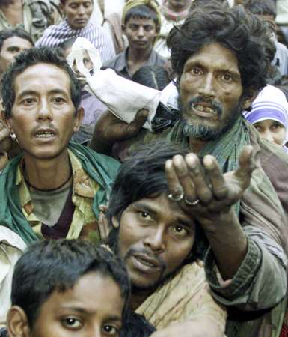
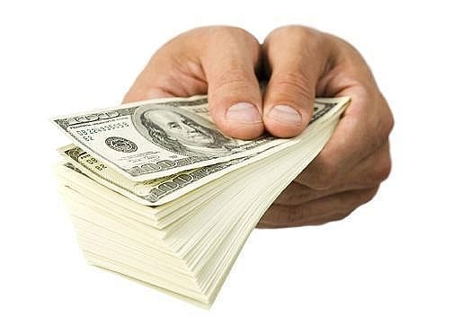
Income Distribution
Marketers should pay attention to income distribution as well as income levels.
Over the past several decades, the rich have grown richer, the middle class has shrunk, and the poor have remained poor.

Slide 24
The Natural Environment
The natural environment involves the physical environment and the natural resources that are needed as inputs by marketers or that are affected by marketing activities.
Marketers should be aware of several trends:
  Increased shortages of raw materials
  Increased pollution
  Increased government intervention
The environmental sustainability is the developing strategies and practices that create a world economy that the planet can support indefinitely.

Slide 25


The Technological Environment
The technological environment is perhaps the most dramatic force now shaping our destiny.
Marketers should watch the technological environment closely. Companies that do not keep up will soon find their products outdated. If that happens, they will miss new product and market opportunities.

Slide 26

The Political and Social Environment
The political environment consists of laws, government agencies, and pressure groups that influence or limit various organizations and individuals in a given society.

Slide 27

Legislation Regulating Business
Business legislation has been enacted for a number of reasons:
  Protect companies from each other
  Protect consumers from unfair business practices
  Protect the interests of society against unrestrained business behavior.

Slide 28
Increased Emphasis on Ethics and Socially Responsible Actions
Socially Responsible Behavior:
  Enlightened companies encourage their managers to look beyond what the regulatory system allows and simply “do the right thing.”
  These socially responsible firms actively seek out ways to protect the long-run interests of their consumers and the environment.

Slide 29
Increased Emphasis on Ethics and Socially Responsible Actions
Caused-Related Marketing:
  Cause-related marketing has become a primary form of corporate giving. It lets companies “do well by doing good” by linking purchases of the company’s products or services with benefiting worthwhile causes or charitable organizations.
  It has some controversy. Critics worry that cause-related marketing is more a strategy for selling than a strategy for giving ─ that “cause related” marketing is really “cause-exploitative” marketing.

Slide 30
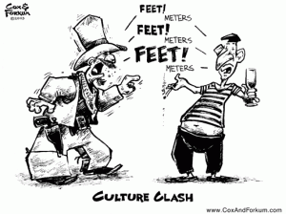
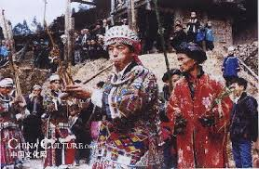

The Cultural Environment
Cultural environment consists of institutions and other forces that affect a society’s basic values, perceptions, preferences, and behaviors

Slide 31
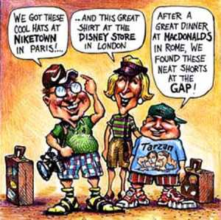


The Persistence of Cultural Values
People in a given society hold many beliefs and values. Their core beliefs and values have a high degree of persistence.
Secondary beliefs and values are more open to change. Believing in marriage is a core belief; believing that people should get married early in life is a secondary belief.
Marketers have some chance of changing secondary values but little chance of changing core values.

Slide 32


Shifts in Secondary Cultural Values
People’s Views of Themselves.
  People vary in their emphasis on serving themselves versus serving others.
  People use products, brands, and services as a means of self-expression, and they buy products and services that match their views of themselves.

Slide 33
Shifts in Secondary Cultural Values
People’s Views of Organizations.
  In recent years, some analysts have voiced concerns that the Internet age would result in diminished human interaction, as people buried their heads in their computers or e-mailed and texted rather than interacting personally.
  Instead, today’s digital technologies seem to have launched an era of what one trend watcher calls “mass mingling.”
  Rather than interacting less, people are using online social media and mobile communications to connect more than ever.
  And, often, more online and mobile interactions result in more offline mingling

Slide 34
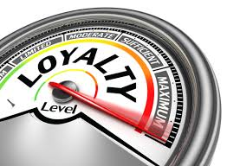
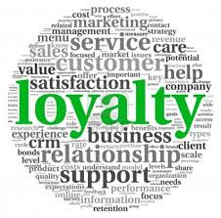
Shifts in Secondary Cultural Values
People’s Views of Organizations.
  People vary in their attitudes toward corporations, government agencies, trade unions, universities, and other organizations.
  The past two decades have seen a sharp decrease in confidence in and loyalty toward America’s business and political organizations and institutions.
  Many people today see work not as a source of satisfaction but as a required chore to earn money to enjoy their non-work hours.
  This trend suggests that organizations need to find new ways to win consumer and employee confidence.

Slide 35
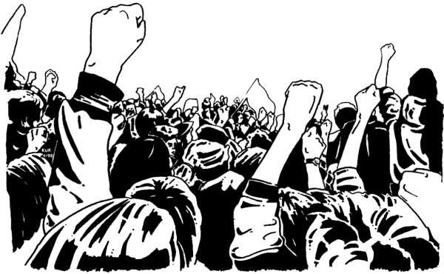

Shifts in Secondary Cultural Values
People’s Views of Society.
  People vary in their attitudes toward their society—patriots defend it, reformers want to change it, and malcontents want to leave it.
  People’s orientation to their society influences their consumption patterns and attitudes toward the marketplace.
  Marketers respond with patriotic products and promotions, offering everything from orange juice to clothing to cars with patriotic themes.

Slide 36

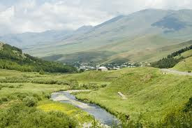
Shifts in Secondary Cultural Values
People’s Views of Nature.
  People vary in their attitudes toward the natural world—some feel ruled by it, others feel in harmony with it, and still others seek to master it.
  A long-term trend has been people’s growing mastery over nature through technology and the belief that nature is bountiful.
  More recently, however, people have recognized that nature is finite and fragile; it can be destroyed or spoiled by human activities.

Slide 37
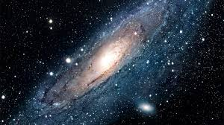

Shifts in Secondary Cultural Values
People’s Views of Universe.
  People vary in their beliefs about the origin of the universe and their place in it.
  In recent years, some futurists have noted a renewed interest in spirituality, perhaps as a part of a broader search for a new inner purpose.
  This affects consumers in everything from television shows they watch and the books they read to the products and services they buy.

Slide 38

The End

