Slide 2
Chapter 7
Supply Chain, Procurement and Logistics Management

Slide 3
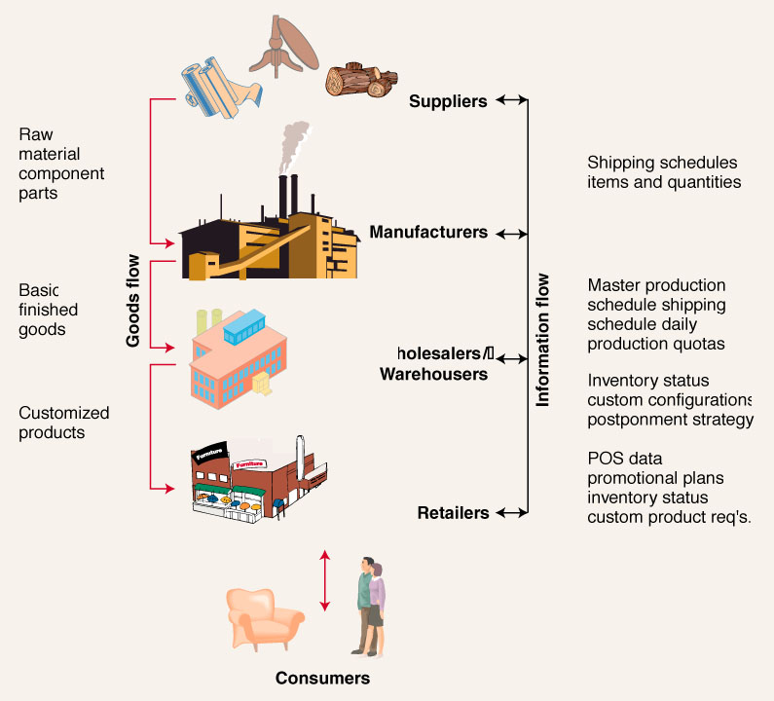
A Basic Supply Chain

Slide 4
Supply Chain Management
Supply Chain Management entails:
  Making decisions regarding the structure of the supply chain
  Coordinating the movement of goods and delivery of services
  Sharing information between members of the supply chain.

Slide 5
SCM Factors
SCM must consider the following trends, improved capabilities, & realities:
  Consumer Expectations and Competition – power has shifted to the consumer
  Globalization – capitalize on emerging markets
  Information Technology – e-commerce, Internet, EDI, scanning data, intranets
  Government Regulations - like trade barriers
  Environment Issues – e.g. waste minimization

Slide 6
Components of a
Typical Supply Chain
External
Suppliers
Internal
Functions
External
Distributors
INFORMATION

Slide 7
External Suppliers
External suppliers provide the necessary raw materials, services, and component parts.
Purchased materials & services frequently represent 50% (or more) of the costs of goods sold.
Suppliers are frequently members of several supply chains – often in different roles.

Slide 8
External Suppliers
Tier one suppliers:
  Directly supplies materials or services to the firm that does business with the final customer
Tier two suppliers:
  Provides materials or services to tier one suppliers
Tier three suppliers:
  Providers materials or services to tier two suppliers

Slide 9
Internal Functions
Vary by industry & firm, but might include:
  Processing
  Purchasing
  Production Planning & Control
  Quality Assurance
  Shipping

Slide 10
Logistics & Distribution
Logistics: getting the right material to the right place at the right time in the right quantity:
  Traffic Management:
    The selection, scheduling & control of carriers (e.g.: trucks & rail) for both incoming & outgoing materials & products
  Distribution Management:
    The packaging, storing & handling of products in transit to the end-user.

Slide 11
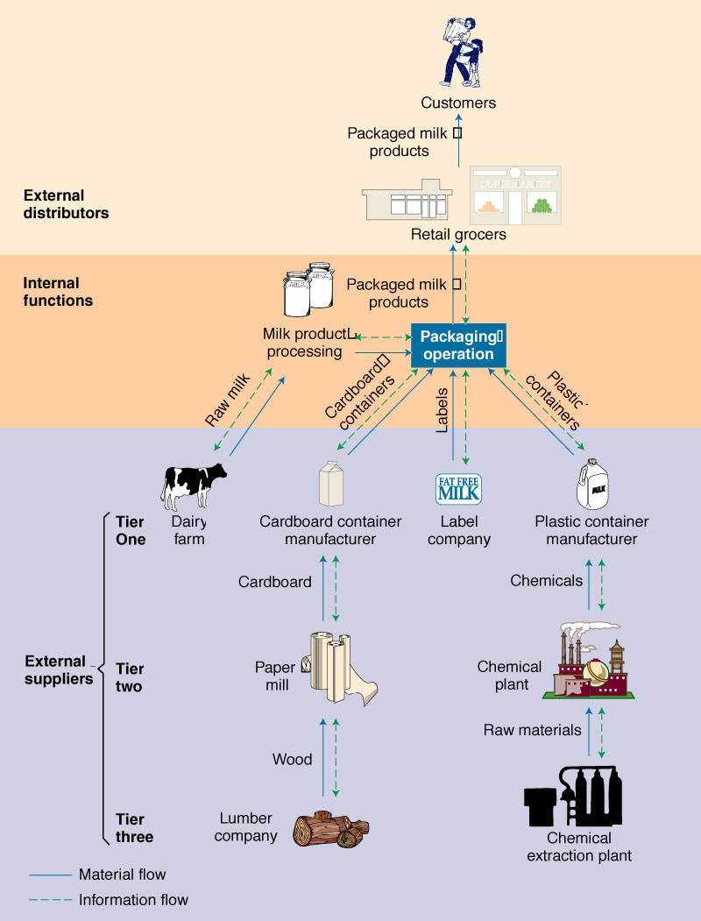
Dairy Products Supply Chain

Slide 12
Vertical Integration
A measure of how much of the supply chain is controlled by the manufacturer.
  Backward integration:
    Acquiring control of raw material suppliers.
  Forward integration:
    Acquiring control of distribution channels.

Slide 13
Outsourcing
Entails paying third-party suppliers to provide raw materials and services, rather than making them in-house.
Outsourcing is increasing as many firms try to focus their internal operations on what they do best.

Slide 14
Insourcing vs. Outsourcing
What questions need to be asked before sourcing decisions are made?
  Is product/service technology critical to firm’s success?
  Is operation a core competency?
  Do you have the capital to provide capacity & keep the process current?
  Will outsourcing extend lead times and limit flexibility?
  Can others do it for less cost and better quality?

Slide 15
Purchasing’s Role in SCM
Purchasing role has attained increased importance since material costs represent 50-60% of cost of goods sold
  Ethics considerations
  Developing supplier relationships
  Determining how many suppliers
  Developing partnerships
Industry trend is to a much smaller supplier base. Why?

Slide 16
Partnering with Suppliers
Involves developing a long-term, mutually-beneficial relationship:
  Requires trust to share information, risk, opportunities, & investing in compatible technology
  Work together to reduce waste and inefficiency & develop new products
  Agree to share the gains

Slide 17
Supplier Relationships and JIT
Use single-source suppliers when possible
Build long-term relationships
Work together to certify processes
Co-locate facilities to reduce transport if possible
Stabilize delivery schedules
Share cost & other information
Early involvement during new product designs

Slide 18
The Role of Warehouses
General Warehouses:
  Used for long-term storage of goods
Distribution Warehouses:
  Transportation consolidation:
    Consolidate LTL into TL deliveries
  Product mixing & blending:
    Group multiple items from various suppliers
  Improve service:
    Reduced response time
    Allow for last-minute customization

Slide 19
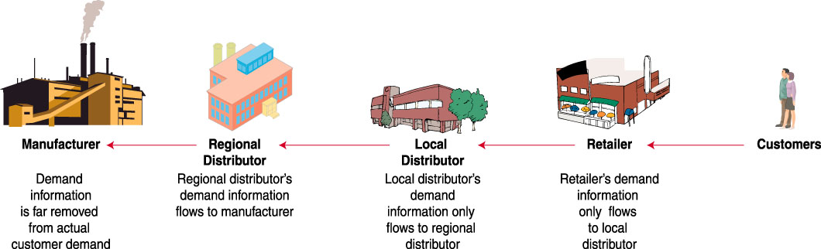
Information Flow in Supply Chains

Slide 20
Information Sharing
Supply chain partners can benefit by sharing information on sales, demand forecasts, inventory levels & marketing campaigns
Inaccurate or distorted information leads to the Bullwhip Effect

Slide 21
The Bullwhip Effect
If information isn’t shared, everyone has to guess what is going on downstream.
Guessing wrong leads to too much or too little inventory:
  If too much, firms hold off buying more until inventories fall (leading suppliers to think demand has fallen).
  If too little, firms demand a rush order & order more than usual to avoid being caught short in the future (leading suppliers to think demand has risen).

Slide 22
Short-Circuit the Bullwhip
Make information transparent:
  Use Electronic Data Interchange (EDI) to support Just-In-Time supplier replenishment
  Use bar codes & electronic scanning to capture & share point-of-sale data
Eliminate wholesale price promotions & quantity discounts

Slide 23
Electronic Data Interchange
The most common method of using computer-to-computer links to exchange data between supply chain partners in a standardized format.
Benefits include:
  Quick transfer of information
  Reduced paperwork & administration
  Improved data accuracy & tracking capability

Slide 24
Integrated SCM
Implementing integrated SCM requires:
  Analyzing the whole supply chain
  Starting by integrating internal functions first
  Integrating external suppliers through partnerships
Possible Supply Chain Objectives
  Reduce costs, improve quality
  Reduce lead time and inventory
  Reduce time to market
  Increase sales
  Improve demand data/forecasting
24

