Slide 1
Chapter 1: Introduction
The main content of the chapter are:
    The Project concepts
    The project Cycle

Slide 2
Cont…,
The objectives of this chapter is to familiarizes the students with:
  D/t concepts of the Project
  The project Cycle

Slide 3
The Project concepts
Project is the group of activities that are planned and executed in a certain sequence to create a unique product and services. Or
It is a complex set of economic activities in which scarce resources are committed in expectation of benefits that exceed the costs of resources consumed.

Slide 4
Cont...,
A project is also defined as “a temporary endeavor undertaken to create or provide a unique Goods or Services.
A project involves the investment of scarce resources (physical, financial, and human) in the expectation of future benefits.
It is a group of tasks performed in a definable time period in order to meet a specific set of objectives.

Slide 5
Cont...,
Projects are said to be desirable if their benefits are greater than the costs incurred on them.
Projects can be: public, private, small, large, agricultural, industrial, etc.

Slide 6
Cont.…,
Project is a conversion process which serves in transforming inputs into outputs.
Constraint
Project
Input
Output
Mechanism

Slide 7
Basic characteristics of a project
Regardless of the size of a project, projects have common characteristics.
Some of these characteristics are:
    A project has a unique purpose
    A project is temporary.
    A project is developed using progressive elaboration.

Slide 8
Cont.…,
    A project requires resources, often from various areas.
    A project should have a primary customer or sponsor.
    Have definite location and target group (beneficiaries).
    A project involves uncertainty.

Slide 9
Classification of project /capital investment/
Projects may be classified into:
  Development projects
  Business projects

Slide 10
Difficulties of capital investment
Although capital investments are so important, they are not without difficulties.
These difficulties may arise from two major sources; namely,
  Measurement problems
  Uncertainty :It is impossible to predict exactly what will happen in the future.

Slide 11
Project success criteria (Parameters)
During a project’s life, project management should give attention to three basic parameters: quality, cost and time.
A successfully managed project is one that is completed at the specified level of quality; on or before the deadline; and within the budget.
Whatever its size, a project’s success is based on these three main criteria.

Slide 12
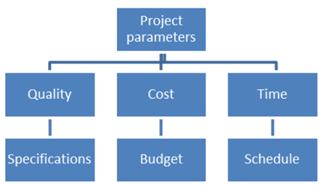
Cont...,

Slide 13
Cont...,
Therefore, project will suppose to be successful if it:
  Delivers the outcome with an agreed upon quality.
  Does not overrun its end date.
  Remains within budget (cost of resources).

Slide 14
Cont...,
In addition, client satisfaction will indicate success and possibility for replication or sustainability.
Generally, to create a successful project, a project manager must consider;
Scope: What work will be done or what unique product, service?
Time: How long should it take to complete the project?
What is the project’s schedule?

Slide 15
Cont...,
Cost: What should it cost to complete the project? Or
What is the project’s budget?
Quality: How good does the quality of the products or services need to be?
What do we need to do to satisfy the customer?
Risk: How much risks are we willing to accept on the project?

Slide 16
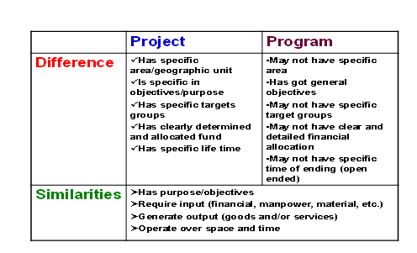
Project and Program

Slide 17
1.2 The project Cycle
Project cycle refers to the various stages through which project planning proceeds from the inception to implementation. Or,
it is the life cycle through which a project advances from infancy to maturity.
The main features of this cycle are information gathering, analysis, and decision–making.

Slide 18
See the following diagram:

Slide 19
1. Project identification
In this stage, projects that can contribute towards achieving the specified objectives are identified (listed).
Project ideas may come from:
    Local leaders
    Entrepreneurs
    Government policy and plans
    Replication of successful project tested elsewhere
    Other sources

Slide 20
2. Project preparation and analysis
Once project ideas have been identified the process of project preparation and analysis starts.
Project preparation must cover the full range of technical, institutional, economic, and financial conditions necessary to achieve the project’s objective.
Critical element of project preparation is identifying and comparing technical and institutional alternatives for achieving the project’s objectives.

Slide 21
Cont…,
D/t alternatives may be available and therefore, resource endowment (labor or capital) would have to be considered in the preparation of projects.
It involves generally two steps:
    Pre-feasibility studies
    Feasibility studies

Slide 22
Cont…,
Pre-feasibility Study
At the pre-feasibility study stage the analyst obtains approximate valuation of the major components of the projects costs and benefits.
Using this preliminary data a preliminary financial and economic analysis will be conducted.

Slide 23
Cont…,
If the project appear viable form in this preliminary assessment, the analysis will be carried to the feasibly stage.
Feasibility Study
The major d/ce b/n the pre-feasibility and feasibility studies is the amount of work required in order to determine whether a project is likely to be viable or not.

Slide 24
Cost…,
If the preliminary screening suggests that the project is prima facie worthwhile, a detailed analysis of the marketing, technical, financial, economic, and ecological aspects will undertaken.
The focus of this phase of capital budgeting is on gathering, preparing, and summarizing relevant information about various project proposals, which are being considered for inclusion in the capital investment.

Slide 25
Cont…,
At this stage a team of specialists (i.e. engineers, economists, scientists, sociologists & etc.) will need to work together.
At this stage more accurate data need to be obtained and the final product of this stage is a feasibility report.
The feasibility report should contain the following elements/ aspect:

Slide 26
Technical Aspects
This may include the works of engineers, soil scientists and agronomists in case of, say, agricultural projects.
Is concerned with the technology of production and processing.
Poor technical analysis would eventually lead to spurious cost and benefit estimates.
Therefore, coordination of creative, committed and competent specialists from d/t fields are needed.

Slide 27
2. Market Aspects
This aspect analysis needs to ensure the existence of effective demand at remunerative price.
Similar arrangements need to be done on the input side too (input supplies).

Slide 28
3. Institutional-Organizational-Managerial Aspects
This is about detail analysis of project organization and management.
The project should be implemented by competent, responsible and committed managers.

Slide 29
4.Financial Aspects
Financial analysis seeks to determine whether the proposed project will be financially viable or not.
This analysis will be the basis for evaluating the project profitability.
Project profitability depends on a comparison of costs versus revenues.

Slide 30
5. Economic Aspects
This is about the social costs and benefits of a project, which may often be different from its monetary or financial costs, and benefits. The financial analysis views
the project from the participants (or owners) point of view, while the economic analysis form the society’s point of view.

Slide 31
6. Social Aspects
This is about examine the broader social implications of the proposed project.
The social aspect analysis should address the income distribution implications of a project and aspect of employment opportunities & etc.

Slide 32
7. Environmental aspect analysis
In recent years environmental concerns have assumed a great deal of significance.
This assessment is about effect of a project on the world of animals, plants, water, air, and humans existing in the project area.

Slide 33
3. Project Appraisal
A The prime objective of project appraisal should be to identify the weaknesses and identify means of strengthening it adequately to ensure final success of the project.
The main objective is then to improve the project.

Slide 34
4. Project implementation
It is the stage at which the conclusions are reached & decisions made are put into action.
Some of the major activities in during project implementation phase include:
    Detailed designs;
    Tender documents are prepared;
    Bids are evaluated,

Slide 35
Cont…,
    Contracts are signed; workers are hired, training;
    Materials are moved to sites & etc.
5. Project Evaluation
Implementation phase is followed by supervision and follow up.
The execution of the project should be supervised closely and progress should be reported regularly.

Slide 36
Cont…,
Project evaluation is a monitoring (checking) activity in order to:
    Find out how things are going
    Encourage the project team
    Check that promised resources are in fact working on project tasks
    Rapidly learn about concerns and difficulties

Slide 37
Cont…,
    Show concern for the success of the project
    Take corrective action if things go wrong
The project management, the sponsoring agency, or other bodies may do the evaluation.

