Slide 1
Introduction
DTU
2019/20
ECONOMETRICS

Slide 2
  1.1. Definition and Scope of Econometrics
The economic theories we learn in various economics courses suggest many relationships among economic variables. For instance the relationship between:
    Quantity demand and price
    Consumption and income
    Investment and rate of interest,
    Unemployment and inflation etc
Many econometricians used different ways of wordings to define econometrics. But, the concept are the same: ‘metrics’ means “measurement”. Hence, Econometrics deals with the measurement of economic relationships.

Slide 3
Cont.….
Econometrics may be considered as the integration of economics, mathematics, and statistics for the purpose of providing numerical values for the parameters of economic relationships and verifying economic theories.
However, it is completely distinct from each one of these three branches of science.

Slide 4
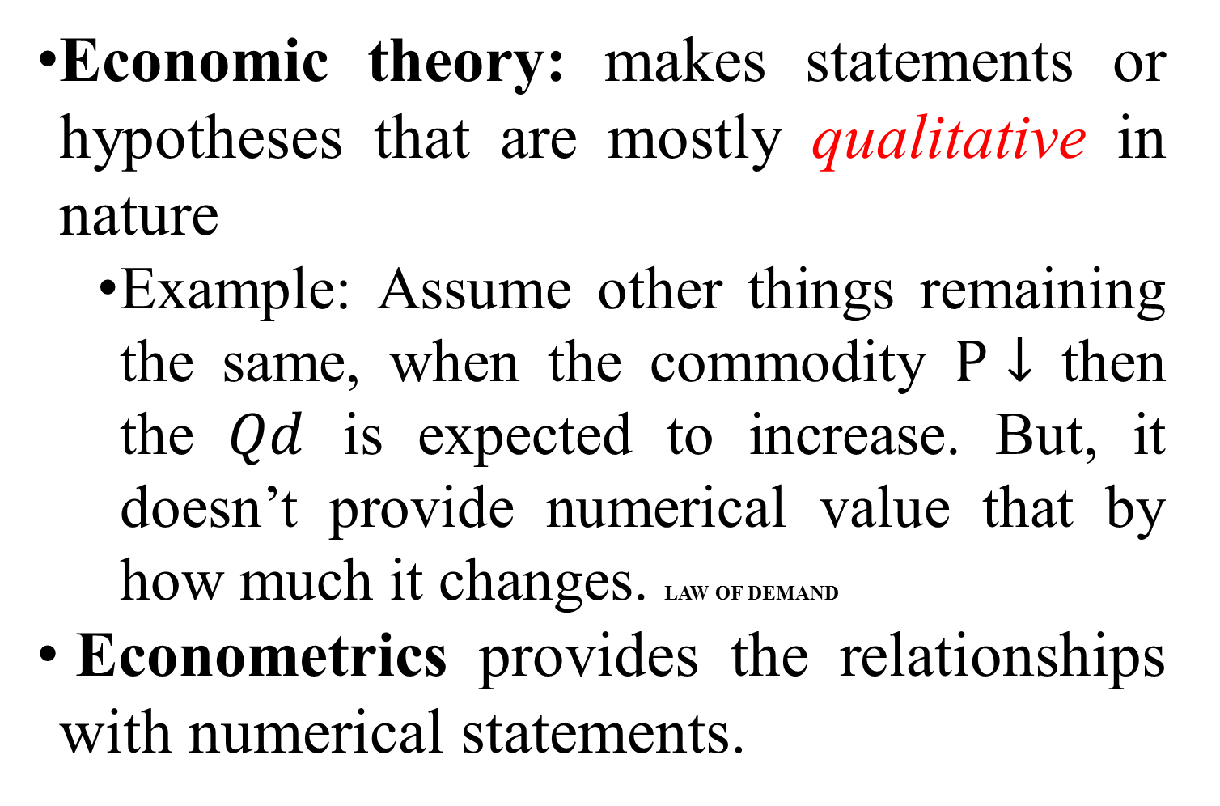
A. Econometrics Vs Economic Theory
Economic theory: makes statements or hypotheses that are mostly qualitative in nature
  Example: Assume other things remaining the same, when the commodity $P↓$ then the $Qd$ is expected to increase. But, it doesn’t provide numerical value that by how much it changes. LAW OF DEMAND
Econometrics provides the relationships with numerical statements.

Slide 5
B. Econometrics Vs mathematical Economics
ME: it express economic theory in mathematical form (equations) without regard to measurability or empirical verification of the theory.
Both Eco. theory and ME do not allow for random elements which might affect the relationship and make it stochastic.
Moreover, they do not provide numerical values for the coefficients of the relationships.

Slide 6
Cont.….
Econometrics, it does not assume that economic relationships are exact (deterministic).
  It assumes that relationships are not exact.
  It is designed to take in to account random disturbances.
  It provides numerical values of the coefficients of economic phenomena.

Slide 7
C. Econometrics vs. statistics
Economic Statistics is mainly concerned with collecting, processing, and presenting economic data in the form of charts and tables. It is mainly a descriptive aspect of economics.
It does not provide explanations of the development of the various variables and it does not provide measurement of the parameters of economic relationships.

Slide 8
Econometric models
The most important characteristic of economic relationships is that they contain a random element which is ignored by mathematical economic models which postulate exact relationships between economic variables.

Slide 9
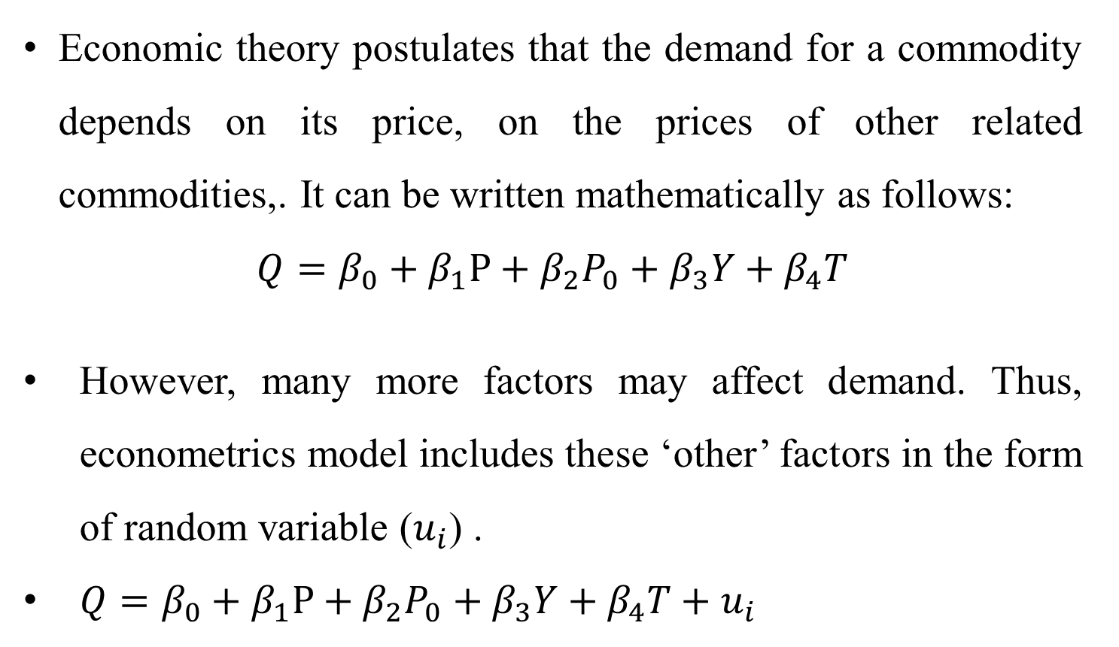
Example
Economic theory postulates that the demand for a commodity depends on its price, on the prices of other related commodities,. It can be written mathematically as follows:
$$Q=β_{0}+β_{1}P+β_{2}P_{0}+β_{3}Y+β_{4}T$$
However, many more factors may affect demand. Thus, econometrics model includes these ‘other’ factors in the form of random variable ($u_{i}$) .
$Q=β_{0}+β_{1}P+β_{2}P_{0}+β_{3}Y+β_{4}T+u_{i}$
It shows exact relationships

Slide 10
1.3. Methodology of Econometrics
Starting with the postulated theoretical relationships among economic variables, econometric research or inquiry generally proceeds along the following lines/stages.
    Specification the model
    Estimation of the model
    Evaluation of the estimates
    Evaluation of the forecasting power of the estimated model

Slide 11
1. Specification of the model
Specification of the model is the most important and the most difficult stage of any econometric research.
Specifying the theoretical relationship of variables in mathematical form. It involves the determination of :
  The dependent and independent (explanatory) variables of the model.
  A priori theoretical expectations about the size and sign of the parameters of the function.
  The mathematical form of the model (number of equations, specific form of the equations, etc.)

Slide 12
The most common errors of specification are:
Omissions of some important variables from the function.
The omissions of some equations (for example, in simultaneous equations model).
The mistaken mathematical form of the functions.

Slide 13
2. Estimation of the model
A technical stage which requires knowledge of the various econometric methods, their assumptions and the economic implications for the estimates of the parameters. This stage includes the following activities.
Gathering the data for variables in the model.
Examination of the identification conditions of the function (especially for simultaneous equations models).
Examination of the problem of multicollinearity……
Choice of appropriate method of estimation: such as, OLS, MLE, Logit, and Probit.

Slide 14
3. Evaluation of the estimates
At this stage econometricians evaluates whether the estimates of the parameters are theoretically meaningful and statistically satisfactory i.e. determine the reliability of the results. The three criteria that helps to evaluate the estimation results:
Economic a priori criteria: it evaluates the size and sign of the parameters of economic relationships.
Statistical criteria (first-order tests): it uses correlation coefficient test, standard error test, t-test, F-test, and R2-test are some of the most commonly used statistical tests.
Econometric criteria (second-order tests): It aims at the detection of the violation or validity of the assumptions of the various econometric techniques. It helps to establish whether the estimates have the desirable properties of unbiasedness, consistency etc.

Slide 15
4. Evaluation of the forecasting power of the model
Forecasting is one of the aims of econometric research.
At this stage involves the investigation of the stability of the estimates and their sensitivity to changes in the size of the sample.
Consequently, we must establish whether the estimated function performs adequately outside the sample of data. i.e. we must test an extra sample performance the model.

Slide 16
Desirable properties of an econometric model
The ‘goodness’ of an econometric model is judged based on the following desirable properties:
Theoretical plausibility. The model should be compatible with the postulates of economic theory.
Explanatory ability. The model should be able to explain the observations of the actual world.
Accuracy of the estimates of the parameters. The estimates should if possible possess the desirable properties of unbiasedness, consistency and efficiency.

Slide 17
Cont. …
4) Forecasting ability. The model should produce satisfactory predictions of future values of he dependent (endogenous) variables.
5) Simplicity. The model should represent the economic relationships with maximum simplicity. The fewer the equations and the simpler their mathematical form, the better the model is considered, ceteris paribus.

Slide 18
Goals of Econometrics
Three main goals of Econometrics are identified:
Analysis i.e. testing economic theory
Policy making i.e. Obtaining numerical estimates of the coefficients of economic relationships for policy simulations.
Forecasting i.e. using the numerical estimates of the coefficients in order to forecast the future values of economic magnitudes.

Slide 19
1.4. The Sources, Types and Nature of Data
The success of any econometric analysis ultimately depends on the availability of the appropriate data.
1.4.1. Types of Data
There are three types of data
1. Cross-section data
Values of one or more variables are collected for several sample units/economic entities at the same point in time. Hence, it is a snapshot at a point in time. Example: Household survey data for Ethiopia.

Slide 20
Cont.….
2. Time series data
Observe the values of one or more variables over time e.g. GDP, money supply for several years. It is like a movie.
3. Panel data (cross-section and time series)
Cross-section repeatedly sampled over time but where the same economic agent has been followed throughout the period of the sample.
Example : Average growth rates for east African countries from 2000-2005. or household survey data for several years.

Slide 21
Data may be qualitative or quantitative
Qualitative data are sometimes called dummy variables or categorical variable. These are variables that cannot be quantified.
Example: male or female, married or unmarried, religion, etc
Quantitative data are data that can be quantified
Example: income, prices, money etc.

Slide 22
1.4.2 The Sources of Data
A governmental agency, an international agency, a private organization or an individual may collect the data used in empirical analysis.
Example. Governmental in Ethiopia: - MEDAC, MOF, CSA, NBE
International agencies: - International Monetary Fund (IMF), World Bank (WB)
The individual (researcher) himself may collect data through interviews or using questionnaire.

Slide 23
Limitations
Although there is plenty of data available for economic research, the quality of the data is often not that good. Reasons are:
  Since most social science data are not experimental in nature, there is the possibility of observational errors.
  Errors of measurement arising from approximations and round offs.
  In questionnaire type surveys, there is the problem of non-response

Slide 24
Cont. …
  Respondents may not answer all the questions correctly
  Sampling methods used in obtaining data
  Economic data is generally available at a highly aggregate level. For example most macro data like GNP, unemp’t, etc are available for the economy as a whole.

Slide 25
Cont. …
  Because of confidentiality, certain data can be published only in highly aggregate form For example, data on individual tax, production, employment etc at firm level are usually available in aggregate form.
Because of all these and many other problems, the researcher should always keep in mind that the results of research are only as good as the quality of the data.

Slide 26
  Simple linear regression
Regression analysis is used to:
Predict the mean value of a dependent variable based on the value of at least one independent variable.
Explain the impact of changes in an independent variable on the dependent variable.
Dependent variable: the variable we wish to explain
Independent variable: the variable used to explain the dependent variable
y = β₀ + β₁x + u

Slide 27
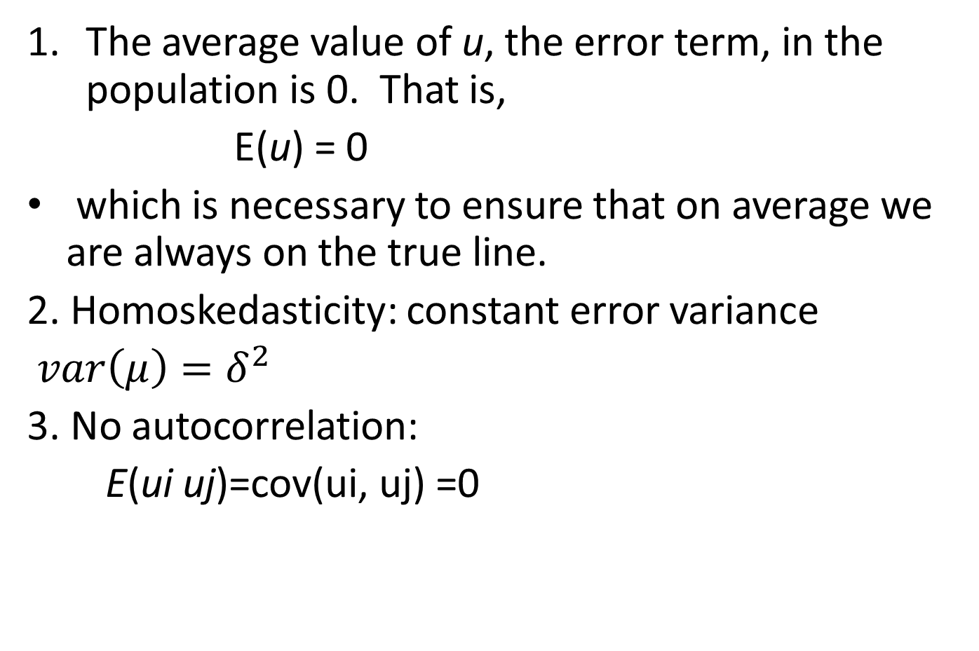
  Ordinary least squares estimation: assumptions
The average value of u, the error term, in the population is 0. That is,
E(u) = 0
which is necessary to ensure that on average we are always on the true line.
2. Homoskedasticity: constant error variance
$var\left(μ\right)=δ^{2}$
3. No autocorrelation:
E(ui uj)=cov(ui, uj) =0

Slide 28

Ordinary least squares estimation: assumptions
4. No corr. with regressor:
5. Normality : $μ\sim N(0,$ $δ^{2}$)

Slide 29
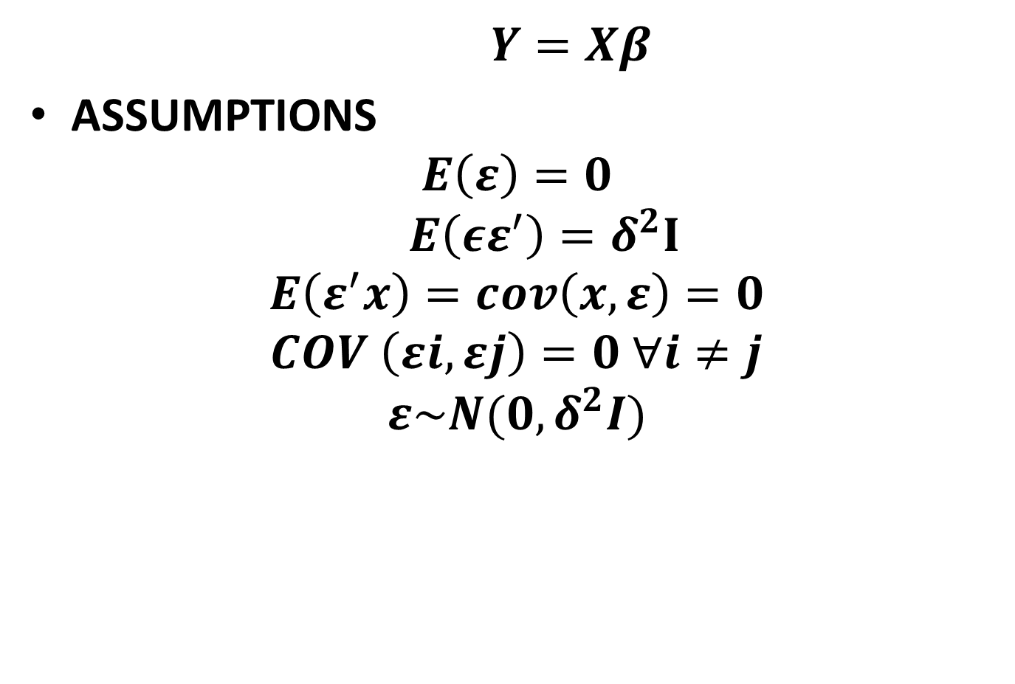
Matrix notation
$$Y=Xβ$$
ASSUMPTIONS
$$E\left(ε\right)=0$$
$$E\left(εε^{′}\right)=δ^{2}I$$
$$E\left(ε^{′}x\right)=cov\left(x,ε\right)=0$$
$$COV \left(εi,εj\right)=0 ∀i≠j$$
$$ε\sim N(0,δ^{2}I)$$

Slide 30
Deriving MOM Estimates
To derive the MoM estimates we need to realize that our main assumption of
E(u|x) = E(u) = 0 ………………….…..(1)
Cov(x,u) = E(xu) = 0 ……………..…..(2)
Why? Remember from basic probability that Cov(X,Y) = E(XY) – E(X)E(Y)

Slide 31
Deriving MoM Estimates
We can write our 2 restrictions just in terms of x, y, β₀ and β₁ , since u = y – β₀ – β₁x
E(y – β₀ – β₁x) = 0……………………..3
E[x(y – β₀ – β₁x)] = 0…………………..4
These are called moment restrictions

Slide 32
Deriving OLS using M.O.M.
The method of moments approach to estimation implies imposing the population moment restrictions on the sample moments.
sample moments = population moment
What does this mean? Recall that for E(X), the mean of a population distribution, a sample estimator of E(X) is simply the arithmetic mean of the sample

Slide 33
Deriving OLS using M.O.M.

Slide 34
Deriving using M.O.M.

Slide 35
Summary of slope estimate
The slope estimate is the sample covariance between x and y divided by the sample variance of x.
If x and y are positively correlated, the slope will be positive
If x and y are negatively correlated, the slope will be negative

Slide 36
OLS
Intuitively, OLS is fitting a line through the sample points such that the sum of squared residuals is as small as possible, hence the term least squares
The residual, û, is an estimate of the error term, u, and is the difference between the fitted line (sample regression function) and the sample point

Slide 37
Sample regression line, and the associated estimated error terms
y
.
y₄
{
û₄
y₃
.
û₃
}
.
y₂
û₂
{
}
û₁
.
y₁
x₁
x₂
x₃
x₄
x

Slide 38
OLS
Given the intuitive idea of fitting a line, we can set up a formal minimization problem
That is, we want to choose our parameters such that we minimize the following:

Slide 39
OLS, continued
If one uses calculus to solve the minimization problem for the two parameters you obtain the following first order conditions, which are the same as we obtained before, multiplied by n.

Slide 40
Algebraic Properties of OLS
The sum of the OLS residuals is zero
Thus, the sample average of the OLS residuals is zero as well
The sample covariance between the regressors and the OLS residuals is zero
The OLS regression line always goes through the mean of the sample

Slide 41
Algebraic Properties (precise)

Slide 42
More terminology

Slide 43
Proof that SST = SSE + SSR

Slide 44
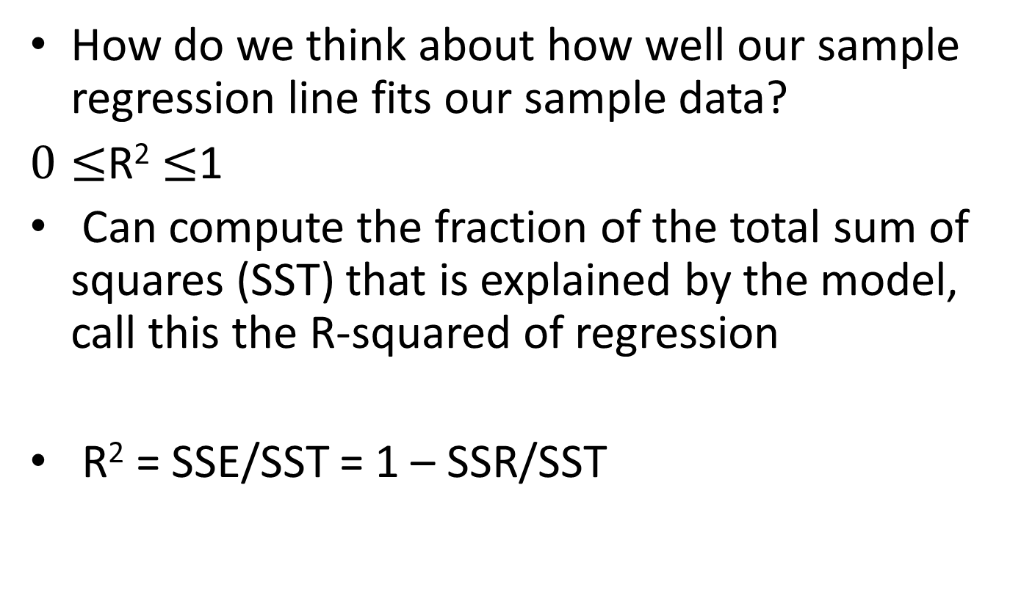
Goodness-of-Fit
How do we think about how well our sample regression line fits our sample data?
$0≤$R² $≤$1
Can compute the fraction of the total sum of squares (SST) that is explained by the model, call this the R-squared of regression
R² = SSE/SST = 1 – SSR/SST

Slide 45
Using Stata for OLS regressions
Now that we’ve derived the formula for calculating the OLS estimates of our parameters, you’ll be happy to know you don’t have to compute them by hand.
Regressions in Stata are very simple, to run the regression of y on x, just type
reg y x

Slide 46
Gauss–Markov Theorem
GMT: “Given the assumptions of the classical linear regression model, the least-squares estimators, in the class of unbiased linear estimators, have minimum variance, that is, they are BLUE.”

Slide 47
1. Linear Estimator

Slide 48
Linear Estimator

Slide 49
2. Unbiased estimator

Slide 50
Unbiased estimator

Slide 51
3. Minimum Variance estimator (or best estimator)

Slide 52
Estimator of the error variance see the proof…

Slide 53
Multiple Regression Analysis
Y = β₀ + β₁X₁ + β₂X₂ + . . . β_{k}X_{k} + u
1. Estimation
simple OLS technique
Minimize RSS
Take the FOC and set equal to zero
Finally solve K+1 equations to find the estimators of the true population parameters.

Slide 54
Parallels with Simple Regression
β₀ is still the intercept
β₁ to β_{k} all called slope parameters
u is still the error term (or disturbance)
Still need to make a zero conditional mean assumption, so now assume that
E(u|x₁,x₂, …,x_{k}) = 0
Still minimizing the sum of squared residuals, so have k+1 first order conditions.

Slide 55
Interpreting Multiple Regression
β₁ measures the change in the mean value of Y, E(Y), per unit change in X₁, holding the value of X₂ ……Xk constant.

Slide 56
MULTIPLE LINEAR REGRESSION
ASSUMPTIONS:
Zero mean value of U_{i}
Homoscedasticity:
Normality:
No serial correlation
Independence of U_{i} and X_{i}
No perfect multicollinearity (No collinearity between the X variables): The explanatory variables are not perfectly linearly correlated. That is, there is no exact linear relationship between X₁ and X₂.

Slide 57
Estimation: the method of least squares

Slide 58
Estimation…

Slide 59
Estimation…

Slide 60
Estimation…

Slide 61
Estimation…

Slide 62
The multiple coefficient of determination (R²) and the Adjusted R²
In a two variable regression model, the coefficient of determination (r²) measures the goodness of fit of the regression equation.
This notion of r² can be easily extended to regression models containing more than two variables.
In the three-variable model, we would like to know the proportion of the variation in Y explained by the variables X₁ and X₂ jointly.
The quantity that gives this information is known as the multiple coefficient of determination.

Slide 63
R²

Slide 64
R²

Slide 65
R²

Slide 66
R²
The value of R² lies between 0 and 1.
The higher R² the greater the percentage of the variation of Y explained by the regression plane, that is, the better the goodness of fit of the regression plane to the sample observations.
The closer R² to zero, the worse the fit is.

Slide 67
adjusted R2
It is immediately apparent from the above equation that for k > 1, adj. R2 < R2 which implies that as the number of explanatory variables increases, the adjusted R2 is increase less than the unadjusted R2.
The adjusted R2, i.e. , can be negative, although R2 is necessarily non-negative. In this case its value is taken as zero.
If n is large, and R2 will not differ much. But with small samples, if the number of regressors (X’s) is large in relation to the sample observations, will be much smaller than R2.

Slide 68
Standard Errors of Least Squares Estimates

Slide 69
Standard Errors of Least Squares Estimates

Slide 70
Standard Errors of Least Squares Estimates

Slide 71
Standard Errors of Least Squares Estimates

Slide 72
Testing the Overall Significance of a Regression

Slide 73
Cont…

Slide 74
Cont…

Slide 75
Multiple Regression Analysis
y = β₀ + β₁x₁ + β₂x₂ + . . . β_{k}x_{k} + u
2. Inference

Slide 76
Assumptions of the Classical Linear Model (CLM)
So far, we know that given the Gauss-Markov assumptions, OLS is BLUE,
In order to do classical hypothesis testing, we need to add another assumption (beyond the Gauss-Markov assumptions)
Assume that u is independent of x₁, x₂,…, x_{k} and u is normally distributed with zero mean and variance s²: u ~ Normal(0,s²)

Slide 77
CLM Assumptions (cont)
Under CLM, OLS is not only BLUE, but is the minimum variance unbiased estimator
We can summarize the population assumptions of CLM as follows
y|x ~ Normal(b₀ + b₁x₁ +…+ b_{k}x_{k}, s²)
While for now we just assume normality, clear that sometimes not the case
Large samples will let us drop normality

Slide 78
The homoskedastic normal distribution with
a single explanatory variable
y
f(y|x)
.
.
E(y|x) = β₀ + β₁x
Normal
distributions
x₁
x₂

Slide 79
Normal Sampling Distributions

Slide 80
The t Test

Slide 81
The t Test (cont)
Knowing the sampling distribution for the standardized estimator allows us to carry out hypothesis tests
Start with a null hypothesis
For example, H₀: β_{j}=0
If accept null, then accept that x_{j} has no effect on y, controlling for other x’s

Slide 82
The t Test (cont)

Slide 83
t Test: One-Sided Alternatives
Besides our null, H₀, we need an alternative hypothesis, H₁, and a significance level
H₁ may be one-sided, or two-sided
H₁: b_{j} > 0 and H₁: b_{j} < 0 are one-sided
H₁: b_{j} ≠ 0 is a two-sided alternative
If we want to have only a 5% probability of rejecting H₀ if it is really true, then we say our significance level is 5%

Slide 84
One-Sided Alternatives (cont)
Having picked a significance level, α, we look up the (1 – α)^{th} percentile in a t distribution with n – k – 1 df and call this c, the critical value
We can reject the null hypothesis if the t statistic is greater than the critical value
If the t statistic is less than the critical value then we fail to reject the null

Slide 85
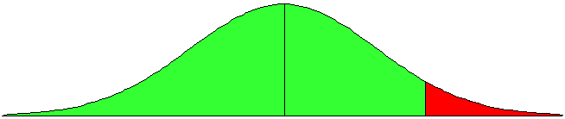
One-Sided Alternatives (cont)
y_{i} = β₀ + β₁x_{i1} + … + β_{k}x_{ik} + u_{i}
H₀: β_{j} = 0 H₁: β_{j} > 0
Fail to reject
reject
(1 − α)
α
0
c

Slide 86
One-sided vs Two-sided
Because the t distribution is symmetric, testing H₁: β_{j} < 0 is straightforward. The critical value is just the negative of before
We can reject the null if the t statistic < –c, and if the t statistic > than –c then we fail to reject the null
For a two-sided test, we set the critical value based on α/2 and reject H₁: β_{j} ≠ 0 if the absolute value of the t statistic > c

Slide 87
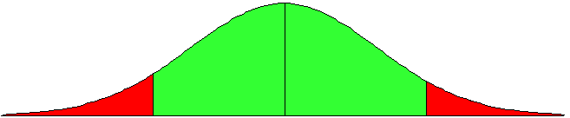
Two-Sided Alternatives
y_{i} = β₀ + β₁X_{i1} + … + β_{k}X_{ik} + u_{i}
H₀: β_{j} = 0 H₁: β_{j} > 0
fail to reject
reject
reject
α/2
(1 − α)
α/2
-c
0
c

Slide 88
Summary for H₀: β_{j} = 0
Unless otherwise stated, the alternative is assumed to be two-sided
If we reject the null, we typically say “x_{j} is statistically significant at the α % level”
If we fail to reject the null, we typically say “x_{j} is statistically insignificant at the α % level”

Slide 89
Testing other hypotheses
A more general form of the t statistic recognizes that we may want to test something like H₀: β_{j} = a_{j}
In this case, the appropriate t statistic is

Slide 90
Confidence Intervals
Another way to use classical statistical testing is to construct a confidence interval using the same critical value as was used for a two-sided test
A (1 - α) % confidence interval is defined as

Slide 91
Computing p-values for t tests
An alternative to the classical approach is to ask, “what is the smallest significance level at which the null would be rejected?”
So, compute the t statistic, and then look up what percentile it is in the appropriate t distribution – this is the p-value
p-value is the probability we would observe the t statistic we did, if the null were true

Slide 92
Stata and p-values, t tests, etc.
Most computer packages will compute the p-value for you, assuming a two-sided test
If you really want a one-sided alternative, just divide the two-sided p-value by 2
Stata provides the t statistic, p-value, and 95% confidence interval for H₀: β_{j} = 0 for you, in columns labeled “t”, “P > |t|” and “[95% Conf. Interval]”, respectively

Slide 93
Testing a Linear Combination
Suppose instead of testing whether β₁ is equal to a constant, you want to test if it is equal to another parameter, that is H₀ : β₁ = β₂
Use same basic procedure for forming a t statistic

Slide 94
Testing Linear Combo (cont)

Slide 95
Testing a Linear Combo (cont)
So, to use formula, need s₁₂, which standard output does not have
Many packages will have an option to get it, or will just perform the test for you
In Stata, after reg y x1 x2 … xk you would type test x1 = x2 to get a p-value for the test
More generally, you can always restate the problem to get the test you want

Slide 96
Example:
Suppose you are interested in the effect of campaign expenditures on outcomes
Model is voteA = β₀ + β₁log(expendA) + β₂log(expendB) + β₃prtystrA + u
H₀: β₁ = - β₂, or H₀: θ₁ = β₁ + β₂ = 0
β₁ = θ₁ – β₂, so substitute in and rearrange ⇒ voteA = β₀ + θ₁log(expendA) + β₂log(expendB - expendA) + β₃prtystrA + u

Slide 97
Example (cont):
This is the same model as originally, but now you get a standard error for β₁ – β₂ = θ₁ directly from the basic regression
Any linear combination of parameters could be tested in a similar manner
Other examples of hypotheses about a single linear combination of parameters:
  β₁ = 1 + β₂ ; β₁ = 5β₂ ; β₁ = -1/2β₂ ; etc

Slide 98
Multiple Linear Restrictions
Everything we’ve done so far has involved testing a single linear restriction, (e.g. β₁ = 0 or β₁ = β₂ )
However, we may want to jointly test multiple hypotheses about our parameters
A typical example is testing “exclusion restrictions” – we want to know if a group of parameters are all equal to zero

Slide 99
Testing Exclusion Restrictions
Now the null hypothesis might be something like H₀: β_{k-q+1} = 0, ... , β_{k} = 0
The alternative is just H₁: H₀ is not true
Can’t just check each t statistic separately, because we want to know if the q parameters are jointly significant at a given level – it is possible for none to be individually significant at that level

Slide 100
Exclusion Restrictions (cont)
To do the test we need to estimate the “restricted model” without x_{k-q+1},, …, x_{k} included, as well as the “unrestricted model” with all x’s included
Intuitively, we want to know if the change in SSR is big enough to warrant inclusion of x_{k-q+1},, …, x_{k}

Slide 101
The F statistic
The F statistic is always positive, since the SSR from the restricted model can’t be less than the SSR from the unrestricted
Essentially the F statistic is measuring the relative increase in SSR when moving from the unrestricted to restricted model
q = number of restrictions, or df_{r} – df_{ur}
n – k – 1 = df_{ur}

Slide 102
The F statistic (cont)
To decide if the increase in SSR when we move to a restricted model is “big enough” to reject the exclusions, we need to know about the sampling distribution of our F stat
Not surprisingly, F ~ F_{q,n-k-1}, where q is referred to as the numerator degrees of freedom and n – k – 1 as the denominator degrees of freedom

Slide 103
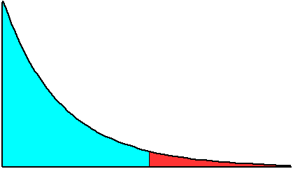
The F statistic (cont)
f(F)
Reject H₀ at α
significance level
if F > c
fail to reject
reject
(1 − α)
α
0
c
F

Slide 104
The R² form of the F statistic
Because the SSR’s may be large and unwieldy, an alternative form of the formula is useful
We use the fact that SSR = SST(1 – R²) for any regression, so can substitute in for SSR_{u} and SSR_{ur}

Slide 105
Overall Significance
A special case of exclusion restrictions is to test H₀: β₁ = β₂ =…= β_{k} = 0
Since the R² from a model with only an intercept will be zero, the F statistic is simply

Slide 106
General Linear Restrictions
The basic form of the F statistic will work for any set of linear restrictions
First estimate the unrestricted model and then estimate the restricted model
In each case, make note of the SSR
Imposing the restrictions can be tricky – will likely have to redefine variables again

Slide 107
Example:
Use same voting model as before
Model is voteA = β₀ + β₁log(expendA) + β₂log(expendB) + β₃prtystrA + u
now null is H₀: β₁ = 1, β₃ = 0
Substituting in the restrictions: voteA = β₀ + log(expendA) + β₂log(expendB) + u, so
Use voteA - log(expendA) = β₀ + β₂log(expendB) + u as restricted model

Slide 108
F Statistic Summary
Just as with t statistics, p-values can be calculated by looking up the percentile in the appropriate F distribution
Stata will do this by entering: display fprob(q, n – k – 1, F), where the appropriate values of F, q,and n – k – 1 are used
If only one exclusion is being tested, then F = t², and the p-values will be the same

Slide 109
VIOLATIONS OF THE CLASSICAL ASSUMPTIONS
1. Multicollinearity
Many social research studies use a large number of predictors.
Problems arise when the various predictors are highly and linearly related (highly collinear).
Recall that, in a multiple regression, only the independent variation in a regressor (an X) is used in estimating the coefficient of that X.
the presence of multicollinearity (an approximate linear relationship among some of the regressors) leads to estimation problems.

Slide 110
MULTiCOLLINEARITY
Intuitively, when any two explanatory variables are changing in nearly the same way, it becomes extremely difficult to establish the influence of each regressor on the dependent variable separately.
Consider the consumption–income model:
Consumption_{i} = β₀ + β₁ Income_{i} + β₂ Wealth_{i} + u_{i}
Wealthier people generally tend to have higher incomes.

Slide 111
MULTiCOLLINEARITY
A. The case of perfect multicollinearity:
consider a three-variable regression model in deviation form

Slide 112
MULTiCOLLINEARITY
Suppose where k is non zero constant.
Suppose where K is positive constant
which is an indeterminate expression. It can also be shown that the expression for is indeterminate.

Slide 113
MULTICOLLINEARITY
Recall that gives the rate of change in the average value of Y as X₁ changes by a unit, holding X₂ constant.
But if X₁ and X₂ are perfectly collinear, there is no way X₂ can be kept constant:
As X₁ changes, so does X₂ by the factor k. What it means, then, is that there is no way of disentangling the separate influences of X₁ and X₂ from the given sample.

Slide 114
MULTICOLLINEARITY

Slide 115
MULTICOLLINEARITY
Therefore, in the case of perfect multicollinearity, the regression coefficients remain indeterminate and their standard errors are infinite.
B. High but imperfect multicollinearity
However, in the case of near or high multicollinearity, one is likely to encounter the following consequences:
1. Although BLUE, the OLS estimators have large variances and covariance, making precise estimation difficult.

Slide 116
MULTICOLLINEARITY
r₁₂ (which is the coefficient of correlation between X₁ and X₂) tends towards 1, that is, as collinearity increases, the variance of the estimator increases.
2. Because of consequence (1), the confidence intervals tend to be much wider, leading to the acceptance of the “Zero null hypothesis” (i.e., the true population coefficient is zero).

Slide 117
MULTICOLLINEARITY
3. Because of consequence (1), the t-ratio of one or more coefficients tends to be statistically insignificant.
4. Although the t-ratio of one or more coefficients is statistically insignificant, R², the overall measure of goodness of fit, can be very high.
5.The OLS estimators and their standard errors can be sensitive to small changes in the data.

Slide 118
MULTICOLLINEARITY
Detecting Multicollinearity:
The classic case of multicollinearity occurs when R-square is high (& significant), but none of X's is significant.
A commonly used for detecting multicollinearity is VIF (Variance Inflation Factor) and Tolerance(TOL) .
VIF shows how the variance of an estimator is inflated by the presence of multicollinearity.

Slide 119
MULTICOLLINEARITY

Slide 120
MULTICOLLINEARITY
Similarly, for k-variable model
As a rule of thumb, if the VIF of a variable exceeds 10 that variable is said to be highly collinear

Slide 121
MULTICOLLINEARITY
Remedial Measures
1. Drop a variable:
2. increase the sample size

Slide 122
Heteroskedasticity
Var(u_{i}) = E{(u_{i} – E(u_{i})}² = E(u_{i}²) = σ²
the variance of each U_{i} is the same for all values of the explanatory variable.
If the above condition is not satisfied in any particular case, we say that the u_{i}’s are hetroscedastic. That is,Var (u_{i}) = σ_{i}².

Slide 123
Heteroskedasticity
The consequence of Heteroscedasticity
If the assumption of homoscedastic disturbance is not fulfilled we have the following consequences:
Heteroskedasticity does not destroy the unbiasedness and consistency properties of OLS estimators.
The OLS estimates do not have the minimum variance property in the class of unbiased estimators. That is, they are not BLUE.
In the presence of heteroskedasticity, the variances of OLS estimators are not provided by the usual OLS formulas. But if we persist in using the usual OLS formulas, the t and F tests based on them can be highly misleading, resulting in erroneous conclusions.

Slide 124
Heteroskedasticity
Detecting the problem of Heteroscedasticity
A. Graphical Method
Run OLS and plot squared residuals versus fitted value of Y (Ŷ) or against each X.
this approach examines whether the error term depicts some systematic pattern or not.
The graph may show some relationship (linear, quadratic, …), which provides clues as to the nature of the problem and a possible remedy.
In stata (after regression): rvfplot

Slide 125
Heteroskedasticity
B. Formal methods
Park Test
Park formalizes the graphical method by suggesting that σ_{i}² is some function of the explanatory variable X_{i} .
The functional form he suggests is
Var(u_{i}) = σ_{i}² = σ²X_{i}^{β}e^{vi}
which could be written in logarithmic form as
lnσ_{i}² = lnσ² + βlnX_{i} + v_{i}
where v_{i} is the stochastic disturbance form.

Slide 126
Heteroskedasticity
Since σ_{i}² is generally not known, park suggests using as a proxy and running the following regression:
ln = lnσ² + βlnX_{i} + v_{i}
= α + βlnX_{i} + v_{i}
If β turns out to be statistically significant, it would suggest that heteroscedasticity is present in the data.
If it turns out to be insignificant, we may accept the assumption of homoscedasticity.

Slide 127
Heteroskedasticity
In the first stage we run the OLS regression disregarding the heteroscedasticity question. We obtain from this regression, and then in the second stage we run the regression ln = lnσ² + βlnX_{i} + V_{i.}
finally, test the significance of Xi

Slide 128
Heteroskedasticity
The Goldfeld – Quandt Test
This popular method is applicable if one assumes that the heteroscedastic variance, σ_{i}² is positively related to one of the explanatory variables in the regression model.
The test assumes normality and serially independent disturbance term, U_{i}’s.
Consider the ff model

Slide 129
Heteroskedasticity
Y_{i} = β₀ + β₁X_{1i} + β₂X_{2i} + …β_{k}X_{ki} + U_{i}
The hypothesis to be tested is
H₀: U_{i}’s are homoscedastic
H₁: Ui’s are heteroscedastic (with increasing variance)
To test this, Goldfeld-Quandt perform the following steps.

Slide 130
Heteroskedasticity
Step 1: The observations are ordered according to the magnitude of the independent variable thought to be related to the variance of the disturbances.
Step2:A certain number of central observations (represented by c) are omitted, leaving two equal-sized groups of observations,
Step 3. We fit separate regression to each sub-sample, and we obtain the sum of squared residuals

Slide 131
Heteroskedasticity
Step IV : Compute the ratio of the two variances given by
If the two variances are the same (that is, if they are homoscedasticc) the value of F* will tend to one.
Rule: reject H0 if the computed F is greter than F table

Slide 132
Heteroskedasticity
Example; Suppose that we have data on consumption expenditure in relation to income for a cross section of 30 families. Suppose we postulate that consumption expenditure is linearly related to income but that heteroscedasticity is present in the data. Suppose further that the middle 4 observations are dropped after the necessary reordering of the data. Suppose we obtain the following result after we perform a separate regression based on the two 13 observations.
the critical F value for 11 numerator and 11 denominator df at the 5% level is 2.82.

Slide 133
Breusch-Pagan(BP) test
consider the k-variable linear regression model
Y_{i} = β₀ + β₁X_{1i} + … + β_{k}X_{ki} + U_{i} ……………………………….. (1)
The Breusch-Pagan test for heteroscedasticity is carried out as follows:
Estimate equation (1) by OLS, and obtain the residual, .
Run the auxiliary regression and obtain the R-squared from this regression, .
Form either the F statistic:
Under the null hypothesis, bp is distributed asymptotically as , that is, chi-square with degrees of freedom equal to number of regressors (excluding the intercept). If the p-value is sufficiently small, that is, below the chosen significance level, then we reject the null hypothesis of homoscedasticity.

Slide 134
The White Test

Slide 135
Heteroskedasticity
Solutions to (or Estimation with) Heteroskedasticity
If heteroskedasticity is detected, first check for some other specification error in the model (omitted variables, wrong functional form, …).
If it persists even after correcting for other specification errors, use one of the following:
1.Use better method of estimation (WLS);
2.Stick to OLS but use robust (heteroskedasticity consistent) standard errors.
In stata:regY X1…XK, robust
This is OK even with homoskedastic errors.

