Slide 1
NATURAL RESOURCE MANAGEMENT POLICY AND LAW
POWER POINT FOR NATURAL RESOURCE MANAGEMNT STUDENTS
CREDIT HOUR OF THE COURSE……
PREPARED BY:- ANDINET G.

Slide 2
Natural resource policy and law
Chapter one
Natural resource put in context
  Definition of natural resource
Introduction
A natural resource is a material that comes from the Earth and in its raw or “natural” state is of value for one reason or another. Natural resource management is the taking care of natural resources such as land, water. It’s about the long-term implications of actions - thinking about the future and not just about now.
The goal is sustainability - balancing social (people and communities), economic (money and jobs) and environmental (land, water, air and living things) factors.
Misuse of natural resources; refers to excessive use, destructive use or achieving imbalance.
A natural resource is what people can use which comes from the natural environment. Examples of natural resources are air, water, wood, oil, wind energy, natural gas, iron, and coal.

Slide 3
THE ECONOMIC SIGNIFICANCE OF NATURAL RESOURCES
Economic significance and sustainability of NR
Managing natural resources sustainably - is as sources of revenue for investment in future growth and allows resource rich countries to establish the foundation for long-term development and poverty alleviation. Therefore, the following are the major significance of natural resources in economic development.

Slide 4
Cont..
1.1 Contribution towards fiscal revenue, income and poverty reduction
The wealth embodied in natural resources makes up a significant proportion of the wealth of most nations, often more than the wealth embodied in produced capital, therefore making natural resources management a key aspect of economic development .

Slide 5
Cont…
Ctd…
countries richly endowed with natural capital have the potential to derive significant current income from resources.
policies that improve natural resources management can have immediate and meaningful poverty reduction impacts.
safety net for the poor, particularly in times of financial crisis, providing food in the form of plant and animal wildlife and fertile soils for subsistence agriculture, and fuel wood.

Slide 6
Economic significance Cont…
Ctd…
2. Employment and job creation potential
. provide a significant number of jobs.
. According to some estimates, environmental protection in Germany employs 1.8 million workers (BMU, 2008).
. Renewable energy related industries provided nearly a million jobs.
. forestry provides steady employment for some 1 to 2% of the world‘s workforce, while over a billion people derive their livelihoods from forests.

Slide 7
STATUS OF ETHIOPIAN NATURAL RESOURCE AND THE ISSUE OF SUSTAINABILITY
Status of Ethiopian natural resource and the issue of sustainability
Ethiopia has abundant natural resources, such as land, minerals, and gas. Gold, copper, potash, platinum, and natural gas lie beneath the surface of the earth in this part of the world, and in 2012, mining reportedly contributed US $500 million to the country’s economy. But mining is still a small contributor.
Water is an important natural resource. Ethiopia has 12 river basins that give the potential for irrigation and hydropower.

Slide 8
Natural resource of ethiopia contd…
Ctd…
There is a need to make better use of the natural resources in Ethiopia. Soil degradation and erosion are both issues, as is deforestation. About 30% of Ethiopia used to be forested and now less than 5% of the country is forest.
The forests have been almost completely destroyed because people needed the land for cultivation and grazing and they needed the wood for construction and/or fuel.

Slide 9
CHAPTER TWO
CHAPTER TWO
POLICY MAKING AND IMPLEMENTATION
Definition of policy and law
Definition of policy
Definition of law
The difference b/n policy and law
Policy vs regulation
Policy vs goal
Stages of policy formulation
Theories and models of policy formulation…..etc will be discussed under this chapter.

Slide 10
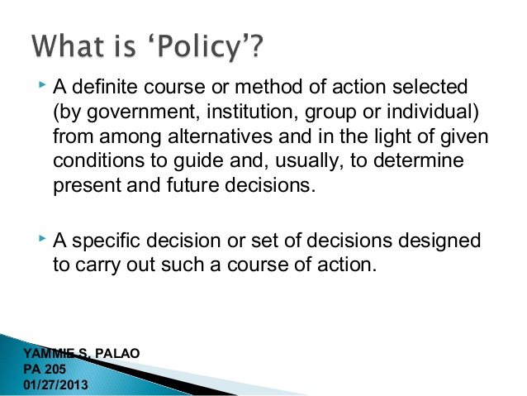
Contd…

Slide 11
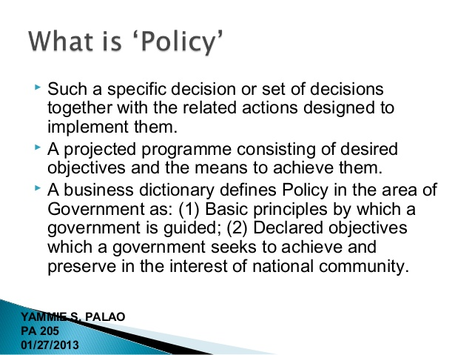
Contd…

Slide 12
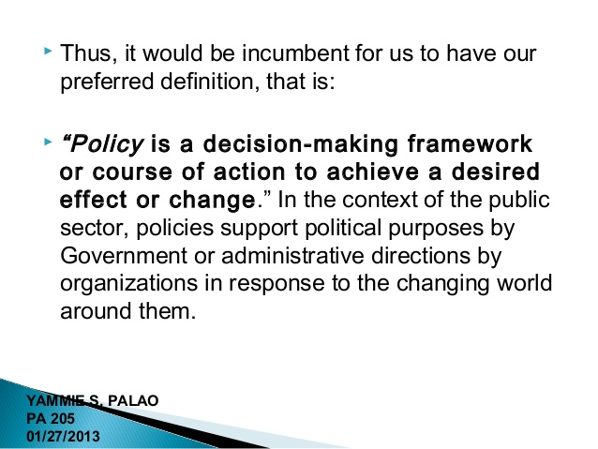
Contd…

Slide 13
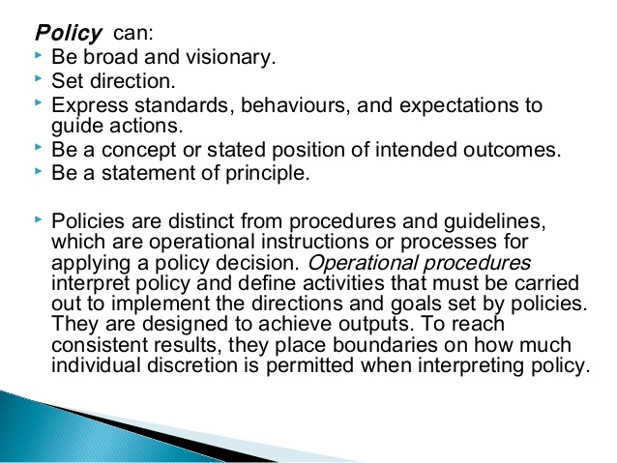
Contd…

Slide 14
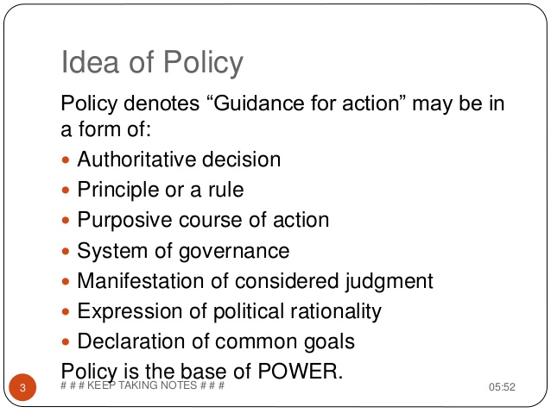
Policy contd…

Slide 15
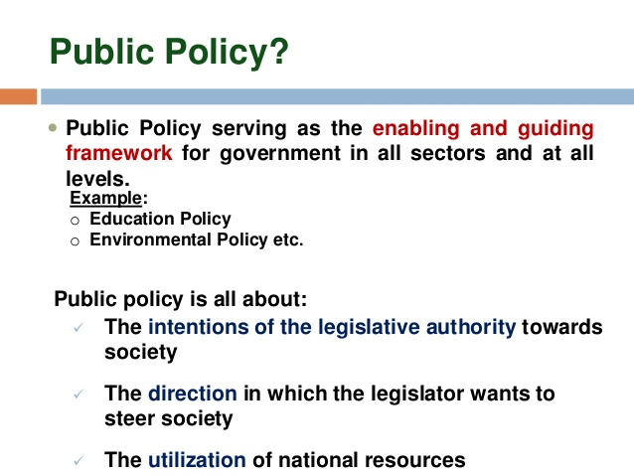
Public policy

Slide 16
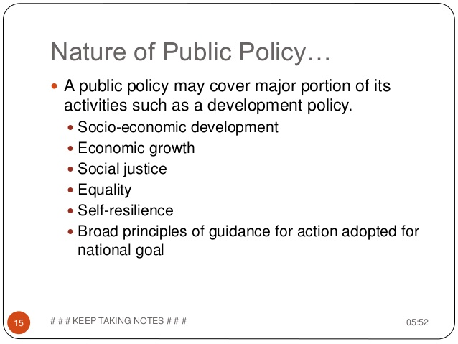
Public policy cond…

Slide 17
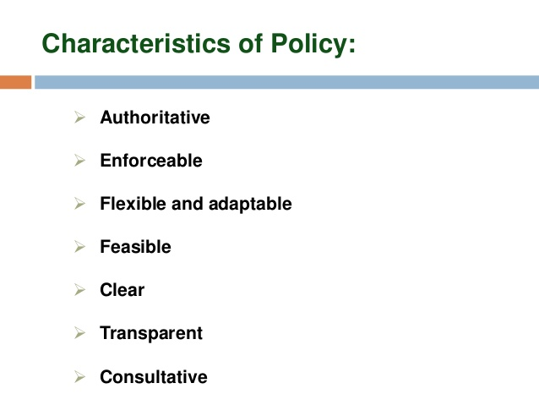
Policy contd…

Slide 18
Policy Vs law
What is the difference between a law and a policy?
It is important to understand the difference between a policy and a law.
A policy outlines what a government ministry hopes to achieve and the methods and principles it will use to achieve them. It states the goals of the ministry. A policy document is not a law but it will often identify new laws needed to achieve its goals.
Laws set out standards, procedures and principles that must be followed. If a law is not followed, those responsible for breaking them can be prosecuted in court.
So, policy sets out the goals and planned activities of a ministry and department but it may be necessary to pass a law to enable government to put in place the necessary institutional and legal frameworks to achieve their aims. Laws must be guided by current government policy.

Slide 19
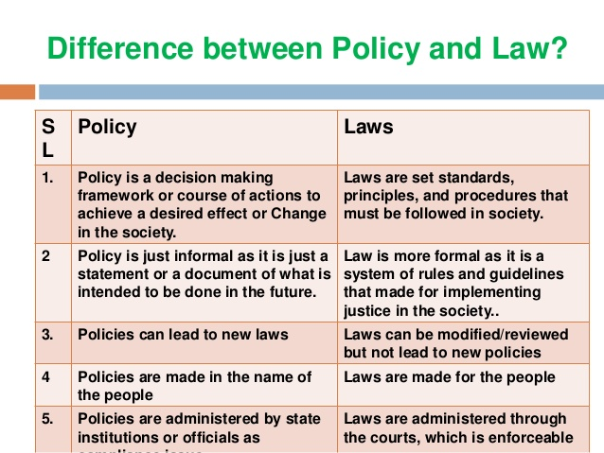

Slide 20
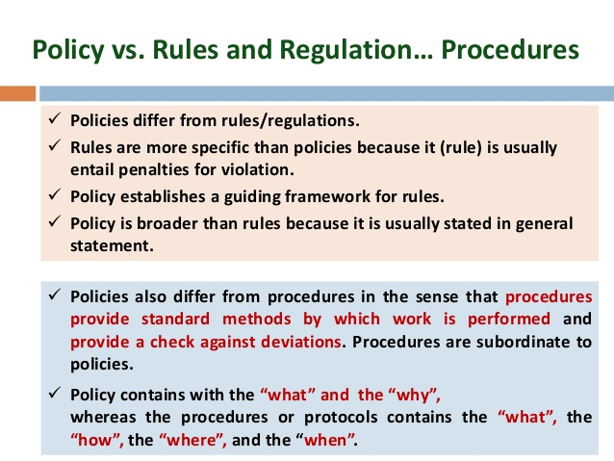

Slide 21
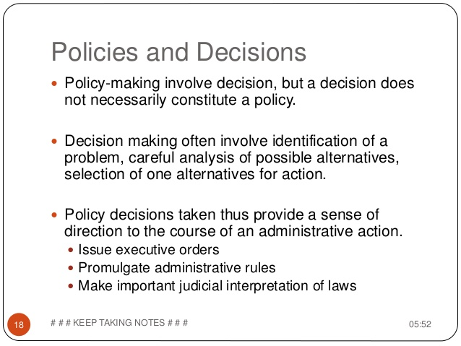

Slide 22
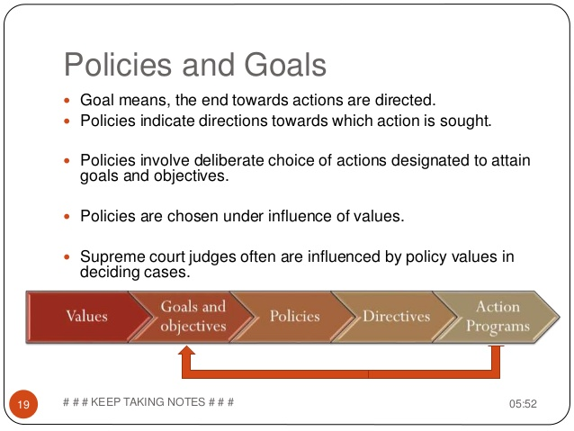

Slide 23
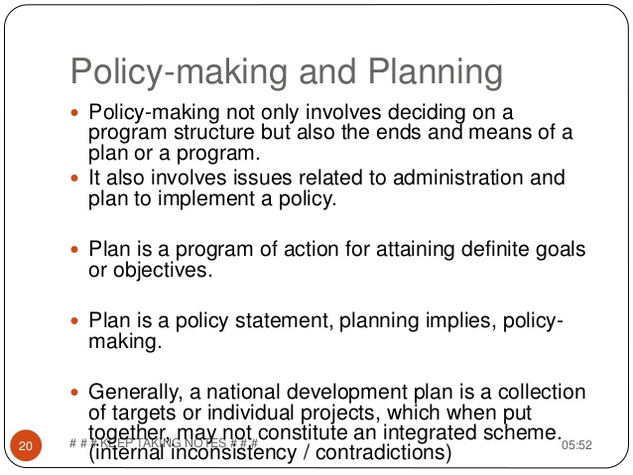

Slide 24
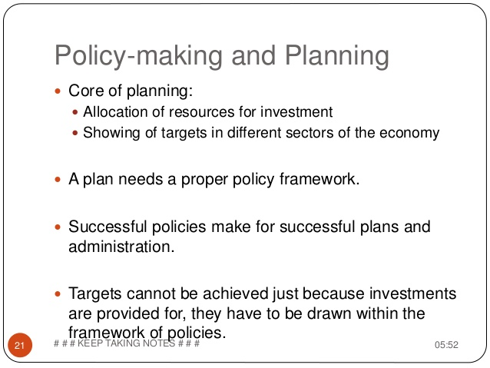

Slide 25
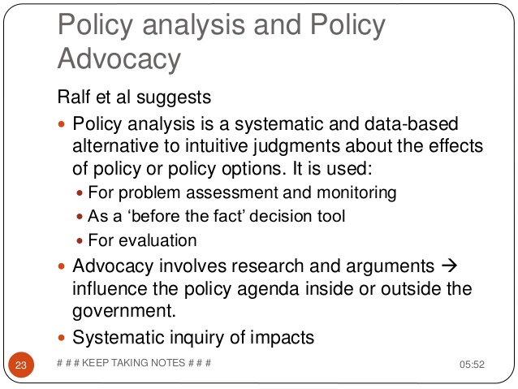

Slide 26
Policy formulation process
Stages in the policy process
Three phases
Phase 1: Initiation: includes problem identification, policy analysis, and stakeholders engagement
Phase 2: Generation: includes policy formulation, decision making and policy adoption/drafting
Phase 3: Implementation

Slide 27
Policy formulation process includes the following steps.
Step 1:Agenda – Setting/problem identification
Process of identifying policy issues/problems which require the attention of a legislator.
Process wherein members of society identify their needs, desires and demands and wherein a legislator decides to place these issues on the agenda for deliberation.
The setting of policy agenda allows to become sensitized to some of the critical policy requirements that affect society.

Slide 28
C
Step 2: Policy analysis
Understanding policy choice and comparing possible outcomes
Exploring possible implications and outcomes of adopting policy
An attempt to determine the cost and benefits of various alternatives or to evaluate the validity of existing policies
Attempt to bring about and transform information pertinent to particular policies to resolve problems pertaining to those policies.

Slide 29
Benefits of policy analysis
To determine whether they are in effect contributing towards the general well- being of society and/ or serving the best interests of organizational stakeholders.
Provide tangible facts.

Slide 30
Step 4: stakeholders engagement, consultation and co- ordination
Objective : to ensure accountability, responsiveness and openness and upholding the right to access to any information held by the state.
Constant interaction with society.
Extensive consultation between the various stakeholders.
Interested group: civic societies associations etc..

Slide 31
Step 5: policy formulation, decision making and policy drafting( adoption)
. Policy recommendation are normally drafted by senior managers and then referred to higher management authorities(executive) for deliberation, approval and adoption.
it remains the responsibility of the highest decision making authorities (executive) to approve or reject a particular policy recommendation
Includes executive orders, budgets, laws, rules and regulations, administrative and court decisions that set policy direction.

Slide 32
Step 6: policy implementation
Policy implementation includes all the activities that result from the official adoption of a policy.
Policy implementation is what happen after a law is passed.
We should never assume that the passage of law is the end of policy making process. Sometimes the law are passed and nothing happens.

Slide 33
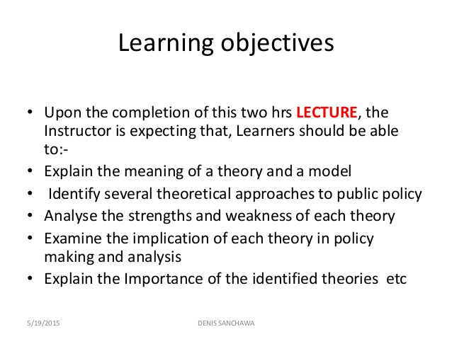
Theoretical approaches or models to public policy

Slide 34
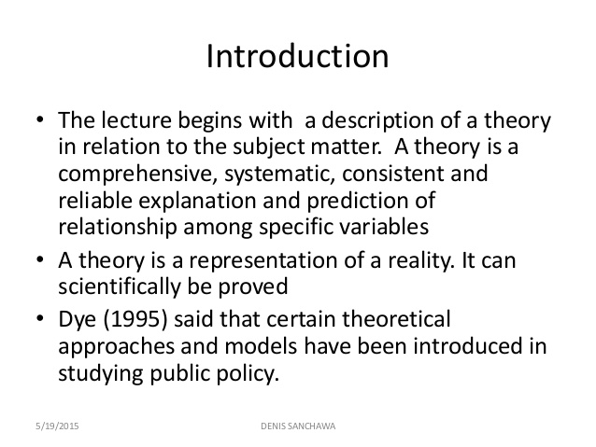

Slide 35
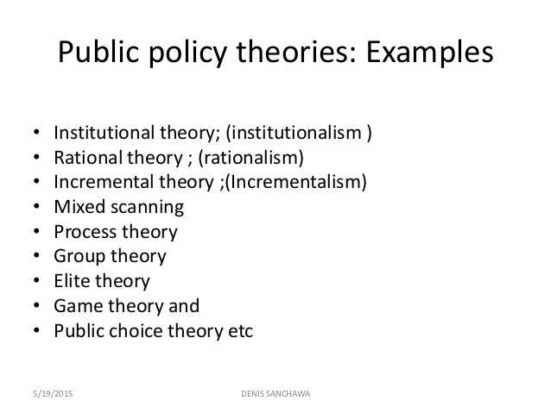

Slide 36
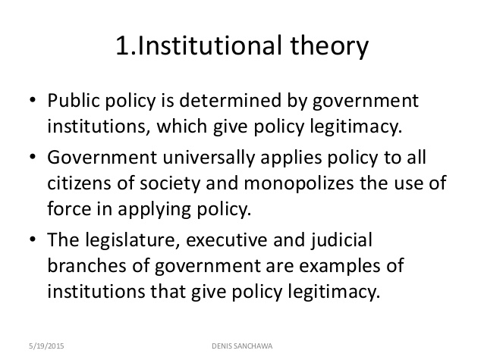

Slide 37
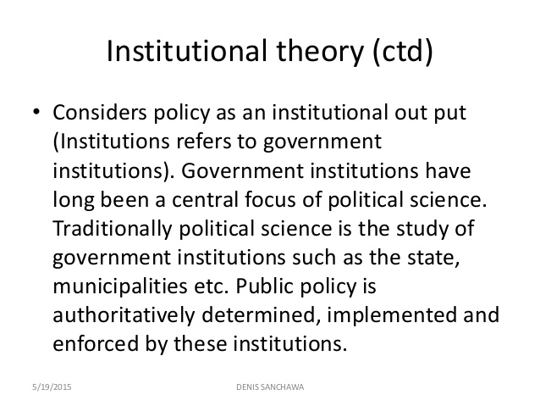

Slide 38
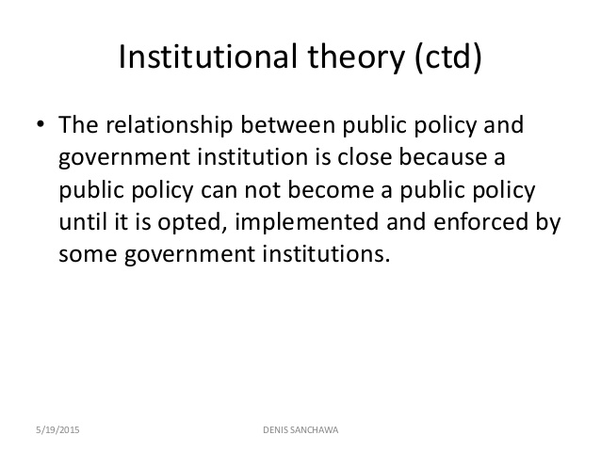

Slide 39
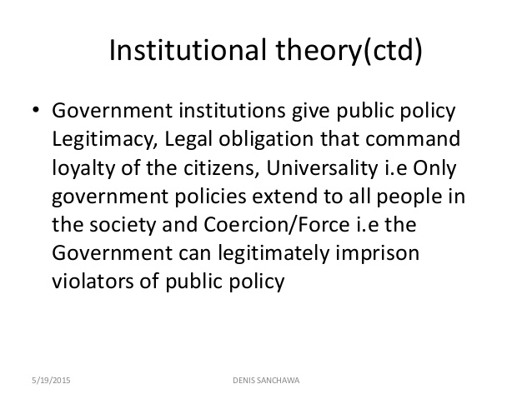

Slide 40
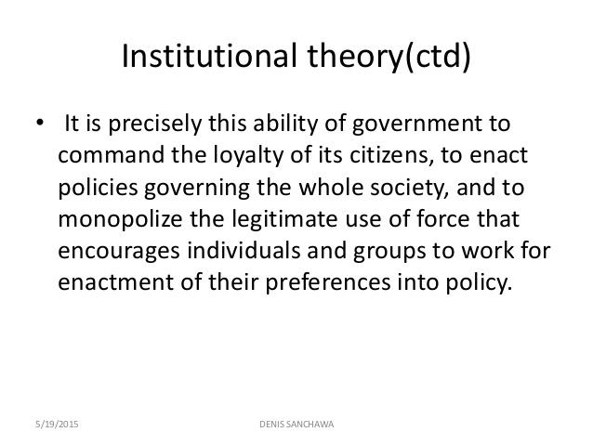

Slide 41
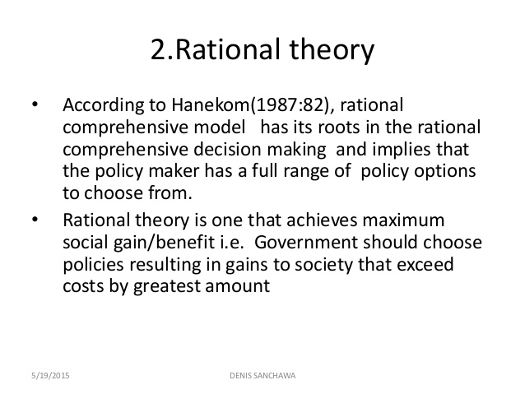

Slide 42
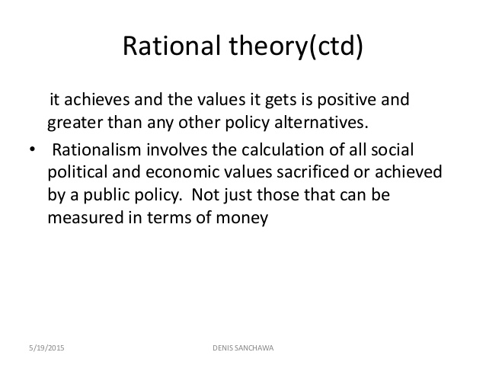

Slide 43
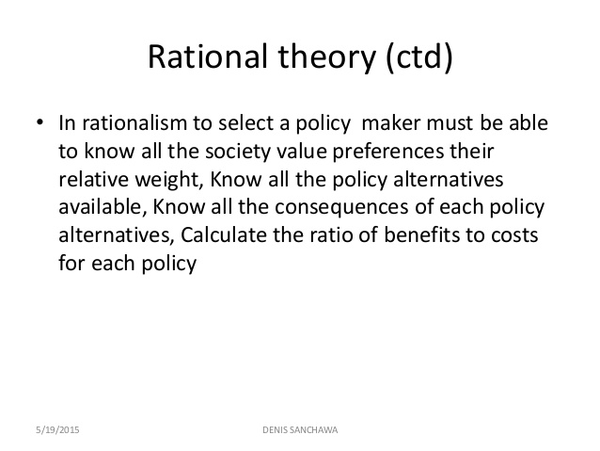

Slide 44
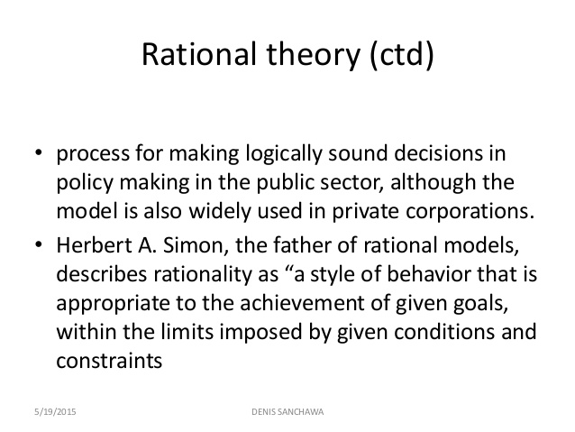

Slide 45
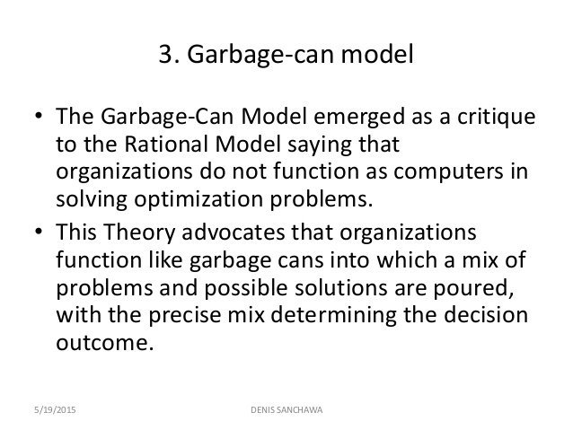

Slide 46
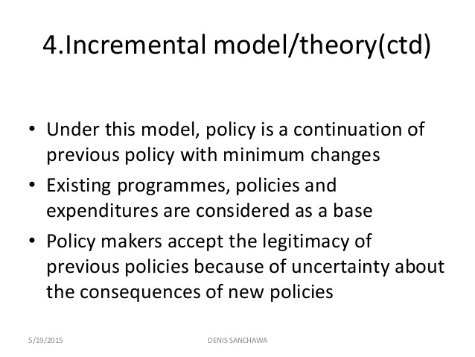

Slide 47
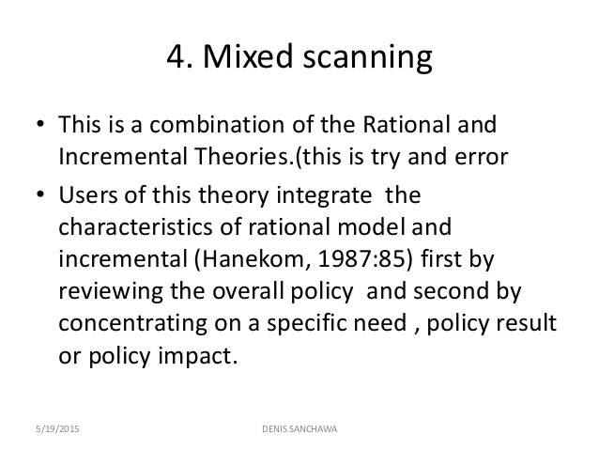

Slide 48
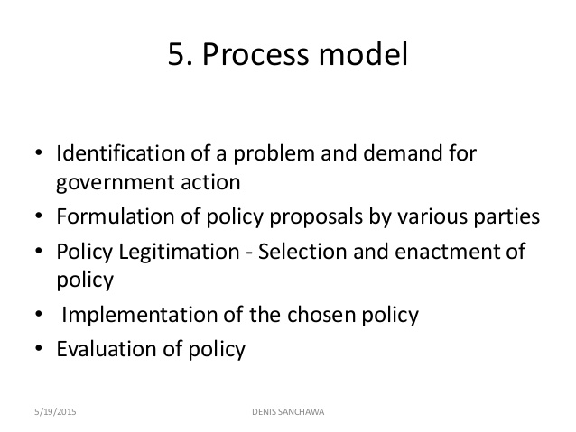

Slide 49
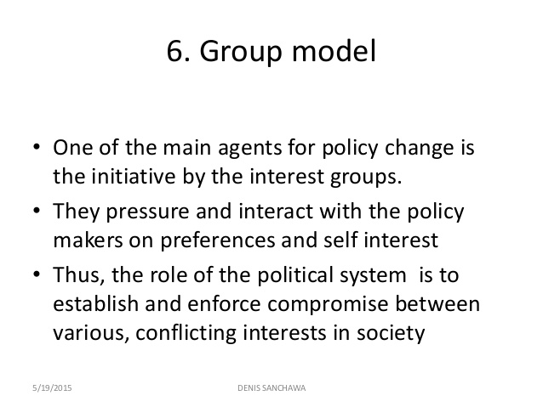

Slide 50
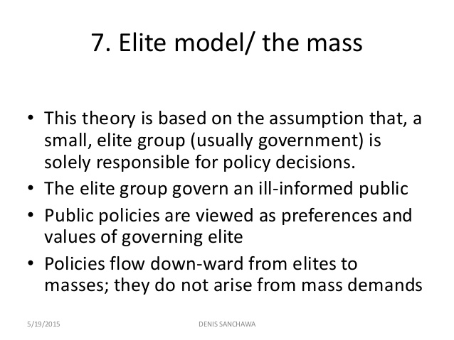

Slide 51


Slide 52


Slide 53


Slide 54
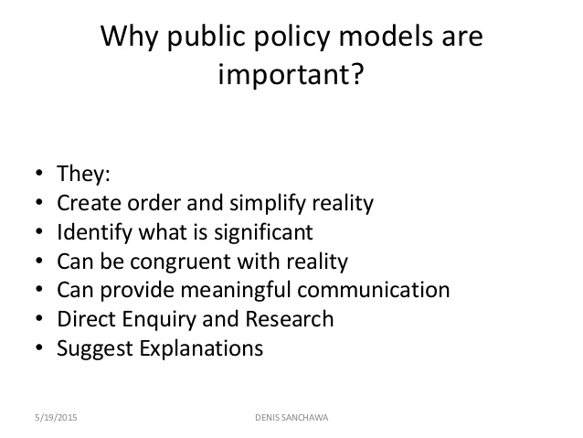

Slide 55
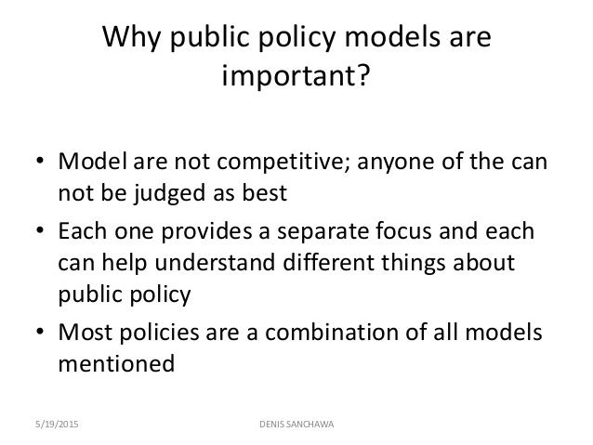

Slide 56
CHAPTER THREE
ENVIRONMENTAL POLICY OF ETHIOPIA
I. THE RESOURCE BASE AND THE NEED FOR A POLICY
1.1 The Natural Resource Base and the Rural Environment
Natural resources are the foundation of the economy. Smallholder peasant agriculture, in some areas including forestry, is the dominant sector accounting for about 45 per cent of the GDP, 85 per cent of exports and 80 per cent of total employment.

Slide 57
Cont’d…
Agriculture has also been the main source of the stagnation and variability in GDP growth caused in the main by policy failures and exacerbated by recurrent drought, civil war, natural resource degradation, and poor infrastructure.
Renewable natural resources, i.e. land, water, forests and trees as well as other forms of Biodiversity, which meet the basic needs for food, water, clothing and shelter have now deteriorated to a low level of productivity.

Slide 58
Cont’d….
In many areas of highland Ethiopia, the present consumption of wood is in excess of unaided natural sustainable production. Estimates of deforestation, which is mainly for expansion of rained agriculture, vary from 80,000 to 200,000 hectares per annum.
Livestock play a number of vital roles in the rural and national economy but according to one estimate some 2 million hectares of pasture land will have been destroyed by soil erosion between 1985 and 1995.
Thus in 1990 approximately 17 per cent of the potential agricultural GDP was lost because of physical and biological soil degradation.

Slide 59
Cont’d…
The permanent loss in value of the country's soil resources caused by soil erosion in 1990 was estimated to be Birr 59 million. This is the amount by which the country's soil "capital" should be depreciated in the National Accounts or which should be deducted (as capital depreciation) from the country's Net National Income (NNI).
The Ethiopian Forestry Action Program (EFAP) estimated the full value of forest depletion in 1990 to have been about Birr 138 million or some 25 per cent of the potential forestry GDP of Birr 544 million.

Slide 60
The Need for A Policy on Natural Resource and the Environment
The Government of the Federal Democratic Republic of Ethiopia (FDRE) has established a macro economic policy and strategy framework.
Sectoral development policies and strategies have been, or are currently being, formulated. Environmental sustainability is recognized in the constitution and in the national economic policy and strategy as a key prerequisite for lasting success.
However, there is as yet no overall comprehensive formulation of cross-sectoral and sectoral issues into a policy framework on natural resources and the environment to harmonize these broad directions and guide the sustainable development, use and management of the natural resources and the environment. Therefore, given the current stage of the country's political and policy development, the time is opportune for developing a comprehensive environmental policy on natural resources and the environment.

Slide 61
THE POLICY GOAL, OBJECTIVES AND GUIDING PRINCIPLES
2.1 The Overall Policy Goal
to improve and enhance the health and quality of life of all Ethiopians and
to promote sustainable social and economic development through the sound management and use of natural, human-made and cultural resources and the environment as a whole so as to meet the needs of the present generation without compromising the ability of future generations to meet their own needs.

Slide 62
2.2 Specific Policy Objectives
The Policy seeks to:
A. Ensure that essential ecological processes and life support systems are sustained, biological diversity is preserved and renewable natural resources are used in such a way that their regenerative and productive capabilities are maintained and where possible enhanced so that the satisfaction of the needs of future generations is not compromised;
B. Ensure that the benefits from the exploitation of non-renewable resources are extended as far into the future as can be managed, and minimize the negative impacts of their exploitation on the use and management of other natural resources and the environment;

Slide 63
C. Identify and develop natural resources that are currently underutilized by finding new technologies, and/or intensifying existing uses which are not widely applied;
D. Improve the environment of human settlements to satisfy the physical, social, economic, cultural and other needs of their inhabitants on a sustainable basis;
Prevent the pollution of land, air and water in the most cost-effective way;
Conserve, develop, sustainably manage and support Ethiopia's rich and diverse cultural heritage;

Slide 64
3. The Key Guiding Principles
Sectoral and cross-sectoral policies and environmental elements of other macro policies will be checked against these principles to ensure consistency.
The Key Guiding Principles are:
a. Every person has the right to live in a healthy environment;
b. Sustainable environmental conditions and economic production systems are impossible in the absence of peace and personal security.

Slide 65
C. The development, use and management of renewable resources shall be based on sustainability;
D. Social equity shall be assured particularly in resource use;
E. Local, regional and international environmental interdependence shall be recognized;
F. Natural resource and environmental management activities shall be integrated laterally across all sectors and vertically among all levels of organization;
G. Increased awareness and understanding of environmental and resource issues shall be promoted by policy makers, by government officials and by the population, and the adoption of a "conservation culture" in environmental matters among all levels of society shall be encouraged;

Slide 66
Government tradition and state capacity for policy making
The natural resource bases of agriculture (environment, land, water) are the key factors of its performance and sustainability. To date several policies relevant to the sector were developed and adapted. Policy priorities are led by the government’s visions. Agriculture and rural centred development (the Agricultural Development Led Industrialization, ADLI) encompassing poverty reduction and food security, commercialization, and export promotion have been the major strategic direction of the Ethiopian Government for the last two decades. The government has also identified five pro-poor sectors including agriculture, health, education, infrastructure, and water.

Slide 67
Cont’d…
Despite progress, significant challenges remain in the policy formulation and analysis process, some of which are:
• There is less consideration given to taking evidences from grassroots (through development performance evaluations) in the policymaking process;
• There is a general lack of adequate and up-to-date database for policy formulation;
• There is a general lack of adequate analytical skill, models and knowledge;
• Limited or no informed debate among the various stakeholders; and
• Weak networking between the different stakeholders in policy formulation and implementation.

Slide 68
In Ethiopia several important national and sectoral policies have been developed and adopted. However, five major challenges are quite often mentioned with respect to policy implementation. These are:
• In many instances, policy implementation guidelines, laws and regulations are lacking;
• There is a general lack of policy implementation capacity at all levels;
• There is a general lack of proper policy implementation, monitoring and evaluation;
• Policies are made without adequate assessment and drawing lessons of existing/old policies (strategies); and
• Policy coordination and integration (across sectors) is a challenge.

Slide 69
The sectorial natural resource policies and laws of Ethiopia
1. Forest policy and laws of Ethiopia
Forest policy in historic perspective
Forest policy is a process it is always in the making. It has a historic future dimension. But in our case, it seems that we come back to square one. Example:
Italian initiated extensive forestry program(1936-41) but forgotten after liberation
The imperial government allowed state, private, and communal ownership of forest but extensive deforestation for agriculture continued.

Slide 70
cont’d…
The military government (till1991) assumed all forestry development responsibilities, and was engaged in major plantations and in forest protections. But the state maintained ownership that discouraged effective community individual participation in forest development.
From mid 1990s huge institutional and organizational vacuum was created as the state moved away from forestry ,(though in some regional states concerted efforts are being made to address this challenge. E.g oromia and amhara are actively involved in forestry.)

Slide 71
Relevant policy documents
The current forest policy and strategies
Rationale
The country has not been able to harness the expected economic, social and environmental benefits from the forest sector.
Deforestation and degradation deteriorate forest resource and increasingly undermine forest benefits the country could get sustainable utilization and development of forest is critical for continued economic development and combating natural resources degradation.

Slide 72
cont’d…
Sustainable forest development requires active community participation.
Major objectives
To meet public demand in forest and forest products
To enhance the socio-economic and environmental contribution of forests.
The forest law
The constitution article 44 and 92
All citizens have the right to live in clean and healthy environment.
The government and citizens have the duty to protect the environment.

Slide 73
Forest proclamation(No.542/2007)
key aspects
defined key terms- tree, forest, forest land, state forest, private forest, local community,
determined types of forest ownership- as private and state.
promotion of forest development
promoting forest technology
promoting markets for forest products
obligation of private of private forest developers
designation, demarcation and registration of forest products
utilization of state forests
Administration of protected forests

Slide 74
Other relevant documents
Investment proclamations, EIA, rural land use and admin, etc…
The conservation strategy
The environmental policy
The energy policy
National policy on biodiversity
Wild life policy

Slide 75
Wild life policy
The development, conservation and utilization of wildlife proclamation(No. 541/2007).
It provides for the legal administration of national parks, wildlife sanctuaries, and trans - boundary wildlife conservation areas.
This proclamation has the following objectives.
To conserve, manage, develop and properly utilize the wildlife resource of Ethiopia.
To create conditions necessary for discharging government obligations assumed under treaties regarding the conservation, development, and utilization of wildlife.
To promote wildlife based tourism and encourage private investment.

Slide 76
Land use and Land Administration Policy and Law
The Ethiopian Constitution asserts state ownership of land; there are no private property rights in land.
While the Government of Ethiopia has decentralized administration of land to the regional governments, the formulation of broad land policy still rests with the federal government.
Federal government proclamations provide some land rights guarantees and some requirements for regional councils, but there is no national land policy and institution that might serve as a coordinating body at the national level of government for policy discussion and coordination of land administration.

Slide 77
Cont’d..
There is no federal institution responsible for land administration to support and coordinate regional efforts.
At the regional level, institutional structures vary . Each has adopted a different approach to land administration institutional structures.
 In several regions those governments have launched land administration reform efforts (not to be confused with land policy reform). The objective of these efforts is to improve land administration and thereby improve land tenure security for land users, though it is unclear how effective that will be in isolation of other interventions.

Slide 78
Cont’d…
Some user rights are transferable in the form of sharecropping, subleasing, or rental arrangements, but there are some restrictions in terms of the lease periods and the amounts of land to be leased out.
 Current land use and land administration policies of the regions present restrictions on the transferability and use of land.
Land redistribution is not ruled out in both the federal land proclamation and some regional proclamations and theoretically can still take place.
Regional proclamations have stated land use rights for landholders, farmers, and others can still be taken away by the regional government or the local kebele administrations. In these cases, land users who have land taken by the government (as opposed to those who abandon it) are supposed to be paid compensation. However, the entire expropriation process is not articulated in these proclamations.

Slide 79
Water policy and strategy
Federal Administrative Structure
•1995 Constitution provides that Ethiopia is a federal polity comprising of nine states constituting the federation
• 2 independent city administrations accountable to the Federal Government
.Federal and Regional states have their respective legislative, executive and judicial powers
. Highest body at the Federal level is the HPR and State Councils in Regional states
Powers not given expressly to the Fed government or held concurrently with the Regional states are reserved to the states

Slide 80
Cont’d..
Regional states have power to enact their own constitutions and other laws, policies strategies and plans
Decentralized system expected to facilitate management of natural resources
Devolution of power designed to ensure participation of stakeholder in decision-making up to the village and community levels as prime movers of development

Slide 81
2. Legal Basis for Water resource management
The Federal Constitution
•Supreme law of Ethiopia
•Provides for public ownership of land and other natural resources
• Provides mandates of Federal Government and Regional States with respect to WRM
. Fed gov’t formulate and implement policies, strategies and plans on overall economic, social and development matters; Regions formulate and execute same for their respective regions

Slide 82
cont’d..
Federal government mandate:
To determine and administer the utilization of the waters of rivers and lakes linking two or more states or crossing the boundaries of the national territorial jurisdiction
to enact laws for the utilization and conservation of land and other natural resources
Mandate of regional state;
To administer land and other natural resources in accordance with federal laws
Fed gov’t may delegate its mandate to regional states.

Slide 83
Cont’d…
Fed government given the predominant role over policy and law making, planning, management, and administration of water resources under the constitution unless delegated to Regions
• Regions have jurisdiction in administering water resources in accordance with fed laws.

Slide 84
Federal Water Resources Management Policy
Relevant provisions incorporated in the policy
Issued by Ministry of Water and Resource in 1999
Integrated water resources management
Articulates the need for establishment of RBOs
Adoption of river basin approach
Coordination and linkage
Decentralized management
Institutional Stability and Continuity
Stakeholder participation

Slide 85
3. Legal Framework
Ethiopian WRM Proclamation 197/2000
Currently the basic legal instrument governing WRM and administration in the country
Provides clear set of provision for WRM through a permit system.
As proclamation now stands, extensive mandate to MOWR but can delegate such mandates to an appropriate body
Lack of integrated water resource management approach

Slide 86
cont’d…
No provisions addressing inter-sectoral coordination and linkages
Does not clearly address the adoption of a River Basin Approach
Centralization vs decentralization is not clearly addressed.

Slide 87
WRM Regulations No. 115/2005
Issued by Council of Ministries in 2005
Further elaboration of WRM Proclamation on issuance and administration of permits for different water uses, construction works and waste discharge
Set schedules of fees for permits
Water use charges to be determined in subsequent regulation
Does not address delegation of powers or establishment of RBOs( River basin organizations)

Slide 88
4. Establishment of River Basin Organizations (RBOs)
. Approach adopted in Ethiopia for WRM is to decentralize water resources planning and management functions at the basin level.
. RBOs to be established by law on a phase-by-phase basis
. Most of the mandates currently held by MoWR at the Federal level delegated to RBOs
.River Basin Councils and Authorities Proclamation (Proclamation No.534/2007)

Slide 89
Cont’d…
RBOs to have a two-tier organizational set-up: Basin High Councils (BHCs) and Basin Authority
BHC-highest policy and strategic decision-making
Basin Authority-administrative and technical arm of BHC
Basin High Council
Composition of the BHC and its accountability to be determined by subsequent regulation
Mandates of BHC-policy guidance and planning oversight; direct the preparation of basin plans; propose water charges to government; prioritize construction of major water works; decide on water allocation rules and principles; manage water disputes between regional states in the basin; provide information and advisory support to body negotiating on transboundary basins.

Slide 90
Con‘t’d…
BHC given mandates to deliberate on major issues within the basin
To effectively make decisions on such issues it needs adequate technical support
Given the mandate to resolve conflicts among the regional states but not sectoral ministries at federal and regional levels or basin authority where likely tensions may arise

Slide 91
Environmental Policy of Ethiopia (EPE) 1997
This policy, issued in 1997, aims to maintain the health and quality of life of all Ethiopians and to promote sustainable social and economic development.
It seeks to do this through the sound management and use of resources and the environment as a whole, in accordance with the principles of sustainable development. It considers the rights and obligations of citizens, organisations, and government to safeguard the environment as indicated in the Constitution of Ethiopia.
The EPE is a comprehensive document that defines policies for ten separate environmental sectors, covering soil and agriculture, forest and woodland, biodiversity, water, energy, minerals, human settlement, industrial waste, climate change and cultural heritage (FDRE, 1997).
It also includes policies for ten cross-sectoral issues that need to be considered for effective implementation: population, community participation, land tenure, land use, social and gender issues, environmental economics, information systems, research, impact assessment, and education.

Slide 92
INTERNATIONAL ENVIRONMENTAL POLICY/LAW
UN Conference on the Human Environment, Stockholm, 1972
  Areas subject to protection
    Natural resources of the earth includes air, land, flora and fauna (Principle 2)
    Capacity of earth to produce vital renewable resources (Principle 3)
    Heritage of wildlife and its habitat (Principle 4)
    Non-renewable resources of the earth (Principle 5)
  Legal duties and responsibilities of states
    State’s right to exploit their own resources and the responsibilities not to cause damage to the environment of other States and beyond national jurisdiction (Principle 21)
    States shall cooperate to develop further the international liability and compensation for the victims of pollution and other environmental damage (Principle 22)

Slide 93
International Environmental Law
  Sources
    Bilateral or multilateral treaties
    Binding acts of international organizations
    Rules of customary international law and
    Judgments of international courts or tribunals
  Soft-law” – not binding but future role towards binding obligations
    Guidelines or codes of conduct
    Agreements, resolutions and declarations to facilitate implementation of treaties
  Sources of Soft-Law
    1972 Stockholm Declaration of the Principles – catalyzed important global treaties like Vienna Convention on Ozone Layer, Biological Diversity

Slide 94
    Ctd….
    1978 Draft Principles on Shared Natural Resources
    1992 Rio Declaration
  1992 UN Conference on Environment and Development (Rio de Janeiro)
    Rio Declaration
    Statement of Principles for a Global Consensus on the Management, Conservation and Sustainable Development of All Types of Forests (The Forest Principle)
  Convention on Biological Diversity
  UN Framework Convention on Climate Change
    Montreal Protocol specified time frame for ban
    Kyoto Protocol on the production of certain
    chemicals

Slide 95
General Principles and Rules in International Environmental Law
1. Sovereign Rights over Natural Resources and Responsibility not to cause environmental damage
      1962 UN Resolution No. 1803 (XVII)
      Rule derived from an extension of the principle of good neighborliness

Slide 96
2. Principle of Preventive Action
      Action to be taken at an early stage
      Obligation to prevent, reduce, limit or control activities which might cause or risk damage
      Environmental standards, access to information and the need of EIAs for proposed activities
      Imposition of penalties and application of liability rules

Slide 97
  3. Principle of Co-operation
    Co-operate in good faith and in a spirit of partnership in the field of sustainable development
    Commitments to implement treaty objective, i.e. obligation to require information-sharing, notification, consultation or participation rights in certain procedure and cooperative emergency procedures
    1982 UN Convention of the Law of the Sea (UNCLOS)

Slide 98
4. Principle of Sustainable Development
    Recurring legal elements
      Need to preserve natural resources for the benefit of future generations
      Exploiting resources which is sustainable or prudent or rational or wise or appropriate
      Equitable use of natural resource which take into account the needs of present and future generations
      Need to ensure that environmental considerations integrated into economic and other development plans.

Slide 99
Precautionary Principles
To act and adopt decisions which are based on scientific findings or methods or knowledge available at the time
Vienna Convention on the Depletion of the Ozone Layer
UN Framework Convention on Climate Change
6. Polluter-Pays Principle
Costs of pollution be borne by the person/s responsible for causing the damage
1960 Convention on Civil Liability for Nuclear Damage

Slide 100
Principle of Common But Differentiated Responsibility
Recognition of the special needs of developing countries
Requires all concerned states to participate in international response measures
END OF THE CLASS WITH NARM
THANK YOU FOR YOUR ATTENTION
GOOD LUCK!

