Slide 1
Continued from Previous

Slide 2
Boston Consulting Group (BCG) Matrix
The Boston Consulting Group (BCG) is a management consulting firm founded by Harvard Business School alum Bruce Henderson in 1963.
The growth-share matrix is a chart created by group in 1970 to help corporation analyze their business units or product lines, and decide where to allocate cash
To use the chart, corporate analysts would plot a scatter graph of their business units, ranking their relative market shares and the growth rates of their respective industries. This led to a categorization of four different types of businesses:

Slide 3
Cont’d…
The BCG Matrix allows a multidivisional organization to manage its portfolio of businesses by examining the relative market share position and the industry growth rate of each division relative to all other divisions in the organization.
Relative market share position is defined as the ratio of a division’s own market share (or revenues) in a particular industry to the market share (or revenues) held by the largest rival firm in that industry

Slide 4
Cont’d…
Relative market share position is given on the x-axis of the BCG Matrix.
The midpoint on the x-axis usually is set at .50, corresponding to a division that has half the market share of the leading firm in the industry.
The y-axis represents the industry growth rate in sales, measured in percentage terms. The growth rate percentages on the y-axis could range from -20 to +20 percent, with 0.0 being the midpoint. The average annual increase in revenues for several leading firms in the industry would be a good estimate of the value.

Slide 5
Cont’d…
The size of the circle corresponds to the proportion of corporate revenue generated by that business unit, and the pie slice indicates the proportion of corporate profits generated by that division.
Divisions located in Quadrant I of the BCG Matrix are called “Question Marks,”
Quadrant II are called “Stars,”
Quadrant III are called “Cash Cows,” and
Quadrant IV are called “Dogs.”

Slide 6
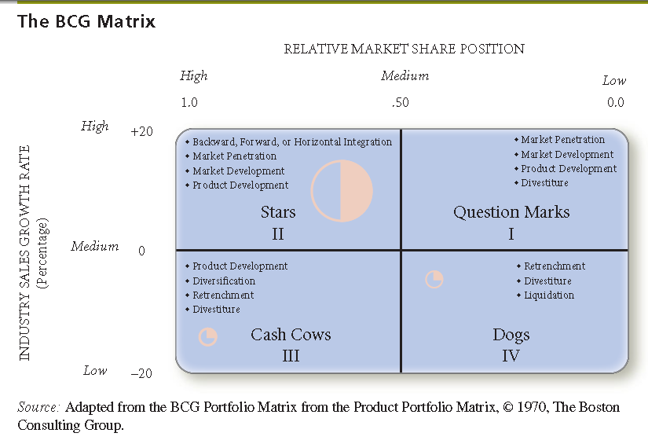
Cont’d…

Slide 7
Cont’d…
The major benefit of the BCG Matrix is that it draws attention to the cash flow, investment characteristics, and needs of an organization’s various divisions.
The divisions of many firms evolve over time: Dogs become Question Marks, Question Marks become Stars, Stars become Cash Cows, and Cash Cows become Dogs in an ongoing counter clockwise motion.
Less frequently, Stars become Question Marks, Question Marks become Dogs, Dogs become Cash Cows, and Cash Cows become Stars (in a clockwise motion).
In some organizations, no cyclical motion is apparent. Over time, organizations should strive to achieve a portfolio of divisions that are Stars.

Slide 8
Example of BCG Matrix
An organization composed of five divisions with annual sales ranging from $5,000 to $60,000.
Division 1 has the greatest sales volume, so the circle representing that division is the largest one in the matrix.
The circle corresponding to Division 5 is the smallest because its sales volume ($5,000) is least among all the divisions. The pie slices within the circles reveal the percent of corporate profits contributed by each division.
As shown, Division 1 contributes the highest profit percentage, 39 percent.
Notice in the diagram that Division 1 is considered a Star, Division 2 is a Question Mark, Division 3 is also a Question Mark, Division 4 is a Cash Cow, and Division 5 is a Dog.

Slide 9
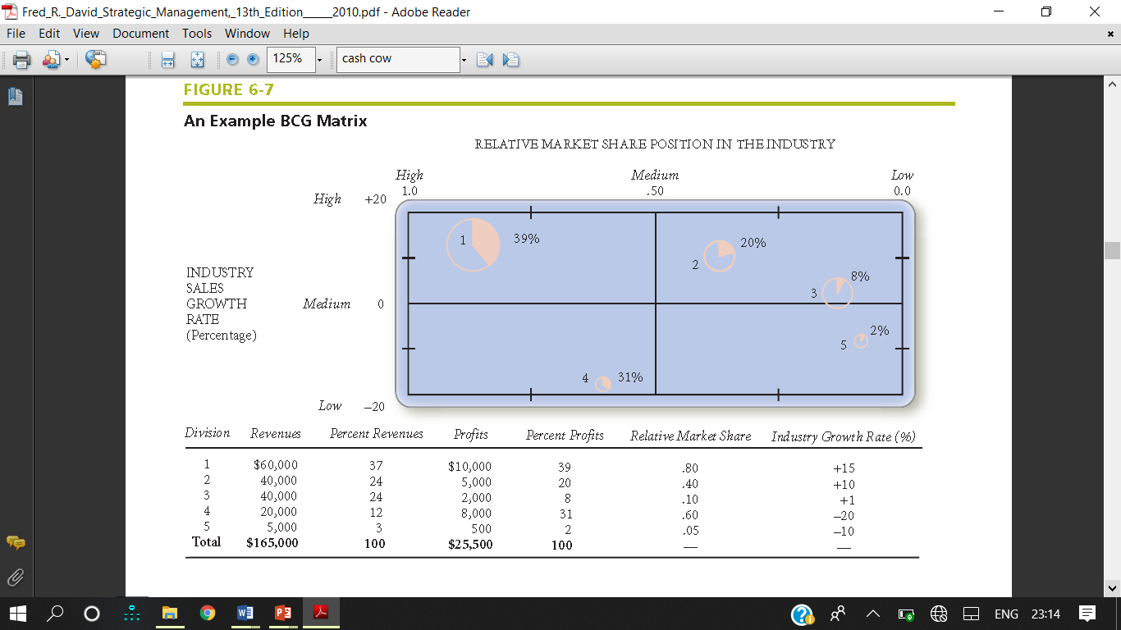
Cont’d…

Slide 10
The BCG Matrix Limitations
Viewing every business as either a Star, Cash Cow, Dog, or Question Mark is an oversimplification; many businesses fall right in the middle of the BCG Matrix and thus are not easily classified.
Furthermore, the BCG Matrix does not reflect whether or not various divisions or their industries are growing over time; that is, the matrix has no temporal qualities, but rather it is a snapshot of an organization at a given point in time.
Finally, other variables besides relative market share position and industry growth rate in sales, such as size of the market and competitive advantages, are important in making strategic decisions about various divisions.

Slide 11
The Internal-External (IE) Matrix
This is also an important matrix of matching stage of strategy formulation. This matrix is already explained earlier. It relate to internal (IFE) and external factor evaluation (EFE).
The findings form internal and external position and weighted score plot on it. It contains nine cells. Its characteristics is as follow:
Positions an organization’s various divisions in a nine-cell display.
Similar to BCG Matrix except the IE Matrix:
Requires more information about the divisions
Strategic implications of each matrix are different

Slide 12
Cont’d…
For these reasons, strategists in multidivisional firms often develop both the BCG Matrix and the IE Matrix in formulating alternative strategies.
A common practice is to develop a BCG Matrix and an IE Matrix for the present and then develop projected matrices to reflect expectations of the future.

Slide 13
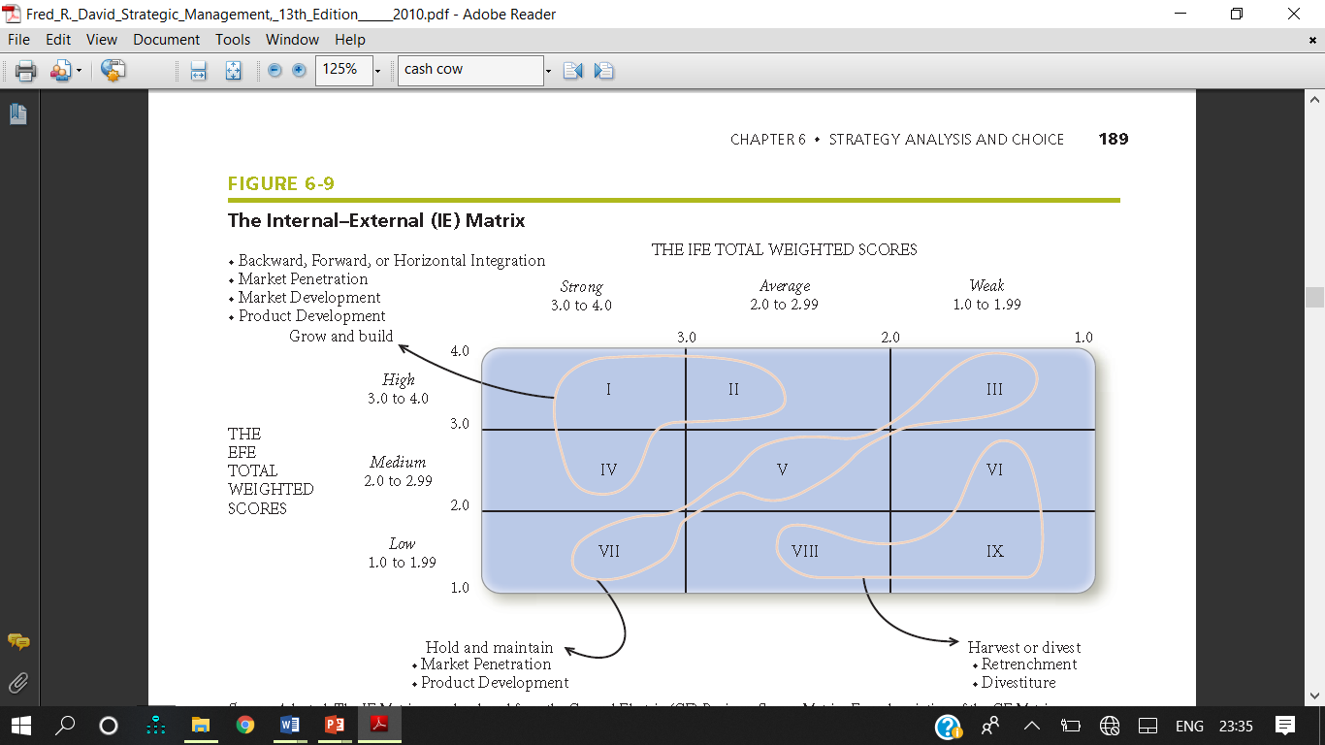

Slide 14
Steps for the development of IE matrix
Based on two key dimensions IFE and EFE.
Plot IFE total weighted scores on the x-axis and the EFE total weighted scores on the y axis
On the x-axis of the IE Matrix, an IFE total weighted score of 1.0 to 1.99 represents a weak internal position; a score of 2.0 to 2.99 is considered average; and a score of 3.0 to 4.0 is strong.
On the y-axis, an EFE total weighted score of 1.0 to 1.99 is considered low; a score of 2.0 to 2.99 is medium; and a score of 3.0 to 4.0 is high.
IE Matrix divided into three major regions.
Grow and build – Cells I, II, or IV
Hold and maintain – Cells III, V, or VII
Harvest or divest – Cells VI, VIII, or IX

Slide 15
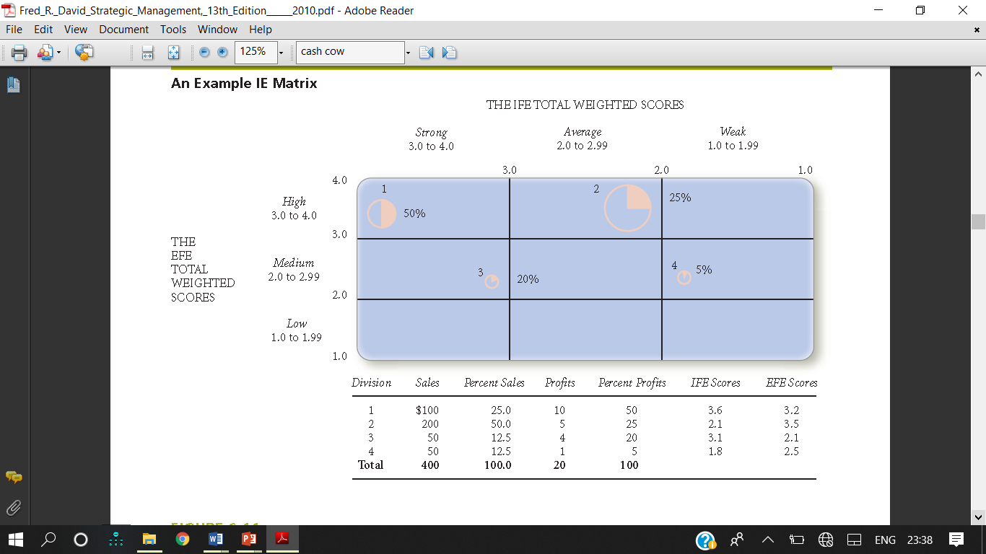

Slide 16
The Grand Strategy Matrix
In addition to the SWOT Matrix, SPACE Matrix, BCG Matrix, and IE Matrix, the Grand Strategy Matrix has become a popular tool for formulating alternative strategies.
All organizations can be positioned in one of the Grand Strategy Matrix’s four strategy quadrants.
Grand Strategy Matrix is based on two evaluative dimensions: competitive position and market (industry) growth.
Any industry whose annual growth in sales exceeds 5 percent could be considered to have rapid growth.
Appropriate strategies for an organization to consider are listed in sequential order of attractiveness in each quadrant of the matrix.

Slide 17
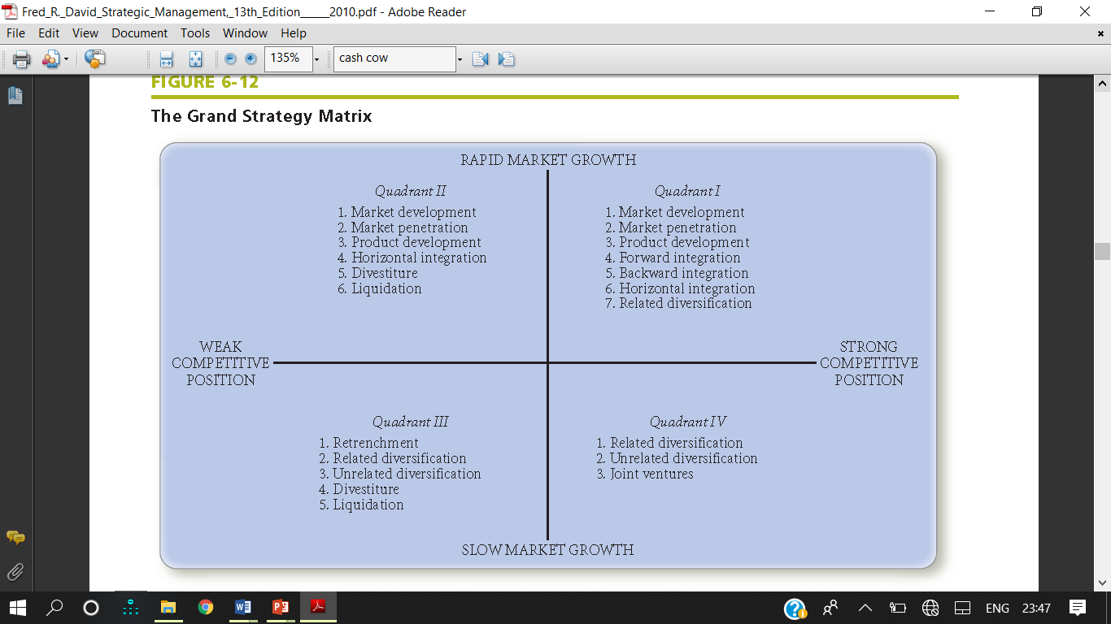

Slide 18
Quadrant-I
Firms located in Quadrant I of the Grand Strategy Matrix are in an excellent strategic position. For these firms, continued concentration on current markets (market penetration and market development) and products (product development) is an appropriate strategy.
It is unwise for a Quadrant I firm to shift notably from its established competitive advantages.
When a Quadrant I organization has excessive resources, then backward, forward, or horizontal integration may be effective strategies.
When a Quadrant I firm is too heavily committed to a single product, then related diversification may reduce the risks associated with a narrow product line.
Quadrant I firms can afford to take advantage of external opportunities in several areas. They can take risks aggressively when necessary.

Slide 19
Quadrant - II
Firms positioned in Quadrant II need to evaluate their present approach to the marketplace seriously. Although their industry is growing, they are unable to compete effectively, and they need to determine why the firm’s current approach is ineffective and how the company can best change to improve its competitiveness.
Because Quadrant II firms are in a rapid-market-growth industry, an intensive strategy (as opposed to integrative or diversification) is usually the first option that should be considered.
However, if the firm is lacking a distinctive competence or competitive advantage, then horizontal integration is often a desirable alternative.
As a last resort, divestiture or liquidation should be considered. Divestiture can provide funds needed to acquire other businesses or buy back shares of stock

Slide 20
Quadrant - III
Quadrant III organizations compete in slow-growth industries and have weak competitive positions.
These firms must make some drastic changes quickly to avoid further decline and possible liquidation.
Extensive cost and asset reduction (retrenchment) should be pursued first. An alternative strategy is to shift resources away from the current business into different areas (diversify).
If all else fails, the final options for Quadrant III businesses are divestiture or liquidation.

Slide 21
Quadrant - IV
Finally, Quadrant IV businesses have a strong competitive position but are in a slow growth industry.
These firms have the strength to launch diversified programs into more promising growth areas:
Quadrant IV firms have characteristically high cash-flow levels and limited internal growth needs and often can pursue related or unrelated diversification successfully.
Quadrant IV firms also may pursue joint ventures.

Slide 22
The Decision Stage
Analysis and intuition provide a basis for making strategy-formulation decisions.
The matching techniques just discussed reveal feasible alternative strategies. Many of these strategies will likely have been proposed by managers and employees participating in the strategy analysis and choice activity.
Any additional strategies resulting from the matching analyses could be discussed and added to the list of feasible alternative options.
As indicated earlier in this chapter, participants could rate these strategies on a 1 to 4 scale so that a prioritized list of the best strategies could be achieved.

Slide 23
The Quantitative Strategic Planning Matrix (QSPM)
Quantitative Strategic Planning Matrix (QSPM) is a technique used to determine the relative attractiveness of feasible alternative actions.
This technique is the which comprises Stage 3 of the strategy-formulation analytical framework.
It helps to judge objectively indicates which alternative strategies are best.
The QSPM uses input from Stage 1 analyses and matching results from Stage 2 analyses to decide objectively among alternative strategies.
Like other strategy-formulation analytical tools, the QSPM requires good intuitive judgment

Slide 24
Cont’d….
Conceptually, the QSPM determines the relative attractiveness of various strategies based on the extent to which key external and internal critical success factors are capitalized upon or improved.
The relative attractiveness of each strategy within a set of alternatives is computed by determining the cumulative impact of each external and internal critical success factor.

Slide 25
Example QSPM
QSPM for a retail computer store is provided in next. This example illustrates all the components of the QSPM: Strategic Alternatives, Key Factors, Weights, Attractiveness Scores (AS), Total Attractiveness Scores (TAS), and the Sum Total Attractiveness Score. The three new terms just introduced—
(1) Attractiveness Scores,
(2) Total Attractiveness Scores, and
(3) the Sum Total Attractiveness Score—are defined and explained as the six steps required to develop a QSPM are discussed.

Slide 26
Cont’d….
Make a list of the firm’s key external opportunities/threats and internal strengths/weaknesses in the left column of the QSPM. This information should be taken directly from the EFE Matrix and IFE Matrix. A minimum of 10 external key success factors and 10 internal key success factors
Assign weights to each key external and internal factor.
Examine the Stage 2 (matching) matrices, and identify alternative strategies that the organization should consider implementing.

Slide 27
Cont’d….
Determine the Attractiveness Scores (AS) defined as numerical values that indicate the relative attractiveness of each strategy in a given set of alternatives. Attractiveness Scores (AS) are determined by examining each key external or internal factor, one at a time, and asking the question “Does this factor affect the choice of strategies being made?”
If the answer to this question is “YES”, then the strategies should be compared relative to that key factor.
Specifically, Attractiveness Scores should be assigned to each strategy to indicate the relative attractiveness of one strategy over others, considering the particular factor.

Slide 28
Cont’d….
The range for Attractiveness Scores is 1 = not attractive, 2 = somewhat attractive, 3 = reasonably attractive, and 4 = highly attractive. By attractive, we mean the extent that one strategy, compared to others, enables the firm to either capitalize on the strength, improve on the weakness, exploit the opportunity, or avoid the threat.
Work row by row in developing a QSPM. If the answer to the previous question is “NO”, indicating that the respective key factor has no effect upon the specific choice being made, then do not assign Attractiveness Scores to the strategies in that set. Use a dash to indicate that the key factor does not affect the choice being made.
Note: If you assign an AS score to one strategy, then assign AS score(s) to the other. In other words, if one strategy receives a dash, then all others must receive a dash in a given row.

Slide 29
Cont’d….
5 Compute the Total Attractiveness Scores. Total Attractiveness Scores (TAS) are defined as the product of multiplying the weights (Step 2) by the Attractiveness Scores (Step 4) in each row.
The Total Attractiveness Scores indicate the relative attractiveness of each alternative strategy, considering only the impact of the adjacent external or internal critical success factor.
The higher the Total Attractiveness Score, the more attractive the strategic alternative (considering only the adjacent critical success factor).

Slide 30
Cont’d….
6 Compute the Sum Total Attractiveness Score. Add Total Attractiveness Scores in each strategy column of the QSPM.
The Sum Total Attractiveness Scores (STAS) reveal which strategy is most attractive in each set of alternatives. Higher scores indicate more attractive strategies, considering all the relevant external and internal factors that could affect the strategic decisions.
The magnitude of the difference between the Sum Total Attractiveness Scores in a given set of strategic alternatives indicates the relative desirability of one strategy over another.

Slide 31
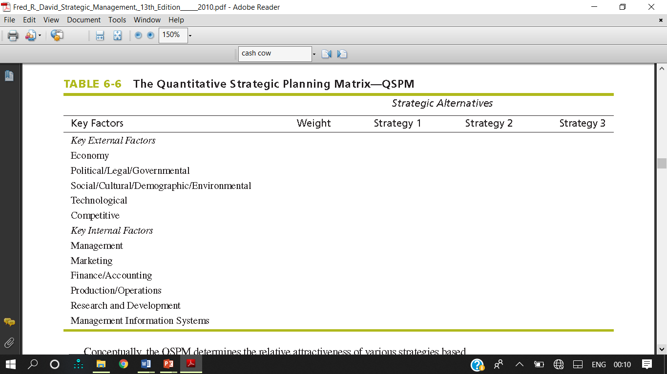
Format of Quantitative Strategic Planning Matrix (QSPM)

Slide 32
Example QSPM
Two alternative strategies—
(1) buy new land and build new larger store and
(2) fully renovate existing store—are being considered by a computer retail store.
Note by sum total attractiveness scores of 4.63 versus 3.27 that the analysis indicates the business should buy new land and build a new larger store. Note the use of dashes to indicate which factors do not affect the strategy choice being considered.
If a particular factor affects one strategy but not the other, it affects the choice being made, so attractiveness scores should be recorded for both strategies. Never rate one strategy and not the other.

Slide 33
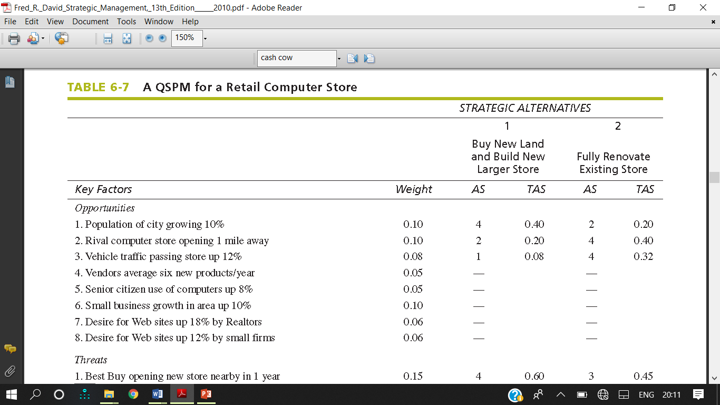

Slide 34
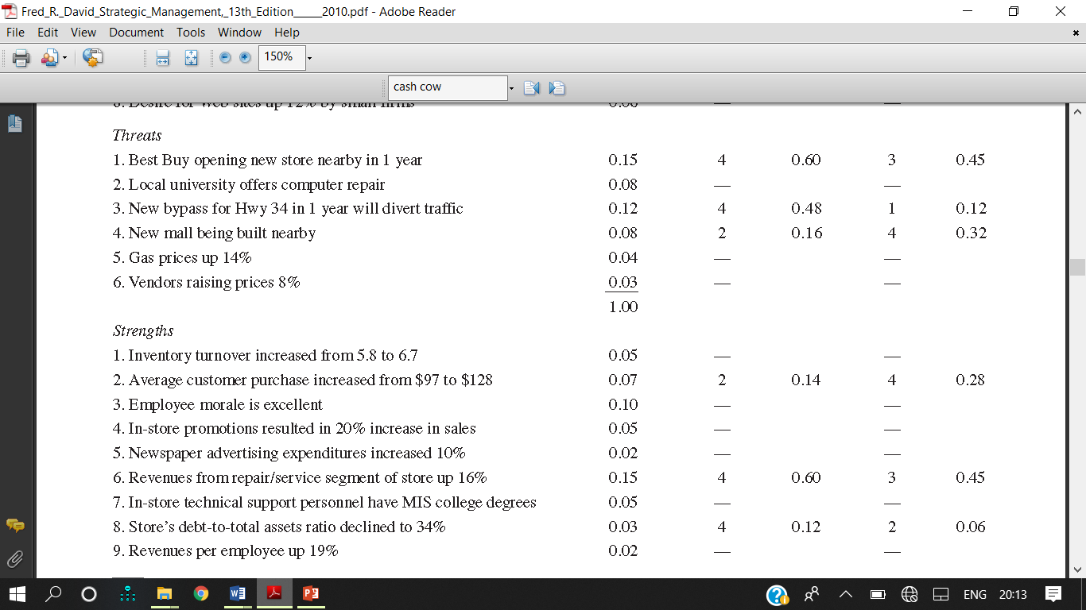

Slide 35
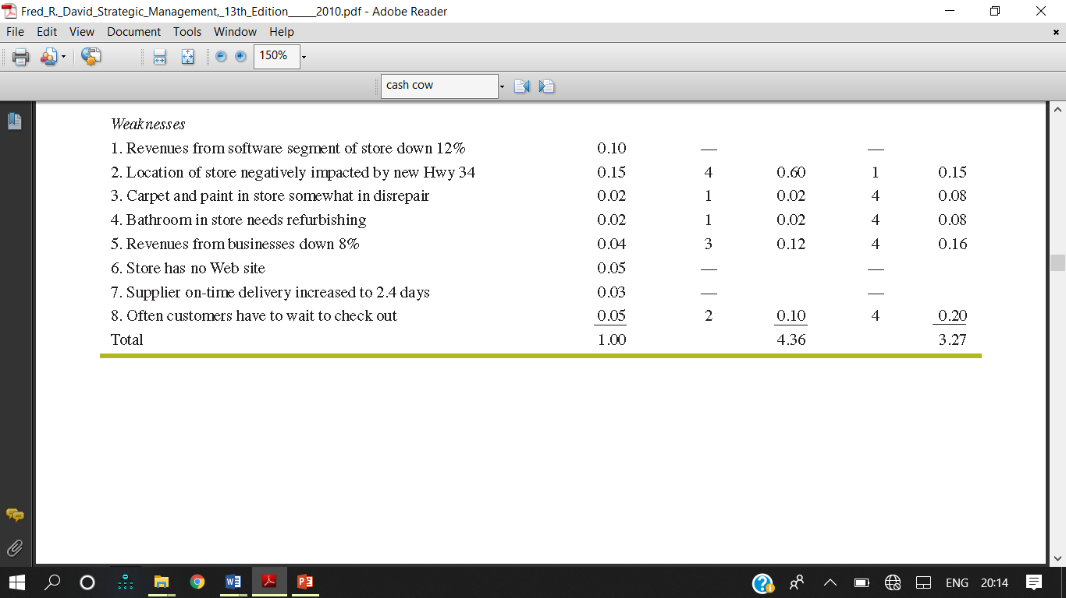

Slide 36
Limitations
Requires intuitive judgments and educated assumptions
Only as good as the prerequisite inputs
Only strategies within a given set are evaluated relative to each other
Advantages
Sets of strategies considered simultaneously or sequentially
Integration of pertinent external and internal factors in the decision making process

Slide 37
Reading Assignment
  BSC model
  The 7’S model
  Concept of Stretch, Leverage & fit

