Slide 1

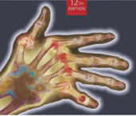
Radiographic Positioning
MeRT2122
(10 ECTS)
Hailegebriel Shiferaw (MRT, PH, MSc)
Department of Medical Radiology Technology
Hawassa University
3/9/2020

Slide 2
Radiographic Positioning
UNIT FOUR
Vertebral Column
3/9/2020

Slide 3
Objectives
At the end of these lesson the student will be able to;
Given diagrams, radiographs, or dry bones, names and describe the bones of vertebral column.
Differentiate between the curves of the vertebral column, to include primary curves, compensatory curves, lordosis, kyphosis and scoliosis.
State the criteria used to determine positioning accuracy on the radiographs of the vertebral column
Evaluate radiographs of the vertebral column in terms of positioning, centring, image quality, radiographic anatomy and pathology.
3/9/2020

Slide 4
What is spine?
3/9/2020

Slide 5
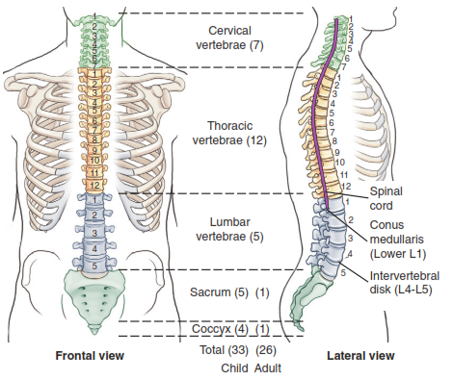
SPINE
3/9/2020

Slide 6
Anatomy
The vertebral column commonly referred to as spine.
Located posteriorly on the midsagittal plane of the body and extends inferiorly from the base of the skull to the tailbone to constitute the longitudinal axis or backbone of the axial skeleton.
A group of 33 bones stake on each other to form column
.
3/9/2020

Slide 7
Anatomy …cont’d
The sturdy column
Supports the head
Surrounds and protects the spinal cord
Transmits the weigh of trunk to the lower limbs
Serves as articulation for the ribs of bony thorax and
Allows for the attachment of many muscles of back.
3/9/2020

Slide 8
Anatomy …cont’d
The vertebral column is divided in to regions according to location and structure of the vertebrae
    Seven cervical located in the neck
    Twelve thoracic vertebrae constitute the posterior thorax
    Five lumbar vertebrae are located posterior to abdomen and form the lower back
    The sacrum and coccyx, both are located in the pelvis.
3/9/2020

Slide 9
Anatomy …cont’d
The sacrum is formed by the fusion of five sacral vertebra and the coccyx are formed by fusion of four coccygeal segments in adulthood.
3/9/2020

Slide 10
Curvature of the vertebral column
The spine is not a straight, inflexible column of bone.
The majority of the vertebral column is curved at birth, with its concavity facing forward.
Additional curvature occurs as the child starts to lift his head and begins to walk.
3/9/2020

Slide 11
Curvature of the vertebral column
The anterior concavity is maintained in the thoracic and sacro-coccigeal regions hence they are given the name primary curve.
The secondary curves develope on the lumbar and cervical regions which are convex anteriorly.
3/9/2020

Slide 12
Curvature of the vertebral …cont’d
On occasion, the normal curves of the vertebral column may become distorted as the result of disease, traums or congenital.
Kyphosis (an exaggerated thoracic curvature and more convex)- individuals suffering from osteoporosis
Lordosis (the lumbar curvature becomes exaggerated and more concave)-individuals who carryindg excessively heavey weight in front of the body, being very obese, wearing shoes with very high heels.
Scoliosis (an abnormal lateral curvature of the spine)- scolio-means bent, crooked
3/9/2020

Slide 13
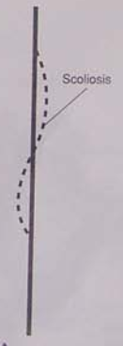
Curvature of the Spine
3/9/2020

Slide 14
Characteristics of typical vertebra
Each vertebra is an irregularly shaped bone composed of two main parts:
Body
Vertebral arch
Body /centrum/
  is anterior, weight-bearing portion of vertebra
  Cylindrical in shape with a slightly flattened posterior surface.
  Superior and inferior surface of the body are flat and rough
3/9/2020

Slide 15
Characteristics of typical vertebra
Vertebral arch
  is the posterior ringlike portion of the vertebra
  Attaches to the body to enclose an opening known as vertebral foramen through this channel spinal cord passes.
  Completely surrounds and protects the spinal cord
  is formed by two pedicles and two laminae.
3/9/2020

Slide 16
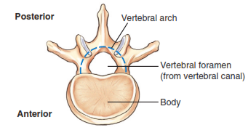
Typical vertebra
3/9/2020

Slide 17
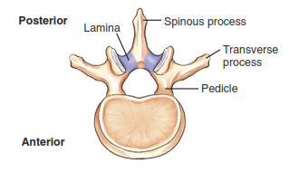
Typical vertebra
3/9/2020

Slide 18
Patient preparation
A patient preparing for a radiographic examination of the cervical spine should be instructed to remove:
    Any earrings
    Necklaces
    Eye glasses
    Oral appliances
    Etc
It may be necessary for the patient to remove clothing above the waist and wear a patient gown.
3/9/2020

Slide 19
Patient preparation …cont’d
For radiographic of the Thoracic spine, patients must remove all clothing and jewellery above the waist and dress in a patients gown that is open in the back.
Lumbar spine radiography requires removal of all clothing above and below waist to eliminate possibility of artifacts on the film.
3/9/2020

Slide 20
Patient preparation …cont’d
Traumatic care
If an accident victim arrives in the radiology department on a stretcher, extreme care must be taken.
Any clothing that interferes with the procedure may have to be carefully removed or cut away.
3/9/2020

Slide 21
Radiographic Positioning of the Vertebral Column
3/9/2020

Slide 22
Cervical spine
Anteroposterior (AP) Cervical spine
Clinical indications
Pathology involving the mid and lower cervical spine (C3 to C7)
Demonstrates clay shoveler’s fracture /avulsion fracture of the spinous process/, compression fractures, and herniated nucleus pulposus (HNP) etc.
3/9/2020

Slide 23
Cervical spine …cont’d
Technical consideration
Film size: 18x24cm/24x30cm lengthwise
Grid: required
Collimation: to the soft tissue of neck crosswise and to film lengthwise.
Shielding: apply gonadal shield
Minimum subject image distance 100cm
3/9/2020

Slide 24
Cervical spine …cont’d
Patient positioning
Assist the patient to the supine position on the radiographic table or standing in front of an upright grid with the posterior aspect of the head and shoulder against the stand Bucky.
Centre the midsagittal plane of the patient to the midline of the table.
3/9/2020

Slide 25
Cervical spine …cont’d
Part Positioning
Extend the patient’s head so that a line between the upper occlusal plane and the mastoid tips become perpendicular to the film plane.
Central Ray
Direct the central ray 15 to 20⁰ cephalad to a point slightly inferior to the most prominent point of the thyroid cartilage.
Centre the cassette to the central ray
3/9/2020

Slide 26
Cervical spine …cont’d
Image Evaluation
Soft tissue of the neck, lower five cervical vertebrae and upper two thoracic vertebrae should be included in the collimated area.
Bony trabeculae should be seen within vertebral bodies.
The fourth cervical body should be in the middle of the film.
The mastoid tips should be symmetrical.
The mandible should be superimposed over the base of the skull.
The intervertebral disk spaces should be clearly demonstrated.
3/9/2020

Slide 27
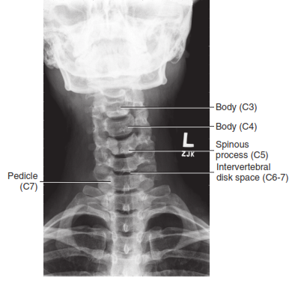
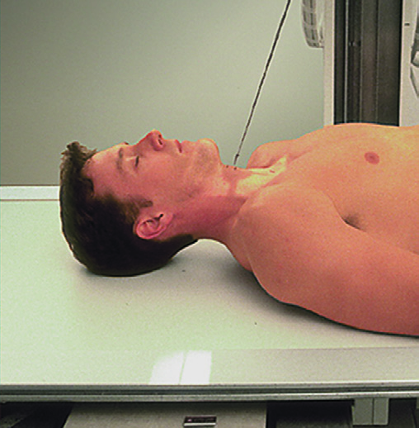
AP Cervical spine …cont’d
Breathing instruction
Instruct the patient to stop breathing during the exposure.
3/9/2020

Slide 28
Lateral C -spine
Clinical indications
Pathology involving the cervical spine and adjacent soft tissue structures, including spondylosis and osteoarthritis
Technical consideration
Film size: 18x24cm/24x30cm
Grid is required
65-75 kvp
Collimate to the soft tissue of the neck crosswise and to the film size lengthwise.
SID 150cm
3/9/2020

Slide 29
Lateral C –spine …cont’d
Shielding
Gonadal shield should be applied on all patients, specially children and adults of reproductive age.
Patient Positioning
Assist the patient to lateral erect position in front of the upright grid device with the arms positioned comfortably at the sides, either lateral may be performed depending on department protocol.
3/9/2020

Slide 30
Lateral C –spine …cont’d
Part Positioning
Centre the coronal plane passing through the external auditory meatus (EAM) to the midline of the upright grid device.
Adjust the entire patient’s body to a true lateral position, with the shoulder nearest the film firmly against the upright grid device.
Elevate the patient’s chin slightly to prevent superimposition of the mandible over the anterior arch of C1.
Depress the shoulder as much as possible and suspend small sandbags of equal weight from each wrist for immobilization.
3/9/2020

Slide 31
Lateral C -spine…cont’d
Central ray
Direct the central ray perpendicular to C4, located at the level of the uppermost part of the thyroid cartilage.
Breathing Instructions
Instruct the patient to take in a breath, blow it out, then hold it during the exposure.
3/9/2020

Slide 32
Lateral C -spine…cont’d
Imaging evaluation
Soft tissue structures of the neck and C1 through C7 should be included in the collimated area.
Bony trabeculae should be seen within the vertebral bodies and spinous process.
The fourth cervical body should be in the middle of the film.
The inter vertebral disk spaces and spines process of C2 through C7 should be clearly demonstrated.
The first two cervical vertebrae should be seen free of superimposition of the mandible.
The EAM, should be superimposed.
3/9/2020

Slide 33
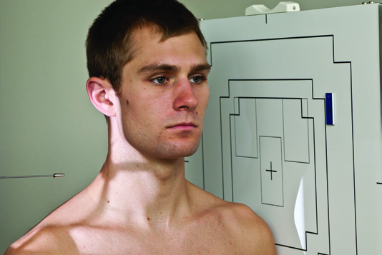
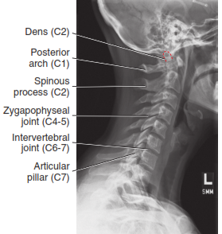
Lateral C –spine
3/9/2020

Slide 34
Oblique C -spine
Clinical indications
Pathology involving the cervical spine and adjacent soft tissue structures, including stenosis involving the intervertebral foramen
Both right and left oblique projections should be taken for comparison purposes.
Anterior oblique positions /RAO, LAO/ are preferred because of reduced thyroid doses.
3/9/2020

Slide 35
Oblique C –spine …cont’d
Technical consideration
Film size: 18x24cm/24x30cm
Grid or non grid
Exposure factor 65-75 kvp
SID 100cm
Collimate to the soft tissue of the neck crosswise and to the film size lengthwise.
Shielding
Gonadal shield should be applied on all patients, specially children and adults of reproductive age.
3/9/2020

Slide 36
Oblique C –spine …cont’d
Patient Positioning
Assist the patient to the AP seated or standing position in front of the upright grid device.
Note: The RAO and LAO projections may be substituted for the LPO and RPO projections.
3/9/2020

Slide 37
Oblique C –spine …cont’d
Part positioning
Rotate the entire body and head to form a 45⁰ angle between the coronal plane and the film; the shoulder nearest the film should be firmly positioned against the upright grid device.
Centre the cervical spine to the midline of the upright grid device;
Elevate the patient’s chin slightly to minimize superimposition of the mandible over the spine; both obliques are obtained.
3/9/2020

Slide 38
Oblique C –spine …cont’d
Central Ray
Direct the central ray 15⁰ to 20⁰ cephalad to a point slightly inferior to the level of the most prominent point of the thyroid cartilage and through the fourth cervical vertebra.
Breathing Instructions
Instruct the patient to stops breathing during the exposure.
3/9/2020

Slide 39
Oblique C –spine …cont’d
Image Evaluation
Soft tissue structure of the neck , lower five cervical vertebrae, and upper two thoracic vertebrae should be included in the collimated area.
The fourth cervical body should be in the middle of the film.
The intervertebral foramina furthest from the film should be clearly demonstrated.
C1 should be demonstrated without superimposition of the occipital bone.
The intervertebral disk spaces should be clearly demonstrate
The mandible should not be superimposed over the cervical vertebrae.
3/9/2020

Slide 40
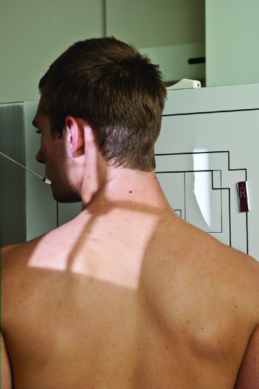
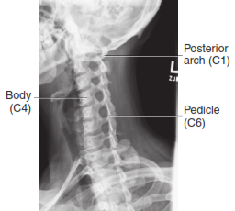
RAO C –spine
3/9/2020

Slide 41
Atlas and Axis (Open mouth-Odontoid)
Antero- posterior
Clinical indications
Pathology (particularly fractures) involving C1 and C2 and adjacent soft tissue structures
Demonstrates odontoid and Jefferson fractures (the fracture of anterior and posterior arches of C1).
Technical consideration
Film size- 18x24cm/24x30cm
Grid required
65-75kvp
Collimate to the area of interest
Minimum SID 100cm
3/9/2020

Slide 42
Atlas and Axis …cont’d
Shielding
Gonad shielding should be used in all patients
Patient positioning
Assist the patient to the supine position on the radiographic table.
Centre the midsagittal plane of the patient to the midline of the table
Adjust the axis of the patient parallel with the long axis of the table
3/9/2020

Slide 43
Atlas and Axis …cont’d
Part Positioning
Instruct the patient to open the mouth as wide as possible
Position the patient’s head so that a line between the lower margin of the upper incisors and the base of the skull (level of the mastoid tips) is perpendicular to the film plane.
Central Ray
Direct the central ray perpendicular to C1 through the open mouth.
Centre the cassette to the central ray.
Breathing instructions
Instruct the patient to maintain the wide open mouth and say “ah” during the exposure.
3/9/2020

Slide 44
Atlas and Axis …cont’d
Image Evaluation
The entire atlas and axis should be included in the collimated area
Bony trabiculae should be seen within the lateral masses of C1, the dens, and the vertebral body of C2.
C1 should be in the middle of the film.
The lateral masses should be equal distances from the rami of the mandible
The lower edge of the upper incisors should be even with the base of the skull.
3/9/2020

Slide 45
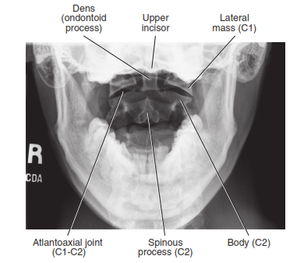
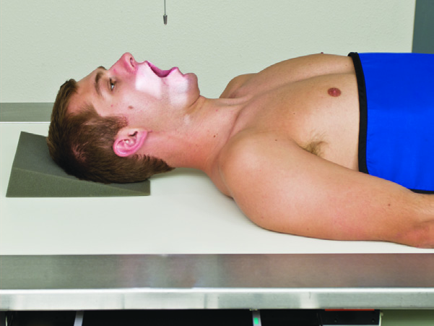
AP Open-mouth
3/9/2020

Slide 46
Cervicothoracic spine
Lateral swimmers’ position
Clinical indications
Pathology involving the inferior cervical spine, superior thoracic spine, and adjacent soft tissue structures
Various fractures (including compression fractures) and subluxation
This is a good projection when C7 to T1 is not visualized on the lateral cervical spine
3/9/2020

Slide 47
Cervicothoracic …cont’d
Lateral swimmers’ position
Technical consideration
Film size 24x30cm
Grid required
70-85 kvp
SID 150cm
Collimate to the soft tissue of the neck crosswise and to film size lengthwise
3/9/2020

Slide 48
Cervicothoracic …cont’d
Shielding
Gonadal shielding should be used on all patients, especially children and adults of reproductive age.
Patient positioning
Assist the patient to lateral recumbent/standing position on the radiographic table.
3/9/2020

Slide 49
Cervicothoracic …cont’d
Part Positioning
Centre the midaxillary plane to the middle of the table.
Adjust the entire patient’s body to a true lateral position
The arm nearest the film raised above the head and the shoulder moved slightly anteriorly
The forearm or sponge should be used to support the patient’s head
Keeping the spine parallel to the table top.
Adjust the head so it is in true lateral position.
3/9/2020

Slide 50
Cervicothoracic …cont’d
Part Positioning
Depress the shoulder furthest from the film rotate it slightly posteriorly to prevent superimposition of the shoulders over the spine, the thoracic spine should remain lateral for this projection.
Place a sheet of leaded rubber on the table behind the patient to reduce the amount of scatter radiation reaching the film and improve radiographic quality.
3/9/2020

Slide 51
Cervicothoracic …cont’d
Central ray
Direct the central ray 3 to 5⁰ cauded through T1, located at the level of the vertebral prominence
Centre the cassette to the central ray.
Breathing instruction
Instruct the patient to take in a breath, blow it out, then hold it during the exposure.
3/9/2020

Slide 52
Cervicothoracic …cont’d
Image evaluation
Soft tissue structure of the neck and C5 through T4 should be included in collimated area.
Bony trabeculae should be seen within the vertebral bodies and spinous processes.
The vertebral disk space of C5 through T4 should be clearly demonstrated.
The vertebral bodies should appear box like, no rotation should be evident.
The humeral head should be separated.
3/9/2020

Slide 53
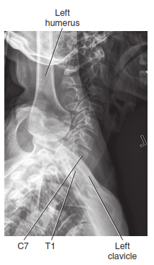
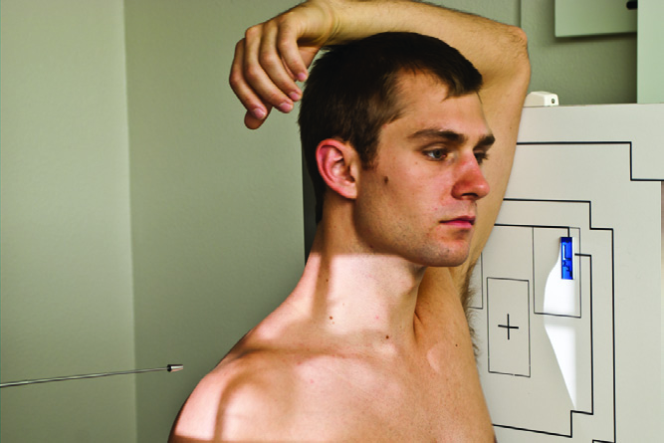
Lateral swimmers’
3/9/2020

Slide 54
Thoracic spine
AP Thoracic Spine
Clinical indications
Compression fractures
Subluxation
Kyphosis
Technical Consideration
Film size: 30x40, 15x40
Grid required
SID 100cm
Collimate to the spine crosswise and to film size lengthwise
3/9/2020

Slide 55
Thoracic spine …cont’d
Shielding
Gonad shielding should be used on all patients, especially children and adults of reproductive age
Patient Positioning
Assist the patient to the supine position on the radiographic table. With knees and hips flexed and support the leg.
Centre the midsagittal plane of the patient to the midline of the table, the head and shoulder should not be rotated.
The patient arm should rest comfortably on the radiographic table.
3/9/2020

Slide 56
Thoracic spine …cont’d
Central Ray
Direct the central ray perpendicular to the film through T7 or 1 to 2 inches below sternal angle
Centre the cassette to the central ray
Breathing instruction
Instruct the patient either to take slow, shallow breath or take a breath in, blow it out and hold during exposure.
3/9/2020

Slide 57
Thoracic spine …cont’d
Image Evaluation
The vertebral bodies of C7 through L1 should be included in the collimated area
Bony trabeculae should be seen within the vertebral bodies.
The seventh thoracic body should be in the middle of the film
The sterno-clavicular joints should be symmetrical
Spinous process should be seen at the midline of the vertebrae
The intervertebral disc space should be clearly demonstrated
3/9/2020

Slide 58
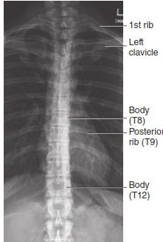
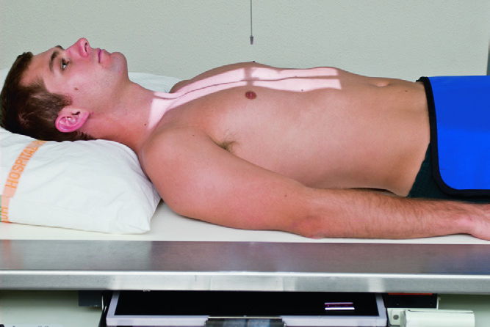
AP Thoracic Spine
3/9/2020

Slide 59
Thoracic spine …cont’d
Lateral thoracic spine
Technical Consideration
Film Size: 30x40cm
Grid required
Exposure factor 70-85kvp
SID 100cm
Collimate to the spine
Apply gonad shield
Patient Positioning
Assist the patient to the left lateral position on the radiographic table.
Flex the knees and hip for comfort and balance.
3/9/2020

Slide 60
Thoracic spine …cont’d
Part Positioning
Centre the midaxillary plane to the midline of the table.
Adjust the long axis of the spine to lie parallel with the long axis of the table, the right leg should lie directly over the left leg.
Adjust the body so that the line through the shoulders and another through the hips are perpendicular to the film plane.
Place a sheet of leaded rubber on the table behind the patient to reduce the amount of scatter radiation reaching the film to improve the amount the quality of the radiograph.
3/9/2020

Slide 61
Thoracic spine …cont’d
Central ray
Direct the central ray perpendicular to the film through T7.
Centre the cassette to the central ray.
Breathing instruction
Instruct the patient either to take slow, shallow breaths during the exposure.
3/9/2020

Slide 62
Thoracic spine …cont’d
Image evaluation
The vertebral bodies of T3 through L1 should be well visualized within the collimated area.
The vertebral bodies should equally be penetrated.
The vertebral bodies should appear boxlike.
The intervertebral disc spaces and pedicles should be clearly demonstrated.
3/9/2020

Slide 63
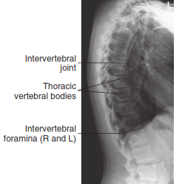
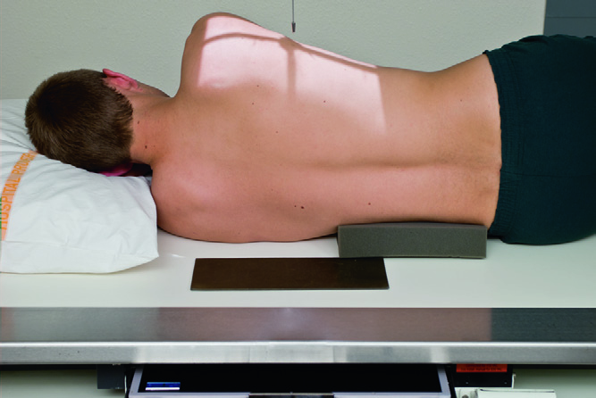
Lateral thoracic spine
3/9/2020

Slide 64
PA Oblique Thoracic spine
Clinical indications
Pathology involving the zygapophyseal joints of the thoracic spine.
Both right and left oblique projections are taken for comparison
3/9/2020

Slide 65
PA Oblique Thoracic spine
Technical consideration
Film Size : 30x40cm
Grid required
70-85 kvp
SID 100cm
Appropriate collimation
Shielding
Apply gonad shield
3/9/2020

Slide 66
PA Oblique Thoracic …cont’d
Patient positioning
Assist the patient to the left lateral position for LAO and to the right lateral position for RAO projection either lying or erect.
Rotate the patient 20⁰ toward the film to form a 70° angle between the coronal plane and film.
The right arm should be elevated with the hand supported on the top of the grid device.
3/9/2020

Slide 67
PA Oblique Thoracic …cont’d
Patient positioning
The left arm should be positioned with the elbow flexed and the back of the hand resting on the hip.
Centre the thoracic spine at the midline of the upright grid device. The shoulder nearest the film should be positioned firmly against the upright grid device.
3/9/2020

Slide 68
PA Oblique Thoracic …cont’d
Central Ray
Direct the central ray perpendicular to the film through T7
Centre the cassette to the central ray
Breathing technique
Allow the patient shallow breathing or tell the patient to take breath in, below it out and hold during exposure
3/9/2020

Slide 69
PA Oblique Thoracic …cont’d
Image Evaluation
The vertebral bodies of C7 through L1 should be well visualised within the collimated area.
Bony trabeculae should be seen within the vertebral bodies
The 7th thoracic body should be in the middle of the film
The first through 12th vertebral bodies should be adequately penetrated
3/9/2020

Slide 70
LAO RAO
3/9/2020

Slide 71
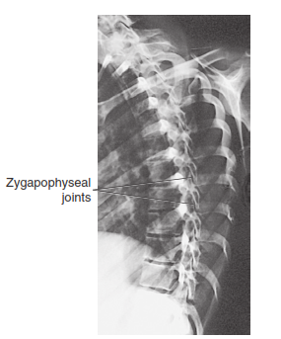
RAO
3/9/2020

Slide 72
Lumbar spine
AP Lumbar spine
Clinical indications
Pathology of the lumbar vertebrae, including fractures, scoliosis, and neoplastic processes
Prepare the patient
The patient should be instructed to be on a low residue diet and to take laxative drug (dulcolax, caster oil or Epsom salt) during 24 hours prior to the examination. In the case of emergency radiography no bowel preparation is possible.
3/9/2020

Slide 73
Lumbar spine …cont’d
Technical consideration
Film size 24x30cm
Grid required
70-80kvp
SID 100cm
Apply proper collimation
Shielding
Apply gonad shield
Patient positioning
Assist the patient to the supine position on the radiographic table; tell the patient to flex his/her knees and hips for proper contact with the table then to the film. Support the legs on suitable support.
3/9/2020

Slide 74
Lumbar spine …cont’d
Part positioning
Centre the midsagittal plane of the patient to the midline of the table
Position the patient’s hands comfortably on the upper chest or radiographic table.
Central ray
Direct the central ray perpendicular to the film through the L4- 5 interspace (at the level of the iliac crests approximately 3 to 5 cm above the crest).
Centre the cassette to the central ray.
3/9/2020

Slide 75
Lumbar spine …cont’d
Breathing instruction
Instruct the patient to take a breath in below it out and hold it out during exposure.
Image evaluation
The vertebral bodies of T12 through S2 should be included in the collimated area.
The iliac crest should be symmetrical.
Spinous processes should be seen at the midline of the vertebrae and in the middle of the film.
The intervertebral disc spaces should be clearly demonstrated.
3/9/2020

Slide 76
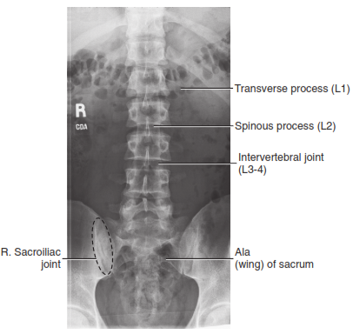
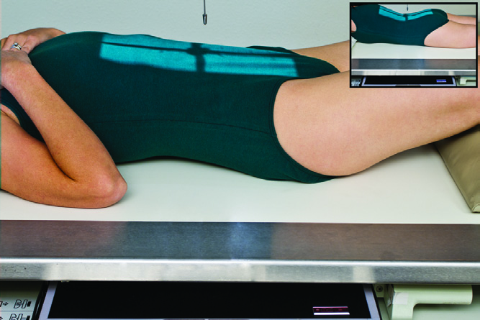
AP Lumbar spine
.
3/9/2020

Slide 77
Lateral Lumbar spine
Clinical indications
Pathology of the lumbar vertebrae including fractures, spondylolisthesis, neoplastic processes, and osteoporosis.
Technical Considerations
Film size 24x30 cm
Gird required
80- 90 kVP
SID 100cm
Collimate to the spine crosswise and to film size lengthwise.
3/9/2020

Slide 78
Lateral Lumbar spine
Shielding
Gonadal shielding should be used on male patients, especially children and adults of reproductive age
Patient positioning
Assist the patient to the lateral recumbent position on the radiographic table, the patient may flex the knees and hips for comfort and balance.
Note: This projection can also be obtained with the patient erect.
3/9/2020

Slide 79
Lateral Lumbar spine …cont’d
Part Positioning
Centre the midaxillary plane to the midline of the table, position the arms at a right angle with the body
Adjust the long axis of the spine to lie parallel with the long axis of the table.
The right leg should be directly over the left leg, a small sandbag between the knees will help prevent rotation.
3/9/2020

Slide 80
Lateral Lumbar spine …cont’d
Part Positioning
Position a firm pillow under the head and radiolucent supports under the waist and lower thoracic area so the spine is parallel with the tabletop.
Adjust the body so a line through the shoulders and another through the hips are perpendicular to the film plane looking down from above the patient or head of the table will help detect any patient rotation.
3/9/2020

Slide 81
Lateral Lumbar spine …cont’d
Central Ray
Direct the central ray perpendicular to the area of the spinal fusion. Approximately 1 to 1.5 in. Above the iliac crest.
Centre the cassette to the central ray.
Breathing instruction
Instruct the patient to take a breath in, below it out and hold it out during the exposure.
3/9/2020

Slide 82
Lateral Lumbar spine …cont’d
Image evaluation
The vertebral bodies of T12 through S2 should be included in the collimated area.
The third lumbar vertebral body should be in the middle of the film.
The through fifth lumbar bodies should be adequately penetrated
The vertebral bodies should appear box like
The intervertebral disk spaces and pedicles should be clearly demonstrated
3/9/2020

Slide 83
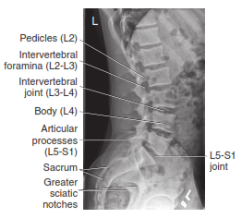
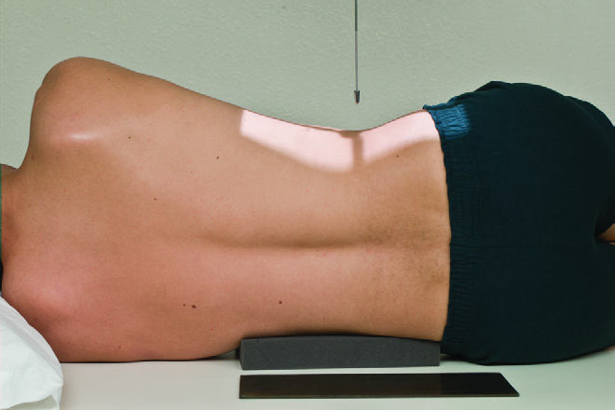
Lateral Lumbar spine
3/9/2020

Slide 84
Right or Left Posterior/Anterior Oblique
Clinical indications
This projection demonstrates pars interarticularis /spondylosis/ and the apophyseal joints on the side nearest the cassette.
Both sides are taken for comparison
Technical consideration
Gird required
Film size 24x30cm
70-80kvp
SID 100cm
Apply proper collimation
Shielding
Apply gonad shield outside region of interest
3/9/2020

Slide 85
Right or Left Posterior …cont’d
Patient positioning
Assist the patient to the supine position on the radiographic table and is then rotated 45° to the right and left side in turn. The patient’s arms are raised with the hands resting on the pillow.
The hips and knees are flexed and the patient is supported with a 45° foam pad placed under the trunk on the raised side.
The cassette is centred at the lower coastal margin
3/9/2020

Slide 86
Right or Left Posterior …cont’d
Central ray
Direct the central ray towards the mid clavicular line on the raised side at the level of the lower costal margin
Breathing Instructions
Instruct the patient to take a breath in, blow it out, and hold it out during the exposure
3/9/2020

Slide 87
Right or Left Posterior …cont’d
Image Evaluation
The vertebral bodies of T12 through S2 should be included in the collimated area.
The third lumbar vertebral body should be in the middle of the film.
When the RPO and LPO projections are compared the iliac should be symmetrical.
The right (RPO) or left (LPO) zygapophyseal joints should be clearly demonstrated.
3/9/2020

Slide 88
RPO LAO
3/9/2020

Slide 89
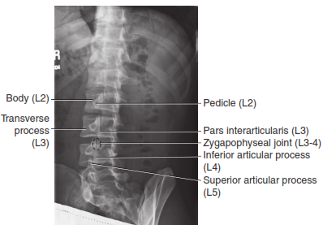
RPO
3/9/2020

Slide 90
Lumbosacral Junction
AP Axial lumbosacral junction
Clinical indications
Pathology of L5-S1 and the sacroiliac joints
Technical consideration
Film size 18x24cm
Grid is used.
SID 100cm
Collimate the area of interest
Shielding
Gonad shield should be applied on male patients.
3/9/2020

Slide 91
Lumbosacral Junction …cont’d
Patient positioning
Assist the patient to the supine position on the radiographic table.
The patients leg should be extended
Part positioning
Centre the midsagittal plane of the patient to the Medline of the x-ray table
Position the patient’s arm comfortably on the radiograph
3/9/2020

Slide 92
Lumbosacral Junction …cont’d
Patient positioning
Central ray
Direct the central ray 30⁰ for male and 35⁰ for female cephalad
Breathing instruction
Instruct the patient to take a breath in, below it out and hold it out during the exposure.
3/9/2020

Slide 93
Lumbosacral Junction …cont’d
Image evaluation
The vertebral bodies of L5 through S1 should be included in the collimated area
Bony trabeculae should be seen within the vertebral bodies
The iliac crests should be symmetrical
3/9/2020

Slide 94
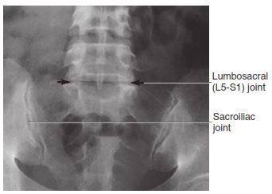
AP Axial Lumbosacral Junction
3/9/2020

Slide 95
Lumbosacral Junction …cont’d
Lateral lumbosacral
Clinical indications
Spondylolisthesis involving L4-L5 or L5-S1 and other L5-S1 pathologies
Technical consideration
Film size 24x30cm
Grid required
85-100kvp
Collimate to the area of interest
Patient Positioning
Assist the patient to the left lateral position on the radiographic table, the patient may flex the knee and hips for comfort.
3/9/2020

Slide 96
Lumbosacral Junction …cont’d
Part positioning
Centre the body to the midline of the table.
Position the arms at a right angle to the body.
Adjust the long axis of the spine to lie parallel with the long axis of the table.
The right leg should be directly over the left leg, a small sand bag between the knees will help prevent rotation.
Position a firm pillow under the head and a radiolucent supports under the waist and lower thoracic area.
3/9/2020

Slide 97
Lumbosacral Junction …cont’d
Centre - to L5-S1 junction
Centre the cassette to the central ray.
Breathing instruction
Instruct the patient to take a breath in, blow it out, and hold it out during the exposure.
3/9/2020

Slide 98
Lumbosacral Junction …cont’d
Image evaluation
The vertebral bodies of L5 through S1 should be visualised within the collimated area.
Bony trabeculae should be seen within the vertebral body
The L5- S1 intervertebral disc space should be clearly demonstrated in the middle of the film. It should be well penetrated.
The vertebral body of the L5 should appear box like.
3/9/2020

Slide 99
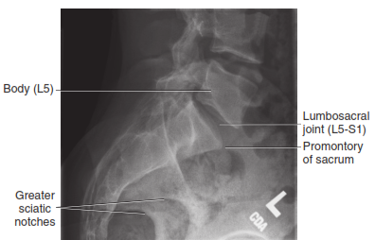
Lateral Lumbosacral Junction
3/9/2020

Slide 100
Sacrum
Anteroposterior (AP)
Clinical indications
Pathology of the sacrum, including fracture.
Technical Consideration
Film size 24x30cm Lengthwise.
Grid required
65-75 kvp
SID 100cm
Collimate to the area of interest
Shielding
Gonad shield should be used on male patient
Preparation
The patient should take cleansing enema to avoid fecal material and empty the bladder prior to radiographic examination
3/9/2020

Slide 101
Sacrum …cont’d
Patient Position
Assist the patient to the supine position on the radiographic table.
Part Positioning
Centre the midsagittal plane of the patient to the midline of the table.
Position the patient’s hands comfortably on the upper chest or radiographic table.
Central Ray
Direct the central ray 15⁰ cephalad to a point 2in superior to the syphysis pubis.
Centre the cassette to the central ray.
3/9/2020

Slide 102
Sacrum …cont’d
Breathing Instruction
Instruct the patient to take a breath in, blow it out, and hold it out during the exposure.
Image Evaluation
The L5-S1 intervertebral disc space and superior rami of the pubic bone should be included.
Bony trabeculae should be seen within the sacrum.
The sacrum should be demonstrated in the middle of the film.
3/9/2020

Slide 103
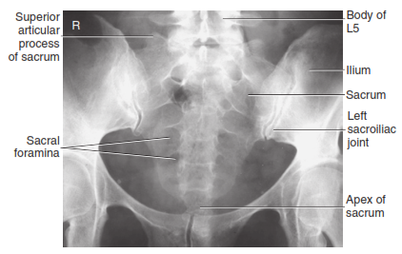
AP Sacrum (axial)
3/9/2020

Slide 104
Sacrum …cont’d
Lateral Sacrum
Technical consideration
Film Size 24x30cm lengthwise
Grid required
70-85 kvp
SID 100cm
Collimate to the area of interest
Shielding
Gonad shield should be used
Patient Positioning
Assist the patient to the left lateral position on the radiographic table, the patient may flex the knee and hips for comfort.
3/9/2020

Slide 105
Lateral Sacral
3/9/2020

Slide 106
Coccyx
Anteroposterior (AP)
Clinical indications
Pathology of the coccyx including fracture
Technical Consideration
Film size 24x30cm Lengthwise.
Grid required
65-75 kvp
Sid 100cm
Collimate to the area of interest
Shielding
Gonad shield should be used on male patient
3/9/2020

Slide 107
Coccyx …cont’d
Preparation
The patient should take cleansing enema to avoid fecal material and empty the bladder prior to radiographic examination.
Patient Position
Assist the patient to the supine position on the radiographic table.
Part Positioning
Centre the midsagittal plane of the patient to the midline of the table
Position the patient’s hands comfortably on the upper chest or radiographic table.
3/9/2020

Slide 108
Coccyx …cont’d
Patient Position
Central Ray
Direct the central ray 10⁰ caudad to a point 2in superior to the symphysis pubis.
Centre the cassette to the central ray.
Breathing Instruction
Instruct the patient to take a breath in, blow it out, and hold it out during the exposure.
3/9/2020

Slide 109
Coccyx …cont’d
Image Evaluation
The coccyx and distal one third of the sacrum should be included.
The coccyx should be clearly demonstrated in the middle of the film.
The coccyx should be adequately demonstrated.
The coccyx should be directly above the symphysis pubis.
3/9/2020

Slide 110
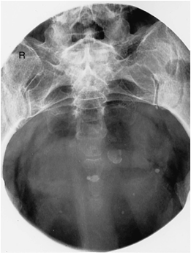
AP Coccyx (axial)
3/9/2020

Slide 111
Lateral Coccyx
Technical consideration
Film size 18x24cm
Grid required
SID 100cm
Exposure factor 75- 85kvp
Apply proper collimation
Shielding
Apply gonad shield for male patient
Patient positioning
Assist the patient to the left lateral position on the radiographic table. The patient may flex knees and hips for comfort and balance
3/9/2020

Slide 112
Lateral Coccyx …cont’d
Part Positioning
Centre the body to the midline of the table.
Adjust the long axis of the spine to lie parallel with long axis of the table, the right leg should be directly superimposed over the left leg.
Position pillow under the head
Central ray
Direct the central ray perpendicular to the coccyx
Centre the cassette to the central ray
3/9/2020

Slide 113
Lateral Coccyx …cont’d
Breathing instruction
Instruct the patient to take a breath in, blow it out, and hold it out during exposure.
Image evaluation
The coccyx and distal end of the sacrum should be well visualized.
The coccyx should be clearly demonstrated in the middle of the film
The coccyx should be adequately penetrated
3/9/2020

Slide 114
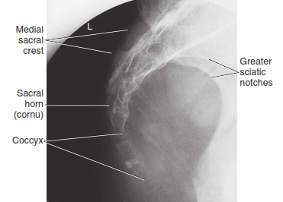
Lateral Coccyx
3/9/2020

Slide 115
Thank You !
3/9/2020

