Slide 1
Chapter six
Film processing

Slide 2
Processing
After a patient is irradiated on the film, the latent image is produced
This invisible latent image is made visible by processing
The term for several procedures that collectively produce the visible and permanent image is called processing.
Exposed films can be processed by using either manual or automatic processor

Slide 3
  Stages of processing are:
  Development - Converts latent image to black metallic silver.
  Rinsing [stop bath] - Removes excess developer.
  Fixing and Hardening - Dissolves out unexposed silver halide crystals.
  Washing - Removes products of processing.
  Dry - Removes water

Slide 4
DEVELOPMENT
The nature of Development
Development is the production of a visible metallic silver image from the latent one which exists in the sensitive material after exposure to light or x-radiation.
Silver halide grains in the emulation which have been exposure to light becomes converted to metallic silver Those which have not receive light remains largely unchanged
The conversion to black metallic silver accounts for the blackness of those parts of the film upon which light or x-ray have acted

Slide 5
Developer is not completely selective between those silver halide grains which have been exposed and those which have not. In time the developer will blacken all the silver halide grains
Therefore the function of developer is to reduce metallic silver grains of silver halide very much more quickly than the unexposed ones
The action of developer reduction is achieved by donating electrons to silver ion in the grains, thus neutralizing their positive charge and converting to metallic silver

Slide 6
The pH scale
pH scale is used to express the degree of acidity or alkalinity of a solution
A scale of acidity can be made based on the hydrogen ion concentration
In a neutral solution, the hydrogen ion concentration is 10⁻⁷ gram ions per liter and the Ph of a neutral solution is 7.

Slide 7
In photographic processing, developers lie on the alkaline side of 7, and fixers are on the acidic side of 7 (neutral point of Ph scale)
Most radiographic developers function at a Ph above 9, and require to be kept constant within 0.1 and 0.2 on the scale.
Fixers are contaminated by developer carried in to them, and in use their Ph rises as the alkaline developer reduces their acidity

Slide 8
The constitutions of developing solution
Developing agents
A developing agent is a substance able to change silver halide into metallic silver
The conversion of a salt or oxide of a metal to the metal is called chemical reduction and
The conversion of metals in to their oxides or salts is called oxidation
When reduction occurs atoms or molecules gains; when oxidation occurs atoms or molecules lose electron

Slide 9
Photographic developing agents are thus chemical reducing agents
Developing agents neutralize silver ions in the silver bromide by donating electrons to them
Since the developing agents lose electrons in this transaction, they become oxidized in carrying out their function

Slide 10
Numerous substances have been used as developing agents
  1. Metol-Hydroquinone combinations -----MQ developer
      Metol and hydroquinone reduce silver halides to metallic silver yet they act in different ways
      Metol
        Metol begins reduction readily
        Develop all exposed grains
        Once the reduction is initiated, the process continues slowly
        Susceptible to increased concentration of bromine

Slide 11
      Hydroquinone
        Requires a strongly alkaline solution to act
        Does not begin development so rapidly as metol
        Has less effect on grains which have had little exposure
        Functions to give high contrast
        Once-----------development proceeds vigorously
        Supperadditivity

Slide 12
2. Phenidone- Hydroquinone combination ----PQ developers
      Phenidone and hydroquinone are supperadditive together
      A little phenidone in comparison with metol is required
      Phenidone is regenerated by hydroquinone with greater efficiency than metol
      Phenidone is much less susceptible than metol to the restraining influence of the increased bromide concentration
      PQ developers do not exhaust as quickly as MQ developers

Slide 13
The accelerators
Soften and swell the emulsion so that the reducers can reach the exposed grains
Developing solution must be alkaline
Too little alkali results in the developer being sluggish in action
Too much alkali makes it overactive and uncontrolled so that it develops unexposed crystals and produces fog

Slide 14
Developing solutions include an alkali so that they may react at the desired rate and this alkali called accelerators
The alkali used in solutions for radiographic developers are sodium carbonate, sodium hydroxide, potassium carbonate and potassium hydroxide

Slide 15
The restrainer (potassium bromide)
Its function is to check action on unexposed ones, i.e., to prevent fog(moderate the rate of development)
Its acts by increasing the barrier of negatively charged bromine ion which exist around the silver bromide crystals
Without any restrainer the developer will be too active and will reduce the unexposed grains too rapidly

Slide 16
The preservative (sodium sulphite or potassium sulphite)
Developing agents are easily oxidized and readily absorb oxygen from the air
Preservatives helps to protect the reducing agent from oxidation because of their contact with air. It also reacts with oxidation products to reduce their activity
Preservative checks the rate of oxidation
Addition of preservative to developing solution
    Does not entirely stop aerial oxidation
    Reduce the rate at which it occurs
    Minimizes the more damaging effect

Slide 17
Hardeners
Glutaraldehyde is used as a hardener to retard the swelling of the emulsion. This is necessary in automatic processors in which the film is transported by a system of roller
The solvent
The solvent used in making photographic solutions is almost always water

Slide 18
Other additions
Further ingredients in addition to the basic group
Water softeners, wetting agents, bactericidal solutions
Some additions are provided in order to buffer the solution
A buffering solution is capable of accepting quantities of acid or alkali without much change in pH
    Sodium carbonate with sodium bicarbonate
    Boric acid with sodium hydroxide

Slide 19
The development time
Development time is the period required for the image to develop to optimum density and contrast
Factors which alter the development time are as follows
    1. The constitution of solution
    2. The temperature of solution
    3. The degree of exhaustion of solution
    4. The agitation given to the solution and the film which is being developed

Slide 20
Temperature of solution
A developer is more active as it becomes warmer
Lower temperature imply longer development time and higher temperature indicate shorter development time
Very low temperatures may make a developer almost inactive
Very high temperature
    Can fog the image
    Physically damage the film, separating the gelatin from the base
    NB: physical damage is more likely if the emulsion is swollen and soft
Different developing agents are affected to different extents by changes in temperature

Slide 21
Time-temperature technique
Practical method used in manual processing
Immersing the film for a certain length of time in developer solution which is at a certain temperature
20 degree Celsius for 4 minutes
Variations

Slide 22
Exhaustion of the developer
since the composition of solution alter as it used activity of developer decreases
The following occurrences take place in the tank of developer
    Developer solution is taken out of the tank in the emulsion and on the surface of the film
    The developing agents are changed by oxidation
    The oxidation products formed may retard the action of development
    The bromine ion released with use------------- increases the bromide content of the solution
    The alkaline content of the developer falls
    Sodium sulphite in the solution forms sulphonates and is used up doing so

Slide 23
Used solutions are less energetic than fresh ones
To make the activity of developer-solution constant a solution called replenisher must be added
The constitution of replenisher
    Developing agents in somewhat higher concentration
    High concentration of alkali
    Some extra sulphite
    Bromide is not included.
    There may be other additions to maintain adequate buffering of the solution

Slide 24
Replenishing a manual system
There is no automatic addition of a certain amount of replenisher for every film processes
Developer tanks must be replenished by hand
The purpose of adding replenisher is:
        To maintain the level of the solution in the tank
        To regenerate the solution of the chemically

Slide 25
Agitation of films and solution
Agitation of the film and movement of the solution about the film during the period of development have two prominent effects
    1. The rate at which development takes place is increased so that shorter development times are required
    2. Uniformity of development is promoted

Slide 26
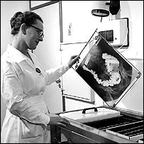
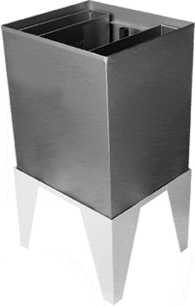
Manual (Hand) Processing
Strong smell of chemicals
Messy
Time comsuming

Slide 27
Constitutions of developers (Automatic developers)
The developers used in automatic processors contain the following
  1. A developing agent
  2. An organic hardening agents such as glutaraldehyde which acts in an alkaline
  3. A preservative such as sodium or potassium sulphite to combat oxidation
  4. Organic antifoggants such as benzotriazone and developer restrainers such as potassium bromide to minimize the growth of film fog

Slide 28
  5. Sodium carbonate or potassium carbonate to act as a source of alkali and also as buffer
  6. NaOH or KOH as a source of alkali and thus to be the accelerator or activator of the developer
  7. A sequesterting agent to combat the formation of insoluble salts

Slide 29
In formulating a developer for an automatic processor, the manufacturer has certain considerations in view:
    Solution injection area into the tank
    Cleanliness of the processor
    Oxidation must be resisted
    pH must be controlled through effective buffering

Slide 30
The effective sensitivity of film depends on several factors associated with the development:
      the type of developer
      developer concentration
      developer replenishment rates
      developer contamination
      development time
      development temperature

Slide 31
Automatic Processor

Slide 32
FIXING
Functions
  Stop any further development
  Clears the image (making the background transparent to light)
  Makes the image permanent (fixed)(no more sensitive to light)by Removing the undeveloped silver bromide crystals from the emulsion
  Hardens the emulsion

Slide 33
Fixer constituents
  Solvent
  Fixing agent
  Acid
  Hardener
  Buffer
  Preservative
  Anti-sludging agent

Slide 34
The fixing agent
Fixing agent is required to
    1. React with silver halide to form a soluble compounds (Ammonium Argento- Thiosulphat &NH4Br)
    2. Leave the gelatin unchanged
    3. Have no appreciable effect on the silver image
Examples of fixing agent
1. Sodium Thiosulphate
      Most commonly used
      Reaction: silver bromide + sodium Thiosulphate=> sodium salt of monoargento – dithiosulphuric acid + sodium bromide
      These compounds are soluble in and removed in water
      Liquid form

Slide 35
2. Ammonium Thiosulphate
      In widespread use for proprietary products supplied as liquid concentrates
      Outcome of the reaction: ammonium salt of monoargento- dithiosulphuric acid and ammonium bromide which are soluble in water
      These ammonium silver complexes are highly soluble in water and be washed out of the film very quickly

Slide 36
Acid, Stabilizer, Buffer
Stop development to provide suitable environment for hardening agent
Developer carried into the fixing bath in or on the film and continuing its action can have certain possible effect
  Cause dichroic fog
  Produce another type of stain
  Produce streaks on the radiograph
A suitable acid is usually included in the fixing solution to preserve the film from the above (1-3) ills

Slide 37
A weak acid (acetic acid frequently) is used (to reduce sulphur decomposition
There is still some tendency by the thiosulphate solution to decompose and precipitate sulphur, even though the acid is not strong
To prevent this, it is usual to include in the solution a preservative or stabilizer
It is general practice to buffer, acid fixing baths, so that the pH will be maintained

Slide 38
Hardener
The emulsion layer of a film absorbs moisture and swells during processing
Hardening of the emulsion during fixing results in its being less swollen at the end of the wet processing cycle
Efficient hardening has certain beneficial effects
  Limit emulsions water absorption
  Reduce drying time
  Minimize physical damage

Slide 39
Three hardening agents have been used for fixing baths in x-ray darkrooms
1. Chrome potassium alum
2. Potassium alum
3. Aluminum chloride
The solvent
The solvent and diluents for fixing solutions is always water
Other additions
Boric acid ----------------------------anti slugging agent

Slide 40
Factors affecting Fixation
Several factors affect the rate of clearing and fixing time.
  The type of fixing agent used
  The concentration of the fixing agent
  The temperature of the solution
  The presence of aluminum, salts such as potassium alum or aluminum chloride used as hardeners
  The fixing material-screen type or direct exposure film
  Agitation of the film during fixing
  Exhaustion of the fixing bath

Slide 41
Replenishment of Fixer
Replenishment of fixer is necessary to
  Maintain the activity
  Maintain the volume
The rate of replenishment depends on
  Area/number of films processed
  Type of emulsion/film
  Type of image

Slide 42
Replenishment of chemicals
Manual processing
Automatic processing
The level of the solution is simply maintained by adding fresh fixer as it falls. The add solution contains
  Fixing agent
  Acid
  Hardener
  Sulphite
Added automatically by the replenishment pumps at a given rate for each film processed
The replenisher are supplied as liquid concentrates

Slide 43
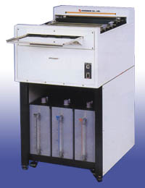
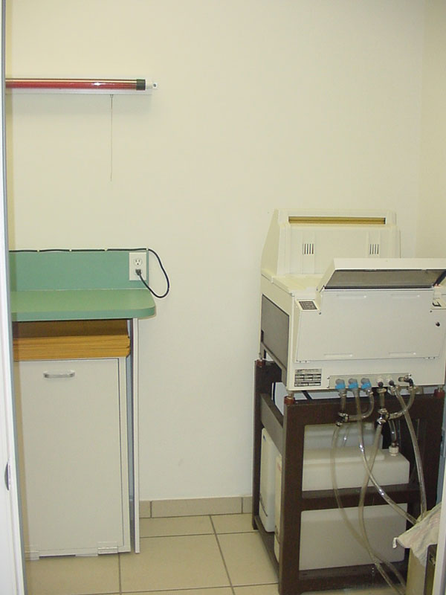
TABLE TOP AUTOMATIC PROCESSOR

Slide 44
Fixer temperature
The activity of fixing agents increases with temperature.
But high temperatures cause emulsion swelling and becomes susceptible to damage.
However precise control of temperature is not necessary

Slide 45
Fixing time
The fixing time should be long enough to complete the fixing process.
The required time for complete fixation depends on the
i. activity
ii. type of film emulsion
iii. Agitation of fixer solution

Slide 46
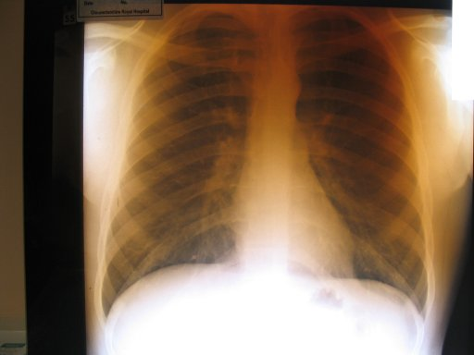
Fixer Retention(Not Washed Off)

Slide 47
Silver recovery
The reclamation of silver after it has been used for its intended photographic purpose
There are two main sources of such silver as is recoverable. These are
i. Exhausted processing solution
ii. Discarded film materials and photographic papers

Slide 48
Reasons for silver recovery -------------------(Economy and Environment)
    Silver is natural resource which is becoming scarcer
    Silver commands a high price
    Recovering helps to save costs
    About ½ of the film’s silver remains in the emulsion after exposure & processing.
    Other ½ (unexposed silver) is removed from the film during fixing process.
    Silver is toxic to public water supply – must have proper disposal

Slide 49
RINSING
The rinse is the stage in the processing cycle which may be b/n development and fixing
Its is to prevent film materials from carrying active developer with them into the fixer
The presence of developing agents in the fixing bath can result in
      Dichronic fog
      Staining from the brown final oxidation products of oxidized developer
      In increased alkalinity of the fixing bath as the developer solution contaminates it

Slide 50
Rinsing in manual processing
Immediately after development the film is dipped in the water in order to:
    Stop development
    To wash the developer from the surface of the film – (reduces developer carry over to fixer)

Slide 51
Rinsing in Automatic processing
    No rinsing stage (omitted)
    The developer is removed from the film surface by passing it through the special type of rollers called “squeegee rollers”
    Alkaline Developer is neutralized by the acid in the fixer

Slide 52
WASHING
In the processing cycle follows fixing
When the film comes out of the fixing bath, it carries on its emulsion layer
  The Argento thiosulphates which have been formed in the chemical action of the fixer
  Residual sodium thiosulphate, or alternative fixing agent
  Remaining salts which the other constituents of bath
Running water is used to maintain a concentration gradient and to improve the diffusion rate of chemicals from the emulsion to water

Slide 53
Factors affecting the washing rate
  Type of film emulsion
  Condition of fixing solution
  Condition of water
  Agitation of water
  Temperature of water
  Washing time

Slide 54
DRYING
Removes all of the surface water and most of the water retained in the emulsion
Manual processing:- Keep the film in a drying cabinet in which hot air is circulated. Takes about 10-15 minutes
Automatic Processing:- Surface water is removed by squeegee rollers ; evaporation removes the emulsion water. 25 sec in a 90 sec cyc

Slide 55
Factors affecting drying time & efficiency
The wetness of the emulsion; governed by:
i. hardness of the emulsion
ii. emulsion thickness
The drying conditions; governed by:
i. Air humidity
ii. Air Temperature
iii. Air circulation – rate of change

