Slide 1
Organizing, leading, & controlling

Slide 2
Session objectives
At the end of this session students will be able to:
Define organizing
Describe elements of organizing
Describe theories of leadership
Describe types of controlling
Explain processes of controlling
Explain forms of controlling

Slide 3
Organizing
Organizing is the mgt function performed after planning
Means of structuring the work of the organization
It is the process of developing intentional pattern of relationship among people and other resources

Slide 4
Cont …
While organizing the manager differentiates and integrates the activities
Differentiation is the process of departmentalization or segmentation of activities
Integration is the process of achieving unity of effort among various departments

Slide 5
Cont ...
Elements of organizing
Work specialization/Division of work
Departmentalization
Chain of command/Hierarchy
Span of control
Centralization & Decentralization
Formalization

Slide 6
Cont …
1. Work specialization/Division of labour
Is breaking of a complex task into components
Deciding what job tasks will be done by whom
It is dividing operating work to manageable units
Work process requirements and employee skill level determine the degree of specialization
Contributes for productivity improvement

Slide 7
Cont ...
Reasons and benefit
  Facilitate control
  Aid Coordination
  Secure adequate attention
  Reduce expenses
  Recognize human consideration
E.g. You rarely find a cardiac surgeon closing up a patient after surgery

Slide 8
Cont ...
2. Departmentalization
Grouping common work activities together so work gets done in a coordinated and integrated way
Jobs are grouped, coordinated & logically connected.
It is the basis on which work or individuals are grouped into manageable units.

Slide 9
Cont …
Departmentalization by function
  Organizes by the functions to be performed
  Helps to obtain efficiencies
  E.g. emergency, OPD, surgical ward…
Departmentalization by product
  Allows specialization in particular product
  E.g. cosmetics, clothing, appliances…

Slide 10
Cont …
Departmentalization by geographical regions
  Groups jobs on the basis of territory or geography
  E.g. central, northeast, southeast…

Slide 11
Cont …
3. Chain of command
The line of authority extending from upper organizational levels to lower levels
Clarifies who reports to whom
Authority refers to the rights inherent in a managerial position to tell people what to do and to expect them to do it

Slide 12
Cont …
Authority can be delegated downward to lower-level managers
Acceptance theory of authority states the ff conditions for acceptance of orders by subordinates:
  They understand the order
  They feel the order is consistent with the organization’s purpose

Slide 13
Cont …
  The order does not conflict with their personal beliefs
  They are able to perform the task as directed
Responsibility is the obligation or expectation to perform a given work
Employees should be held accountable for their performance

Slide 14
Cont …
Assigning work authority without responsibility and accountability can create opportunities for abuse
Likewise, no one should be held responsible or accountable for work tasks over which he or she has no authority to complete those tasks

Slide 15
Cont …
Unity of command: states that a person should report to only one manager
  But nowadays, you may encounter organizations that break this principle

Slide 16
Cont …
4. Span of control
Decides the number of employees a manager should oversee
It determines the number of levels and managers in an organization
How many employees can a manager efficiently and effectively manage?

Slide 17
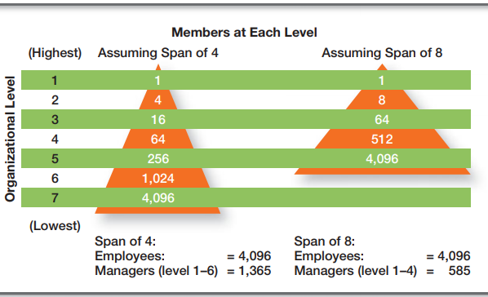
Cont …
All other things being equal, the wider the span, the more efficient an organization is

Slide 18
Cont …
Contemporary view of span of control recognizes that there is no magic
number
  Factors such as the skills and abilities of the manager and the employees, and the characteristics of the work being done determine the number

Slide 19
Cont …
5. Centralization & decentralization
Centralization is the degree to which decision making takes place at upper levels of the organization
Decentralization is when lower-level employees provide input or actually make decisions

Slide 20
Cont …
An organization is never completely centralized or decentralized
In today’s world, managers often choose the amount of centralization or decentralization that will allow them to best implement their decisions and achieve organizational
goals

Slide 21
Cont …
6. Formalization
It refers to how standardized an organization’s jobs are and the extent to which employee behavior is guided by rules and procedures
In highly formalized organizations, there are explicit job descriptions, numerous organizational rules, and clearly defined procedures covering work processes

Slide 22
Cont …
In formalized org’s employees have little discretion (freedom to make one’s own decision) over what’s done, when it’s done, and how it’s done
However, where formalization is low, employees have more discretion in how they do their work

Slide 23
Cont …
Organizational structures
Mechanistic organizational structure
  Is a combination of elements of organizing
  Adheres to command of chain
  Organization is rigid and stable
  Has standardized jobs & regulations
  More centralized
  Tightly controlled

Slide 24
Cont …
Organic organizational structure
Is a highly adaptive form that is as loose and flexible
Jobs & regulations can be changed rapidly as required
Professionals are technically proficient and trained to handle diverse problems
They need few formal rules and little direct supervision

Slide 25
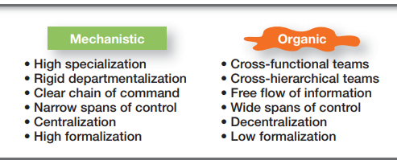
Cont …
  Professional standards guide the workers’ behavior
  Less centralized

Slide 26
Cont …
Factors that affect choice of org’nal structure
Choosing appropriate org’nal structure depends on d/t factors:
  Organization’s strategy
  Size of an organization
  Use of technology
  Degree of environmental uncertainty

Slide 27
Leading/Directing
It is a mgt function in which managers motivate their employees to achieve the organization’s goals—quickly and efficiently.
Leadership is the most important ingredient for a manager’s success
Great leaders can make great things happen, inspiring their employees to do extraordinary
things and accomplish extraordinary goals.

Slide 28
Cont …
Leadership is a process of leading a group and influencing that group to achieve its goals
A leader is an individual in a team capable of influencing group activities towards goal formulation & achievement
Successfully persuading others to follow
This days we need managers who lead

Slide 29
Cont …
Theories of Leadership
A. Early leadership theories
1. Trait theory: focuses on characteristics that would differentiate leaders from non-leaders
Traits studied included physical stature, appearance, social class, emotional stability, fluency of speech, and sociability

Slide 30
Cont …
It was impossible to identify a set of traits that would always differentiate a leader from a non-leader
Seven traits shown to be associated with effective leadership:
  Drive, desire to lead, honesty and integrity, self-confidence, intelligence, job relevant knowledge, extraversion

Slide 31
Cont …
2. Behavioral theory: examines how leaders act towards their followers.
Autocratic style: when a leader dictates work methods, make unilateral decisions, and limits employee participation
Democratic style: described a leader who involved employees in decision making, delegated authority, and used feedback as an opportunity for coaching employees

Slide 32
Cont …
Laissez-faire style: leader let the group make decisions and complete the work in
whatever way it saw fit
Democratic style of leadership was most
effective, although later studies showed
mixed results

Slide 33
Cont …
Other behavioral theories
  People vs production oriented
  Consideration vs initiating structure
  Managerial grid

Slide 34
Cont …
B. Contingency theories of leadership
“The corporate world is filled with stories of leaders who failed to achieve greatness because they failed to understand the context they were working in.”

Slide 35
Cont …
Look at defining leadership style and the situation, and attempts to answer the if-then contingencies
If this is the context or situation, then this is the best leadership style to use
Fiedler model, Hersey-Blanchard theory, and path-goal model

Slide 36
Cont …
C. Contemporary theories of leadership
Leader–member exchange theory (LMX)
Leadership style in which leaders create
in-groups and out-groups
In-groups will have higher performance ratings, less turnover, and greater job satisfaction

Slide 37
Cont …
Leaders reward in-groups while punishing out-groups
Evidences shows that in-group members have demographic, attitude, personality, and even
gender similarities with the leader
Or they have a higher level of competence than out-group members

Slide 38
Cont …
2. Transformational-Transactional
Leadership
Transactional leaders: guide or motivate followers to work toward established goals by exchanging rewards for their productivity
  Correcting problems actively when performance goes wrong
  Refrain from interruptions of performance if it meets standards

Slide 39
Cont …
Transformational leaders: stimulates and inspires followers to achieve extraordinary outcomes
    Influence through vision
    Stimulate the intellect of subordinates
    Help followers to look at old problems in new ways

Slide 40
Cont …
  Excite, arouse, and inspire followers to exert extra effort to achieve group goals
  Attempt to instill in followers the ability to question not only established views but those
  views held by the leader
Studies revealed that transformational leaders
were evaluated as more effective, higher performers, more promotable than their transactional counterparts, and more interpersonally sensitive

Slide 41
Cont …
3. Charismatic-Visionary Leadership
Charismatic leadership: that is, an enthusiastic, self-confident leader whose personality and actions influence people to behave in certain ways
  they have a vision
  ability to articulate that vision

Slide 42
Cont …
  A willingness to take risks to achieve that vision
  A sensitivity to both environmental constraints and follower needs
  Behaviors that are out of the ordinary
E.g. Martin Luther King Jr., Jeff Bezos (founder and CEO of Amazon.com)

Slide 43
Cont …
Visionary leadership: it’s the ability to create and articulate a realistic, credible, and attractive vision of the future that improves upon the present situation
  Vision should offer clear and compelling imagery
  Visions that are clearly articulated and have powerful imagery are easily grasped and accepted

Slide 44
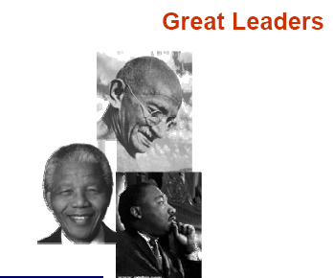
Cont …

Slide 45
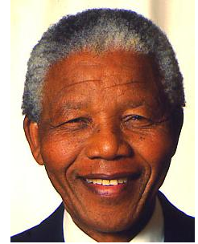
Cont …
Vision
“A democratic South Africa
Free of apartheid.”
Initial reaction
“You are crazy!”
Price paid
27 years in prison

Slide 46
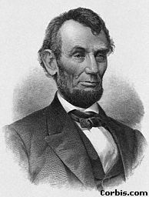
Cont …
Vision
“ No man will be a slave. Everyone man is created equal.”
Initial reaction
“You are going to break the nation apart!”
Price paid
His life

Slide 47
Cont …
Leadership practices
Scanning: examining both the external and internal environments
Focusing: concentrates the team’s attention in order to address challenges with a strategy & goals

Slide 48
Cont …
3. Align & Mobilize: adjusting people, energy, work, & other resources toward achievement of common goal
4. Inspiring: continually motivating others by creating env’t in which they want to take part & put forth their best effort

Slide 49
Controlling
It’s the process of monitoring, comparing, and correcting work performance
Effective controls ensure that activities are completed in ways that lead to the attainment of goals
It’s the only way that managers know whether
organizational goals are being met and if not, the reasons why

Slide 50
Cont …
Stating goals or having employees accept goals doesn’t guarantee that the necessary actions to accomplish those goals have been taken
As final management process, controlling provides the critical link back to planning
Without controlling there is no way of knowing whether goals and plans were being achieved and what future actions to take

Slide 51
Cont …
Reasons for controlling
Measure org’nal performance
Employee empowerment
Protection of an org’n & its assets

Slide 52
Cont …
The control process
It has three steps
The control process assumes that performance standards already exist
They’re the specific goals created during the planning process

Slide 53
Cont …
Measuring Actual Performance
Information is needed
Personal observations, statistical reports, oral reports, and written reports

Slide 54
Cont …
 | Benefits | Drawbacks
Personal observations | Get firsthand knowledge Information isn’t filtered Intensive coverage of work activities | Subject to personal biases Time consuming Obtrusive
Statistical Reports | • Easy to visualize • Effective for showing relationships | Provide limited information Ignore subjective factors

Slide 55
Cont …
Oral Reports | • Fast way to get information • Allow for verbal and nonverbal feedback | • Information is filtered • Information can’t be documented
Written Reports • | Comprehensive • Formal • Easy to file and retrieve | • Take more time to prepare

Slide 56
Cont …
Most managers use a combination of these approaches
2. Comparing Actual Performance Against the Standard
This step determines the variation between actual performance and the standard
Although some variation in performance can be expected in all activities, it’s critical to determine an acceptable range of variation

Slide 57
Cont …
Deviations outside this range need attention
3. Taking Managerial Action
Three possible courses of action: do nothing, correct the actual performance, or revise the standards

Slide 58
Cont …
Correcting Actual Performance
Depending on what the problem is, a manager could take different corrective actions
Immediate corrective action: corrects problems at once to get performance back
on track

Slide 59
Cont …
Basic corrective action: looks at how and why performance deviated before correcting the source of deviation
Revising the standard
Sometimes variance can be a result of an unrealistic standard—too low or too high a goal
In that situation, the standard needs the corrective action, not the performance

Slide 60
Cont …
Forms of Controlling
There are three basic forms of management control: Monitoring, Supervision & Evaluation.
1. Monitoring
Monitoring is the day-to-day watch on, or continuous follow-up of the on going activities
It is used to improve a campaign by influencing immediate decisions about how activities can be improved.

Slide 61
Cont …
The key question in monitoring is: Are things going all right?
It is carried out through observation of people and materials, discussion with workers, supervisors and beneficiaries, and review of reports, diaries and statistical data.
Monitoring is one of the tools for evaluation.

Slide 62
Cont …
It is about collecting information and keeping records about activities to check whether the work is being carried out as planned and to assess reactions of people receiving the services or involved in the project.
The goals of monitoring are:
  To identify any problem early,
  To solve without delaying the progress of the program.

Slide 63
Cont …
Key areas of monitoring
  Adequacy of supply, materials and budget.
  Training, type, relevance and quality.
  Quantity and quality of work done.
  Communication.
  Supervisory activities.

Slide 64
Cont …
Steps in Monitoring
Establish data sources
Collect data on program implementation and outcome
Compare program outcomes with prior or expected outcomes
Assist in making policy and management decisions

Slide 65
Cont ...
2. Supervision
It is a teaching-learning process of ensuring that workers execute the work and spend money as per the plan.
It is an investigative - corrective process
Health service supervision is defined as "A process of guiding, helping, training and encouraging staff to improve their performance in order to provide high quality health services. “

Slide 66
Cont …
It is not fault finding.
The two main styles of supervision are autocratic and democratic
Autocratic (traditional) supervisions tend to humiliate people, make them irresponsible and mostly it is one way

Slide 67
Cont …
  It may also dry up the initiative of colleagues.
Democratic (supportive) supervision helps people to grow, to become responsible for their own work to show initiative and it follows two-ways communication

Slide 68
Cont …
Supervisors needs knowledge of the work and responsibilities, skill in instructing , skill in improving methods and skill in leadership to be effective
Main Features of a Supervisor
  Guidance and training
  Assistance with resources and logistics
  Support, encouragement and advocacy

Slide 69
Cont …
Effective Supervision
To make an effective supervision and to facilitate the work, it is advisable to remember and apply the following issues.
  Create good communication and understanding, and participatory discussions with the staff.
  Share the overall goals and objectives of the program with the staff.

Slide 70
Cont …
  Develop and create team working and team spirit among the staff involved in supervision.
  Equip yourself with a checklist
  Reward (in kind or cash) for those with better performances.

Slide 71
Cont ...
3. Evaluation
It is a systematic collection, analysis, interpretation and use of data about the activities, characteristics, and outcomes of programs to make judgments about the program, improve program effectiveness, and/or inform decisions about future program development.

Slide 72
Cont …
It deals with determining the value or worth of the objects of interest (health programs) against standard of acceptability.
It is the use of special studies to measure the extent to which changes in desired health outcomes are attributable to a program’s intervention

Slide 73
Purposes of Evaluation
Program
Improvement
Generating knowledge
Accountability

Slide 74
Cont …
To determine achievements of objectives related to improved health status
To improve program implementation
To provide accountability to funders, community and other stakeholders

Slide 75
Cont …
To increase community support for initiatives
To contribute to the scientific basis for community public health intervention
To inform policy decisions

Slide 76
Cont …
Types of evaluation
There are several types of evaluations that can be conducted. Some of them include the following:
Formative evaluation ensures that a program or program activity is feasible, appropriate, and acceptable before it is fully implemented.

Slide 77
Cont …
  It is usually conducted when a new program or activity is being developed or when an existing one is being adapted or modified.
  Process/implementation evaluation: determines whether program activities have been implemented as intended.

Slide 78
Cont …
Outcome/effectiveness evaluation: measures program effects in the target population by assessing the progress in the outcomes or outcome objectives that the program is to achieve.
Impact evaluation: assesses program effectiveness in achieving its ultimate goals

Slide 79
Summary
Organizing
Leading
Controlling

Slide 80
Thank you!!

Slide 81
Quiz
List two features of mechanistic organizational structure
Define division of labor
Define span of control
List the three leadership styles of behavioral theory of leadership
Differentiate b/n transactional and transformational leadership

