Slide 1
Introduction to health service management

Slide 2
Outline
Definitions
Historical development
Concepts and principles in management
Types, skills and roles of managers

Slide 3
Objectives
At the end of the session, you are expected to:
  Define management
  Define health service management
  Describe rationale of studying mgt
  Explain principles of management
  Explain concepts of management
  Explain types of managers
  Explain roles of managers

Slide 4
Brainstorming
Define the terms:
    Health
    Health services
    Management
Why do we need managers?
What tasks do you think a manager should be able to perform?

Slide 5
Introduction
Definitions of terms
Health
Lay person: The absence of disease.
Medical personnels: Free from medically defined diseases.
WHO (1948) defined:
A state of complete physical, mental, and social well-being, not merely the absence of disease .
Additionally :the ability to lead socially acceptable and economically productive life.

Slide 6
Cont …
Health services
Are specific activities undertaken to maintain or improve health or to prevent decrements of health.
    Can be preventive, promotive, curative or rehabilitative in nature.
WHO has defined health services as a set of interventions aimed at contributing to improved health across the continuum of care, including health promotion, disease prevention, diagnosis, treatment, rehabilitation, and palliation.

Slide 7
Cont …
These interventions will predominantly be delivered by the health system, yet availability and accessibility are determined by socio-economic determinants.
Health service organizations (HSOs)
Organizational structure within which the delivery of health services is directed to consumers.

Slide 8
Cont …
Management
Has been defined in ways that appear different but with a strong underlying similarity.
The process of reaching organizational goals by working with and through people and other resources

Slide 9
Cont …
The process composed of interrelated social and technical functions & activities, occurring in a formal organizational setting for the purpose of accomplishing predetermined objectives through the use of human and other resources.

Slide 10
Cont …
Common points for all definitions:
Is a process – a set of interactive & interrelated ongoing functions and activities
Involves accomplishing organizational objectives
Use of people & other resources
Occurs in a formal organizational setting
N.B people are the most important resources

Slide 11
Cont …
Why managers are needed?
Org’ns need their managerial skills and abilities more than ever in these uncertain, complex, and chaotic times
They are critical to getting things done in an org’n

Slide 12
Cont …
Several researches confirm that quality of r/ship b/n employees & their direct supervisors is important for productivity & loyalty of employees than payment and work env’t

Slide 13
Cont …
“ A great boss can change your life, inspiring you to new heights both professionally and personally, and energizing you and your team to together overcome new challenges bigger than any one of you could tackle alone.”
(J. Welch & S. Welch, 2009)

Slide 14
Cont …
Who are managers?
A manager is someone who coordinates and oversees the work of other people so that org’nal goals can be accomplished
They are org’nal members who tell others what to do and how to do it
Their job is not about personal achievement rather it’s about helping others to do their work

Slide 15
Cont …
They can be young/old, male/female, frontline/top managers; they have exciting and challenging jobs
In our globe, women are few in top-level manager positions

Slide 16
Cont …
What is an organization?
It’s a deliberate arrangement of people to accomplish some specific purpose
  Has a distinct purpose
  Is composed of people
  Has premeditated structure: it can be flexible/rigid

Slide 17
Cont …
What managers do?
  Functions
  Skills
  Roles

Slide 18
Cont …
Rationale for studying management
It is universal and essential function in all kinds of organizations
  This is because every organization requires:- proper planning, making decisions, coordinating activities, handling people, efficient use of resources, and evaluating the performance directed toward its objectives.

Slide 19
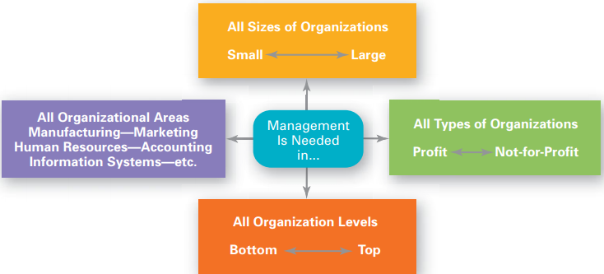
Cont …

Slide 20
Cont …
Reality of the work
  After graduation when beginning your career, you will either manage or be managed
  For those who plan to be managers, an understanding of management forms the foundation upon which to build your management skills

Slide 21
Cont …
  You’ll probably have some managerial responsibilities even if you’re not a manager
  To gain an insight of the way your boss and fellow employees behave and how organizations function

Slide 22
Cont …
Being a manager can be rewarding
  There are many challenges for managers
  The job can become tough & thankless
  Despite the challenges, being manager can be rewarding

Slide 23
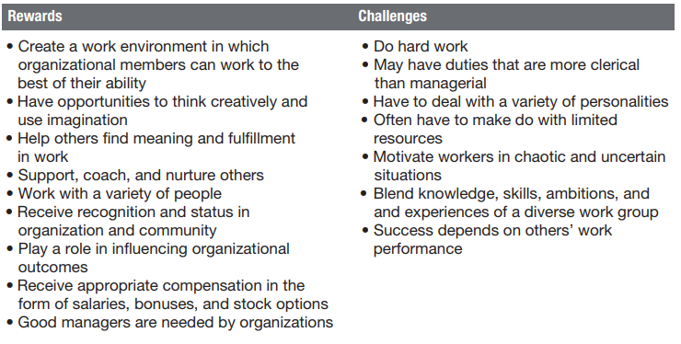
Cont …

Slide 24
Cont …
Health professionals find themselves in a managerial position without proper orientation and training
It is necessary to prioritize problems and make an informed decision which requires technicians with such skills
It is a means for development & provides abundant job opportunities

Slide 25
Cont …
Historical development of management
What is the importance of studying history of mgt?
Management has existed ever since man has been organized into communities
Management is as old as civilization

Slide 26
Cont …
It can be traced back to ancient time when people started forming group, which needed somebody to organize and coordinate the activities of the people
e.g. The Egyptian Pyramids and
  The Great Wall of China

Slide 27
Cont …
In 1776, Adam Smith published the book named ‘The Wealth of Nations’
He has argued the economic advantages that organizations and society would gain from the division of labor
  breaking down jobs into narrow and repetitive tasks increases productivity of workers

Slide 28
Cont …
Industrial revolution contributed a lot for development of modern management
In Europe the Industrial Revolution began in the eighteenth century; in the United States, it began around 1860
Before the Industrial Revolution, the US economy was based on agriculture

Slide 29
Cont …
Most people worked on small farms, using only simple technology, such as horse-drawn plows.
Professional managers were not needed because most people worked for themselves

Slide 30
Cont …
Toward the end of the nineteenth century, powerful business people who created enormous business empires dominated and shaped the US economy (oil, steel, banking, rail road companies)
Many people left their farms to take jobs in factories, where professional managers supervised their work.
The new industrial enterprises that emerged in the nineteenth century demanded management skills that had not been necessary earlier.

Slide 31
Cont …
Study of management as a separate & distinct subject with different theories and techniques is a product of the 20th C.
It is the work of Fredrick Winslow Taylor ,during the scientific management movement
In 1911, his book ‘Principles of Scientific Management’ was published
Introduced into health care system very recently, only 4 - 5 decades back.

Slide 32
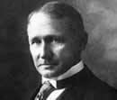
Cont …
Frederick W. Taylor
The father of Scientific Management
– the 1st Efficiency Expert.
Proposed set of management practices that are based on facts and observations.

Slide 33
Cont …
Concepts in management
Effectiveness: is the degree to which a stated objective is being achieved. It is something that management tries to improve.
Efficiency: is about reaching ends by only the necessary means or by the least wasteful use of means. It is a measure of the relation between the results obtained and the effort expended

Slide 34
          Cont …
Economy: often many resources are scarce and costly thus we have to economize.
Responsibility & authority: work activities should be distributed among workers appropriately.
  Information: necessary to make the right decision for action. It should be the right kind, at the right time and in the right hands

Slide 35
Cont …
Principles of management
Management by objective: is about deciding what is to be accomplished. An objective should state:
  what is to be done
  how much is to be done
  where it is to be done
  when it is to be completed
  the standard by which it will be possible to tell whether, or the extent to which, it has been achieved.

Slide 36
Cont …
Learning from experience: underlies the comparison of objectives with their achievement in order to judge effectiveness
  derives from and justifies proves the value of the first management principle, namely, management by objectives.
  Any gap between objectives and obtained results (achievements) →analysis → discover causes of the gap

Slide 37
Cont …
Division of labor: is when work is divided, or distributed, among members of a group, and the work is directed and coordinated
  It makes groups a team.
  Assign the right proportion of each kind of staff to the task at hand
  It implies efficient use of workforce such as team approach
  Team approach is when management attempts to bring about balance of work among different people concerned.

Slide 38
Cont …
Convergence of work: implies that the activities
should be designed, assigned and directed in such a way that they support each other in moving towards a common goal
  working relations should contribute to the success of each activity and so to the general goal of the organization
Substitution of Resources: when the resources normally used to provide service become scarce or too expensive, different resources may be used to deliver the same service.

Slide 39
Cont …
Functions determine structure: when the functions and duties of individual members of the team are clearly defined and known to all, the working relations (the structure) follow.
Delegation: it is when someone with authority lends the authority to another person so as to enable that person to take responsibility when the need arises.
  Assigning job activities and corresponding authority
  Managers should not make themselves busy doing every thing

Slide 40
Cont …
Management by exception: Selectivity in handling information & prioritized decision making
Short Decision path: decision must be made as closely as possible in time and place to the object of decision and to those affected by it.

Slide 41
Group discussion
“Running an organization is kind of like steering a ship on the ocean” (Bob Nelson, 2005)
What does it mean?

Slide 42
Cont …
Types of Managers
Managers are people formally appointed/selected to positions of authority in organizations or systems who:
  Enable others to do their work effectively
  Have responsibility for resource utilization
  Are accountable for work results
Are the people who plan, organize, direct, and control so as to manage organizations and organizational units.

Slide 43
Cont …
Based on level/ degree of authority and scope of responsibility managers are of three levels.
  Top level
  Middle level
  First line: sometimes called as supervisory, front-line and operating level of management.

Slide 44
Cont …
Top
Middle
Front line

Slide 45
Cont …
Top level (senior) managers
  Have authority over and are responsible for the entire organization i.e. all staff, resources and organizational results
  Are accountable to the governing body
  Establish operating policies and guide the organization with its environment

Slide 46
Cont …
  Include individuals with the title of chairperson, president, chief executive officer, executive vice president, vice president, or chief operating officer.
Managerial work at this level consists mainly of performing the planning activities needed to develop the organization’s mission and strategic goals.

Slide 47
Cont …
Top management’s responsibilities include adjusting the organization’s overall direction on the basis of information reviewed in the controlling procedures.
Because strategic planning, organizing, and controlling require a great deal of time, top managers have little time to spend in directing subordinates’ activities.
Typically, they delegate responsibility for such direction to middle managers lower in the hierarchy of authority.

Slide 48
Cont …
Middle-level managers
Reporting to senior managers
There are numerous middle level managers than top managers
Have authority over & responsibility for a specific segments of the organization
Terms such as director or manager are usually a part of a middle manager’s title—for example, director of human resources or western regional manager.

Slide 49
Cont …
First-level (front line) managers
Supervisory (front line) managers, often called superintendents, supervisors, or foremen.
Are charged with overseeing the nonsupervisory employees who perform the organization’s basic work.
Of the three types of managers, supervisory managers spend the greatest amount of time actually directing employees.

Slide 50
Cont …
Except for making small, on-the-job adjustments, they seldom perform planning and organizing activities.
Instead, supervisory managers initiate the upward flow of information that middle and top managers use to control organizational behavior.
Report to middle-level managers
Have authority over & responsibility for overseeing specific work & a particular group of workers

Slide 51
Cont …
Managerial skills
1. Conceptual skills
The ability to perceive an organization or organizational unit as a whole.
Reflect the mental abilities of managers to visualize the complex interrelationships in a work place .
These skills are used most frequently by top managers, who take responsibility for organization-wide strategic endeavors.

Slide 52
Cont …
2. Human relation skill
Are the abilities of managers to get along well with other people, to understand them, & lead them in the work place
The ability to motivate, facilitate, coordinate, lead, communicate & resolve conflicts.
The ability to work effectively as a group member and build cooperation among the members of an organization or unit

Slide 53
Cont …
3. Technical skill
Is the understanding of technical element of activities in general and proficiency in specific kind of technical activity
It includes:
    Methods & techniques
    Specialized knowledge
    Competent use of tools
    techniques to solve problems in that specific discipline

Slide 54
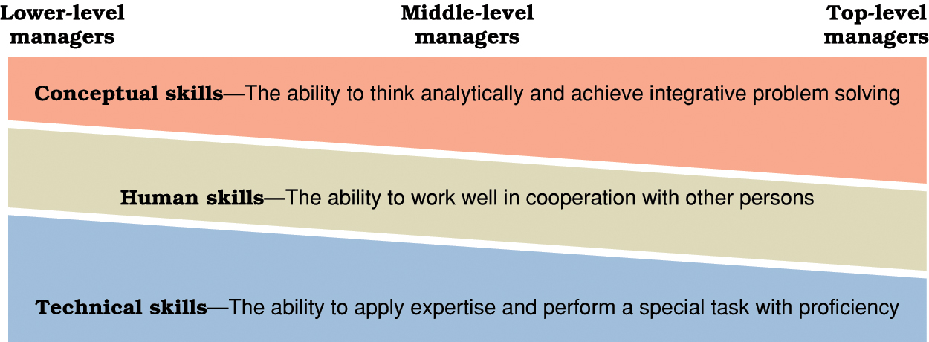
Essential Managerial Skills Vs Types of managers

Slide 55
Cont …
Managerial Roles
Managerial role is the behavioral pattern expected of someone within a functional unit.
All managers have formal authority over their organizational units
The work of managers is viewed as a series of three broad categories of roles.
Developed by Henry Mintzberg in 1970s

Slide 56
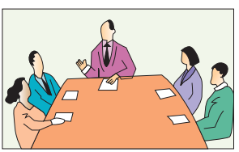
Cont …
1. Interpersonal roles
In fulfilling interpersonal roles, managers create and maintain interpersonal relationships to ensure the well-being of their organizations or units.

Slide 57
Cont …
Figurehead role
Managers represent their organizations or units to other people in the figurehead role.
Include such ceremonial and symbolic activities as greeting visitors, attending awards ceremonies, and cutting ribbons to open new facilities.

Slide 58
Cont …
B. Leader (influencer)
  Direct & motivate subordinates
  Are expected to be responsible & accountable for their subordinations action as well as their own
C. Liaison
This role allows managers in formal & informal contacts both inside & outside their organization to establish relationships that will help them achieve organizational objectives.

Slide 59

Cont …
2. Informational roles
This role is related to communication and information channeling

Slide 60
Cont …
  A. Monitor role
Managers scan the environment surrounding their organizations or units, seeking information to enhance performance.
Serving as a focal person for all types of communications

Slide 61
Cont …
B. Disseminator
This role grows out of the managers’ access to information and his ability to choose what to do with that information
Managers pass information to subordinates who would otherwise have no access to it.
To share information with subordinates, they may hold meetings, write memoranda, make telephone calls, and so forth.

Slide 62
Cont …
C. Spokesperson
Communicating selected information to outsiders through meetings, annual reports, memos etc

Slide 63
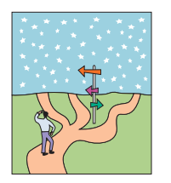
Cont …
3 . Decisional roles
A manager has a legal authority to decide on matters that are assigned to him based on his job description.

Slide 64
Cont …
A. Entrepreneur
designing and initiating changes within the organization
B. Disturbance handler
taking corrective action and handling conflicts
The ability to make good decisions about handling disturbances is an important determinant of managerial success

Slide 65
Cont …
C. Resource allocator
Prioritize tasks and make decisions regarding the use of limited resources to meet conflicting needs to achieve goals
D. Negotiator
Interact and bargain employees, suppliers, regulators, customers, clients and others.
Represent organizational interests during negotiations

Slide 66
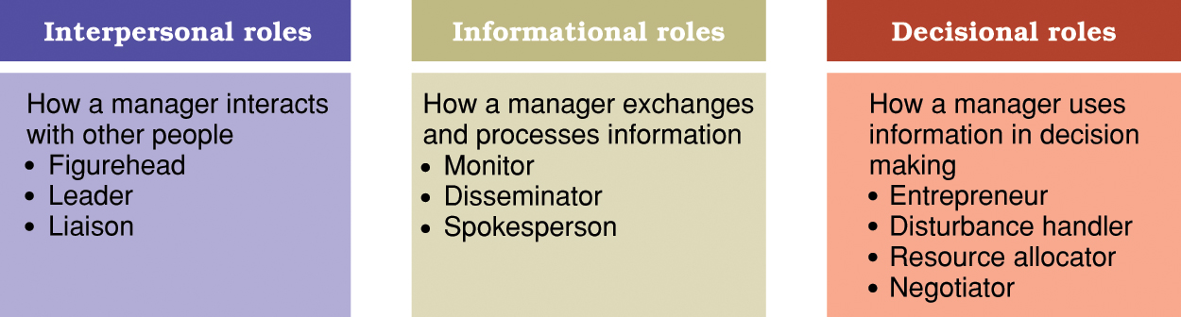
Mintzberg’s 10 managerial roles.

Slide 67
Summary
Definition of management
Rationale of studying mgt
Historical dev’t of mgt
Concepts & principles of management
Types of managers
Roles of managers

Slide 68
Reading assignment
Differences b/n management and administration
Challenges of management in medical radiology technology discipline

Slide 69
References
Mc Mahn R. Barton G, Piot M, (1992). On Being In charge - A guide to Management in primary health care, WHO Geneva.
Challi J, Getnet M, Amsalu F. 2003. Health services management to health science students. Lecture note. Jimma University
Robbins SP, Coulter M. Management. 11th ed. Prentice Hall publisher. 2012

Slide 70
Thank You !!!

Slide 71
Group assignment
Ethiopian health care quality strategy
Conflict management in health care organizations
Motivation in health care organizations
Action plan with examples
Management and medical radiology technology
Decision making in health service organizations

