Slide 1
  Health and Human Behavior
By: Dereje Geleta (BSc, MPH)

Slide 2
Learning Objective
At the end of this session; students will be able to:
- Recognize the concept of Behavior
- Lists the components of behaviour
- List down the Determinants of human behaviors

Slide 3
Behaviour
Behavior- is an action that has specific
frequency, duration, and purpose, whether conscious or unconscious.
It is both the act and the way we act.
Action –types of overt behavior, such as Hand washing, Exercise, diet, ANC follow Up, Health Seeking, drinking, smoking, chat chewing, etc
To say a person has Physical exercise behavior
Duration –it is the time spent since the action started or noticed such as for a week/months (it for a week/month)
Frequency- how it is repeated in a certain period of time.
Purpose –is he/she doing consciously or not

Slide 4
Components of Behaviour
Basically our behavior has 3 domains
A) Cognitive domain- “stored information”
  Encodes, stores, retrieves, processes information;
  purpose is manipulation of information
Knowledge
Perception
Thinking

Slide 5
Cont. …
B) Affective domain-cognition +feeling
Attitude
Beliefs
Value
  purpose is to create arousal
C) Psychomotor domain
Psycho-mind
Motor – action

Slide 6
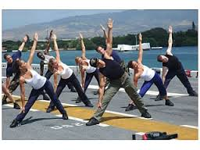

Behavior and Health
1. Healthy behavior : can promote health
E.g. Physical exercise,
BF, seeking treatment
2. Ill/unhealthy behavior :
can harm health
  Smoking, chat chewing, excessive
  alcohol consumption, unsafe sex,
  sedentary life style etc.

Slide 7
Why Dealing With Human Behaviour Is Concern Of Public Health??
The world is experiencing shift in cause of ill- Health:
Bacteria
Behavior

Slide 8
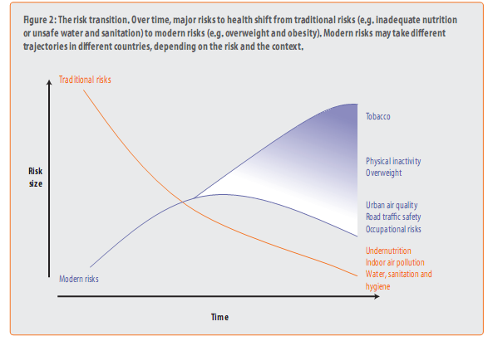
Cont …
Risk factors: traditional risk to modern risk

Slide 9
Cont. …
Disease burden: Communicable disease to non-communicable –double burden (for developing countries)
  Human behaviors plays significant role as a cause as well as a solutions for existing and emerging problems

Slide 10
Factors Determines Human Behavior
There are three categories of factors affecting (determining) individual or collective behavior, each of which has a different type of influence on behavior:
A. predisposing factor
B. Enabling factors
C. Reinforcing factors

Slide 11
1.Predisposing factors
Are antecedents or prior to behavior that provide the rationale or motivation for the behavior to occur.
E.g. Knowledge, Perception, Belief , Attitude, Values etc.
They are generally referred to cognitive variables because they are inside the mind –inside head factors and have to do with knowing or believing

Slide 12
1. Knowledge
Knowledge is necessary but not sufficient in behavior change.
It is necessary, because, without adequate knowledge , people may unaware of and concerned about health problem and unable to manage their behavior.

Slide 13
2. Attitude
Social psychologists define an attitude as an enduring evaluation, positive or negative, of people, objects, or ideas.
We are not neutral observers of the world; we evaluate what we encounter.
Attitudes are often a matter of good or bad; as soon as you know what something is, you start to know whether you like it or dislike it.

Slide 14
3. Belief
Beliefs are what one perceive as a true, it may be correct or not.
It also refers to a conviction that a phenomenon or object is true or real.
It is different from knowledge in that it is perceived whereas knowledge is accepted as objective truth.

Slide 15
Cont …
Beliefs are derived from parents, grand parents, and other people we respect to listen and are accepted as true.
But we accept beliefs without trying to prove that they are true or false.

Slide 16
Difficulty index of changing beliefs
It is usually difficult to change those beliefs that
are held by the whole community
Have been deep rooted in the culture
Come from highly respected and trusted sources
Are part of the a religion or traditional medical system

Slide 17
Cont …
It is usually easier to influence those beliefs that:
  are held by individuals
  have been acquired recently
  come from not highly respected sources
  are not part of religion or traditional medical system

Slide 18
Types of Beliefs
Harmful belief: is a belief which damage health.
Helpful beliefs: is a belief which preserves health.
Neutral beliefs: is a belief which neither damages nor preserves health.
What do you if you are unsure???

Slide 19
4. VALUE
The relative preference/judgment individual gives every thing around is known as value.
value is something is held to be important or worth; and prized by an individuals or community.

Slide 20
Value conflict and value clarification
People value life, i.e. health. However, in opposite engaged in unhealthy behavior, for instance, smoking. This reveals conflict of values=inconsistencies between two or more values.
In health education one shouldn’t seek to change values rather should help people recognize inconsistencies between and among their values.
We, often trying to encourage people to think about their values. This process is called value-clarification

Slide 21
Difficult index; Relationship between Attitude and Value
Values are more permanent and resistant to change than attitudes and beliefs and they determine attitude.
In terms of difficulty of changing:
Knowledge
Beliefs
Attitude
Value
<
<
<

Slide 22
2. Enabling Factors
Enabling factors are those antecedents to behavior that facilitate a motivation to be realized.
They help individuals to choose, decide and adopt behaviors and may be barriers and assets to needed changes.
The absence of enabling conditions inhibits action/s

Slide 23
Cont …
Enabling factors are those skills, resources, barriers that can help or hinder the desired behavioral changes as well as environmental changes.
The health-care environment
-availability
-accessibility
-affordability
New skills: different skills
Resources. E.g.. Facilities, money, time, labor services, skills, transportation, materials and the distribution and their location.

Slide 24
3. Reinforcing Factors
Reinforcing factors are those factors subsequent to a behavior that provide the continuing reward or incentives for the behavior to be persistent and repeated.
Are those consequences of actions that determine whether the actor receives positive or negative feedback and is supported socially or by significant others after it occur/s.

Slide 25
Cont …
Among these important people are elders, friends, peers, parents, grand parents, village leaders, religious leaders and people with a lot of experience and skills (teachers, health workers, etc.).
Examples
The woman does not adopt FP because her husband disapproves.
The young man who starts smoking because his friends encourage him to do so

Slide 26
Summary of factors affect human behaviors
Predisposing factors
create intention to act
Enabling factors
Realizes the intentions
Reinforcing factors
Encourage behaviors to persist
Sustainable behavior
Remember: Any given behavior can be explained as a function of the collective influence of these three factors

Slide 27
Theoretical sequence to address determinants of behaviors
Predisposing factors
Enabling factors
Reinforcing factors
Behaviors
Knowledge, attitude, beliefs, values
Availability, affordability, accessibility & others resources
Peer influence & social pressure
In practice simultaneously

Slide 28
Educational approaches to behavior change
Direct communication with target individuals-educational approaches
Enabling factors
Organization change, avail services, accessibility, advocacy , resource mobilization
Reinforcing factors
In direct communication with the social environments , influential peoples
Predisposing factors
Approaches to change
Determinants of behaviors

Slide 29
Some reference materials
Lawrence W. Green et al. 1980. Health education planning a diagnostic approach
Randall R. Cottrell, James T. Girvan, James F. McKenzie 2006. Principles& foundations of health promotion and education. Third ed. USA.
BruceG, Wlter H, Nell H. Introduction to Health education and Health promotion;2nd edition, 1984
Ramachandran L. and Dharmalingam. T. 1995. Health education’s new approach.

Slide 30
The End
THANK YOU !!

