Slide 1
Environmental Monitoring

Slide 2
Functions of EM
To identify various pollutants
To evaluate the environmental status according to relevant environmental quality standards;
To find the trends of pollution and predict environemntal quality;
To lay a solid foundation for pollution controlling, law-making and environmental protection planing

Slide 3
General procedures for EM
Field investigation
Program design
Sampling
Sample pretreatment
Data processing
Sample analysis
Reporting results

Slide 4
§3 Priority pollutants
A collection of pollutants which receive most concern for their acute in toxicity, canerigenic, teratogenic and mutagenic characteristics.
129 compounds (U.S. Priority pollutants lists)

Slide 5
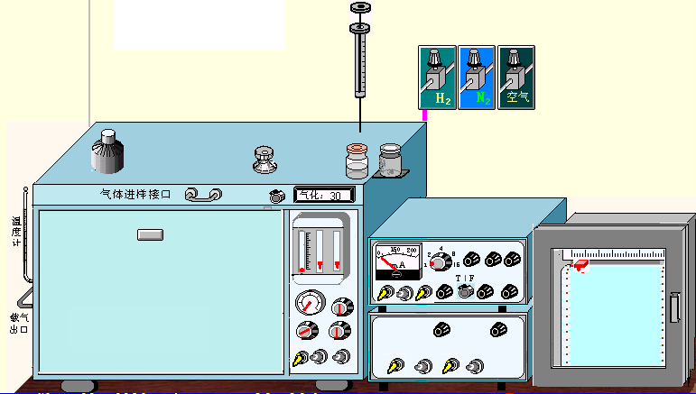
§3 Advanced methods for EM Why instrumental technique?
Lower pollutant concentration;
Various pollutants unable to detected by chemical methods
A GC system

Slide 6
Level of pollutants and relevant analytical methods
 | micro | trace | Ultra trace
gram | milligram | micro gram | Nano-gram | Pico-gram | Fetto-gram
1 | 10⁻³ | 10⁻⁶ | 10⁻⁹ | 10⁻¹² | 10⁻¹⁵
 | milli | ppm | ppb | ppt | …
>1% | 0.01-1% | <0.01%
Chemical analysis
Instrument analysis

Slide 7
Classfication of instrumental analysis
Spectrometry: atomic absorption spectrometry (AAS)
atomic emission spectrometry (AES)
fluoresence, UV-Vis, infra-red(IR) etc.
Chromatography: gas chromatography (GC), HPLC
gel exclusive chromatography
thin layer chromatography (TLC)
Electroanalysis
Mass spectrometry (MS)
Surface analysis
Nuclear magnetic resonance (NMR)

Slide 8
Trends of instrumental techniques for environmental monitoring
1 higher performance
2 lower limits of detectioin (LODs)
3 excellent selectivity
4 automation and even intelligence
5 on-line, in site, fast analysis

Slide 9
Applications
Case 1
Determination of Cu, Zn, Pb and Cd in soil by FAAS
Cu, Zn, Pb and Cd has relevant environmental standards in Chinese Environmental Quality Standard for Soil (GB15618-1995)
Pb, Cd, Ni, As and Hg has been the most important elements in soil pollutant and soil remediation in Chinese 12th Five-Year Plan.
Standard values for selected elements
Element | Cu | Zn | Pb | Cd
Values/ppm | 50 | 200 | 250 | 0.30

Slide 10
Analytical process
Sampling
Drying in air
Grinding
Sieving
Digestion
Volume metered
Filtration
Results
Analysis
Standards preparation

Slide 11
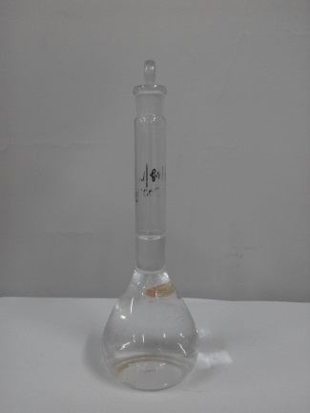
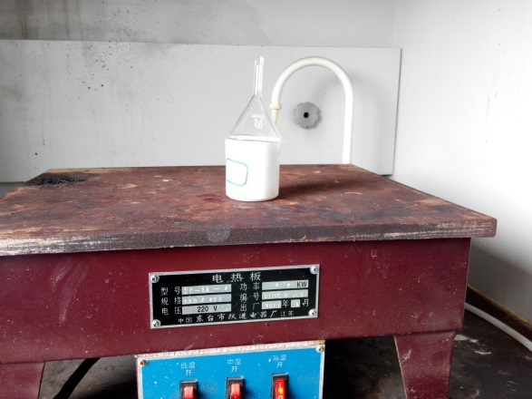
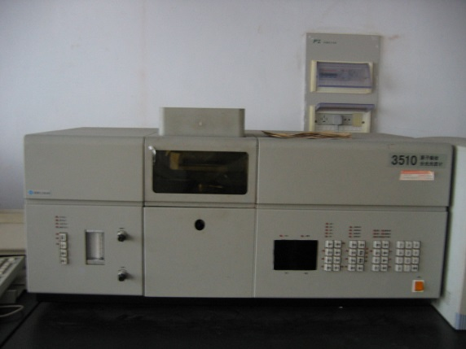
Applications
Case 2 Determination of Cu and Cd in waste water from a electroplating factory
Sampling Digestion Analysis

Slide 12
Part of standard values for selected elements*
Element | TCu | TCd | TNi | TCr
Values/ppm | 0.5 | 0.05 | 0.5 | 1.0
*Emission Standard of Pollutants for Electroplating (GB 21900-2008)

Slide 13
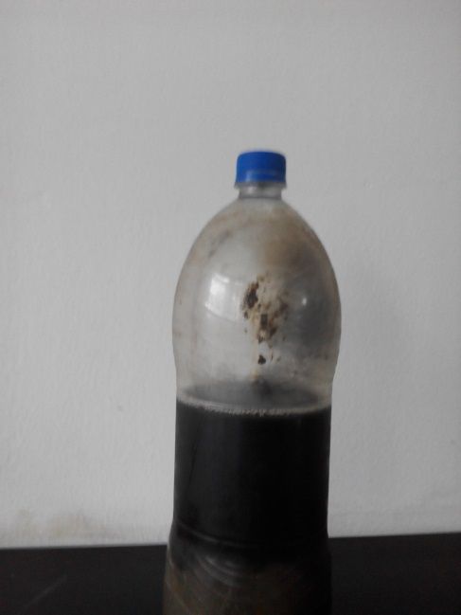
§4 Applications
Case 1 analysis of Cu, Pb and Cd in landfill leachate
COD: up to 20000, TOC: 2000-4000, digestion before
analysis
Photo of a landfill leachate

Slide 14
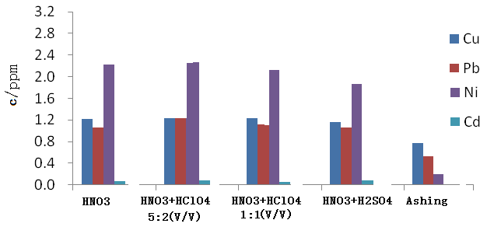
Comparison among several digestion methods

Slide 15
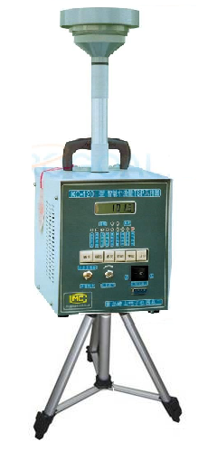
Case 2 analysis of Pb in air
Sampling
Digestion
Filtration
Analysis
Results
Standards preparation
TSP sampler (left)

