Slide 1
Collection of Water and Wastewater Samples
Learning objectives:
At the end this of chapter students will be able to:
Learn the reasons for sampling
Develop an understanding about different sampling methods
Discuss the relative advantages & disadvantages of each sampling methods

Slide 2
§1 sampling methods and requirements
Sampling and sample preparation
Data processing
Analysis
Time used in an analysis process

Slide 3
SAMPLING:
The act of collecting a portion of material for analytical purposes that accurately represents the material being sampled with respect to stated objectives.
Success of Sampling depends on:
Clear definition of sampling objectives
Sample quality
Sample integrity
Sample representativeness
Sampling
Chemical /Physical Analysis
Data Interpretation

Slide 4
Importance of sampling and sample preparation
It spends analysts almost 40% time in a whole analysis;
It has an important effect on the analytical results, even vital to results
It converts the sample to proper status (physcial state, specification, isomer) for analysis

Slide 5
Planning of Sampling
Ask yourself the purpose of study (?)
What data are needed (?) and then select most suitable location that can provide the required information.

Slide 6
Sampling requirements:
  @Representative
  @Homogeneous
  @Enough amount
  @Removal of obvious interferences

Slide 7
Water Sampling
The objective of sampling is:
to collect a portion of water which is small enough in volume to be transported conveniently
handled in the laboratory
representative of the characteristics of the water available in that water body
Why sample?
  Resources (time, money) and workload
  Gives results with known accuracy that can be calculated mathematically.

Slide 8
Site location for river
Upstream (u/s) of the industrial and domestic discharge points
Immediately downstream (dis) of industrial and domestic discharge points.
At a place of abstraction for industrial use and public water supply.
Baseline stations where water is available in natural state.

Slide 9


Attenuation
section
Contrast Section
Control section
Control section
500m
1500m
Example 1: Sampling methods for a river water

Slide 10
A-A’ Contrast section
G-G’ Attenuation section
B-B’、C-C’、D-D’、F-F’ Control section
C’
A
C
Water intake
F
D
B
G
A’
B’
G’
F’
D’
E
E’
A river with branch

Slide 11
>1500m
Sampling at a section

Slide 12
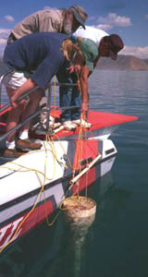
0.3～0.5m under surface
10～50m
<5m
5～10m
½ water depth
0.5m upper river bed
Sampling depth

Slide 13
Grid sampling Sector sampling
Example 2: sampling methods for air and exhaust gas

Slide 14
Concentric circle sampling

Slide 15
General requirements
Meet the requirements of the sampling program
Handle sample so that it does not deteriorate or become contaminated or compromised before analyzed.
Ensure sampling equipments are clean and quality assured before use.
Use sample containers that are clean and free of contaminants.
Fill sample containers with/or without pre-rinsing with sample.
Make a record of every sample collected and identify every bottle.

Slide 16
§2. Sample preparation
General principles:
Should not lose any analytes
Converting the analytes into the best chemical form for the assay
Removal interferences in matrix as much as possible
Without adding any new interference
Concentrating the analytes

Slide 17
Tradtional techniques in sample preparation:
sample | Prepration methods
Water and waste water | filtration, digestion, evaporation, ashing, extraction
Gas and exhaust gas | Absorption, memberance filtration, digestion, extraction, headspace
Soil and solid waste | Dry, grind, size-sorted, digestion,
Biological samples | Grind, extraction, digestion

Slide 18
Advanced techniques in sample preparation:
Solid phase extraction (SPE) 1970s
Solid phase microextraction (SPME) 1980s
Dispersive solid phase extraction (DSPE)
Accelerated solvent extraction (ASE) 1968
Microwave-assisted extraction (MAE) 1968
Liquid phase microextraction (LPME) 1996
Matrix solid phase dispersion (MSPD) 1989
Supercritical fluid extraction (SFE) 1970s
Purge and trap (P&T) 1974

Slide 19
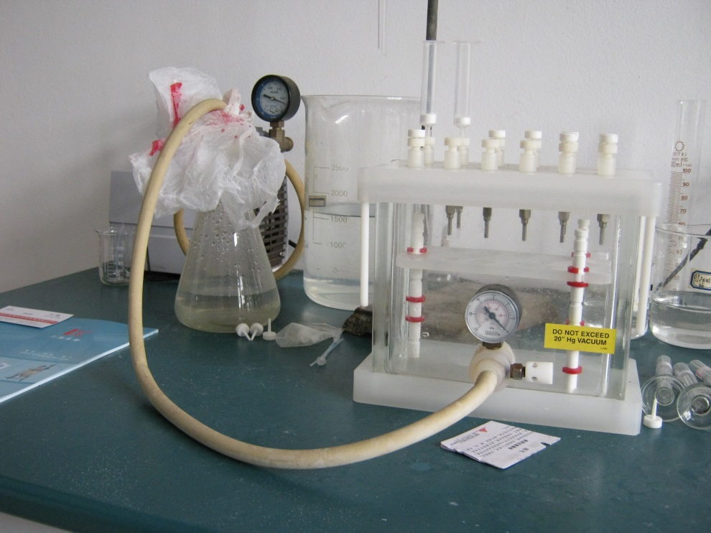
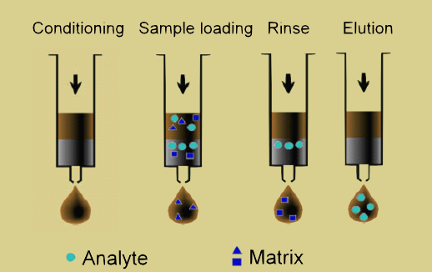
Left: An real SPE instrument
Right: SPE Procedures

Slide 20
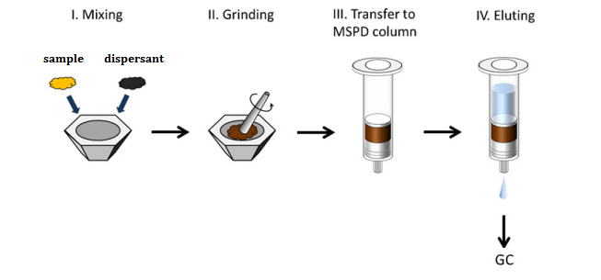
or HPLC
General steps of matrix solid-phase dispersion (MSPD) process

Slide 21
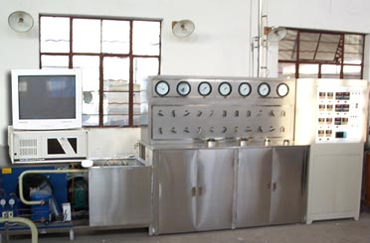
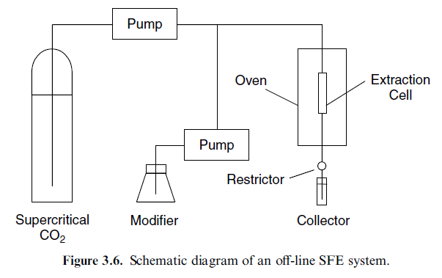
Left: A SFE instrument

