Slide 1
Environmental Biological Analysis (5 ECTS)
For Environmental Health Regular students 3rd year.
Lecture 1.
Introduction to environmental biological analysis
Safety in Laboratory

Slide 2
Environmental Biological Analysis
What is Environment/al?
Environment includes but not limited to; air, soil, water/wastewater, and solids.
Biological/Biology
Is related to the living organisms.
So, Environmental Biological Analysis is the study or analysis of living organisms which can be found in the environment such as in the water, air, food or wastewater.

Slide 3
Environmental Biological Analysis
Most of biological analysis are performed in the laboratory.
So everyone who enters the lab to do some tests should follow certain procedures.
In mean time it is critically important to stick to laboratory safety rules. So that students will not harm themselves, their classmates or laboratory personnel because of the lack of awareness.

Slide 4
Environmental Biological Analysis
Or sometimes there is high probability that the person can cause damage to laboratory equipment's or to the infrastructures if the safety rules are not followed.
So first we will discuss about the laboratory safety before we jumped in to the details of biological analysis of certain parameters.

Slide 5
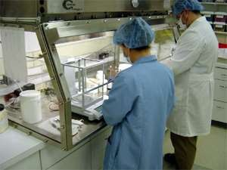
1.1. Laboratory safety

Slide 6
Laboratory safety…
Laboratory safety rules are a major aspect of every Laboratory.
Each student in laboratory must follow specific safety rules and procedures.

Slide 7
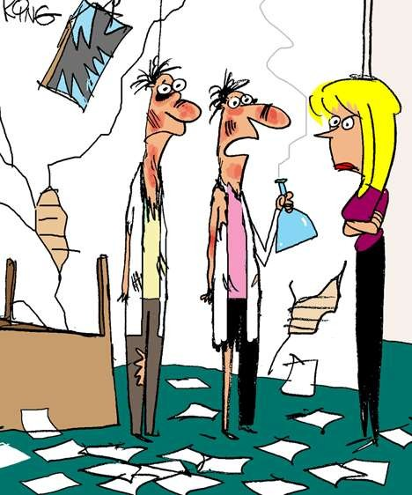
Why is Lab Safety Important?
Lab safety rules and symbols are needed so that students do not injure themselves or their classmates.
Laboratory safety is the key to reducing injury and illness. There are many exposures in the laboratory that pose a hazard to your health and you may have never considered them as a hazard before.

Slide 8
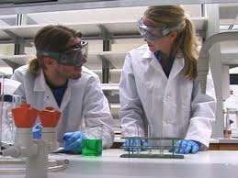

Lab Safety Rules
Wear protective clothing .

Slide 9
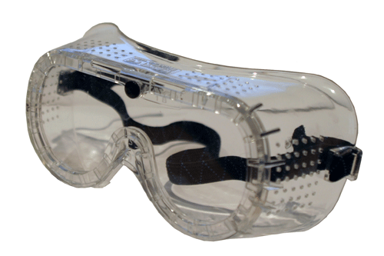
Always Wear Safety Goggles in the Lab!!!
Eyeglasses and sunglasses are not adequate substitutes.

Slide 10

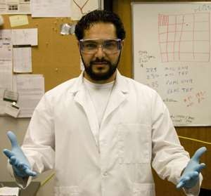

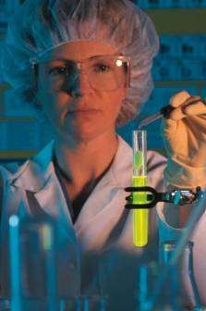
Protective clothes
Gloves are essential.
Lab coats are required.
Safety glasses
( goggles) may be required to avoid splashes.

Slide 11

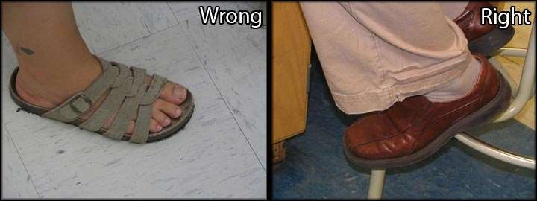
Laboratory personnel should not wear sandals

Slide 12
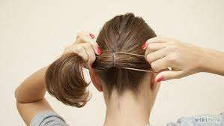

Long hair must be tied back or covered to minimize fire hazard or contamination of experiments.

Slide 13
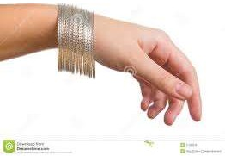
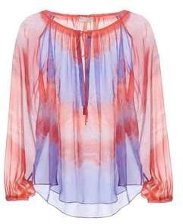
Do NOT Wear:
Jewelry
Loose or Baggy clothing

Slide 14
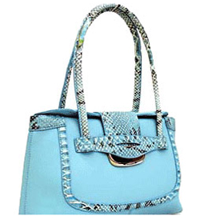
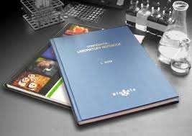
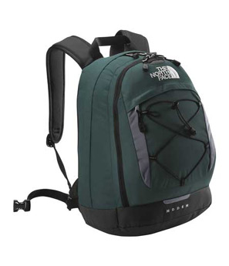
No Backpacks or Purses at Lab Tables
Keep nonessential books and clothing far away from your work area.

Slide 15
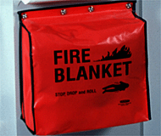
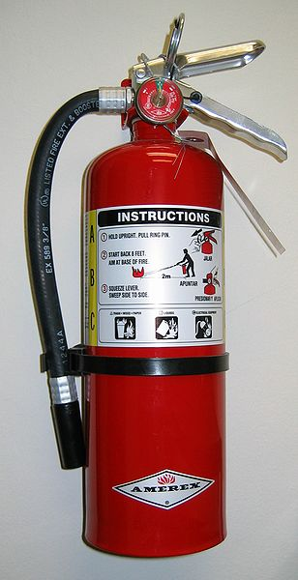
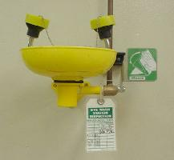
Know the Location of the Following…
Eyewash
Fire blanket
Fire Extinguisher

Slide 16
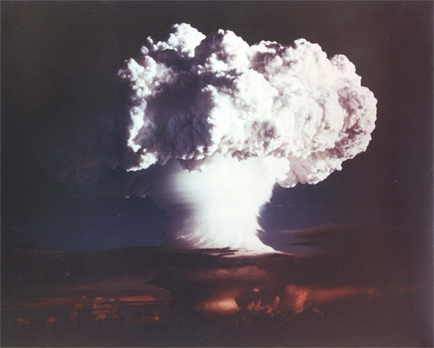
Never Perform Unauthorized Experiments!

Slide 17
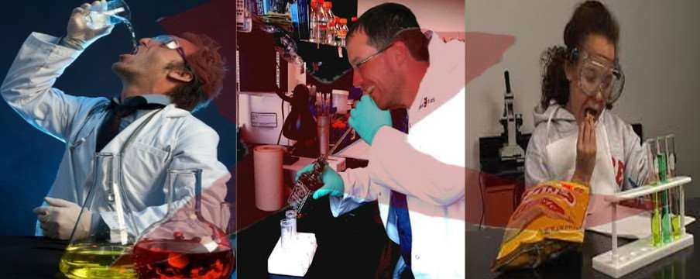
Do not eat food or drink water in the lab.
Don’t use lab glassware as food or water containers.

Slide 18
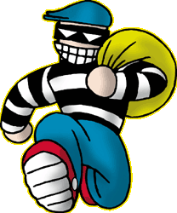
Never remove chemicals or equipment from the lab

Slide 19
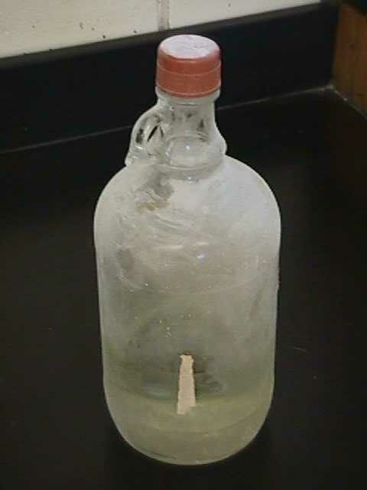
Never use chemicals from an unlabeled container

Slide 20
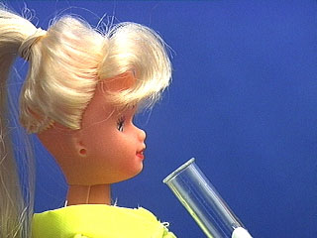
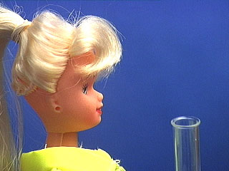
Heating Test Tubes
NEVER point the mouth of a test tube or Erlenmeyer flask at yourself or another person!
ALWAYS direct the mouth away from people!
Wrong!
Correct!

Slide 21
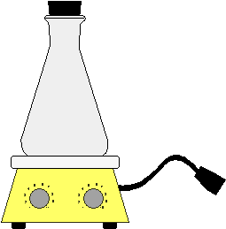
Never Heat a Closed Container
The increasing pressure in the container can cause the contents to spray out the top, or the container shatters, spreading shards of glass

Slide 22
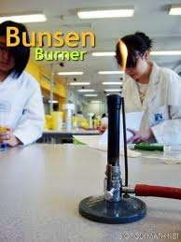
Caution must be taken when using gas burners. Be sure gas burners are turned off when finished.

Slide 23
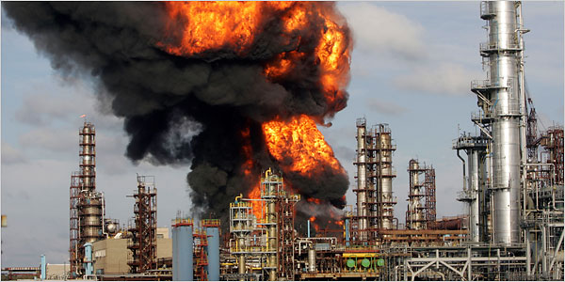
Keep Flammable Substances Away From Heat Sources

Slide 24
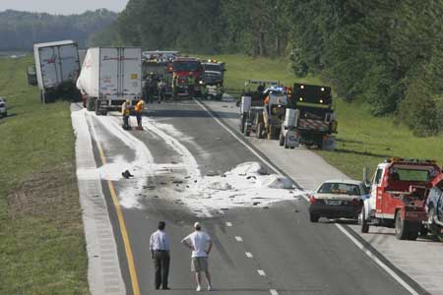
Clean up all spills immediately
Never return spilled or unused material to the reagent bottle.
Solids should be swept up and placed in the waste disposal container for that lab
Small liquid spills should be diluted with lots of water and mopped up with a cloth towel.
Large spills must be handled by the instructor.

Slide 25
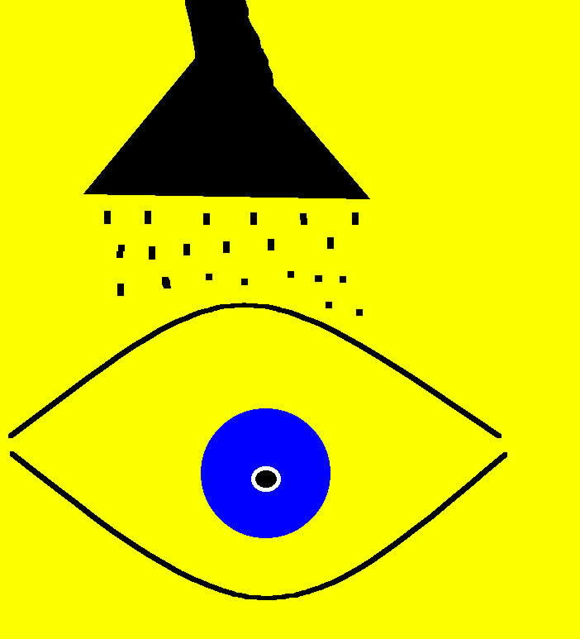
Incase of accident begin First Aid Immediately
Alert the instructor
If chemicals have come in contact with the eyes, begin eyewashing NOW!
Remove clothes that have chemical contamination
Move everyone away from the area to avoid further contamination

Slide 26

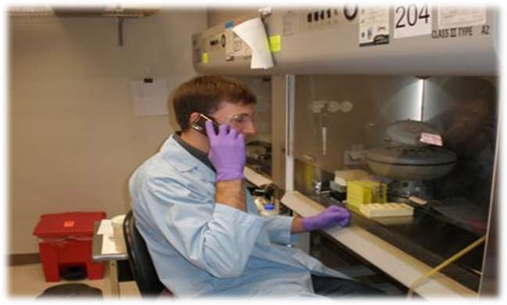
Avoid touching objects (e.g., pencils, cell phones, door handles) while wearing gloves.

Slide 27
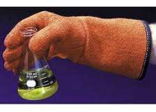
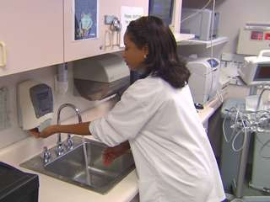
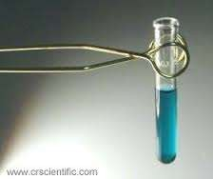
Protect your hands safety:
wash hands after every lab.
Handle glassware, sharp tools and heated containers carefully.

Slide 28
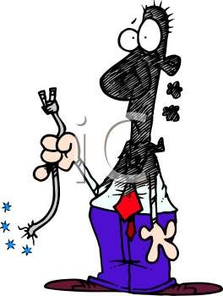
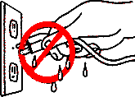
Electrical safety:
  unplug electrical equipment after use.
  keep all electrical cords and wires away from water .

Slide 29
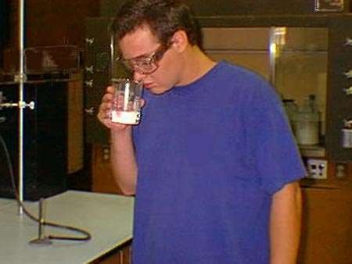
Chemical safety:
-never touch, taste or smell a chemical unless instructed to do so.
- never mix chemicals unless instructed to do so.
-keep lids on chemical containers when not in use.

Slide 30
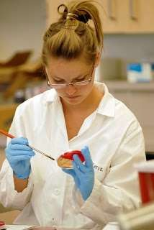
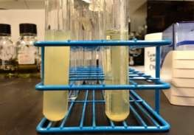
Do not take any cultures out of the
lab for any reason.
  All cultures should be handled as potentially pathogenic.
  Liquid cultures must always be
kept in a test tube rack.

Slide 31
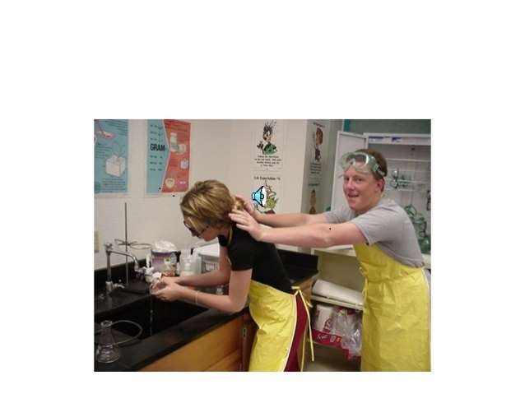
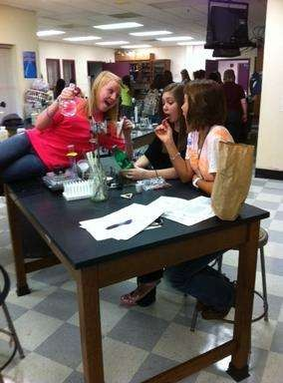
Do not engage in practical jokes or horseplay in the lab.

Slide 32
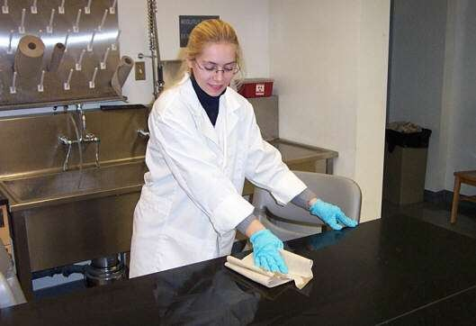
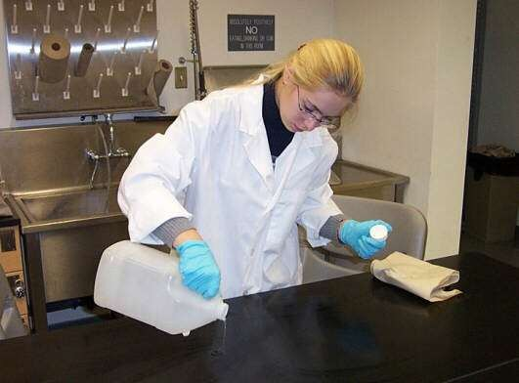
Wipe the bench tops down with disinfectant both before you
begin your work and after you have completed your work.

Slide 33
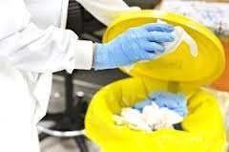
Dispose of waste products according to instructions.

Slide 34
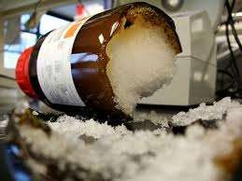
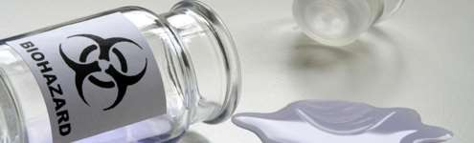
Report all accidents, no matter how minor, to your supervisor!!

Slide 35
Lab Safety Equipment

Slide 36
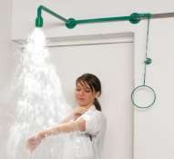
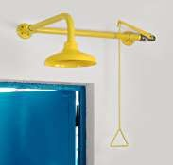
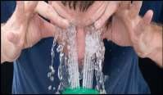
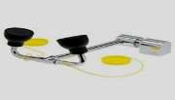
Lab Safety Equipment
Safety shower
Eye wash

Slide 37
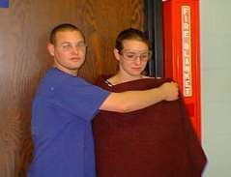
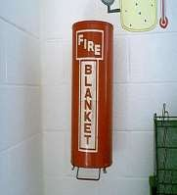
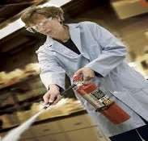

Lab Safety Equipment
Fire Blanket
Fire Extinguisher

Slide 38
Lab Safety Symbols

Slide 39

Lab Safety Symbols
They alert about the possible dangers in the lab.

Slide 40
Biological Safety Levels

Slide 41


Biological Safety Levels
BSL1
BSL2
BSL3
BSL4

Slide 42

BSL-1
– Not known to cause disease in healthy adult humans
Safety equipment
  Minimal requirements
Facilities
  Open bench top

Slide 43

BSL-2
– Associated with mild to moderate disease in humans
Safety equipment
  Biological Safety Cabinet and personal protective equipment as needed.
Facilities
  BSL-1 plus the availability of a mechanism for decontamination.

Slide 44

BSL-3
– Associated with serious or potentially lethal disease in humans
Safety equipment
  Biological Safety Cabinet and personal protective equipment required.
Facilities
  BSL-2 with self-closing double door access and single-pass negative directional airflow.

Slide 45

BSL-4
– Associated with high risk of life-threatening disease in humans and/or animals
Safety equipment
  Biological Safety Cabinet
  Full-body air-supplied, positive pressure personnel suit
Facilities
  BSL-3 plus dedicated air and exhaust, decontamination procedures for exit, separate building, etc.

