Slide 1
Early pregnancy bleeding
Abortion
Ectopic pregnancy
GTD

Slide 2
1.Abortion
Outlines
Definition
Etiology
Classification
Diagnosis
Management

Slide 3
By the end of the lesson the student should be able to
Define Abortion
Describe the ethologic of abortion
Describe the management of abortion
List post abortion cares

Slide 4
Abortion
Definition -is
Loss of pregnancy before viability:
- spontaneously
- induced
It implies the process of expulsion or extraction of products of conception
Viability:
- 20 wk, 24wk, 28 wk
- 500gm, 1000gm
Ethiopian context is 28 wk or 1000 gm

Slide 5
Etiology
First trimester abortion :(the first 12 wk)
  Fetal chromosomal abnormalities - particularly Trisomy,
  2 . Anembryonic pregnancy - Blighted ovum
  3. Parental balanced translocation
  4. Infections: genital tract infection , systemic infection with pyrexia & ToRCH syndrome
  5. Endocrine disorders : Diabetes, hypothyroidism , PCOS & Corpus luteum insufficiency,erythroblastosis fetais
  6. Uterine disorders: Uterine anomalies , sub mucus fibroid & Asher man's syndrome
  7. Thrombophilia
  8. Immunological disorders
  9. Cigarette smoking ,alcohol, anaesthetic agents & chemical agents .
  10. Psychological disorders
Notes:
5

Slide 6
Etiology…
B. Second trimester abortion:
  Multiple pregnancy
  Cervical incompetence (congenital & acquired )
  Uterine anomalies and sub mucous fibroid
  Genital tract infection and PROM
  5. Systemic infections: HIV, Malaria, syphilis, Rubella
6. Maternal health: Diabetes, Renal disease, Hypertension
Notes:
6

Slide 7
Unexplained Abortion
Unexplained:
The etiology of spontaneous abortion of chromosomally and structurally normal embryos/fetuses in apparently healthy women is unclear.

Slide 8
Classification of abortion
A. Clinically:
Threatened abortion
Inevitable abortion
Incomplete abortion
Complete abortion
Missed abortion
Septic abortion
Recurrent abortion

Slide 9
Classification…
B. Gestational Age:
Fist trimester
Second trimester
Method
Spontaneous
Induced

Slide 10
Differential diagnosis
Ectopic pregnancy
Molar pregnancy
AUB other than Pregnancy
Local causes like cervicitis
Urinary tract, GI tract bleeding

Slide 11
Threatened abortion
History → Mild vaginal bleeding.
→ No or mild abdominal pain
Examination → Good general condition.
→ The cervix is closed
→ The uterus is usually the correct size for date
U/S which is essential for the diagnosis Showed the presence of fetal heart activity.

Slide 12
Threatened abortion
(Management)
Reassurance If fetal heart activity is present, > 90% of cases will be progressed satisfactorily
Advice: Decrease physical activity (bed rest is of no therapeutic value), avoid intercourse.
Hormones i.e. Progesterone & hCG Which are used in the first trimester to support pregnancy
Anti- D: An adequate dose of
ANC as high risk patients

Slide 13
Inevitable and Incomplete abortions-read danforth
History
  Heavy vaginal bleeding.
    with no passage of products conception (inevitable)
    with the passage of products of conception (incomplete abortion)
  Severe lower abdominal pain which follows the bleeding (both)

Slide 14
Inevitable and Incomplete…
Examinations
  Poor general condition.
  The cervix is dilating and products of conception may be passing trough the os
  The uterus may be the correct size for date (inevitable abortion) or small for date (incomplete abortion)
U/S → Fetal heart activity may or may not present in inevitable abortion or retained products of conception ( RPOC ) in incomplete abortion

Slide 15
Inevitable and incomplete abortions
(Management)
CBC , blood grouping , Blood
Resuscitation → large IV line, fluids & blood transfusion
Oxytoxic drugs
Evacuation & curettage
Give anti D in the same way like threatened abortion
6. Post-abortion management.

Slide 16
Complete abortion
History
  Heavy vaginal bleeding →which has been stopped.
  lower abdominal pain which follows the bleeding →which has been stopped.
Examination
  Initially cervix closed but later
U/S
  showed empty uterine cavity or PROP

Slide 17
Complete abortion
(Management)
Confirm it is complete by U/S
Post-abortion care

Slide 18
Missed abortion
A missed abortion refers to in-utero death of the embryo or fetus prior to the 20th/28th week of gestation, with retention of the pregnancy for a prolonged period of time.(1 wk and above)
NB- IUFD –is inutero death of fetus of >=28 GA

Slide 19
Missed abortion
Most of missed abortions are diagnosed accidentally during routine U/S in early pregnancy .
In some cases there may be a history of :
  Episodes of mild vaginal bleeding
  Regression of early symptoms of pregnancy .
  Stop of fetal movements after 20 weeks gestation.
Examination
  The uterus may be small for date

Slide 20
Missed abortion
U/S (which is essential for diagnosis ) diagnosed if two ultrasound ( T/V or T/A) at least 7days apart showed an embryo of > 7 weeks gestation ( CRL > 6mm in diameter and gestational sac > 20 mm in diameter ) with no evidence of heart activity .

Slide 21
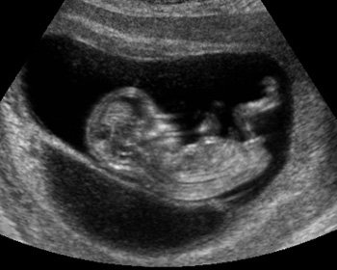
No fetal cardiac activity

Slide 22
Missed abortion
(Management)
CBC , blood grouping , units of blood
Platelets count, PT, PTT – to exclude the risk of DIC
- magt- D &c

Slide 23
Anembryonic pregnancy
(Blighted ovum)
It is due to an early death and resorption of the embryo with the persistence of the placental tissue.
It is diagnosed if two ultrasound ( T/V or T/A) at least 7 days apart showed after 7 weeks of gestation (i.e. gestational sac > 20mm ) an empty gestational sac with no fetal echoes seen .
It is treated in a similar way to missed abortion .

Slide 24
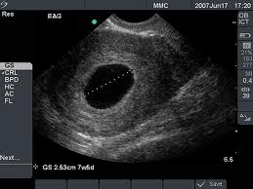
Blighted ovum
Anembryonic pregnancy
Empty gestational sac

Slide 25
Septic abortion
Definition :
  Commonly it is an incomplete abortion which complicated by infection of the uterine contents .
  It can be any clinical variety: Induced, Spontaneous, Incomplete. Inevitable, Complete, missed abortions.
Features : Poor general condition
  Include the features of incomplete abortion i.e. severe vaginal bleeding with passage of product of conception, with or without history of evacuation.
  Features of pelvic infection i.e. pyrexia , tachycardia , general malaise , lower abdominal pain , pelvic tenderness & purulent vaginal discharge .

Slide 26
Septic abortion
Bacteriology : Mixed infection
  The commonest organisms are :
    Gram -ve : E.coli , strepto & staphylococcu
    Anaerobics : Bacteroides
    These organisms indicate that the infection is ascending from vaginal flora
  Rarely Cl. tetani , which is potentially lethal if not treated adequately .
Types :
  Mild → the infection is confined to decidua or endometrium : 80%
  Moderate →the infection extended to myometrium15%
  Severe →the infection extended to pelvis + Endotoxic shock + DIC 5%

Slide 27
Septic abortion
Management :
Investigations :
  CBC , blood grouping , 2 units of blood .
  Coagulation profile , serum electrolytes & blood culture if pyrexia > 38.5°C
Antibiotics
Surgical evacuation of)
Post-abortion management.

Slide 28
Complications of abortion
Hemorrhage .
Complication related to surgical evacuation ie E&C and D&C.
  Uterine perforation- which may lead to rupture uterus in the subsequent pregnancy.
  Cervical tear & excessive cervical dilatation – which may lead to cervical incompetence.
  Infection – which may lead to infertility & Asher man's syndrome.
  Excessive curettage – which may lead to Adenomyosis
Rh- iso immunization
Psychological trauma .

Slide 29
Post - abortion management
In cases of incomplete, inevitable, complete, missed & septic abortions
  Support: from the husband, family& obstetric
  staff
  Anti D – to all Rh –ve, nonimmunised patients, whose husbands are Rh+ve
  Counseling & explanation:
    Contraception (Hormonal, IUCD, Barrier) Should start immediately after abortion if the patient choose to wait , because ovulation can occur 14 days after abortion and so pregnancy can occur before the expected next period .

Slide 30
PAC(post Abortion care) : Five elements
Emergency treatment of incomplete abortion and its complications
Counseling- about procedure, post procedure cxn prevention, when to seek care etc
FP services
Linkage with other RH services
Community-service provider partnership (community awareness creation on safe abortion methods)

Slide 31
Recurrent abortion
Definition :
  Is defined as 3 or more consecutive spontaneous abortions
  It may presented clinically as any of other types of abortions .
Types :
  Primary : All pregnancies have ended in loss
  Secondary : One pregnancy or more has proceeded to viability(>24 weeks gestation) with all others ending in loss
Incidence :
  occurs in about 1% of women of reproductive age .

Slide 32
Recurrent abortion
Causes
Idiopathic recurrent abortion, in about 50%, in which no cause can be found .
The known causes include the followings :
  Chromosomal disorders:
    Fetal chromosomal abnormalities & structural abnormalities
    Parental balanced translocation
2. Anatomical disorders:
Cervical incompetence: →congenital and acquired
Uterine causes: → sub mucous fibroids, uterine anomalies & Asher man's syndrome

Slide 33
Recurrent abortion
Causes
3. Medical disorder:s
Endocrine disorders : diabetes , thyroid disorders , PCOS & corpus luteum insufficiency .
Immunological disorders
Thrombophilia: congenital deficiency of Protein C&S and antithrombin III, & presence of factor V leiden.
    Infections
        ToRCH - CMV may be a cause of recurrent abortion
      Genital tract infection e.g. Bacterial vaginosis
  Rh – isoimmunization

Slide 34
THANK YOU SO MUCH!!!

Slide 35
2. Ectopic pregnancy
Outlines
Definition
Risk factors
Manifestations
Diagnosis
Management

Slide 36
Ectopic Pregnancy
Definition:
Ectopic pregnancy is one in which the blastocyst implants anywhere other than the endometrial lining of the uterine cavity.
Ectopic pregnancy accounted for 10 % of all pregnancy-related deaths
Incidence
Ectopic pregnancies occurred, at a rate of 16 ectopic pregnancies per 1,000 reported pregnancies (1.6%)
More than 95 % ectopic pregnancy are tubal

Slide 37
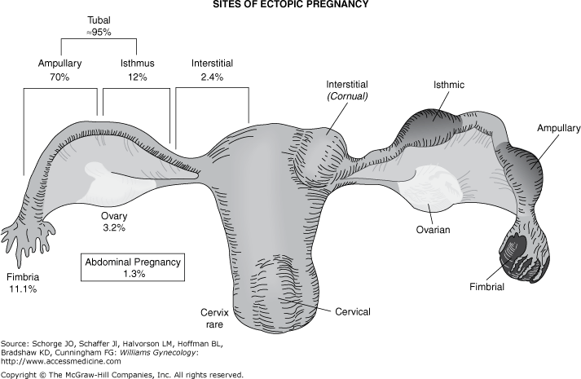
Various sites and frequency of ectopic pregnancies.

Slide 38
Risk Factors
An appreciation of risk factors for ectopic pregnancy leads to a more timely diagnosis with improved maternal survival and future reproductive potential.
Prior ectopic pregnancy, documented tubal pathology, surgery to restore tubal patency, or tubal sterilization carry the highest risks of obstruction and subsequent ectopic pregnancy
Risk factors for ectopic pregnancy can be divided into those that confer
    High
    Moderate, or
    Low/slight risk

Slide 39
Risk factor for ectopic pregnancy
Risk factor | Odds Ratio
High Risk
Tubal corrective surgery | 21.0
Tubal sterilization | 9.3
Previous ectopic pregnancy | 8.3
In utero DES exposure | 5.6
Intrauterine device | 4.2–45
Documented tubal pathology | 3.8–21
Moderate Risk
Infertility | 2.5–21
Previous genital infection | 2.5–3.7
Multiple partners | 2.1
Slight Risk
Previous pelvic or abdominal surgery | 0.93–3.8
Smoking | 2.3–2.5
Douching | 1.1–3.1
Intercourse before 18 years | 1.6

Slide 40
Risk Factors Contd.
Cigarette smoking :
  In the period increases the risk of ectopic pregnancy in a dose-dependent manner, thus it can be either a low or moderate risk factor depending on the patient's habits.
  This may be the result of impaired immunity in smokers, thus predisposing them to pelvic inflammatory disease, or to impairment in tubal motility
In vitro fertilization:
  May be doe to impaired tubal motility from hormonal stimulation
  Increased the incidence of "Atypical" implantation: Cornual, abdominal, cervical & ovarian

Slide 41
Risk Factors Contd.
Age > 40 years
  Myoelectrical activity is responsible for propulsive activity in the fallopian tube.
  This activity facilitates movement of the sperm and ova toward each other and propels the zygote toward the uterine cavity.
  Aging results in progressive loss of myoelectrical activity along the fallopian tube, which may explain the increased incidence of tubal pregnancy in perimenopausal women .

Slide 42
Risk Factors Contd.
Contraceptives
Most forms of contraception will ironically increase the relative incidence of ectopic pregnancy by decreasing the number of intrauterine pregnancies.
The relative number of ectopic pregnancies varies by contraceptive use.
For example, barrier contraception and the TCu380A IUD do not confer an increased ectopic pregnancy rate .
Hormonal control of the muscular activity in the fallopian tube may explain the increased incidence of tubal pregnancy associated with failures of the morning after pill, minipill, progesterone-containing intrauterine devices (IUDs), and ovulation induction.
Tubal sterilization can be followed by an ectopic pregnancy.

Slide 43
Clinical Manifestations
Symptoms
Triads occur in 50% of patients
    Amenorrhea
    vaginal bleeding
    Abdominal pain on the affected side
Other pregnancy discomforts such as breast tenderness, nausea, and urinary frequency may accompany more ominous findings.
Shoulder pain
Vertigo and syncope from hemorrhagic hypovolemia.
Many women with a small unruptured ectopic pregnancy have unremarkable clinical findings.

Slide 44
Clinical Manifestations Contd.
Physical examination
Vital Signs normal or deranged
Abdominal and pelvic findings are notoriously scant in many women before tubal rupture.
With rupture
      Pale
      Acutely sick
      Signs of fluid collection
      signs of acute abdomen.
      Cervical motion tenderness
      Adnexal mass
      Buldged cul-de-sac

Slide 45
Differential diagnosis
Abortion
GTD
PID
Corpus luteum cyst
Cystitis
Renal colic
Adnexal cyst torsion
Degenereting Mayoma
Appendicitis
Mesenteric lymph adenitis

Slide 46
Diagnosis
Clinical: high index of suspicion
Laboratory tests:
        Hct
        Blood group & Rh
        Urine HCG
        Serum beta HCG
        Serum progesterone
        Ultrasound
Culdocentesis
Endometrial Sampling
Diagnostic laparoscopy : Gold standard for diagnosis of ectopic pregnancy

Slide 47
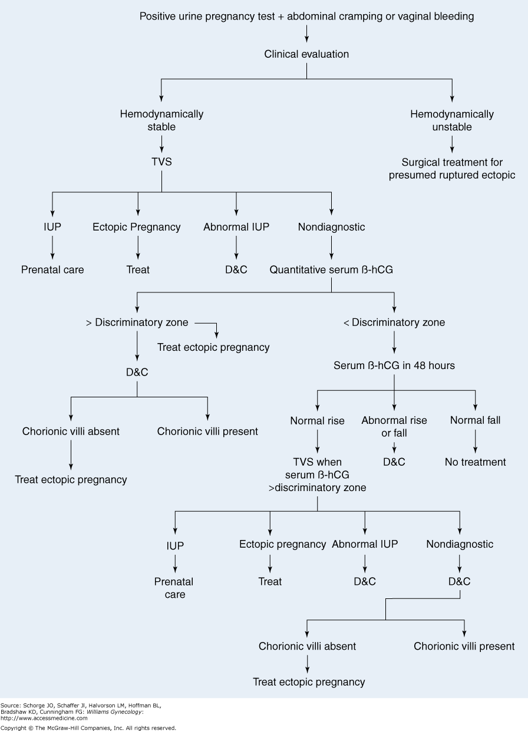
Algorithm for the diagnosis of ectopic pregnancy

Slide 48
Management of ectopic pregnancy
Medical: Oral, parenteral or direct Injection into Ectopic Pregnancy
    Methotrexate
    Prostaglandins
    Mifepristone
    Potassium chloride - When a tubal pregnancy coexists with a uterine pregnancy, potassium chloride can be injected into the tubal pregnancy sac as methotrexate is c/I in the presence of intrauterine preg.
    Hyperosmolar glucose
2. Surgical
3. Expectant management
4. Anti D for Rh negative women

Slide 49
Medical Treatment Protocols for Ectopic Pregnancy
 | Single Dose | Two dose | Multidose(but max. is upto 4 dose)
Dosing | One dose; repeat if necessary | Days 0 and 4 | Up to 4 doses of both drugs until serum β-HCG declines by 15%
Medication Dosage
Methotrexate | 50 mg/m² BSA (day 1) IM | 50 mg/m2 BSA IM | 1 mg/kg, days 1, 3, 5, and 7
Leucovorin | N/A | N/A | 0.1 mg/kg days 2, 4, 6, and 8
Serum β-HCG level | Days 0 (baseline), 4, and 7 | Days 0 (baseline),4, and 7 Days 11 and 14 if repeat dose is given | Days 0 (baseline), 1, 3, 5, and 7
Indication for additional dose | If serum β-HCG level does not decline by 15% from day 4 to day 7 Less than 15% decline during weekly surveillance | If serum β-HCG does not decline by 15% from day 4 to day 7 If serum β-HCG does not decline by 15% from day 7 to day 11 If the above occur Maximum of four doses is given | If serum β-HCG declines <15%, give additional dose; repeat serum β-HCG in 48 hours and compare with previous value; maximum four doses
Post therapy surveillance | After dy 7 HCG measurement do Weekly measurement until serum -hCG undetectable | Weekly until serum β-HCG undetectable | Weekly until serum β-HCG undetectable

Slide 50
Prevention
Tubal pathology carries one of the highest risks and pelvic inflammatory disease plays a major role in tubal adhesions and obstruction.
Because chlamydial infections constitute nearly half of pelvic inflammatory disease cases, efforts have been directed towards screening high-risk populations for asymptomatic infections.
These include sexually active women under the age of 25 or women who use non barrier forms of contraception.
Such screening programs in Sweden have demonstrated steady declines in both chlamydial infections and ectopic pregnancy rates, especially in women aged 20 to 24 years

Slide 51
Thank you

Slide 52
3. Gestational Trophoblastic Disease

Slide 53
Outlines
definition,
risk factor,
classification,
diagnosis,
management

Slide 54
LEARING OUT COME
By the end of the lesson the student should be able to
Define GTD
List the risk factor of GTD
Describe the classification of GTD
Describe the clinical manifestation of GTD
Describe the diagnosis of GTD
Describe the management of GTD

Slide 55
Gestational trophoblastic disease
Gestational trophoblastic disease (GTD) is a proliferative disorder of trophoblastic cells.
All forms of GTD are characterized by a distinct tumor marker, the beta subunit of human chorionic gonadotropin (hCG).
The pathogenesis of GTD is unique because the maternal tumor arises from gestational rather than maternal tissue.
It is principally a disease of chorion

Slide 56
classification
1) Benign tumors
Hydatidiform mole -complete mole
-partial mole
2) Malignant tumor
Persistent gestational trophoblastic tumor
Invasive mole
placental site trophoblastic tumor
choriocarcinoma

Slide 57
Pathologic and clinical classifications for gestational trophoblastic disease
PATHOLOGIC CLASSIFICATION |  | CLINICAL CLASSIFICATION
Hydatidiform mole *complete *incomplete |  | Benign gestational trophoblastic disease
Invasive mole |  | Malignant trophoblastic disease | Nonmetastatic
Placental site trophoblastic tumor |  | Metastatic
Choriocarcinoma |  | High risk | Low risk

Slide 58
“molar pregnancy”, can occur after any
gestation”
Induced or spontaneous abortion
Ectopic pregnancy
Term pregnancy

Slide 59
Risk factors
1. Maternal age > 40 years
< 20 years –teenage pregnancy
2. Paternal age > 45 years
3. Previous Hydatidiform mole 1st 1-2%
2nd 15-28%
4. Nutrional deficiency - folic acid
⁻ carotene
-Vitamin A deficiency

Slide 60
HYDATIDFORM MOLE
Xied by histologically by abnormalities of the chorionic villi that consist of trophoblastic proliferation and edema of villous stroma
The absence or presence of a fetus ,gross morphology and karyotype used to describe them as
1. complete mole
2. Partial mole

Slide 61
Cont….
Hydatidiform mole is a pregnancy characterized by vesicular swelling of placental villi and usually the absence of an intact fetus. (without embryo, membrane, or cord development)
The etiology of Hydatidiform mole remains unclear, but it appears to be due to abnormal gametogenesis and fertilization
In a ‘complete mole’ the mass of tissue is completely made up of abnormal cells
There is no fetus and nothing can be found at the time of the first scan.

Slide 62
Cont…
In a ‘partial mole’, the mass may contain both these abnormal cells and often a fetus that has severe defects.
In this case the fetus will be consumed ( destroyed) by the growing abnormal mass very quickly. (shrink)

Slide 63
Incidence
1 out of 1500-2000 pregnancies in the U.S. and Europe
1 out of 500-600 pregnancies in some Asian countries.
Complete > incomplete
Repeat H. moles occur in 0.5-2.6% of patients, and these patients have a subsequent greater risk of developing invasive mole or Choriocarcinoma
There is an increased risk of molar pregnancy for women over the age 40

Slide 64
Incidence
~10-17% of H.moles will result in invasive mole
~2-3% of H. moles progress to Choriocarcinoma (most of them are curable)
Vary with ethnic variation
Common in oriental countries
The highest incidence in Philippines(1in 80) and lowest in European countries(1in 752).

Slide 65
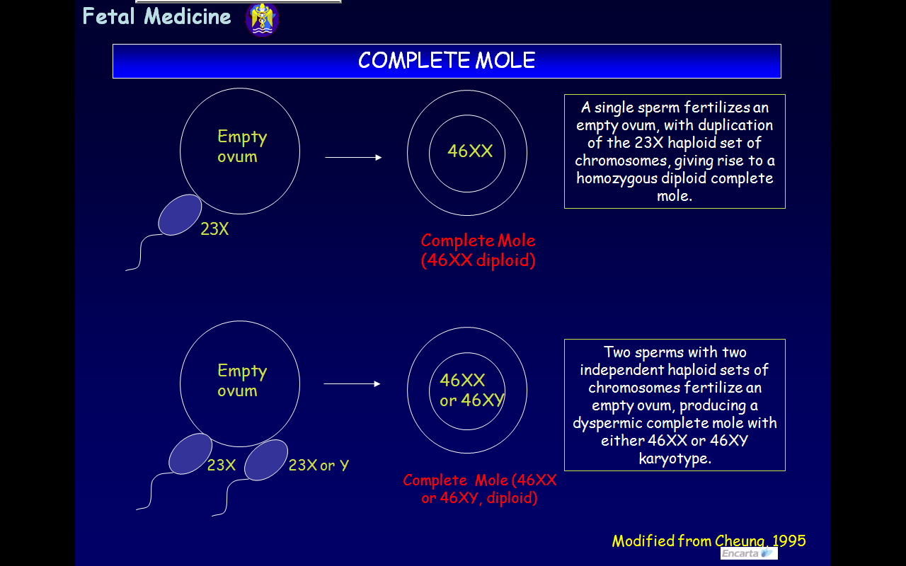

Slide 66
Clinical presentation
Complete mole
Vaginal bleeding 97%
Excessive uterus size 50%
Amenorrhea and Abdominal pain
Preeclampsia 27% before 20wks
  Hyperemesise gravidrum 25% and Thyrotoxicosis 7%
Theca lutein ovarian cysts >50%
Expulsion of snow storm appearance
USG-Snow storm appearance and Absence of fetal part and FHB

Slide 67
Partial mole
Sign and symptom of incomplete or missed abortion
Could have fetus
vaginal bleeding
preeclampsia

Slide 68
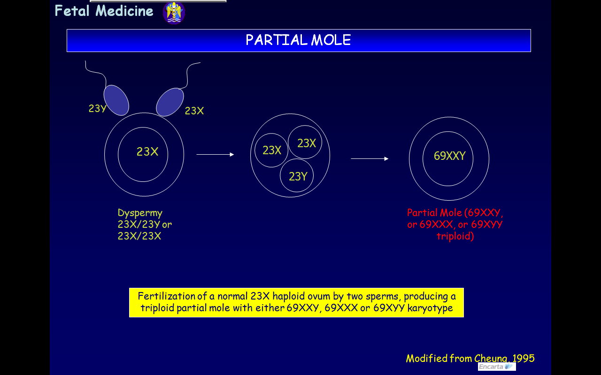

Slide 69
Feature of complete and partial mole
features | Complete mole | Partial mole
Embryonic tissue | Absent | present
Swelling of chorionic villi | diffuse | focal
Trophoblastic hyperplasia | diffuse | focal
karyotype | 46XX, 46XY Paternal | Triploid both

Slide 70
Natural history
Complete mole
After evacuation
*Local uterine invasion 15%, metastasis occurs in 4%
*high risk for developing post molar tumor
HCG level > 100,000 mIU/ml
Excessive uterine enlargement
Theca lutein cyst >6 cm. in diameter
Partial mole
Persistent tumor, usually non metastatic develop (2-4%).

Slide 71
Diagnosis
1. complete mole
Vesicular sonographic pattern
Markedly elevated ß HCG levels for gestational age
pre-eclampsia before 20wks of gestation
Sign and symptom

Slide 72
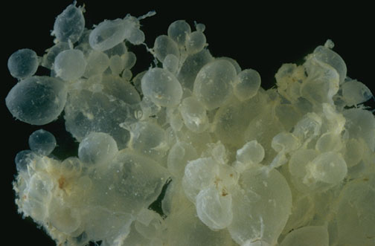

Slide 73
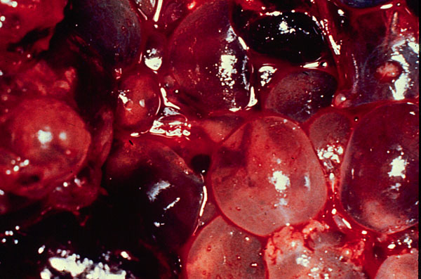

Slide 74
2. Partial mole
focal cystic space in placental tissue
Increase in the transverse diameter of gestational sac
Increased ß HCG levels

Slide 75
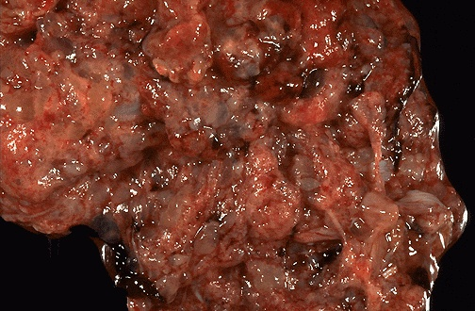

Slide 76
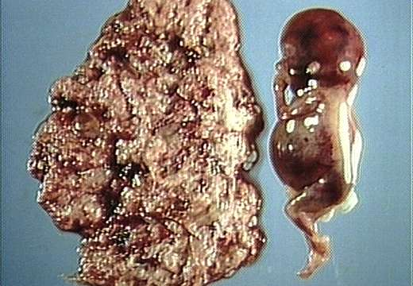
Partial Hydatidiform mole

Slide 77
Differential diagnosis
Threatened abortion
Ovarian tumor with pregnancy
Multiple pregnancy

Slide 78
Complications
Hemorrhage and shock
Sepsis
Perforation of the uterus
Coagulopathy
choriocarcinoma

Slide 79
Management
Supportive management
Correction of anemia and infection
Infusion with ringers solution
Blood transfusion
Counseling for regular follow up
Patient who are RH-ve should receive RH immunoglobulin

Slide 80
Definitive management…………
Suction evacuation
2) Hysterectomy
Indications:-
Age greater than 35 years
Grandmultiparous
Uncontrolled hemorrhage
Perforation during evacuation
3).Prophylactic chemotherapy

Slide 81
Follow up
Routine follow is mandatory for all cases for at least one year.
Choriocarcinoma is mostly confined to this period
HCG level following evacuation should regress to normal with in three months.
Intervals:-initially, every week till the serum HCG level becomes negative. This usually happens 4-8 weeks. After this the patient is followed every month for 6 months

Slide 82
Follow up protocols
History and physical examination
hCG assay

Slide 83
Contraceptive advice
If the patient desires her fertility, she may be pregnant after a minimum of 6 month following negative hCG titer.
IUD is contra indicated because it is associated with irregular bleeding.
Combined oral contraceptives can be used after HCG value has become normal.
Injectables of contraception can also be used.
Surgical sterilization is another method if she completed her family.

Slide 84
The End!!!

