Slide 1
Chapter 7: Communicable and Non-communicable Diseases
Course code: Biot. 3113
Course name: Medical Biotechnology
Department of Biotechnology
University of Gondar

Slide 2
Part 1 – Overview of Communicable Diseases (CDs)
Introduction and Definition
Importance of CDs
Selected CDs of Public Health Concern
Part 2- Mounting a Global Response
Approaches to intervention
Key elements of a global response
World Bank’s role and involvement
Notes:
Introduction and Definition
Definition:
Modes of transmission
Examples of CDs
Common Infectious diseases
Neglected diseases
History of Communicable Diseases
Burden of Disease
Global burden of disease and communicable diseases, by region, gender and income levels
Importance of CDs
Sheer Burden
Economic impact
Rate of spread
Recurrence of diseases
Security and CDs
Interventions
Why intervene? Why should policy makers care about CDs?
History of interventions and policy issues
What is needed for effective control of CDs
Global Approaches
Global responsibility
International law
Partnerships and collaboration
Financial support
World Bank’s role and involvement
Total lending in health
Special programs the Bank is involved in.
Conclusions and Way forward

Slide 3
Distinguish between communicable and non-communicable diseases
Non-Communicable disease
Also called non-infectious diseases
For example: Heart disease
Communicable diseases
Also called infectious diseases.
Passed through direct/indirect contact
Causes of Communicable Diseases
How Communicable Diseases are Transmitted
Preventing the Spread of Disease

Slide 4
Causes of non-communicable diseases
1. Hereditary-passed from parent to child
2. Environmental
Place of living–or work
For example: Nuclear power plant
3. Lifestyle
Poor health habits – tanning, smoking, drinking, poor diet, lack of exercise and emotional stress.

Slide 5
Communicable Diseases
Caused by direct or indirect spread of pathogens from a person or thing to another.
Pathogens are disease causing agents
Vectors are disease-causing organisms that carry pathogens from one host to another
For example:
Mosquitoes transmit malaria
Ticks transmit Lyme disease

Slide 6
How diseases are spread
Direct contact - touching infected area of person
Indirect - sneezing, coughing, sharing personal items
Contact with vectors (animals and insects) - bites
Other contact - eating contaminated foods

Slide 7
Where Diseases Enter The Body
Mouth
Eyes
Nose
A break in skin (cuts)
Genitals

Slide 8
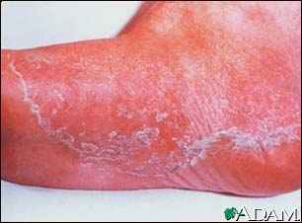
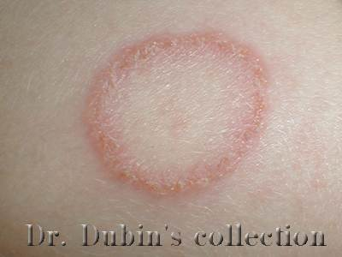
Common Types of Pathogens
Bacteria
Virus
Fungi
Protozoan
Athlete’s Foot
Fungi
Ring Worm

Slide 9
PREVENTING COMMUNICABLE DISEASES
Physical & Chemical Barriers
1st line of defense
Physical: skin, mucous membranes
Chemical: enzymes in tears

Slide 10
PREVENTING COMMUNICABLE DISEASES
The Immune Response
Pathogens invade the body.
Macrophages engulf the pathogen.
Macrophages digest the pathogen and T cells recognize antigens of the pathogen as an invader.
T cells bind to the antigens.
B cells bind to antigens and helper T cells
B cells produce plasma cells.
Plasma cells release antibodies into the bloodstream.
Antibodies bind to antigens to help other cells identify and destroy pathogens.

Slide 11
Communicable Diseases: Definition
Defined as
“any condition which is transmitted directly or indirectly to a person from an infected person or animal through the agency of an intermediate animal, host, or vector, or through the inanimate environment”.
Transmission is facilitated by the following
more frequent human contact due to
Increase in the volume and means of transportation,
globalization
Microbial adaptation and change
Breakdown of public health capacity at various levels
Change in human demographics and behavior
Economic development and land use patterns
Notes:
These have become more important given the modern means of transportation and increased interaction across countries that makes it easy for an infectious pathogen to spread from one part of the world to another

Slide 12
Importance of Communicable Diseases
Significant burden of disease especially in low and middle income countries
Social impact
Economic impact
Potential for rapid spread
Human security concerns
Intentional use

Slide 13
Human Security concerns
Potential magnitude and rapid spread of outbreaks/pandemics.
e.g. SARS outbreak
No country or region can contain a full blown outbreak of Avian influenza
Bioterrorism and intentional outbreaks
Anthrax, Small pox
New and re-emerging diseases
Ebola, TB (MDR-TB and XDR-TB), HPAI, Rift valley fever.

Slide 14
Non-communicable diseases
Diseases that cannot be spread from one person/thing to another
Diseases that are not caused by pathogens
Can affect any system in the body
(circulatory, nervous, respiratory)
Can be treated but not usually cured

Slide 15
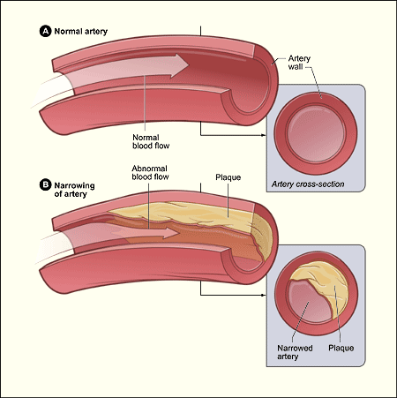
CARDIOVASCULAR DISEASES
Atherosclerosis – plaques accumulate on artery walls.
Buildup is due mainly to food choices.
Can cause blood clots that can lead to heart attack or strokes.

Slide 16
Risk Factors for Cancer
Abnormal cells that have the potential to become cancer cells are produced every day and the immune system destroys most of them.
If the immune systems becomes weakened or the number of cancer cells becomes overwhelming, cancer may develop.
Some cases – normal cells may change by themselves, in others it is due to a faulty gene.
Majority of cancers are caused by exposure to certain factors that increase the risk of cell damage.
Carcinogen from cigarette smoke
Ultraviolet light
Sexually Transmitted Diseases
Dietary factors

Slide 17
DIABETES
Serious side effects:
Blindness
Kidney Failure
Limb Amputations
Heart Disease
Stroke

Slide 18
MENTAL RETARDATION
Causes:
Injury
Disease
Brain Abnormality
Genetic Disorder
Down Syndrome
PKU
Tay-Sachs
Fragile X Syndrome
Pregnant women who use Alcohol or other Drugs
Low birth weight
Mental Retardation
Fetal Alcohol Syndrome
Restricted supply of oxygen during birth
Stroke
Certain infections
Meningitis

Slide 19
Body’s Primary Defenses Against Communicable Diseases
Skin
Most important – keeps out harmful germs
Produces sweat that kills some types of pathogens
Mucus Membrane
Cells that line nose, mouth and throat produce mucus to trap germs
Skin
Mucus Membrane
Cilia

Slide 20
Body’s Defense Against Communicable Disease
Cilia
Wavelike hairs that sweep out germs from throat, nose, etc

Slide 21
Body’s Secondary Defenses
Fever – the temperature of the body increases to slow multiplication of pathogens
White Blood Cells – special cells that kill pathogens
Chemical Barriers – tears and saliva
Reflexes – blinking, coughing and sneezing

Slide 22
Tuberculosis Control
Challenges for tuberculosis control
Multi-drug-resistant tuberculosis (MDR-TB) is a form of tuberculosis (TB) infection caused by bacteria that are resistant to treatment with at least two of the most powerful first-line anti-TB medications (drugs), isoniazid and rifampin.
MDR-TB - In most countries.
About 450000 new cases annually.

Slide 23
Tuberculosis Control
Drug-resistant TB (XDR TB) is a rare type of multidrug-resistant tuberculosis (MDR TB) that is resistant to isoniazid and rifampin, plus any fluoroquinolone and at least one of three injectable second-line drugs (i.e., amikacin, kanamycin, or capreomycin).
XDR-TB cases confirmed in South Africa.
Weak health systems
TB and HIV

Slide 24
Malaria Control
Malaria control
Early diagnosis and prompt treatment to cure patients and reduce parasite reservoir
Vector control:
Indoor residual spraying
Long lasting Insecticide treated bed nets
Intermittent preventive treatment of pregnant women
Challenges in malaria control
Widespread resistance to conventional anti-malaria drugs
Malaria and HIV
Health Systems Constraints
Access to services
Coverage of prevention interventions
Notes:
With full LLITN coverage, child mortality from all causes is reduced by 18%

Slide 25
HIV Co-infections
Impact of TB on HIV
TB considerably shortens the survival of people with HIV/AIDS.
TB kills up to half of all AIDS patients worldwide.
TB bacteria accelerate the progress of AIDS infection in the patient
HIV and Malaria
Diseases of poverty
HIV infected adults are at risk of developing severe malaria
Acute malaria episodes temporarily increase HIV viral load
Adults with low CD4 count more susceptible to treatment failure
Notes:
Growing body of evidence on the interactions between both conditions
Both are diseases of poverty

Slide 26
HIV/AIDS
Interventions depend on
Epidemiology – mode of transmission, age group
Stage of epidemic –concentrated vs. generalized
Elements of an effective intervention
Strong political support and enabling environment.
Linking prevention to care and access to care and treatment
Integrate it into poverty reduction and address gender inequality
Effective monitoring and evaluation
Strengthening the health system and Multisectoral approaches

Slide 27
HIV/AIDS
Challenges in prevention and scaling up treatment globally include
Constraints to access to care and treatment
Stigma and discrimination
Inadequate prevention measures.
Co-infections (TB, Malaria)

Slide 28
Avian Influenza
Seasonal influenza causes severe illness in 3-5 million people and 250000 – 500000 deaths yearly
1st H5N1 avian influenza case in Hong Kong in 1997.
By October 2007 – 331 human cases, 202 deaths.

