Slide 1
Chapter 6 Topic: Cancer Immunotherapy
Course code: Biot. 3113
Course name: Medical Biotechnology
Department of Biotechnology
University of Gondar

Slide 2
General principles
The immune system recognizes and reacts against cancers
The immune response against tumors is often dominated by regulation or tolerance
Evasion of host immunity is one of the hallmarks of cancer
Some immune responses promote cancer growth
Defining the immune response against cancers will help in developing new immunotherapies

Slide 3
The immune system, which recognizes foreign micro-organisms as 'non-self' and mounts a response to destroy these disease-causing agents, plays a similar role in protecting the body from malignancy.
The damaged DNA in cancer cells frequently directs the mutated cell to produce abnormal proteins known as tumor antigens.
Effector T-cells specifically recognize foreign components and their function is to destroy them.
Dendritic cells are dedicated antigen-presenting cells present in barrier tissues (eg, skin, lymph nodes).
They play a central role in initiation of tumor-specific immune response.
These cells take up tumor-associated proteins, process them, and present tumor-associated antigens (TAAs) to T cells to stimulate the Cytotoxic T lymphocytes (CTL) response against tumor.

Slide 4
Tumor immunology describes the interaction between cells of the immune system with tumor cells.
Understanding these interactions is important for the development of new therapies for cancer treatment.
Cancer can weaken the immune system by spreading into the bone marrow.
The bone marrow makes blood cells that help to fight infection.
This happens most often in leukaemia or lymphoma, but it can happen with other cancers too.
Certain cancer treatments can temporarily weaken the immune system

Slide 5
What are signs of a weak immune system?
Symptoms
Frequent and recurrent pneumonia, bronchitis, sinus infections, ear infections, meningitis or skin infections.
Inflammation and infection of internal organs.
Blood disorders, such as low platelet counts or anemia.
Digestive problems, such as cramping, loss of appetite, nausea and diarrhea.
Delayed growth and development.

Slide 6
T cell responses to tumors

Slide 7
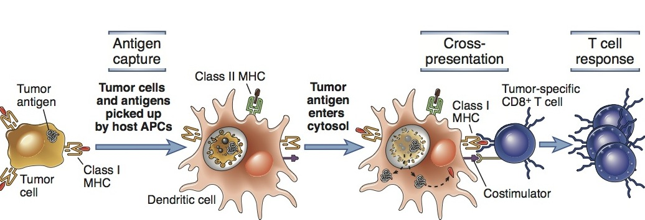
Cross-presentation of tumor antigens

Slide 8
Types of tumor antigens
Most tumor antigens that elicit immune responses are neoantigens
Neoantigens are newly formed antigens that have not been previously recognized by the immune system.
Neoantigens can arise from altered tumor proteins formed as a result of tumor mutations or from viral proteins.
Somatic mutations in coding regions of the genome have the potential to generate neoantigens, thereby influencing patient response to targeted immunotherapies.
Neoantigens are antigens encoded by tumor-specific mutated genes.
Studies in the past few years have suggested a key role for neoantigens in cancer immunotherapy.

Slide 9
Types of tumor antigens
Most tumor antigens that elicit immune responses are neoantigens
Not present normally, so no tolerance
Produced by mutated genes that may be involved in
oncogenesis (driver mutations) or
reflect genomic instability (passenger mutations)
In tumors caused by oncogenic viruses (HPV, EBV), neoantigens are encoded by viral DNA
Some are unmutated proteins (tyrosinase, cancer-testis antigens)
Derepressed (epigenetic changes), over-expressed

Slide 10
The commonly accepted definition of a driver mutation is a mutation within a gene that confers a selective growth advantage (thus promoting cancer development), while passenger mutations are those that do not provide a growth advantage.
Passenger mutation = a mutation that has no effect on the fitness of a clone but may be associated with a clonal expansion because it occurs in the same genome with a driver mutation.
Clone = a set of cells that all descend from a common ancestor cell.

Slide 11
What is a cancer genome?
Cancer is a group of genetic diseases that result from changes in the genome of cells in the body, leading them to grow uncontrollably.
These changes involve DNA mutations in the genome.
Our cells are constantly finding and fixing mutations that occur in our genome as the cells divide over and over again.
What is clonality in cancer?
Cancers evolve by a reiterative process of clonal expansion, genetic diversification and clonal selection within the adaptive landscapes of tissue ecosystems.
The translation of cancer genomics to cancer therapy needs to accommodate the cellular complexity of the disease and address its dynamic, evolutionary character.

Slide 12
How many different forms of cancer are there?
100 types
There are more than 100 types of cancer, characterized by abnormal cell growth.
There are many different causes, ranging from radiation to chemicals to viruses; an individual has varying degrees of control over exposure to cancer-causing agents.
DNA damage occurs to a gene that makes a DNA repair protein, a cell has less ability to repair itself.
So errors will build up in other genes over time and allow a cancer to form.
Scientists have found damaged DNA repair genes in some cancers, including bowel cancer.

Slide 13
Limitations and challenges of CAR-T cell therapy
Cytokine storm – many T cells respond to target antigen
Requires anti-inflammatory therapy (anti-IL-6R)
Risk of long-term damage (especially brain)
Unclear how well it will work against solid tumors
Problem of T cells entering tumor site
Will tumors lose target antigen and develop resistance?
Technical and regulatory challenges of producing genetically modified CAR-T cells for each patient
Prospect of gene-edited “universal” CAR-T cells?

Slide 14
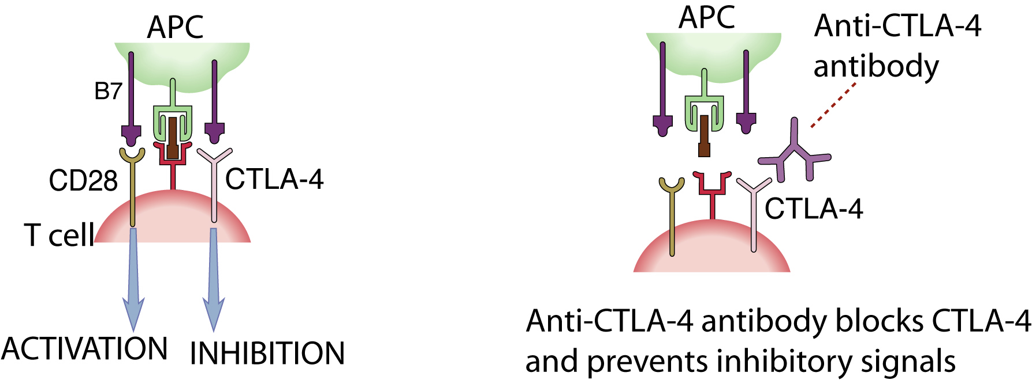
Checkpoint blockade: Removing the brakes on the immune response
Anti-CTLA-4 antibody is approved for tumor immunotherapy (enhancing immune responses against tumors)
Even more impressive results with anti-PD-1 in cancer patients

Slide 15
Why do tumors engage CTLA-4 and PD-1?
CTLA-4: tumor induces low levels of B7 costimulation → preferential engagement of the high-affinity receptor CTLA-4
PD-1: tumors may express PD-L1
Is checkpoint blockade more effective than vaccination for tumor therapy?
Tumor vaccines have been tried for many years with limited success
Immune evasion is a hallmark of cancer
Multiple regulatory mechanisms
Vaccines have to overcome regulation
Tumor vaccines are the only examples of therapeutic (not prophylactic) vaccines
Vaccination after tumor detection means regulatory mechanisms are already active

Slide 16
Targeting inhibitory receptors for cancer immunotherapy
Blocking inhibitory receptors induces tumor regression
Partial or complete responses in up to 40%
Biomarkers for therapeutic responses?
May be more effective than vaccination
Vaccines have to overcome tumor-induced regulation/tolerance
Adverse effects (inflammatory autoimmune reactions)
Typically manageable (risk-benefit analysis)

Slide 17
Combination strategies for cancer immunotherapy
Combinations of checkpoint blockers, or bispecific antibodies targeting two checkpoints
Already done with CTLA-4 and PD-1
Checkpoint blockade (anti-PD1 or -CTLA-4) + vaccination (DCs presenting tumor antigen)
Checkpoint blockade + agonist antibody specific for activating receptor
Checkpoint blockade + kinase inhibitor to target oncogene

Slide 18
Checkpoint blockade: prospects and challenges
Exploiting combinations of checkpoints
Poor biology underlying choice of combinations to block
Difficult to reliably produce agonistic antibodies
Typically, 20-40% response rates; risk of developing resistance?
Possible biomarkers of response vs resistance:
Nature of cellular infiltrate around tumor
Expression of ligands for inhibitory receptors (e.g. PD-L1) on tumor or DCs
Frequency of neoantigens (HLA-binding mutated peptides) in tumors from different patients
Frequency of tumor-specific “exhausted” T cells

