Slide 1
Chapter 2 Topic: Molecular techniques in prenatal diagnosis
Course code: Biot. 3113
Course name: Medical Biotechnology
Department of Biotechnology
University of Gondar

Slide 2
Definition:
Prenatal diagnosis is defined as the detection of abnormalities in the fetus, before birth.
All diagnostic modalities aimed at gaining information about the embryo or fetus.
Why Prenatal screening/diagnosis?
Congenital anomalies account for 20 to 25% of perinatal deaths.
What are genetic disorders?
Genetic disorders are caused by changes in a person’s genes or chromosomes.
Aneuploidy is a condition in which there are missing or extra chromosomes.
In a trisomy, there is an extra chromosome.
In a monosomy, a chromosome is missing.
Inherited disorders are caused by changes in genes called mutations.
E.g.: sickle cell disease, cystic fibrosis, Tay–Sachs disease, and many others.
In most cases, both parents must carry the same gene to have an affected child.

Slide 3
Sickle Cell Disease:
An inherited disorder in which red blood cells have a crescent shape, which causes chronic anemia and episodes of pain.
The disease occurs most often in African Americans
(African Americans (also referred to as Black Americans or Afro-Americans) are an ethnic group of Americans with total or partial ancestry from any of the black racial groups of Africa).
Cystic fibrosis:
An inherited life-threatening disorder that damages the lungs and digestive system.
Tay–Sachs Disease:
An inherited disorder that causes intellectual disability, blindness, seizures, and death, usually by age 5.
It most commonly affects people of Eastern or Central European Jewish backgrounds, as well as people of French Canadian and Cajun backgrounds.

Slide 4
A disease of wholly or partly genetic in origin is present in around 4% of all neonates.
Genetically determined or co-determined diseases can be divided into three groups:
Chromosomal aberrations
Monogenetic diseases which are caused by single gene mutation
Polygenetic/multifactorial diseases, which are caused by mutations in several genetic areas as well as exogenous factors.

Slide 5
Classification of Congenital Abnormalities
Chromosomal Abnormalities:
Trisomy 21 (D.S: Down syndrome)
Trisomy 18 (E.S: Edwards syndrome)
Trisomy 13 (P.S: Patau syndrome)
Structural Abnormalities:
entral nervous system (CNS)
ardiovascular system (CVS)
Gastrointestinal tract (GIT)
Bone
Renal system
Genetic Disorders:
Inborn error of metabolism
Haemoglobinopathies

Slide 6
Provide a range of informed choice to the couples at risk of having a child with abnormality.
Provide reassurance & remove anxiety, especially among high risk groups.
Allow couples at high risk to know that the presence or absence of the disorder can be confirmed by testing.
Allow the couples the option of appropriate management (psychological, pregnancy/delivery, postnatal)
To enable prenatal treatment of the fetus.

Slide 7
Prenatal Diagnosis of fetal Abnormalities
Benefits:
Malformation incompatible with life may be terminated.
Certain abnormalities may be correctible in-utero.
Provides opportunity to arrange corrective measures before hand.
Offer a chance to be delivered at a place where the required facilities are available.
Parents decision to continue pregnancy/ mentally prepare to have a handicapped child

Slide 8
There are two general types of prenatal tests for genetic disorders:
Prenatal screening tests:
These tests can tell the chances that fetus has an aneuploidy and a few additional disorders.
Prenatal diagnostic tests:
These tests can tell, with as much certainty as possible, whether the fetus actually has an aneuploidy or specific inherited disorders for which testing.
These tests are done on cells from the fetus or placenta obtained through amniocentesis or chorionic villus sampling (CVS).
Both screening and diagnostic testing are offered to all pregnant women.

Slide 9
Maternal Risk Factors
Maternal age > 35 years
Family history of neural tube defects
Previous baby born with neural tube defect
Previous child with chromosomal anomaly
One or both parents – carriers of sex linked or autosomal traits
One parent is known to carry a balanced translocation
History of recurrent miscarriage

Slide 10
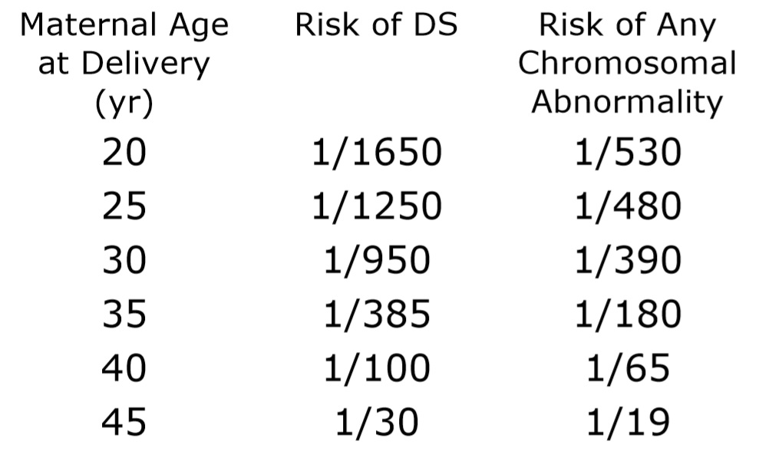
Risk of DS and Chromosomal Abnormalities at Term

Slide 11
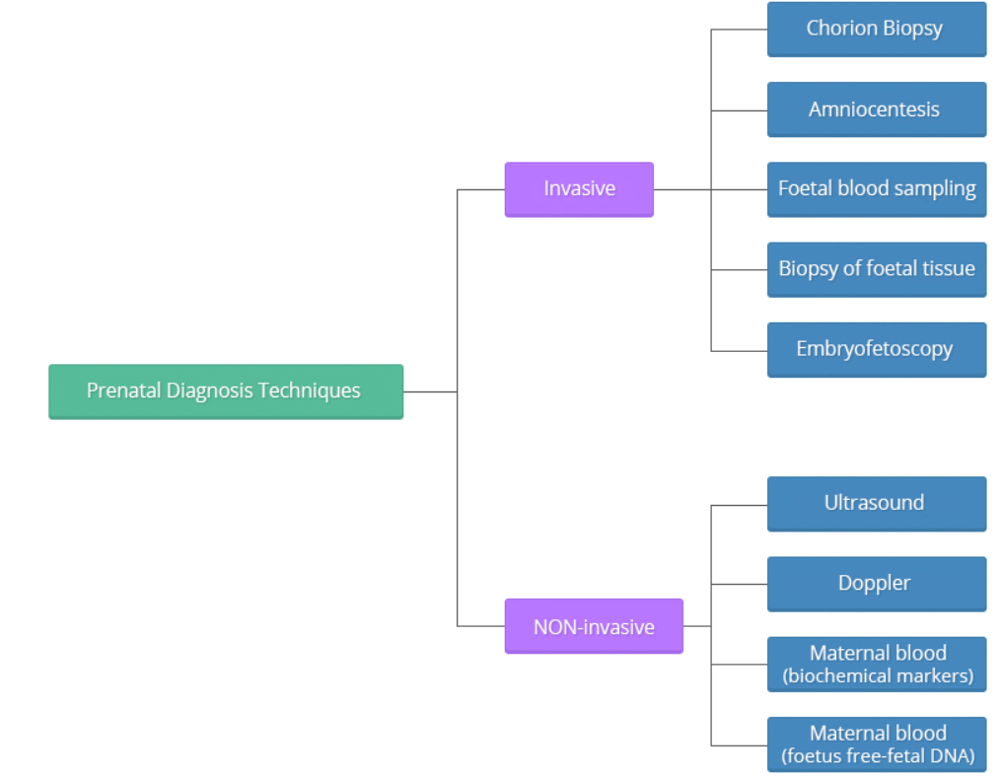
Methods of prenatal diagnosis

Slide 12
Invasive techniques
Invasive techniques are defined as those that invade or physically enter the foetal space or surroundings, for example, puncturing the amniotic sack to withdraw fluid. These tests must be performed observing very strict sterility measures.
The difference among these techniques is:
the time or weeks of gestation at which they are performed during the pregnancy;
the reliability of the tests, as they all present an error margin (remember that in medicine there is never 0 or 100, we always talk in terms of probability); and
the risk of miscarriage, which varies depending on each particular technique.
These techniques should be performed at specific times throughout the gestational period in order to increase the possibility of getting a reliable result while, at the same time, decreasing the risk of miscarriage, and should always be performed under ultrasound guidance.

Slide 13
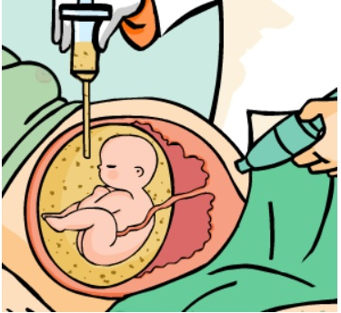
Amniocentesis:
A procedure in which amniotic fluid and cells are taken from the uterus for testing.
The procedure uses a needle to withdraw fluid and cells from the sac that holds the fetus.
Amniocentesis is a diagnostic test.
It usually is done between 15 weeks and 20 weeks of pregnancy, but it also can be done up until given birth.
To perform the test, a very thin needle is used to withdraw a small amount of amniotic fluid.
Ultrasound is used to guide the procedure.
Depending on the way the cells are analyzed and the information needs, results can take from 1 day to several weeks.
There is a very small chance of pregnancy loss with amniocentesis.
Leakage of amniotic fluid and slight bleeding can occur after amniocentesis.
In most cases, both stop on their own.

Slide 14
Chorionic villus sampling:
A procedure in which a small sample of cells is taken from the placenta and tested.
The main advantage of having CVS over amniocentesis is that CVS is performed earlier than amniocentesis, between 10 weeks and 13 weeks of pregnancy.
The chance of miscarriage with CVS is slightly higher than the chance of miscarriage with amniocentesis.
Chorion Biopsy
A chorion biopsy is the collection of villi from the chorionic area of the growing placenta.
This type of biopsy should always be performed under ultrasound guidance,

Slide 15
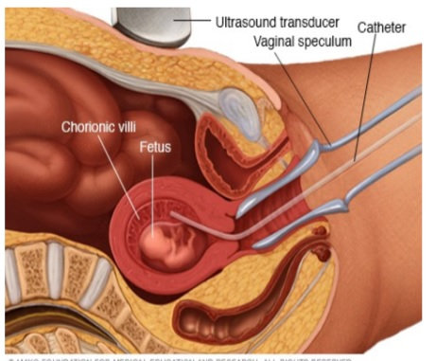
Chorionic villus sampling

Slide 16
May either performed
transcervically or
transabdominally using a catheter or a clamp appropriate to the gestational age.
The test must be performed after the 11th week of pregnancy to term.
If the test if performed before the 10th week, it can lead to
abnormalities of the fetal limbs, micrognathia and microglossia.
Prenatal diagnosis of chromosomal defects or inherited diseases for DNA alterations, the optimum gestational age to carry out the procedure is between the 11th and 12th weeks of pregnancy.
Chorionic villi provide excellent material to conduct DNA molecular studies and enzymatic determinations.

Slide 17
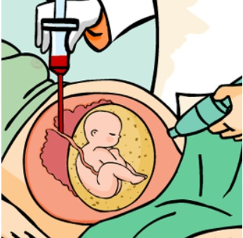
Foetal blood sampling
This test obtains foetal blood by direct puncture of the funicular vessels
under ultrasound or foetoscopic guidance.
The main indications of this technique include:
Rapid assessment of foetal chromosomes (results can be obtained within 24 to 48 hours),
Immunological assessment of the foetus, and
Assessment of certain haemopathies or blood disorders.
This test is usually performed after the 20th week of pregnancy through delivery.
Normally between 0.5 and 4 ml of foetal blood are collected.
The risk of spontaneous abortion as a result of the test is approximately 1-3%.

Slide 18
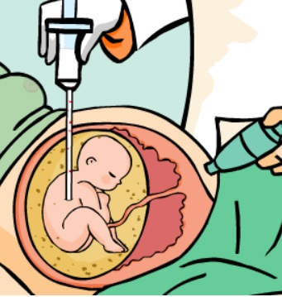
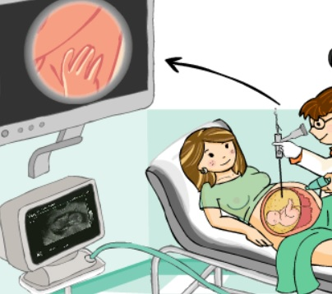
Biopsy of foetal tissue
This technique is used for specific testing or screening:
such as skin, liver or muscular biopsies.
The procedure is always carried out under ultrasound or foetoscopic guidance.
Embryofetoscopy
direct visualisation of the embryo or fetus during pregnancy through a device called endoscope or fetoscope.
When this technique is performed during the first 12 weeks of pregnancy, it is called embryoscopy.
When performed after the 12th week of pregnancy, it is called fetoscopy.

Slide 19
Method of Cordocentesis:
Under ultrasound guidance needle is inserted in the umbilical vein within the umbilical cord at its placental end or fetal end.
The needle is withdrawn, then the puncture site is monitored for bleeding, and the fetal heart rate is assessed.
After this procedure, the fetal heart rate and uterine contraction are monitored for 1-2 hours.
Complications:
Pregnancy loss, overall fetal loss risk of 1- 2%.
Transient fetal bradycardia, manifestations of a vasovagal response caused by local vasospasm, more with umbilical artery puncture.
Bleeding from the puncture site, cord hematoma.
Fetomaternal hemorrhage
Premature labor
Infection
Rh iso- immunization

Slide 20
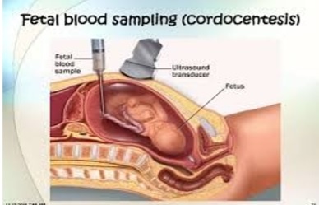

Slide 21
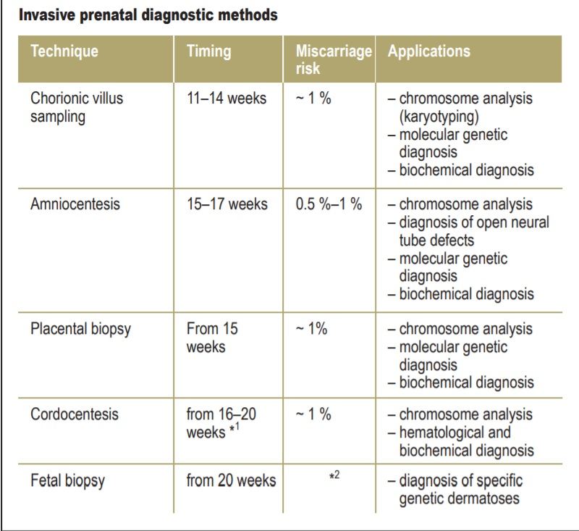

Slide 22
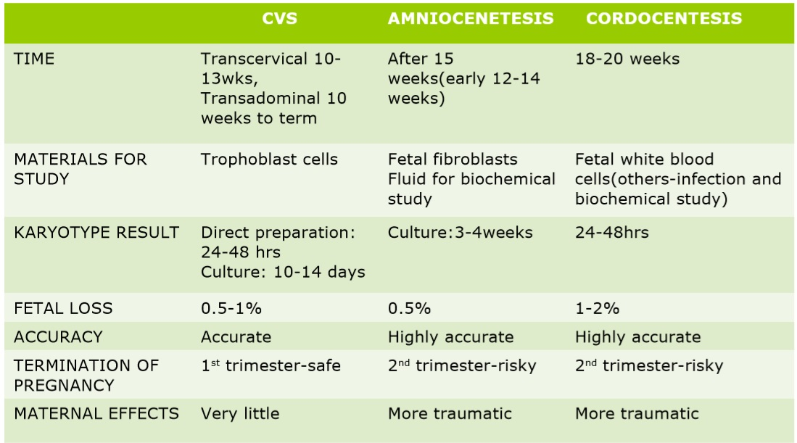

Slide 23
Fetal Tissue Sampling
Preimplantation Biopsy or Preimplantation Genetic Diagnosis (PGD):
The most frequent candidates are parents with family histories of serious monogenic disorders & translocations, who are therefore at increased risk for transmitting these conditions to future generations.
Polar body & blastomere testing are the two primary methods.
In Polar Body Testing, positive test results in two polar bodies ensure that the egg itself is unaffected – therefore, the mutation has segregated to the polar body, not to the developing ovum.
Once an egg is found to be unaffected, it is fertilized via traditional in vitro fertilization (IVF) & implanted into the uterus.

Slide 24
Blastomere PGD first requires traditional in vitro fertilization, after which cells are grown to the 8-cell stage.
One or two cells are harvested & analysed, & an unaffected blastocyst is implanted into the uterus.
An advantage to preconception testing over traditional postconception prenatal diagnosis is that it allows parents to avoid the possibility of receiving abnormal prenatal diagnosis results, & thus the difficult decisions associated with pregnancy management and/or maintenance.
PGD can be laborious, time-consuming & expensive.
Complicating factors include a high rate of polyspermia, & a small amount of DNA in polar bodies (making it difficult to amplify) which can produce less definitive test results.

Slide 25
Other organ biopsies, including muscle & liver biopsy:
Fetal liver biopsy is best performed between 17-20 weeks to diagnose inborn errors of metabolism, such as
glucose-6-phosphatase deficiency,
glycogen storage disease type IA &
nonketotic hyperglycemia.
Fetal muscle biopsy is carried out under ultrasound guidance at about 18 weeks' gestation to analyze the muscle fibers histochemically for prenatal diagnosis of
Becker-Duchenne muscular dystrophy.

Slide 26
NON-Invasive techniques
As regards non-invasive techniques, these procedures do not pose any risk of abortion.
Non-invasive diagnostic methods include:
Methods that employ ultrasonic waves such as the ULTRASOUND and
the DOPPLER examination, which can be safely used at any time during the pregnancy through delivery.
Blood chemistry tests using MATERNAL BLOOD (maternal blood testing) during the first and second trimesters of the pregnancy.

Slide 27
Prenatal diagnosis of monogenetically determined diseases
At the present time around 5000 known disorders are inherited in a monogenetic Mendelian fashion.
autosomal dominant,
An autosomal dominant condition carries an a priori 50% inheritance risk where one parent is affected.
autosomal recessive and
An autosomal recessive disease carries a 25% inheritance risk for children of a healthy carrier couple.
X-linked disorders, which carry a higher risk of illness than that conveyed by age-related risk.
An X-linked recessive disorder carries a 50% risk for the son of a carrier mother.

Slide 28
GENETIC TESTS:
Cytogenetic analysis
Fluorescence in situ hybridization
Southern blotting
Polymerase chain reaction
Linkage analysis
Chromosomal microarray analysis

Slide 29
Cytogenetic Investigations
Chromosome Analysis (Karyotype Analysis)
Fluorescence in situ Hybridization (FISH)
Chromosome Analysis:
The most common method of detecting aneuploidy is karyotype analysis, wherein metaphase cells are examined microscopically & the number of chromosomes counted.
Typically 10–15 cells are analysed to rule aneuploidy.
Karyotype Analysis:
Each chromosome pair has a unique banding pattern that can be seen with various stains like Giemsa.
Counting the number of staining chromosomes allows for detection of aneuploidies.
Analysing for the absence, presence, rearrangement, etc. of these bands allows for detection of larger deletions, duplications and structural aberrations

Slide 30
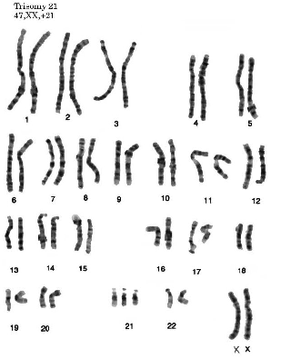
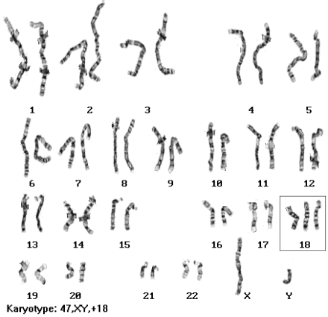
How are the cells analyzed in prenatal diagnostic testing?
Karyotype:
An image of a person’s chromosomes, arranged in order of size.
Missing, extra, or damaged chromosomes can be detected by taking a picture of the chromosomes and arranging them in order from largest to smallest.
Karyotyping results are ready in 1–2 weeks after the cells are sampled.

Slide 31
Fluorescence in situ hybridization (FISH):
A screening test for common chromosome problems.
The test is done using a tissue sample from an amniocentesis or chorionic villus test.
This technique can be used to detect common aneuploidies involving chromosomes 13, 18, and 21 and the X and Y chromosomes.
Results are ready more quickly (usually within 1–2 days) than with traditional karyotyping.
Positive test results are confirmed with a karyotype.
Fluorescence in situ Hybridization (FISH):
FISH is mainly used to detect the presence or absence of microdeletions, microduplications & aneuploidy without the full effort associated with DNA sequencing or complete karyotype analysis

Slide 32
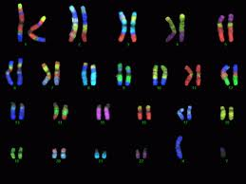
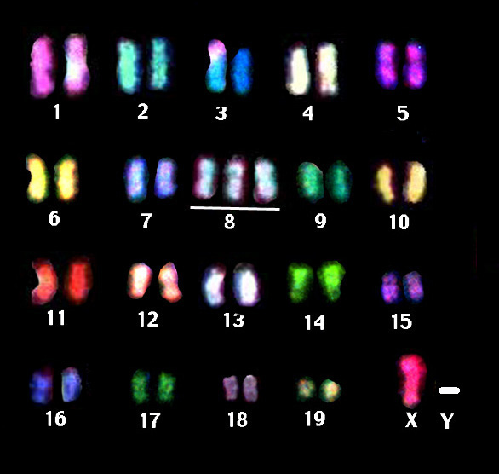
This three-step technique allows specific DNA sequences or chromosomes to be visualized microscopically.
1. A specific, single-stranded DNA probe is hybridized to its complementary, target DNA sequence, while the cell is in prophase, metaphase or interphase;
2. Fluorescent antibodies are then hybridized to the probe DNA sequence;
3. Finally, the fluorescent signals are examined under the microscope.
FISH can be performed with probes that fluoresce different colors.
This is called spectral karyotyping.
It is very useful in identifying missing parts of chromosomes, extra chromosomes, and translocation mutations.

Slide 33
Chromosome microarray analysis (CMA):
A Clinical Diagnostic Tool in the Prenatal and Postnatal Settings.
A technology used for the detection of clinically-significant microdeietions or duplications, with a high sensitivity for submicroscopic aberrations.
This test can look for different kinds of chromosome problems, including aneuploidy, throughout the entire set of chromosomes.
It can find some chromosome problems that karyotyping can miss.
Results can be ready in about 7 days.
CMA does not detect:
Small changes in the sequence of single genes (point mutations)
Tiny duplications and deletions of DNA segments within a single gene (Fragile X syndrome, for example)
Balanced chromosomal rearrangements (balanced translocations, inversions)

Slide 34
“Microarray” refers to a microchip-based testing platform that allows high-volume, automated analysis of many pieces of DNA at once.
CMA chips use labels or probes that bond to specific chromosome regions.
Computer analysis is used to compare a patient’s genetic material to that of a reference sample. A difference between a patient’s DNA and the reference sample is called a variant.
Should CMA replace traditional chromosome analysis or other genetic tests?
In 2010, the American College of Medical Genetics recommended CMA as first-tier testing in the population of individuals with developmental delay, intellectual impairment, autism spectrum and multiple congenital anomalies.
CMA leads to a diagnosis in 10-15%, which is significantly better than the ~3% yield with traditional chromosome analysis.
CMA can also detect most gross chromosome abnormalities detected by standard karyotype.
Karyotype is still appropriate for patients who strongly fit the features of a specific chromosomal abnormality diagnosis, such as Down syndrome.
Targeted molecular genetic testing is appropriate for conditions such as Fragile X syndrome that are not detected by CMA.
However, CMA may be useful when those tests have failed to yield a diagnosis, when a patient has a diagnosis but an unusual course, or when the differential includes multiple conditions with overlapping features.

Slide 36
Molecular genetics
Direct DNA Analysis
Linkage Analysis (indirect DNA analysis)
DNA Sequencing
Direct DNA analysis:
Direct mutation analysis involves analysing a target segment of DNA for the presence of a specific mutation.
Like FISH, it requires knowledge of the correct sequence for the specific gene or DNA segment before analysis.
Once known, the sample sequence may be compared to the known, ‘model’, genomic sequence in a variety of methods, as described below :
Mutation analysis with restriction enzymes.
Sequencing of restriction enzyme products.
Allele-Specific Oligonucleotide (ASO) analysis.

Slide 37
Mutation analysis with restriction enzymes:
If the putative mutation is known to alter the recognition for a splice site, direct analysis by restriction enzyme assay is possible.
The presence of a mutation can be detected by digesting control and sample DNA with the same restriction enzymes (known to cut the DNA at a specific splice site) and
then analysing resultant DNA fragments (called Restriction Fragment Length Polymorphisms, or RFLPs ) for differences by
Southern blotting.
Those segments containing mutation(s) at or near a splice site are identifiable because they were not cut by a restriction enzyme, and are therefore longer, appearing higher on the Southern blot gel.
This technique is used in genetic testing for sickle cell anaemia.

Slide 38
Restriction length polymorphisms analysis (RFLP) Analysis
Most genetic diseases result from gene mutations rather than chromosomal abnormalities
The basic idea behind RFLP is that a defective gene may be cut differently than its normal counterpart by restriction enzymes.
If DNA from a healthy individual (HBB gene) and DNA from an individual (HBB gene) with sickle cell disease are cut by restriction enzymes, the fragments will be different sizes because the base sequences are different.
DNA from a patient is subjected to restriction enzymes and the DNA fragments undergo gel electrophoresis.
Patient DNA fragment length is compared to normal fragment lengths to diagnose disease

Slide 39
Sequencing of restriction enzyme products:
Disorders secondary to deletion of DNA
e. g α thalassemia, DMD, CF & growth hormone deficiency,
can be detected by the altered size of DNA segments produced following a Polymerase Chain Reaction (PCR)
DNA sequences that have been cut with restriction enzymes can also be sequenced by a specialized amplification technique.
Copies of a particular piece of DNA(cut by restriction enzymes) are placed into four vials & amplified by polymerase chain reaction (PCR).
Fragments from the vials are then allowed to migrate, in parallel, down a Southern blot gel.
The shortest fragments travel furthest, the longer segments remain closer to the top.
From top to bottom, the banding pattern produced represents fragments that decrease in size by one nucleotide base.
The DNA sequence can therefore be read from the shortest, single-base strand at the bottom of the gel, up to the entire sequence length at the top

Slide 40
Linkage Analysis (Indirect DNA analysis):
Linkage analysis is a means of indirectly detecting a patient’s mutation status, when several family members are known to be affected with the same genetic disorder, & when an exact mutation is not known.
DNA from affected & unaffected family members is analysed for polymorphisms such as:
microsatellite repeats,
restriction fragment length polymorphisms (RFLPs) and
variable number tandem repeats (VNTRs)

Slide 41
Allele-Specific Oligonucleotide (ASO) analysis:
ASO is a short piece of synthetic DNA complementary to the sequence of a variable target DNA.
It acts as a probe for the presence of the target in a Southern blot assay or, more commonly, in the simpler Dot blot assay.
Direct detection of a DNA mutation can also be accomplished by allele specific oligonucleotide analysis.
If the PCR –amplified DNA is not altered in size by deletion or insertion,
Recognition of mutated DNA sequence can occur by hybridization with the known mutant allele.
Two probes are required, one specific for each allele, and stringency conditions are employed such that a single-base mismatch is sufficient to prevent hybridization of the nonmatching probe

Slide 42
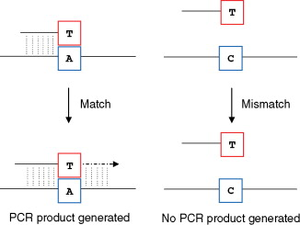
ASO analysis allows direct DNA diagnosis of
Tay-Sachs Disease,
alpha & beta thalassemia,
Cystic fibrosis &
Phenylketonuria

Slide 43
DNA Sequencing:
DNA sequencing for many disorders has revealed that a multitude of different mutations within a gene can result in same clinical disease.
For Example, Cystic Fibrosis can result from more than 1,000 different mutations.
Therefore, for any specific disease, prenatal diagnosis by DNA testing may require both Direct & Indirect methods.
SNPs
Because SNPs occur frequently throughout the genome, they are valuable markers to identifying disease related genes.
SNPs are being used to predict stroke, cancer, heart disease, and behavioral illnesses.
Many groups of SNPs on the same chromosome are called a haplotype.
The HapMap project is identifying and cataloguing the chromosomal location of over 1.4 million SNPs present in 3 billion base pairs of the human genome.

Slide 44
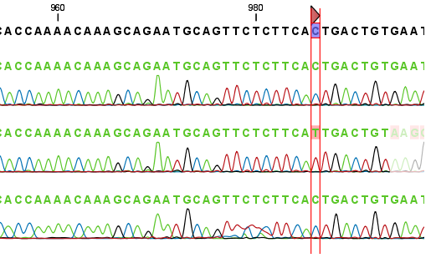
Single Nucleotide Polymorphisms
99.9% of DNA sequencing is identical in humans.
One of the common forms of genetic variations (in the .1%) in humans is called the single nucleotide polymorphism.
SNPs are single nucleotide changes that vary from person to person.
SNPs occur about every 100 to 300 base pairs and most of them are in non coding regions of DNA.
If a SNP occurs in a gene sequence, it can produce disease or confer susceptibility for a disease.

Slide 46
New assays or techniques for mutation detection in single gene disorders
amplification refractory mutation system polymerase chain reaction (ARMS-PCR),
fluorescent polymerase chain reaction (FISH),
heteroduplex analysis (HDA),
protein truncation test (PTT),
comparative genomic hybridization (CGH),
primed in-situ labeling technique (PISH),
telomeric probes (TP),
spectral karyotyping (SKY).
These methods may greatly improve the accuracy and applicability of preimplantation genetic diagnosis or diagnosis on fetal cells isolated from maternal blood.

Slide 47
The amplification refractory mutation system (ARMS) is an amplification strategy in which a polymerase chain reaction (PCR) primer is designed in such a way that it is able to discriminate among templates that differ by a single nucleotide residue
ARMS has also been termed allele-specific PCR or PCR amplification of specific alleles (PASA).
An ARMS primer can be designed to amplify a specific member of a multi-allelic system while remaining refractory to amplification of another allele that may differ by as little as a single base from the former.
Main advantage of ARMS:
Is that the amplification step and the diagnostic steps are combined, in that the presence of an amplified product indicates the presence of a particular allele and vice versa.
It is a very time-efficient method.
Disadvantage:
May not be as robust as some of the other methods in which these two important steps amplification step and the diagnostic steps are separated, e.g., PCR followed by restriction enzyme analysis,

Slide 48
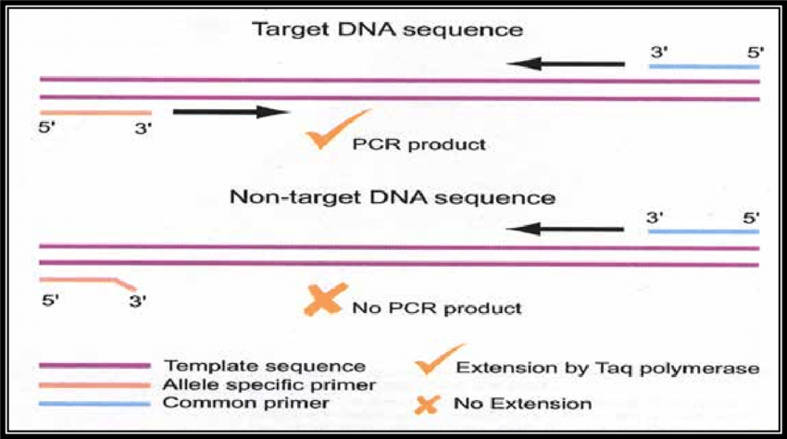

Slide 49
Quantitative Fluorescence-Polymerase Chain Reaction QF-PCR
QF-PCR uses fluorescent labelled primers
QF-PCR is a quantitative method
Used to amplify specific regions (STR) of DNA and quantify the amount of DNA present in those regions.
Short tandem repeats (STR) are highly polymorphic sequences found in the human DNA.
The amount of fluorescently labelled amplicons are measured after fragment length separation in capillary electrophoresis.
Determines the presence of different alleles, means the determination of chromosomal copy number
Diagnosis of fetal chromosomal ploidy within a working day!(4-5 hours)

Slide 51
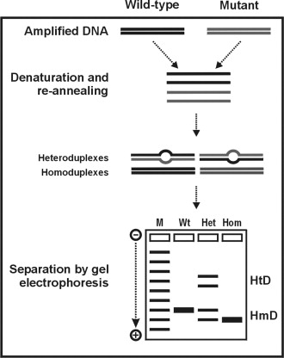
Heteroduplex analysis (HDA) is a method in biochemistry used to detect point mutations in DNA since 1992.
Heteroduplexes are dsDNA molecules that have one or more mismatched pairs, on the other hand
Homoduplexes are dsDNA which are perfectly paired.

Slide 52
Protein truncation test (PTT):
simple and fast method to screen for biologically relevant gene mutations.
The method is based on the size analysis of products resulting from in vitro transcription and translation.
Proteins of lower mass than the expected full-length protein represent translation products derived from truncating frame shift or stop mutations in the analyzed gene.
Recently, modifications like fluorescent labels or the use of tagged epitopes were established.
Several epitopes in different reading frames are used, the mutation detection spectrum can be expanded to all possible frame shift mutations.
PTT into a powerful nonradioactive technique to detect mutations with high sensitivity.

Slide 54
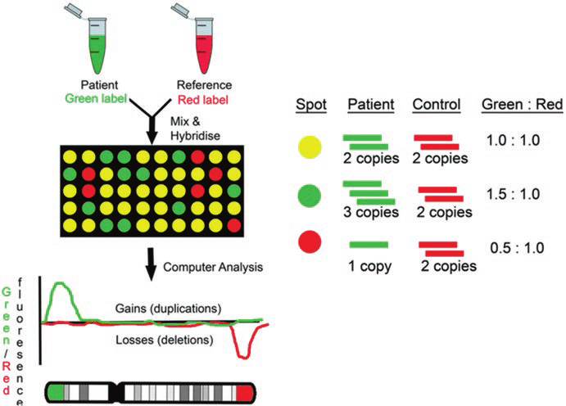
Comparative genomic hybridization (CGH)
is a molecular cytogenetic method for analysing copy number variations (CNVs) relative to ploidy level in the DNA of a test sample compared to a reference sample, without the need for culturing cells.

Slide 55
Primed in situ labeling (PRINS)
is a fast and sensitive technique for sequence specific in situ detection of DNA.
An unlabeled oligonucleotide probe is hybridized and used as primer for chain elongation in situ catalyzed by a DNA polymerase.
Thus, using high probe concentrations the hybridization is very fast.
Alternative method for the identification of chromosomes in metaphase spreads or interphase nuclei.
Denatured DNA is hybridized to short DNA fragments, or oligonucleotides followed by primer extension with labeled nucleotides.
Labeling is detected with a fluorescent conjugated antibody.
Technique can be coupled with PCR (Cycling PRINS).

Slide 56
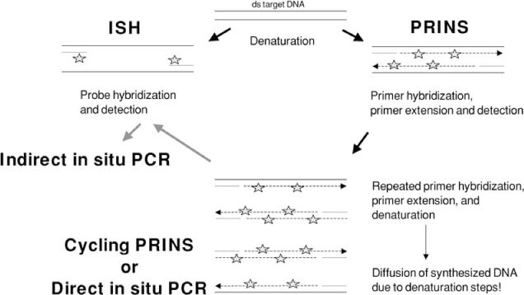

Slide 57
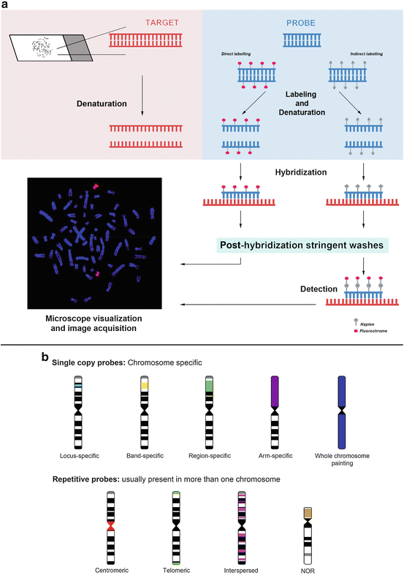
Spectral karyotyping (SKY) is a FISH-based method that labels each chromosome with a different color, allowing the identification of the chromosomal origin of all elements of the examined karyotype.

Slide 58
Neural tube defects
NTD (Neural tube defects) can affect 1 in 500 infants
Commonest forms of NTD known as anencephaly or spina bifida
Neural tube beneath the backbone fails to develop definitive diagnosis relies on amniocentesis
high levels of AFP (Alpha-fetoprotein) seen in NTD

Slide 59
Molecular basis of PKU
An autosomal recessive disorder
An average incidence of 1/10000
Different mutations in the phenylalanine hydroxylase (PAH) gene
Clinical features:
Affected children are normal at birth and would not be detected in the absence of compulsory mass screening.
In newborns with classic PKU hyper-phenylalaninemia develops 48 – 72 hours after initiation of milk feeding.
When blood phenylalanine concentration reach 15 mg/dl. phenylalanine spills over into the urine.
Molecular Prenatal Diagnosis (PKU)
Families with known mutations
(ex: IVS10, R261Q, Y277D, L48S)
PCR amplification followed by restriction digestion
Families with unidentified mutation in VNTR and STR

Slide 60
