Slide 1
Chapter 3 Molecular diagnosis and cancer therapy Topic: Introduction to Cancer
Course code: Biot. 3113
Course name: Medical Biotechnology
Department of Biotechnology
University of Gondar

Slide 2
Molecular diagnosis and cancer therapy
Markers for cancers
Cancer therapy:
DNA synthesis and repair
Anti-gene therapy:
RNAi approaches: ribozyme technology, antisense techn.
Immunology and immunotherapy for cancer:
Tumor immunotherapy and tumor suppressors,
Drug resistance,
Hematopoietic gene transfer,
Translational research,
Gene delivery systems (viral and non-viral),
Apoptosis: mechanisms and therapies,
Vaccine development for cancer.

Slide 3
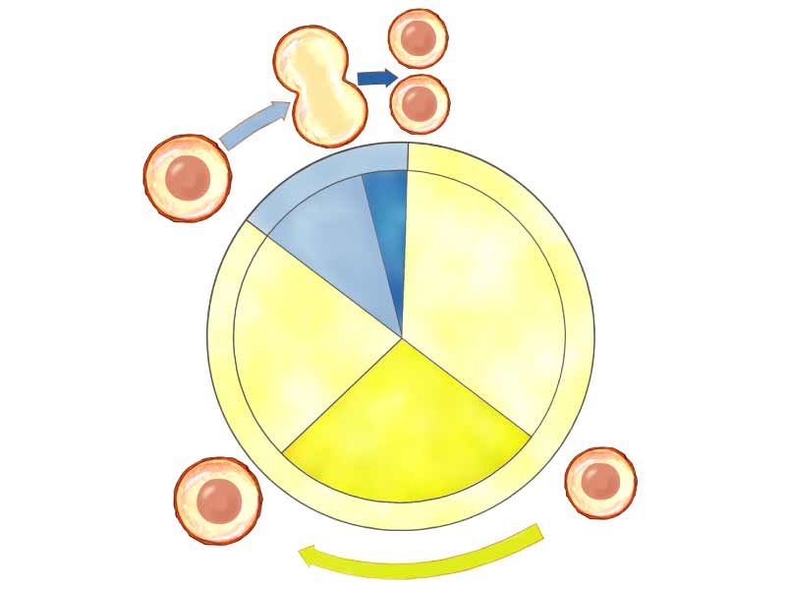
Mitotic Phase (M)
DNA
DNA
DNA
DNA
Interphase
DNA
DNA
Cytokinesis
Mitosis
G₁
Cell growth
G₂ Cell growth preparation for division
Interphase
S
DNA replication
DNA
DNA
DNA
Interphase
Notes:
Figure: 09-09
Title:
The cell cycle.
Caption:
The three main stages of cell division—DNA replication, mitosis, and cytokinesis—can be seen here in the context of a complete cell cycle. This cycle traditionally is divided into two main phases, interphase and mitotic (or “M”) phase, which are in turn divided into other phases.

Slide 4
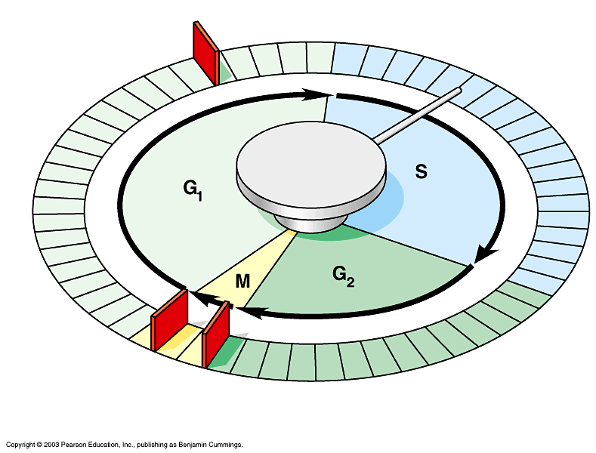
Proteins within the cell control the cell cycle
Signals affecting critical checkpoints determine whether the cell will divide (cyclins, kinases)
Anchorage, cell density, and chemical growth factors affect cell division
Growth factors bind to specific receptors on the plasma membrane to trigger cell division
Cancer cells have abnormal cell cycles
divide excessively and form tumors
G₁ checkpoint
Control system
M checkpoint
G₂ checkpoint

Slide 5
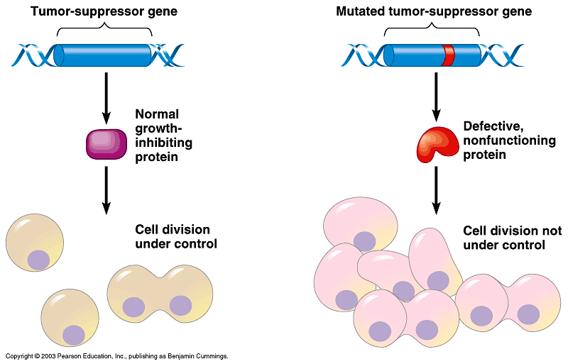
Traits of cancer cells
1. Independent of GROW signal from other cells.
often, oncogenes.
Ex. ras
2. Ignores STOP signal
defective damage control, so problems not corrected.
Often, tumor suppressor genes.
Ex. P53
3. No cell suicide (apoptosis)
4. No limit to cell divisions
telomeres rebuilt on ends of the chromosomes
new treatment target: telomerase
5. Angiogenesis - formation of blood vessels
6. Metastasis - ability to move to other tissues
benign: do not move from tumor site
malignant: invasive cells, can travel in blood and lymph system
Malignant tumors can invade other tissues and may kill the organism

Slide 6
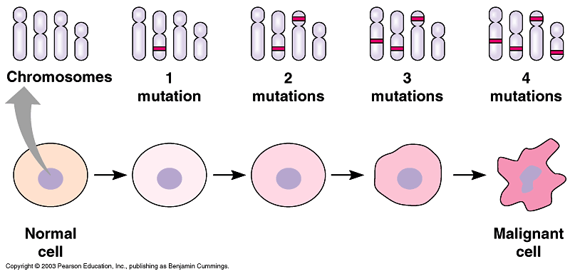
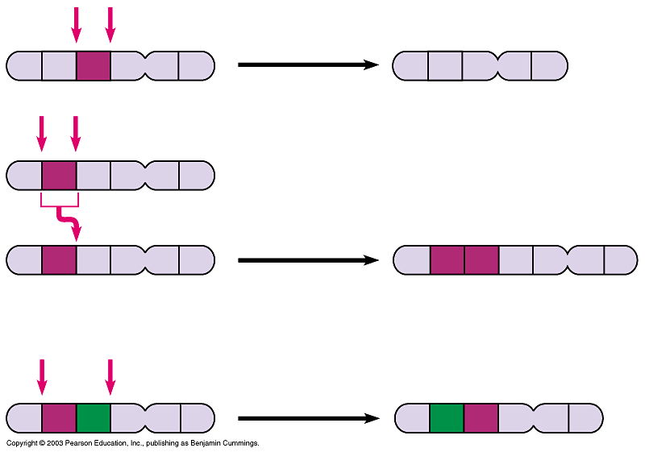
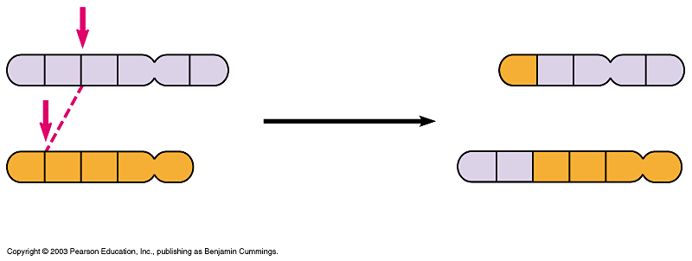
How do normal cells become cancerous?
Source of oncogenes?
Mutation of a normal gene = change in DNA sequence
UV light, X rays, natural or synthetic chemicals
Virus (ex. HPV and cervical cancer)
Chromosomal changes can be large or small
chronic myelogenous leukemia
Deletion
Homologous chromosomes
Duplication
Inversion
Nonhomologous chromosomes
Reciprocal translocation
Chromosomal translocation can activate an oncogene

Slide 7
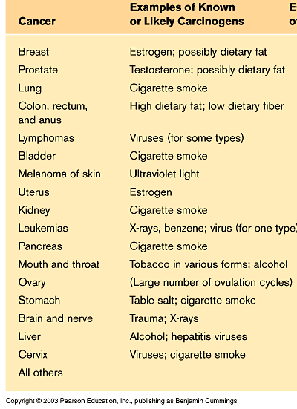
Cancer
Cancer is one of the most common diseases in the developed world:
1 in 4 deaths are due to cancer
1 in 17 deaths are due to lung cancer
Lung cancer is the most common cancer in men
Breast cancer is the most common cancer in women
There are over 100 different forms of cancer

Slide 8
Cancer
The division of normal cells is precisely controlled.
New cells are only formed for growth or to replace dead ones.
Cancerous cells divide repeatedly out of control even though they are not needed, they crowd out other normal cells and function abnormally.
They can also destroy the correct functioning of major organs.
What causes cancer?
Mutations: Cancer arises from the mutation of a normal gene.
Mutated genes that cause cancer are called oncogenes.
It is thought that several mutations need to occur to give rise to cancer
Apoptosis: Cells that are old or not functioning properly normally self destruct and are replaced by new cells.
However, cancerous cells do not self destruct and continue to divide rapidly producing millions of new cancerous cells.

Slide 9
Carcinogens
Ionising radiation – X Rays, UV light
Chemicals – tar from cigarettes
Virus infection – papilloma virus can be responsible for cervical cancer.
Hereditary predisposition – Some families are more susceptible to getting certain cancers.
Benign or malignant?
Benign tumours
do not spread from their site of origin, but can crowd out (squash) surrounding cells
e.g. brain tumour, warts.
Malignant tumours
can spread from the original site and cause secondary tumours.
This is called metastasis.
They interfere with neighbouring cells and can block blood vessels, the gut, glands, lungs etc.

Slide 10
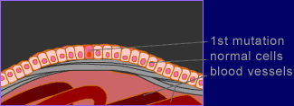
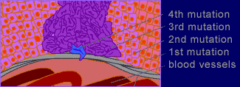
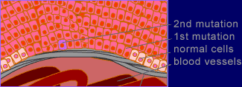
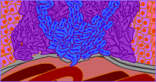
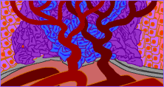
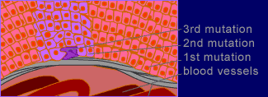
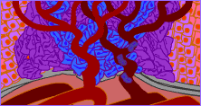
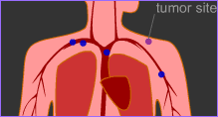
The Development of Cancer

Slide 11
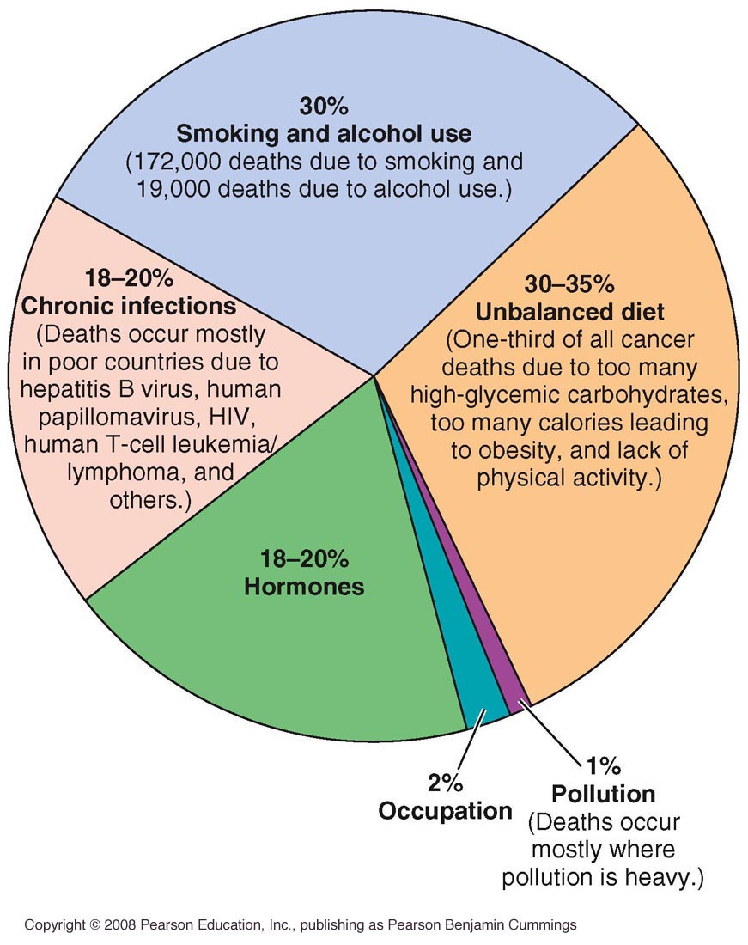
Factors Believed to Contribute to Global Causes of Cancer

Slide 12
Risks For Cancer
Lifetime risk
the probability that an individual, over the course of a lifetime, will develop cancer or die from it
Relative risk
measure of the strength of the relationship between risk factors and a particular cancer
Smoking
30% of all cancer deaths, 87% of lung cancer deaths
Obesity
50% higher risk for breast cancer in postmenopausal women,
40% higher risk in colon cancer for men

Slide 13
Biological Factors
Some cancers such as breast, stomach, colon, prostate, uterus, ovaries and lung appear to run in families
Hodgkin’s disease and certain leukemia's show similar patterns
University of Utah research suggests that a gene for breast cancer exists
A rare form of eye cancer appears to be transmitted genetically from mother to child
Reproductive And Hormonal Risks For Cancer
Pregnancy and oral contraceptives increase a woman’s chances of breast cancer
Late menarche, early menopause, early first childbirth, having many children have been shown to reduce risk of breast cancer

Slide 14
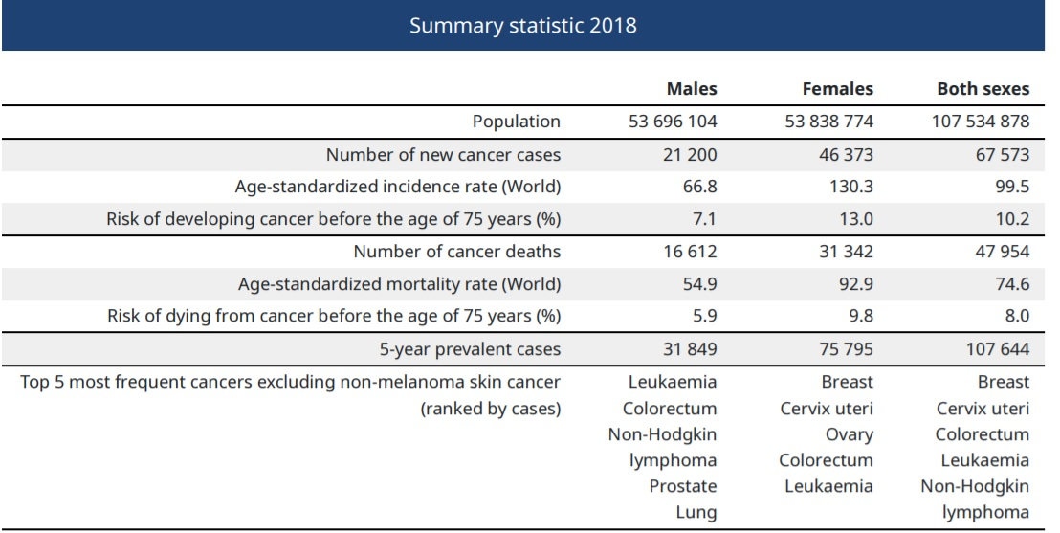
Occupational And Environmental Factors
Asbestos
Nickel
Chromate
Benzene
Arsenic
Cool tars
Radioactive substances
Herbicides/pesticides
Ethiopia

Slide 15
Social And Psychological Factors
Stress has been implicated in increased susceptibility to several types of cancers
Sleep disturbances, diet, or a combination of factors may weaken the body’s immune system
Chemicals In Foods
Sodium nitrate when ingested forms a potential carcinogen, nitrosamine
Sodium nitrate is still used because it is effective in preventing botulism
Pesticide and herbicide residues

Slide 16
Viral Factors
Herpes
related viruses may be involved in the development of leukemia, Hodgkin’s disease, cervical cancer, and Burkitt’s lymphoma
Epstein-Barr virus
associated with mononucleosis (an abnormally high proportion of monocytes in the blood), may contribute to cancer
Human papillomavirus (HPV)
virus that causes genital warts, has been linked to cervical cancer
Helicobacter pylori
causes ulcers which are a major factor in the development of stomach cancer

Slide 17
Medical Factors
Some medical treatments actually increase a person’s risk for cancer
Diethylstilbestrol (DES) used 1940 to 1960 to control bleeding during pregnancy, the daughters of mothers that used DES were found to have an increased risk for cancers of the reproductive organs
Estrogen supplementation
Chemotherapy used to treat one form of cancer may increase risk for another type of cancer
Types of Cancers
Classification of cancers
Carcinomas:
a cancer arising in the epithelial tissue of the skin or of the lining of the internal organs.
Sarcomas
a malignant tumour of connective or other non-epithelial tissue.
Lymphomas
cancer of the lymph nodes
Leukemias
bone marrow and other blood-forming organs

Slide 18
Colon And Rectal Cancers
Third most common cancer in men and women
Risk factors: over 50 years old, obese, family history of colon or rectum cancer or polyps, diets high in fats, low in fiber, smoking, high alcohol consumption, lack of exercise
90% of colorectal cancers are preventable
Treatment: radiation, surgery, and possible chemotherapy
Prevention: regular exercise, a diet heavy in fruits and plant-origin foods, a health weight, and moderation in alcohol consumption

Slide 19
Prostate Cancer
1 in 3 men will be diagnosed in their lifetime
Prostate is a muscular, walnut-sized gland the surrounds part of the urethra.
Its primary function is to produce seminal fluid.
Symptoms: nonspecific, weak or interrupted urine flow, difficulty starting or stopping urination
Risk factors: age, race, nationality, family history, diet, lifestyle, and vasectomy
Prevention: diet high in lycopenes, vitamin E

Slide 20
Skin Cancer
Long term effects of sun exposure can result in skin cancer
Malignant melanoma, deadliest form of skin cancer
Sun give off 3 types of harmful rays:
UVA
UVB
UVC
Prevention: limit exposure to harmful UV rays, drink more fluids than usual, apply cool compresses to skin, moisturize skin
The ABCD rule
Asymmetry – half of mole does not look like the other half
Border irregularity – the edges are uneven
Color – pigmentation is not uniform
Diameter – greater than 6 mm

Slide 21
Testicular Cancer
Men between the ages 15-35 are at the greatest risk
Important to practice regular testicular self exams
Ovarian Cancer
Fifth leading cause of cancer death for women
Most common symptom is enlargement of the abdomen
Risk factors include: family history, age, childbearing, cancer history, fertility drugs, talc use in genital area, genetic predisposition
Prevention: diet high in vegetables and low in fat, exercise, sleep, stress management, and weight control

Slide 22
Cervical and Endometrial (Uterine) Cancer
2nd leading cancer in Ethiopia
Pap test – cells are taken from the cervical region
Risk factors:
Cervical cancer: early age at first intercourse, multiple sex partners, cigarette smoking, and certain STIs
Endometrial cancer: age, endometrial hyperplasia, overweight, diabetes, and high blood pressure
Other Cancers
Pancreatic cancer – “silent” 4% 5-year survival rate
Leukemia – cancer of blood forming tissues

Slide 23
Detecting Cancer
The earlier the diagnosis the better the prospect for survival
Magnetic resonance imaging (MRI)
Computerized axial tomography scan (CAT scan)
Prostatic ultrasound
Regular self-exams, and check ups
New Hope In Cancer Treatments
Remove less surrounding tissue during surgery
Combine surgery with radiation or chemotherapy
Immunotherapy
Cancer-fighting vaccines
Gene therapy
Stem cell research

Slide 24
