Slide 1
Ch-6
POULTRY
&
GAME

Slide 2
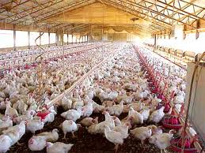
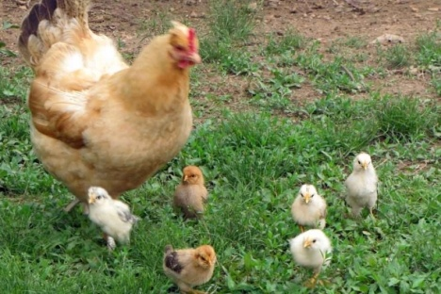
Definition-Poultry
Poultry is the catch-all term for domesticated birds that are meaty enough to eat.
Poultry tends to be lower in saturated fat than other meats, so it's a good choice for health or weight.
The fat can be still more lowered by removing the skin and by using light meat from the breast instead of the darker meat from the thighs and legs.
Younger birds are tenderer than older ones, so they're best for grilling, roasting, and frying. Older, tougher birds do better if they're cooked in stews or soups.

Slide 3
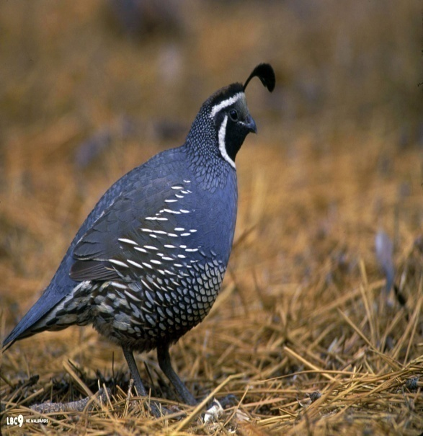
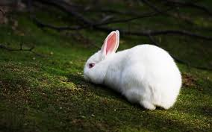
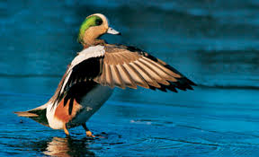
Definition-Game
Game is any animal hunted for food or not normally domesticated .
The type and range of animals inhabit and hunted for food varies in different parts of the world. This will be influenced by climate, animal diversity, local taste and locally accepted view about what can or cannot be legitimately hunted.
In Africa, wild animals hunted for their meat are called bush meat. As it is less fatty than poultry or meat, game is easily digested, with the exception of water fowl, which has oily flesh.
Game is useful for building and repairing body tissues and for energy.

Slide 4
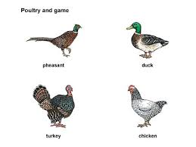
Types of poultry
Poultry includes the different varieties and sizes of chicken, turkey ducks; geese and guinea fowls.
Chicken: Chicken is the meat derived from the chicken. It is the most common type of poultry in the world, and is frequently prepared as food in a large number of ways.

Slide 5
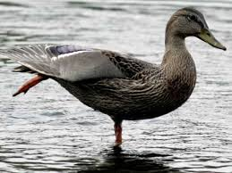
Duck
This fatty bird makes a divine roast, but it's hard to cook without setting off the smoke alarm. It helps to pour off the fat while it's roasting.
Wild ducks are less fatty than store-bought ducks.
A young duck, called a duckling, broiler duckling, roaster duckling, is tenderer than an old duck or mature duck.
High fat meats like duck generally should be cooked at a higher temperature and for a longer time than low-fat meats.

Slide 6
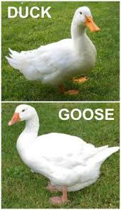
Goose
The meat is dark and fatty, and more like beef than chicken.
Young goslings are the priciest, and the tenderest. Wild goose is tougher and has a much stronger flavor than a domesticated goose.
High-fat meats like goose should be cooked at a higher temperature and for a longer time than low-fat meats.
Frozen goose is a good substitute for fresh.

Slide 7
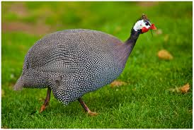
Contd….
Guinea fowl: This small bird is very lean and tastes like a pheasant. It's very lean, so bard it before roasting, or marinate it before putting it on the grill.
Poussin: A poussin is a very young chicken, and it has a very delicate flavor and very little fat. They're available in some gourmet markets.

Slide 8
Types of Game-Birds
Quail: Quails have dark meat that's quite tasty. They're very lean, so they are generally bard before roasting or marinated before grilling. Quail are commonly e a t e n complete with the bones, since these are easily chewed and the small size of the bird makes it inconvenient to remove them.
Wild Duck: The meat of a duck is mostly on the breast and the legs. The meat of the legs is darker and somewhat fattier than the meat of the breasts. Boneless duck breast is also called "magret" and can be grilled like steak.
Partridge: These small, plump birds are related to pheasants, and very tasty.
Pigeon: Pigeon meat is dark and very tender.

Slide 9
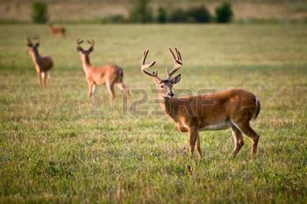

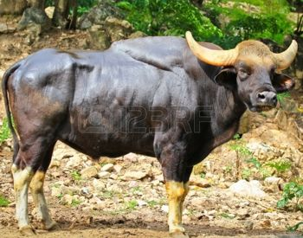
Types of Game-Animals
Venison: The term venison applies to deer meat. Venison is very lean, so it's important not to overcook it. The best cuts are from the back strap, or loin area.
Bison: Buffalo (Bison) meat tastes like beef, but it's a lot leaner. Tougher cuts are cooked very slowly over low heat. Meat is pale coloured and slightly sweetish.
Rabbit: Rabbit is low in fat and similar in taste and texture to chicken.
Kangaroo: Kangaroo meat is becoming increasingly popular in Australia. It has a very strong, gamy flavor that's a bit like venison. It's very lean, so overcooking should be avoided.

Slide 10
Market Forms
1. Live Poultry – When selecting live poultry choose those hats are alert, well feathered, and well formed
2. Whole Poultry – Hunted birds, similar to the form of live poultry but no longer alive
3. Dressed Poultry – These are slaughtered poultry with head, feet and viscera intact. Blood and feathers are removed
4. Ready to Cook – slaughtered birds that have been defeathered, visceral organs, feet, head removed ready for cooking.
5. Poultry Parts – Several pieces of poultry parts is usually packed in one package (thighs, wings, breast, liver, gizzard)

Slide 11
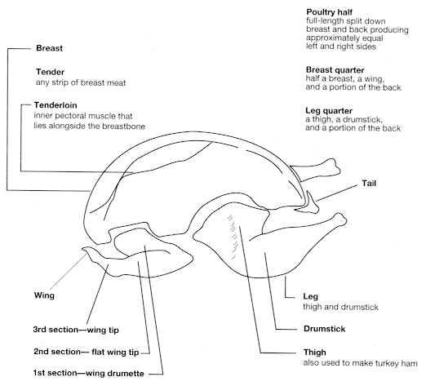
Cuts of poultry

Slide 12
Cuts of poultry
To show parts from the main word document
Please wait……..

Slide 13
Storing of poultry
Fresh, raw chicken can be stored in its original wrap for up to 2 days in the coldest part of the refrigerator.
Not plan to use it within2 days after purchasing. You can freeze most chicken in its original packaging safely for up to two months; if you plan to freeze it longer, consider double- wrapping or rewrapping with freezer paper, aluminum foil, or plastic wrap.

Slide 14
Contd…
Divide the chicken into efficient, meal-size portions and package for freezing.
Airtight packaging is the key to freezing chicken successfully. When freezing whole chickens, remove and rinse giblets (if any) and pat dry with paper towels. Trim away any excess fat from the chicken. Tightly wrap, label, date, and freeze both chicken and giblets in separate freezer-strength plastic, paper, or foil wraps.
Thaw frozen chicken, wrapped, in the refrigerator for best results.

Slide 15
Cooking poultry
Poultry can be cooked in any of the methods either as a moist heat or even dry heat method as the meat is suitable for cooking using any methods. Some of the methods are as follows:
Baking, poaching, braising, browning, frying, grilling and roasting etc.

Slide 16
Thank you so much..!
For your listening
Ch-6 is completed
Are you happy???

