Slide 1
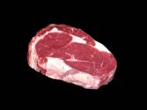
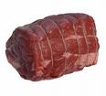
Chapter-1- MEAT
Topics for Discussion
Structure and composition
Ageing of meat
Artificial tenderizing of meat
Curing of meat
Smoking of meat methods

Slide 2
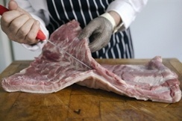
What is Meat?
Meat is considered to be the flesh of an animal used as food; fish and poultry are not usually called meat.
Red Meats:
Beef Pork
Veal Lamb
Fish
Poultry

Slide 3
Structure & Composition
Composition of Meat.
Edible Meat/Muscle.………………………………………..………..75.0% to 77.0%
Water............................................................................ 0.8% to 1.8%
Mineral matter............................................................... 0.5% to 3.0%
Fat................................................................................. 13.0% to 18.0%
Muscle Fibre and Connective tissue............................. 2.0% to 5.0%
Extractives......................................................................0.5%

Slide 4
Muscles
Muscles are of two types with two respective functions.
The involuntary muscles are the smooth muscles of the blood vessels and digestive tract which do their jobs automatically and virtually continuously. These muscles are lacking in interspersed fat and are, therefore, very tough.
The voluntary muscles are composed of many tiny fibers joined together by connective tissues in a fashion which is analogous to the wire cables used in building bridges. This type of formation is called straited.
Muscles are composed of cells of sizes and shapes which vary according to the feed, age, sex, and type of animal.

Slide 5
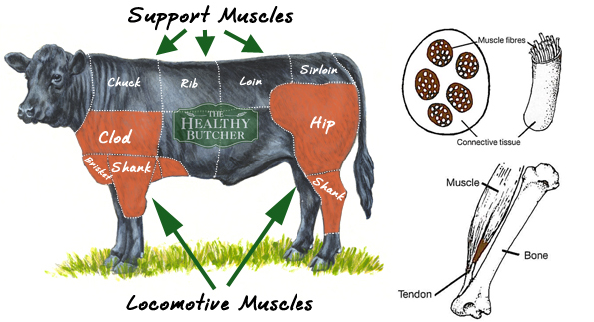

Slide 6
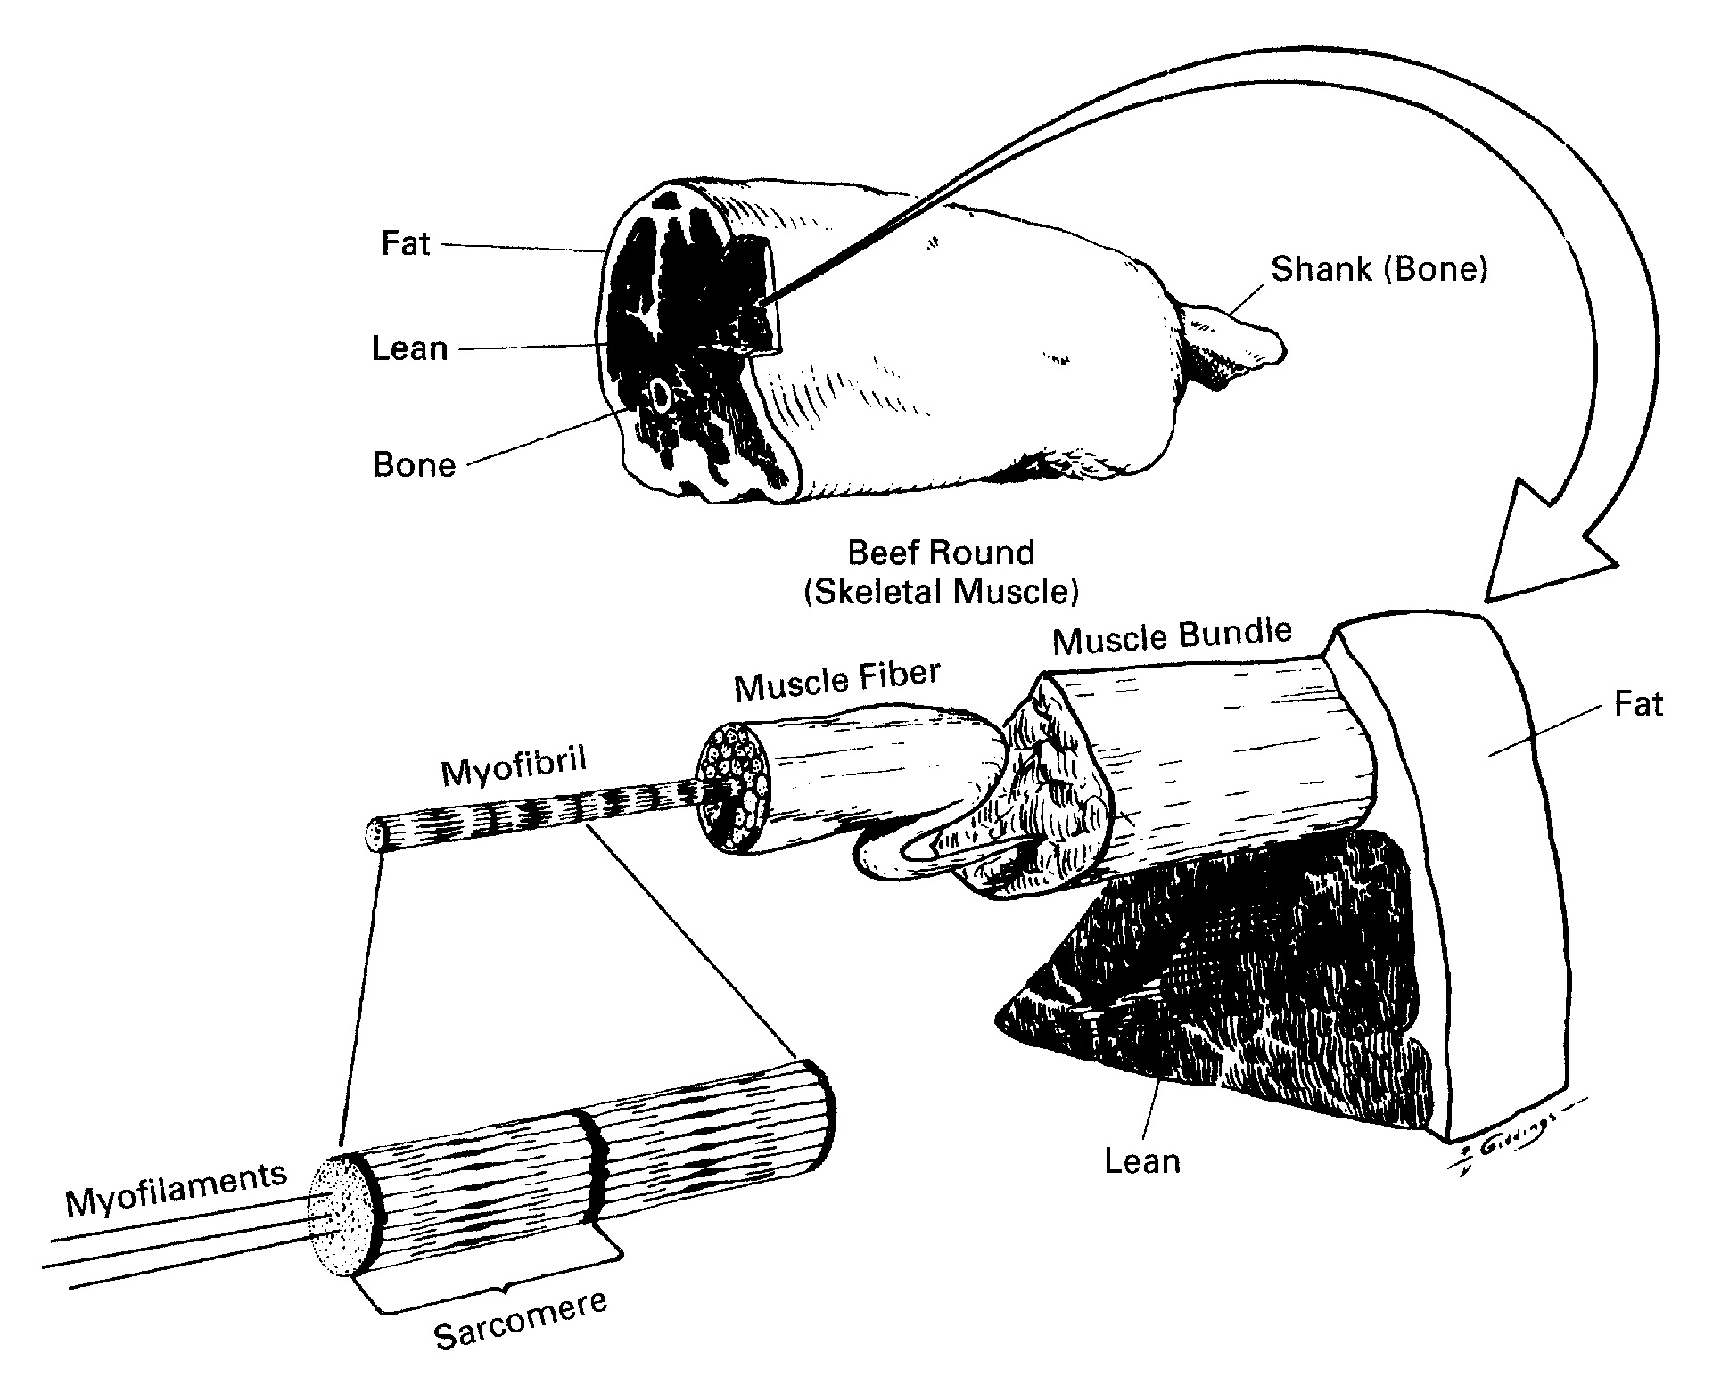
Figure 3.8 The fundamental structure of meat and muscle in the beef carcass.

Slide 7
Connective Tissue Cells
The connective tissue cells are joined together into bundles by two types of proteins, collagen and elastin.
The collagen, when boiled with water, forms gelatine.
The fibers are hollow with walls composed of the protein sub-stance called elastin. This is like collagen in some of its properties, but it will not dissolve on boiling with water.

Slide 8
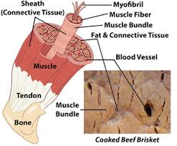

Slide 9
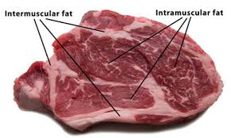
Muscle juice, fat & extractives
The content of the fibers is called muscle juice. It is composed of water in which are proteins, coloring matter, salts, and extractives.
fat deposited in varying amounts, mainly in the connective tissue.
The proteins of the muscle juice are mainly myosin and albumin, and both coagulate with heat.
The extractives, so named because they can be extracted from the meat by boiling it in water, are of value because they give the meat its flavor.

Slide 10
Ageing of Meat
Ageing is nothing but a process of “conditioning” or “ripening” or “Tenderizing” the meat after the animal has been slaughtered in the refrigerated conditions after a few days between 3-7 days and for a period of 21-28 days.
The word ageing can be always used in the other form as postmortem ageing in the meat terminology and it is done normally with two important center cuts of beef especially “loin” and “rib”.
There are two types of postmortem ageing such as
        Dry ageing
          Wet ageing

Slide 11
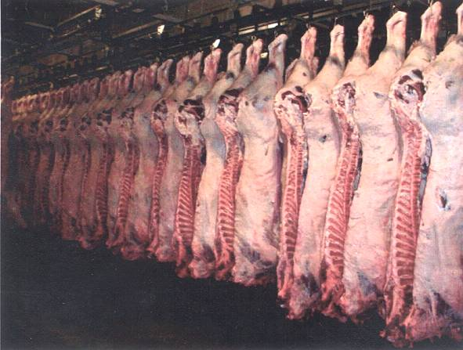
Dry ageing
Dry aging is the traditional process of placing an entire carcass or wholesale cut (without covering or packaging) in a refrigerated room for 21 to 28 days at 32-34 degrees F. and 100-85% relative humidity, with an air velocity of 0.5 to 2.5 m/sec.

Slide 12
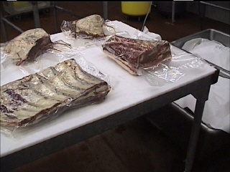
Wet ageing
Wet aging is the aging of meat in vacuum bags (usually the middle meats) under refrigerated conditions of 32-34° F. Obviously, humidity and air velocity are not necessary requirements for proper wet aging.

Slide 13
Accelerated ageing
There is also a third method, accelerated aging that uses a higher holding temperature with ultraviolet light used to retard microbial growth which would normally occur at higher temperatures.
This method, however, has not been used commercially to a significant degree in recent years, due to the extent that vacuum packaged products are subjected to wet aging.

Slide 14
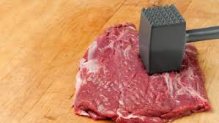
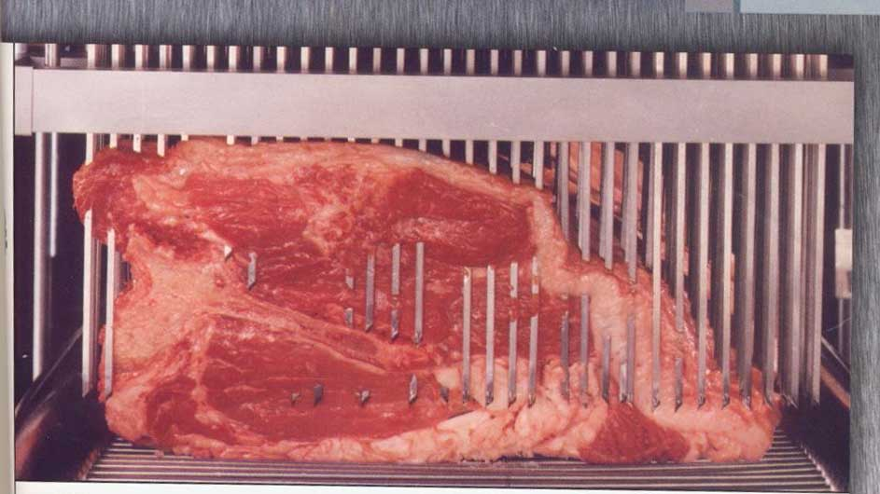
Artificial tenderizing of meat
In cooking, tenderizing is breaking down collagens in meat to make it more palatable.
There are a number of ways to tenderize meat:
Mechanical tenderization, such as pounding and piercing.
The tenderization that occurs through cooking, such as braising.

Slide 15
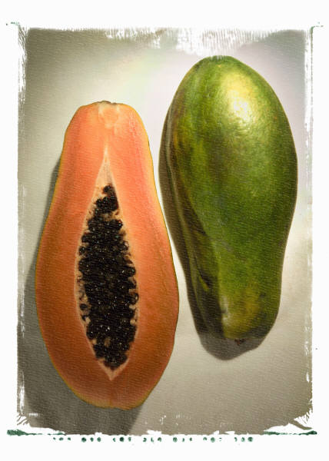
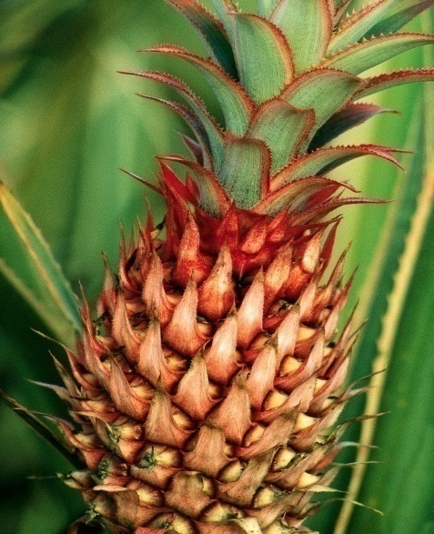
Contd….
  Tenderizers in the form of naturally occurring enzymes, which can be added to food before cooking. Eg (papain from papaya, bromelain from pineapple and Ficin extracted from figs)
Marinating the meat with vinegar, wine, lemon juice, buttermilk or yogurt.
Enzyme is a substance produced by a living organism which acts as a catalyst to bring about a specific biochemical reaction.

Slide 16
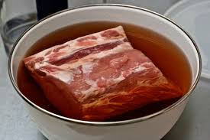
Contd….
Brining the meat in a salt solution. (Brine is a mixture of water and salt used to preserve or season vegetables, fruit, fish and meat in a process known as brining.)
Dry aging of meat at 0 to 2 °C (32 to 36 °F).

Slide 17
Play-Video
Students watch carefully

Slide 18
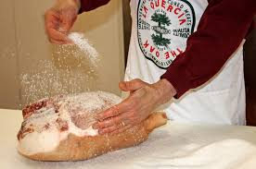
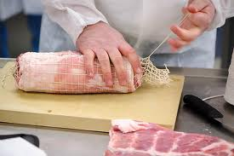
Curing of Meat
Curing is any of various food preservation and flavoring processes of foods by the addition of combinations of salt, nitrates, nitrites, and/or sugar, with the aim of drawing moisture out of the food by the process of osmosis.
Many curing processes also involve smoking, spicing, or cooking.
Dehydration was the earliest form of food curing. Because curing increases the solute concentration in the food and hence decreases its water potential, the food becomes inhospitable for the microbe growth that causes food spoilage.

Slide 19
Curing-Ingredients
Salt
Table salt (sodium chloride) is the primary ingredient used in meat curing. Removal of water and addition of salt to meat creates a solute-rich environment where osmotic pressure draws water out of microorganisms, slowing down their growth.

Slide 20
Contd…..
Sugar
The sugar added to meat for the purpose of curing it comes in many forms, including honey, corn syrup solids, and maple syrup. However, with the exception of bacon, it does not contribute much to the flavor, but it does alleviate the harsh flavor of the salt. Sugar also contributes to the growth of beneficial bacteria such as Lactobacillus by feeding them.

Slide 21
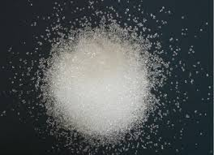
Contd….
Nitrates and nitrites
Nitrates and nitrites not only help kill bacteria, but also produce a characteristic flavor and give meat a pink or red color.

Slide 22
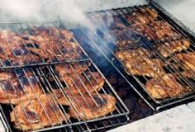
Smoking of meat
Smoking is one of the oldest food preservation methods, probably having arisen shortly after the development of cooking with fire.
Smoking, in food processing, the exposure of cured meat and fish products to smoke for the purposes of preserving them and increasing their palatability by adding flavour and imparting a rich brown colour.

Slide 23
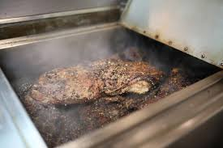
Contd…..
The smoking technique involves hanging the meat or placing it on racks in a chamber designed to contain the smoke. Commercial smokehouses, usually several stories high, often use steam pipes to supplement the heat of a natural sawdust fire.
Hickory sawdust is the preferred fuel. Whatever the size of the smoking operation, it is imperative that a hardwood fire be used.
The softwood of conifers such as spruce and pine contains pitch, which produces a film on the meat and imparts a bitter taste

Slide 24
Contd…..
Generally, smokehouse temperatures vary from 109° to 160° F (43° to 71° C), and smoking periods vary from as short as a few hours to as long as several days, depending on the type of meat and its moisture content. After smoking, the meat is chilled as rapidly as possible and cut and wrapped for the retail trade.

Slide 25



Fuels for smoking
Wood-Hard wood is advisable
- Soft woods which produces a film on the meat and imparts a bitter taste
Sawdust will burn more slowly than wood chip but faster than wood pellets. The cut also produces less heat than woodchip or smoking pellets.
Woodchip burns faster than Sawdust or smoking pellets. Because of their larger size, more air/oxygen surrounds the chips which in turns fuels the burn.
Pellets are made by compacting fine, 100% natural hardwood sawdust under extreme pressure. pellets burn hotter and more slowly than sawdust or woodchip. Pellets are arguably the most economical, cost effective "cut" for smoking food.

Slide 26
Smoking Methods
Cold smoking-temperatures below 85°F (30°C).
Hot smoking-185 °F (85 °C),
Smoke roasting or baking-above 250 °F (121 °C), or in a conventional oven by placing a pan filled with hardwood chips on the floor of the oven

Slide 27
Play-Video
Students watch keenly

Slide 28
Thank you…!!!
For your active listening
Chapter-1 is completed
Are you happy?

