Slide 1
In a “matching” problem, do not try to fully analyze each spectrum. Look for differences in the possible compounds that will show up in an infrared spectrum.

Slide 2
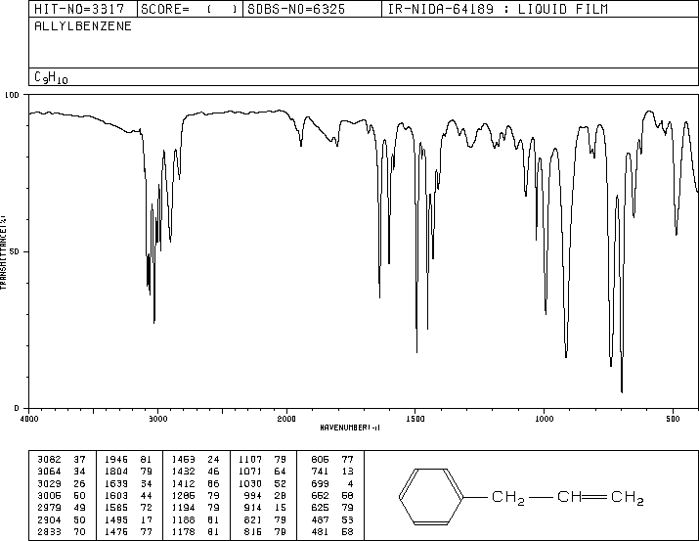
1
1500 & 1600
benzene
1640
C=C
910-920 & 990-1000
RCH=CH₂
C-H unsat’d & sat’d
mono
C₉H₁₀ – C₆H₅ = -C₃H₅

Slide 3
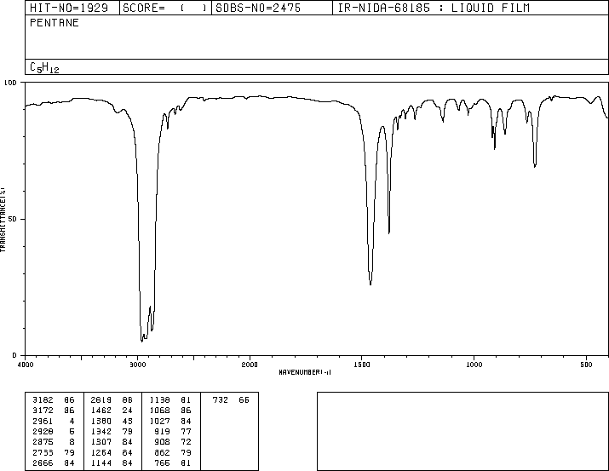
2
2850-2960 cm⁻¹
sat’d C-H
3000 cm⁻¹
1470 &1375 cm⁻¹
CH₃CH₂CH₂CH₂ CH₃

Slide 4
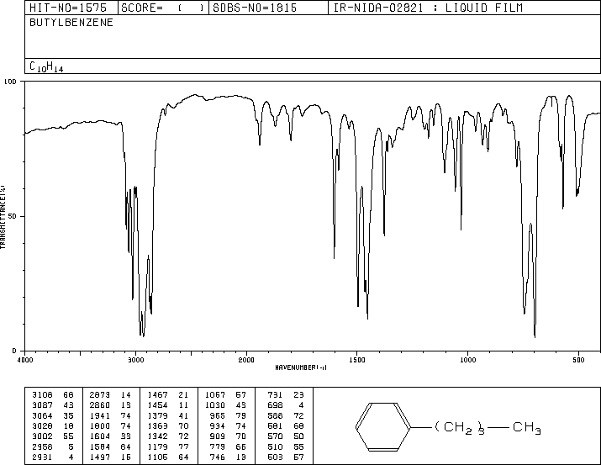
3
C-H unsat’d & sat’d
1500 & 1600
benzene
mono
C₁₀H₁₄ – C₆H₅ = -C₄H₉

Slide 5
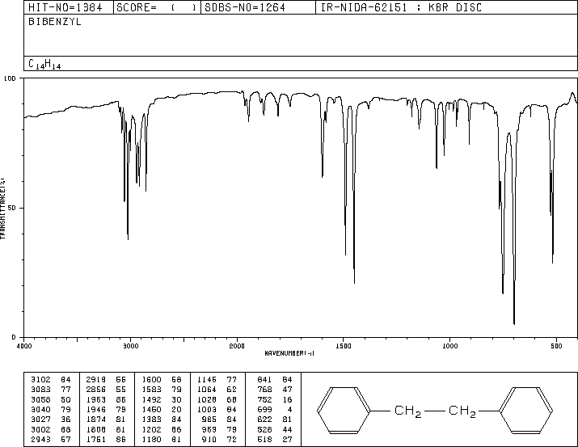
4
C-H unsat’d & sat’d
1500 & 1600
benzene
mono
C₁₄H₁₄ – C₆H₅ = C₈H₉ – C₆H₅ = – C₂H₄

Slide 6
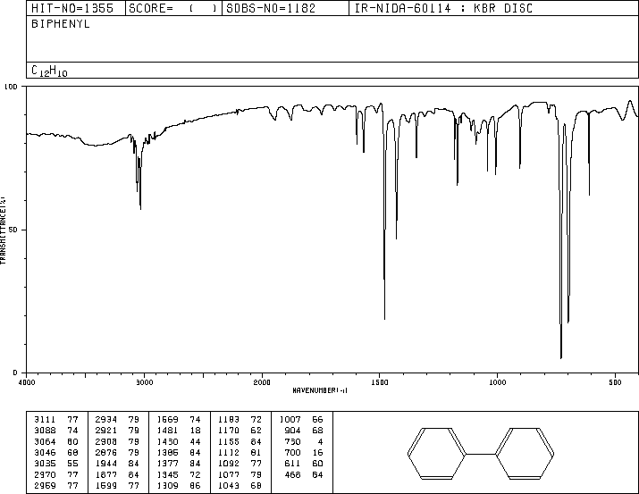
5
C-H unsat’d & no sat’d
1500 & 1600
benzene
mono
C₁₂H₁₀ – C₆H₅ = -C₆H₅

Slide 7
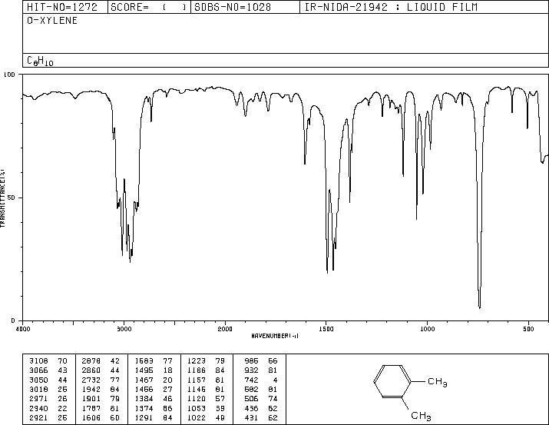
6
1500 & 1600
benzene
C-H unsat’d & sat’d
735-770
ortho
C₈H₁₀– C₆H₄= C₂H₆

