Slide 1
Chapter seven
PERFORMANCE APPRAISAL

Slide 2
Performance management
Performance management- can be defined as a systematic process for improving organizational performance by developing the performance of individuals and teams.
Performance management- is the process of creating a work environment in which people can perform to the best of their abilities in order to meet a company’s goals.

Slide 3
Performance
Performance is not only the matter of achievement of quantified objectives/outputs its also concerned with how the results are achieved.
High performance results from appropriate behavior, and the effective use of the required knowledge, skills and competencies.
Performance is a cumulative effect of understanding task requirement, ability to do it , motivation to do it and having the right environment.
When managing performance, both inputs (behavior) and outputs (results) need to be considered.

Slide 4
The processes of performance management
Planning: agreeing objectives and competence requirements and producing performance agreements and performance improvement and personal development plans.
Acting: carrying out the activities required to achieve objectives and plans.
Monitoring: checking on progress in achieving objectives.
Reviewing: assessing progress and achievements so that action plans can be prepared and agreed.

Slide 5
Performance Appraisal (PA)
Performance appraisal - is a tool organizations can use to maintain and enhance their productivity and facilitate progress toward their strategic goals.
Performance appraisal- the result of an annual or biannual process in which a manager evaluates an employee’s performance relative to the requirements of his or her job and uses the information to show the person where improvements are needed and why.
Performance appraisal – is the formal assessment and rating of individuals.

Slide 6
Purpose of performance Appraisal
Developmental
Administration
Ensures employees get regular feedback
Identify individual strengths and weaknesses
Evaluate goal achievement of employees
Identify individual training needs
Provides managers opportunity to help their employees
maintain accurate, objective employee performance records
provide input for promotions, transfers, termination and compensation decisions.
Identify performance problems and ways to correct them
Validate selection criteria
Evaluate training and development programs

Slide 7
Performance standard
Performance standards – helps to translate an organization’s goals and objectives into job requirements that communicate to employees the definitions of acceptable and unacceptable performance levels.
Performance standards- Yardstick used to evaluate how well employees have achieved objectives. Such as quality, Quantity(How much, how many, how often, at what cost) and Time (delivery time, cycle times, how quickly...)

Slide 8
The basic elements of performance standard
there are four basic elements that must be considered when establishing performance standards:
Strategic relevance-refers to the extent to which the standards of an appraisal relate to the strategic objectives of the organization in which they are applied.

Slide 9
The basic elements of performance standard
Avoid criterion deficiency-a performance Standard will have criterion deficiency when it only focus on a single criterion (e.g., Increased sales volume to the exclusion of other important performance dimensions such as, increased customer experience.
A good performance standard captures the entire range of an employee’s responsibilities.

Slide 10
The basic elements of performance standard
Avoid Criterion contamination- a performance standard will be contaminated when it contains elements that affect the appraisal measures that are not part of the actual performance. i.e., a good performance standard contains criteria's that jobholder can influence.
Reliability - refers to the stability or consistency of a standard.

Slide 11
Who should appraise an Employee’s performance
Manager and/or supervisor appraisal - a performance appraisal done by an employee’s manager.
Self-appraisal- a performance appraisal done by the employee being evaluated, generally on an appraisal form completed by the employee prior to the performance discussion session.

Slide 12
Who should appraise an Employee’s performance
Subordinate appraisal- a performance appraisal of a superior by an employee.

Slide 13
Who should appraise an Employee’s performance
peer appraisal- a performance appraisal of an employee done by co-workers, generally on forms that are compiled into a single form for use in the performance review discussion conducted by the employee’s manager.
  For peer appraisal to be effective:-
  The peer must trust each other
  work group needs to be stable over a long period of time
  co-workers must know the performance level of the employee being evaluated

Slide 14
Who should appraise an Employee’s performance
Customer appraisal- a performance appraisal includes evaluation from both a firm’s external and internal customers.
Combination of the above appraisal approaches which is called 360 appraisal.

Slide 15
Performance appraisal methods
Graphic Rating Scale method- each trait or characteristic to be rated is represented by a scale on which a rater indicates the degree to which an employee possesses that trait or characteristic.

Slide 16
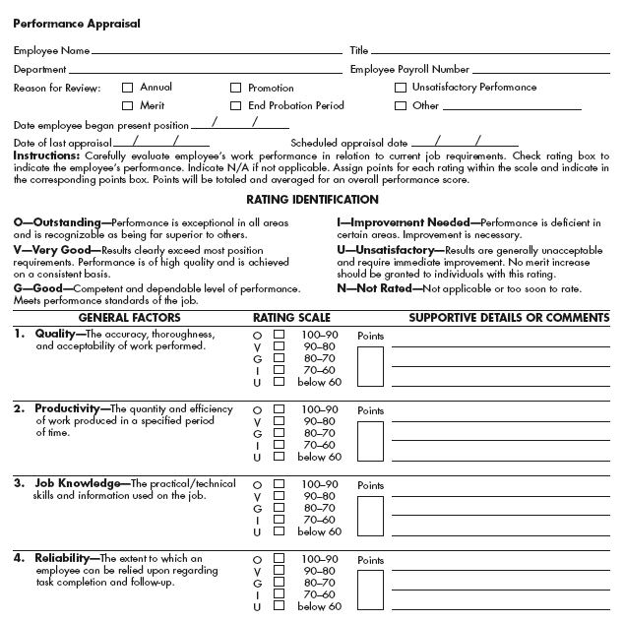

Slide 17
Performance appraisal methods
forced-choice method - a trait approach to performance appraisal that requires the rater to choose from statements designed to distinguish between successful and unsuccessful performance.
Example:-
a) Works slowly b) Works quickly
a) Produces poor quality b) Produce high quality

Slide 18
Performance appraisal methods
Essay method- requires the rater to write a brief narrative description of employee's performance and characteristics.
Essay method requires the appraiser to describe the strength, weakness and to make recommendations for his or her development.

Slide 19
Performance appraisal methods
Critical incident method- an unusual event that denotes superior or inferior employee performance in some part of the job.
Critical incident occurs when employee behavior results in unusual success or unusual failure in some part of the job.
Critical incident method requires manager to keep a log or diary to note specific critical incidents for each employee throughout the appraisal period.

Slide 20
Performance appraisal methods
An example of a favorable critical incident:
a janitor observes that a file cabinet containing classified documents has been left unlocked at the close of business and calls the firm’s security officer to correct the problem.
An example of an unfavorable incident:
occurs when a mail clerk fails to deliver urgent Mail package immediately, instead putting it in with regular mail to be routed two hours later.

Slide 21
Performance appraisal methods
management by objectives (MBO)- a philosophy of management that rates performance on the basis of employee achievement of goals set by mutual agreement of employee and manager.

Slide 22
Performance appraisal methods
Steps of management by objectives(MBO)-
Objectives and measurements are established for the organization
Objectives and measurements are established for the department
Both the supervisor and the employee propose goals and measurements and they will discuss to reach on mutual agreement.
Periodically assessment of progress
Final review
Review of the connection between the employees’ performance and the organization’s.

Slide 23
Rating errors
Error of central tendency- a performance rating error in which all employees are rated about average. raters who are reluctant to assign either extremely high or extremely low ratings commit the error of central tendency.
To reduce this error:
raters need to recognize its normal to expect significant difference among employees in terms of productivity ,behavior and other characteristics.

Slide 24
Rating errors
leniency or strictness error- a performance rating error in which the appraiser tends to give employees either unusually high or unusually low ratings
To reduce this error:
Defining clearly Measurement criteria is important.

Slide 25
Rating errors
Forced distribution- a performance appraisal ranking system whereby raters are required to place a certain percentage of employees into various performance categories. E.g., 15% high performers, 20% high-average performers, 30% average performers, 20% low-average performers &15% low performers.
To reduce this error:
Defining clearly Measurement criteria is important.

Slide 26
Rating errors
Recency error – a performance rating error in which the appraisal is based largely on the employee’s most recent behavior rather than on behavior throughout the appraisal period.
To reduce this error:
Documenting employee accomplishments and failures throughout the whole appraisal period can minimize the recency error.

Slide 27
Rating errors
Contrast error - a performance rating error in which an employee’s evaluation is biased either upward or downward because of comparison with another employee just previously evaluated.
To reduce this error:
Using objective standards or measurement criteria is important.

Slide 28
Rating errors
Similar to me error – occurs when appraisers inflate the evaluations of people with whom they have something in common.
Halo effect- refers to the tendency to generalize one positive or negative aspect of a person to the person’s entire performance, resulting in either a higher or lower rating than the employee deserves.
To reduce this error:
Training raters on purpose of performance appraisal is important to reduce the error.

Slide 29
The Performance Appraisal Process
Establish
Performance
standard
Take corrective
actions
Discuss
Appraisal
With
Employees
Communicate
Standards
To
Employees
Measure
Actual
Performance
Compare
Performance
With
Standard

