Slide 1
Human Resource Management Environment
Chapter Two

Slide 2
Recap questions
what is the difference between Michigan/matching model and Harvard model
What are the major components of Guest’s HRM model

Slide 3
A diagnostic model in HRM Framework
Is a framework that can be used to help managers focus on a set of relevant factors to analyze and solve HRM related problems.
It is based on the assumption that HR activities are all related to each other and have a combined effect on people.
Example:
factors- properly designed job, performance evaluation system, relevance and attractiveness of benefits, organizational values

Slide 4
A diagnostic model in HRM Framework
The management must have a deep understanding and appreciation of the internal and external environments.
It is desirable that managers know what the environment is and how it influences HRM functions in an organization.
Managers must always be aware of the environmental forces influencing their decisions; at the same time, they must be aware of how their decisions may affect the environment.

Slide 5
Reflection
What is the difference between internal and external environment? Give examples.
How does the environmental factors affect HRM practices of an organization?

Slide 6
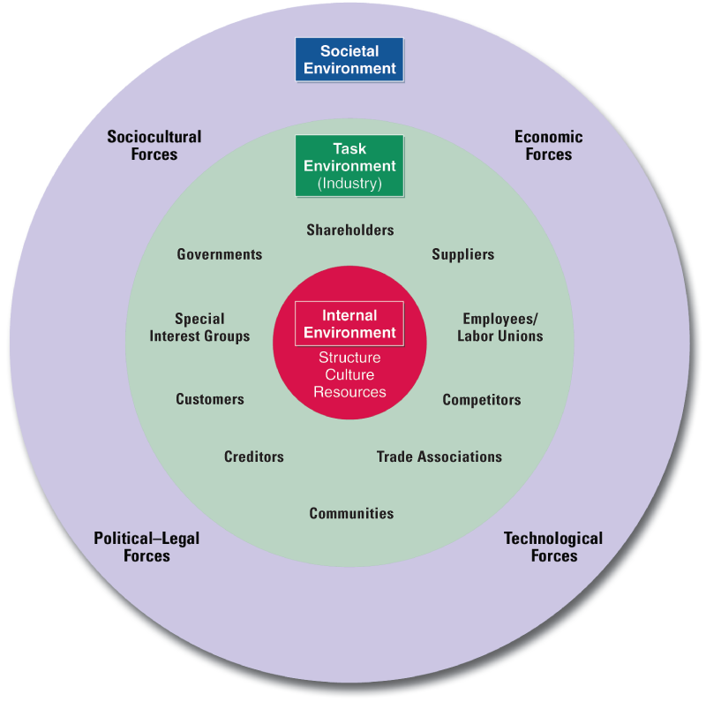
The Environmental Factors Affecting HRM

Slide 7
HRM Environment
Environment is the totality of factors that influence an organization and its sub systems such HRM.
External Environment -forces external to a firm that affect the firm’s performance but are beyond the control of management.
In order to adopt to the external environment constant monitoring of the external environment for opportunities and threats is important.
Internal Environment- are concerns or problems internal to the organization.

Slide 8
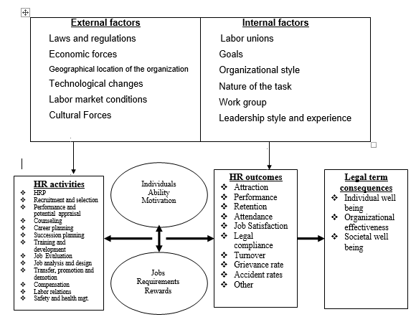
The diagnostic model

Slide 9
Strategic issues (Challenges) facing HRM
Invest on HR professionalism and professionals;
Understanding and Managing people;
  How to find, motivate , nurture, develop and keep them
Learn and adapt to evolving role of HRM;
Discern, create, and adapt organizational culture;
Availing Skilled and motivated workforce;

Slide 10
Strategic issues (Challenges) facing HRM
See HR as a decision science and bring discipline to it;
  HRM is not a random set of events, but a disciplined set of choices
Responding strategically to changes in the market place;
  Requires continuous monitoring for pressing competitive issues of the organization
Advancing HRM with technology;

Slide 11
Strategic issues (Challenges) facing HRM
Managing knowledge workers
Maintain cost while retaining top performing employees
Managing workforce diversity
Globalization

Slide 12
Reading assignment
Read about international human resource management Armstrong page 99

Slide 13
INTERNATIONAL HUMAN RESOURCE MANAGEMENT (IHRM)
IHRM is the process of employing, developing and rewarding people in international or global organizations.
IHRM is ‘human resource management issues, functions and policies and practices that result from the strategic activities of multinational enterprises and that impact on the international concerns and goals of those enterprises’

Slide 14
Why study IHRM?
Effective HRM is one of the major determinant of success or failure in international business
The availability of internationally experienced managers has significant contribution for the successful implementation of global strategies
Expatriate failures continue to be a significant problem for many international firms

Slide 15
HRM policy issues
From where to hire people with the right competence for the international operations.
Whether to use local nationals or expatriates
Expatriates are people who are the nationals of the parent company or who have third-country nationality.

Slide 16
local nationals or expatriates
Local national
Expatriates
are familiar with local markets, communities, the cultural setting and the local economy
speak the local language and are culturally assimilated
can take a long-term view and contribute for a long period
do not take the patronizing (neo-colonial) attitude
Relatively cheaper labor
provide the experience and expertise that local nationals lack
cost three or four times local nationals
Have short term perspective

Slide 17
HRM policy issues
Recruitment and selection issues
Specifying role requirements:- behavior’s required for those who work internationally
Examples
tolerate and adjust to local conditions
gain acceptance as a representative of one’s company abroad
inform and communicate effectively with a foreign environment about the home company’s policies
take into account the foreign environment when negotiating contracts and partnerships

Slide 18
HRM policy issues
Providing realistic previews about the job assignment such as :-
  About the overseas operation
  Any special features of the work
  How to adjust to local conditions
  Career progression options
  Re-entry policy on completion of the assignment
  Pay and benefits
cultural familiarization sessions

Slide 19
HRM policy issues
Training
  need analysis (in terms of skill and cultural requirements of the assignment)
  set training goals
  Develop training course
  Evaluate success

Slide 20
HRM policy issues
Performance management issues
  Assimilations review – to assess the potential and ability of individuals to cope with overseas conditions

Slide 21
HRM policy issues
  Pay and allowances policies
4.1 Home based pay
the value of the salary of expatriates is the same as in their home country
4.2. The host-based pay
expatriates are paid salaries and benefits that are in line with those given to nationals of the host country in similar jobs.
Allowances can be hardship, housing, school fee….holiday , company cars

Slide 22
HRM policy issues
Should we have the same HR policies for all firms?(global /local dilemma)
‘converge’ worldwide to be basically the same in each location, or
‘diverge’ to be differentiated in response to local requirements.

Slide 23
HRM strategic options
Notes:
Multi domestic company
1.The firms having HRm policies which would resemeble that of their home-country styles
2. Similar to the host countries’ indigenous styles
3. Company wide style irrespective of home and host countries preferred and prevalent styles.
Ethenocentric
Superior , logical, worked well tested over the years familiar
Lead to higher performance at home so will lead to higher performance as well in international practice
It also help the company to have unifed and coherent approach
Polycentric
Giving freedom due consideration for local conditions only provide guidelines , reserve some HR activites for HQ
They are tune to the culture and envirnoment so they are easier to implement
Disadvanatge – independence, harmful mgt practise
Globaly
Incorporating best practices regardless of coutry of origin company’s way of doing things centrLIZED , standardized

Slide 24
local factors that influence strategic choices
Local conditions
Parent- company strategy
The workforce doesn’t enjoy much power
Unskilled and uneducated workforce
Scare job opportunities
high unemployment rate
Employees are young with little or no experience
No well established organizational culture
Subsidiary located in a developing country and less advanced in technical and professional management issues
Ethnocentric
Global

Slide 25
local factors that influence strategic choices
Local conditions
Parent- company strategy
Highly skilled and educated workforce
Employees are aware of their rights
Pro-workers rules and regulations
Low unemployment rate
Economic boom
Subsidiary located in a technically and professionally advanced industrialized country
Polycentric

Slide 26
how to develop international approach
An explicit recognition by the parent organization that :-
Its own peculiar ways of managing human resources reflect some of the assumptions and values of its home culture.
its foreign subsidiaries may have other preferred ways of managing people that are neither intrinsically better nor worse, but could possibly be more effective locally.
genuine belief that more creative and effective ways of managing people could be developed as a result of cross-cultural learning.
acknowledge, discuss and make useable cultural differences

Slide 27
Recap questions
what are the major strategic issues international environment pause for human resource managers ?
What are the strategic options when it comes to developing HRM policy for subsidiaries?

Slide 28
The Legal aspects of HRM
Understanding and complying with HR law is important for three reasons:-
To do the right thing
Realize the limitations of firm’s HR
Minimize firm’s potential liability

Slide 29
Equal employment opportunity (EEO)
Is the condition in which all individuals have an equal chance for employment, regardless of their race, color, religion, sex, age, disability, or national origin.
The treatment of individuals in all aspects of employment in a fair and nonbiased manner.

Slide 30
Equal employment opportunity …
EEO demands the practice of reasonable accommodation
which refers to an attempt by employers to adjust, without unnecessary hardship, the working conditions or schedules of employees with disabilities or religious preferences.

Slide 31
Discrimination in the workplace
Discrimination is defined us the making of distinctions among people.

Slide 32
Disparate Treatment
One sign of discrimination is disparate treatment —differing treatment of individuals, where the differences are based on the individuals’ race, color, religion, sex, national origin, age, or disability status.
Example:-
hiring or promoting one person over an equally qualified person because of the individual’s race.
Failing to hire women with school-age children but hiring men with school-age children.

Slide 33
To avoid disparate treatment
Evaluating interview questions and decision criteria to make sure they are job related

Slide 34
Affirmative Action
A strategy intended to achieve fair employment by urging employers to hire certain groups of people who were discriminated against in the past.
An organization’s active effort to find opportunities to hire or promote people in a particular group.
taking extra effort to attract and retain minority employees.
Affirmative action measures are temporary interventions

Slide 35
Affirmative Action and ETHIOPIAN law
Article 35
The historical legacy of inequality and discrimination suffered by women in Ethiopia taken into account, women, in order to remedy this legacy, are entitled to affirmative measures.
The purpose of such measures shall be to provide special attention to women so as to enable them to compete and participate on the basis of equality with men in political, social and economic life as well as in public and private institutions.

Slide 36
Affirmative Action and ETHIOPIAN law
Proclamation 515/2007
In recruitment promotion and deployment preference shall be given to:
female candidates
candidates with disabilities; and
members of nationalities comparatively less represented in the government office, having equal or close scores to that other candidates.

Slide 37
harassment in the workplace
Sexual Harassment
Unwelcome advances, requests for sexual favors, and other verbal or physical conduct of a sexual nature in the working environment
Sexual harassment includes any type of behavior, comments, gestures, and actions of a sexual nature that create a hostile work environment for an employee.

Slide 38
activity
What can you do as a human resource manager to deal with harassment in the workplace ?

Slide 39
How to deal with harassment
Have clear well communicated harassment prohibiting policy
  Definition of sexual harassment (physical conduct, verbal conduct & non-verbal conduct)
  Training and refreshment training programs
  Compliant procedure
  Disciplinary measures (from warning to dismissal)
In place effective complaint procedure
Guard against retaliation
Quickly investigate all claims
Take remedial action to correct past harassment
Follow up to prevent continuation of harassment

Slide 40
Reading assignment
Read about job analysis Scott, S. A. & Bohlander , G. W., 2012. Managing human resource.

