Slide 1
JIMMA UNIVERSITY
COLLEGE OF NATURAL SCIENCE
DEPARTMENT OF BIOLOGY
FUNDAMENTALS OF BIOTECHNOLOGY NOTE
FOR 3RD YEAR STUDENTS
COURSE INSTRUCTOR: G. M

Slide 2
Course Title: Fundamentals of Biotechnology
Course Code: Biol3073
Course Credit: 3 (3 theoretical classes /week)
Course Credit point: 5 ECTS
Pre-requisite: Molecular Biology (Biol3072)
Semester: II

Slide 3
1. INTRODUCTION
What is Biotechnology
General Definition
The application of technology to improve a biological organism.
Detailed Definition
The application of the technology to modify the biological function of an organism by adding genes from another organism

Slide 4
Biotechnology involves the modification of a whole range of organisms.
This foreign gene can be inserted into plants, animals, fungi, bacteria or viruses.
Before we can understand how man goes about using biotechnology approaches to modify a species, we must understand basic genetic principles and terminology.
Gene - a piece of DNA that controls the expression of a trait
Allele - the alternate forms of a gene

Slide 5
Gene Manipulation
Identify a gene from another species which controls a trait of interest Or modify an existing gene (create a new allele)
For example, we may wish to add a gene from bacteria into a plant species.
Another approach would be to isolate a gene from our species of interest, modify that gene to change its function, and then reinsert the modified form back into the species. This is the first major biotechnology step, and it is called gene manipulation.

Slide 6
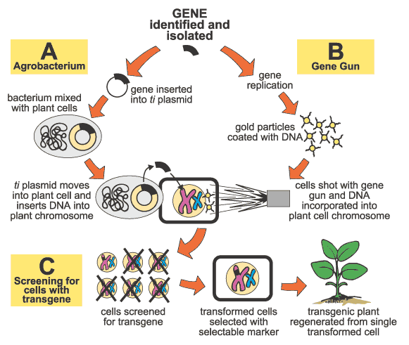
e. g Gene Manipulation and Introduction in Plant Biotechnology

Slide 7
Gene Introduction
Introduces the gene into an organism
Technique called transformation
Forms transgenic organisms
Once we have isolated or modified the gene of interest, the next step is gene introduction.
This step involves the addition of the gene to our species of interest.
In all cases, this introduction must be accompanied by stable integration of that gene into the genome of the target species.

Slide 8
Once the gene is stably integrated, it is passed along to all subsequent generation in the same manner as all other genes in the genome.
The technique used to integrate the gene into the species is called transformation,
and the modified organism is called a transgenic organism.

Slide 9
Importance of Biotechnology
Health care
An important part of quality of life is the access to good healthcare.(Which promotes good health). Health can be impaired when disease strikes.
Quality of life includes healthcare practices that prevent disease as
well as treat and heal disease

Slide 10
plant biotechnology
Many species of plants are used for food and shelter.
Yields and quality are important issues dealing with plant biotechnology.
disease resistance
pest resistance
herbicide resistance

Slide 11
Animal Biotechnology
Animal biotechnology has been used to improve livestock and poultry.
Livestock includes beef cattle, dairy cattle, and sheep
Poultry includes chickens, ducks, and turkeys. These species produce meat, eggs, and feathers

Slide 12
vaccines
Vaccines protect people from specific diseases.
Different diseases need different vaccinations.
These vaccines contain a “dead” or less–active copy of the virus.
Biotechnology provides new methods for making vaccines and leads to the development of new vaccines against different diseases.

Slide 13
pharmaceuticals
Pharmaceuticals were isolated from plants or fungi. An example of biotechnology –engineered pharmaceuticals is human insulin.Originally humans used insulin that was from pigs.
Biotechnology techniques are utilized to manufacture vitamin C and vitamin B-2.
tissue engineering
People die because organs, such as liver, heart, or pancreas fail to work properly. These lives can be saved by organ transplants.
Organ transplants are not always the best answer because there are fewer organs available to people who need them but not always

Slide 14
Developmental stages of Biotechnology
1st Generation Biotechnology :
- producing wine, beer, cheese, vaccines
2nd Generation Biotechnology:
- conventional breeding, tissue culture techniques
3rd Generation Biotechnology or “Modern Biotechnology
- Recombinant DNA technology, GMO’s, genomics,
proteomics, metabolomics, Human genome project…

Slide 15
Basic techniques in Biotechnology
  Recombinant DNA technology
Recombinant DNA is defined as the invitro joining together of DNA molecules from non-homologous sources.
It exploits features of genes, gene expression, and DNA enzymology to create novel DNA molecules with many applications.
rDNA technology is also known as genetic engineering.
It is now possible to transfer genetic material from any sources to a plasmid (vectors), an extra-chromosomal element of bacteria or to a virus.

Slide 16
In both these, the DNA may be cloned and replicated in a bacterial cell.
Genetic recombination is of fundamental important to all living organisms
It is the basis of science of genetics that has been exploited to great social benefit by plant and animal breeders.
Tools of Recombinant DNA Technology
Restriction Enzymes
Restriction enzymes are divided in two:
Restriction enzymes Exonucleases
Restriction enzymes Endonucleases

Slide 17
There are 3 types Restriction endonucleases.
I. Type I
II. Type II
III. Type III
NB . Type I and III is complex and have very limited role in genetic engineering.
Digestion of DNA with restriction endonucleases is the first step in many gene manipulation projects.
These enzymes are part of the system that carries out restriction and modification.

Slide 18
It appears that their main role is to protect cells from invasion by foreign DNA’s, especially bacteriophage DNA.
Restriction endonucleases recognize :
specific 4-base (tetramer),
5-base (pentamer), or
6-base (hexamer) sites located on the incoming DNA, and make double-stranded cuts.
There are over 200 different types of restriction enzymes that have been identified.
Examples:

Slide 19
Restriction Enzymes | Recognition Sequence DNA Sequence (both strands are represented)
Bam HI | G GATCC CCTAG G
Eco RI | G AATTC CTTAA G
Hpa I | GTT AAC CAA TTG
Hind III | A AGCTT TTCGA A
Nde I | CA TATG GTAT AC
Sal I | G TCGAC CAGCT G

Slide 20
Restriction enzymes recognize particular sequences in DNA and cut at specific points within that sequence.
For example, Bam HI recognizes the DNA sequence “GGATCC”. It then cuts between the G and the G.
Remember, the DNA is double stranded. The restriction enzymes will cut both strands.
Therefore, Bam HI will cut between the Gs on both strands creating “sticky ends.”
Hpa I cut creating “blunt ends”.

Slide 21
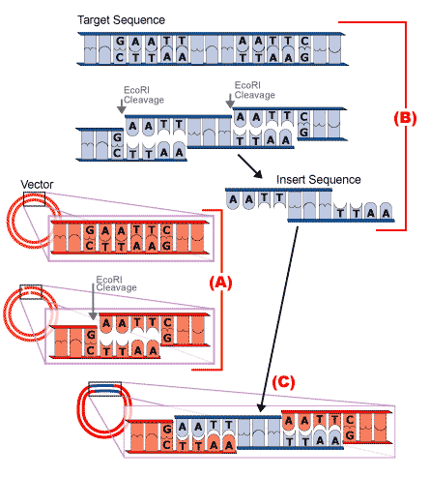
HindIII the third enzyme from Haemophilus influenzae strain d
BamHI the first enzyme from Bacillus amyloliquifaciens strain H
Eco RI the first restriction enzyme from E. coli carrying an R factor is Eco R I.

Slide 22
The sticky ends are generated by the same enzyme on vector as well as the target DNA are complementary and hence are cohesive

Slide 23
The sticky ends of the cleaved DNA segment cohere with those of the vector, thus the cut DNA sequence can now be introduced into the plasmid.
The cut ends are joined by DNA ligase enzyme and the introduced gene becomes a part of the plasmid.
Ligase is an enzyme that covalently joins the sugarphosphate backbone of bases together

Slide 24
Isolation and cutting of DNA fragments
First step in making recombinant DNA is isolation of DNA.
DNA can be cut in a sequence-specific manner by restriction endonucleases.
The technique involved in recombinant DNA technology is to slice (cut) the desired DNA segment and introduce it into a vector (e.g., plasmid).
Sometimes, the restriction sequence occurs on both strands but in reverse direction

Slide 25
Such a segment of DNA with identical sequences but opposite in direction is called a palindrome.
A palindrome site is a sequence of base pairs in double stranded DNA that reads the same backwards and forward across the double strand.
When a restriction enzyme acts on palindrome, it cleaves both the strands of DNA molecule.

Slide 26
Vectors
Bacterial plasmid is the most commonly used vector.
Plasmids used in genetic engineering are said to be under relaxed control, their replication is totally independent of chromosomal replication.
These plasmids may be present in copies of 10-700 per cell.
Specially developed bacteriophage lambda chromosome can incorporate up to 15-16 kilobases of DNA segment.
A central one-third of its genome is normally not required for phage infection and therefore can be replaced by foreign DNA.

Slide 27
The chimeric phage DNA can be introduced into the host cells by infecting them with phages.
Cosmids are recombinant vectors that combine features of both plasmids and bacteriophage Chromosome.
It can accommodate DNA segments up to 50 kilobases. Since cosmids have no phage DNA, upon introduction into a host cell via phage infection, they reproduce as plasmids.
Yeast artificial chromosome (YAC) is a specially constructed linear yeast chromosome that can incorporate DNA strands up to 1 million base pairs.

Slide 28
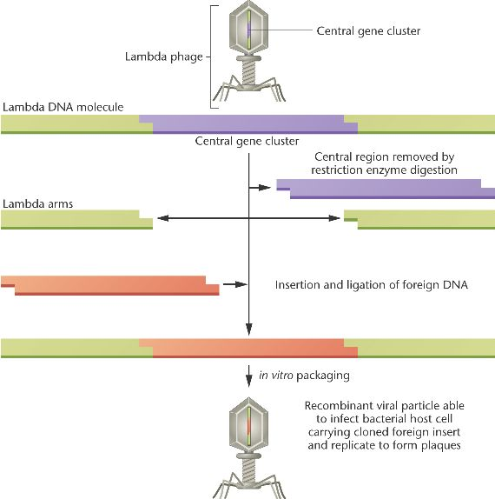

Slide 29
Assignment 1
Write the importance of vectors and their main types
What is the main deference's between invitro joining and ex-vivo joining DNA
What is the role of Restriction Enzymes in Recombinant DNA Technology

Slide 30
Construction of DNA library (Gene Library)
Gene library: a collection of different DNA sequence from an organism, each of which has been cloned into a vector for ease of purification, storage and analysis.
Genomic libraries
(made from genomic DNA)
Gene library
cDNA libraries
(made from cDNA- copy of mRNA)

Slide 31
A. Genomic DNA libraries
eukaryotes
Purify genomic DNA
Fragment this DNA : physical shearing and restriction enzyme digestion
prokaryotes
Clone the fragments into vectors

Slide 32
To make a representative genomic libraries,genomic DNA must be purified and then broken randomly into fragments that are correct in size for cloning into the chosen vector.
Purification of genomic DNA :
Eukaryotes :prepare cell nuclei
remove protein, lipids and other unwanted macro-molecules by protease digestion and phase extraction.
Prokaryotes :extracted DNA directly from cells. Why?

Slide 33
Break DNA into fragments randomly:
Physical shearing : pipeting, mixing or sonicaion
Restriction enzyme digestion: partial digestion is preferred to get a greater lengths of DNA fragments.
According to genome’s size, we can select a proper vector to construct a library .
Vectors Plasmid phageλ cosmid YAC
insert (kb) 5 23 45 1000

Slide 34
The most commonly chosen genomic cloning vectors are λ relacement vectors which must be digested with restriction enzymes to produce the two λ end fragment or λ arms between which the genomic DNA will be digested
λ phage vector in cloning
Long (left)
arm
short (right)
arm
cos
Exogenous DNA
(~20-23 kb)
cos

Slide 35
cDNA libraries
No cDNA library was made from prokaryotic mRNA.
Prokaryotic mRNA is very unstable
Genomic libraries of prokaryotes are easier to make and contain all the genome sequences.
cDNA libraries are very useful for eukaryotic gene analysis
Condensed protein encoded gene libraries, have much less junk sequences.
cDNAs have no introns → genes can be expressed in E. coli directly
Are very useful to identify new genes

Slide 36
Tissue or cell type specific (differential expression of genes)
mRNA isolation
Most eukaryotic mRNAs are polyadenylated at their 3’ ends
5’ cap
AAAAAAAAAAn
oligo (dT) can be bound to the poly(A) tail and used to recover the mRNA

Slide 37
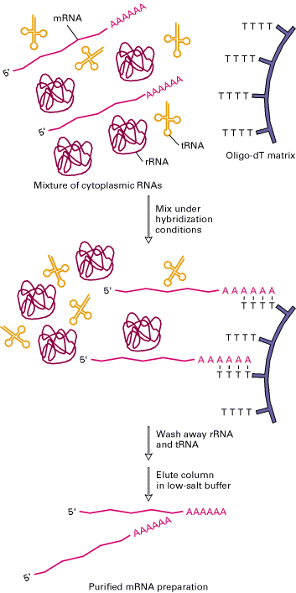

Slide 38
Three methods to isolate mRNA
1.Traditionally method was done by pass a preparation of total RNA down a column of oligo (dT)-cellulose
2.More rapid procedure is to add oligo(dT) linked to magnetic beads directly to a cell lysate and ‘pulling out’ the mRNA using a strong magnet
3.Alternative route of isolating mRNA is lysing cells and then preparing mRNA-ribosome complexes on sucrose gradients

Slide 39
synthesis of cDNA
First strand synthesis:
materials as reverse transcriptase ,primer( oligo(dT) or hexanucleotides) and dNTPs
Second strand synthesis:
best way of making full-length cDNA is to ‘tail’ the 3’-end of the first strand and then use a complementary primer to make the second.

Slide 40
Screening
The process of identifying one particular clone containing the gene of interest from among the very large number of others in the gene library .
Using nucleic acid probe to screen the library based on hybridization with nucleic acids.
Analyze the protein product.
Screening libraries
Searching the genes of interest in a DNA library
Hybridization: to identify the interested DNA or its RNA product
1. Radiolabeled probes which is complementary to a region of the interested gene

Slide 41
  Probes:
  An oligonucleotide derived from the sequence of a protein product of the gene
  A DNA fragment/oligo from a related gene of another species
2. Blotting the DNA or RNA on a membrane
3. Hybridize the labeled probe with DNA membrane (Southern) or RNA (Northern) membrane
DNA probes are short, single-stranded stretches of nucleic acid that are complementary to target nucleic acids,
  10 - 1000s of base pairs in length,

Slide 42
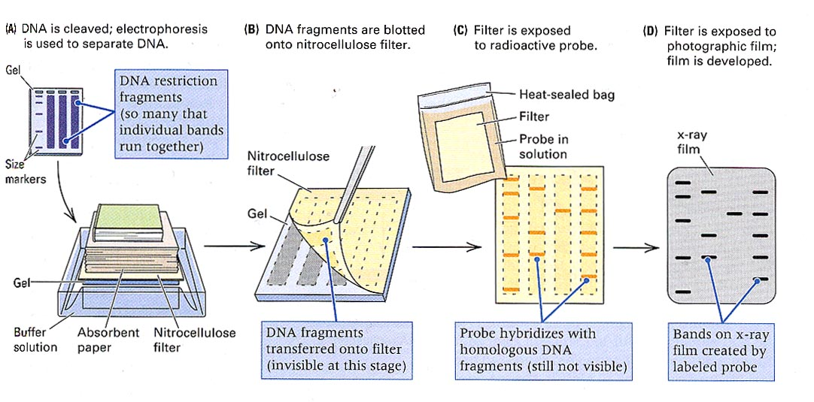
Southern Blot

Slide 43
Question
1. Is it possible to identify RNA by southern Blot? If yes how and if not why?
2. How proteins are identified?
A nitrocellulose paper is a sticky membrane used for immobilizing nucleic acids in southern blots and northern blots.
It is also used for immobilization of proteins in western blots and atomic force microscopy for its nonspecific affinity for amino acids.

Slide 44
Polymerase chain reaction (PCR)
It is an effective procedure to generate large quantities of specific DNA region invitro
A PCR machine is sort of like a photocopier for genes.
Any region of any DNA molecules can be amplified as long as the sequences at the border of the DNA region of interest are known
There is a cycle of in PCR:
I. Denaturation: DNA melts
II. Annealing : Primers bind
III. Chain elongation(Extension): DNA is replicated

Slide 45
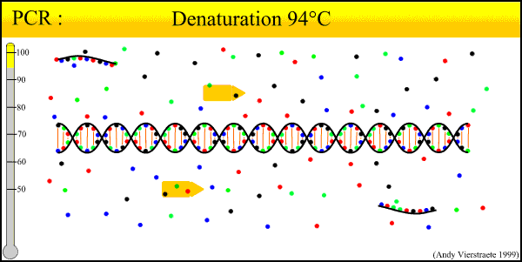
PCR Animation

Slide 46
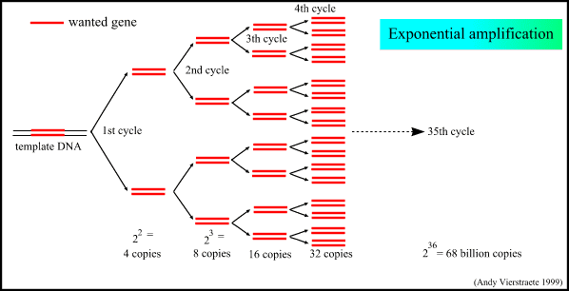

Slide 47
PCR Applications
used for mapping genes,
used as probes,
PCR products can be probed
used to identify genotypes
used to sequence DNA directly

Slide 48
Assignment 2
What is Gene library? List their main types
What is Screening libraries in Genetic Engineering
Write the difference between Southern, North and western blot
What is Polymerase chain reaction (PCR)?

Slide 49
Biotechnology in health
Hybridomas technology
In 1975, Kohler and Milstein first fused lymphocytes to produce a cell line which was both immortal and a producer of specific antibodies.
The two scientists were awarded the Nobel Prize for Medicine in 1984 for the development of this "hybridoma.“
The value of hybridomas to the field was not truly appreciated until about 1987, when MAbs were regularly produced in rodents for diagnostics.
are cells that have been engineered to produce a desired antibody in large amounts, to produce monoclonal antibodies

Slide 50
is hybrid cell produced by the fusion of a tumor cell with an ordinary antibody producing cell which then proliferate and yield large amount of a monoclonal antibody.
Monoclonal antibodies can be produced in specialized cells through a technique now popularly known as hybridoma technology.
In a specific immune response, only those T and B cells that can bind to the antigens of the pathogen are selected to participate in the response.

Slide 51
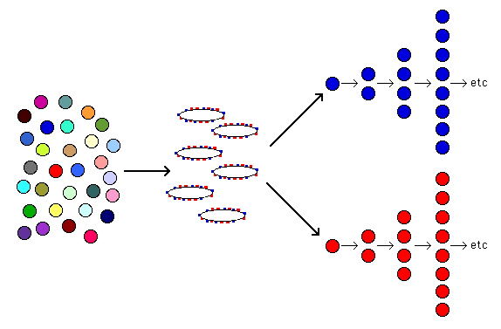
Proliferation of cells
with receptors capable
of binding epitopes of
the antigen
Mixture of T and B cells
with different antigen
specificities
An antigen with 2 epitopes
- red epitope, blue epitope
Clonal selection of lymphocytes during the specific immune response

Slide 52
Hybridomas Technique
B lymphocytes can mutate into tumor cells that result in a type of cancer termed myeloma.
Myeloma cells become “immortal” and will grow indefinitely in culture.
Fusion of a single activated B cell and a myeloma cell will create a hybridoma that can grow indefinitely in culture.
Myeloma cells have been genetically engineered such that they can not use hypoxanthine, aminopterin, and thymidine (HAT medium) as a source for nucleic acid biosynthesis and will die in culture.
Notes:
A lymphocyte is one of the subtypes of white blood cell in a vertebrate's immune system. Lymphocytes include natural killer cells(which function in cell-mediated, cytotoxic innate immunity), T cells (for cell-mediated, cytotoxic adaptive immunity), and B cells (for humoral, antibody-driven adaptive immunity

Slide 53
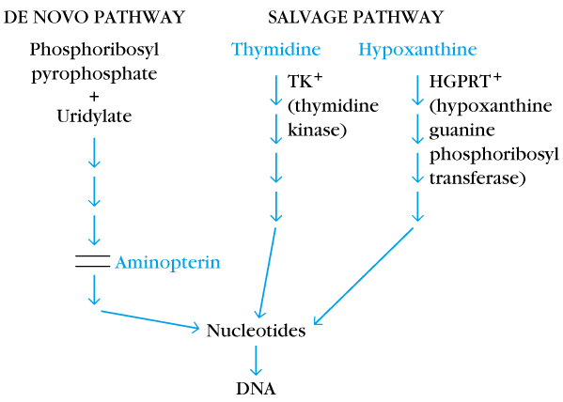
Only B cells that have fused with the engineered myeloma cells will survive in culture when grown in HAT
Two different pathways to synthesis nucleotide in mammalian cells
(Folic acid analog)
Myeloma cells used in hybridoma technology are double mutants, they lack the HGPRTase and lose the ability to produce Ig

Slide 54
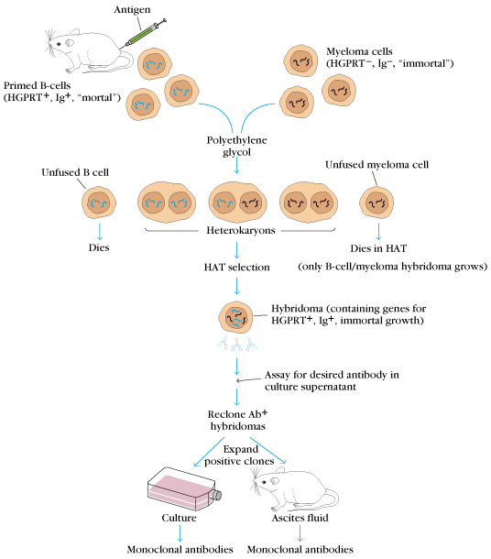

Slide 55
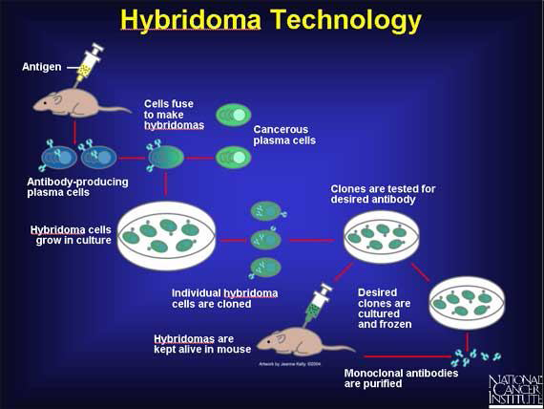

Slide 56
Antibody Production
Poly- Clonal Antibodies
Mono- Clonal Antibodies
Polyclonal antibodies
If an animal is immunized with a protein, a wide array of B cells will be stimulated to produce anti-protein antibodies.
Antibodies may be made to a number of different epitopes of the protein.
Even antibodies that bind to the same epitope may have different antigen-binding sites and bind the epitope with different affinity.

Slide 57
The mixture of antibodies produced in response to an antigens are referred to as polyclonal antibodies (they are produced by many different clones of B cells).
The serum obtained from an immunized animal is referred to as a polyclonal antiserum
Serum antibodies are heterogeneous
    - To increase immune protection in vivo
    -To reduces the efficacy of antiserum for various in vitro uses

Slide 58
Fig. below shows Polyclonal antibodies
Protein
Immunize
Antibodies
Immune Response
Epitopes
Polyclonal antibodies

Slide 59
Monoclonal Antibody (MAb)
Antibodies produced from a single clone of B cells.
Produced by fusing a B cell secreting the desired antibody with a myeloma cell capable of growing indefinitely in tissue culture.
Monoclonal antibodies all have identical antigen-binding sites.
Thus they all bind to the same epitope with the same affinity.
They are all of the same antibody class (isotype)

Slide 60
Importance of MAbs
detection of pregnancy
diagnose disease, including acquired immunodeficiency syndrome (AIDS), hepatitis, and
various kinds of cancer; and treat conditions caused by toxins, or poisonous substances, such as snake venom.
used to identify malignant cells (cells with abnormal growth) in tissues

Slide 61
b
Polyclonal antibodies
(Polyclonal antiserum)
Harvest Ab
Monoclonal antibodies

Slide 62
Humanized Monoclonal Antibodies
Mouse monoclonal antibodies have been genetically engineered to replace all of the antibody molecule with human counterparts except the hypervariable regions directly involved with antigen binding.
Humanized monoclonal antibodies are currently be tested in human clinical trials

Slide 63
Polyclonal antibodies Monoclonal Antibodies
Produced by: Many B cell clones A single B cell clone
Bind to: Multiple epitopes of all A single epitope of a single
antigens used in the antigen
immunization
Antibody class: A mixture of different All of a single Ab class
Ab classes (isotypes)
Ag-binding sites: A mixture of Abs with All Abs have the same antigen
different antigen-binding sites binding site
Potential for cross-reactivity: High Low

Slide 64
Gene therapy
Treatment of disease by replacing genes: the treatment of a genetic disease through the insertion of normal or genetically altered genes into cells in order to replace or make up for the non-functional or missing genes or it is the application of genetic principles in the treatment of human disease
It is an experimental medical treatment that manipulates a gene or genes within cells in order to produce proteins that change the function of those cells
In somatic gene therapy, new genes are introduced to the body

Slide 65
In germ line therapy, the human germ line is modified, conferring heritable modifications to the offspring
However, germ line therapy is not permitted in any county, on the basis that it is unethical
Essential to the progression of gene therapy is a comprehensive understanding of the human genome and various genetic diseases
Gene therapy originated in efforts to treat and cure some of the more than 9,000 known genetic disorders, most of which lack an effective therapy.

Slide 66
In the United States 1 infant in every 28 is born with a disorder caused by a defect in 1 or more of the estimated 31,000 genes found in the human body.
The original goal of gene therapy was to substitute a healthy gene for a defective one, or to repair a faulty gene, thereby eliminating symptoms of disease.
But researchers have moved beyond inherited genetic disorders to treat other kinds of diseases. Today, nearly 75 percent of all clinical trials involving gene therapy are aimed at treatments for cancer and acquired immunodeficiency syndrome (AIDS).

Slide 67
Three types of gene therapy:
I. Monogenic gene therapy
  Provides genes to encode for the production of a specific protein
    Cystic fibrosis, Muscular dystrophy, Sickle cell disease, Haemophilia
II. Suicide gene therapy
  Provide ‘suicide’ genes to target cancer cells for destruction
    Cancer
III. Antisense gene therapy
  Provides a single stranded gene in an 'antisense’ (backward) orientation to block the production of harmful proteins
    AIDS/HIV

Slide 68
How Does Gene Therapy Work?
In most gene therapy studies, a "normal" gene is inserted into the genome to replace an "abnormal," disease-causing gene.
A carrier molecule called a vector must be used to deliver the therapeutic gene to the patient's target cells.
The most common vector is a virus that has been genetically altered to carry normal human DNA.
Viruses have evolved a way of encapsulating and delivering their genes to human cells in a pathogenic manner.

Slide 69
Scientists manipulate the virus genome to remove disease-causing genes and insert therapeutic ones
Target cells, such as the patient's liver or lung cells, are infected with the viral vector
Non-viral options:
Direct introduction of therapeutic DNA into target cells
  Can be used only with certain tissues and requires large amounts of DNA.
  An artificial lipid sphere with an aqueous core, called a liposome, carries the therapeutic DNA, is capable of passing the DNA through the target cell's membrane.

Slide 70
Viral Vector Carrying Healthy Gene
Cell with mutated gene(s)
Vector inserts healthy gene into cell
New gene in the cell along with original genes
Functional proteins are created from the therapeutic gene causing the cell to return to a normal state.

Slide 71
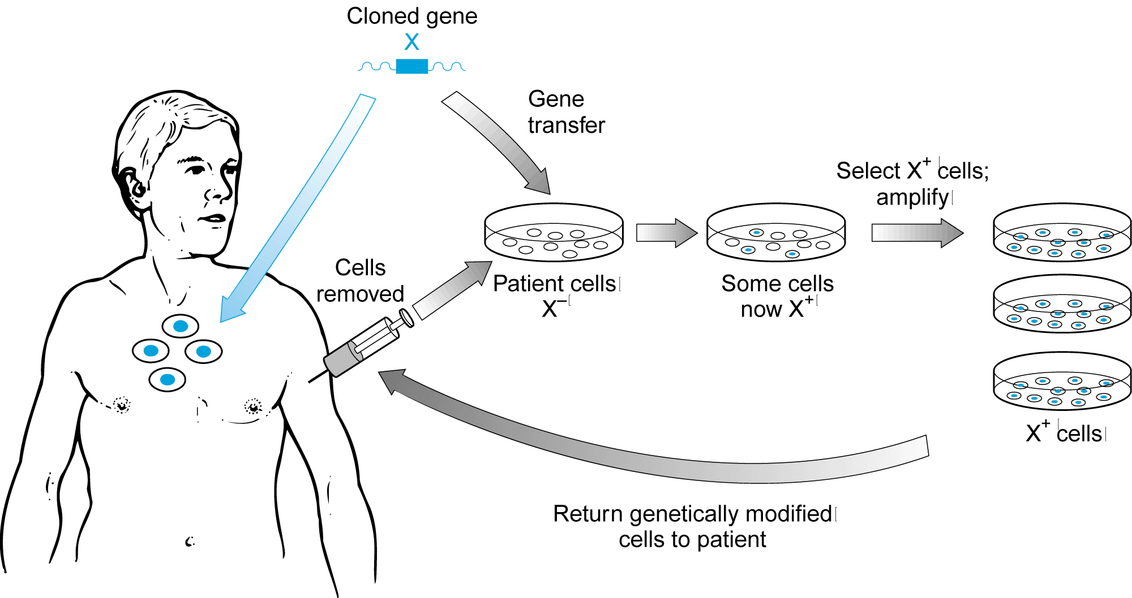
Different Delivery Systems are Available
In vivo versus ex vivo
  In vivo = delivery of genes takes place in the body
  Ex vivo = delivery takes place out of the body, and then cells are placed back into the body

Slide 72
Gene delivery approaches
  Non-viral vectors
  Viral vectors
In vivo techniques
In vivo techniques usually utilize viral vectors
  -Virus = carrier of desired gene
  -Virus is usually “crippled” to disable its ability to cause disease
  -Viral methods have proved to be the most efficient to date
  -Many viral vectors can stable integrate the desired gene into the target cell’s genome

Slide 73
  Problem: Replication defective viruses adversely affect the virus’ normal ability to spread genes in the body
    Reliant on diffusion and spread
    Hampered by small intercellular spaces for transport
    Restricted by viral-binding ligands on cell surface → therefore cannot advance far.
    Limitations
Gene delivery
  -Limited tropism of viral vectors
  -Dependence on cell cycle by some viral vectors (i.e. mitosis required)

Slide 74
Duration of gene activity
  -Non-integrating delivery will be transient (transient expression)
  -Integrated delivery will be stable
Patient safety
  -Immune hyperresponsiveness (hypersensitivity reactions directed against viral vector components or against transgenes expressed in treated cells)
  -Integration is not controlled → oncogenes may be involved at insertion point → cancer

Slide 75
Gene control/regulation
  Most viral vectors are unable to accommodate full length human genes containing all of their original regulatory sequences
  Human cDNA often used → much regulatory information is lost (e.g. enhancers inside introns)
  Often promoters are substituted → therefore gene expression pattern may be very different
  Random integration can adversely affect expression (insertion near highly methylated heterogeneous DNA may silence gene expression)

Slide 76
Expense
  Costly because of cell culturing needs involved in ex vivo techniques
  Virus cultures for in vivo delivery
  Usually the number of patients enrolled in any given trial is <20
  More than 5000 patients have been treated in last ~12 years worldwide

Slide 77
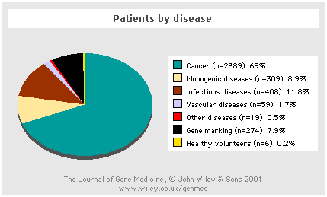
Applications of gene therapy

Slide 78
Problem with Gene Therapy
Short-lived nature of gene therapy:
- patients will have to undergo multiple rounds of gene therapy.
Immune response:
- risk of stimulating the immune system in a way that reduces gene therapy effectiveness is always a potential risk.
Problems with viral vectors: viruses, the carrier of choice, present potential problems to the patient, like toxicity, immune and inflammatory responses, and gene control and targeting.

Slide 79
Multi-gene disorders:
most common disorders, such as heart disease, high blood pressure, Alzheimer's disease, arthritis and diabetes, are caused by the combined effects of variations in many genes.
Is Gene Therapy Ethical?

Slide 80
Organ/tissue transplantation
It is the act of transferring an organ, tissue, or cell from one place to another
Modern techniques of medical transplantation:
surgically removing a diseased or malfunctioning kidney, heart, or other organ, and replacing it with a healthy organ from a donor has brought new life and new hope to patients who, just a few generations ago, would have died.
But the practice has also raised significant ethical questions.

Slide 81
Types Transplantation:
Broadly speaking, transplants are divided into three categories based on the similarity between the donor and the recipient:
a. Autotransplants
b. Allotransplants
c. Xenotransplants
Autotransplants
Involve the transfer of tissue or organs from one part of an individual to another part of the same individual.

Slide 82
They are the most common type of transplants and include skin grafts and vein grafts for by passes.
No immunosuppression is required
Allotransplants
Involve the transfer of tissue or organs from one individual to a different individual of the same species
The most common scenario for most solid organ transplants performed today.
Immunosuppression is required for allograft recipients to prevent rejection.

Slide 83
Xenotransplants
Involve transfer across species barriers.
Currently, xenotransplants are largely relegated to the laboratory, given the complex, potent immunologic barriers to success
Transplant Antigens:
The main antigens involved in triggering rejection are coded for by a group of genes known as the major histocompatibility complex (MHC).
In humans, the MHC complex is known as the human leukocyte antigen (HLA) system.

Slide 84
It comprises a series of genes located on chromosome 6.
New directions for organ Transplantation
Stem cells
Cell therapy
Tissue engineering
Stem cells therapy means treatment in which stem cells are induced to differentiate into the specific cell type required to repair damaged tissues.
Cell therapy can be defined as «The use of living cells to restore, maintain or enhance the function of tissues and organs».

Slide 85
Tissue engineering is the process of creating living, physiological three dimensional tissues and organs.
The process starts with a source of cells derived from a patient or from a donor.
The cells may be immature cells, in the stem cell stage, or cells that are already capable of carrying out tissue functions; often, a mixture of different cell types (e.g., liver cells and blood vessel cells) and cell maturity levels is needed.

Slide 86
Tissue engineering-based therapies may provide a possible solution to alleviate the current shortage of organ donors.
In tissue engineering, biological and engineering principles are combined to produce cell-based substitutes with or without the use of materials.
One of the major obstacles in engineering tissue constructs for clinical use is the limit in available human cells.
Stem cells isolated from adults or developing embryos are a current source for cells for tissue engineering

Slide 87



How Stem Cells and Gene Therapy Might Work Together
A sample of bone marrow is removed.
Stem cells are isolated and allowed to multiply in culture.
Cells are treated with a modified virus containing a therapeutic gene

Slide 88

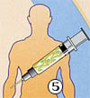
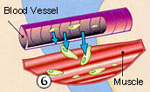

CONT..
4.The virus is taken up by individual cells and the therapeutic gene goes into the cell's nucleus.
5. Treated ("corrected") cells are injected into the bloodstream.
6. Treated cells respond to injury signals from degenerating muscle or other tissues and migrate out of the bloodstream.
7. Treated cells patch damage and build healthy tissue

Slide 89
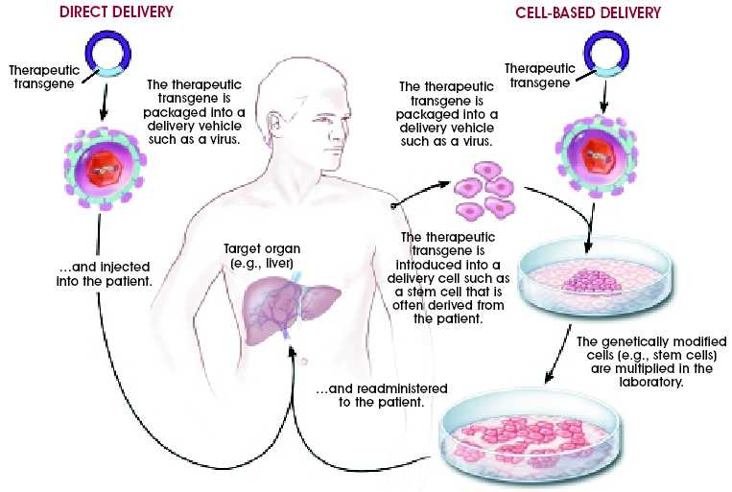
Stem cells for Gene Therapy

Slide 90
Forensic medicine
Over the last 20 years the development and application of genetics has revolutionized forensic science.
In 1984, the analysis of polymorphic regions of DNA produced what was termed ‘a DNA fingerprint.
DNA Fingerprinting, method of identification that compares fragments of deoxyribonucleic acid (DNA) it is sometimes called DNA typing.
DNA is the genetic material found within the cell nuclei of all living things.
In mammals the strands of DNA are grouped into structures called chromosomes.

Slide 91
With the exception of identical twins, the complete DNA of each individual is unique.
A DNA fingerprint is constructed by first extracting a DNA sample from body tissue or fluid such as hair, blood, or saliva.
The sample is then segmented using enzymes, and the segments are arranged by size using a process called electrophoresis.
The segments are marked with probes and exposed on X-ray film, where they form a characteristic pattern of black bars the DNA fingerprint.

Slide 92
If the DNA fingerprints produced from two different samples match, the two samples probably came from the same person.

Slide 93
ladders were run alongside the tested samples that allowed the size of the DNA fragments to be estimated.
A control sample labelled K562 is analysed along with the tested samples
The first criminal conviction based on DNA evidence in the United States occurred in 1988.
In criminal investigations, DNA fingerprints derived from evidence collected at the crime scene are compared to the DNA fingerprints of suspects.
The DNA evidence can implicate or exonerate a suspect.

Slide 94
Generally, courts have accepted the reliability of DNA testing and admitted DNA test results into evidence.
However, DNA fingerprinting is controversial in a number of areas: the accuracy of the results, the cost of testing, and the possible misuse of the technique.
In DNA fingerprinting procedure, scientists use restriction enzymes to cleave a sample of DNA into an assortment of fragments.
Solutions containing these fragments are placed at the surface of a gel to which an electric current is applied.

Slide 95
The electric current causes the DNA fragments to move through the gel.
Because smaller fragments move more quickly than larger ones, this process, called electrophoresis, separates the fragments according to their size.
The fragments are then marked with probes and exposed on X-ray film, where they form the DNA fingerprint a pattern of characteristic black bars that is unique for each type of DNA.

Slide 96
Genomics and the potential for new drug development
Genomics definitions: Generation of information about living things by systematic approaches that can be performed on an industrial scale.
The systematic study of the complete DNA sequences (GENOME) of organisms.
functional analysis and characterization of drug targets and disease pathways is becoming key in pharmaceutical research.
Understanding the role of specific genes in disease requires a highly parallelized and multidisciplinary approach.

Slide 97
Armed with more- powerful, higher- throughput tools for:
- gene knock- out/ knock- down
-protein characterization
-metabolic profiling
- high- content screening and data management researchers are now in a position to acquire and integrate genomic, proteomic, metabolite, phenotype, and clinical data to provide a systems- wide view of biological function and disease pathways/ mechanisms.

Slide 98
Proteomics:
proteomics represents the effort to establish the identities, quantities, structures and biochemical and cellular functions of all proteins in an organism, organ, or organelle, and how these properties vary in space, time and physiological state
The analysis of complete complements of proteins.
Proteomics includes not only the identification and quantification of proteins, but also the determination of their localization, modifications, interactions, activities, and, ultimately, their function.

Slide 99
Proteomic technologies will play an important role in drug discovery, diagnostics and molecular medicine because is the link between genes, proteins and disease.
As researchers study defective proteins that cause particular diseases, their findings will help develop new drugs that either alter the shape of a defective protein or mimic a missing one
Current research is looking at protein families linked to diseases including cancer, diabetes and heart disease.

Slide 100
Vaccine production
Traditional vs. rDNA vaccines
Subunit vaccines
Peptide vaccines
Genetic immunization: DNA vaccines
Attenuated vaccines
Vector vaccines
Notes:
Subunitvaccines:A vaccine containing viral antigens made free of viral nucleic acid bychemical extraction and containing only minimal amounts of nonviralantigens derived from the culture medium; it is less likely to cause adversereactions than a vaccine containing the whole virion.

Slide 101
Traditional vaccines and their drawbacks
Traditional vaccines are either inactivated or attenuated infectious agents (bacteria or viruses) injected into an antibody-producing organism to produce immunity
Drawbacks include: inability to grow enough agent, safety concerns, reversion of attenuated strains, incomplete inactivation, shelf life may require refrigeration
Recombinant DNA technology can create better, safer, reliable vaccines
Immunologically active, non-infectious agents can be produced by deleting virulence genes

Slide 102
A gene(s) encoding a major antigenic determinant(s) can be cloned into a benign carrier organisms (virus or bacteria)
Genes or portions of genes encoding major antigenic determinants can be cloned in expression vectors and large amounts of the product purified and used as a subunit or peptide vaccine, respectively
Table below shows Some human disease agents for which rDNA vaccines are being developed

Slide 103
Pathogenic agent | Disease
Varicella-zoster virus | Chicken pox
Hepatitis A and B viruses | High fever, liver damage
Herpes simplex virus type 2 | Genital ulcers
Influenza A and B viruses | Acute respiratory disease
Rabies virus | Encephalitis
Human immunodeficiency virus | AIDS
Vibrio cholerae | Cholera

Slide 104
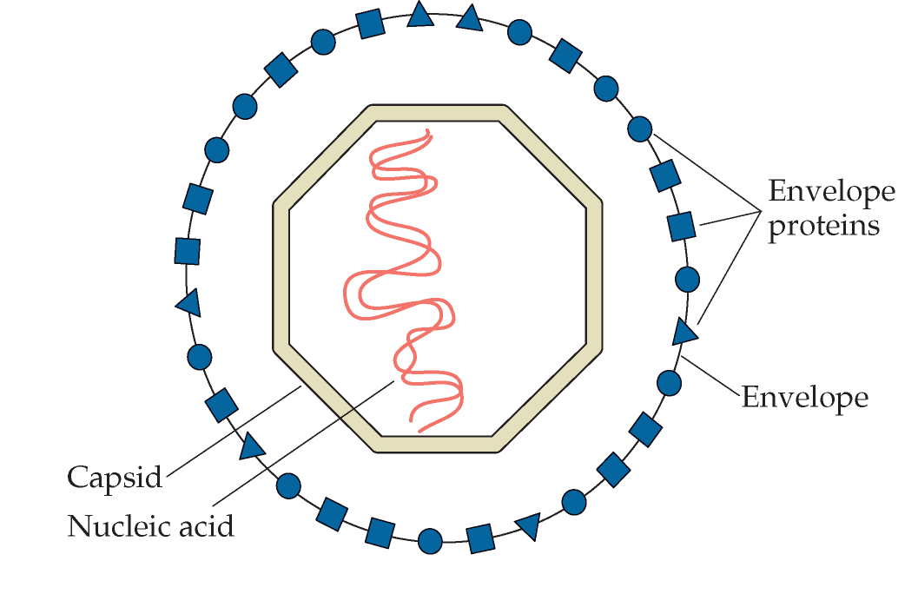
Figure below shows typical animal virus structure
Note: capsid and envelope proteins can elicit neutralizing antibodies

Slide 105
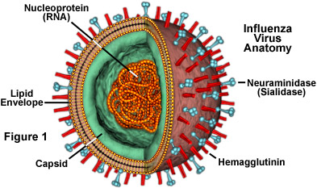
Influenza (Flu) virus structure

Slide 106
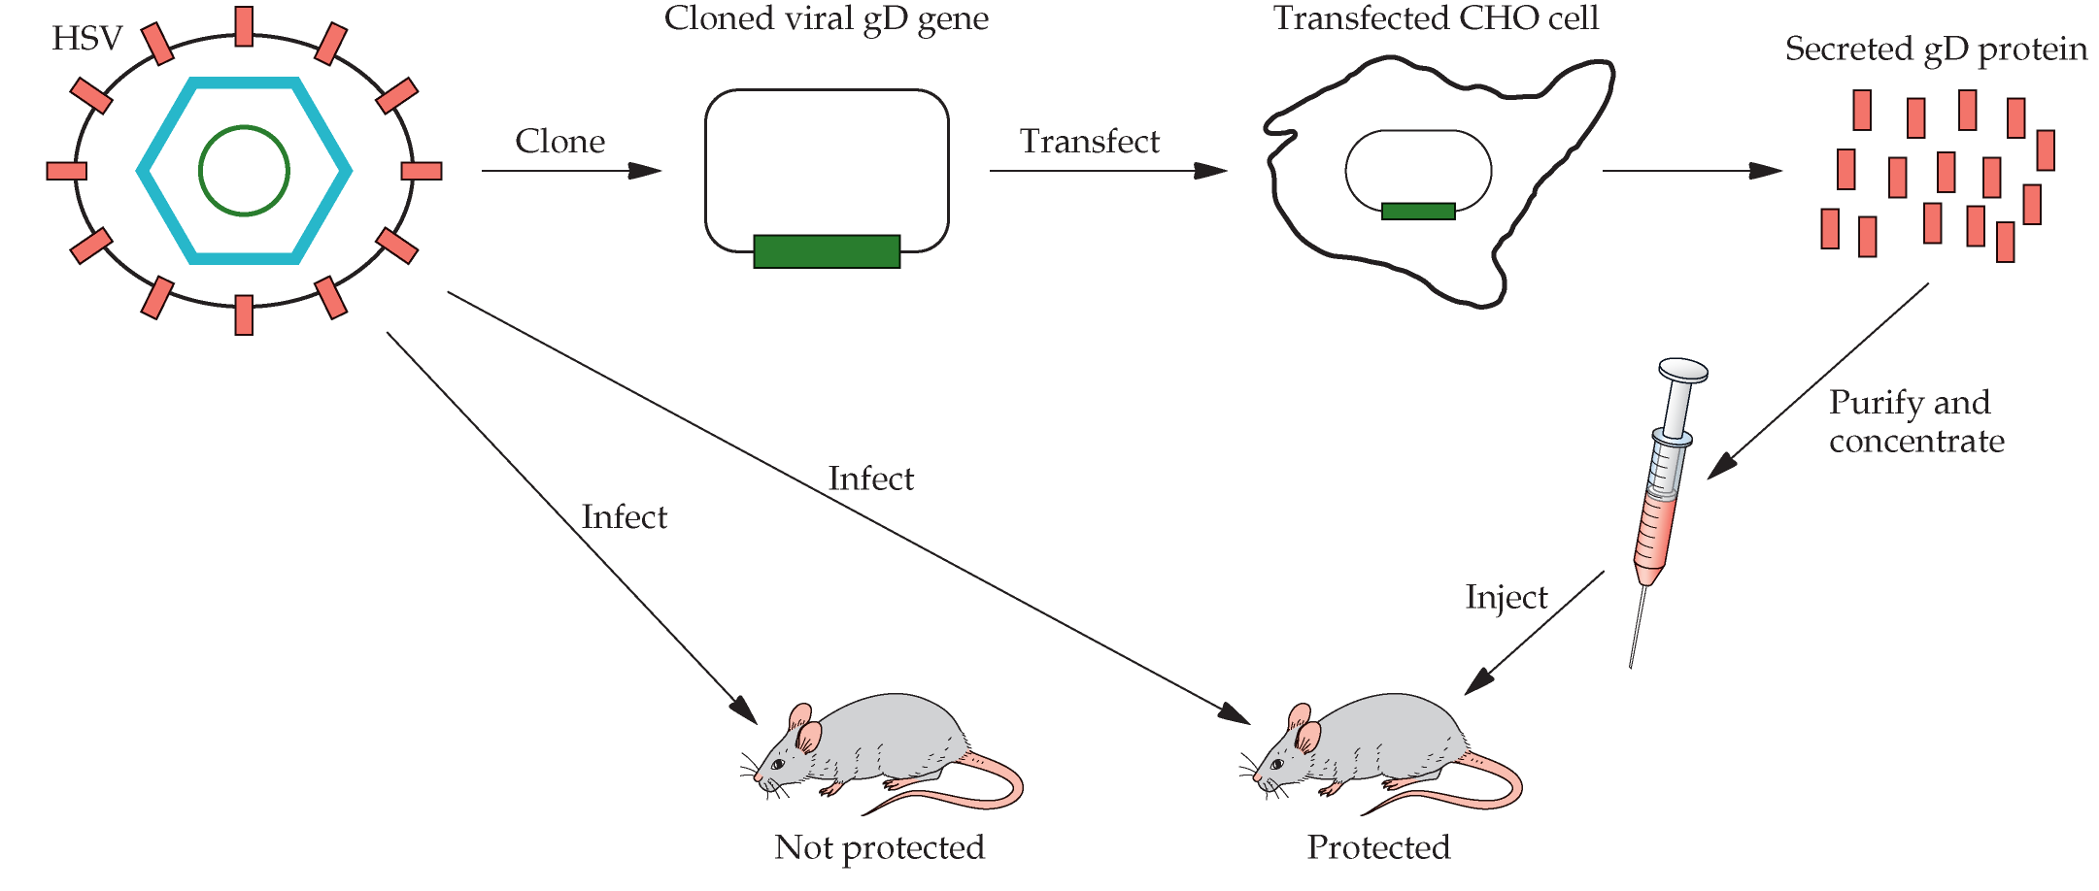
Figure below shows a subunit vaccine against Herpes Simplex Virus (HSV)

Slide 107
CHO cell = Chinese Hamster Ovary cell
gD = glycoprotein D
Glycoprotein D (gD) is a structural component of the herpes simplex virus (HSV) envelope which is essential for virus entry into host cells.
A similar approach was used to create a subunit vaccine against foot-and-mouth disease virus (FMDV) and Human Papillovmavirus (HPV)
FMDV has a devastating effect on cattle and swine
The successful subunit vaccine is based on the expression of the capsid viral protein 1 (VP1) as a fusion protein with the bacteriophage MS2 replicase protein in E. coli

Slide 108
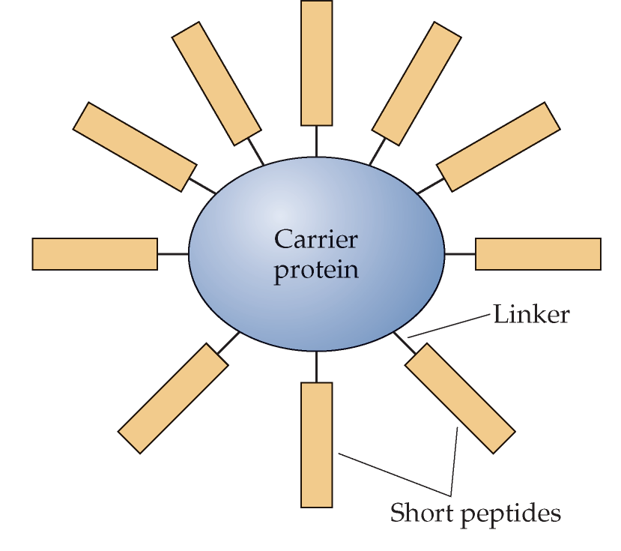
The FMDV genome consists of a 8kb ssRNA; a cDNA was made to this genome and the VP1 region identified immunologically
A subunit vaccine (Gardasil) was developed against Human Papillomavirus; this virus causes genital warts and is associated with the development of cervical cancers; used the capsid proteins from four HPVs
Figure above shows Structure of a peptide vaccine, representing yet another rDNA approach

Slide 109
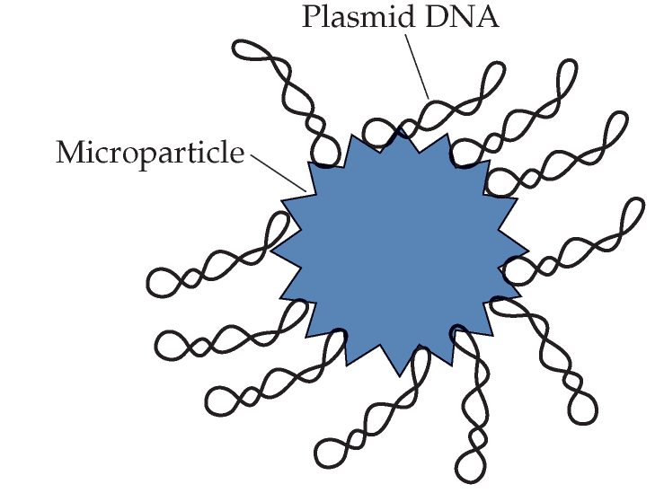
Figure below showsGenetic immunization: DNA vaccines represent another rDNA approach
A biolistic system or direct injection is used to introduce this DNA microparticle into animals

Slide 110
Attenuated vaccines
Attenuated vaccines traditionally use nonpathogenic bacteria or viruses related to their pathogenic counterparts
Genetic manipulation may also be used to create attenuated vaccines by deleting a key disease causing gene from the pathogenic agent
Example: the enterotoxin gene for the A1 peptide of V. cholerae, the causative agent of cholera, was deleted; the resulting bacteria was non-pathogenic and yet elicits a good immunoprotection (some side effects noted however)

Slide 111
Vector vaccines
Here the idea is to use a benign virus as a vector to carry your favorite antigen gene from some pathogenic agent
The vaccinia virus is one such benign virus and has been used to express such antigens
Properties of the vaccinia virus: 187kb dsDNA genome, encodes ~200 different proteins, replicates in the cytoplasm with its own replication machinery, broad host range, stable for years after drying

Slide 112
Stem cell research and its potential in medicine
It is a type of cell that can make any kind of cell required to build an organism.
When a stem cell divides, one new cell that results can remain a stem cell while the other new cell becomes an ordinary cell with a particular function in the organism.
Sometimes a stem cell that divides produces two identical stem cells.
With either process, stem cells can renew themselves indefinitely

Slide 113
By contrast, ordinary cells can only make copies of themselves when they divide and can only divide a limited number of times.
Sometimes a stem cell may divide into two ordinary cells, producing no more stem cells.
The ability of stem cells to produce new cells of specific types is of special interest to medical science.
Medical researchers and other scientists study stem cells to understand basic processes in cell development and disease.
The special properties of stem cells make them potentially powerful medical tools that could repair or replace diseased or injured tissues or organs in humans.

Slide 114
Research is usually done with stem cells from mice or from humans.
Types of stem cells
Two basic types of stem cells occur in humans and animals: embyronic stem cells and adult stem cells.
Embryonic stem cells have the potential to develop into any organ or type of tissue in the body.
This property is called pluripotency.
Embryonic stems cells exist in fully developing embryos for a limited period of time (about three weeks).

Slide 115
However, embryonic stem cells produced in laboratory conditions continue to divide and can be sustained almost indefinitely in nutrient cultures.
Adult stem cells, also called somatic stem cells, are found in humans and animals after birth and remain active in the body throughout a lifetime.
Adult stem cells can only turn into certain specialized types of cells.
Different types of adult stem cells act as a repair system and are able to replace such cells as blood cells, bone cells, or certain nerve cells in the body.

Slide 116
Cloning techniques to insert the nucleus from a skin cell from one individual into a human egg that has had its own nucleus with DNA removed.
The egg began to develop into a blastocyst with DNA matched to the new individual’s immune system.
The egg did not develop to the stage of producing embryonic stem cells, but this step may be reached in the future.
However, using a human egg carries similar ethical issues to using embryos, in the views of some people.

Slide 117
An important advance in the study of stem cells has been the genetic reprogramming of ordinary differentiated cells to act like embryonic stem cells.
In work first announced in 2007, viruses were used to insert genetic instructions into human skin cells that made the cells pluripotent (able to make all other types of cells), similar to embryonic stem cells.
However, using viruses carries the risk of tumors or cancer, and other, safer methods of reprogramming cells will need to be developed.
Other researchers have used cloning techniques to insert the nucleus

Slide 118
from a skin cell from one individual into a human egg that has had its own nucleus with DNA removed
The dominant view in the scientific community is that stem cell research has great scientific and medical promise for the understanding and treatment of a wide range of human diseases.
Scientists believe it should be possible to use stem cells to:
Study how body tissues develop and how disease takes hold.
Test the effects of experimental drugs on pure populations of specific differentiated cells, e.g. cardiac muscle cells.

Slide 119
Deliver gene therapy.
Generate healthy tissue and organs, which are genetically matched to patients, to replace damaged or diseased tissue.
Help develop cures for Parkinson’s disease, Alzheimer’s, stroke, arthritis, burns, spinal injury, multiple sclerosis, heart disease, diabetes and even perhaps some forms of cancer.
On the other hand, using stem cells for therapeutic purposes may have potential risks that:
-Viruses and other disease causing agents are passed on to people who receive cell transplants.

Slide 120
-Nutrients from animal sources currently used to cultivate stem cells could possibly pass disease on to humans.
-Stem cells may possibly turn cancerous.

Slide 121
Assignment 3
What is Hybridomas Technology?
What is the difference between Poly- Clonal Antibodies and Mono- Clonal Antibodies
Define Gene therapy and its application
List three types of Gene therapy
What is Organ/tissue transplantation?
What is Forensic medicine?

Slide 122
Agricultural biotechnology
Plant breeding is closely related to human prosperity, producing food, feed, fiber, and fuel.
It is also closely related to human socioeconomic development, from subsistence farming through stages of societal development to industrial farming and forestry.
Plant biotechnology developed swiftly during the last quarter of the 20th century.
With that, new tools have become available to plant breeding.

Slide 123
- Agricultural biotechnology includes plant breeding and life stock production.
- Plant breeding is the selection of plants with desired traits after sexual exchange of genes by hybridization between two genetically different pants.
There are two types of Plant breeding:
i . Conventional method
ii. Molecular breeding(biotechnological)

Slide 124
Convectional method
It is crossing:
a. Between individuals of the same variety(intravarietal)
b. Between individuals of different variety but the same spp.(intervarietal) hybridization
c. Between individuals of different spp. but the same genus (inter specific hybridization) (intra generic hybridization)
d. Between individuals of different spp. and different genera (inter generic hybridization, distant hybridization)

Slide 125
Objectives of plant breeding:
Crop improvement
- Production of new variety
- Improving existing variety
- yield and quality
- Resistant of pests
- diseases
- environmental stress

Slide 126
Draw backs of convectional plant breeding
a. Limited available gene pool: there is a restriction by the range of plants capable of sexual hybridization
b. Time consuming: commonly takes 10-15 years to get a new variety into farmers field
c. Plant management
d. Constraints of genetic frame work
Agricultural biotechnology could be used as an alternative method to overcome draw backs (limitation) of conventional plant breeding methodology.

Slide 127
Biotechnological methods of crop improvement
It includes:
i. Tissue culture
ii. Invitro fertilization and embryo rescue
iii. Protoplants culture and fusion (somatic cell hybridization)
iv. Genetic transformation
i. Tissue culture
It is a method of growing plant cells, tissues and organs in artificially prepared nutrient medium (static or liquid) under aseptic conditions

Slide 128
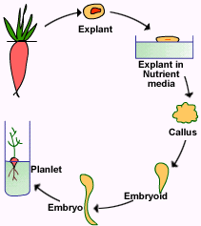
Plant cells are totipotent
Totipotency: ability of a cell or tissue or organ to grow and develop into a fully differentiated organism.

Slide 130
Plant tissue culture :
- callus culture
- Meristem culture
- Organ culture
Culture Media:
-Minerals, carbon source
and plant growth regulator

Slide 131
1. Callus culture
Callus is amorphous mass of cell
It is a common type of tissue culture
In a callus culture a cell or tissue is taken from any plant parts wounded Inoculated in a suitable medium under aseptic condition
Callus induced embroyoids plant lets whole viable plants

Slide 132
2. Meristem culture
Meristem is a localized region of continuing mitotic cell division
Are located- tip of shoot and root or apical meristem
- Axillaries marginal
Lateral
Or in any other growing points

Slide 133
Meristem culture medium a small plant bearing 5-6 leaves stem micro cutting into 5-6 pieces culture under favourable condition each micro cut become fully growing plant
3. Organ culture
In this method a particular organ is isolated and cultured under laboratory conditions in a chemically defined medium, where they retain their specific characteristics and continue to grow as usual
In this method organs are not induced to form callus.

Slide 134
Organ culture vegetative organ
Reproductive organ
vegetative organ are:
- root culture
- Leaf culture
- Shoot tip culture
Reproductive organ are:
- Complete flower culture
- isolated ovary culture

Slide 135
- isolated ovule and embryo culture
- Pollen mother cell culture
- Seed and fruit culture
It helps to define the nutrients and growth factors that are usually received by the organ from other organs and from the surrounding environment.
It also helps to understand the inter-dependence of organs with respect to various physical and chemical growth factors including growth hormones.

Slide 136
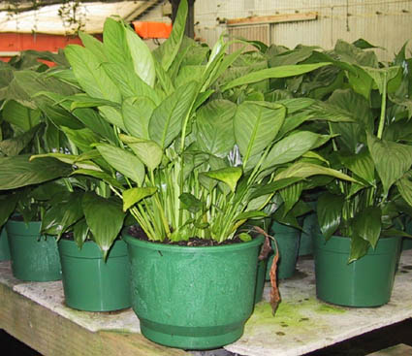
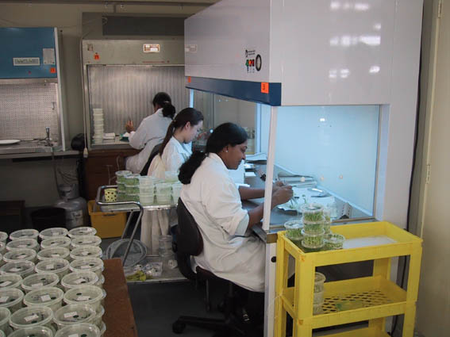
Culturing (micropropagating) Plant Tissue - the steps
Selection of the plant tissue (explants) from a healthy vigorous ‘mother plant’ - this is often the apical bud, but can be other tissue
This tissue must be sterilized to remove microbial contaminants

Slide 137
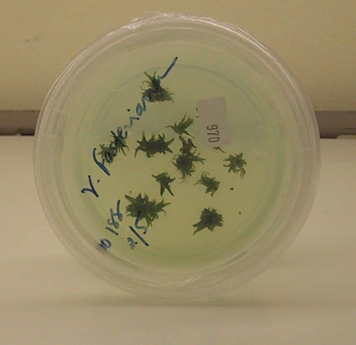
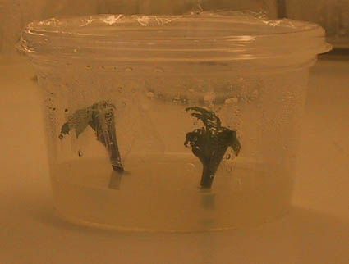
Establishment of the explants in a culture medium. The medium sustains the plant cells and encourages cell division. It can be solid or liquid
Each plant species (and sometimes the variety within a species) has particular medium requirements that must be established by trial and error

Slide 138
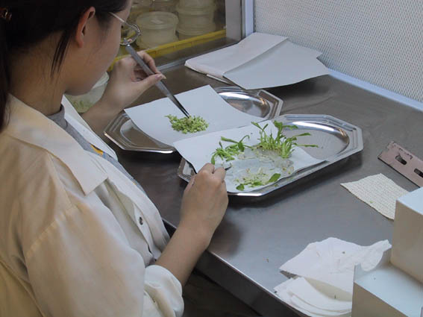
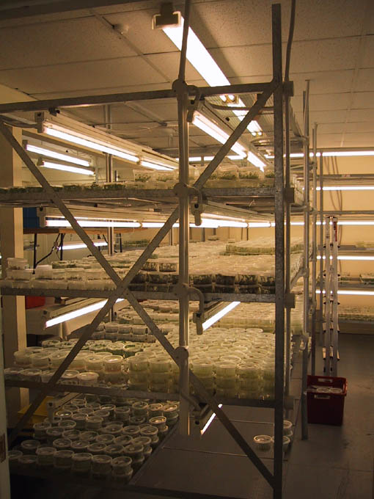
Multiplication- The explants gives rise to a callus (a mass of loosely arranged cells) which is manipulated by varying sugar concentrations and the auxin (low): cytokinin (high) ratios to form multiple shoots
The callus may be subdivided a number of times
Dividing shoots
Warmth and good light are essential

Slide 139
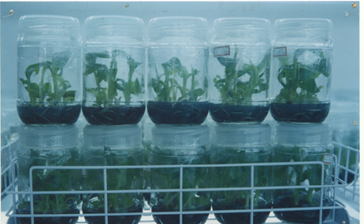
Root formation - The shoots are transferred to a growth medium with relatively higher auxin: cytokinin ratios
The bottles on these racks are young banana plants and are
growing roots

Slide 140
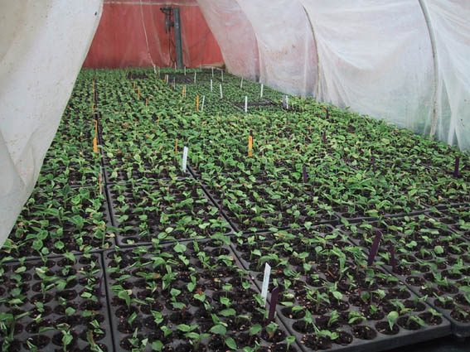
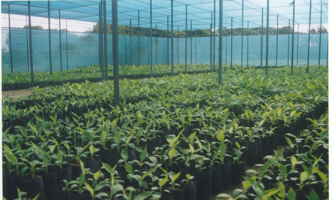
The rooted shoots are potted up (deflasked) and ‘hardened off’ by gradually decreasing the humidity
This is necessary as many young tissue culture plants have no waxy cuticle to prevent water loss
Tissue culture plants sold to
a nursery & then potted up

Slide 141
Steps in tissue culture (micro propagation)
Selection and sterilization of elite plant
Establishment of explants to invitro culture
Multiplication of explants in culture
Rooting of invitroplant
Transfer explants to the compost(acclimatization)
Application of tissue culture
Selection of somaclones resistant to herbicides
Production of specific pathogen free plants

Slide 142
Rapid introduction of new varieties of both ornamental and vegetable crops
Rapid bulking up of elite germ plasm.
In genetic manipulation and genetic engineering techniques

Slide 143
ii. Invitro (Artificial) fertilization and embryo rescue
In vitro culture is the culturing of cells, tissues and organs under aseptic laboratory conditions in culture media.
The culture medium generally contains the macronutrients and other supplementary materials like micronutrients necessary for plant growth and materials like vitamins, amino acids, carbohydrates and growth regulators.
Plant parts known as explants are cultured in the nutrient medium. Explants may be roots, cotyledons, leaves, shoots apices, nodal segments, anthers, embryos etc.

Slide 144
The explants are surface sterilized with disinfectants like sodium hypochlorite or mercuric chloride, washed with sterile water and cultured in the nutrient media at 25 ± 10℃.
This technique involves hybridization between economically important crop spp and their wide relative spp followed by excision and culturing of hybrid zygote embryo on nutrient media.
Embryo developed in distinct crosses, suffers from past fertilization developmental blocks.
This prevents the formation of normal seeds

Slide 145
The hybrid embryo or ovary can be rescued from damage (collapse) by excision and growing it in artificial media.
Embryo rescue techniques:
- embryo culture
- Embryo implantation
- Ovule culture
- Ovary culture

Slide 146
iii. Protoplast fusion ( somatic cell hybridization) (parasexual)
By employing conventional breeding techniques, it is not possible to obtain interspecific and intergeneric hybrids.
Therefore a protoplast fusion technique provides an opportunity to overcome this problem.
Protoplast : a plant cell from which cell wall is stripped off (removed)

Slide 147
Protoplast fusion involves three steps:
Isolation of the protoplast : plant tissue from two different sources (spp) are subjected to mixture of enzymes (cellulases pectinase in an osmotically stable solution such as sorbital and manital
Fusion of the protoplasts in the presence of fusains like polyethylene glycol
Culture of hybrid protoplast to regenerate whole plant.

Slide 148
Protoplast fusion (somatic cell hybridization) is used in creating new varieties.
The protoplast fusion may be of three kinds.
i. Spontaneous
ii. Mechanical
iii. Induced
- electro fusion
- Treatment with chemicals NaNO_{3,} polyethelene glycol (PEP)

Slide 149
Somatic hybridization needs the isolation' of intact protoplasts, the interparental 'fusion' of these naked cells, the 'sustained divisions' of fusion products before or after their 'selection' and the 'regeneration' of plants.
The somatic hybridization techniques should be used where sexual means do not function because of some form of incompatibility.
Also, one must clearly define what characters may be useful to manipulate by fusion and how such hybrids can be integrated in breeding programs.

Slide 150
Generally, wide hybridization in plants is used in order to integrate or incorporate valuable traits between species or in some cases even between genera.
It comes at the very beginning of a breeding program, generally to widen the scope of genetic variability, later selected for useful and balanced gene combinations.
Genetic engineering (production of genetically modified organisms) (GMO)
Transgenic crop plant: is transformed crop plant

Slide 151
Transgenic plant is a plant to which exotic (foreign) DNA or gene is integrated inserted in to its chromosome by transformation technique.
Transformation is a technique of transferring foreign gene into an organism by non-sexual means.
The DNA (gene) to transferred by non-sexual means may be from:
- plant, animal, bacterial, viruses
Methods of gene transfer
Agrobacterium mediated gene transfer
Direct gene transfer techniques
Gene transfer by micro infection

Slide 152
Gene transfer by using particle bombardment (gene gun method )
Gene transfer by electroporation
i. Agrobacterium mediated gene transfer
The bacterium that causes crown gall disease in plants.
Typically, when Agrobacterium tumefaciens bacteria enter a plant through a wound, they transfer the Ti plasmid into nearby plant cells.
The presence of this plasmid drastically changes the growth of the plant cells, resulting in the formation of a large tumor on the plant.

Slide 153
Scientists manipulate this natural process by removing the Ti plasmids from Agrobacterium tumefaciens cells to replace the plasmids’ tumor-causing genes with genes that code for desirable characteristics.
These recombinant plasmids are then introduced into plant cells to produce, for example, crop plants that are resistant to certain diseases, insect pests, or herbicides.
These techniques may someday be used to improve the nutritional value of food plants

Slide 154
Genetic information needed for crown gall development
The ability of Agrobacterium tumefaciens to induce crown gall disease in plants is controlled by genetic information called transferred DNA(T-DNA) carried on a large plasmid known as Ti plasmid (tumor inducing plasmid ).
During the transformation process, the T-DNA is excised from the Ti plasmid, transferred to plant cell and integrated into the chromosome of the plant cell.
The transformed cells lose control of mitotic cell division and proliferate continuously resulting in tumor formation

Slide 155
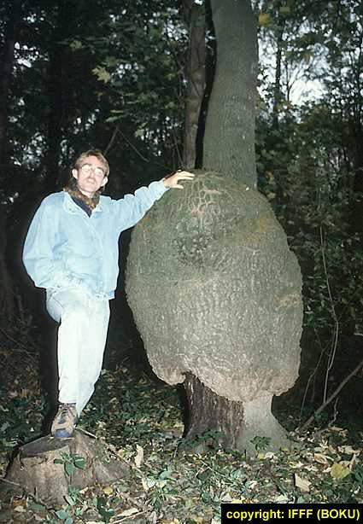
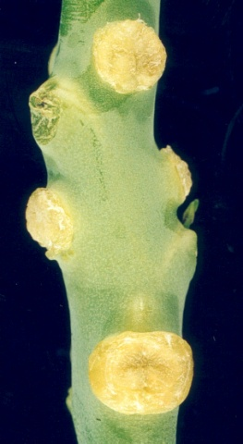
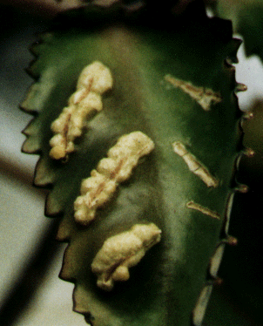
Limitation of Agrobacterium tumefaciens based on gene transfer
This technique is limited to Dicotyledons plants (limited host range)
It cannot be used for gene transfer in to monocotyledons plants.
Gall on
stem
Gall on
leaf

Slide 156
ii. Direct gene transfer techniques
It is a means of escaping host range limitations
iii. Gene transfer by Micro injection
The host cell is immobilized by applying a mild suction with a blunt pipette.
The foreign gene is then injected with a micro-injection needle.
Intra nuclear micro injection is direct physical approaches that overcome many of the biological and other obstacles.

Slide 157
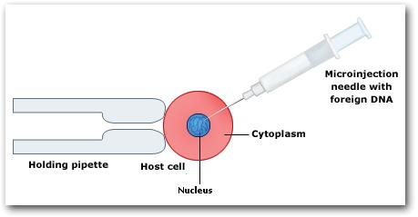
Gene transfer by Micro injection
Introduction of Foreign DNA in a Host Cell with a Microinjection Needle

Slide 158
It use fine capillary needle to deliver DNA (gene) precisely into the cell or even into the nuclei of cells in such a way that the cells are killed but survive the treatment and can develop into transgenic whole plant.
Draw backs
Only one cell is targeted per injection
Requires specialized skill and instruments
iv. Gene transfer using :
- particle bombardment

Slide 159
- Gene gun method
- Particle acceleration method
- Micro projectile method
The basic principles of this method are to use high velocity micro projection to incorporate the introduced gene.
The outer cell layers are penetrated in order to introduce genetic material in to the living cells.
The micro projectiles are usually DNA coated gold or tungsten particles, which accelerated to a high initial velocity of 1,400 ft per second.

Slide 160
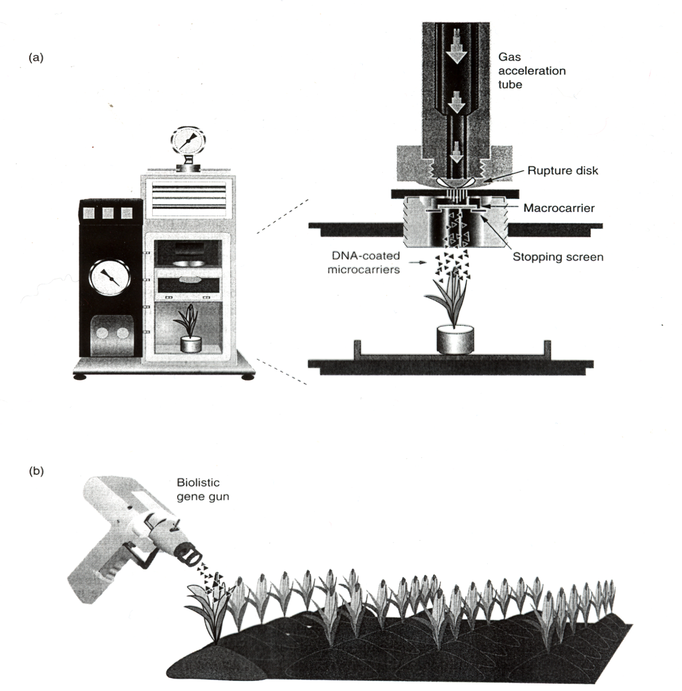
figure a and b shows Microp
Projectile bombardment

Slide 161
Draw backs of Gene transfer
Physical state and morphological character of the cell
The DNA carrying ability of the tungsten or gold particles
The degree of expression of the foreign gene in the bombarded cells.
v. Gene transfer by electroporation
This method uses an electrical pulse to introduce DNA into the cells
By introducing or exposing the cells to brief electric shock; the cells become temporarily permeable to DNA.

Slide 162
Application of biotechnology to livestock production
Improvement in efficiency of reproduction of farm animals
- Super ovulation
- Intro fertilization and embryo transfer
- Nuclear transfer
- Transgenic animal production and cloning
Improvement in yield of life stock products such as meat, milk, egg and wool.
Improvement in nutritive value of law quality feeds

Slide 163
- Modification of rumen microbial ecosystems to enhance cellulolytic activity
- Introduce enzymes capable of degrading the lingo-hemicelluloses complexes
Introduction of novel food (protein) sources
- Single cell proteins originating from the growth of micro organism.
Super ovulation: increased ovulatory response by external hormonal therapy.
e.g. varieties of gonadotrophine preparations isolated from pituitary tissue

Slide 164
Factors influencing super ovulatory response
Animal variability
Hormone variability
Animal variability : infertility
- Age
- Seasonal effect (during environmental stress)
- Repeat super ovulatory treatments

Slide 165
Invitrofertilization and embryo transfer
A technique that has been developed more recently than artificial insemination and provides a means for exploiting the genetic potential of the female rather than male.
In Invitro fertilization eggs are fertilized outside the body of the female in glass vessels for re introduction into the whomb (uterus)

Slide 166
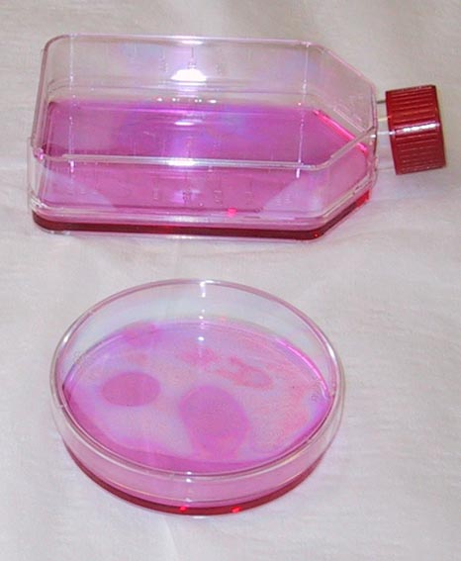
Culturing Animal Tissue- the Steps
Animal tissue is obtained either from a particular specimen, or from a ‘tissue bank’ of cryo-preserved (cryo = frozen at very low temperatures in a special medium)
Establishment of the tissue is accomplished in the required medium under aseptic conditions
Culture vessels and medium
for animal cell culture

Slide 167
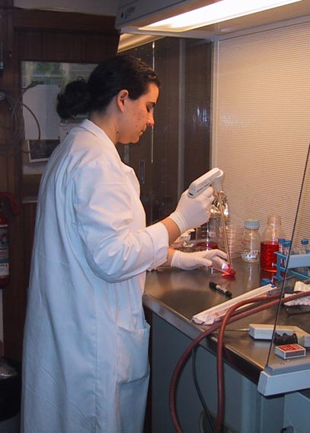
Culturing Animal Tissue, II
Growing the cells / tissue requires an optimum temperature, and subculturing when required
Human cells, for example are grown at 37degrees and 5% CO2
Incubator

Slide 168
Animal tissue/cell culture - differences from plant tissue culture
Animal cell lines have limited numbers of cell cycles before they begin to degrade
Animal cells need frequent subculturing to remain viable
Tissue culture media is not as fully defined as that of plants - in addition to inorganic salts, energy sources, amino acids, vitamins, etc., they require the addition of serum (bovine serum is very common, but others are used

Slide 169
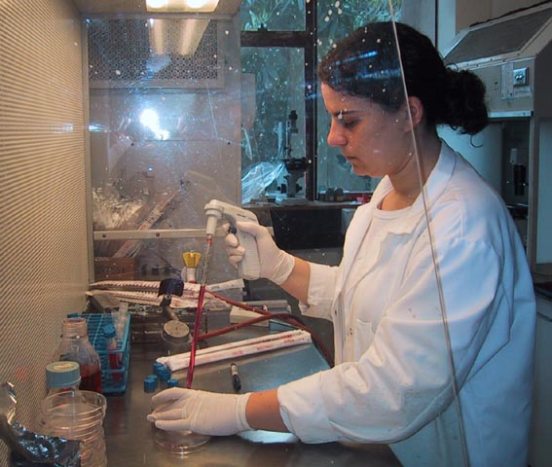
Animal tissue/cell culture - differences from plant tissue culture
Animal tissue cultures can pose biohazard concerns, and cultures require special inactivation with hypochlorite (e.g. Janola,Chlorox, etc.) and then incineration
Gloves and labcoat are
always worn
The pipettes are disposable

Slide 170
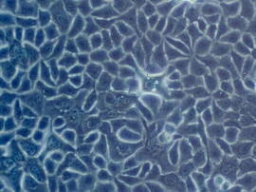
Uses of Animal Tissue Culture
Growing viruses - these require living host cells
Making monoclonal antibodies, used for diagnosis and research
Studying basic cell processes
Genetic modification & analysis

Slide 171
Knockout’ technology - inactivating certain genes and tracing their effects
Providing DNA for the Human Genome Project (and other species’ genome projects

Slide 172
Assignment 4
What is the role of Biotechnology in plant and animal breeding
Write the difference between Conventional method Molecular breeding (biotechnological)
Describe the following
i. Tissue culture
ii. Invitro fertilization and embryo rescue
iii. Protoplants culture and fusion (somatic cell hybridization)
iv. Genetic transformation
4. Write the differences between Animal tissue/cell culture - from plant tissue culture

Slide 173
Biotechnology in industry
Using cells and their products to manufacture things is called industrial biotechnology.
Putting them to work on preventing or cleaning up pollution caused by people’s activities is called environmental biotechnology.
Using cells effectively requires knowing a lot about them, including what they need to grow, how they produce the material we’re interested in, and what conditions make them produce more of it.
The study of all an organism’s genes is called genomics, and the study of all its proteins is called proteomics.

Slide 174
Genomics and proteomics produce mountains of important information about the cell.
Bioinformatics uses computers for organizing and analyzing all that information
Together, genomics, proteomics, and bioinformatics provide powerful insights into how cells work and how they can be made to work for us.
Industrial Biotechnology, also known as White Biotechnology, is the modern use and application of biotechnology for the sustainable processing and production of chemicals, materials and fuels.

Slide 175
Biotechnological processing uses enzymes and micro-organisms to make products in a wide range of industrial sectors including chemicals, pharmaceuticals, food and feed, detergents, paper and pulp, textiles, energy, materials and polymers.
Mankind has already benefited from biotech for a long time, but with the advance of new technologies and a much deeper understanding of cell metabolism and materials science, many new opportunities have been identified, and others are continuing to emerge.
A renewed interest in the sustainability of industrial processes has also contributed to biotechnology’s attractiveness.

Slide 176
All major facets of European society and economic activity, including agriculture, environmental protection and industry are being challenged to demonstrate their sustainability.
Industrial Biotechnology can make a major contribution.
For example:
Make agriculture (in its broadest sense, including forestry) more competitive and sustainable by creating new non-food markets;
improve the quality of life of European citizens while reducing environmental impact by developing innovative products at affordable costs; and

Slide 177
Help industry increase its economic and environmental efficiency (eco-efficiency) and sustainability, while maintaining or improving its competitive advantage and ability to generate growth.
White Biotechnology can make a positive impact across all three dimensions of inability: Society, the Environment and the Economy.
In short, Industrial Biotechnology is a cornerstone of the knowledge-based bio-economy.

Slide 178
It adds value to agricultural products and builds new industrial production schemes targeted towards an overall greater degree of sustainability.
The environment:
Benefits because biotechnological processes are efficient users of (often renewable) raw materials, creating little end-of-pipe waste, which itself can be often used as input into a further biological process.

Slide 179
At the same time, moving from chemical to biological processes can lead to significant reductions in carbon dioxide emissions, energy consumption and water use.
The economy:
A benefit as biotechnology enables the introduction of more efficient, less energy-intensive processes.
Already, fermentation and enzymatic processes are commonly used in the fine chemicals sector, to produce for example vitamins, pharmaceutical intermediates and flavours.

Slide 180
They are also making their first inroads into larger volume segments such as polymers, bulk chemicals and bio-fuels, and many other industrial sectors.
Together, these environmental and economic benefits will contribute towards a more sustainable society, with greater opportunities for job creation and retention, and a reduced dependence on fossil fuels.
Recovery and purification of recombinant proteins
A protein obtained by introducing recombinant DNA into a host (microorganism or yeast cell) and causing it to produce the gene product.

Slide 181
Basic steps to get recombinant Protein:
1. Amplification of gene of interest. ( Using PCR).
2. Insert into cloning vector.
3. Sub cloning into expression vector
4. Transformation into protein expressing bacteria (E coli) or yeast.
5. Test for identification of recombinant protein. (Western blot or Fluoroscence)
6. Large scale production. (Large scale fermentor)
7. Isolation and purification.

Slide 182
Isolation of protein:
Disruption of cells: Osmotic
Chemical
Enzymatic
Mechanical
Clarification: Centrifugation
Filtration
Concentration: Precipitation
Ultra filtration

Slide 183
The design of a biochemical separation
Ion exchange chromatography, in common with other separation techniques in the life sciences, is rarely sufficient as the sole purification stage in the separation or analysis of complex biological samples.
Ion exchange is frequently combined with other techniques which separate according to other parameters such as size (gel filtration), hydrophobicity (hydrophobic interaction chromatography or RPC) or biological activity (affinity chromatography).

Slide 184
Ion exchange chromatography has been used successfully to separate all classes of charged biological molecules.
The following are some representative examples.
  a. Enzymes
  b. Isoenzymes
  c. Immunoglobulins
  d. Nucleic acid separation
  e. Polypeptides and polynucleotides

Slide 185
Enzymes
  In the purification of biologically active proteins such as enzymes the recovery of biological activity is usually as important as the recovery of protein mass or degree of homogeneity.
  Ion exchange chromatography has played a role in the purification of thousands of enzymes, and using modern matrices with optimized separation conditions gives extremely high recoveries.
Notes:
Many enzymes consist of a protein and a non-protein (called the cofactor). The proteins in enzymes are usually globular. ... cations - positively charged metal ions (activators), which temporarily bind to the active site of the enzyme, giving an intense positive charge to the enzyme's protein.

Slide 186
Isoenzymes
Normally the isoforms of an enzyme have approximately the same molecular weight.
This makes their separation impossible by gel filtration. However, the small differences in charge properties resulting from altered amino acid composition enable the separation of isoenzymes using ion exchange chromatography.
Immunoglobulins
Ion exchange is frequently used for the purification of immunoglobulins.
Notes:
each of two or more enzymes with identical function but different structure.
Immunoglobulins, also known as antibodies, are glycoprotein molecules produced by plasma cells (white blood cells).

Slide 187
Nucleic acid separation
Nucleic acids, being charged molecules, can also be fractionated and purified using ion exchange chromatography.
A recent application of the technique in this area is the purification of plasmids from bacterial cultures.
This process is traditionally done by centrifugation using CsCl gradients.
Polypeptides and polynucleotides
Ion exchange chromatography is not limited in its application to macromolecules such as proteins and nucleic acids.

Slide 188
The technique can be used in the separation of peptides as illustrated by the separation of cyanogen bromide fragments of collagen
Gel filtration
Gel filtration chromatography (sometimes referred to as molecular sieve chromatography) is a method that separates molecules according to their size and shape
Gel filtration is the simplest and mildest of all the chromatography techniques and separates molecules on the basis of different in size.
The separation of the components in the sample mixture, with some exceptions, correlates with their molecular weights.

Slide 189
In these cases, gel filtration can be used as an analytical method to determine the molecular weight of an uncharacterized molecule.
Gel filtration is also an important preparative technique since it is often a chromatographic step in the purification of proteins, polysaccharides and nucleic acids.
The gel filtration matrix consists of microscopic beads that contain pores and internal channels.
Two Gel Filtration Calibration Kits are available for protein molecular weight determination by gel filtration.

Slide 190
The Low Molecular Weight Kit contains 5 proteins with molecular weights in the range 6500 to 75 000 and Blue Dextran 2000.
The High Molecular Weight Kit contains 5 proteins with molecular weights in the range 44 000 to 669 000 and Blue Dextran 2000.
The use of gel filtration chromatography for the determination of the molecular weight and size of proteins is well documented.

Slide 191
Enzyme Technology
The study of industrial enzymes and their uses is called enzyme technology.
For thousands of years natural enzymes made by microorganisms have been used to make products such as cheese, bread, wine, and beer.
Enzymes are now used in a wide range of industrial processes.
Microbes are the most common source of industrial enzymes.

Slide 192
Microorganisms produce enzymes inside their cells (intracellular enzymes) and may also secrete enzymes for action outside the cell (extracellular enzymes).
The microorganisms selected are usually cultured in large fermentation chambers (known as fermenters) under controlled conditions to maximise enzyme production.
The microorganisms may have specific genes introduced into their DNA through genetic engineering.
The advantages and disadvantages of using enzymes are directly related to their properties:

Slide 193
Advantages | Disadvantages
They are specific in their action and are therefore less likely to produce unwanted by-products | They are highly sensitive to changes in physical and chemical conditions surrounding them.
They are biodegradable and therefore cause less environmental pollution | They are easily denatured by even a small increase in temperature and are highly susceptible to poisons and changes in pH. Therefore the conditions in which they work must be tightly controlled
They work in mild conditions, i.e. low temperatures, neutral pH and normal atmospheric pressure, and therefore are energy saving | The enzyme substrate mixture must be uncontaminated with other substances that might affect the reaction.

Slide 194
Growing microbes in a fermenter
A suitable nutrient medium and the right conditions (temperature, pH, oxygen levels (many microbes are obligate anaerobes, i.e. are killed by oxygen)
It is easy to grow microbes on a laboratory scale in Petri dishes, test tubes and flasks.
However, producing substances such as penicillin from microbes on an industrial scale causes serious problems because massive numbers of organisms have to be grown for commercial use.

Slide 195
The microorganisms are grown in very large vessels called fermenters – as shown in this simplified diagram:

Slide 196
The large stainless steel cavity is filled with a sterile nutrient solution, which is then inoculated with a pure culture of the carefully selected fungus or bacterium.
Paddles rotate the mixture so that the suspension is mixed well. As the nutrients are used up, more can be added.
Probes monitor the mixture and changes in pH, oxygen concentration and temperature are all computer controlled.
A water jacket surrounding the fermenter contains fast flowing cold water to cool the fermenter since fermentation is a heat generating process.

Slide 197
Isolating the Enzyme
Pure enzymes are needed for commercial use; therefore microbes must be grown in aseptic conditions, free from contaminants such as unwanted chemicals and other microbes.
It is necessary to prevent contamination with other bacteria since:
- there may be competition for nutrients;
- the required enzyme may not be produced as readily;
- The end-product may be contaminated and unsafe.

Slide 198
The required enzyme that is finally produced must also be isolated from the microbial cells.
Extracellular enzymes are present in the culture outside the microbial cells, since they have been secreted.
They are often soluble in water, so they can readily be extracted from the culture medium and purified.
Less common in Nature (though genetic engineering can be used to modify cells to promote this), these enzymes are cheaper to produce and tend to be more stable they are therefore the preferred choice, when available!

Slide 199
To obtain an intracellular enzyme, the microbe cells are harvested (by filtration or centrifugation) from the culture and are then broken up.
The mixture is next centrifuged to remove large cell fragments and the enzymes (all of them!) are precipitated from solution by a salt or alcohol.
The required enzyme must then be purified by techniques such as electrophoresis or column chromatography.

Slide 200
Applications of enzymes in industry
Historically, three examples of the industrial use of microbes (and their enzymes) are:
- Brewing
- Vinegar production
- Yoghurt production
Brewing
In which yeast (Saccharomyces cerevisiae) reacts with the sugars in fruit or malted barley to produce ethanol and carbon dioxide.

Slide 201
In Nature, the yeast is competing with bacteria for the available sugar in the wild fruit.
Its response is a form of ‘chemical warfare’, since the ethanol it makes it poisonous to many bacteria and, indeed, ethanol can be used as a disinfectant (though it stings a lot!).
The process of fermentation takes several days or weeks and results in a product with a maximum alcohol content of about 12% - above which the yeast is itself killed.
More alcoholic beverages can only be made by distilling the raw brew. From wine we get brandy, cider gives Calvados, ale gives whisky.

Slide 202
Vinegar production
sour-tasting condiment and preservative prepared by two successive microbial processes, the first being an alcoholic fermentation effected by yeasts and the second an oxidation of alcohol by Acetobacter, a genus of aerobic bacteria.
To make vinegar, wine is slowly pored over oak chips in a tall tower, open to the air.
Bacteria (Acetobacter) on the wood oxidise the ethanol in the wine and turn it into ethanoic acid or vinegar, giving out a great deal of heat as well.

Slide 203
Immobilized enzymes
Immobilized enzymes are used in organic syntheses to fully exploit the technical and economical advantages of biocatalysts based on isolated enzymes.
Immobilization enables the separation of the enzyme catalyst easily from the reaction mixture, and can lower the costs of enzymes dramatically.
This is true for immobilized enzyme preparations that provide a well balanced overall performance, based on reasonable immobilization yields, low mass transfer limitations, and high operational stability.

Slide 204
There are many methods available for immobilization which span from binding on prefabricated carrier materials to incorporation into in situ prepared carriers.
Operative binding forces vary between weak multiple adsorptive interactions and single attachments through strong covalent binding.
Which of the methods is the most appropriate is usually a matter of the desired applications.

Slide 205
Strategies for the production of stable biocatalysts
Screening for intrinsically stable biocatalysts is a prominent area of research in biocatalysis.
Research on extremophiles, i.e. organisms able to survive and thrive in extreme environmental conditions, as promising sources for highly stable enzymes is a very active research subject at present.
Those conditions (extreme temperatures, extreme pHs and aggressive chemicals) may be present in the reaction medium,

Slide 206
being then fruitful to produce enzymes suited to express and retain their activities in such conditions
Biocatalyst thermostability allows a higher operation temperature, which is clearly advantageous because of a higher reactivity (higher reaction rate, lower diffusional restrictions), higher stability, higher process yield (increased solubility of substrates and products and favorable equilibrium displacement in endothermic reactions), lower viscosity and fewer contamination problems

Slide 207
Genetic engineering and protein engineering are modern techniques already in use for the commercial production of biocatalysts of improved stability, not only to high temperatures, but also to extremes of pH, oxidizing agents and organic solvents.
Cloning and expression in suitable hosts is being used routinely by major enzyme production companies to produce improved biocatalysts; this certainly applies to the cloning of thermostable enzyme genes.
Protein engineering is also being used to obtain improved biocatalysts, the case of alkaline protease being a paradigm.

Slide 208
Already in the market, thermostable proteases capable to withstand harsh washing conditions (high pH, high concentration of strong oxidants) are products of protein engineering produced by point aminoacid substitutions in the most labile region of the molecule

Slide 209
Assignment 5
Write the deference between green, red and white Biotechnology
Write the deference between intracellular enzymes and extracellular enzymes.

