Slide 1
CHAPTER FIVE
In Small Business

Slide 2
Outline
Definition of Marketing
Marketing Mix Elements
Market Segmentation
Competitive Analysis
Marketing Strategies
International Marketing

Slide 3
5.1 An overview of Marketing
“Marketing is a societal process by which individuals or groups obtain what they need and want through creating, offering and freely exchanging products and services of value with other”. Philip Khotler
“Marketing as knowing and understanding the customer so well that the product or service fits him and sells itself.” Piter Druker
“Marketing is a set of processes for creating, communicating and delivering value to customers and for managing customer relationships in way that benefit the organization and its stakeholder.” AMA

Slide 4
Marketing is the process of satisfying the organization’s stakeholders and creating value for these stake-holders.
Stakeholders are persons or organizations that have a relationship with the organization. Every organization has a different set of stakeholders.
The success of a company is determined to a large degree by how it manages and satisfies the relationship with its stakeholders.

Slide 5
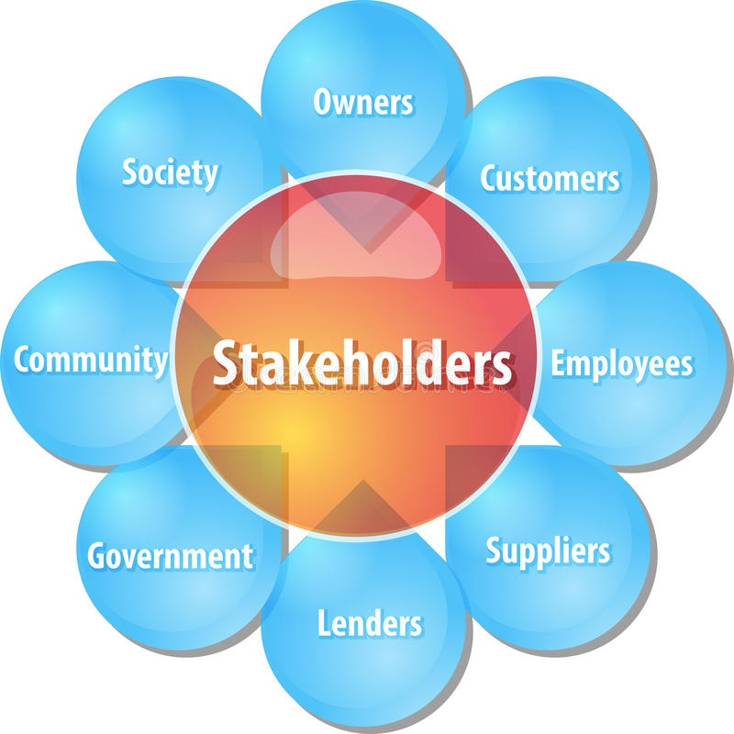
Typically stakeholders are ….

Slide 6
Marketing is to deliver satisfaction and value to all of its stakeholders so concern and a responsibility for marketing is must. Therefore The firm must know :
what its stakeholders want
An efficient way of delivering satisfaction,
How to do all these things without upsetting any one in its sphere. It is a balancing act.
For example: the firm drop the price and make its customers happy, but shareholders unhappy, and employees are upset because they will not receive their annual bonus due to low profits.

Slide 7
5.2 The Marketing Mix Elements
Product: is anything that can be offered to a market to satisfy a want or need. Products include physical goods, services, experiences, events, persons, places, properties, organizations, information, and ideas.
It includes physical objects or services being sold, together with: packaging, image, brand name and warranty and, physical attributes that influence consumer’s perceptions such as: colors, shapes, sizes and materials.

Slide 8
Price: is the monetary unit required for a purchase, and from an entrepreneur’s view point, it is the unit of income ( it is the only element in the marketing mix that produces revenue)
It is the amount of money charged for a product, It communicates information about the products value, image and competition.
Promotion: is the act of communication that provides consumers with information about a company’s products, its services or the venture itself.
It includes: advertising, personal selling, direct marketing, public relations.

Slide 9
Distribution: is concerned with how products or services are made available to customers. Distribution can mean the physical channels or transporting products from manufacturers to end user.
It includes agents, wholesalers, retailers and etc…

Slide 10
5.3 Market Segmentation
Market segmentation is breaking down a market into groups of customers with similar characteristics.
The key for most small firms is to concentrate their efforts and resources on one or more closely defined market segments.
Research studies show a relationship between profitability and firms that do this and thereby gain a high share of that market segment.
Basis for segmentations are geographic, demographic, psychographic and behavioral.

Slide 11
5.4 Marketing Strategies for MSEs
5.4.1 Market Research in the Pre-Start-Up Phase
Before entrepreneurs actually commit themselves to opening a business they have to answer the following:
Who Is the Customer? A clear profile of potential customers is a basic element of market research. Customers may be young or old, married or single, teachers or students, homeowners or renters, poor or wealthy.
This identification of the customers can be done through geographic, demographic, psychographic and behavioral. segmentation basis.

Slide 12
Where Is the Market? Part of the customer scenario will involve locating the potential customer base. This helps to get the advantage of location and making arrangements to make the products easily accessible/available for the customers.
Concerning this activity, it also helps to
determine the market size and changes
determine the potential for current and future sales, to
identify local market characteristics that differ significantly because of population size, economic development, industrial profile, ethnic groups, weather, legislation and culture.

Slide 13
Who are the Market Players (Competitors)? Helps to identify both the existing competitors and potential that provide substitute products.
When the firm studies the competitors, it identifies the weak side they have and their strong side.

Slide 14
5.4.2 Competitive Analysis: Research after Start Up
A competitive analysis is essentially a structured method of examining an organization or industry in order to provide a clear understanding of the factors that affect a business.
Michael Porter’s (Competitive Strategy) five forces model of competition

Slide 15
The Threat of Entry: A segment's attractiveness varies with the height of its entry and exit barriers.
The most attractive segment is one in which entry barriers are high and exit barriers are low. Here few new firms can enter the industry, and poor performing firms can easily exit.
When both entry and exit barriers are high, profit potential is high, but firms face more risk because poorer-performing firms stay in and fight it out.
When both entry and exit barriers are low, firms easily enter and leave the industry and the returns are stable and low.
The worst case is when entry barriers are low and exit barriers are high: Here firms enter during good times but find it hard to leave during bad times.

Slide 16
So, what is the threat of other companies entering the industry? Some points to be considered are:
Capital requirements: If the type of business requires a large critical capital investment, fewer entrepreneurs are likely to enter the industry.
Economies of scale: Due to mass scale production, the cost of production can be minimized, which benefits the firm.
Distribution systems: Lacking established distribution systems or access to them is a major barrier to new entrants.
Differentiation: extent to which an enterprise can establish a brand image, service, product innovation, or reputation describes its differentiation or distinct competency.

Slide 17
2. The Power of Buyers:
A segment is unattractive if buyers possess strong or growing bargaining power.
Buyers' bargaining power grows when:
they become more concentrated or organized,
the company get significant profit from such buyers,
the product is undifferentiated,
when the buyers' switching costs are low,
when buyers are price sensitive
when buyers are relatively large and command a high percentage of the smaller company’s sales, the buyers exercise negotiating power; entrepreneurs become price takers.

Slide 18
3. The Power of Suppliers: A segment is unattractive if the company's suppliers are able to raise prices or reduce quantity supplied.
The fewer suppliers there are, and the more you need their help, the stronger their position and their ability to charge you more. That can impact your profit.
Suppliers tend to be powerful when
they are concentrated or organized,
when there are few substitutes,
when the supplied product is an important input, when the costs of switching suppliers are high,
and when the suppliers can integrate downstream

Slide 19
4. The Threat of Substitutes: A segment is unattractive when there are actual or potential substitutes for the product.
Substitutes place a limit on prices and on profits.
If technology advances or competition increases in these substitute industries, prices and profits in the segment are likely to fall.
A substitution that is easy and cheap to make can weaken your position and threaten your profitability.

Slide 20
5. Competitive Rivalry: A segment is unattractive if it already contains numerous, strong, or aggressive competitors.
It is even more unattractive:-
If market is stable or declining,
If plant capacity additions are done in large increments,
If fixed costs are high,
If exit barriers are high,
If competitors have high stakes in staying in the segment. These conditions will lead to frequent price wars, advertising battles, and new product introductions, and will make it expensive to compete.
The extent to which an enterprise faces competitive rivalry is partially the result of a combined effort of the other four forces.

Slide 21
5.5 Marketing Strategies: A marketing strategy is a formulated plan that describes how a new venture will compete.
It focuses on the enterprises activities related to competing in its market niche. subsequently providing guidelines for decisions about strategic objectives, allocation of resources, and responsibilities required to implement a marketing plan.
Strategic Objectives: Entrepreneurs should be able to establish objectives that can be easily measured.

Slide 22
Several types of objectives can be considered with similar measurable criteria this are:-
Growth: is measured through sales activities and should be expressed in terms of sales or units sold.
Profitability: In a business where prices and costs are sensitive, an entrepreneur will want to track “return on sales” to monitor the gap between income and expenses, and calculate a targeted “rate of return” on assets, equity and investments. Most companies can use these criteria to indicate how well they are utilizing assets to generate sales.

Slide 23
Customer Service: define how the enterprise will serve customers, in terms of product quality, diversification, or innovation.
Human Resources: Most excellent companies have this objectives such as helping employees to improve their career opportunities, or improving performance through job skill training.

Slide 24
General Approaches to Strategy:
Small business must first establish the fundamental business endeavor. Once established, a venture may be positioned to diversify into new products or markets. These strategies are called product or market diversification.
A vertical integration is a strategy of expanding backward into the vendor chain to secure resources, or of reaching forward into distribution channels to consolidate intermediaries.

Slide 25
The primary strategies for new ventures are shown below.
Concentration: An intense growth can be achieved through “market penetration” tactics that include low prices, widespread advertising, and sales promotions. Growth can also be achieved by concentrating on a specific market with high-priced goods for select clients in up market locations.
New market development: Another method of intense growth is to develop several closely associated markets.
New Product Development: A third alternative is product diversification which means to develop new products or services that are closely associated with existing product and services.

Slide 26
5.6 International Markets
International marketing is the multinational process of planning and executing the conception, pricing, promotion, and distribution of ideas, goods, and services to create exchanges that satisfy individual and organizational objectives.
International marketing is nothing but domestic marketing on a larger scale.

Slide 27
Domestic marketing involves one set of uncontrollable derived from the domestic market.
International marketing is much more complex because a marketer faces two or more sets of uncontrollable variables originating from various countries.
The marketer must cope with different cultural, legal, political, and monetary systems.

Slide 28
The Company is subject to the risks of doing business internationally, including:-
Unexpected changes in regulatory requirements,
ﬂuctuations in foreign currency exchange rates,
Imposition of tariffs and other barriers and restrictions,
The burdens of complying with a variety of foreign laws,
General economic and geopolitical conditions, including inﬂation and trade relationships.

Slide 29
A firm’s marketing mix is determined by the uncontrollable factors within each country’s environment as well as by the interaction between the sets.
For optimum results, a ﬁrm’s marketing mix may have to be modiﬁed to conform to a different environment, though wholesale modiﬁcation is not often necessary.

