Slide 1
Chapter Four
4. Product Concept

Slide 2
Product
In marketing, a product is anything that can be offered to a market to satisfy a need or want.
Product is anything that can be offered to a market for attention, acquisition, use or consumption
People satisfy their needs and wants with marketing offerings.
Product is a problem solver , what we sell should match with what customers want.
It can be the combination of 10 basic entities that marketers offer to the market like goods, services, experiences, events, persons, places, properties, organizations, information, and ideas.

Slide 3
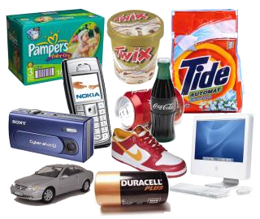
Goods:- are commodities, or tangible items that satisfies some human needs and want.
Services:- are intangible
Things of value that satisfies
human needs and wants .

Slide 4
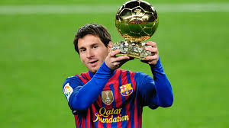
Experience:- by organizing several
services and goods, one can create,
stage, and market experiences.
Persons :- Due to a rise in testimonial advertising, celebrity, marketing has become a business.

Slide 5
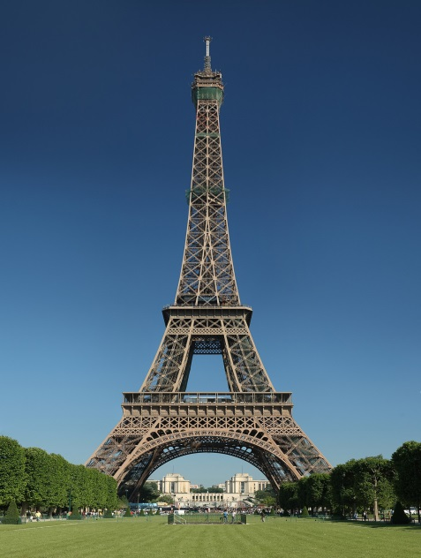
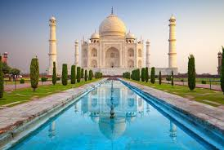
Places:- Cities, states, regions, and countries compete to attract tourists.
Properties:- can be categorized as real properties or financial properties. Real property is the ownership of real estates, whereas financial property relates to stocks and bonds.

Slide 6
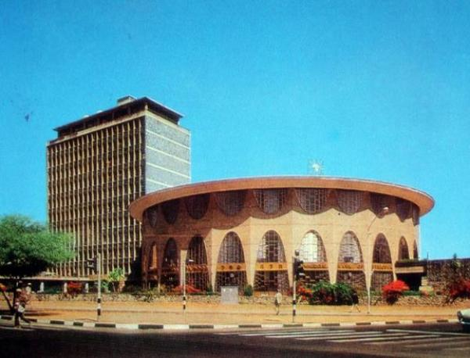
Events:- can be trade shows, company anniversaries, entertainment award shows, sporting events, health camps, and so on.
Organizations:- actively work to build image in the minds of their target public.

Slide 7
Information:- can be produced and marketed as a product. Educational institutions, encyclopedias, non-fiction books, specialized magazines and newspapers market information.
Idea:- Every market offering has a basic idea at its core.

Slide 8
4.4 Product Planning and Development Process
Once ideas emerge from idea sources or creative problem solving, they need further development and refinement into the final product or service to be offered.
This refining process – the product planning and development process – is divided into five major stages

Slide 9
Commercialization stage
Idea stage
Concept stage
Prod’t Deve’t stage
Test mkt stage
Introduction | Growth | Maturity | Decline
Fig 4.1 Product planning and development process

Slide 10
Establishing Evaluation Criteria
At each stage of the product planning and development process, criteria for evaluation need to be established.
These criteria should be broad, yet quantitative enough-to screen the product carefully in the particular stage of development.
Criteria should be developed to evaluate the new product in terms of- market opportunity, competition, the marketing system, financial factors, and production factors.

Slide 11
Cont’d
The determination of market demand is by far the most important criterion of a proposed new product idea.
Assessment of the market opportunity and size needs to include consideration of the following:
The characteristics and attitudes of consumers
The size of this potential market in dollars or units
The nature of the market with respect to its stage in the life cycle -growing or declining)
The share of the market the product could reasonably capture

Slide 12
Cont’d
The new product should be compatible with existing management capabilities and marketing strategies.
The proposed product should be able to be supported by and contribute to the company‘s financial structure.
This should be evaluated by:
Estimating manufacturing cost per unit
Sales and advertising expense per
Amount of capital and inventory required.

Slide 13
New product development process
1. Idea Stage
New product development starts with idea generation.
2. Concept Stage
The refined product idea is tested to determine consumer acceptance without necessarily incurring the costs of manufacturing the physical product.
The concept are obtained from potential customers or members of the distribution channels.
Conversational interview about he physical characteristics and attributes of the product idea.

Slide 14
The relative advantage of the new product versus competitive products can be determined through the following questions.
How does the new concept compare with competitive products in terms of quality and reliability?
Is the concept superior or deficient compared with products currently available in the market?
Is this a good market opportunity for the firm?
Similar evaluations should be done for each of the remaining aspects of the product, price, promotion, and distribution.

Slide 15
3. Product Development Stage
Determine consumer reaction to the physical product by using consumer panel.
The panel of potential customers can also be given a sample of the product
Risk analysis, level of repeat purchases, or intensity of preference analysis.
4. Test Marketing Stage
A market test can be done to increase the certainty of successful commercialization.
This last step in the evaluation process, the test marketing stage, provides actual sales results

Slide 16
5. Commercialization Stage
At this stage the product will be offered for the market and hereafter the product may pass through additional four stages:
Introduction
Growth
Maturity Product life cycle
Decline

Slide 17
Product life cycle
Introduction Stage
This stage starts when the new product is first launched.
It takes time and sales growth is apt to be slow.
Profits are negative or low
Require much money to attract distributors and build their inventories.
Promotion spending is relatively high

Slide 18
Marketing Strategy
Firms focus their selling on those buyers who are the most ready to buy.
Continuously formulate new pricing, promotion and other marketing strategies
The firm has the best chance of building and retaining market leadership

Slide 19
2. Growth Stage
If the new product satisfies the market, it will enter a growth stage, in which sales will start climbing quickly.
New competitors will enter the market, because of the attractions by opportunities for profit.
In this case, firms will introduce new product features, and the market will expand.

Slide 20
Cont’d
Prices remain where they are or fall only slightly.
Companies keep their promotion spending at the same or a slightly higher level.
Profits increase during the growth stage, as promotion costs are spread over a large volume and as unit manufacturing costs fall.

Slide 21
Marketing Strategy
The firm uses several strategies to sustain rapid market growth through:
By improving product quality and adds new product features and models.
By entering new market segments and new distribution channels.

Slide 22
Cont’d
By shifting some advertising from building product awareness to building product conviction and purchase
By lowering prices at the right time to attract more buyers.
By spending a lot of money on product improvement, promotion and distribution, the company can capture a dominant position

Slide 23
C. Maturity Stage
Slowdown in sales growth
Marking down prices
Increasing their advertising and sales promotion
Upping their R&D budgets to find better versions of the product.

Slide 24
Cont’d
This step leads to:
Drop in profit
Some of the weak competitors start dropping out
The industry eventually contains only well-established competitors.
Marketing strategy
Looks for new users and market segments.
Modify characteristics of the product like quality, features, or styles to attract new users and to inspire more usage.

Slide 25
Cont’d
The company try to modify the marketing mix
It can cut prices to attract new users and competitor‘s customers.
It can launch a better advertising campaign or use aggressive sales promotion, trade deals, cents-off, premiums, and contests.

Slide 26
Cont’d
It can also move in to larger market channels, using mass merchandisers, if these channels are growing.
Finally the firm can offer new or improved services to buyers.

Slide 27
D. Decline Stage
Sales decline for many reasons including due to:
Technological advances
Shifts in consumer
Tastes or increased competition
As sales and profits decline, some firms withdraw from the market. In this case, carrying a weak product can be very costly to a firm

Slide 28
Product protection
One of the challenges the beginner entrepreneur will face as he/she goes into business understands the regulatory environment laws and regulations.
Following are the key legal issues for the entrepreneur.
Intellectual Property (IP)
Intellectual property is a legal definition of ideas, inventions, artistic works and other commercially viable products created out of one‘s own mental processes.

Slide 29
Intellectual property is protected by such legal means as patents, copyrights, and trademark registrations.
In order to enjoy the benefits arising from the exclusive ownership of these properties, the entrepreneur needs to protect these assets by the relevant law.
Some entrepreneurs ignore important steps that should be taken to protect their intellectual properties.

Slide 30
1. Patent
A patent is a grant of a property right by the government to an inventor
Patents are exclusive property rights that can be sold, transferred, willed, licensed, or used as collateral.
Most independent investors do not commercialize their inventions instead, they sell or license their patents to others who have the resources to develop products.

Slide 31
2. Copyright
A copyright is that the intellectual property is protected for the life of the originator plus 50 years.
This protection affords an extraordinary property right and a substantial estate.
Among the things that need to be protected through copyrights are:
Music, books, software, scripts, articles, poems, sculptures, models, maps, and blueprints.

Slide 32
Cont’d
If that property cannot be patented, the copyright only prevents duplicating or using the original material.
In Ethiopia, the revised copyright law was enacted in July 2004.
The law severely punishes those who infringe others‘ copyright, whether intentionally or with negligence, with imprisonment of up to 10 years and material and moral compensation of Birr 100,000 minimum.

Slide 33
3. Trademarks
A trade mark includes any word, name, symbol, or distinguishing device.
A trade mark is granted through the U.S Patent and Trade Mark office for a period of 20 years.
It needs the necessary renewal.

