Slide 1
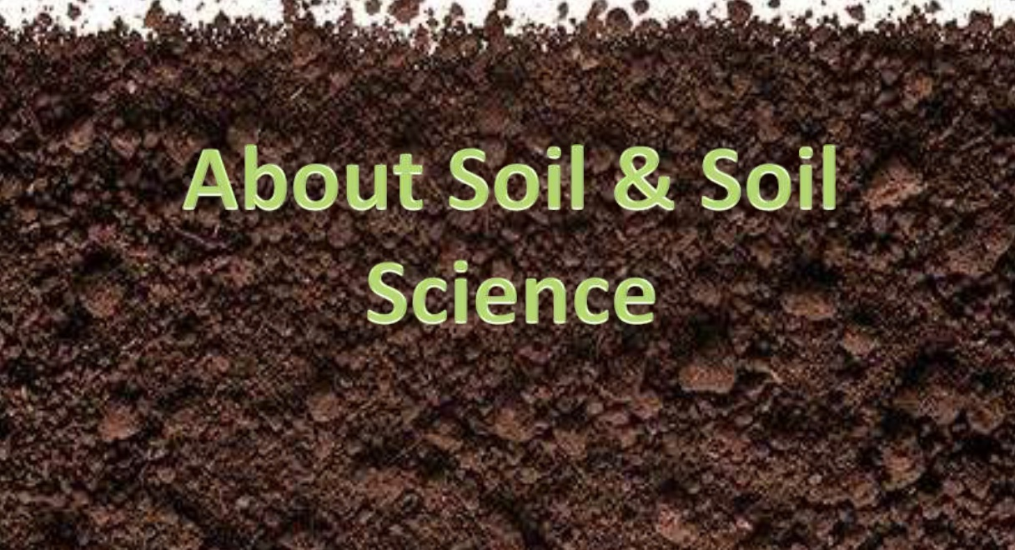
Soil science and water quality

Slide 2
Soil Science
The soil science dealing with soil as a natural resource on the surface of the earth, including Pedology, physical, chemical, biological and fertility properties of soil.

Slide 3
Soil Science has six well defined and developed disciplines
Soil fertility: Nutrient supplying properties of soil
Soil chemistry: Chemical constituents, chemical properties and the chemical reactions
Soil physics: Involves the study of physical properties
Soil microbiology: Deals with micro organisms, its population, classification, its role in transformations

Slide 4
cont…
Soil conservation: Dealing with protection of soil against physical loss by erosion or against chemical deterioration i.e. excessive loss of nutrients either natural or artificial means.
Soil Pedology: Dealing with the genesis, survey and classification

Slide 5
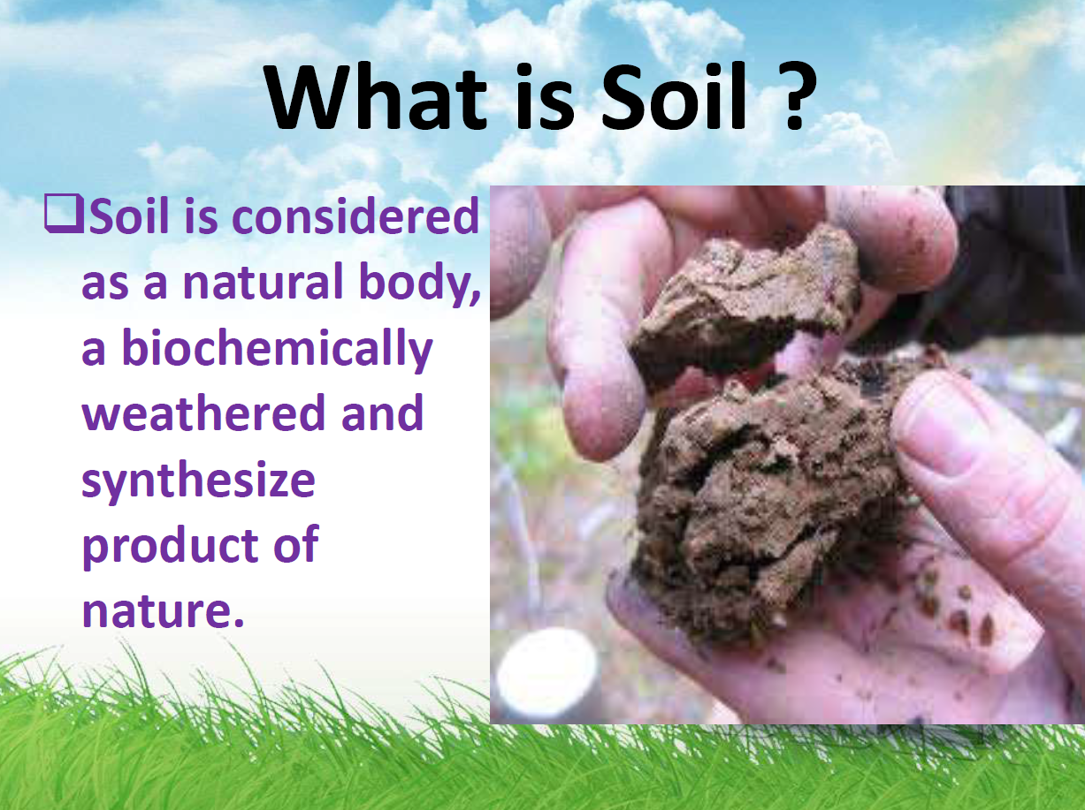
Nature, origin and formation of soils

Slide 6
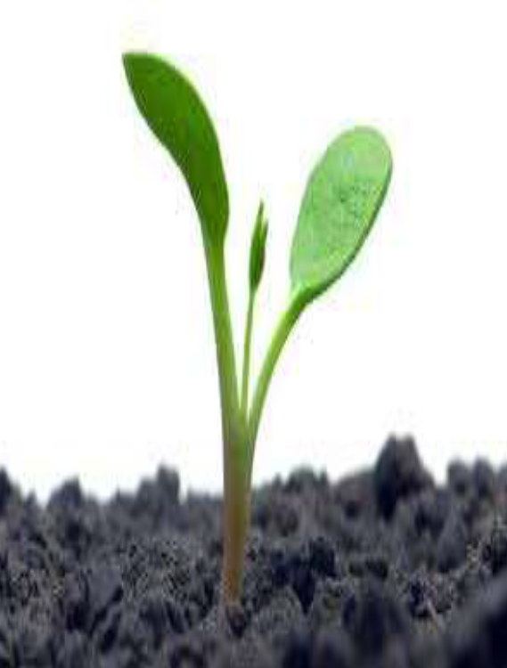
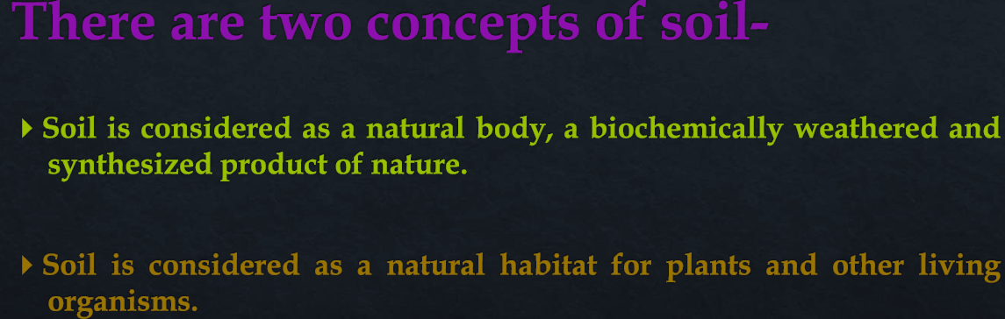
Concept of Soil

Slide 7
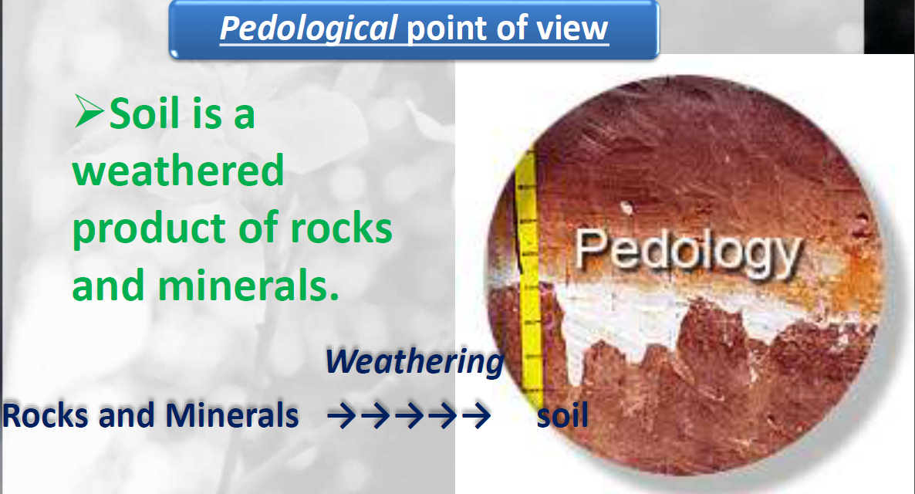
Soil in different point of view

Slide 8
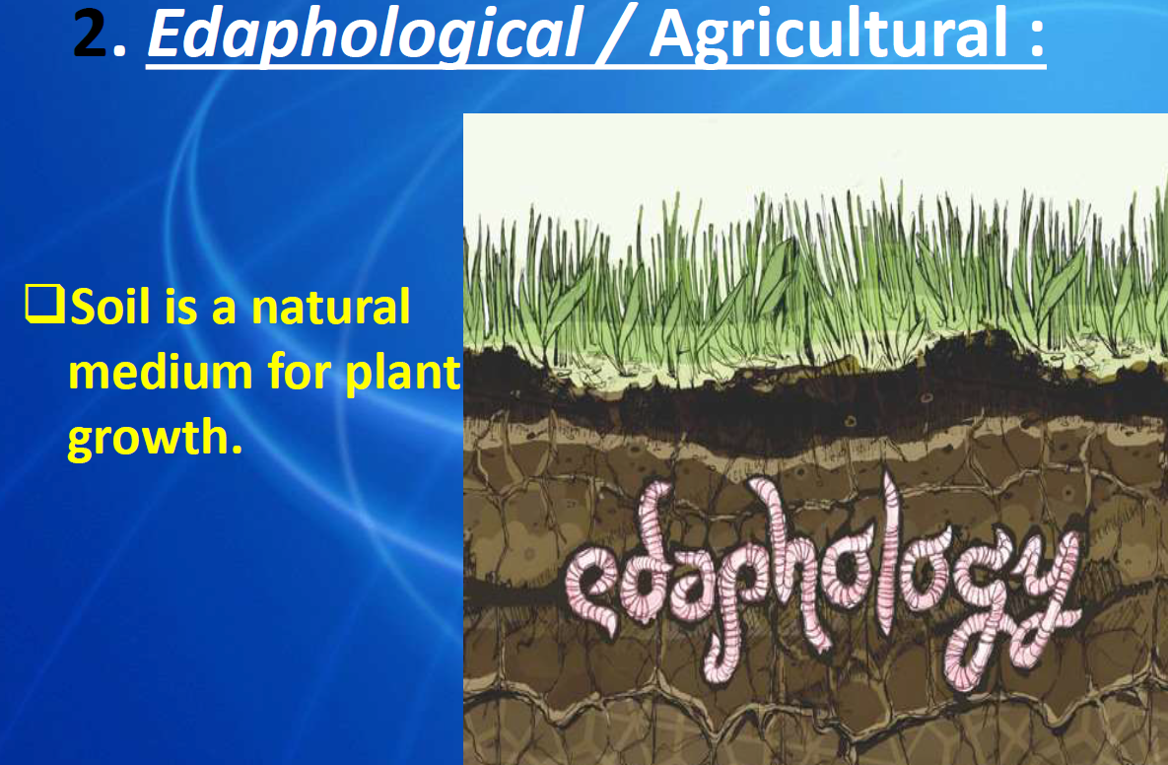
Cont…

Slide 9
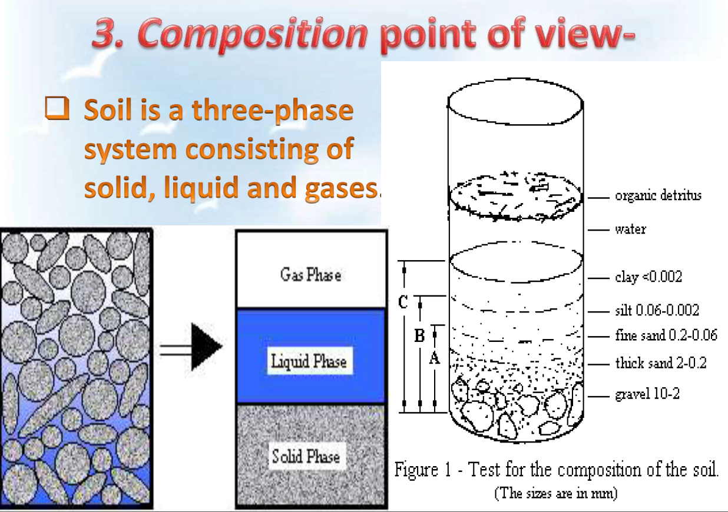
Cont…

Slide 10
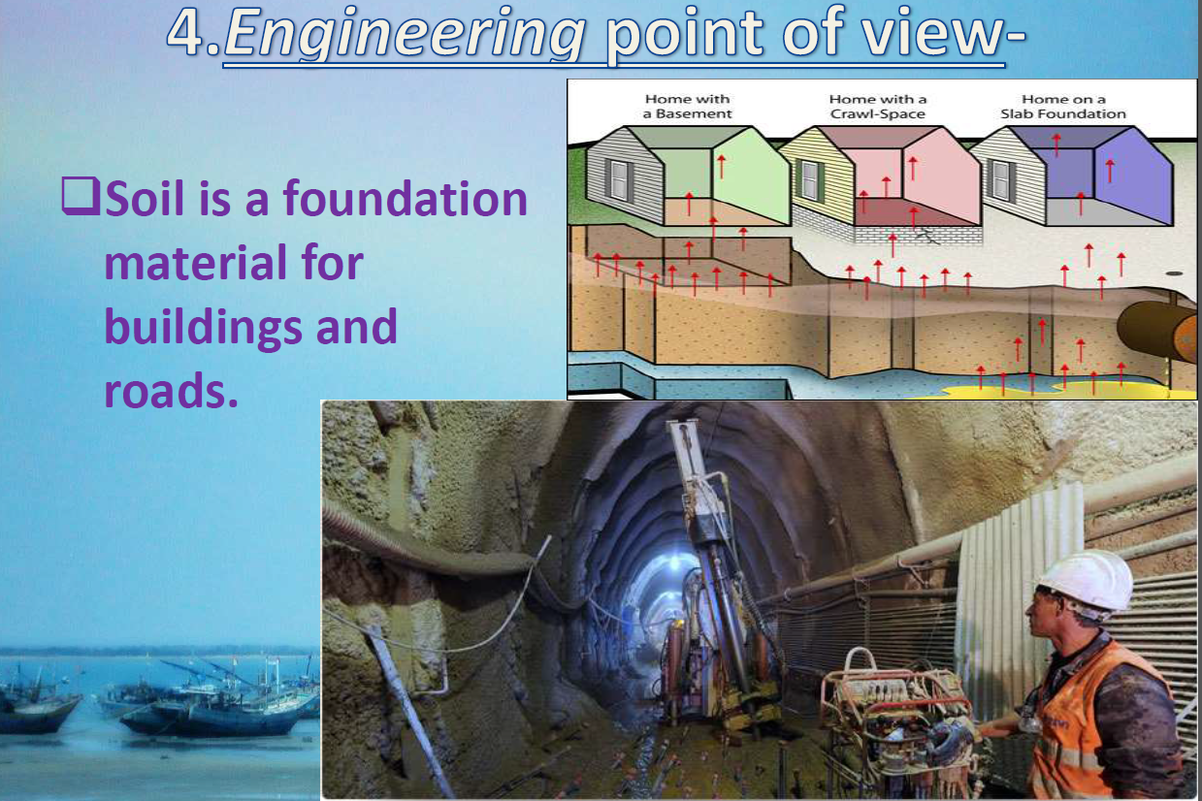
Cont…

Slide 11
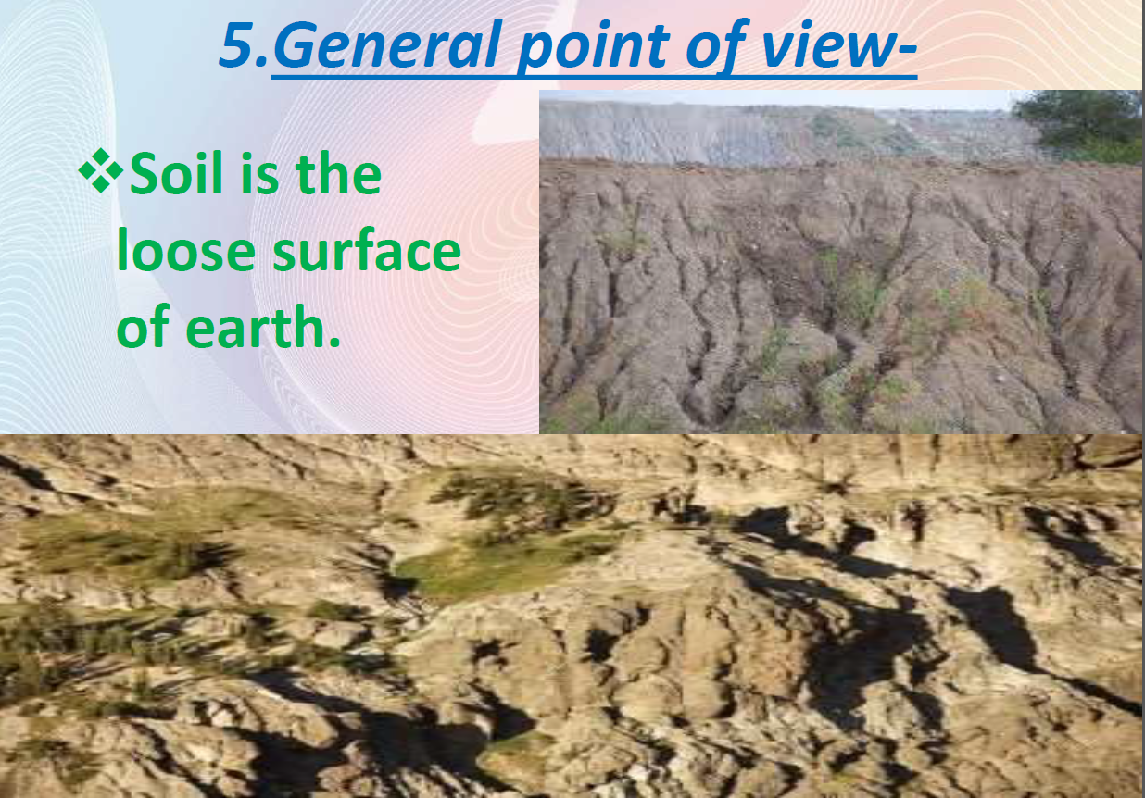
Cont…

Slide 12
Definition of soil by different scientist
Generally soil refers to the loose surface of the earth as identified from the original rocks and minerals from which it is derived through weathering process.
Whitney (1892): Soil is a nutrient bin which supplies all the nutrients required for plant growth
Hilgard (1892): Soil is more or less a loose and friable material in which plants, by means of their roots, find a foothold for nourishment as well as for other conditions of growth”

Slide 13
Cont…
Dokuchaiev (1900): Soil is a natural body composed of mineral and organic constituents, having a definite genesis and a distinct nature of its own.
Jenny (1941): Soil is a naturally occurring body that has been formed due to combined influence of climate and living organisms acting on parent material as conditioned by relief over a period of time.

Slide 14
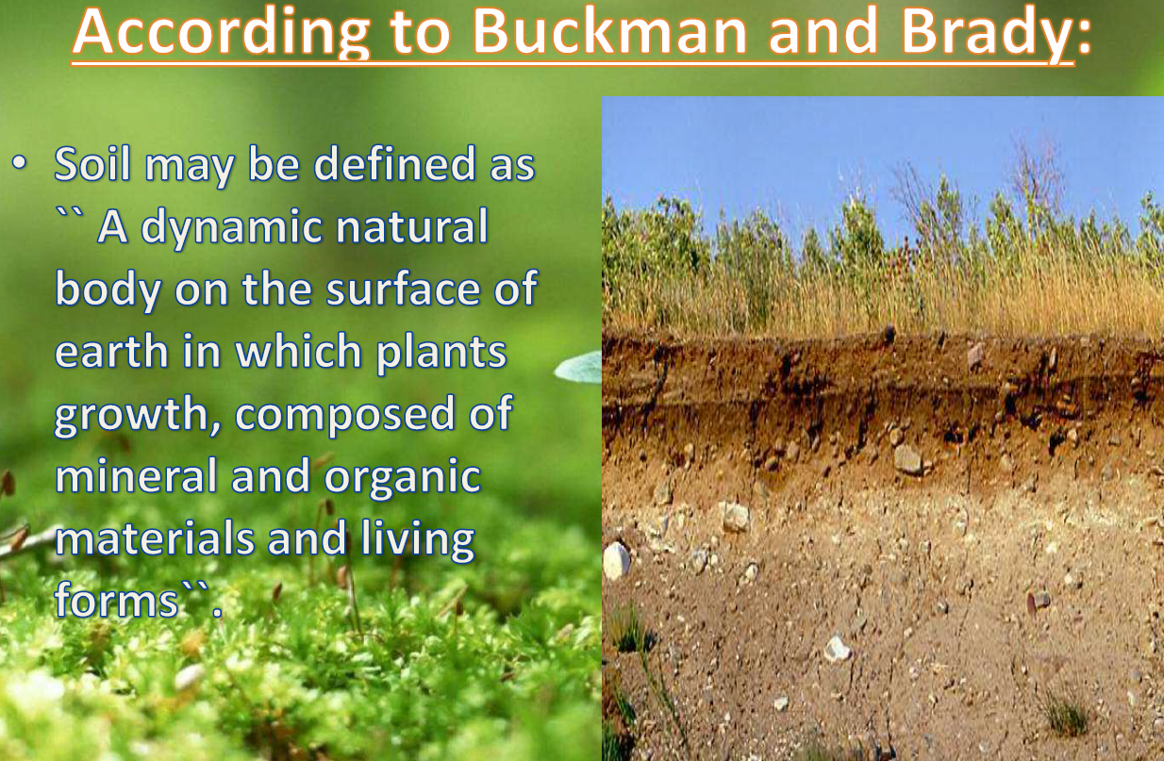
Cont…

Slide 15
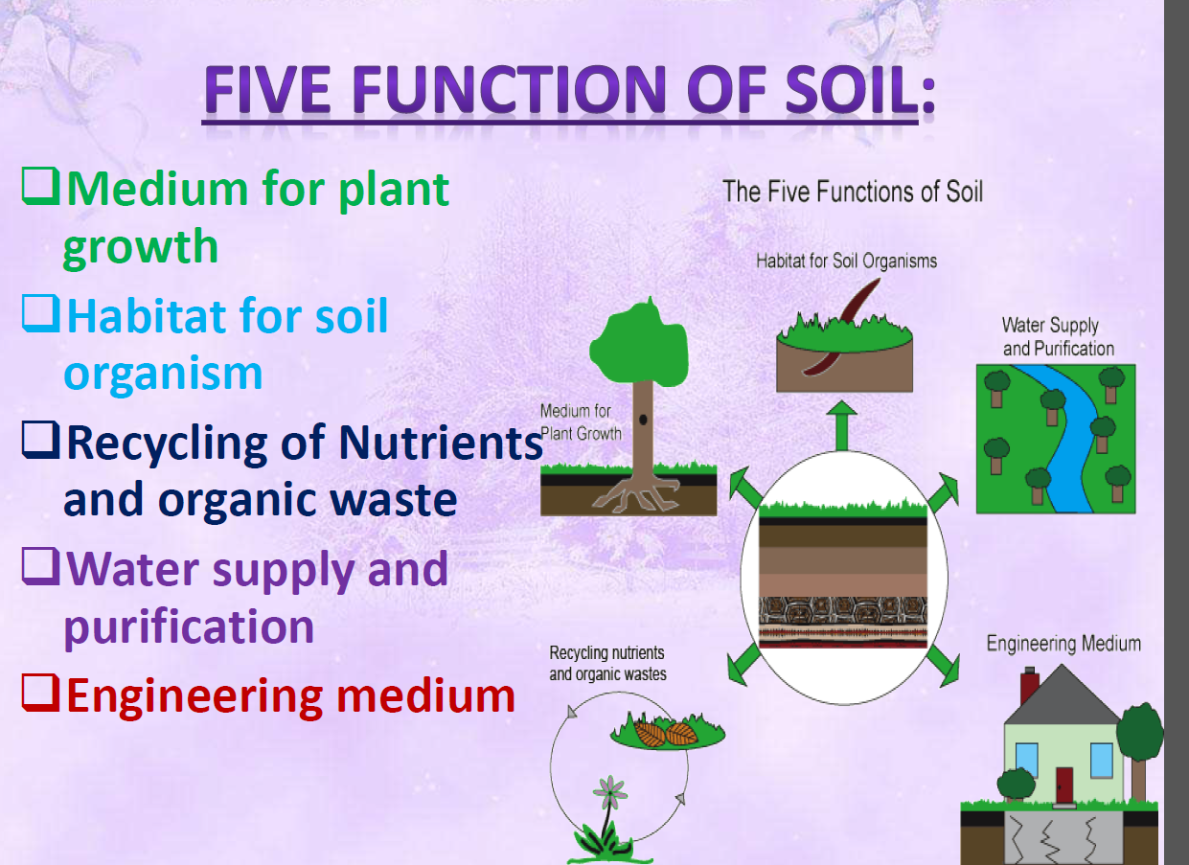
Cont…

Slide 16
Why we study soil?
Soils are living systems that provide many of the most fundamental functions needed for life.
Some reasons of studying soil are describe as the following:
  Providing the fertile medium in which we grow our food and fiber
  Producing and storing gases such as CO2
  Storing heat and water
  Providing a home for billions of plants, animals and microorganisms

Slide 17
Cont…
  Filtering water and wastes
  Providing the source material for construction, medicine, art, makeup, etc.
  Decomposing wastes
  Providing a snapshot of geologic, climatic, biological, and human history
  Moderate and regulate distributions of solar energy & etc.

Slide 18
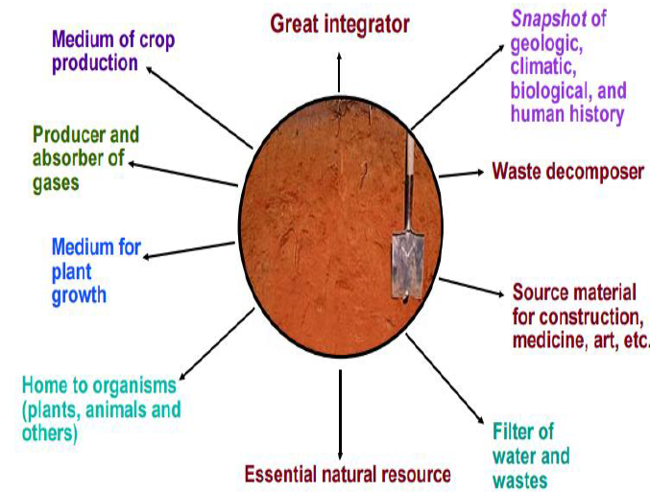
Cont…

Slide 19
What’s in soil?
Soil is a three-phase system containing:
    Solids,
    Liquids and
    Gasses
Soil contain four components:
    Mineral fragments,
    Organic matter,
    Soil air and water.

Slide 20
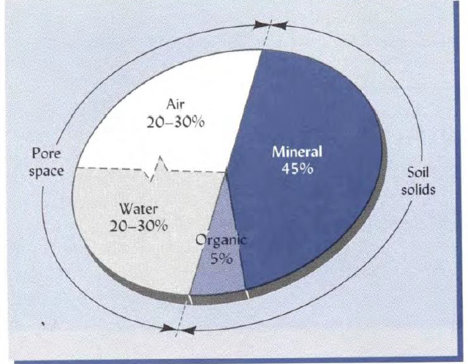
Cont…

Slide 21
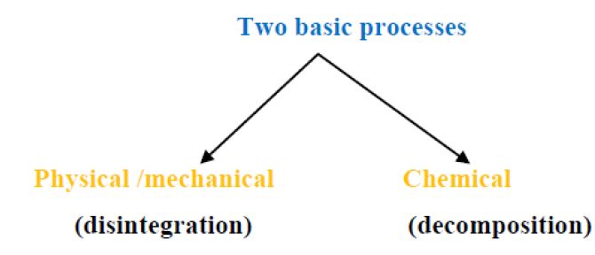
Soil formation and process
Weathering:
  A process of disintegration and decomposition of rocks and minerals which are brought about by physical agents and chemical processes.
  It is a transformation of solid rocks into parent material or Regolith.

Slide 22
Different agents of weathering
i) Physical weathering
The rocks are disintegrated and are broken down to comparatively smaller pieces, without producing any new substances.
The cause of this process are:
1. Physical condition of rocks
2. Action of temperature
3. Action of water
  i. Fragmentation and transport
Water beats over the surface of the rock when the rain occurs and starts flowing towards the ocean

Slide 23
Cont…
  ii) Action of freezing
Frost is much more effective than heat in producing physical weathering.
  iii) Alternate wetting and Drying
Some natural substances increase considerably in volume on wetting and shrink on drying.
4. Action of wind
5. Atmospheric electrical phenomenon

Slide 24
ii) Chemical Weathering
Chemical weathering takes place mainly at the surface of rocks and minerals with disappearance of certain minerals and the formation of secondary products (new materials).
Chemical Processes of weathering:
1. Hydration
Chemical combination of water molecules with a particular substance or mineral leading to a change in structure.

Slide 25
2. Hyrolysis
It is occur due to the dissociation of H2O into H+ and OH- ions which chemically combine with minerals and bring about changes
This reaction is important because of two reasons
➢ Clay, bases and silicic acid - the substances formed in these reactions - are available to plants
➢ water often containing CO2 (absorbed from atmosphere)

Slide 26
Cont…
3. Solution
4. Carbonation:
Carbon dioxide when dissolved in water it forms carbonic acid.
5. Oxidation
It is the process of addition and combination of oxygen to minerals.
6. Reduction
The process of removal of oxygen and is the reverse of oxidation.

Slide 27
iii) Biological Weathering
The biological or living agents are responsible for both decomposition and disintegration of rocks and minerals.
1. Man and Animals
The action of man in disintegration of rocks is well known as he/she cuts rocks to build dams, channels and construct roads and buildings.
2. Higher Plants and Roots
The roots of trees and other plants penetrate into the joints and crevices of the rocks.
As they grew, they exert a great disruptive force and the hard rock may break apart.

Slide 28
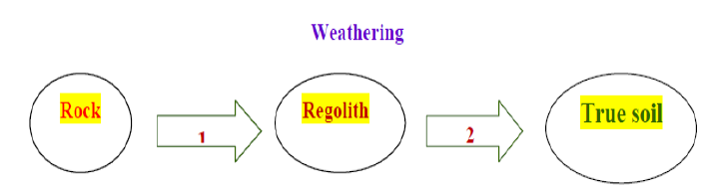
Cont…
3. Micro- organisms
The soil formation is the process of two consecutive stages.
  1. The weathering of rock (R) into Regolith
  2. The formation of true soil from Regolith

Slide 29
Cont…
Factors
The soils develop as a result of the action of soil forming factors
S = f (Cl, O, R, P, T, …)
Where,
  Cl – environmental climate
  O – Organisms and vegetation (biosphere)
  R – Relief or topography
  P – Parent material
  T- Time and …….. additional unspecified factors

Slide 30
Cont…
The five soil forming factors can be groped in to Two
  Passive: Parent material, Relief &Time
  Active: Climate and Vegetation & organism
A) Passive Soil forming factors
Parental material
Parent material can be groups in to two:
a) Sedentary: It is formed in original place.
It is the residual parent material.

Slide 31
Cont…
b) Transported
The parent material transported from their place of origin.
  by gravity - Colluvial
  by water - Alluvial, Marine, Locustrine
  by ice - Glacial
  by wind - Eolian
2. Relief or Topography
It denotes the configuration of the land surface.
Soil formation in different elevation by different process (read in detail from your handout).

Slide 32
Cont…
3. Time
Soil formation is a very slow process requiring thousands of years to develop a mature pedon.
The soil properties also change with time, for instance nitrogen and organic matter contents increase with time provided the soil temperature is not high.

Slide 33
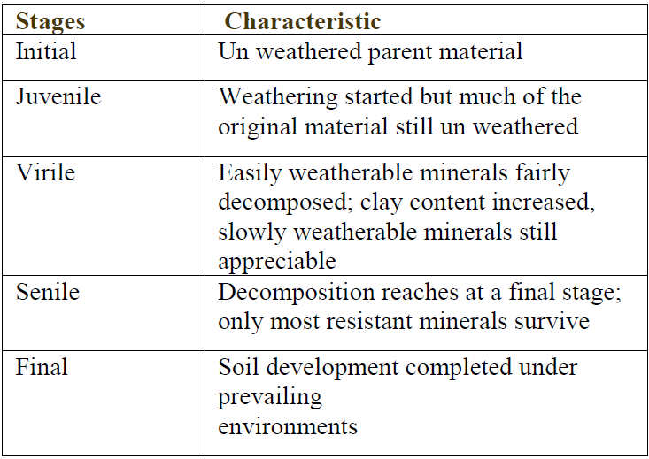
Weathering stages in soil formation

Slide 34
B) Active Soil Forming Factors
These factors are climate and vegetation (biosphere).
Climate:
Arid climate
Humid climate
Oceanic climate
Mediterranean climate
Continental climate
Temperate climate
Tropical and subtropical climate:

Slide 35
Cont…
2. Organism & Vegetation
i) Organism:
The active components of soil ecosystem are plants, animals, microorganisms and man.
The role of microorganisms in soil formation is related to the humification and mineralization of vegetation
ii) Vegetation:
The roots of the plants penetrate into the parent material and act both mechanically and chemically.

Slide 36
Soil physical properties
The physical properties of a soil depend on the amount, size, shape, arrangement and mineral composition of its particles.
These properties also depend on organic matter content and pore spaces.
Important physical properties of soils
1) Soil texture 2) Soil structure 3) Surface area
4) Soil density 5) Soil porosity, 6) Soil colour,
7) Soil consistence (read in detail from your handout).

Slide 37
Particle size distribution
Two steps are involved
i. Separation of all the particles from each other i.e. Complete dispersion into ultimate particles
ii. Measuring the amount of each group
    Coarser fractions
    Finer fractions

Slide 38

Stokes' Law
Particle size analysis is based on a simple principle i.e. "when soil particles are suspended in water they tend to sink.
is referred to as stokes’ law.
Where, V = settling velocity
r = radius of particle
k = constant

Slide 39

Cont…
The relation between the diameter of a particle and its settling velocity is governed by Stokes' Law:
Where ,
  V - Velocity of settling particle (cm/sec.)
  g - Acceleration due to gravity cm/ sec2 (981)
  ds - Density of soil particle (2.65)
  dw - density of water (1 )
  n - Coefficient of viscosity of water (0.0015 at 4oC)
  r - Radius of spherical particles (cm).

Slide 40
Cont…
Methods of Textural determination
Numerous methods have been developed for lab and field determination of Texture
  i) Elutriation method – Water & Air;
  ii) Pipette method
  iii) Decantation/ beaker method;
  iv) Test tube shaking method
  v) Feel method – Applicable to the field – quick
  method – by feeling the soil between thumb and
  fingers
Read in detail about them.

Slide 41
Soil Texture classes
To convey an idea of the textural make up of soils and to give an indication of their physical properties, soil textural class names are used.
These are grouped into three main fractions viz., Sand, Silt and Clay.
Sands
The sand group includes all soils in which the sand separates make up at least 70% and the clay separate 15% or less of the material by weight.

Slide 42
Cont…
Silt
The silt group includes soils with at least 80% silt and 12% or less clay.
Clays
To be designated a clay soi1 must contain at least 35% of the clay separate and in most cases not less than 40%.
Loams
The loam group, which contains many subdivisions, is a more complicated soil textural class. An ideal loam may be defined as a mixture of sand, silt and day particles that exhibits the properties of those separates in about equal proportions.

Slide 43
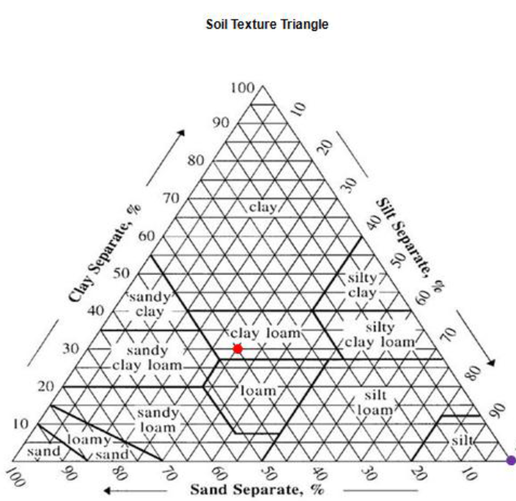
Cont…
The textural triangle:
It is used to determine the soil textural name after the percentages of sand, silt, and clay are determined from a laboratory analysis.

Slide 44
Importance of soil Texture
Texture has good effect on management and productivity of soil.
Sand facilitates drainage and aeration. It allows rapid evaporation and percolation.
Clay particles play a very important role in soil fertility.
Clayey soils are difficult to till and require much skill in handling.

Slide 45
Cont…
Loam and Silt loam soils are highly desirable for cultivation.
Generally, the best agriculture soils are those contain 10 – 20 per cent clay, 5 – 10 percent organic matter
The rest equally shared by silt and sand and 30% silt - called as clay rather than clay loam.

Slide 46
Soil structure classification
Structure is studied in the field under natural conditions and it is described under three categories.
i. Type - Shape or form and arrangement pattern of peds
ii. Class - Size of Peds
iii. Grade - Degree of distinctness of peds
Types of Structure: There are four principal forms of soil structure
Plate -like (platy):
In this type, the aggregates are arranged in relatively thin horizontal plates or leaflets.

Slide 47
Cont…
The horizontal axis or dimensions are larger than the vertical axis.
Prism-like:
The vertical axis is more developed than horizontal, giving a pillar like shape.
Vary in length from 1- 10 cm.
Commonly occur in sub soil horizons of Arid and Semi arid regions.

Slide 48
Cont…
Block-like:
All three dimensions are about the same size.
The aggregates have been reduced to blocks.
Spheroidal (Sphere like)
All rounded aggregates (peds) may be placed in this category.
Not exceeding an inch in diameter.
Grades of Structure
Grades indicate the degree of distinctness of the individual peds.

Slide 49
Cont…
Grade also depends on organic matter, texture etc.
Four terms commonly used to describe the grade of soil structure are:
1. Structureless: There is no noticeable aggregation, such as conditions exhibited by loose sand.
2. Weak Structure: Poorly formed, indistinct formation of peds, which are not durable and much unaggregated material.

Slide 50
Cont…
3. Moderate structure:
Moderately well developed peds, which are fairly durable and distinct.
4. Strong structure:
Very well formed peds, which are quite durable and distinct.

Slide 51
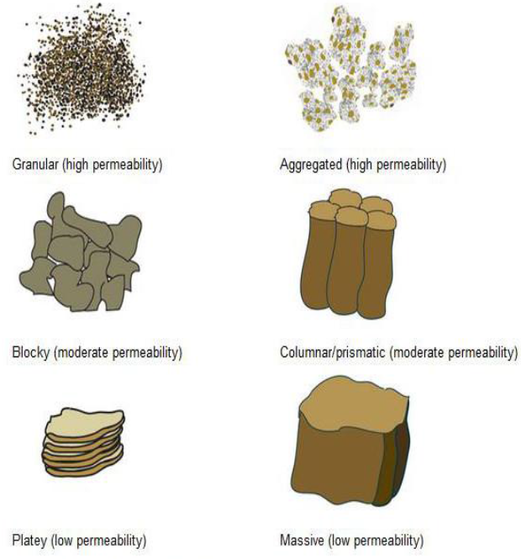
Cont….

Slide 52
Factors Affecting Soil Structure
1. Climate
Climate has considerable influence on the degree of aggregation as well as on the type of structure.
In arid regions there is very little aggregation of primary particles.
2. Organic matter
Organic matter improves the structure of a sandy soil as well as of a clay soil.
3. Tillage
Cultivation implements break down the large clods into smaller fragments and aggregates.

Slide 53
Cont…
4. Plants, Roots and Residues
Excretion of gelatinous organic compounds and exudates from roots serve as a link Root hairs make soil particles to cling together.
5. Animals
Among the soil fauna small animals like earthworms, moles and insects etc., that burrow in the soil are the chief agents that take part in the aggregation of finer particles.

Slide 54
Cont…
6. Microbes
Algae, fungi, actinomycetes and fungi keep the soil particles together. Fungi and actinomycetes exert mechanical binding by mycelia, Cementation by the products of decomposition and materials synthesized by bacteria.
7. Fertilizers
Fertilizer like Sodium Nitrate destroys granulation by reducing the stability of aggregates.

Slide 55
Cont…
8. Wetting and drying
When a dry soil is wetted, the soil colloids swell on absorbing water.
9. Exchangeable cations
Ca, Mg ----------------- H, Na
Flocculating Deflocculating
Good structure Poor structure
10. Inorganic cements: CaCO3 and Sesquioxides
11. Clay,
12. Water

Slide 56
Effect of Soil Structure on other Physical Properties
Porosity
Porosity of a soil is easily changed. In plate like structure, pore spaces are less where as in crumby structure pore spaces are more.
Temperature
Crumby structure provides good aeration and percolation of water in the soil.
Density
Bulk density varies with the total pore space present in the soil.

Slide 57
Cont…
Consistence
Consistence of soil also depends on structure.
Plate-like structure exhibits strong plasticity.
Colour
Bluish and greenish colors of soil are generally due to poor drainage of soil.
Soil Consistence
Soil consistence is defined as “the resistance of a soil at various moisture contents to mechanical stresses or manipulations”.
It combines both the ‘cohesive’ and ‘adhesive’ forces.

Slide 58
Cont…
Adhesion
Molecular attraction that holds the surfaces of two substances (eg.Water and soil particles) in contact.
Cohesion
Holding together: force holding a solid or liquid together, owing to attraction between like molecules. Decreases with rise in temperature.
Soil consistence is described at three moisture levels namely ‘wet’, ‘moist’ and ‘dry’.

Slide 59
Cont…
1. Wet soils:
Consistency is denoted by terms stickiness and plasticity.
Stickiness is grouped into four categories namely i) non sticky, ii) slightly sticky, iii) sticky and iv) very sticky.
Plasticity of a soil is its capacity to be moulded (to change its shape depending on stress) and to retain the shape even when the stress is removed.

Slide 60
Cont…
There are four degrees in plasticity namely i) non plastic, ii) slightly plastic, iii) plastic and iv) very plastic
2. Moist soil:
Moist soil with least coherence adheres very strongly and resists crushing between the thumb and forefinger.
The different categories are i. Loose-non coherent ii. Very friable - coherent, but very easily crushed
iii. Friable - easily crushed iv. Firm - crushable with moderate pressure v. Very firm - crushable only under strong pressure vi. Extremely firm - completely resistant to crushing.

Slide 61
Cont…
3. Dry soil:
In the absence of moisture, the degree of resistance is related to the attraction of particles for each other.
The different categories are:
i) Loose - non coherent ii) Soft - breaks with slight pressure and becomes powder
iii) Slightly hard - break under moderate pressure
iv) Hard - breaks with difficulty with pressure
v) Very hard - very resistant to pressure
vi) Extremely hard - extreme resistance and cannot be broken.

Slide 62
Cont…
Soil Colour
Soil colour indicates many soil features.
Kinds of soil colour
Soil colour is inherited from its parent material and that is referred to as lithochromic, e.g. red soils developed from red sandstone.
Determination of soil colour
The soil colours are best determined by the comparison with the Munsell colour.

Slide 63
Cont…
The colour of the soil is a result of the light reflected from the soil.
Soil colour rotation is divided into three parts:
Hue - it denotes the dominant spectral colour (red,yellow ,blue and green).
In the Munsell system these are given letter codes, i.e. Red (R), Yellow-Red (YR), Green (G), Green-Yellow (GY) and so on.
Value - it denotes the lightness or darkness of a colour (the amount of reflected light).

Slide 64
Cont…
In the Munsell system, value is indicated with a number, i.e. 2, 4, 6 and so on.
The value scale runs vertically and moves from lightest (at the top) to darkest (at the bottom) in descending order, so a 2 is going to be darker than a 6.
Chroma – it represents the purity of the colour (strength of the colour).
In the Munsell system, chroma is indicated with a number, typically in the range of 2-14 (upwards of 30 for colors in the fluorescent family).

Slide 65
The soil profile
A Soil Profile is a vertical cross-section of layers of soil found in a given area.
Soil horizons are the horizontal layers of soil that are similar in make-up used to classify soil types.
The Horizons are categorized based on color, texture, roots, structure, rock fragments, and any unique characteristic worth noting.
Master Soil Horizons are depicted by a capital letter in the order (from top down): O, A, E, B, C, and R.

Slide 66
Cont…
Over time, soil layers differentiate into distinct ‘horizons’ not deposited, but zones of chemical action.
Soil layers are formed through chemical reactions and formation of secondary minerals (clays),
Leaching by infiltrating water (elluviation) and Deposition and accumulation of material leached from higher levels in the soil (illuviation).

Slide 67
Cont…
O-Horizon
  • This horizon is known as the “Organic Matter” Horizon
  • Surface-layer, at depths of 0-2 feet
  • Dark in color, soft in texture
  • Humus - rich organic material of plant and animal origin in a stage of decomposition
  • Leaf litter – leaves, needles, twigs, moss, lichens that are not decomposing

Slide 68
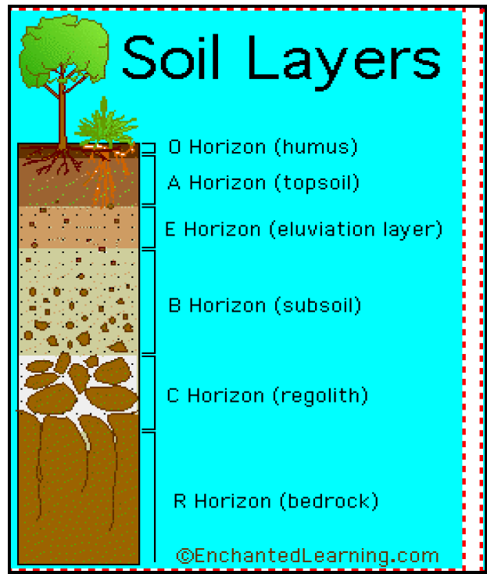
Cont…

Slide 69
Cont…
A horizon: “Topsoil” or “Biomantle” Horizon
  • Topmost layer of mineral soil, at depths of 2-10 feet
  • Some humus present, darker in color than layers below
  • Biomantle - most biological productive layer; earthworms, fungi, and bacteria live this layer
  • Smallest and finest soil particles

Slide 70
Cont…
E-Horizon: The “Leaching Layer” Horizon
• Small layer between A & B horizons
• At depths of 10-15 feet
• Light in color, mainly sand & silt
• Poor mineral and clay content due to leaching – the loss of water-retaining plant nutrients to the water table
• Soil particles larger than in A horizon but smaller than in B horizon

Slide 71
Cont…
B-Horizon: The “Subsoil” Horizon
  • At depths of 10-30 feet
  • Rich in clay and minerals like Fe & Al
  • Some organic material may reach here through leaching
  • Plant roots can extend into this layer
  • Red/brown in color due to oxides of Fe & clay

Slide 72
Cont…
C-Horizon: The “Regolith” Horizon
  • At depths of 30-48 feet
  • Made up of large rocks or lumps of partially broken bedrock
  • Least affected by weathering and have changed the least since their origin
  • Devoid of organic matter due to it being so far down in the soil profile

Slide 73
Cont…
R-Horizon: The “Bedrock” Horizon
  • At depths of 48+ feet
  • Deepest soil horizon in the soil profile
  • No rocks or boulders, only a continuous mass of bedrock
  • Colors are those of the original rock of the area

Slide 74
Chapter Two
  CRITICAL HYDRAULIC GRADIENT AND PIPING
                Introduction
Structures are built on soils and it transfer loads to the subsoil through the foundations.
The main objectives of compaction are:
  To increase strength and stability
  To decrease permeability
  To enhance resistance to erosion
  Decrease compressibility under load and minimize settlement

Slide 75
Compressibility
The settlement is defined as the compression of a soil layer due to the loading applied at or near its top surface.
The total compression of soil under load is composed of three components (i.e. elastic settlement, primary consolidation settlement, and secondary compression).
There are three types of settlement:
Immediate or Elastic Settlement (Se):
Caused by the elastic deformation of dry soil and of moist and saturated soils without change in the moisture content.

Slide 76
Cont…
2. Primary Consolidation Settlement (Sc):
Volume change in saturated cohesive soils as a result of expulsion of the water that occupies the void spaces.
3. Secondary Consolidation Settlement (Ss):
Volume change due to the plastic adjustment of soil fabrics under a constant effective stress (creep).

Slide 77
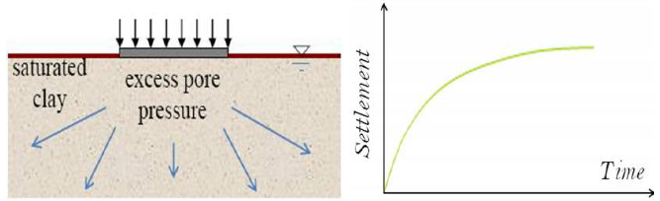
Consolidation
It is the time-dependent settlement of fine grained soils resulting from the expulsion of water from the soil pores.
The rate of escape of water depends on the permeability of the soil.

Slide 78
Cont…
Types of Consolidation:
    Primary consolidation
It is the reduction in volume due to expulsion of water from the voids.
    2. Secondary consolidation
When all the water is squeezed out of the voids and primary consolidation is completed, further reduction in volume of soil is called secondary consolidation.

Slide 79
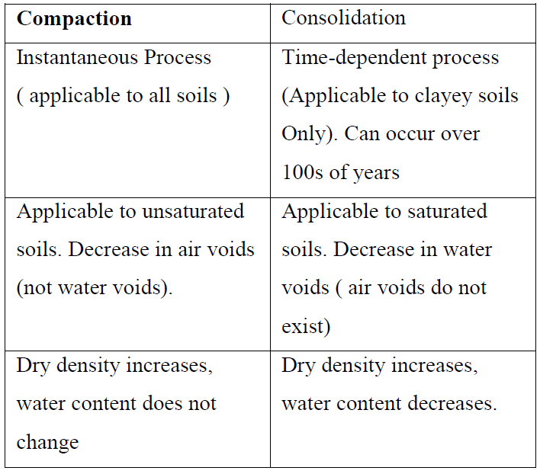
Cont…

Slide 80
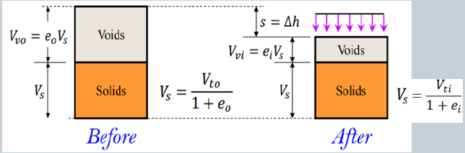
Consolidation processes
Consolidation settlement
The clay layer is shown as a phase diagram in below.

Slide 81
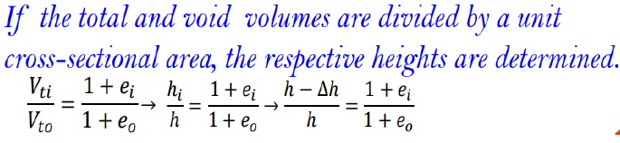
Cont…
The volume of solid remains constant in the soil profile.
Any change in height in the soil is equal to the change in height of voids.

Slide 82
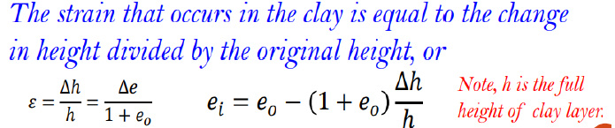

Cont…
In one-dimensional compression the change in height Δh per unit of original height h equals the change in volume ΔV per unit of original volume V. For constant area.

Slide 83
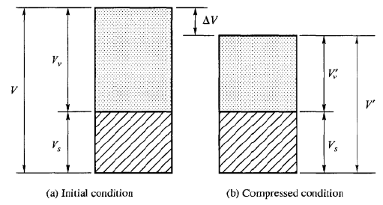
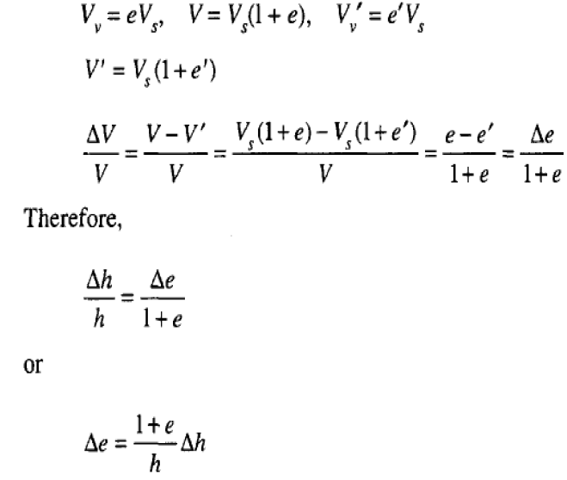

Slide 84
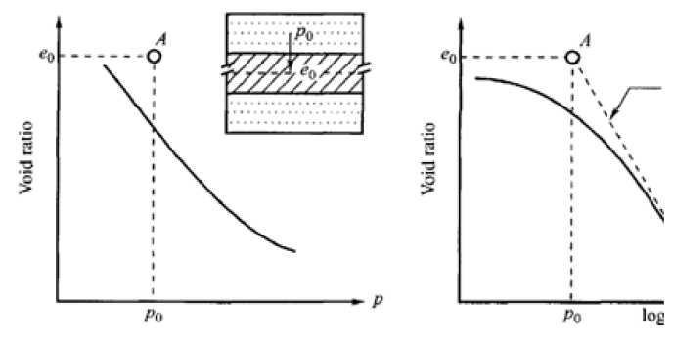
Hhhhhhhhhhhhh

Slide 85
Cont…
Example:
A soil sample has a compression index of 0.3.
If the void ratio e at a stress of 2940 Ib/ft2 is 0.5, compute:
(i) the void ratio if the stress is increased to 4200 Ib/ft2, and
(ii) the settlement of a soil stratum 13 ft thick.

Slide 86
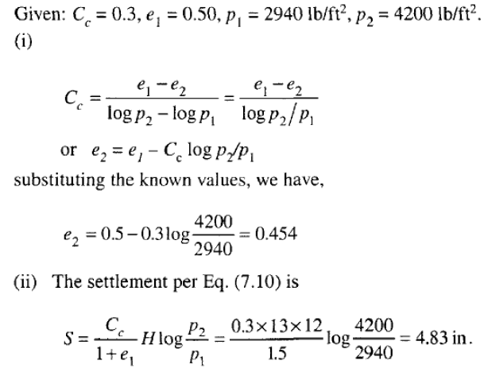
Cont…
Solution:

Slide 87
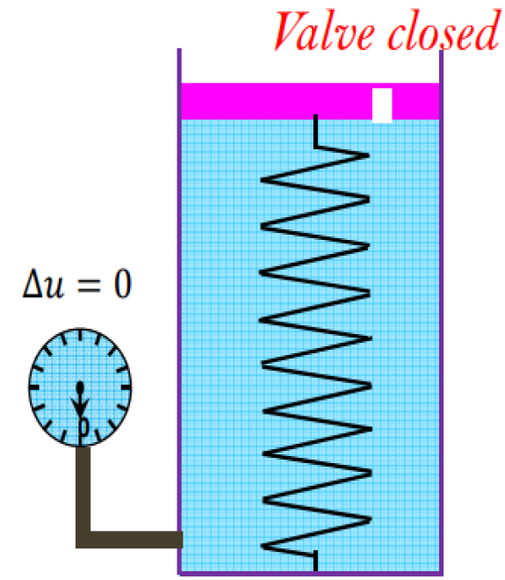
Fundamentals of Consolidation
Strain is defined as change in length per unit length (normal strain) or change in angle between lines in a deforming body (shear strain).
Spring-cylinder model:
The excess hydrostatic pressure at this time can be given as Δu = P/A and the effective stress is equal to zero.

Slide 88
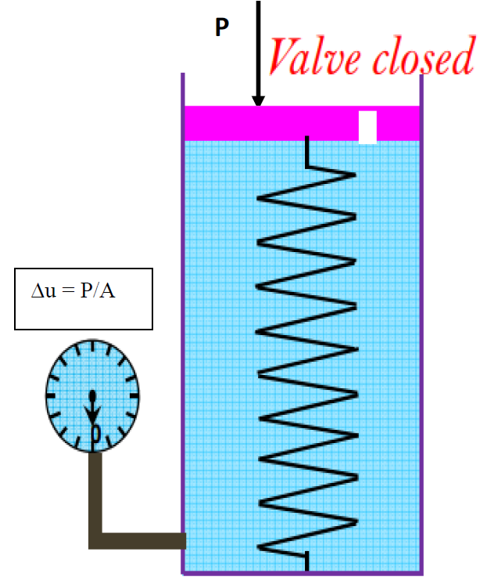
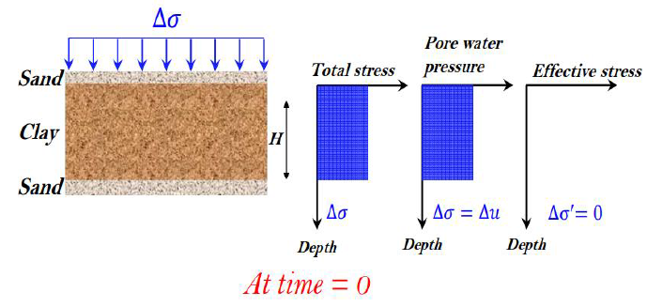
Cont…
Variation of total stress, pore water pressure, and effective stress in a clay layer drained at top and bottom as the result of an added stress Δσ

Slide 89
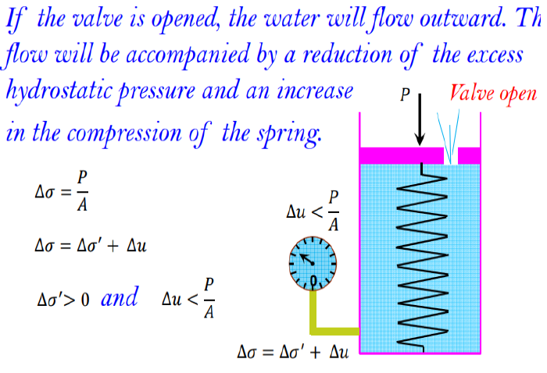
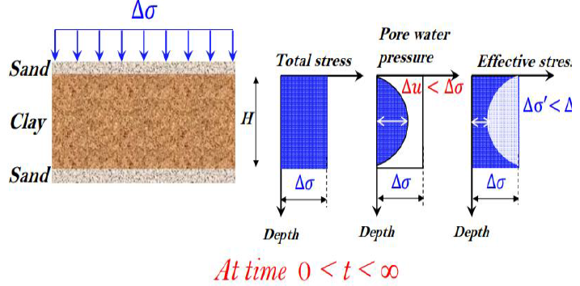
Cont…

Slide 90
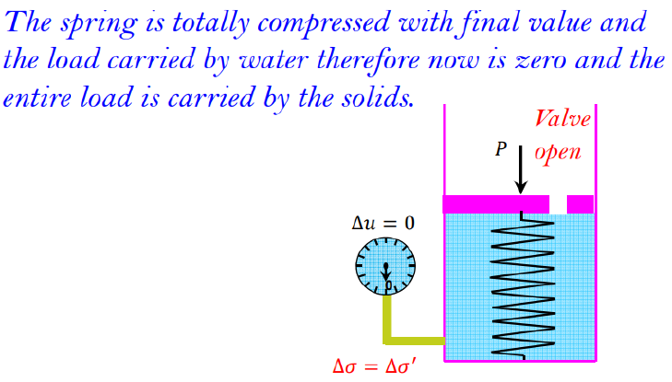
Cont…
Variation of total stress, pore water pressure, and effective stress in a clay layer drained at top and bottom as the result of an added stress Δσ :

Slide 91
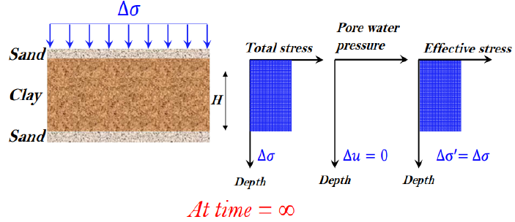
Cont…
Effect of compaction
    • Soil Structure
    • Permeability
    • Pore water pressure
    • Swelling
    • Compressibility
Read more about each

