Slide 1


SOIL MECHANICS-II(CENG 2082)
Lecture 03: LATERAL EARTH PRESSURE
Programme: BSc in Hydraulic and Water Resources Engineering
Lecture by: Yonas B.(MSc.)
Faculty of Hydraulic and Water Resources Engineering
Arba Minch Water Technology Institute

Slide 2
Objectives
Understand lateral earth pressure.
Determine lateral earth pressure.

Slide 3
CHAPTER OUTLINES
  3.1 Introduction
  3.2 Definitions
  3.3 Lateral Earth Pressure( At Rest, Active And Passive)
  3.4 Rankine’s Lateral Earth Pressure theory
  3.5 Coulomb’s Lateral Earth Pressure theory

Slide 4
3.1 Introduction…
Vertical slopes of soil are supported by retaining walls, cantilever sheet pile walls,sheet pile bulkheads, bracedcuts, and other, similar structures.
Lateral earth pressure is lateral stress from soil laterally on soil retaining structures.
Retaining structures may be classified as :
  Retaining walls
  Sheet-pile walls
  Sheet-pile bulkheads
  Braced cuts
The proper design of these structures requires estimation of lateral earth pressure (LEP).

Slide 5
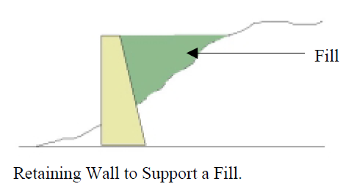
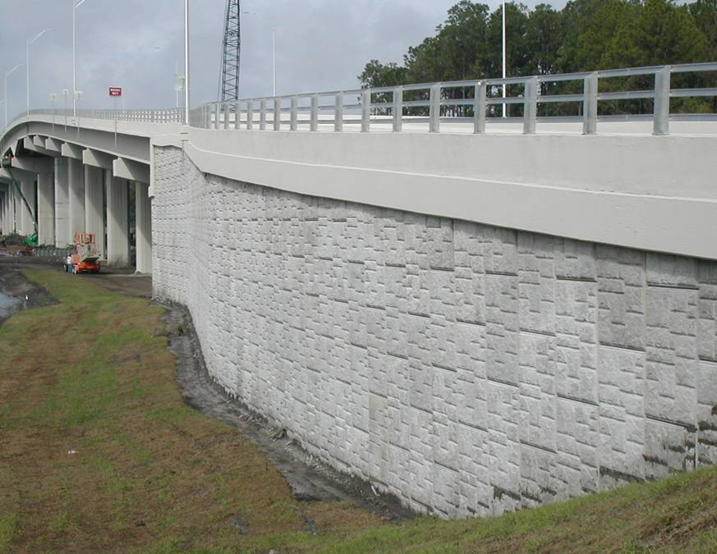
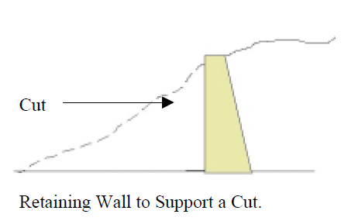
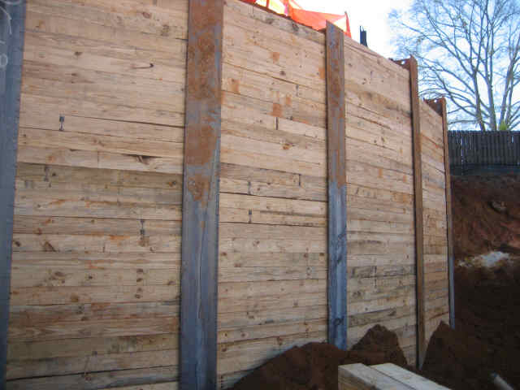
3.1 Introduction…
Lateral Earth Pressure
??
(R.P. Weber)
??
(R.P. Weber)

Slide 6
3.1 Introduction…
A retaining wall is a structure that is used to support a vertical or near vertical slopes of soil. The resulting horizontal stress from the soil on the wall is called lateral earth pressure.
To determine the magnitude of the lateral earth pressure, a geotechnical engineer must know the basic soil parameters – that is, unit weight , angle of friction , and cohesion c – for the soil retained behind the wall.
In the evaluation of the magnitude of this lateral earth pressure, it is assumed that the soil behind the wall (called backfill soil) is on the verge of failure and obeys some failure criterion, for example, the Mohr-Coulomb failure criterion.

Slide 7
3.1 Introduction …
LEP is a function of several factors, including the following:
  The type & amount of wall movement
  Type of backfill used
  The effective unit weight of the backfill soil,
  Ground water position
  The drainage condition in the backfill
  Ground Surcharge
  Surcharge application

Slide 8
3.2 Definitions
Backfill: is soil at back of retaining structures, which can develop LEP. This soil in practically, granular, but sometimes may be C-pa soil.
At rest earth pressure coefficient (k0) is the ratio between the lateral and vertical principal effective stresses when an earth retaining structure is at rest (or is not allowed to move at all).
Active earth pressure coefficient (ka) is the ratio between the lateral and vertical principal effective stresses when an earth retaining structure moves away from the retained soil.
Passive earth pressure coefficient (kp) is the ratio between the lateral and vertical principal effective stresses when an earth retaining structure is forced to move against a soil mass.

Slide 9
  3.3 Lateral Eath Pressure( At Rest, Active And Passive)
Three Types of LEP
PRESSURE AT REST-If the wall restrained/Fixed from moving – the LEP at any depth is referred to as earth pressure at-rest
ACTIVE EARTH PRESSURE-If the wall tilts away from the retained soil – Active earth pressure.
PASSIVE EARTH PRESSURE- If the wall is pushed into the retained soil – Passive earth pressure.

Slide 10
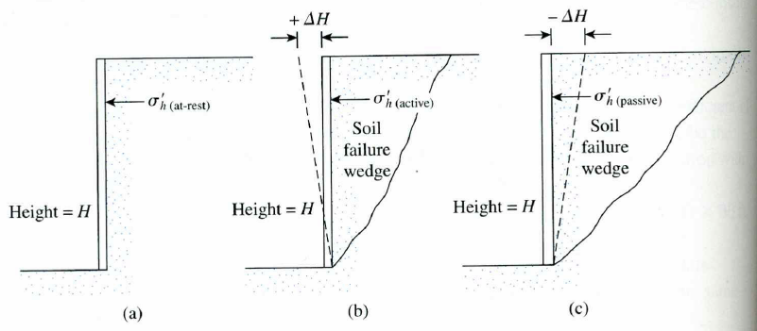
Type of lateral Earth pressure developed on retaining walls :(a)at rest,(b)active&(c)passive

Slide 11
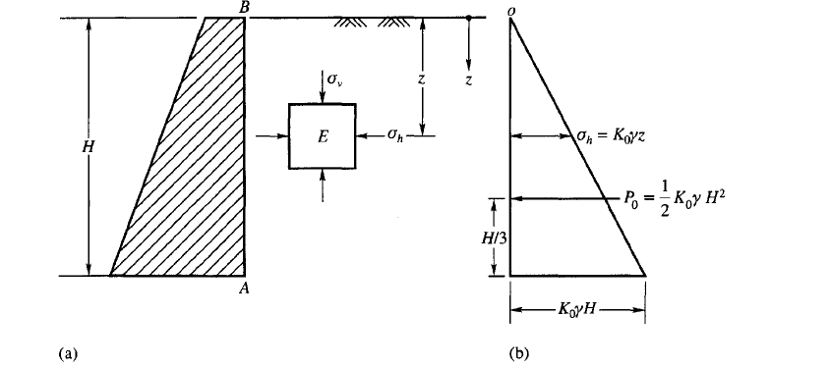

I. At Rest Earth Pressure
If the wall is rigid and does not move with the pressure exerted on the wall, the soil behind the wall will be in a state of elastic equilibrium. Consider a prismatic element E in the backfill at depth z shown in Fig.
$$Pa=\frac{1}{2}∗\left(K_{o}γh\right)∗h$$
  Where: Ko is the “at rest” earth pressure coefficient

Slide 12
I. LEP at-rest
If the wall is at rest and is not allowed to move at all, either from the soil mass or into the soil mass (i.e., there is zero horizontal strain), the lateral pressure at a depth Z is:
But for φ soils;
Without GWT
If GWT is there
But for C- φ soils;
σ_{ho} = K_{o} γH – 2 c (K_{o})^{1/2}
Where
u = pore water pressure
K_{o} = Coefficient of at-rest earth pressure

Slide 13
LEP at-rest ….
Jacky eqn-For coarse material/NC soils
For overconsolidated
The total force P_{o}, per unit length of the wall can be calculated from the pressure diagram as:
Based on experiments, the typical value of K0 is about 0.40 – 0.50 for sand, 0.35 – 0.70 for normally consolidated clay, and 0.50 – 3.00 for over-consolidated soil.
Where ϕ’ is the effective angle of internal friction of the soil. another formula is proposed by Brooker and Ireland (1965) for normally consolidated clay:

Slide 14
CONT…
Empirical correlation between the coefficient of lateral earth pressure K₀ and the plasticity of normally consolidated clay is proposed by Alpan (1967)
Where PI is the plasticity index of the soil. other empirical correlations were proposed by Mayne and Kulhawy (1982)

Slide 15
  3.3. Active and Passive Lateral Earth Pressures
Failure of the backfill soil occurs by two mechanisms depending on the direction of wall displacement.
If the displacement of the wall is away from the backfill soil the resulting failure is called active and the lateral pressure exerted on the wall by the backfill soil is called active lateral earth pressure.
A passive failure occurs if the wall is displaced towards the backfill soil until the limiting displacement is achieved. the passive resistance provided by the backfill soil against the wall displacement is called passive earth pressure.
In the next sections, we will deal with two active and passive earth pressure theories: one proposed by Rankine (1857) and the other by Coulomb (1776).

Slide 16
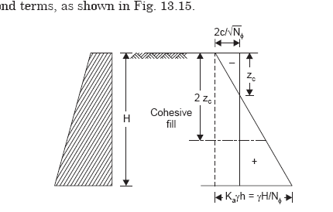
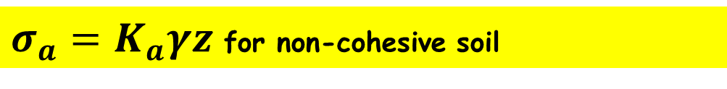
3.3.1 Rankine’s Active and passive Theory
Consider a vertical frictionless (smooth) wall retaining a soil mass in both front and back of the wall; vertical walls only
$σ_{a}=K_{a}γz$ for non-cohesive soil
For cohesive backfill
For lateral earth pressure (active) :

Slide 17
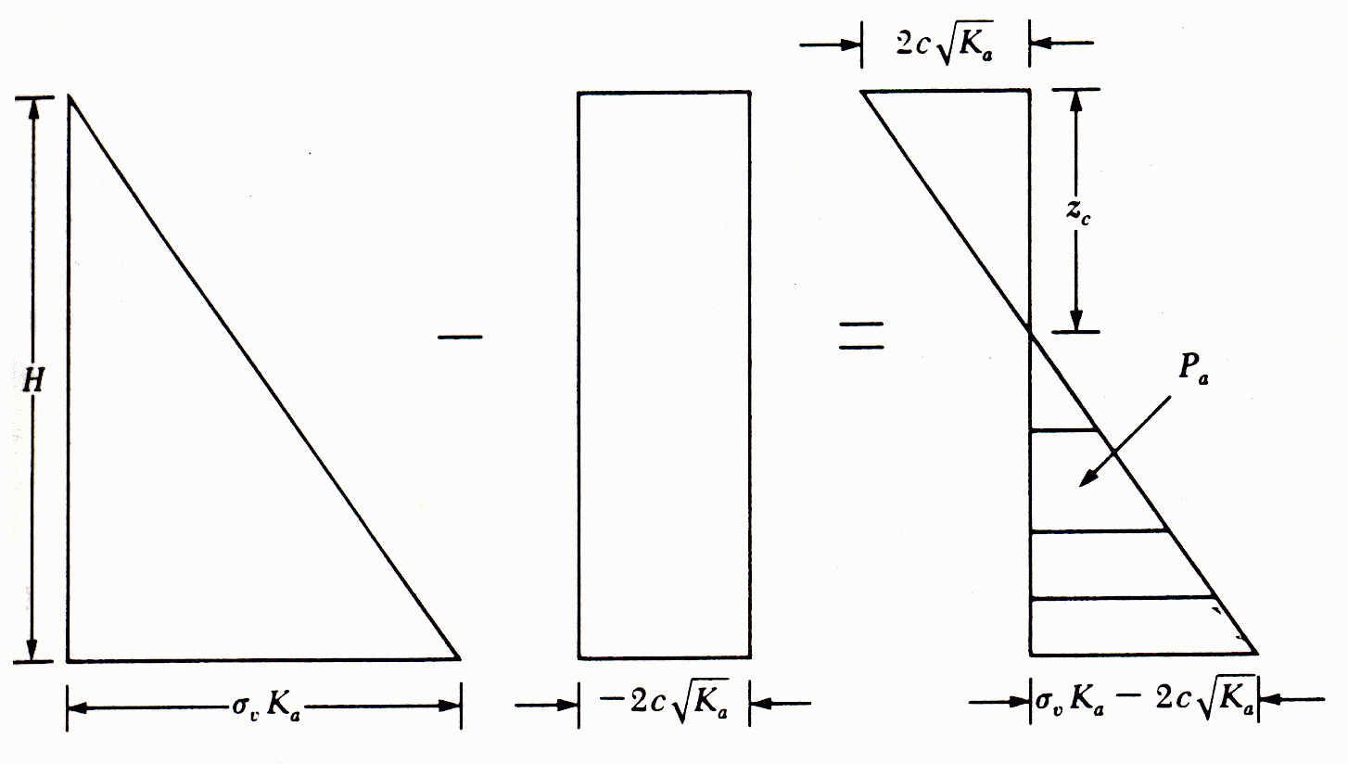
RANKINE ACTIVE EARTH PRESSURE
σ₃ = σ₁ . tan² (45-φ/2)-2c.tan (45-φ/2)
From chapter 1; Mohr-coulomb theory
σ_{a} = σ_{v} . tan² (45-φ/2)-2c.tan (45-φ/2)
σ_{a} = σ_{v} . Ka – 2c√Ka
Ka = tan² (45 - φ/2)
for C- ɸ soils
Tension zone

Slide 18

ACTIVE EARTH PRESSURE
Note :
z = 0 → σ_{v} = 0 ; σ_{a} = -2c√K_{a}
z = H → σ_{v} = γH
The tensile stress decreases with depth and becomes zero at a depth z = z_{c} or
γz_{c}K_{a} – 2c√K_{a} = 0
and
z_{c} = depth of tensile crack
For undrained condition

Slide 19
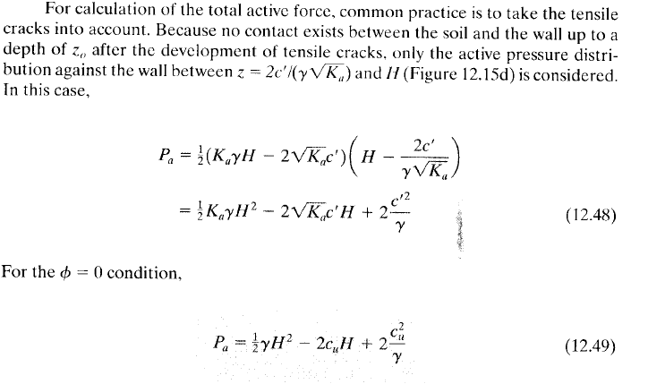

Slide 20
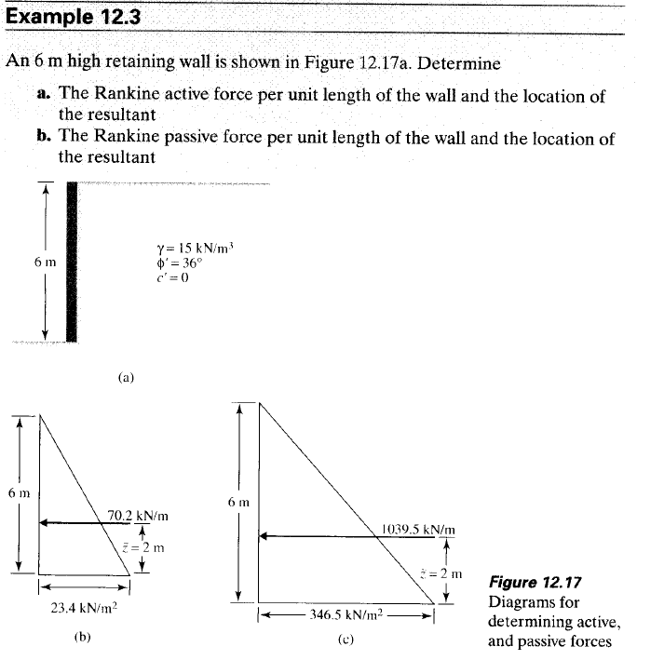
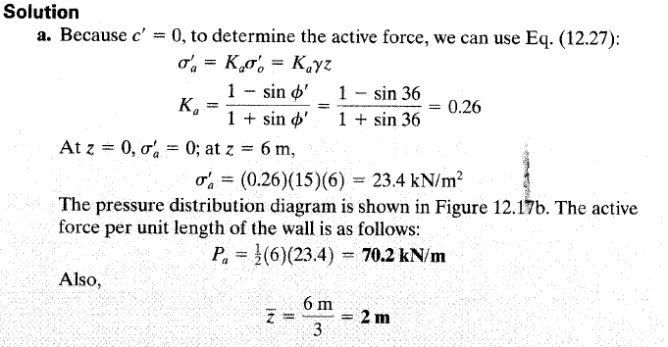

Slide 21
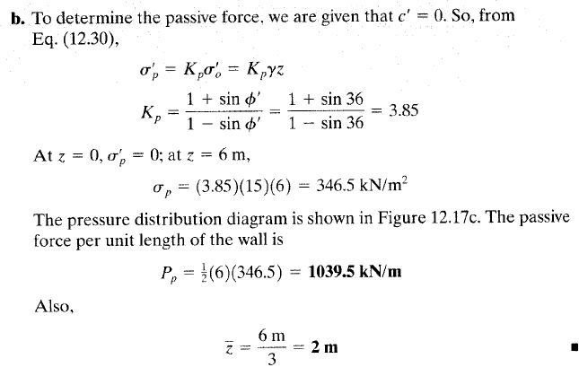

Slide 22
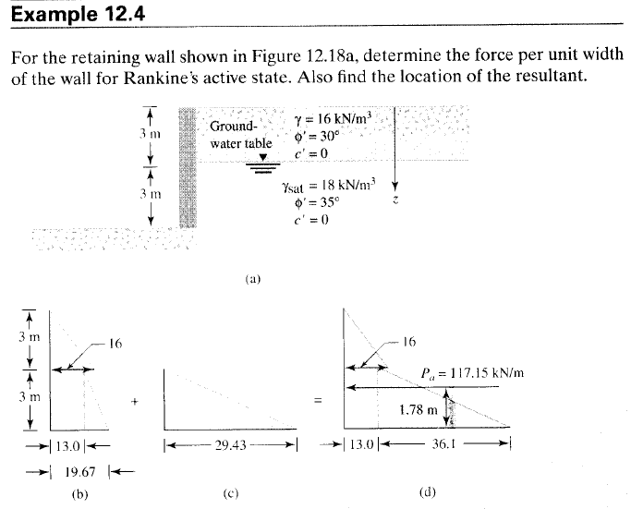

Slide 23
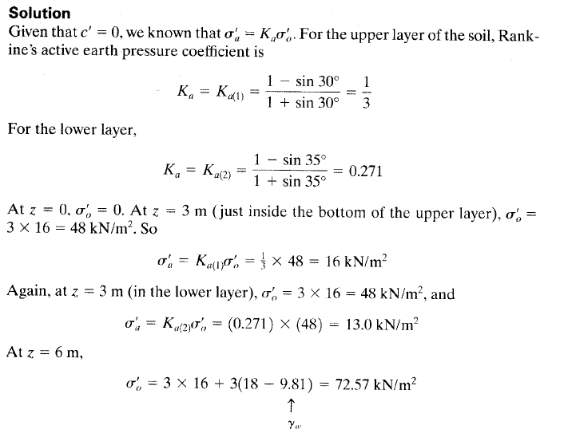

Slide 24
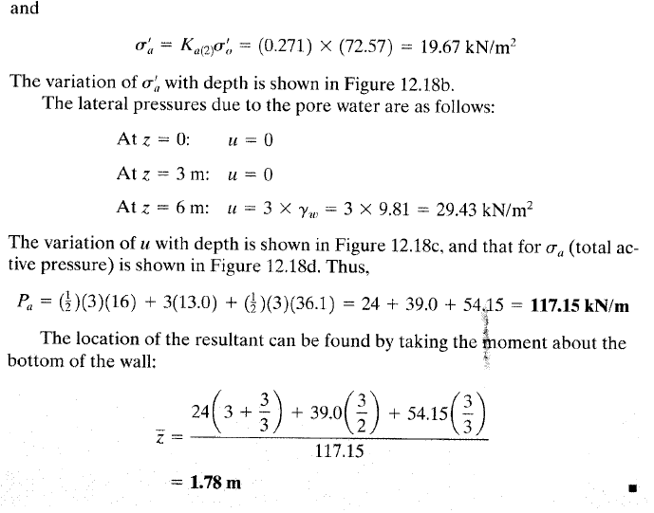

Slide 25
➲ coefficient of active earth pressure, K_{a}
➲ Lateral soil pressure, σ_{a} = K_{a}γH for non-cohesive
➲ Resultant force per unit length of wall,
P_{a} = ½ K_{a}γH² for non-cohesive
i)
*** Normally (i) and (ii) use for horizontal backfill while (iii) use for sloping backfill.
ii)
iii)

Slide 26
EXAMPLE ACTIVE LEP
Calculate the Rankine active force per unit length of the wall shown below, and also determine the location of the resultant.
γ=15.7kN/m³
Φ’=30°
c’=0
5m
Ans : Pa = 65.4kN/m , y = 1.67m

Slide 27
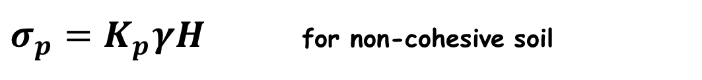
3.3.2 RANKIN’S PASSIVE CONDITION
For total passive pressure for non cohesive soils:
For total passive pressure for cohesive soils/C- φ soils :
$σ_{p}=K_{p}γH$ for non-cohesive soil
K_{a} < K₀< K_{p}

Slide 28
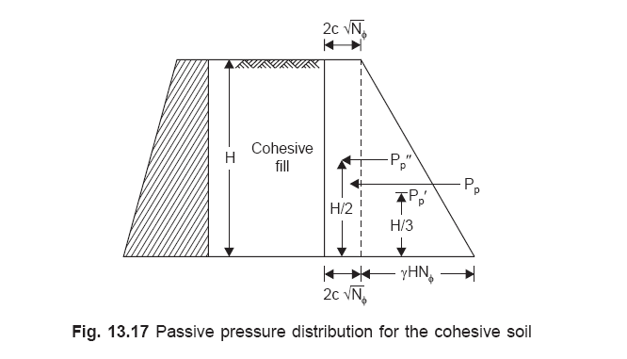
3.3.2 RANKIN’S PASSIVE CONDITION
WITH COHESIVE BACKFILL
For lateral earth pressure (passive) :

Slide 29
➲ coefficient of passive earth pressure, K_{p}
➲
i)
*** Normally (i) and (ii) use for horizontal backfill while (iii) use for sloping backfill.
ii)
iii)

Slide 30
EXAMPLE PASSIVE LEP
For the retaining wall considered below, what is the Rankine passive force per unit length of the wall?
γ=15.7kN/m³
Φ’=30°
c’=0
5m
Ans : Pp = 588.75kN/m , y = 1.67m

Slide 31
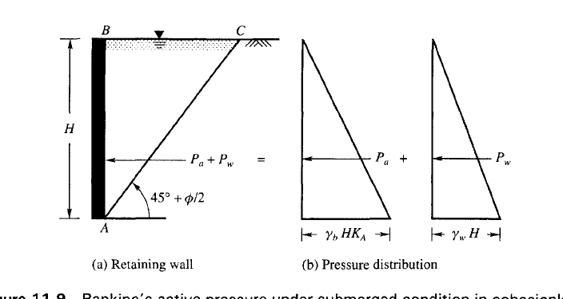

Active Earth Pressure- Backfill Soil Submerged
If backfill is affected by GWT, its effect is considered during determination of LEP

Slide 32
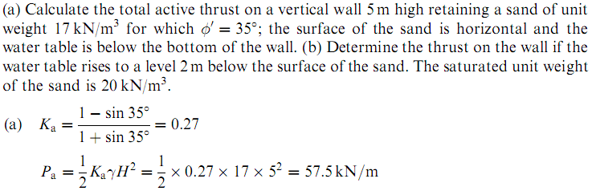
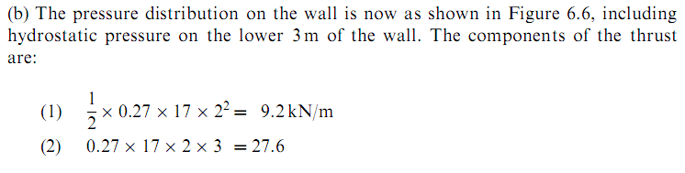
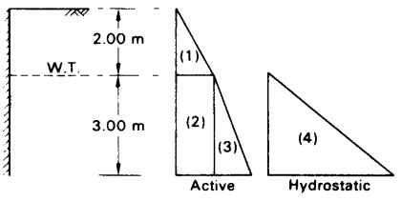
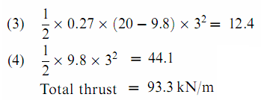
Example
Forces( area of LEP diagram)
Location of resultant active force

Slide 33
Example 2(Layered soils)
From the following retaining wall having backfill soil profile, determine lateral earth pressure and force with its point of action.
A
γ₁=17kN/m³
c₁=0
ϕ₁=34º
Ka1=0.283 calculated
h₁ =2m
B
h=5m
γ₂=19kN/m³
c₂=10kPa
ϕ₂=16º
Ka2=0.57 calculated
h₂ =3m
C

Slide 34
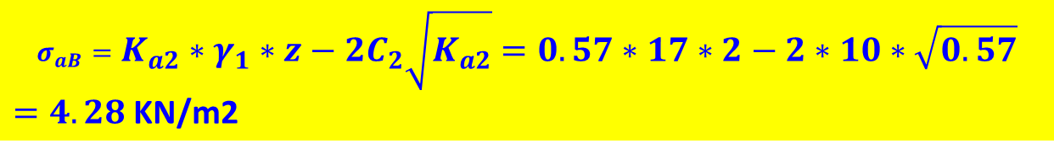

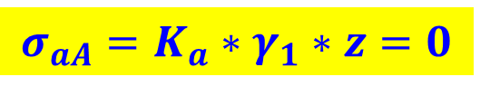
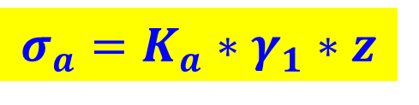
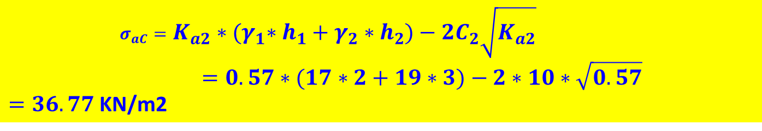
Solution:
Horizontal stresses at each points as follows:
A
$$σ_{a}=K_{a}∗γ_{1}∗z$$
h₁=2m
10.4kPa
B
$$σ_{aA}=K_{a}∗γ_{1}∗z=0$$
h=5m
4.2kPa
$σ_{aB}=0.306∗17∗2=10.4$ KN/m2
h₂=3m
Ka1=0.306
Is just above point B.
Ka2=0.283
C
36.6kPa
$$σ_{aB}=K_{a2}∗γ_{1}∗z−2C_{2}\sqrt{K_{a2}}=0.57∗17∗2−2∗10∗\sqrt{0.57}$$
$=4.28$ KN/m2
Is just Below point B.
$$σ_{aC}=K_{a2}∗{(γ}_{1}∗h_{1}+γ_{2}∗h_{2})−2C_{2}\sqrt{K_{a2}}=0.57∗(17∗2+19∗3)−2∗10∗\sqrt{0.57}$$
$=36.77$ KN/m2
Total horizontal force:

Slide 35
WORK EXAMPLE 4
Determine the active force per unit length of the wall for Rankine state. Also find the location of the resultant.
γ = 16 kN/m³
Φ’ = 30°
c’ = 0
3m
GWT
γ_{sat} = 18 kN/m³
Φ’ = 30°
c’ = 0
3m
z
Ans : Pa = 128.394kN/m , y = 1.78m

Slide 36
  Lateral Earth Pressure due to Surcharge
For φ soils;

Slide 37
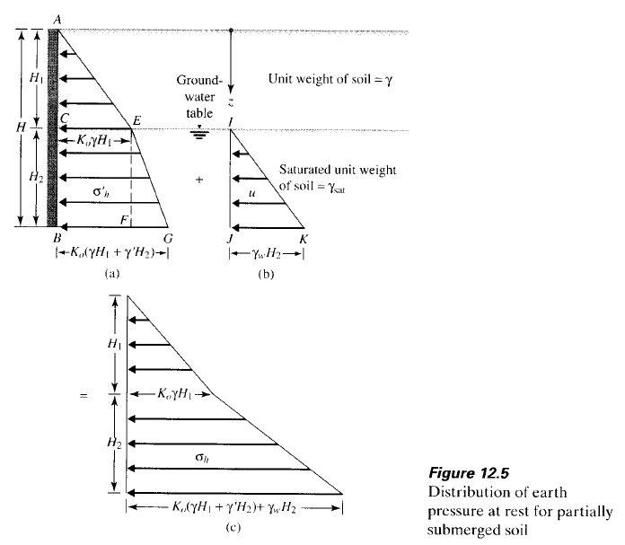
Active LEP-Backfill Soil Partly Submerged

Slide 38
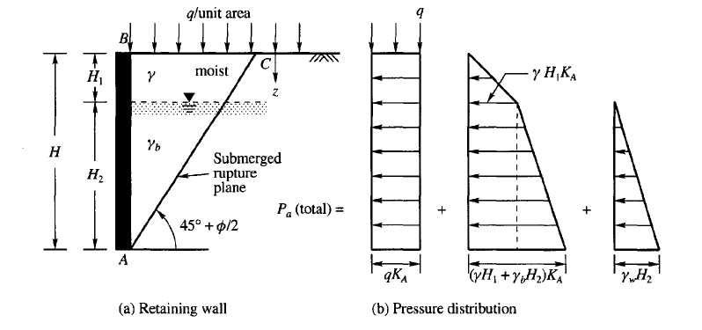
Active Earth Pressure-Backfill Soil Partly Submerged & Uniformly Surcharge Load

Slide 39
For C- φ soils;

Slide 40
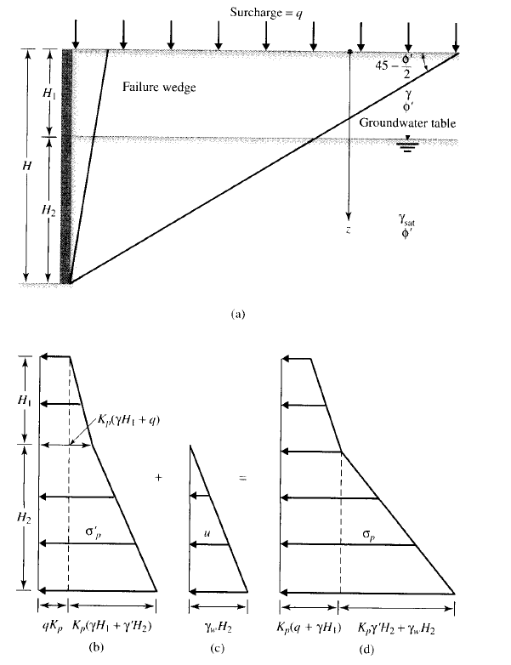
Active Earth Pressure-Backfill Soil Partly Submerged & Uniformly Surcharge Load

Slide 41
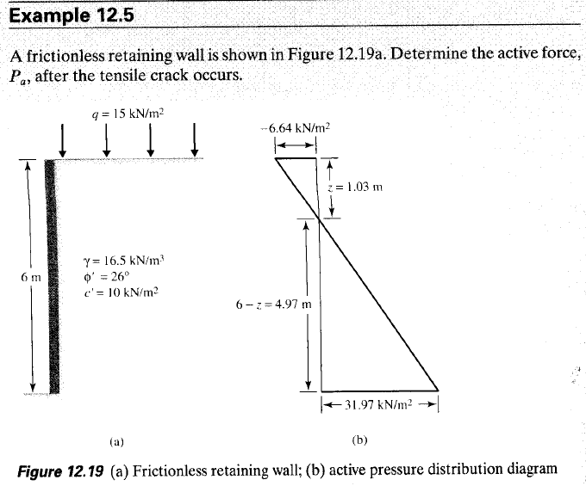

Slide 42
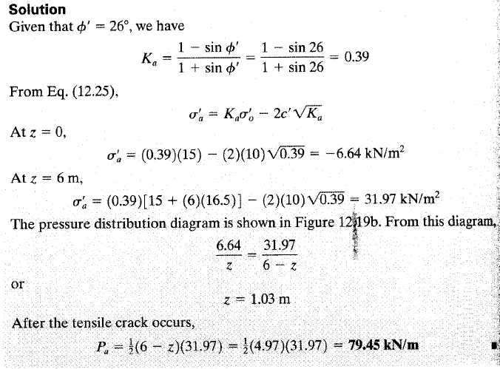

Slide 43
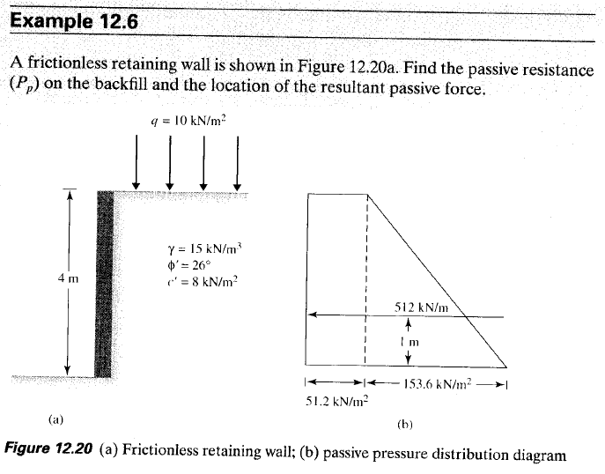

Slide 44
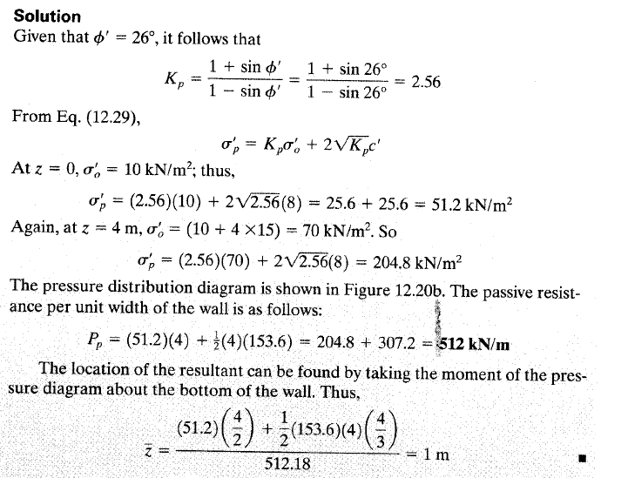

Slide 45
WORK EXAMPLE 5
A frictionless retaining wall is shown below, find the passive resistance (P_{p}) on the backfill, and the location of the resultant passive force.
q=10kN/m²
γ=15kN/m³
Φ=26 °
c’=8kN/m²
4m
Ans : Pp = 512kN/m , y = 1.0m

Slide 46
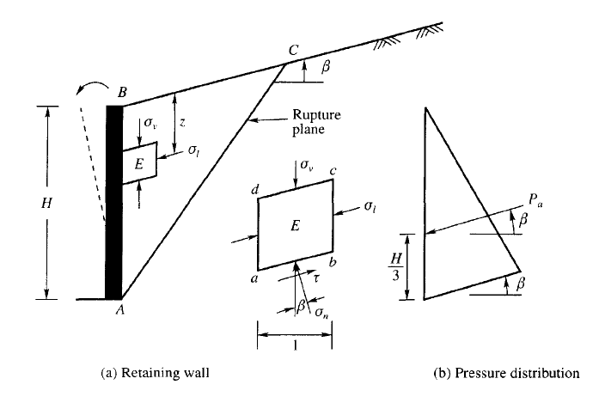

SLOPING SURFACE-ACTIVE EARTH PRESSURE

Slide 47
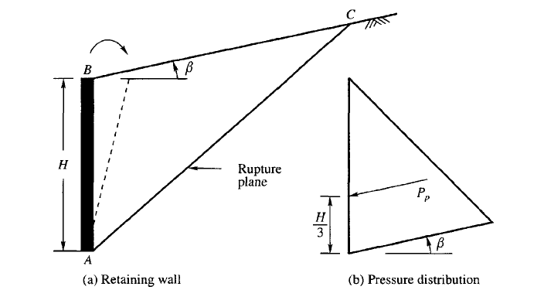

SLOPING SURFACE-PASSIVE EARTH PRESSURE

Slide 48
  3.3.2 Coulomb’s Earth Pressure Theory
As described in the previous sections, the Rankine earth pressure theory: (1) assumes the retaining wall is frictionless (or smooth), and (2) considers stress states and uses such tools as the Mohr’s circle of stress.
Coulomb (1776) proposed a theory to determine the lateral earth pressure on a retaining wall by assuming a granular backfill (c = 0) and a plane sliding surface. He account for the effects of friction (usually expressed by angle ) between the backfill and the wall.
Besides, he considered the more general case of the sloped face of a retaining wall, and in this respect, Coulomb’s theory is a more general approach than the Rankine theory described earlier.

Slide 49
COULOMB'S EARTH PRESSURE THEORY
Coulomb made the following assumptions in the development of his theory:
1. The soil is isotropic and homogeneous
2. The rupture surface is a plane surface
3. The failure wedge is a rigid body
4. The pressure surface is a plane surface
5. There is wall friction on the pressure surface
6. Failure is two-dimensional and
7. The soil is cohesionless

Slide 50
Cont…
Figure 3.8: Direction of active and passive forces when wall friction is present.

Slide 51
CONT….
Coulomb assumed a wedge shape collapse mechanism which is bounded by the face of the retaining wall, a horizontal or inclined ground surface and a linear failure plane.
The wedge slides downwards on the failure plane in the active state or upwards in the passive state.
Figure 3.8 illustrates direction of active and passive forces when wall friction is present.

Slide 52
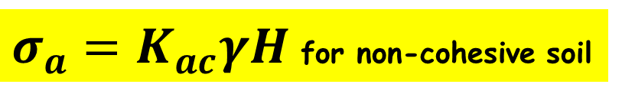
Coulomb’s Active earth pressure at sloped fill
$σ_{a}=K_{ac}γH$ for non-cohesive soil
k_{ac} is Coulomb’s active pressure coefficient
Figure 3.9: Retaining wall with slopping back, wall friction, and sloping soil surface for use with Coulomb’s method for active state.

Slide 53
Cont …
Note that the line of action of the active force P_{a} will act at a distance H/3 above the base of the wall and will be inclined at angle б to the normal drawn to the back of the wall.
In the actual design of retaining walls, the б value of the wall friction angle,φ/2 , is assumed to be between 2φ/3 and .

Slide 54
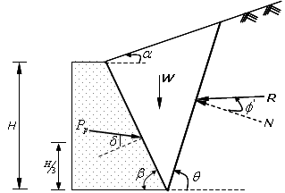
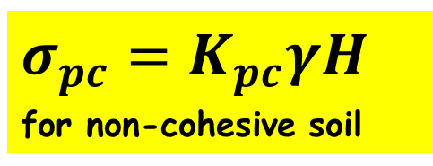
Coulomb’s passive earth pressure at sloped fill
$σ_{pc}=K_{pc}γH$
for non-cohesive soil
Figure 3.10: Retaining wall with slopping back, wall friction, and sloping soil surface for use with Coulomb’s method for passive state.

Slide 55
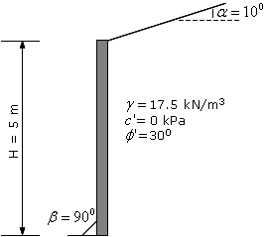
EXAMPLE 3.5
What is the total active force per meter of wall for the soil-wall system, shown in Fig. E3.5 using the Coulomb equation? Where does P_{a} act?

Slide 56

Solution 4.5
$$σ_{a}=K_{ac}∗γ∗H$$
$P_{a}={\frac{1}{2}∗K}_{ac}∗γ∗H^{2}$ at H/3 from base of wall
Assume frictional angle b/n wall and soil φ/2 to 2φ/3; taking б= φ/2 the soil-wall
Kac= 0.343

Slide 57
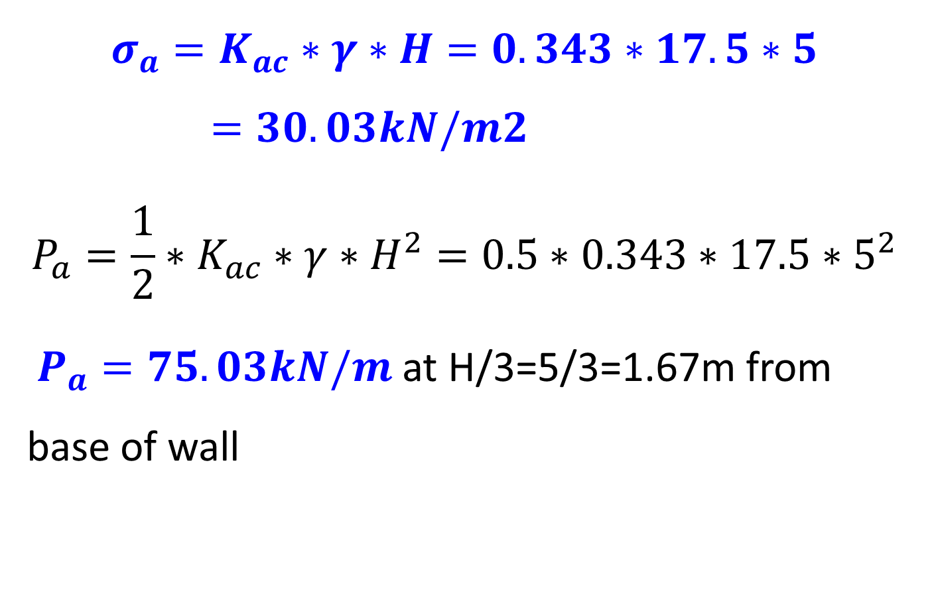
Solution cont…
$$σ_{a}=K_{ac}∗γ∗H=0.343∗17.5∗5=30.03kN/m2$$
$$P_{a}={\frac{1}{2}∗K}_{ac}∗γ∗H^{2}{=0.5∗0.343∗17.5∗5}^{2}$$
$P_{a}=75.03kN/m$ at H/3=5/3=1.67m from base of wall

Slide 58
References:
1. Das, Braja, Principles of Geotechnical Engineering, 5th ed.,Brooks/Cole, 2002.
2. Budhu M. (2000), Soil Mechanics and Foundations, Wiley and Sons.
3. Lambe, T. W., Whitman, R. V. (1999), Soil Mechanics, John Wiley & Sons Inc.
4. Teferra, A. & Mesfin, L., Soil Mechanics, AAU
5. Craig, R.F. (2004), Craig's Soil Mechanics, 7th edition, Taylor & Francis.
6. Bowles, J. E., 1996. Foundation Analysis and Design, Joseph E. Bowles, McGraw-Hill.

Slide 59
Thank you

